Slide 1
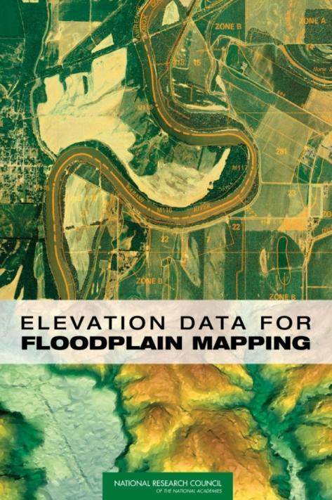
Floodplain Mapping
David R. Maidment
CE 374K Hydrology
Spring 2013

Slide 2
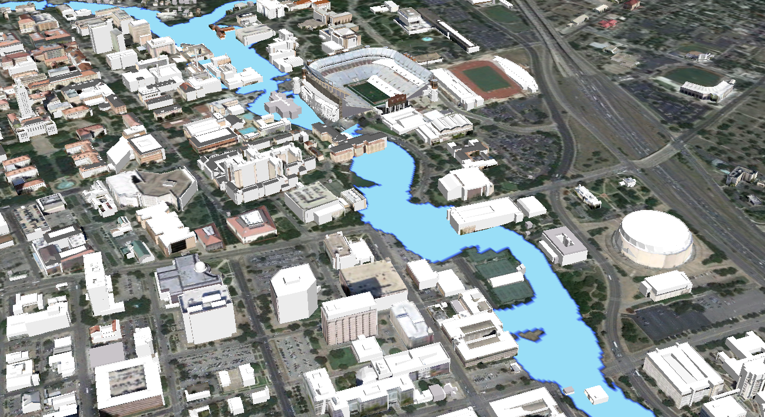
100 Year Floodplain through the UT Campus
Building images and floodplain data from the City of Austin

Slide 3
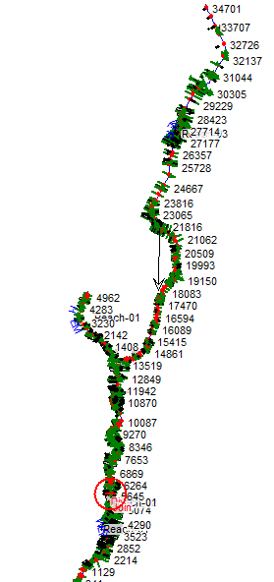
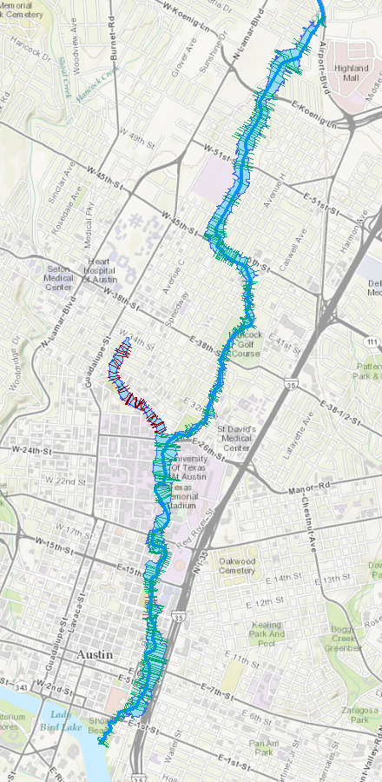
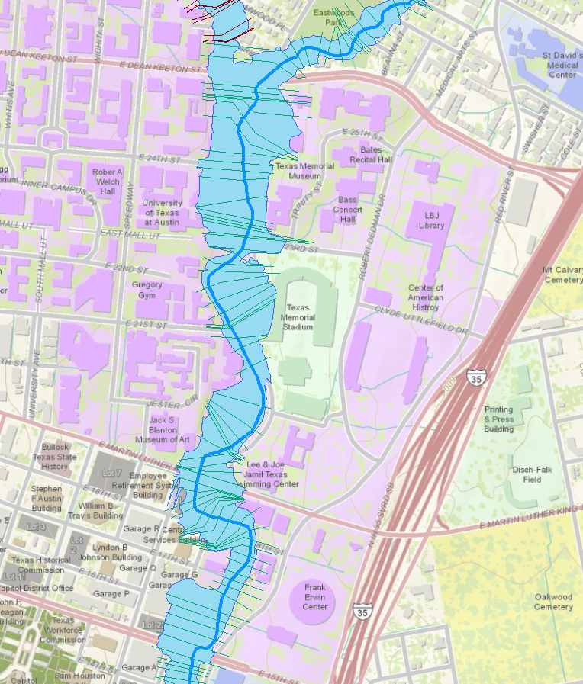
Campus Flood Mapping
Waller Creek
Hemphill Branch
Waller Creek

Slide 4
National Flood Insurance Program
Begun in 1968
Federal government provides a national flood insurance program
Local communities regulate land development in floodplains
Requires floodplain maps
Base Flood Elevation for 100 year flood is the key
Keep building floor elevations above this level
Keep building out of 100 year inundated area

Slide 5
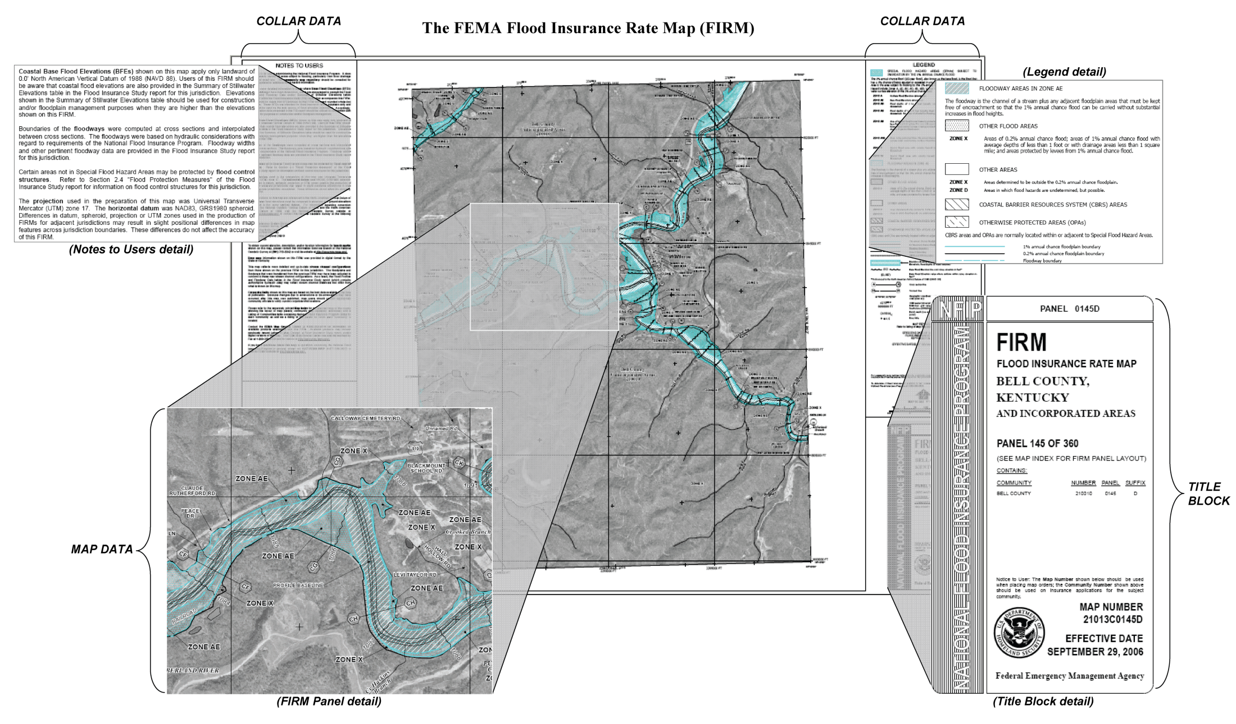
FEMA Floodplain Map

Slide 6
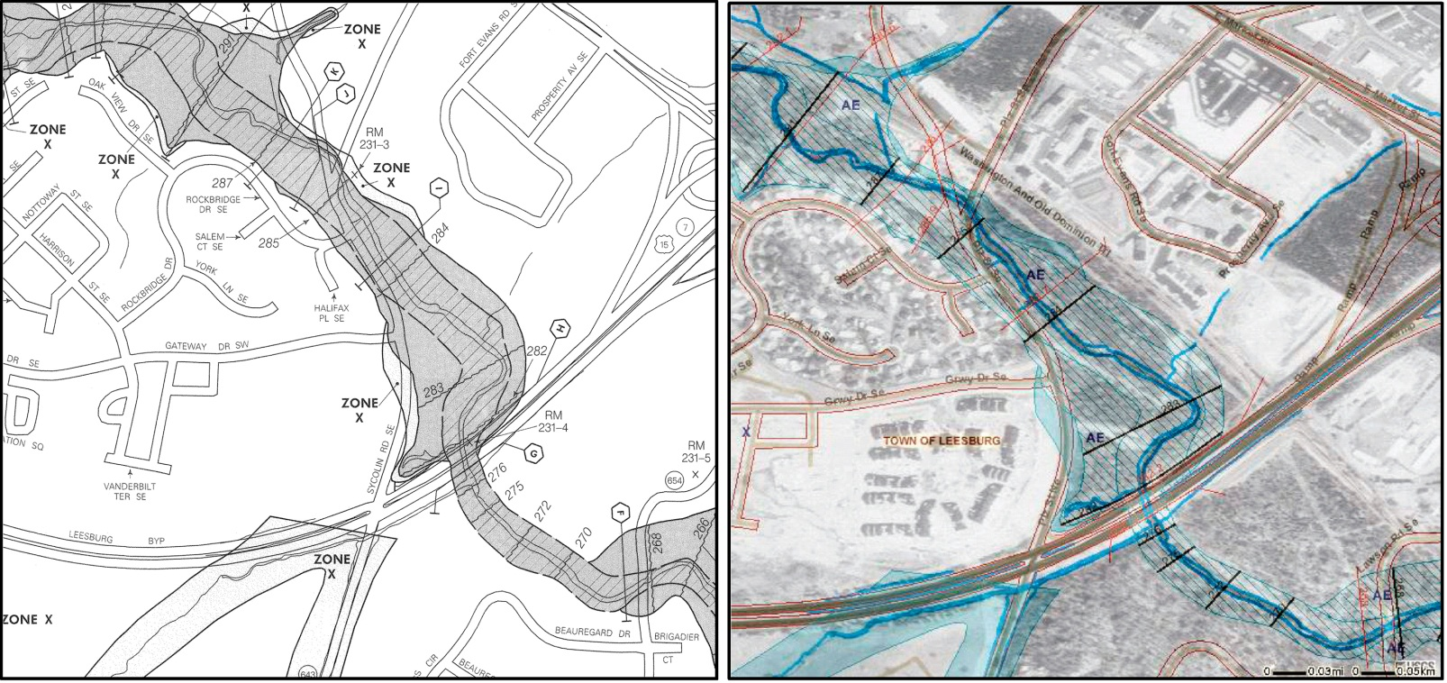
Old, paper FIRM
New, digital (D)FIRM
- The conversion from FIRMs to DFIRMs was intended to create national, digital floodplain map coverage
- The ideal DFIRM: more accurate than paper FIRM, more flexible to use and update, more versatile for community use

Slide 7
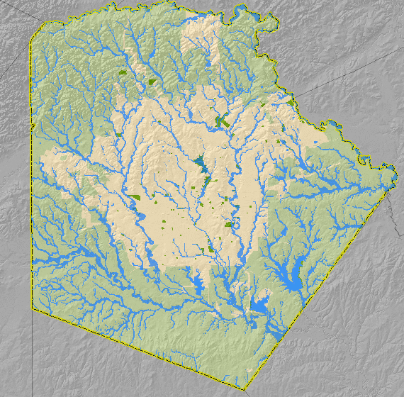
Map Showing Inundation in Bexar County, Texas

Slide 8
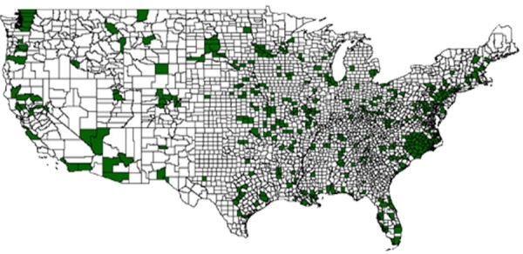
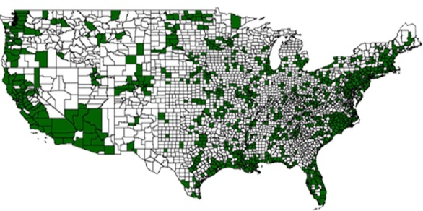
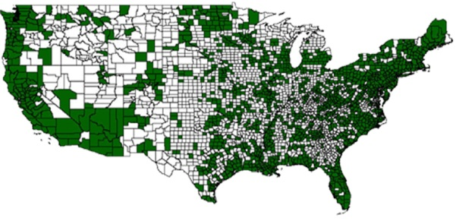
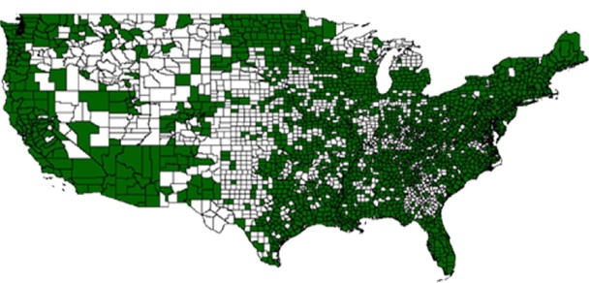
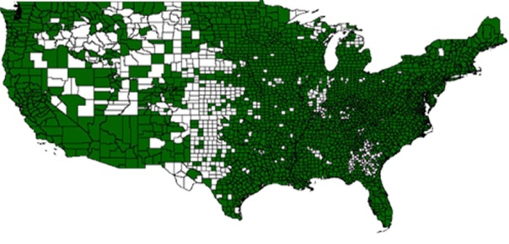
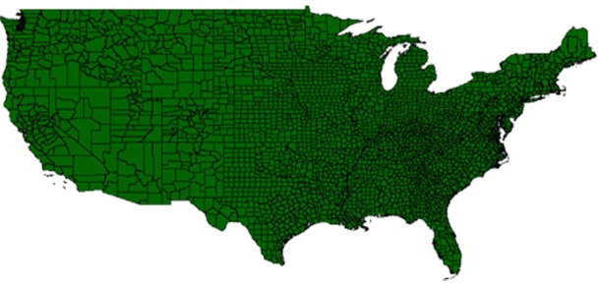
Flood Map Modernization (as of 2005)
Federal Emergency Management Agency (FEMA), embarked on Map Modernization to update the Nation’s flood hazard maps.
2004
2005
2006
2007
2008
2009
Slide: Paul Rooney, FEMA

Slide 9
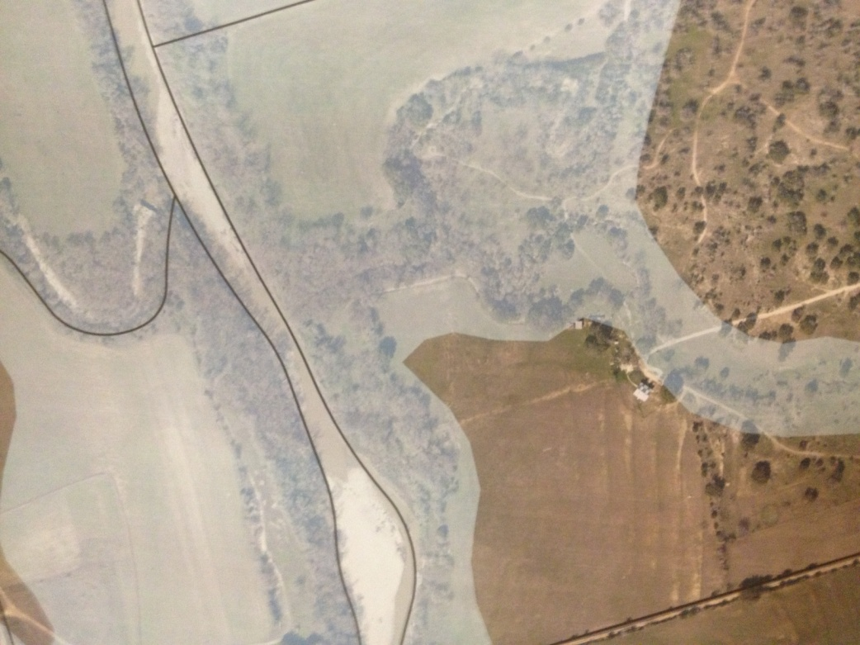
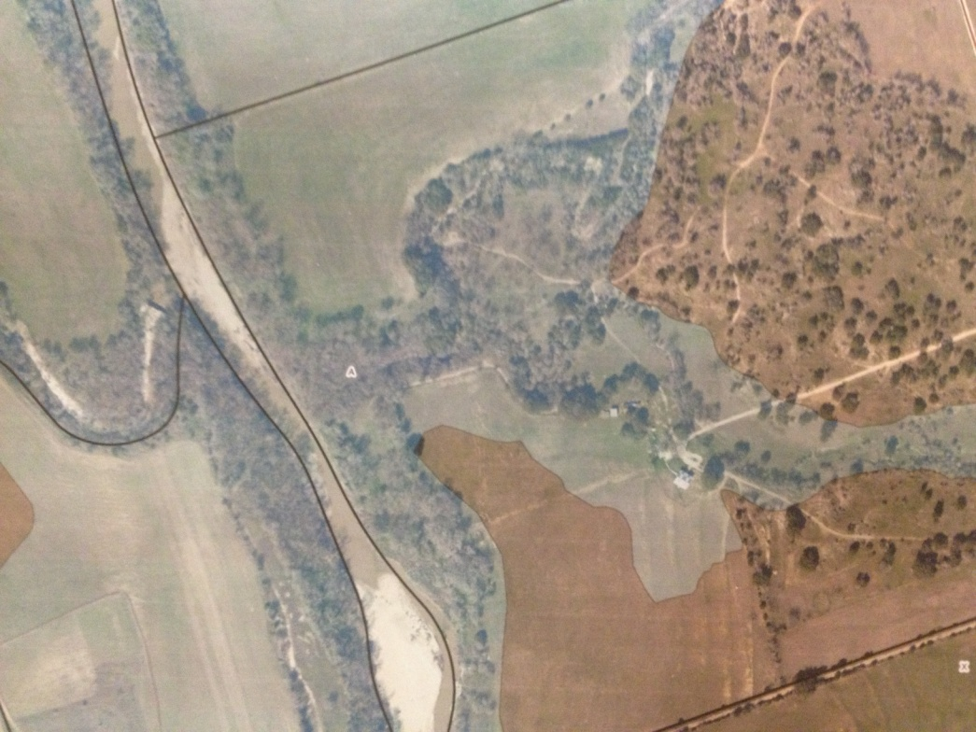
Edgar’s House Story…
Courtesy of Roxana Darvari
CE 394K.3 Fall 2012
Edgar Ranch located in northeast Burnet County
In the old floodplain map, the Edgar Ranch was out of the flooding zone but in the new map issued in 2011 by FEMA; Edgar Ranch locates in Zone “A” floodplain
Moss Branch
Moss Branch
Edgar’s House
Edgar’s House
Edgar Draw
Edgar Draw
Old floodplain Map
New floodplain Map

Slide 10
Progress to June 2005
The nation has about 4.2 million miles of riverine streams and about 60,000 miles of coastlines
About 1 million river miles are on federal lands – no flood insurance
As of June 2005 ~ 1 million miles had been mapped
¼ (247,000 stream miles) showing Base Flood Elevations (BFEs) (detailed studies)
¾ (745,000 stream miles) not showing BFE’s (approximate studies using existing topographic data)

Slide 11
Map Mod MidCourse Correction
Rather than attempting to cover all the nation with updated flood maps, focus on 65% of the nation’s land area containing 92% of the population
Implement a floodplain boundary standard which ensures alignment of flood map with existing topographic data

Slide 12
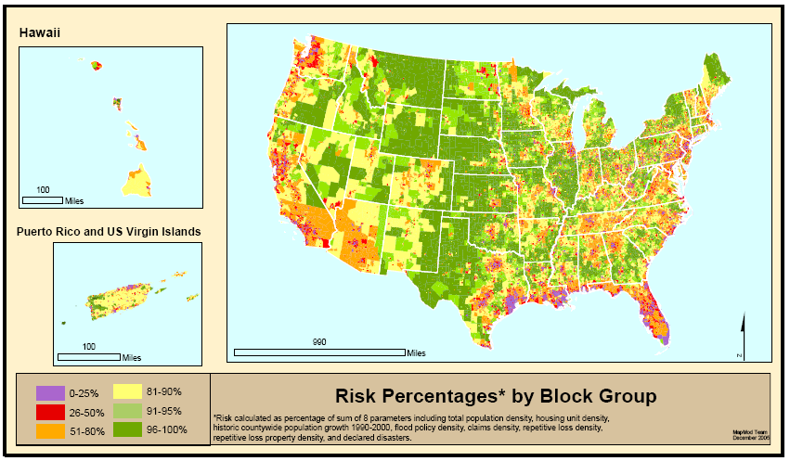
Where is Risk the Greatest?
Source: Scott Edelman (Watershed Concepts)
Notes:
Risk here is where floods and people are in general proximity (or will be)
Risk parameters for block groups
Population, population growth, housing units
Claims, repetitive losses, policies
Flood Disaster declarations (From county distribution)
We aggregate this information to a FEMA Regional level and allocate the majority of the appropriated map mod funding to the Regions who work with their state and local partners to develop flood production schedules at the county level.
All of this is explained in great detail in the Multi-Year Flood Hazard Identification Plan, which is published at least once a year.
Hard around the edges and somewhat softer in the middle.

Slide 13
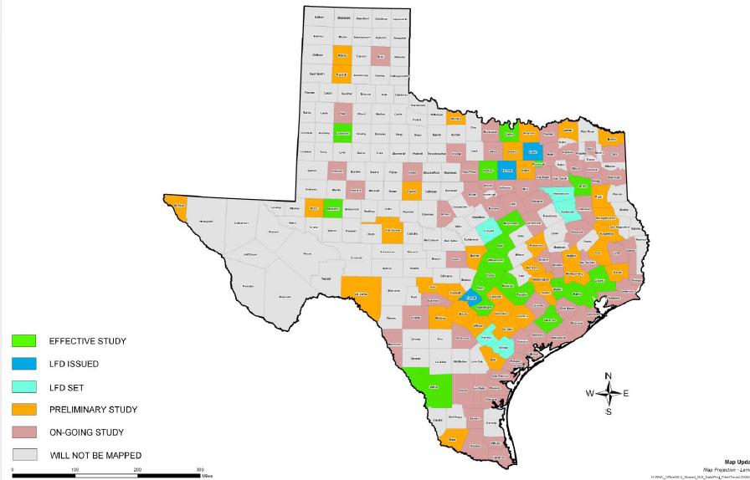
Map Modernization in Texas
Source: FEMA Region VI RMC
Half of Texas Counties have updated digital flood maps (94% of population)

Slide 14
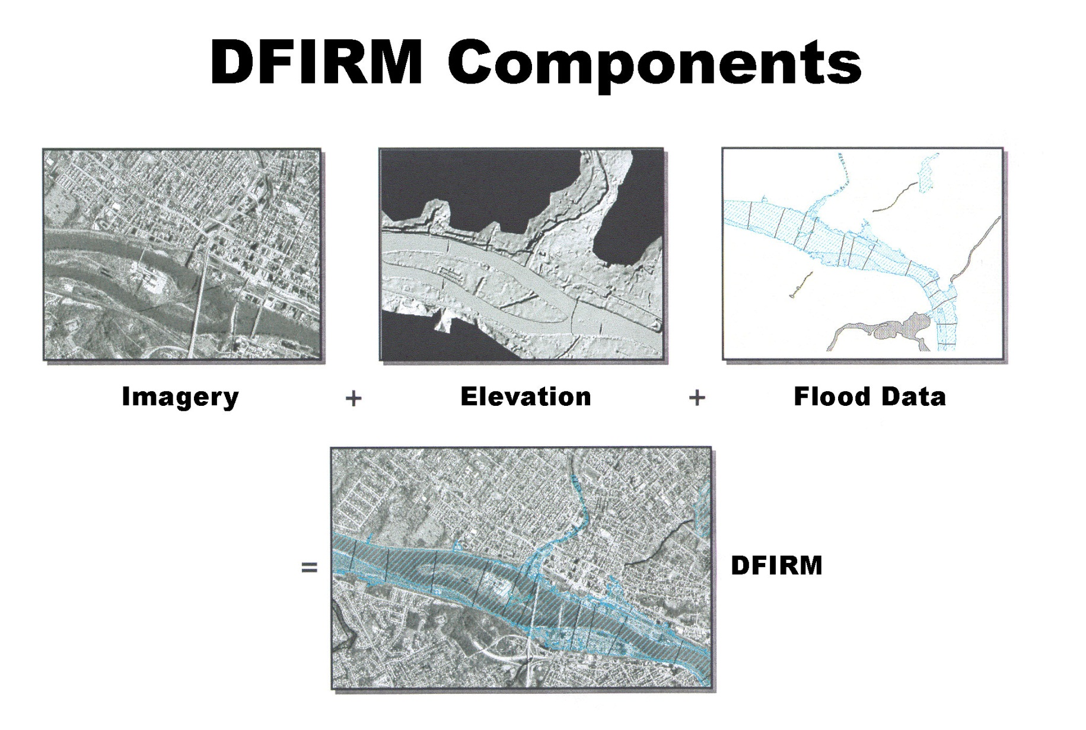
‘Base map information’
*
This study addressed the technologies producing Imagery and Elevation data components of the DFIRM
*New, 2-year NRC study sponsored by FEMA will look at Flood Map Accuracy and include analysis of Flood Data component of the DFIRM

Slide 15
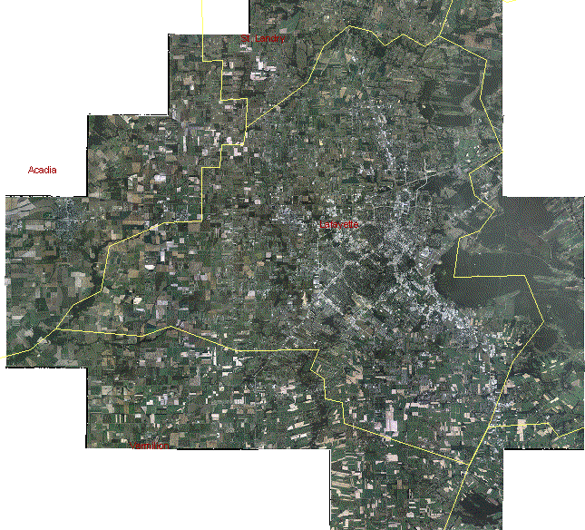
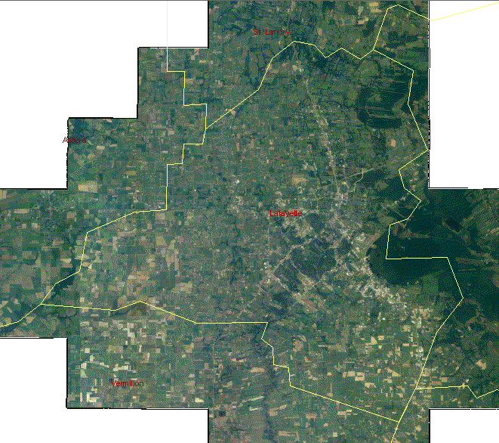
National Agricultural Imagery for Lafayette Parish, LA
2005
2004
NAIP: A new image for
each county each year
IMAGERY READY
TO USE

Slide 16
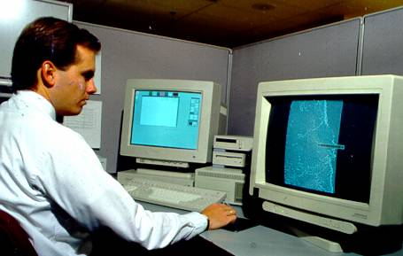
Base Elevation Data in Detail—Photogrammetry
Photogrammetry can also be used to produce bare-earth digital elevation models, but the process is expensive, labor intensive, and therefore inappropriate for a national program

Slide 17
Elevation Data in Detail—Photogrammetry
Photogrammetry uses multiple views of the same point on the ground from two (stereo) perspectives to create 3-D point measurements, including DEMs
Strength: Best for generation of breaklines for edges such as shorelines, tops & bottoms of stream banks, etc.
Weakness: Vegetation blocks stereo views necessary to map the bare earth terrain in forests and heavily vegetated areas

Slide 18
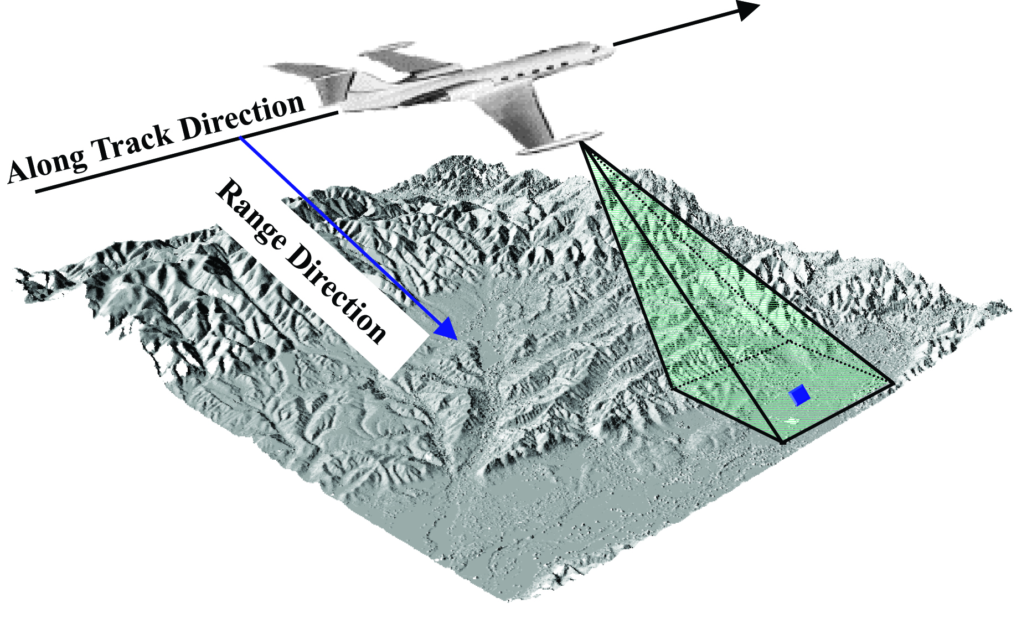
Base Elevation Data in Detail—
InterFerometric Synthetic Aperture Radar (IFSAR)
Uses microwave signal and radar antenna (measures echoes back from ground)—’sees’ roughness of surfaces
Advantage: Can be used in cloudy conditions, night/day, and relatively low cost
Disadvantage: Does not satisfy FEMA accuracy requirements; poorest along vegetated stream banks

Slide 19
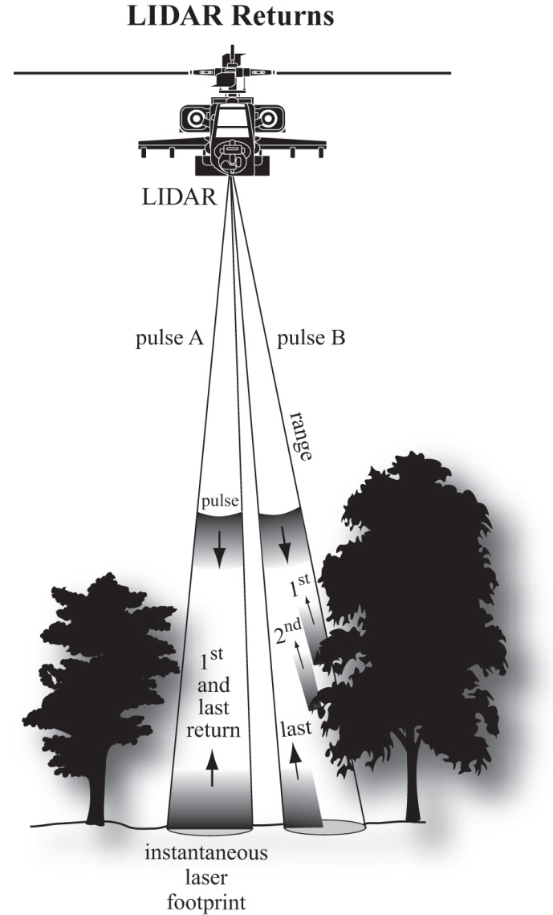
Base Elevation Data in Detail—
Light Detection and Ranging (lidar)
Lidar uses single laser pulses to see through or between the trees to create thousands of 3-D point measurements per second
Advantage: The most accurate method for mapping the bare-earth terrain in vegetated areas
Disadvantage: Poor for generation of breaklines for edges such as shorelines, tops & bottoms of stream banks,

Slide 20
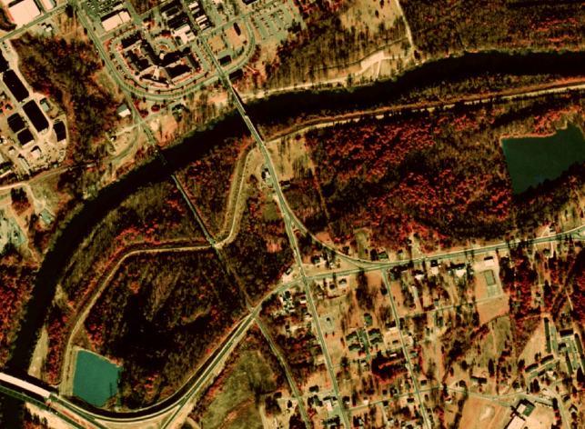
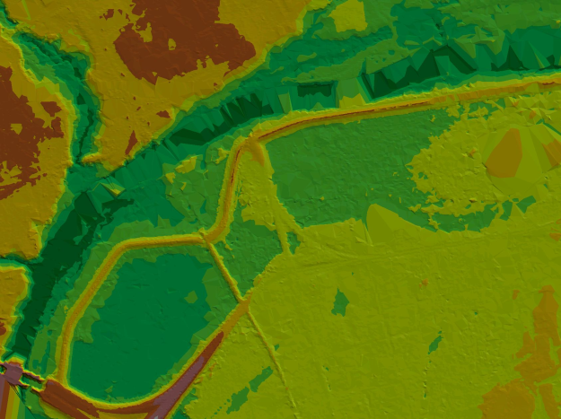
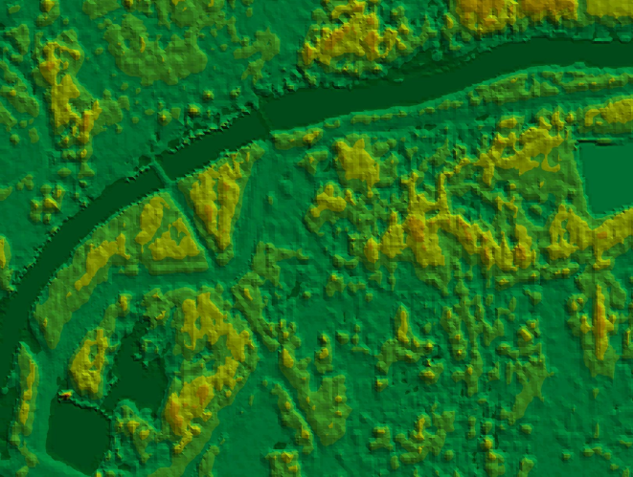
Base Elevation Data in Detail—
Strengths and Weaknesses Compared
Digital elevation model from National Elevation Dataset
Photogrammetry/digital orthophoto
Digital elevation model from lidar
Digital elevation model from IFSAR

Slide 21
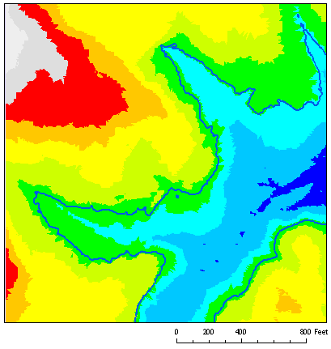
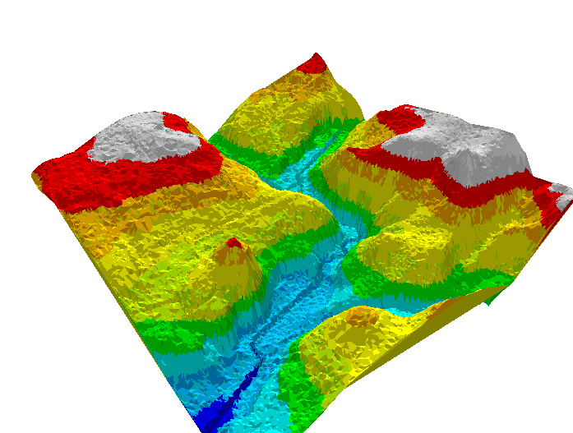
Base Elevation Data in Detail—
Light Detection and Ranging (lidar)
Current 2-D Determinations: Lidar data enables the most accurate delineation of floodplains consistent with current methodology for flood risk determinations based on horizontal location of a structure relative to Special Flood Hazard Areas depicted on flat Flood Insurance Rate Maps.
Future 3-D Determinations: Lidar data would also enable accurate flood risk determinations based on the vertical comparison of a structure’s lowest adjacent grade (LAG) relative to the Base Flood Elevation (BFE)

Slide 22
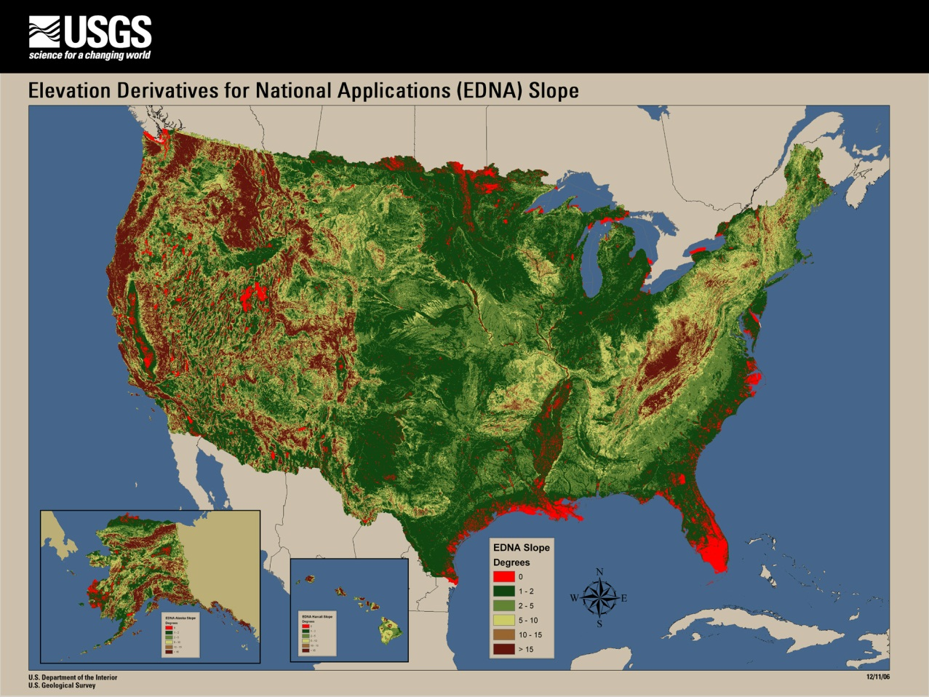
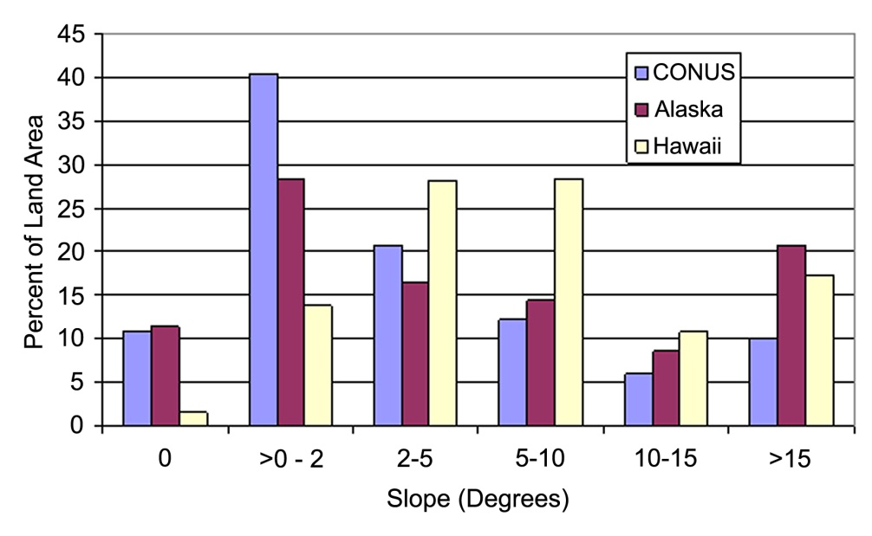
National Elevation Dataset
Slope map of the U.S. gives approximate scope of a national elevation program
Conversion of contours on 1:24,000 topographic maps to
a 30m grid in continental United States
Root Mean Square error of national elevation data is 2.34 m (8 ft)
FEMA flood map standards call for error 17 -- 35cm (0.6 --1.2 ft)
11% of the continental US and Alaska has zero slope in the current National Elevation Dataset, much of which is in high-risk,
coastal flooding areas.

Slide 23
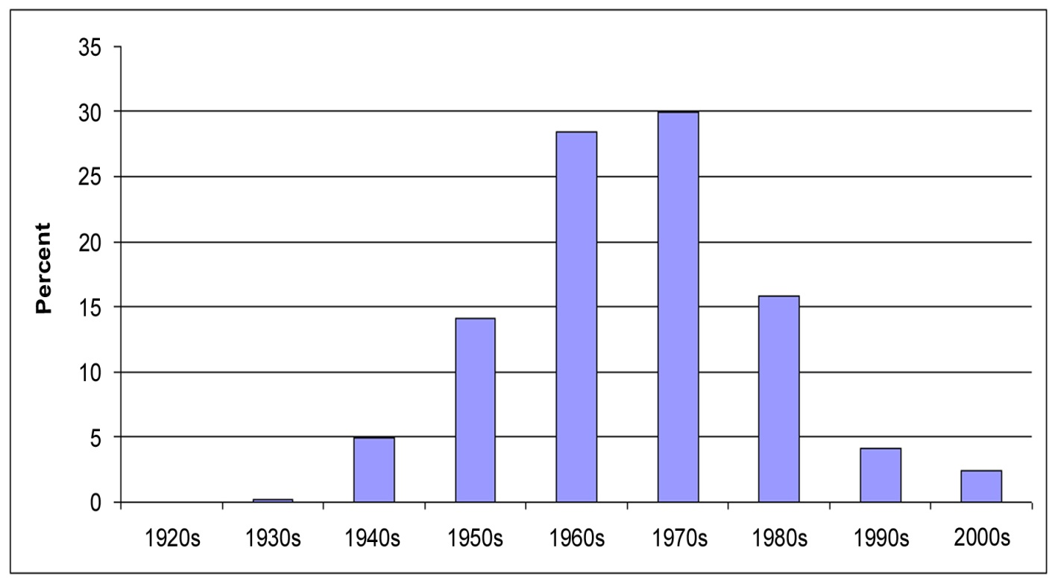
Elevation for the Nation
Age of USGS topographic maps in the
National Elevation Dataset (NED)
Terrain data in USGS topographic maps are on average 35 years old and flood mapping requires data that are either collected or considered for updating within the last 7 years.
Existing elevation data are thus ~ 1/10 accuracy and about 5 times older than needed for the flood mapping task.

Slide 24
Why is Elevation for the Nation Needed?
Existing elevation data are old, and there is a large gap between their accuracy and the accuracy required for floodplain mapping
2. The required elevation mapping technology exists and has been commercially deployed such that implementing Elevation for the Nation is technically feasible with lidar.
Can Download the report the report in pdf format at National Academy Press
http://www.nap.edu/catalog.php?record_id=11829

Slide 25
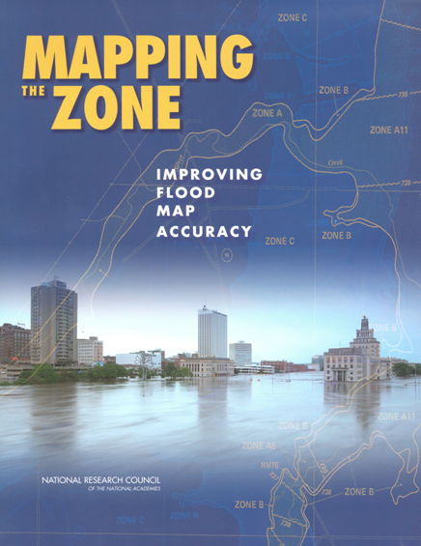
FEMA Flood Map Accuracy
David Maidment
University of Texas at Austin
http://www.nap.edu/catalog.php?record_id=12573

Slide 26
FEMA Map Modernization
Five-year program 2003-2008 to modernize the nation’s flood maps and convert them to digital form
$1billion budget for FEMA and ~ $200 million from state and local partners
Produced Digital Flood Insurance Rate Maps
How accurate are they?

Slide 29
NRC Committee on FEMA Flood Map Accuracy
Study commissioned from the National Academies of Science and Engineering by FEMA
Tasked to examine the technical factors that affect flood map accuracy and cost-effectiveness of Detailed versus Approximate studies
Inland and coastal flooding

Slide 30
Flood Maps
Riverine
Coastal
Two very different flood modeling and mapping problems

Slide 31
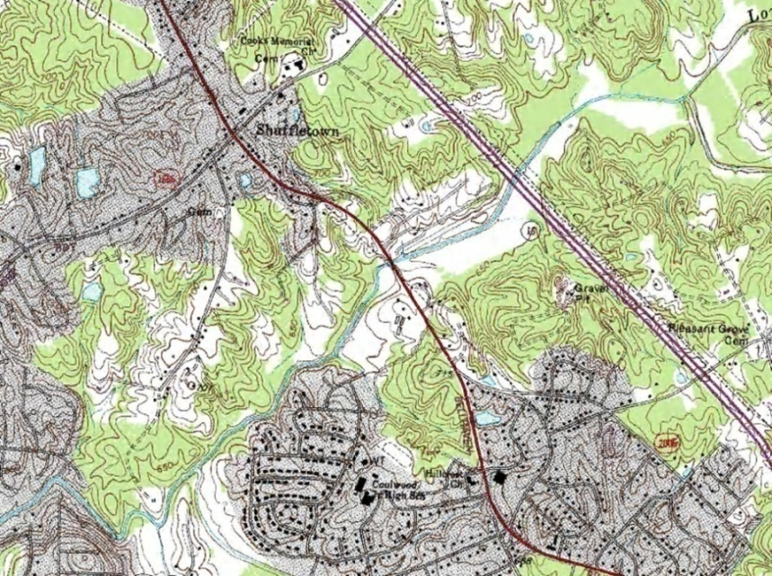
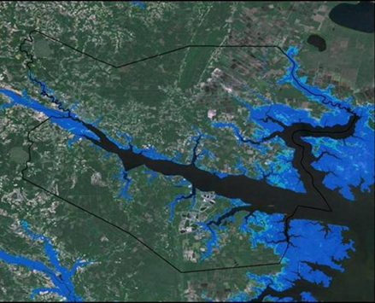
Terrain Data for Case Studies
USGS DEMs (30m)
NCFPM Lidar (3m)

Slide 32
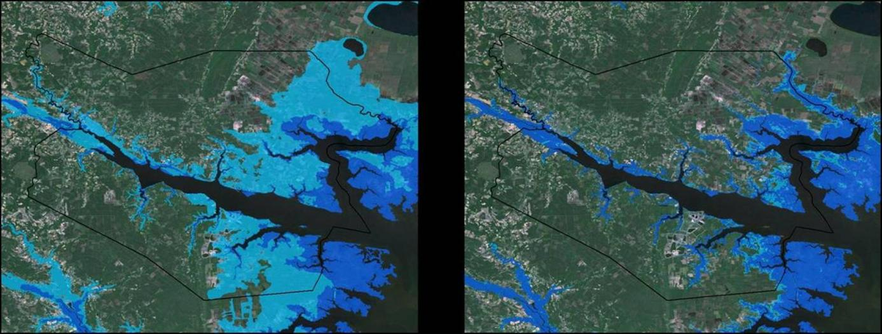
Terrain data accuracy matters
USGS NED (30m)
NCFMP Lidar (3m)
Inundation for a 1ft storm surge or sea level rise in the Tar-Pamlico estuary (Source: USGS)

Slide 33
North Carolina Case Studies http://www.ncfloodmaps.com/program_review.htm
Economics
H&H
Studies done for the NRC Committee by the North Carolina Floodplain Mapping Program (NCFMP)
Mountains of Western NC
Rolling hills of Piedmont
Flat coastal plain
H&H and Economics
(H&H = Hydrology and Hydraulics)

Slide 34
One River Reach studied in detail in each region (each reach 5-7 miles long)

Slide 35
NED - Lidar | Feet
Mean | -2.0
Standard deviation | 17.5
Maximum | 89.7
Minimum | -139.3
NED is higher
(green)
Lidar is higher
(purple)

Slide 36
NED is higher
(green)
NED - Lidar | Feet
Mean | 14.7
Standard deviation | 15.6
Maximum | 81.5
Minimum | - 46.0
An elevation “bust”
Systematic and random errors

Slide 37
NED - Lidar | Feet
Mean | 0.5
Standard deviation | 3.9
Maximum | 34.8
Minimum | -25.3

Slide 38
Terrain Data
Our study demonstrates that there are large differences between LIDAR and NED
Random differences everywhere
Systematic differences in some places

Slide 39
USGS Peak-Flow Regression Equations for 100-year discharge

Slide 40
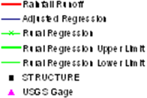
Effect on BFE of Variation in Hydrologic Methods (Long Creek, Mecklenburg County)

Slide 41
Effect of Hydrologic methods on BFE
Choice of hydrologic method affects the BFE by usually less than 1 foot
All methods in our study are calibrated to the gage frequency curve and all our reaches have a gage, so gage calibration dominates variation in hydrologic methods
Stream gage data are important

Slide 42
Effect on BFE of variation in hydraulic methods and terrain data (Swannanoa River)

Slide 43
Effect on BFE of variation in hydraulic methods and terrain data (Ahoskie Creek)

Slide 44
Effect on BFE of variation in hydraulic methods and terrain data (Long Creek)
Approximate Study using NED
21 ft

Slide 45
Approximate Study BFE Profiles
Approximate - Lidar
Approximate - NED
Misalignment (100 – 200 ft) of mapped 2D planimetric streamline with NED 3D elevation data

Slide 46
Alignment of planimetrics and
elevation data really matters

Slide 47
Final Thoughts
Flooding – largest hazard for people
Two thirds of all federal disasters involve flooding
Floodplain mapping is a large industry
$2 Billion invested over the last 10 years
Has raised LIDAR for terrain mapping into a mature industry
1/3 of US now covered by LIDAR at a cost of $360 million
Very large scale application of open channel flow

