Slide 1
Frequency Analysis and Data
Reading: Applied Hydrology Sections 12.3-12.6

Slide 2
Hydrologic extremes
Extreme events
  Floods
  Droughts
Magnitude of extreme events is related to their frequency of occurrence
The objective of frequency analysis is to relate the magnitude of events to their frequency of occurrence through probability distribution
It is assumed the events (data) are independent and come from identical distribution

Slide 3
Return Period
Random variable:
Threshold level:
Extreme event occurs if:
Recurrence interval:
Return Period:
  Average recurrence interval between events equalling or exceeding a threshold
If p is the probability of occurrence of an extreme event, then
or

Slide 4
More on return period
If p is probability of success, then (1-p) is the probability of failure
Find probability that (X ≥ x_{T}) at least once in N years.

Slide 5
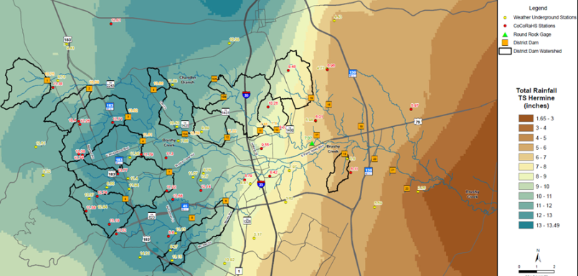
Upper Brushy Creek Hydrologic Model
Jeff Irvin, URS

Slide 6
Hydrology: the Mindset
Hydrology = Data (Rainfall, Runoff, Land Use)
Data bad = Hydrology bad
Data good = Hydrology good
How do you test data?

Slide 7
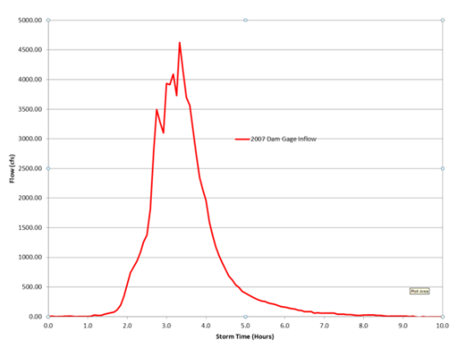
Choice of Calibration storms
The runoff hydrograph has two main parameters that define shape:
A parameter that defines how much rain runs off (runoff volume)
A parameter that defines time of peak (runoff temporal shape)

Slide 8
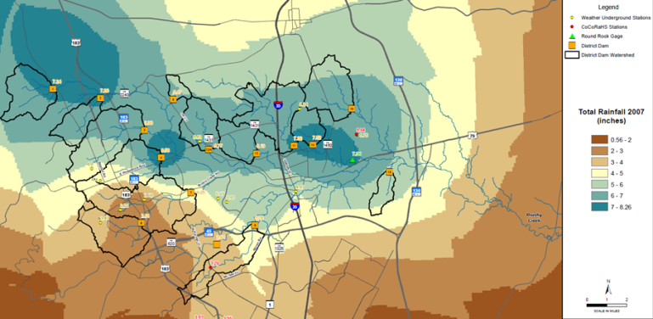
Choice of Calibration Storms: Storm of 2007
    Representative in location and time?
    Are there enough data?
      Spatially vs storm shape

Slide 9
Choice of Calibration Storms: TS Hermine
    Are there enough data?
      Spatially vs storm shape

Slide 10
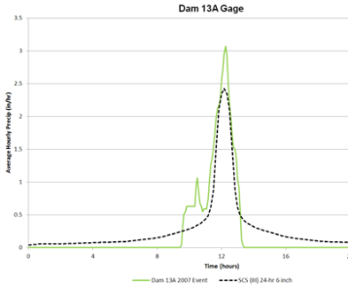
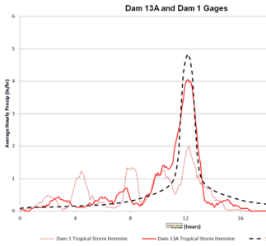
Choice of Calibration Storms
    Representative?
      In temporal shape
2007 Storm vs SCS 24 hour hyetograph
TS Hermine vs SCS 24 hour hyetograph

Slide 11
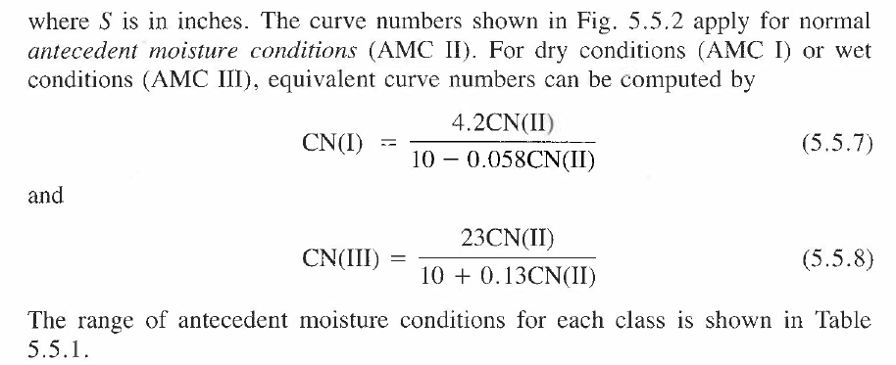
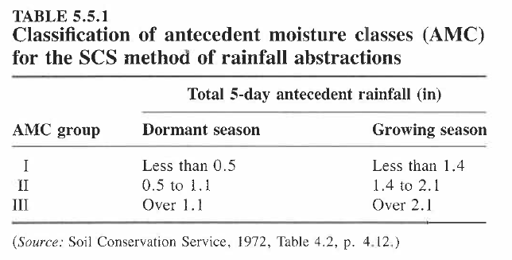


Antecedent Moisture Condition
p. 149 Applied Hydrology
http://www.wcc.nrcs.usda.gov/ftpref/wntsc/H&H/CNarchive/CNbeyond.doc

Slide 12
Choice of Calibration Storms

Slide 13
Results of Rainfall/Runoff Calibration

Slide 14
Why are results inconsistent?
Can we compare 2007 storm runoff results to 2012 storm runoff results?
Are the conditions that affect runoff homogeneous between the two storms?
Rainfall
Land Use
Soil Type
% Impervious
Antecedent Runoff Condition

Slide 15
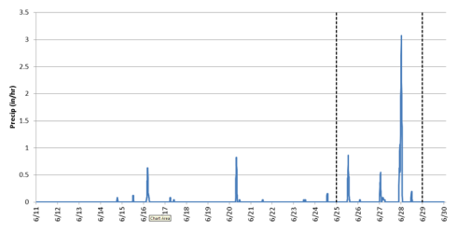
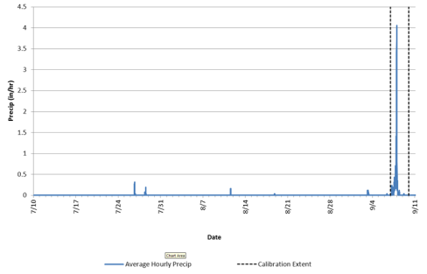
Antecedent Runoff
Are the two storms homogeneous in terms of antecedent conditions?
2007 Rainfall
2010 Rainfall

Slide 16
Results of Rainfall/Runoff Calibration
Antecedent Runoff Condition 1
(Dry)
Antecedent Runoff Condition 2
(Normal)

Slide 17
Results of Rainfall/Runoff Calibration

