Slide 1
CE 374K Hydrology
Frequency Factors

Slide 2
Frequency Analysis using Frequency Factors
The magnitude of an extreme event can be thought of as a departure from the mean expressed as a number of standard deviations
$x_{T}= µ+K_{T}σ$
The frequency factor, $K_{T}$, is a number in the range (-1, 5) that depends on:
Probability distribution
Return period, T
Coefficient of skewness, C_{s}
f(x)
P($x≥$ x_{T})
$$K_{T}σ$$
x
$$µ$$
x_{T}

Slide 3
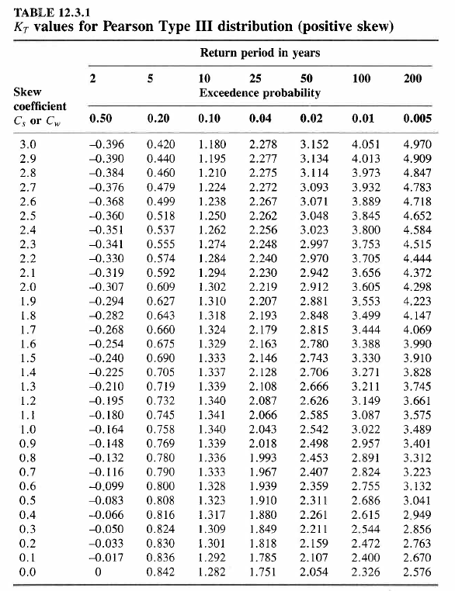
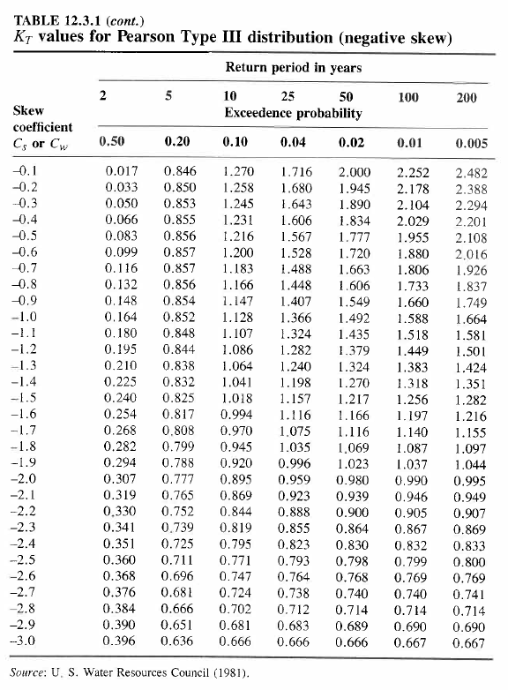
Frequency Factors for Log Pearson Type III Distribution

Slide 4
Example: 100 year flood on Colorado River
Colorado River at Austin, annual maximum flows, 1900 to 1940. What is the 100 year flood based on these data?
Take logs to base 10 of the annual flows
Compute the mean, standard deviation and coefficient of skewness of the data (Excel functions: Average, Stdev, Skew)
Results:
Mean = 4.7546, Standard Dev = 0.3423, Skew = 0.6919
From Table 12.3.1,
For T = 100 years, and C_{s} = 0.6, K_{T} = 2.755;
For T = 100 years, and C_{s} = 0.7, K_{T} = 2.824;
By interpolation,
For T = 100 years, and C_{s} = 0.6919, K_{T} = 2.8184;

Slide 5
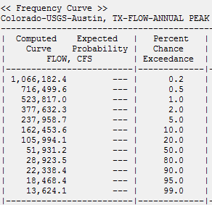
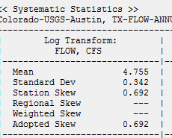
Example continued …
Hence
$x_{T}= µ+K_{T}σ$
$x_{100}=4.7546+2.8184∗0.3423=$5.7193
$Q_{100}={10}^{5.7193}=523,969 cfs$
or $Q_{100}=524,000 cfs$
Result from HEC-SSP

Slide 6
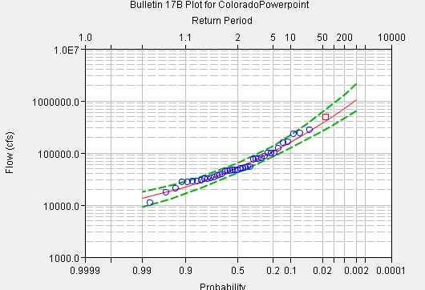
Results in HEC-SSP
Q_{T} = 524,000 cfs for T = 100 years or p = 0.01

Slide 7
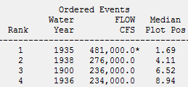
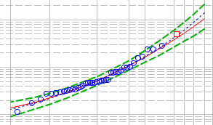
Probability Plotting
So, for largest value on n = 41 data, m = 1, so
$P(X≥x_{m}$)=$\frac{1−0.3}{41+0.4}$ = 0.0169 or 1.69%
This means that the largest value in 41 years has a chance of being exceeded in any year of 1.69%
Goal is to assign an exceedance probability to each observed value
Rank all data from largest (m = 1) to smallest (m = n)
Use plotting formula (A= B= 0.3)
$P(X≥x_{m}$)=$\frac{m−A}{n+1−A−B}$
$P(X≥x_{m}$)=$\frac{m−0.3}{n+0.4}$

Slide 8
Coefficient of Skewness, C_{s}
This has considerable uncertainty, especially for small datasets
Desirable to balance the value computed from sample data, C_{s} with an mapped value, C_{m} for flood peaks recorded in this region
Use weighted Skew
$C_{w}=\frac{V\left(C_{m}\right)C_{s}+V\left(C_{s}\right)C_{m}}{V\left(C_{m}\right)+V\left(C_{s}\right)}$
The variance of the weighted skewness for the US is V(C_{m}) = 0.3025
The variance of the sample skewness is
$V\left(C_{s}\right){=10}^{A−B\log_{10}\left(n/10\right)}$

Slide 9
Coefficient of Skewness (Cont.)
For Colorado River example (n = 41)
C_{s} = 0.692
A = - 0.33+0.08*0.692 = - 0.2746
B = 0.94 – 0.26*0.692 = 0.7601
$V\left(C_{s}\right){=10}^{A−B\log_{10}\left(n/10\right)}$
${=10}^{−0.2746−0.7601\log_{10}\left(41/10\right)}$
V(C_{s}) = 0.182
If, for Austin, Texas, we assume that the mapped skew is -0.25
Then the weighted skew is
$C_{w}=\frac{V\left(C_{m}\right)C_{s}+V\left(C_{s}\right)C_{m}}{V\left(C_{m}\right)+V\left(C_{s}\right)}$
$C_{w}=\frac{0.3025∗0.692+0.182∗(−0.25)}{0.3025+0.182}$
Or C_{w} = 0.338

Slide 10
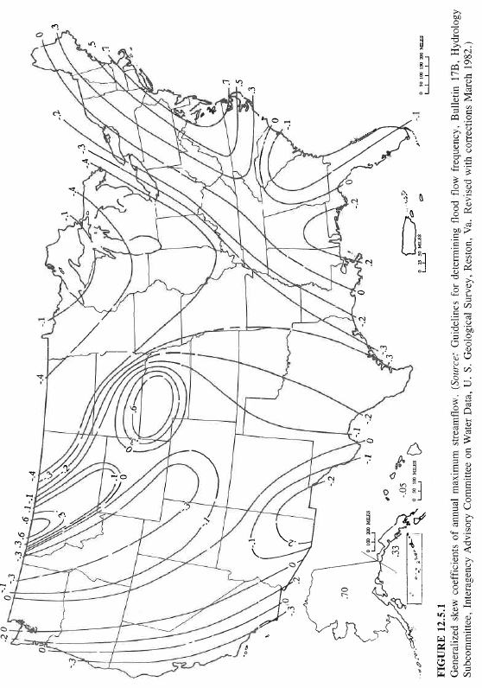
Mapped Skewness Values
-0.2
-0.3

Slide 11
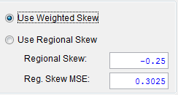
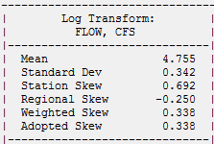
Coefficient of Skewness (Cont.)
If we repeat the frequency analysis using the weighted skewness

Slide 12
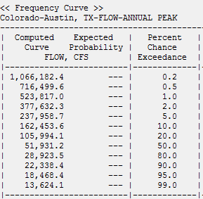
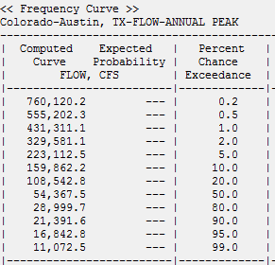
Big impact on extreme flood estimates, less so for small ones
With sample skewness, 0.692
With the adjusted skewness, 0.338
100 year
10 year

Slide 13
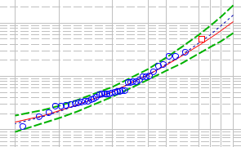
Additional Considerations
Expected Probability
Outliers
Confidence Limits

Slide 14
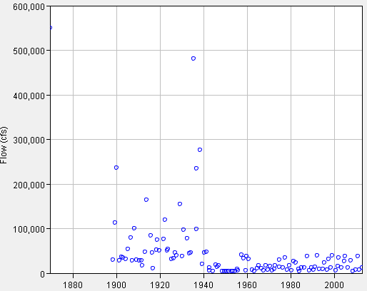
Outliers
Is this value (481,000 cfs) representative of the rest of the data?
Frequency analysis of extreme events is based on an underlying probability model (LPIII in this case)
It is assumed the sample parameters, ($\overline{y}{,s}_{y}$) are representative of the population values (µ,σ) (more data is better)
Test
High Outliers:$y_{H}=\overline{y}+K_{n}s_{y}$
Low Outliers: $y_{L}=\overline{y}−K_{n}s_{y}$

Slide 15
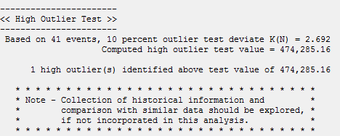
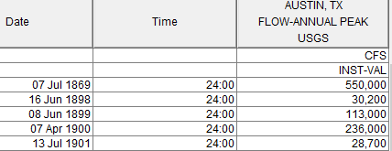
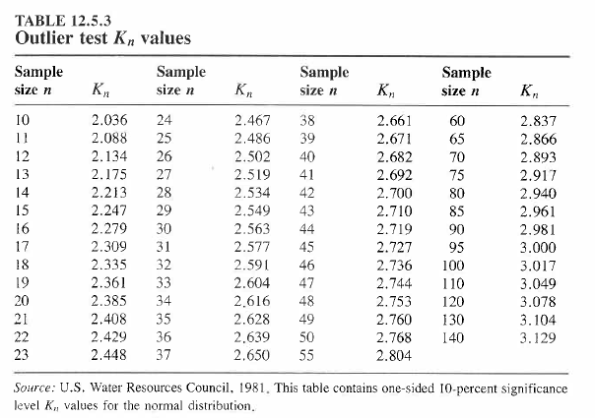
Example
For Colorado River, 1900-1940
($\overline{y}{,s}_{y}$) = (4.7546, 0.3423)
N = 41, K_{n} = 2.692
$y_{H}=\overline{y}+K_{n}s_{y}$
$y_{H}=4.7546+2.692∗0.3423$
$y_{H}=5.676072$
$Q_{H}={10}^{5.676072}$= 474,320 cfs
Observed maximum is 481,000 cfs, hence it’s a high outlier, but we’ll keep it in the analysis anyway.

Slide 16
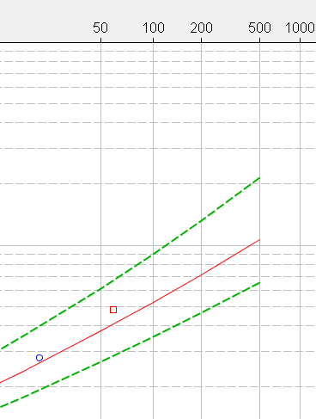
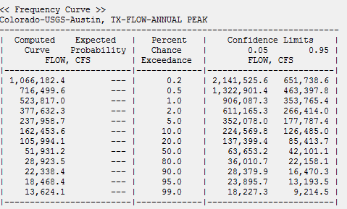
Confidence Limits (90% of observed 100 year floods are expected to be between these limits)
906087 – 523817 = 382270 cfs
382270 (73% larger)
170052 (32% smaller)
95 %
523817 – 353765 = 170052 cfs
5 %

Slide 17
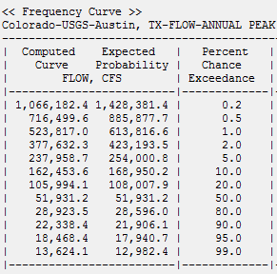
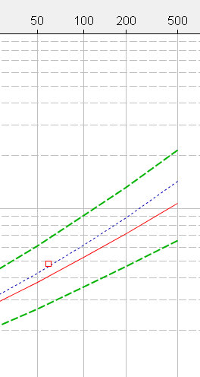
Expected Probability
If there are lots of floods, average value is E(Q_{T})
This what you need if you are insuring $6 billion in property over the US for lots of floods, as is the National Flood Insurance Program
Skewed distribution
(non-central t distn)
Median
(50% above and below)
Mean
Expected Value of Q_{T} E(Q_{T})

Slide 18
Flood discharge Vs Return Period
Discharge
Design discharge rises less than proportional to return period
Return Period (Years)

