Slide 1
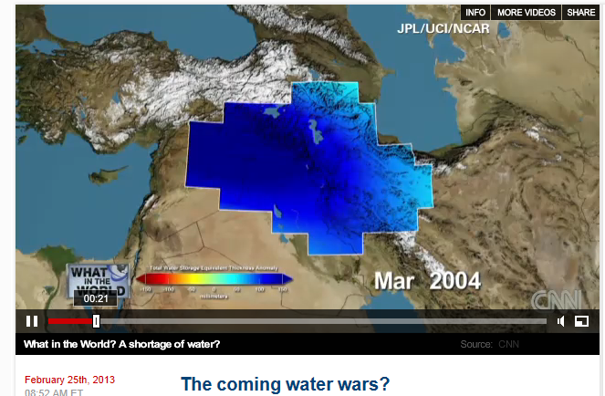
Global Water Issues
http://globalpublicsquare.blogs.cnn.com/2013/02/25/the-coming-water-wars/

Slide 2
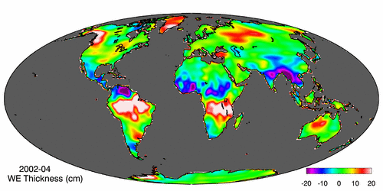
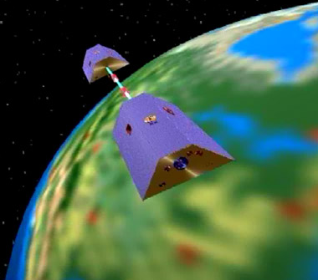
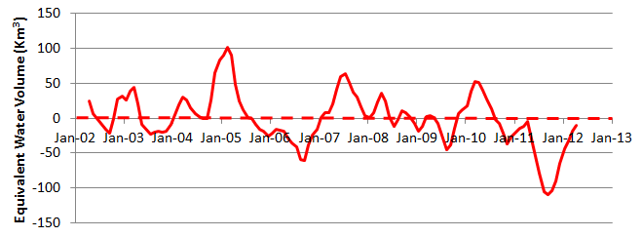
Measuring Gravity Anomaly from Space (GRACE) Force of gravity responds to changes in water volume Water is really heavy!
Gravity Anomaly of Texas, 2002 – 2012
Normal
In 2011, we lost 100 Km³ of water or 70 Lake Travis’s

Slide 3
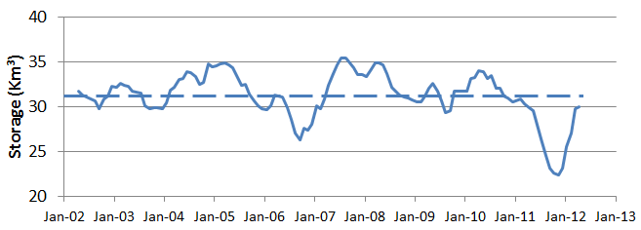
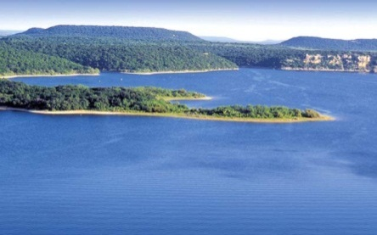
GRACE and Texas Reservoir Water Storage
Surface water reservoir storage is closely correlated with the GRACE data
Grace Satellites
Normal
In 2011 we lost 100 Km³ of water overall
Surface Water Reservoirs
Normal
In 2011 we lost 9 Km³ of water from reservoirs

Slide 4
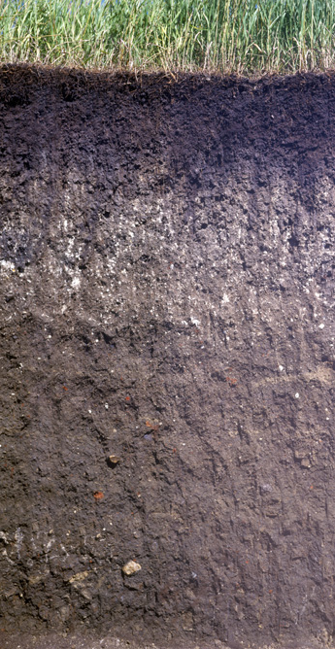
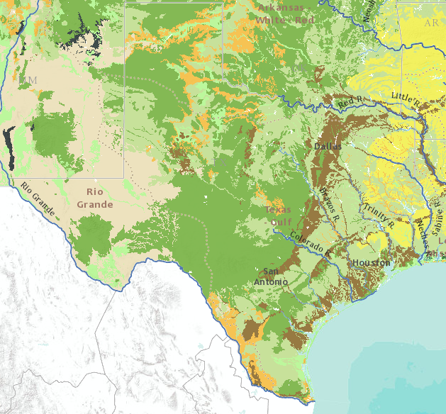
Soil Water In Texas
Soil water system has 78 Km³ of water storage capacity in top 1m of soil
Soil Wetness Index
Saturated
100
Soil Air
Oven Dry
Soil Water
0
Solid Particles
Soil Texture Map
First meter of Texas soil contains 11 cm of soil water and soil air

Slide 5
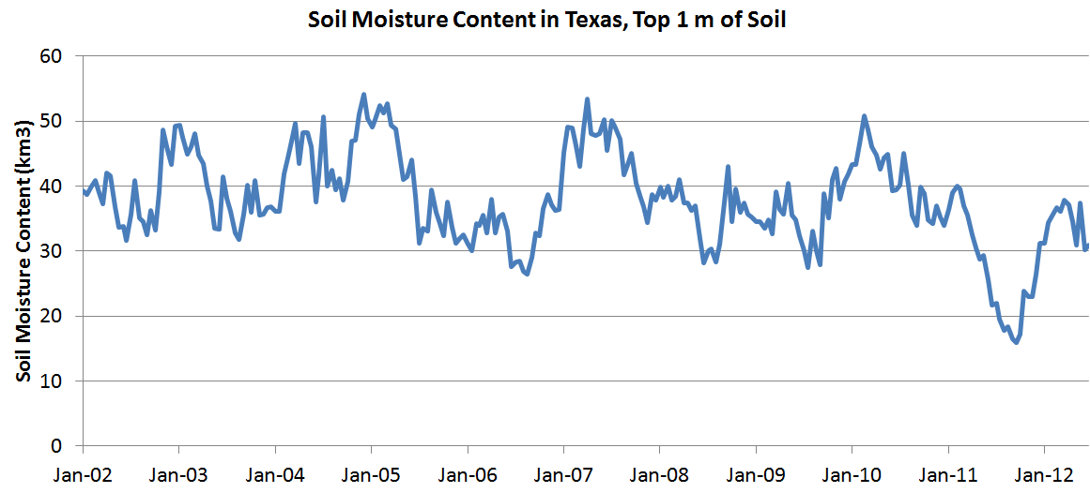
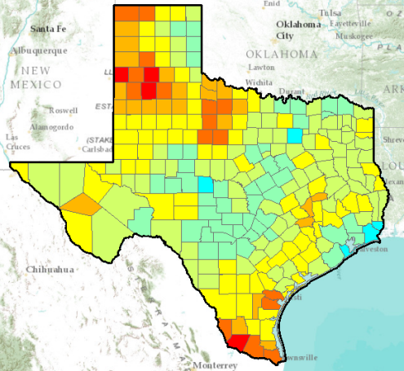
GRACE and Soil Water Levels
Soil water levels are also correlated with the GRACE data
Grace Satellites
Normal
In 2011 we lost 100 Km³ of water overall
Normal
We lost 25 Km³ of water from top 1m of soil

