Slide 1
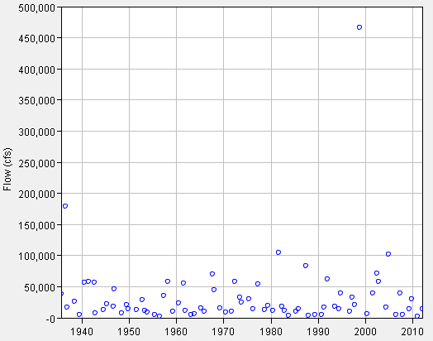
Annual Maximum Discharges Guadalupe River at Victoria, Texas, 1935-2012
466,000 cfs
20 Oct 1998
179,000 cfs
03 Jul 1998
105,000 cfs
02 Sept 1981
102,000 cfs
26 Nov 2004

Slide 2
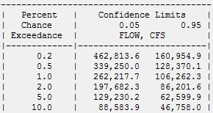
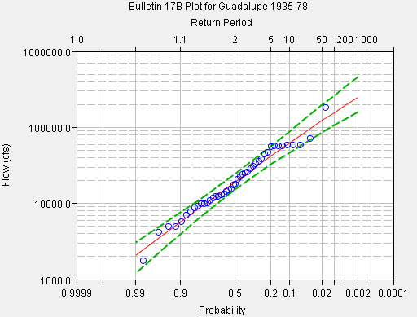
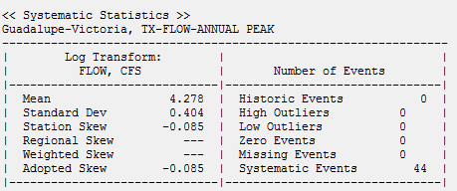
Frequency Analysis, 1935-1978

Slide 3
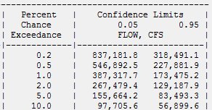
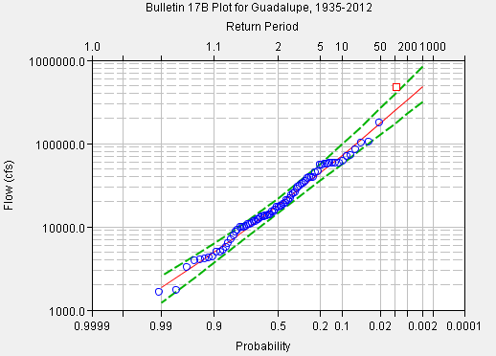
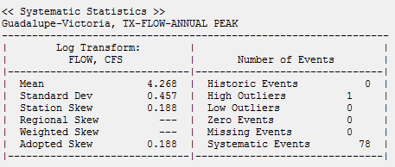
Frequency Analysis, 1935-2012

Slide 4
Comparison of Two Analyses
1935-1978 (44 years)
Mean 4.278
StdDev 0.404
Skew -0.085
Design discharges
10 yr 61,929 cfs
100 yr 155,880 cfs
500 yr 250,962 cfs
1935-2012 (78 years)
Mean 4.268
StdDev 0.457
Skew 0.188
Design discharges
10 yr 72,760 cfs
100 yr 247,472 cfs
500 yr 487,051 cfs

Slide 5
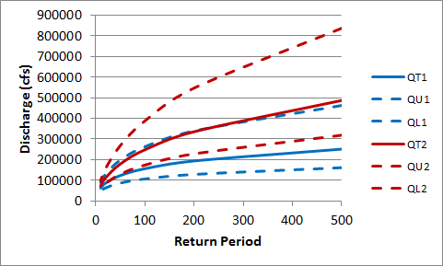
Comparison of Design Discharges Guadalupe River at Victoria, Texas
1935-2012 (78 years)
1935-1978
(44 years)

