Slide 1
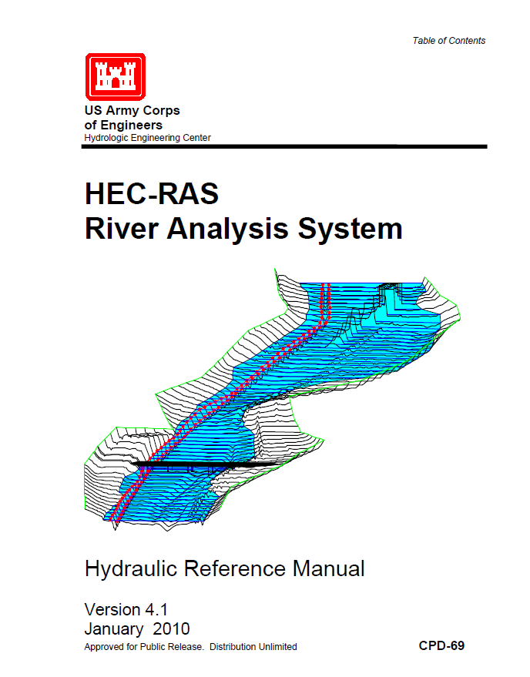
Hydraulic Routing in Rivers
Reference: HEC-RAS Hydraulic Reference Manual, Version 4.1,
Reading: HEC-RAS Manual pp. 3-1 to 3-13
http://www.hec.usace.army.mil/software/hec-ras/documentation/HEC-RAS_4.1_Users_Manual.pdf

Slide 2
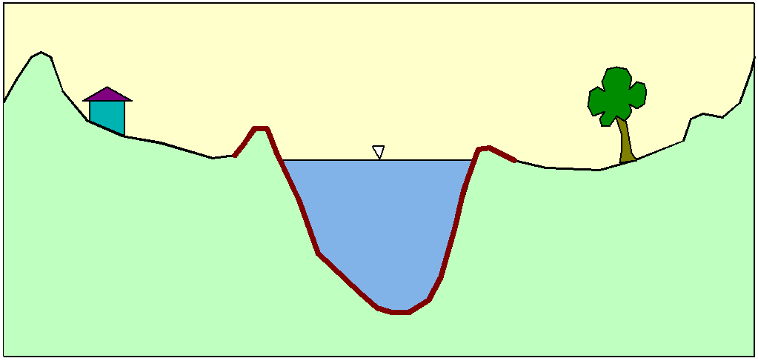
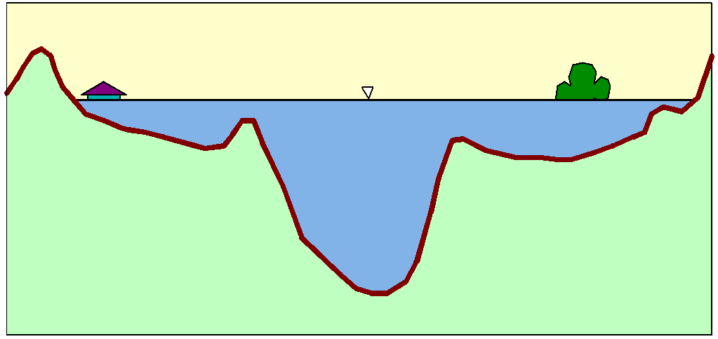
Flood Inundation

Slide 3
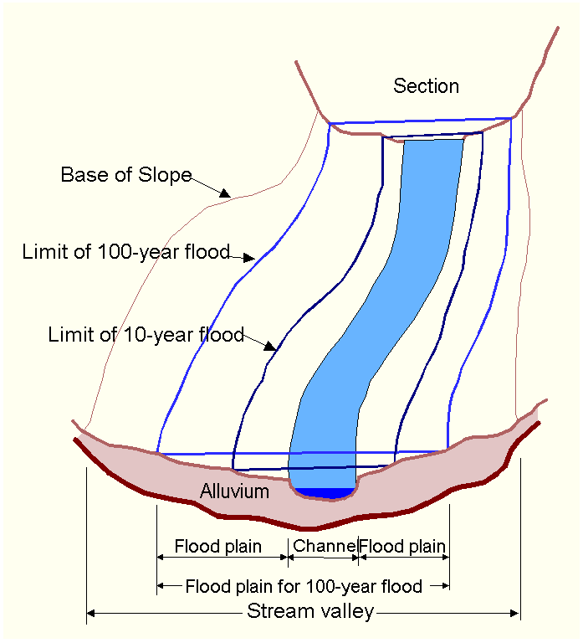
Floodplain Delineation
Notes:
The channel and floodplain are both integral parts of the natural conveyance of a stream. The floodplain carries flow in excess of the channel capacity. The greater the discharge, the greater the extent of inundation. …. Because of its devastating nature, flooding poses serious hazards to human populations in many parts of the world. “The Flood Disaster Protection Act of 1973” required the identification of all floodplain areas in the United States and the establishments of flood-risk zones within those areas.

Slide 4
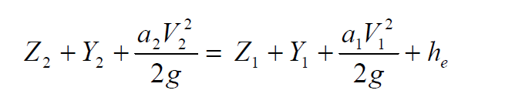
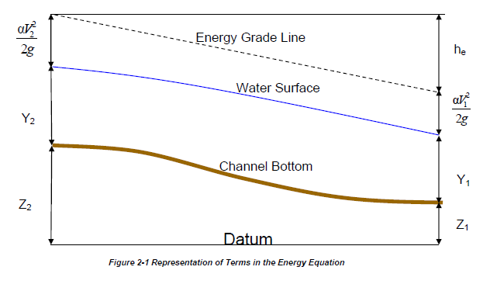
Steady Flow Solution

Slide 5
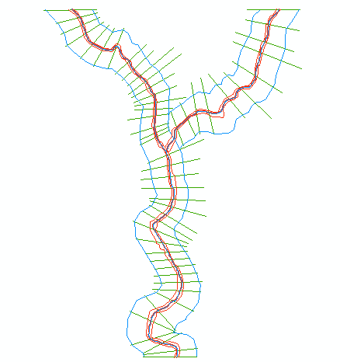
One-Dimensional Flow Computations
Cross-section
Channel centerline
and banklines
Right Overbank
Left Overbank

Slide 6
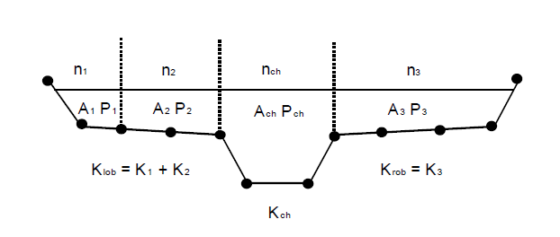


Flow Conveyance, K
Left Overbank
Channel
Right Overbank
$$Q=\frac{1.49}{n}AR^{2/3}S_{f}^{1/2}$$
$$or Q=KS_{f}^{1/2}$$
$$K=\frac{1.49}{n}AR^{2/3}$$
$$or K=\frac{1.49}{n}{\frac{A^{5/3}}{P^{2/3}} }^{}$$

Slide 7
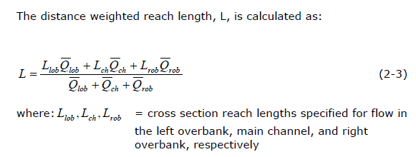
Reach Lengths
(1)
Floodplain
L_{ch}
R_{ob}
L_{ob}
Floodplain
(2)
Left to Right looking downstream

Slide 8
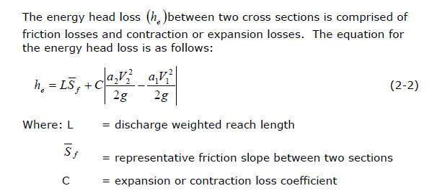
Energy Head Loss

Slide 9
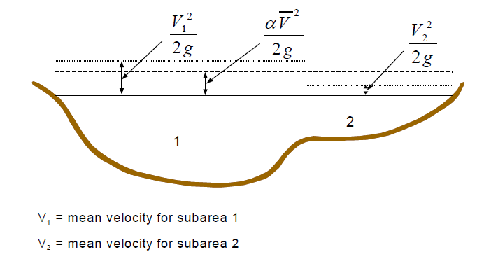
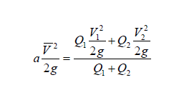
Velocity Coefficient, α

Slide 10
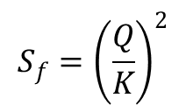
Solving Steady Flow Equations
Q is known throughout reach
All conditions at (1) are known, Q is known
Select h₂
compute Y₂, V₂, K₂, S_{f}, h_{e}
Using energy equation (A), compute h₂
Compare new h₂ with the value assumed in Step 2, and repeat until convergence occurs
(A)
h₂
h₁
(2)
(1)
$$S_{f}={\left(\frac{Q}{K}\right)}^{2}$$

Slide 11
Flow Computations
Reach 3
Reach 2
Start at the downstream end (for subcritical flow)
Treat each reach separately
Compute h upstream, one cross-section at a time
Use computed h values to delineate the floodplain
Reach 1

Slide 12
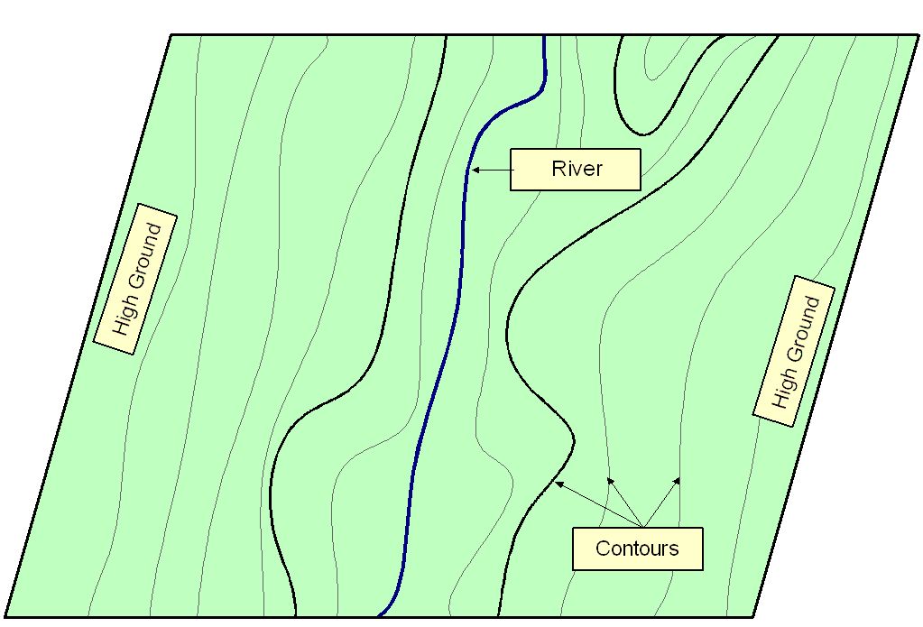
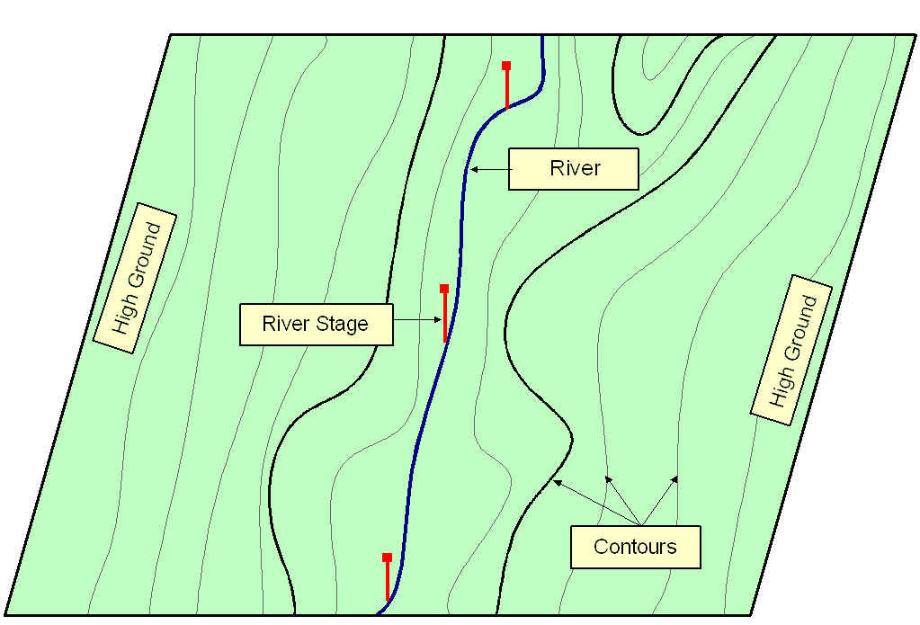
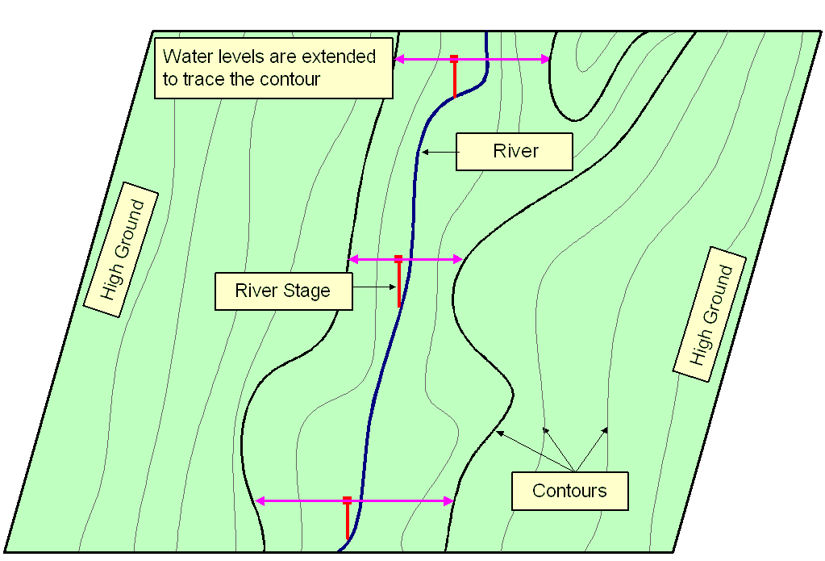
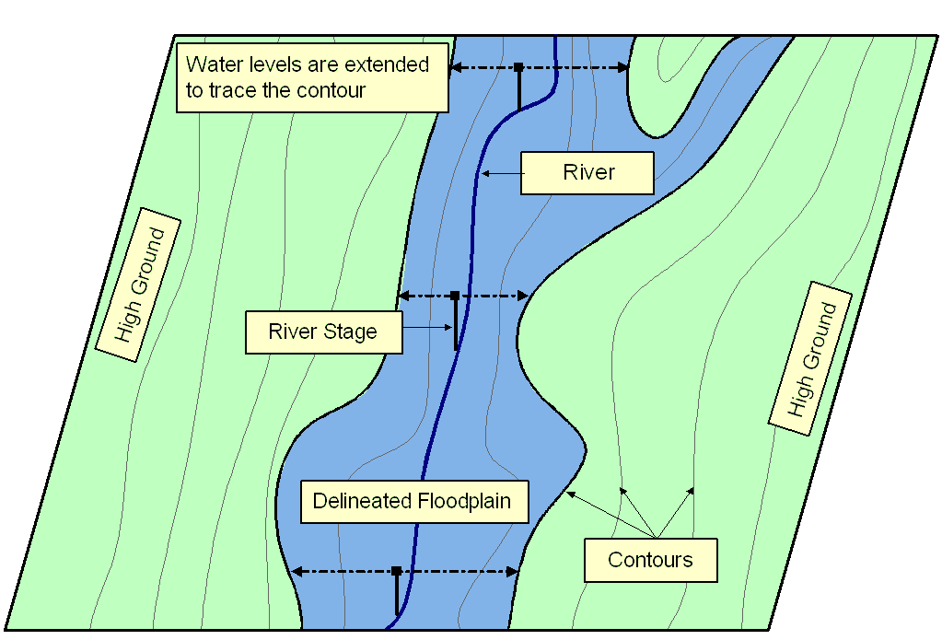
Floodplain Delineation
Notes:
Ideally should have Two D Models…... A floodplain delineation process determines inundation extent by comparing water levels with ground surface elevations. We start with a DTM or topomap. > Water levels are computed based on cross-sections. During normal condition, flow remains within the main channel, but > during flood, water spill over the bank. In these cases it’s important to extent cross-section over the floodplain. > We then bring back water levels on the topomap. > Extent water levels until hit contour of higher elevations. > Finally delineate floodplain following the contours. The accuracy largely depends on water levels and in turns on the cross-section used for computation.

Slide 13
Momentum Equation
Steady, uniform flow
Steady, non-uniform flow
Unsteady, non-uniform flow

Slide 14
HMS-RAS Integration Strategy/Workflow
Brushy Creek Example
Dean Djokic, ESRI
22 March 2012

Slide 15
Lecture Overview
Approach to integrated H&H model development
Upper Brushy Creek – GeoHMS/HMS development
Flood modeling for area of interest – GeoRAS/RAS development

Slide 16
HMS-RAS Integration Overview

Slide 17
Integration Approach
Mix of planning, GIS, and H&H modeling operations – not a push button operation.
Types of integration
  Modeling support (preparing data for model input)
    e.g. land use/soils/CN or rainfall processing – Arc Hydro or general GIS data processing
  Linked
    GeoHMS
    GeoRAS
  Integrated
    DSS

Slide 18
Integration Approach (2)
Key steps:
  Plan (roughly) hydrologic and hydraulic model layouts – flow exchange locations
    e.g. location of HMS modeling elements and RAS cross-sections
  Identify sources of precipitation input into the hydrologic model and techniques for their incorporation into the dataset
    e.g. Nexrad rainfall
  Develop GeoHMS model (and precipitation sub model)
  Finalize and run HMS model and generate results (DSS)
  Develop GeoRAS model
  Finalize and run RAS taking HMS results as input
  Feedback between HMS and RAS is manual
    e.g. modification of time of concentration or routing parameters

Slide 19
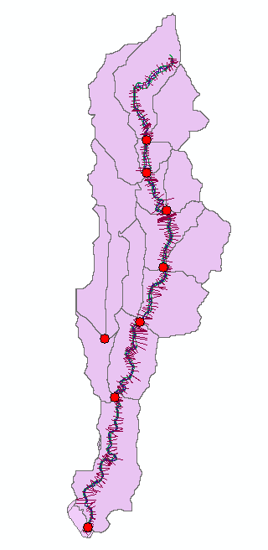
Integration Planning
Identify where outputs from one model (HMS) become input to the second one (RAS)
  Place hydrologic elements (subbasins, reaches, junctions) to capture flows at points of interest (confluences, structures)
  Place hydraulic elements (cross-sections) at points of interest
  Identify/specify element naming conventions between the two models (persistent or transient names)

Slide 20
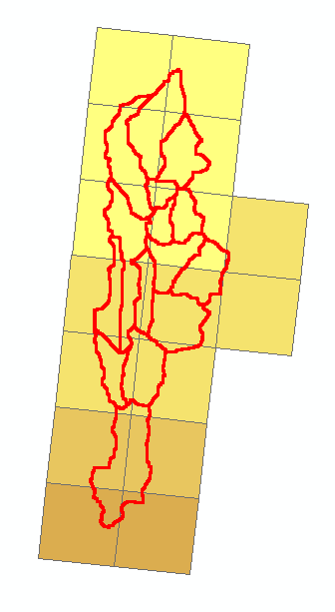
Precipitation Sources
Identify sources of precipitation input into the hydrologic model and techniques for their incorporation into the dataset
  Point (rain gage)
  Polygon (Nexrad cells)
  Surface (TIN/grid)

Slide 21
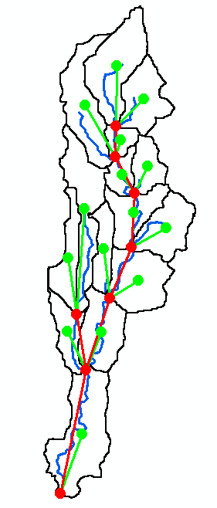
Develop GeoHMS model
Follow all principles in development of a hydrologic model
In addition, take into consideration integration planning aspects developed earlier
  Placement of flow exchange points
  Naming conventions
Incorporate precipitation submodel
  Develop Arc Hydro time series for the final subbasin delineation and export to DSS
Export to HMS

Slide 22
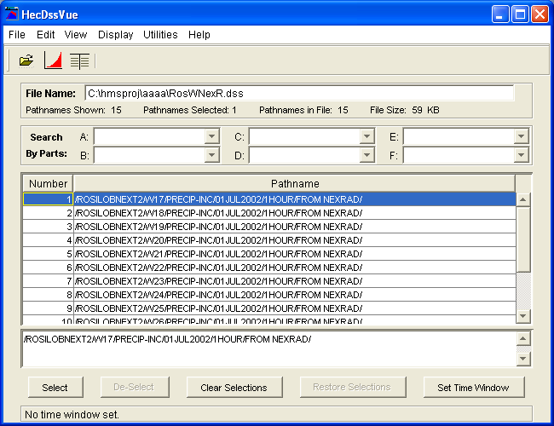
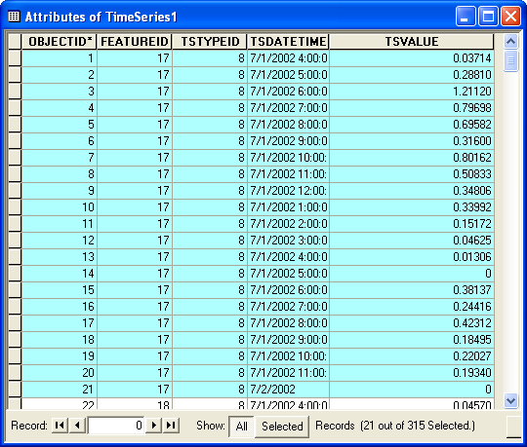
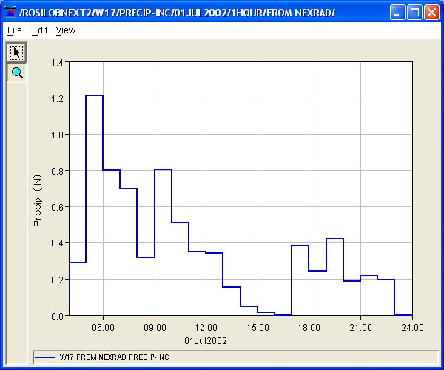
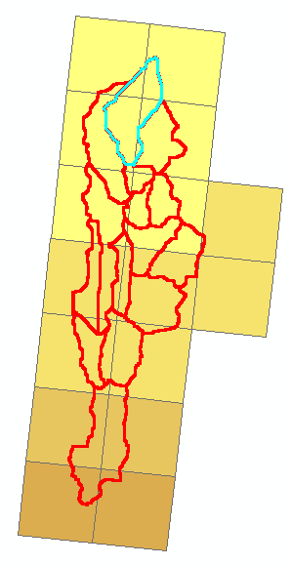
Meteorological Component
Develop a custom “gage” for each subbasin or for each rainfall observation element with corresponding weights for subbasins.
Export the time series for the subbasin “gage” from Arc Hydro time series data structure into DSS
Arc Hydro
Arc Hydro to DSS transfer
DSS

Slide 23
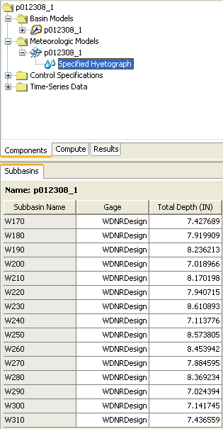
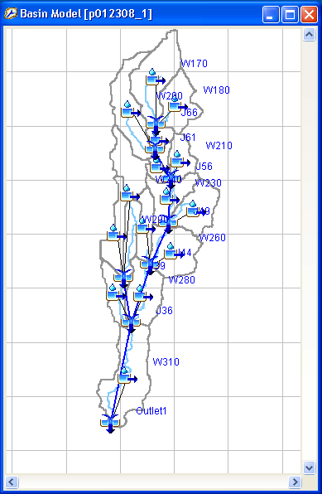
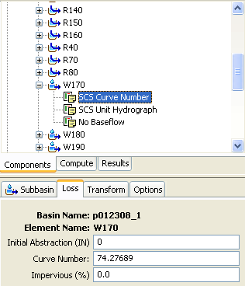
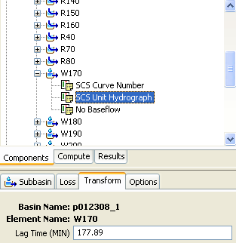
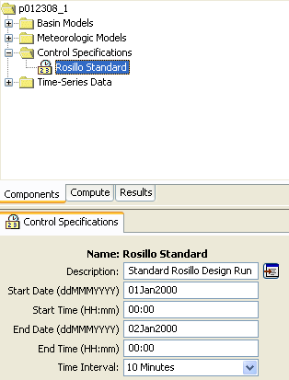
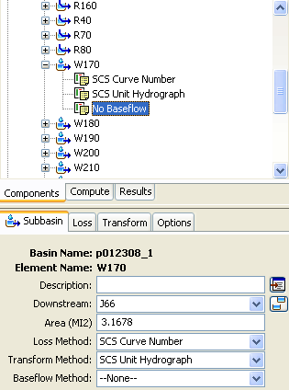
Finalize and Run HMS
Complete HMS model with any additional parameters including meteorological model and control specifications
Follow all principles in HMS model development (calibration, etc.)

Slide 24
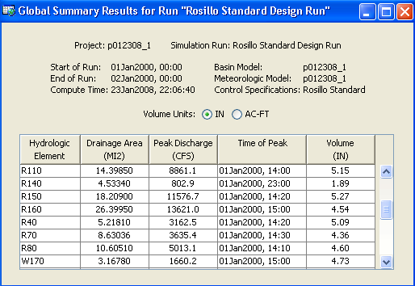
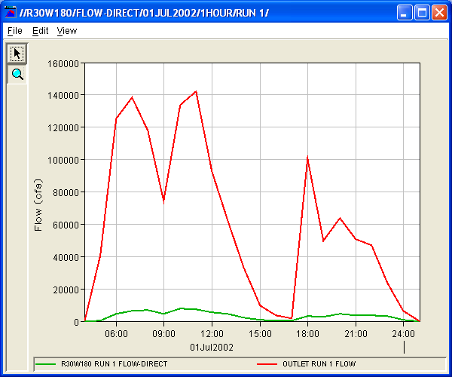
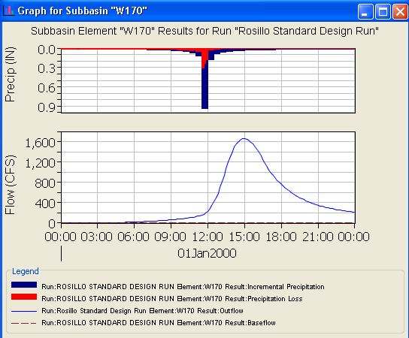
Finalize and Run HMS (2)
Do the final run and generate results (DSS)
HMS View
DSS View

Slide 25
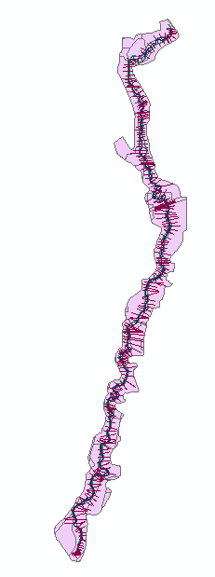
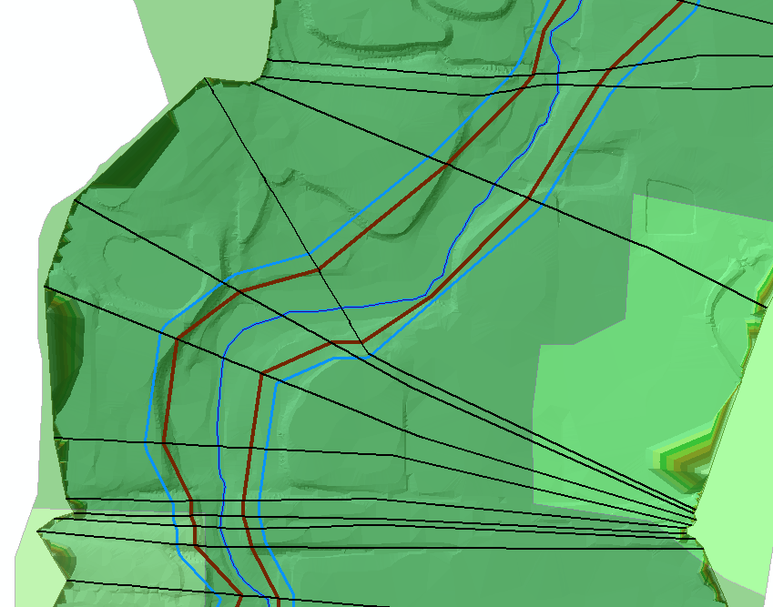
Develop GeoRAS model (pre-processing)
Follow all principles in development of a hydraulic model for element placement (confluences, structures, …)
In addition, take into consideration integration planning aspects developed earlier
  Naming conventions (add name of the HMS element to the cross-section that will get the element’s flows)
Export to RAS

Slide 26
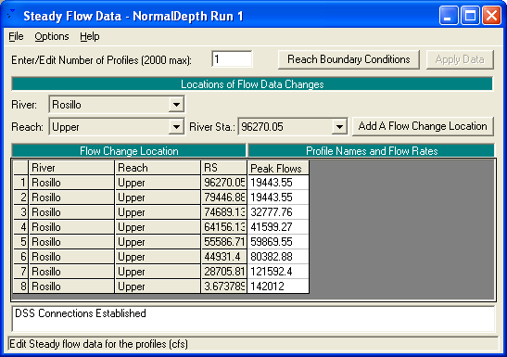
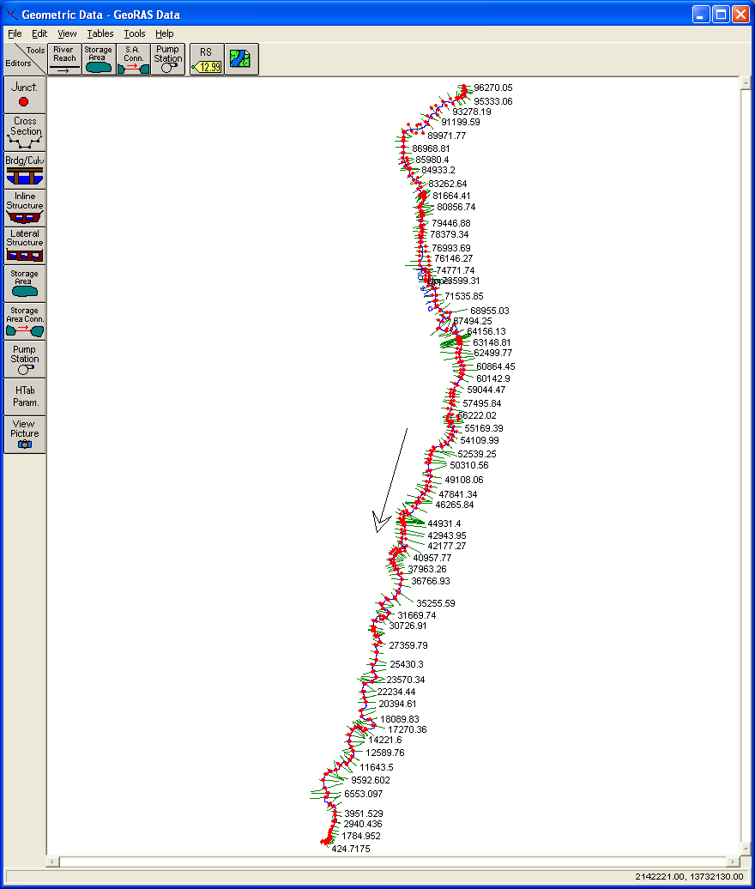
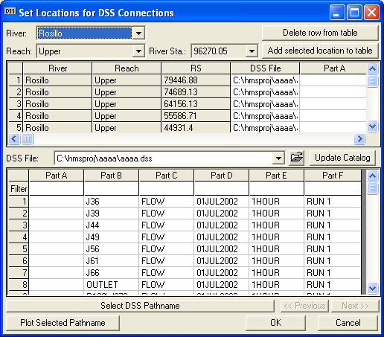
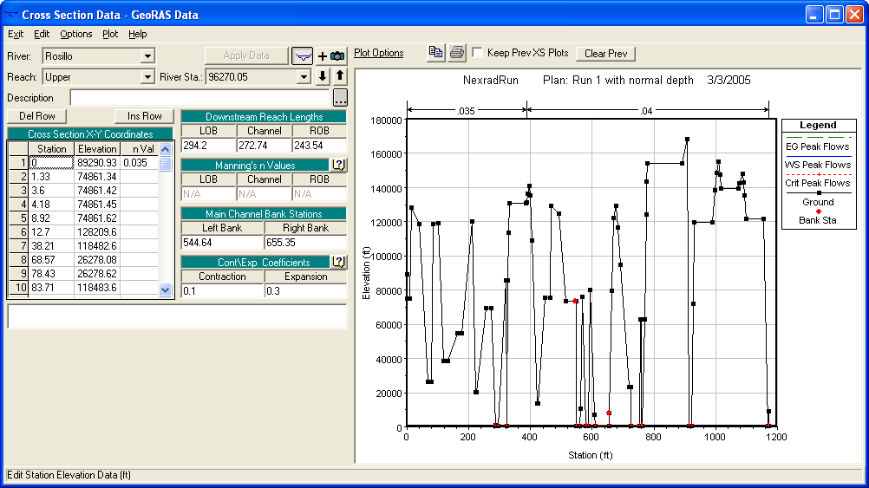
Finalize and Run RAS
Complete RAS model with any additional parameters including initial and boundary conditions
Follow all principles in RAS model development (calibration, etc.)

Slide 27
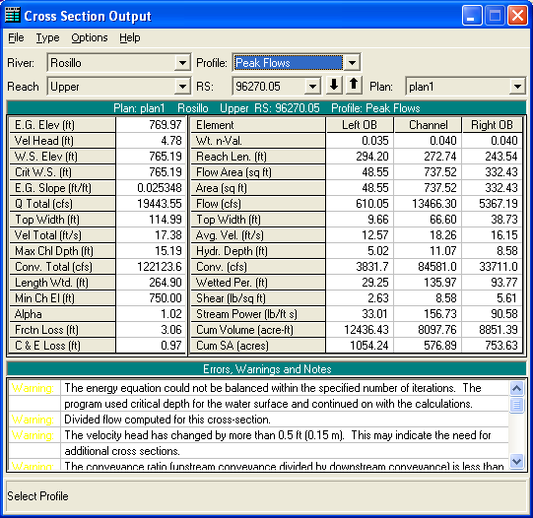
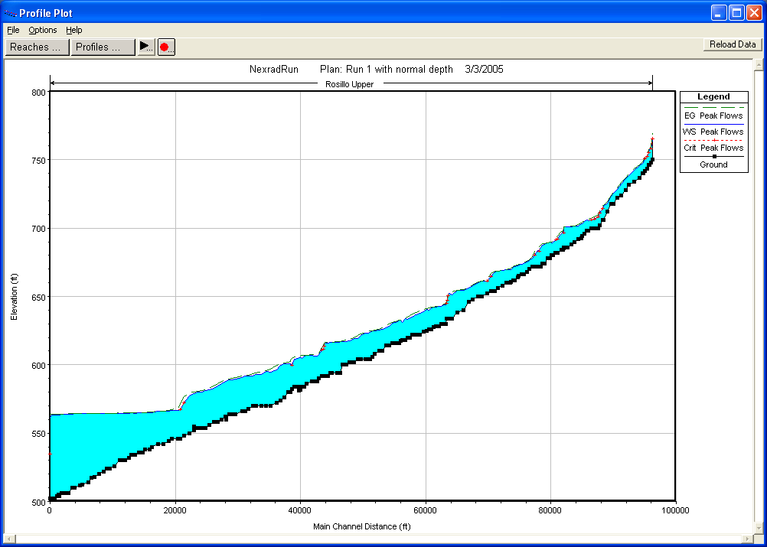
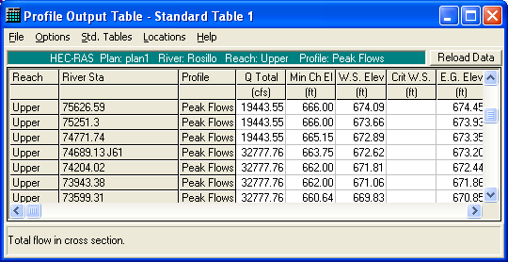
Finalize and Run RAS (2)
Do the final run and generate results (export to sdf file)

Slide 28
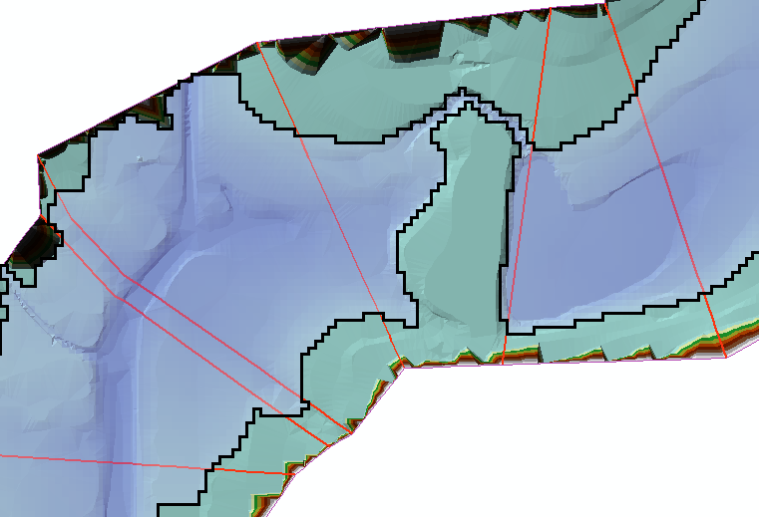
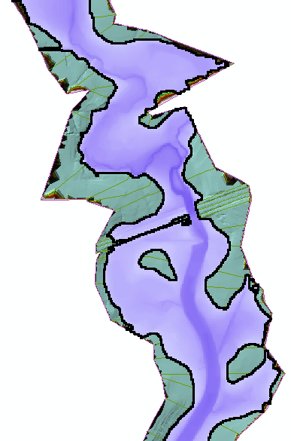
Process RAS results in GeoRAS
Construct the floodplain based on the results in the sdf
Review the results with respect to spatial integrity (extents of cross-sections, ineffective flow areas, disconnected flood areas, …)
Clean results
Revisit RAS

Slide 29
GIS – HMS – RAS Feedback
At present it is manual and at discretion of modeler
  GIS – H&H interaction
  H – H interaction
Visualization in both pre and post-processing – not just a “pretty picture”
  Fly-over in preprocessing (GeoHMS and GeoRAS)
    Identification of data problems
    Modeling element placement
  Post-processing (GeoRAS)
    Validity of element placement

