Slide 1
Hydrologic Design
Reading: Applied Hydrology Sections 13-1, 13-2

Slide 2
Hydrologic design
Water control
  Peak flows, erosion, pollution, etc.
Water management
  Domestic and industrial use, irrigation, instream flows, etc
Tasks
  Determine design inflow
  Route the design inflow
  Find the output
    check if it is sufficient to meet the demands (for management)
    Check if the outflow is at safe level (for control)

Slide 3
Hydrologic design scale
Hydrologic design scale – range in magnitude of the design variable within which a value must be selected
Design considerations
  Safety
  Cost
Do not design small structures for large peak values (not cost effective)
Do not design large structures for small peak values (unsafe)
Balance between safety and cost.

Slide 4
Estimated Limiting Value (ELV)
Lower limit on design value – 0
Upper limit on design value – ELV
ELV – largest magnitude possible for a hydrologic event at a given location, based on the best available hydrologic information.
  Length of record
  Reliability of information
  Accuracy of analysis
Probable Maximum Precipitation (PMP) / Probable Maximum Flood (PMF)

Slide 5
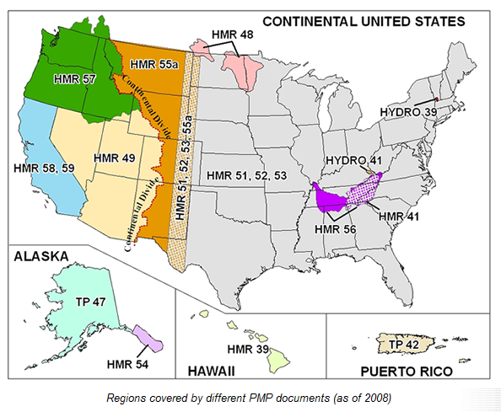
Probable Maximum Precipitation
Most recent report 1999
http://www.nws.noaa.gov/oh/hdsc/studies/pmp.html

Slide 6
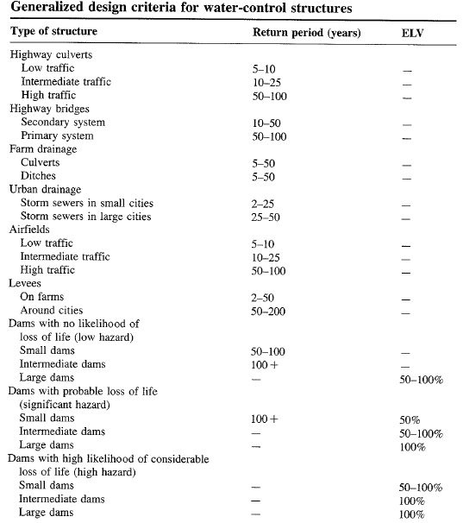

Slide 7
TxDOT Recommendations

Slide 8
Hydrologic design level
Hydrologic design level – magnitude of the hydrologic event to be considered for the design or a structure or project.
Three approaches for determining design level
  Empirical/probabilistic
  Risk analysis
  Hydroeconomic analysis

Slide 9
Empirical/Probabilitic
P(most extreme event of last N years will be exceeded once in next n years)
P(largest flood of last N years will be exceeded in n=N years) = 0.5
Drought lasting m years is worst in N year record. What is the probability that a worse drought will occur in next n years?
  # sequences of length m in N years = N-m+1
  # sequences of length m in n years = n-m+1

Slide 10
Example 13.2.1
If the critical drought of the record, as determined from 40 yrs of data, lasted 5 yrs, what is the chance that a more severe drought will occur during the next 20 yrs?
Solution:
N = 40, m = 5 and n = 20

Slide 11
Risk Analysis
Uncertainty in hydrology
  Inherent - stochastic nature of hydrologic phenomena
  Model – approximations in equations
  Parameter – estimation of coefficients in equations
Consideration of Risk
  Structure may fail if event exceeds T–year design magnitude
  R = P(event occurs at least once in n years)
    Natural inherent risk of failure

Slide 12
Example 13.2.2
Expected life of culvert = 10 yrs
Acceptable risk of 10 % for the culvert capacity
Find the design return period
What is the chance that the culvert designed for an event of 95 yr return period will have its capacity exceeded at least once in 50 yrs?
The chance that the capacity will not be exceeded during the next 50 yrs is 1-0.41 = 0.59

Slide 13
Hydroeconomic Analysis
Probability distribution of hydrologic event and damage associated with its occurrence are known
As the design period increases, capital cost increases, but the cost associated with expected damages decreases.
In hydroeconomic analysis, find return period that has minimum total (capital + damage) cost.

Slide 14
