Slide 1
Hydrologic Measurement
Precipitation
Evaporation
Streamflow
Channel Properties
Topography
GIS datasets
Reading: Applied Hydrology Chapter 6

Slide 2
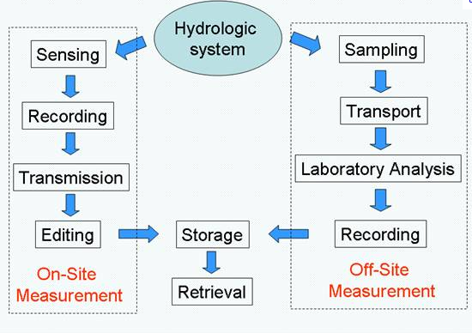
Hydrologic Measurement
Precipitation, Climate, Stream Gaging
Water Quality Sampling

Slide 3
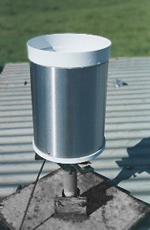
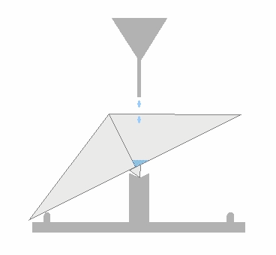
Precipitation Station
Tipping Bucket Raingage
  The gauge registers precipitation (rainfall) by counting small increments of rain collected.
  When rain falls into the funnel it runs into a container divided into two equal compartments by a partition
  When a specified amount of rain has drained from the funnel the bucket tilts the opposite way.
  The number and rate of bucket movements are counted and logged electronically.

Slide 4
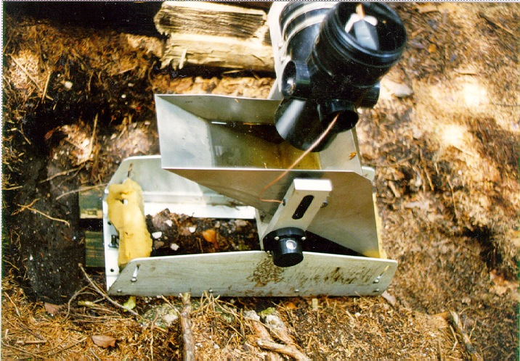
Tipping bucket rain gage

Slide 5
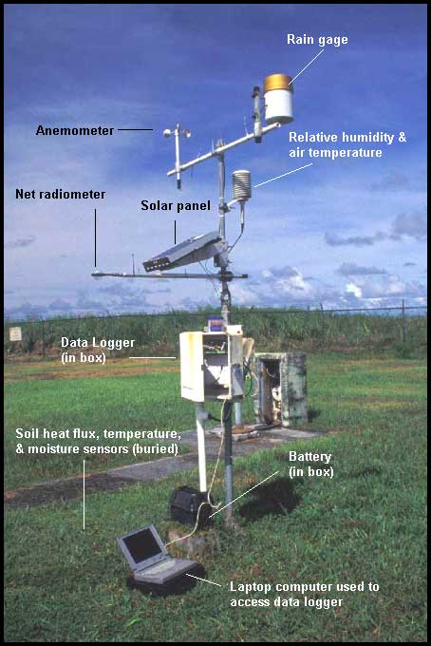
Weather/climate station
Following variables are recorded
  Wind velocity/direction
  Rainfall
  Relative humidity and temperature
  Radiation

Slide 6
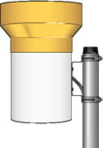
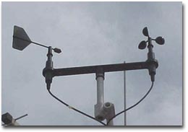
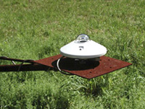
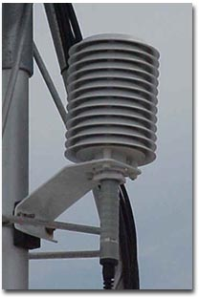
Components of a weather station
Anemometer
Tipping bucket raingage
Radiometer
Relative humidity and temperature

Slide 7
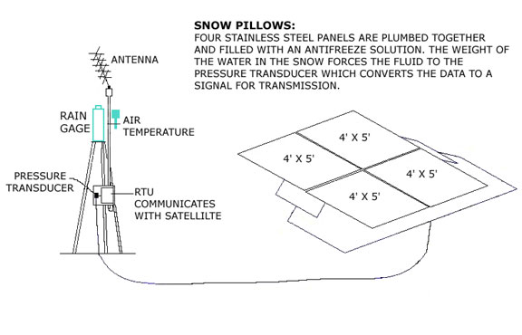
Precipitation (continued)
Snow Pillows
http://wsoweb.ladwp.com/Aqueduct/snow/pillow.htm

Slide 8
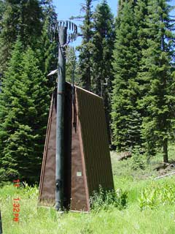
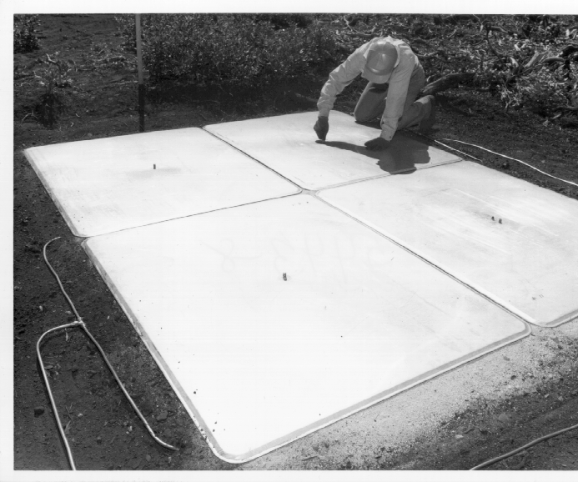
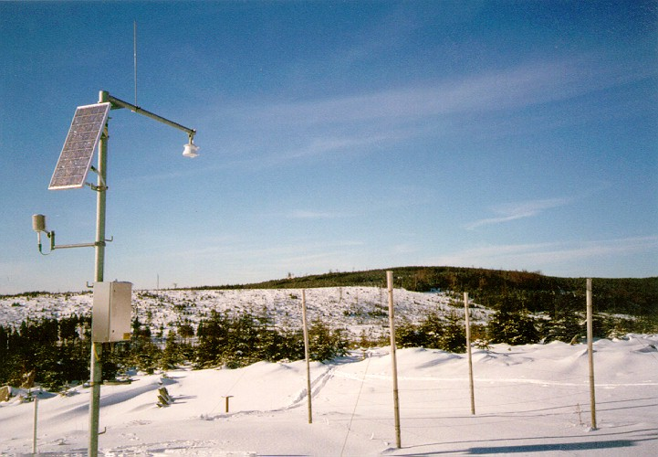
Snow Pillows

Slide 9
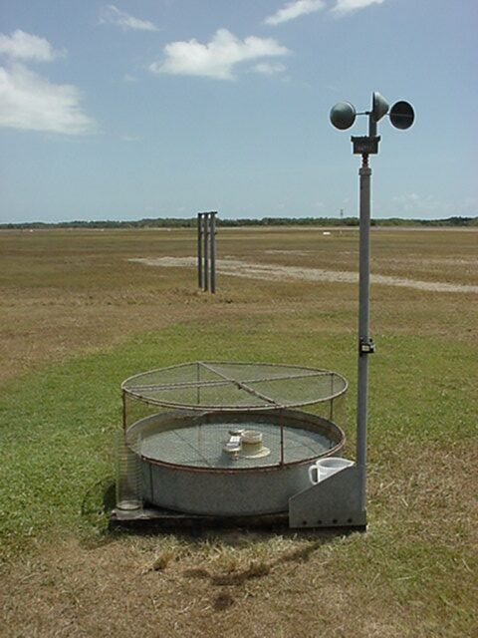
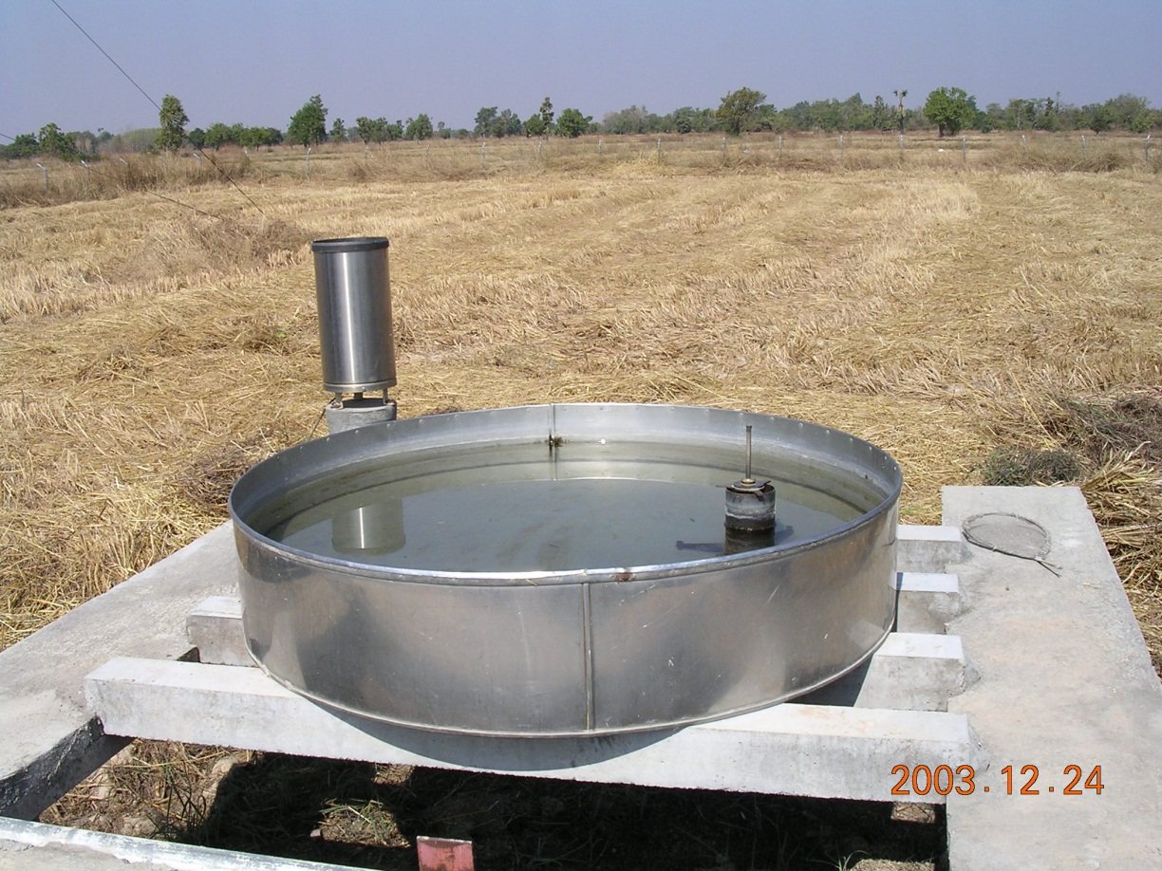
Evaporation pan

Slide 10
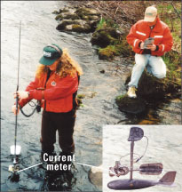
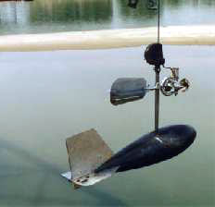
Measuring streamflow

Slide 11
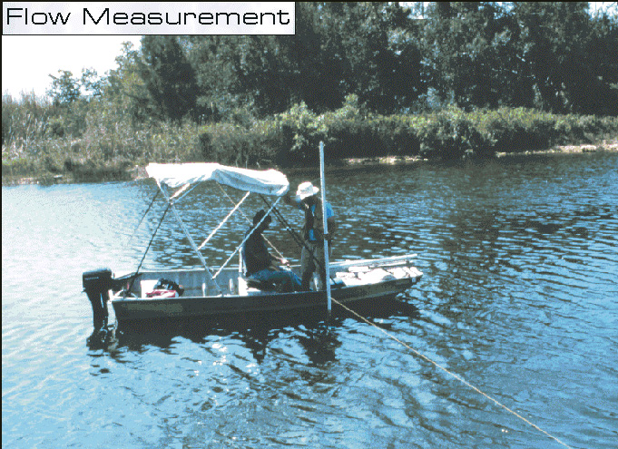
Streamflow using a boat
Tag line

Slide 12
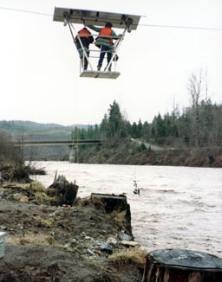
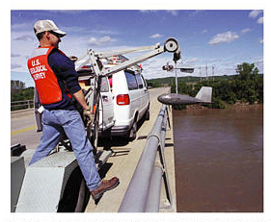
Measurement at high flows
Using stream gaging cable car
From bridge

Slide 13
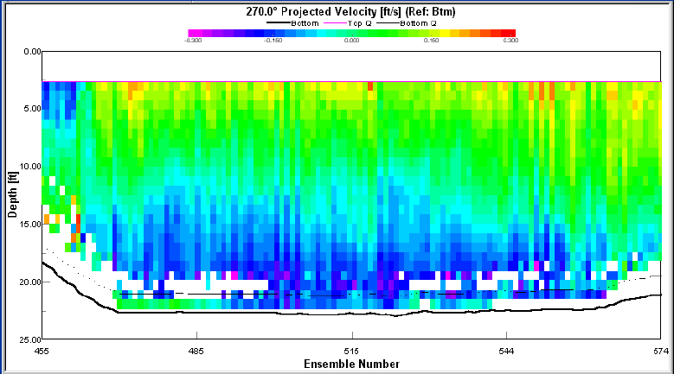

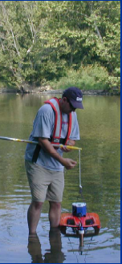
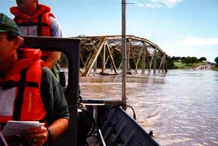
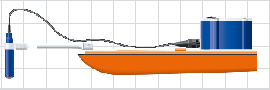
Acoustic Doppler Current Profiler

Slide 14
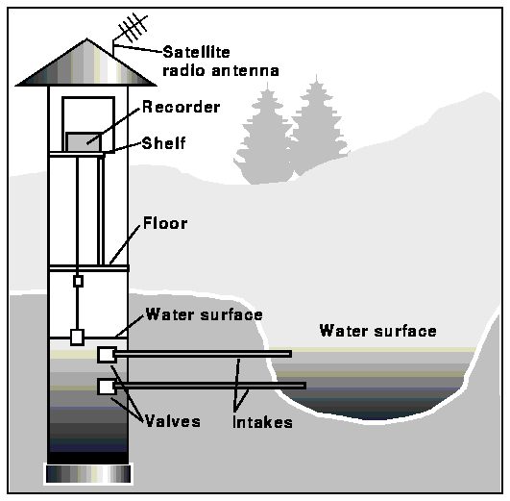
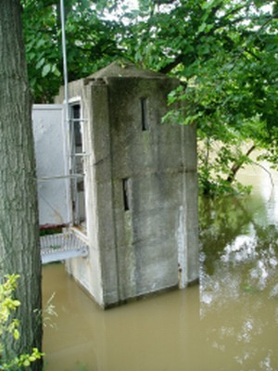
Schematic of a stilling well gaging station

Slide 15
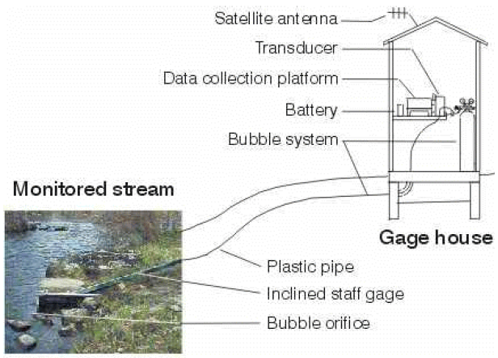
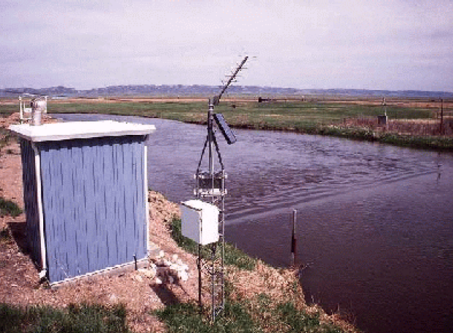
Pressure transducer gaging station

Slide 16
Stream Flow Rate
Water Surface
Height
above
bed
Depth
Averaged
Velocity
Velocity
Velocity profile in stream
Discharge at a cross-section

Slide 17
Example
Colorado River at Austin

Slide 18
Example (Cont.)
Q = 3061 ft3/s
V = Q/A = 1.81 ft/s

Slide 19
Rating Curve
It is not feasible to measure flow daily.
Rating curves are used to estimate flow from stage data
Rating curve defines stage/streamflow relationship
http://nwis.waterdata.usgs.gov/nwis/measurements/?site_no=08158000

Slide 20
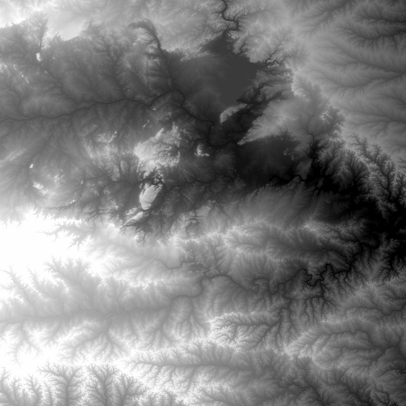
National Elevation Dataset
http://ned.usgs.gov/
Digital Elevation Model with 1 arc-second (30m) cells
Seamless in 1° blocks for the United States
10 billion data
Derived from USGS 1:24,000 quadrangle sheets
Get the data:
http://seamless.usgs.gov/

Slide 21
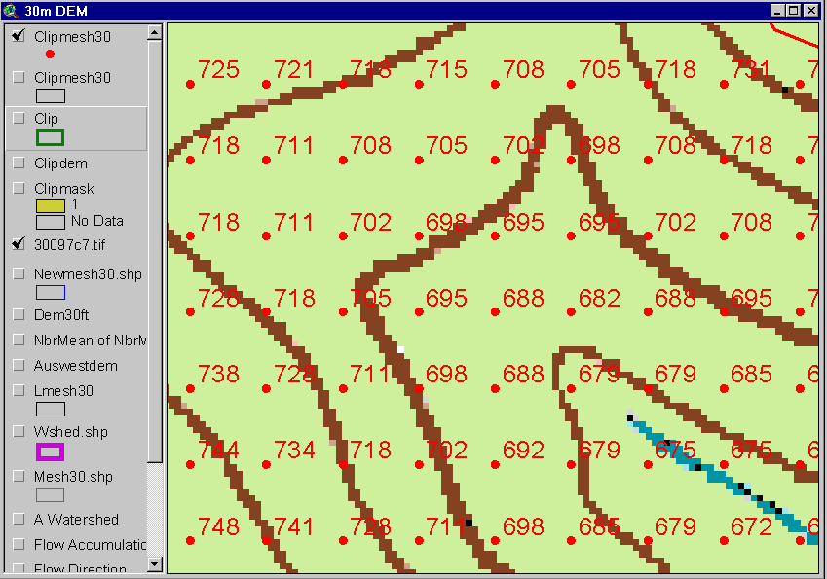
Digital Elevation Model (DEM)
720
720
Contours
740
720
700
680
740
720
700
680

Slide 22
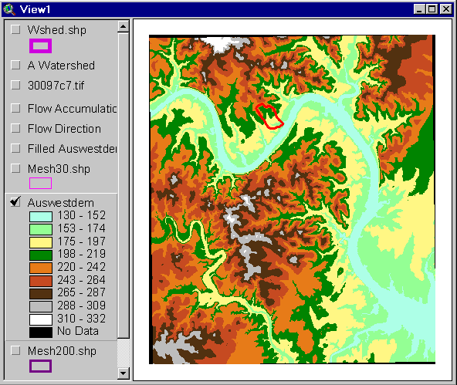
Austin West 30 Meter DEM

Slide 23
Eight Direction Pour Point Model
32
64
128
16
1
8
4
2
Water flows in the direction of steepest descent

Slide 24
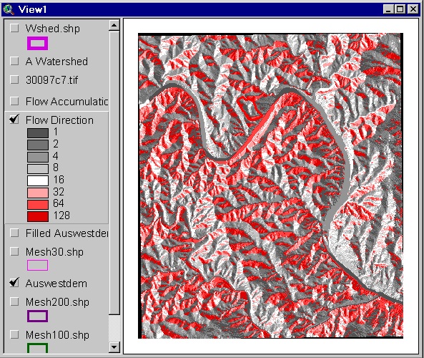
Flow Direction Grid
32
64
128
16
1
8
4
2

Slide 25
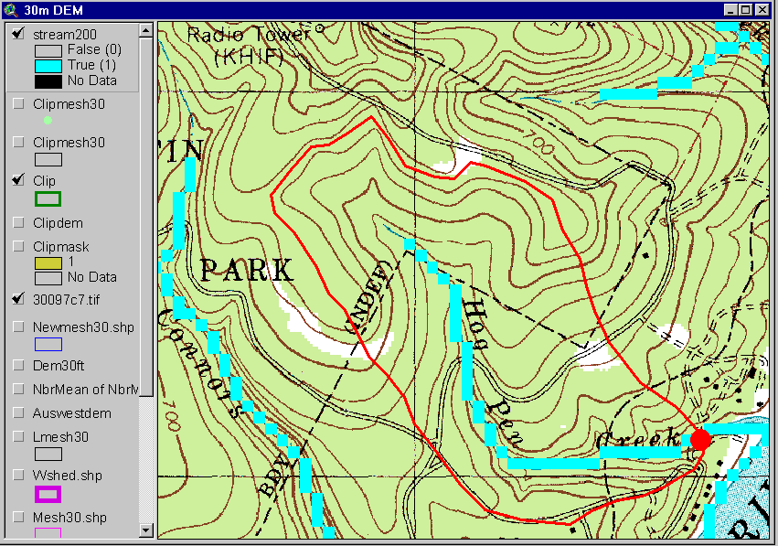
Delineation of Streams and Watersheds on a DEM

Slide 26
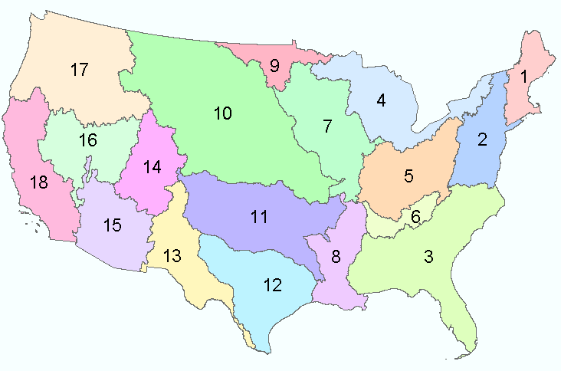
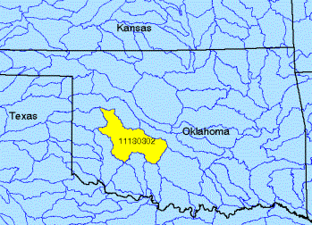
Watersheds of the US
2-digit water resource regions
8-digit HUC watersheds

Slide 27
Watershed Hierarchy
Digit #
2
4
6
8 HUC
10
12
NHDPlus
Available
In Progress

Slide 28
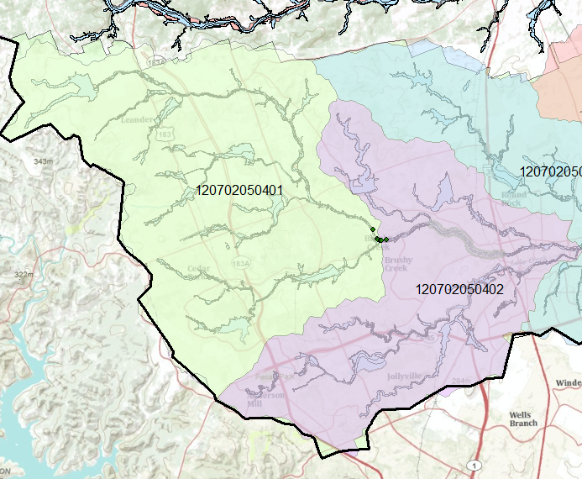
Watershed of Brushy Creek
HUC12 number

Slide 29
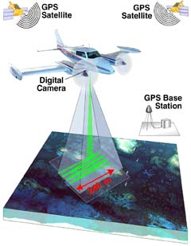
LIDAR surveying
LIDAR (Light Detection and Ranging; or Laser Imaging Detection and Ranging) is a technology that determines distance to an object or surface using laser pulses. Like the similar radar technology, which uses radio waves instead of light, the range to an object is determined by measuring the time delay between transmission of a pulse and detection of the reflected signal.

Slide 30
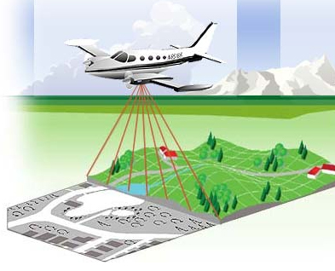
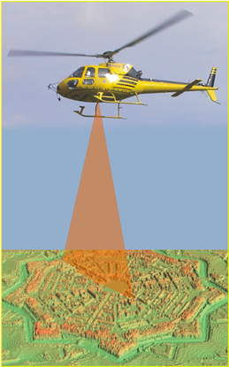
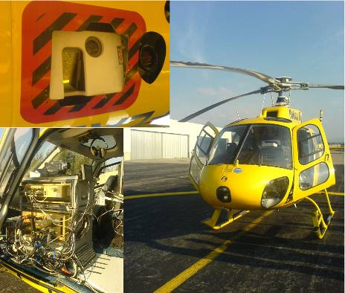
Airborne Lidar
Airborne laser altimetry technology (LiDAR, Light Detection And Ranging) provides high-resolution topographical data, which can significantly contribute to a better representation of land surface. A valuable characteristic of this technology, which marks advantages over the traditional topographic survey techniques, is the capability to derive a high-resolution Digital Terrain Model (DTM) from the last pulse LiDAR data by filtering the vegetation points (Slatton et al., 2007).
Slide courtesy of Dr. Paolo Tarolli, University of Padova, Italy

Slide 31
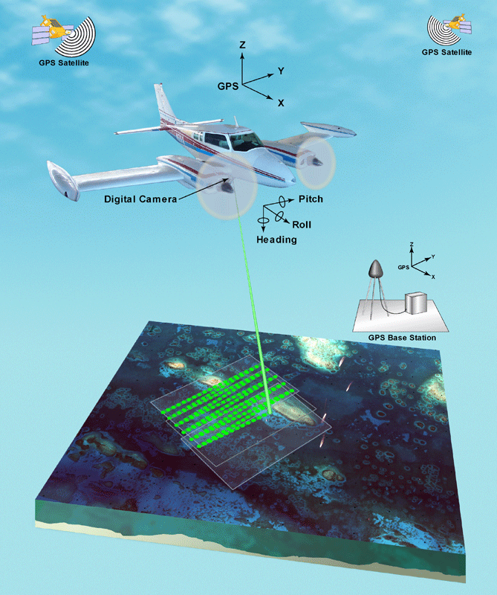
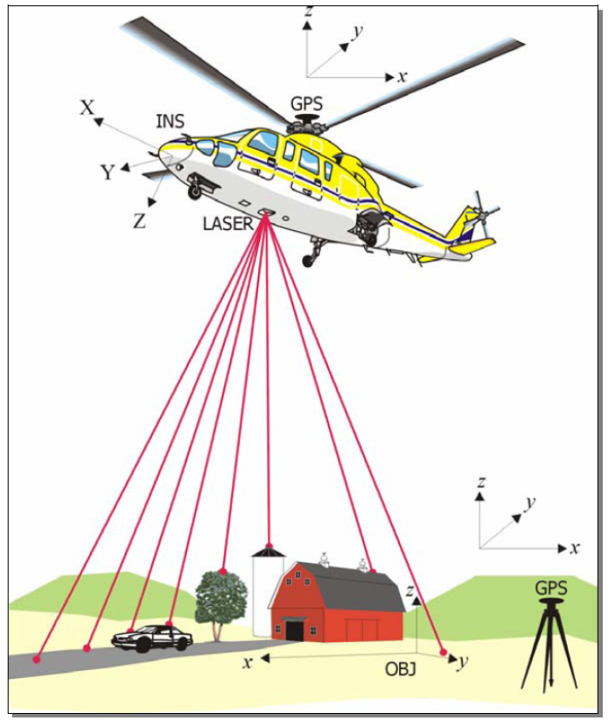
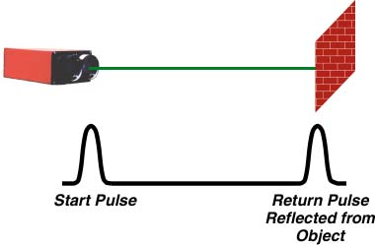
Slide courtesy of Dr. Paolo Tarolli, University of Padova, Italy

Slide 32
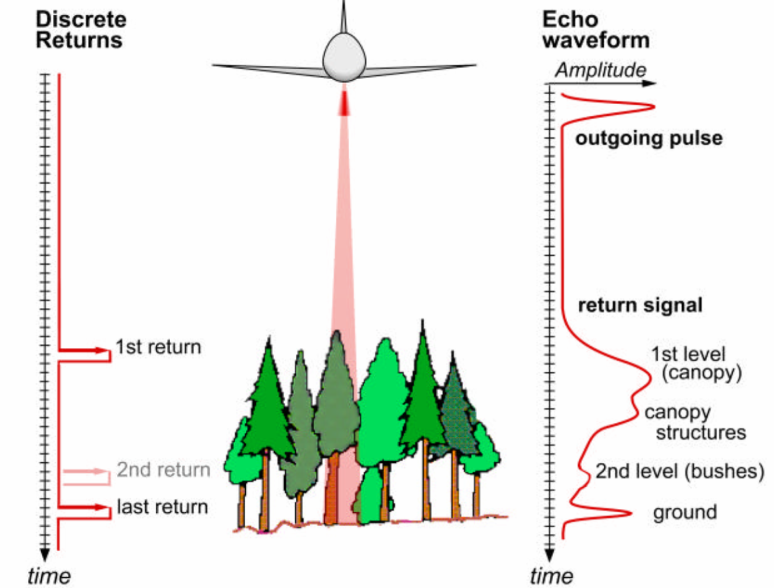
x,y,z
Slide courtesy of Dr. Paolo Tarolli, University of Padova, Italy

Slide 33
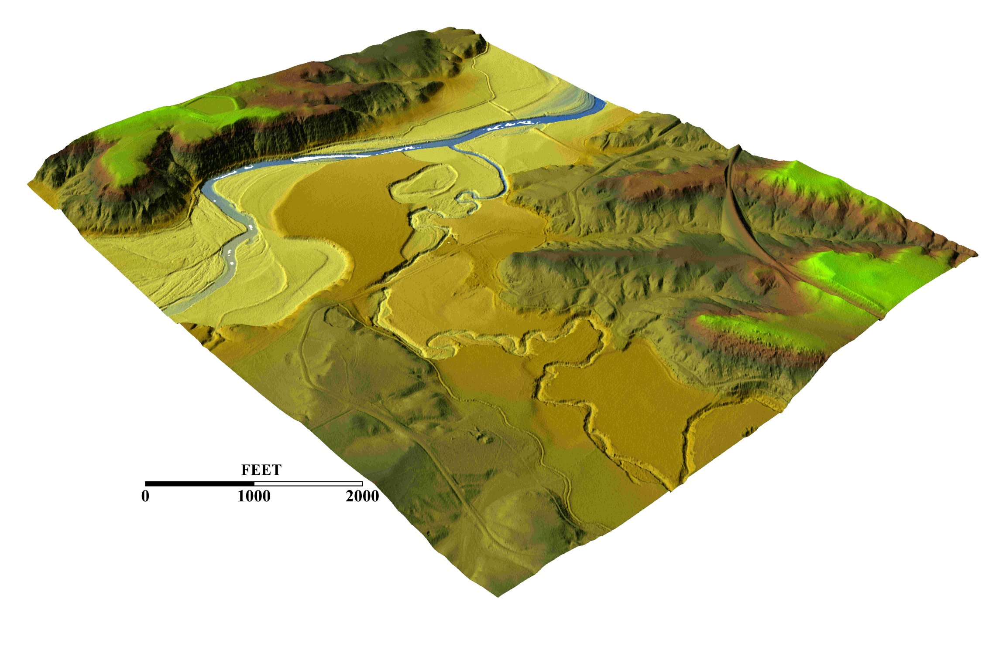
3-D detail of the Tongue river at the WY/Mont border from LIDAR.
Roberto Gutierrez
University of Texas at Austin

Slide 34
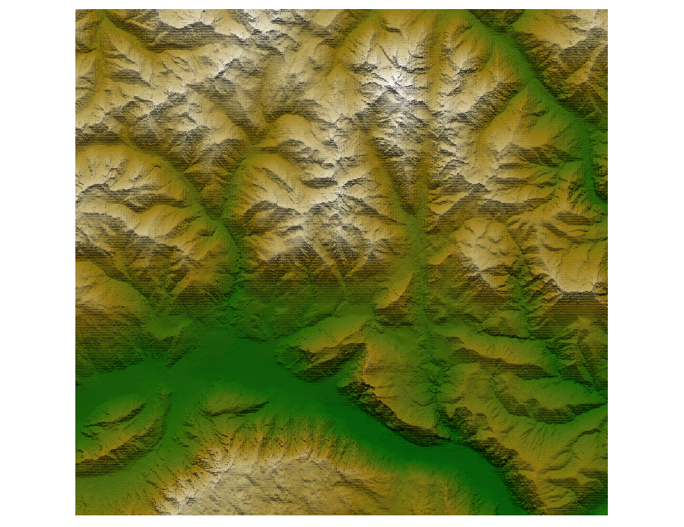
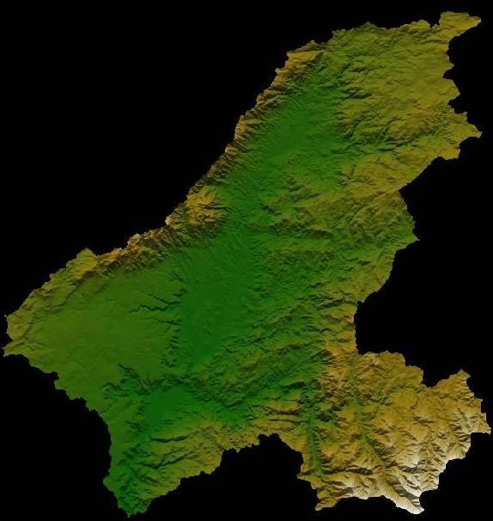
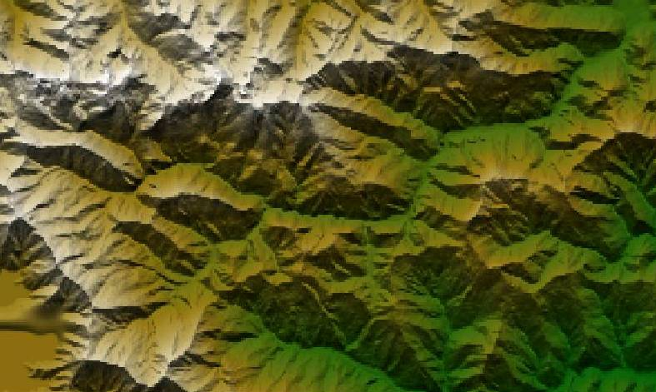
Digital elevation data
Data resolution available until recently 30-100 m.
Grigno basin, Italy
Resolution 30 m x 30 m
Data source: University of Padova
Tirso basin, Italy
Resolution 100 m x 100 m
Data source: University of Padova
Tanaro basin, Italy
Resolution 90 m x 90 m
Data source: University of Padova

Slide 35
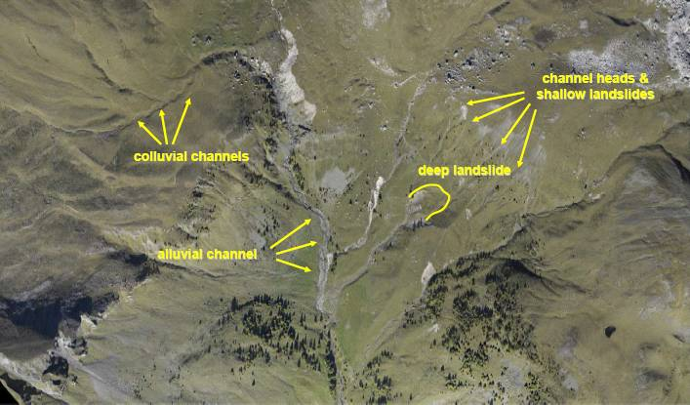
Rio Cordon basin, Selva di Cadore, Italy
Slide courtesy of Dr. Paolo Tarolli, University of Padova, Italy

Slide 36
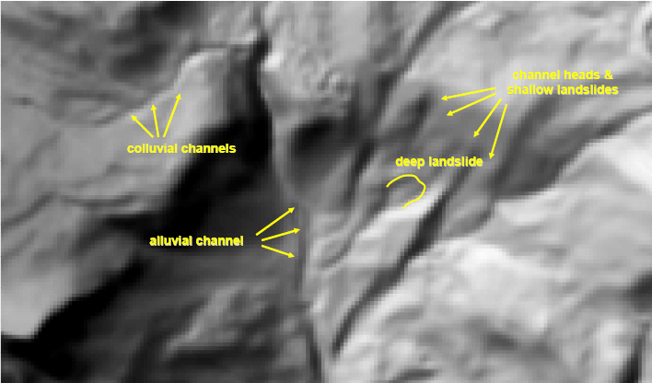
The role of data resolution
DTM 10x10 m
Slide courtesy of Dr. Paolo Tarolli, University of Padova, Italy

Slide 37

The role of data resolution
DTM 1x1 m
Slide courtesy of Dr. Paolo Tarolli, University of Padova, Italy

Slide 38

Topographic Lidar
λ = 1064 nm
Green LiDAR
λ = 532 nm + λ =1064 nm
It is important to remember that the deep water surfaces normally do not reflect the signal: however this is not true in case of presence of floating sediments or when using bathymetric lidar. The bathymetric lidar, that is based on the same principles as topographic lidar, emits laser beams in two wavelengths: an infrared (1064 nm) and a green one (532 nm). The infrared wavelength is reflected on the water surface, while the green one penetrates the water and is reflected by the bottom surface or other objects in the water. Due to this reason the bathymetric lidar is also called green lidar.
Slide courtesy of Dr. Paolo Tarolli, University of Padova, Italy

Slide 39

Fonte: www.optech.ca
During optimal environment condition, when the water is clear, the green lidar survey may reach 50 m water depth with an horizontal accuracy of ±2.5 m, and vertical accuracy of ±0.25 m. This technology is growing fast, and some of the first applications in rivers are coming out (Hilldale and Raff, 2008; McKean et al., 2009).
Slide courtesy of Dr. Paolo Tarolli, University of Padova, Italy

Slide 40

http://srtm.usgs.gov/

Slide 41

HydroSheds derived from SRTM
http://hydrosheds.cr.usgs.gov/

Slide 42


Slide 43


River networks
for 8-digit HUC
watersheds
http://nhd.usgs.gov/

Slide 44


Slide 45

Lower West Fork, Trinity River Basin
HUC = 12030102

Slide 46



1:250,000 Scale Soil Information
http://www.ncgc.nrcs.usda.gov/products/datasets/statsgo/

Slide 47


Ssurgo for Travis County
103 soil map units described by 7530 polygons of average area 35.37 ha (87 acres)

Slide 48


National Land Cover Dataset
Get the data:
http://seamless.usgs.gov/

Slide 49


