Slide 1
Hydrologic Routing
Reading: Applied Hydrology Sections 8.1, 8.2, 8.4

Slide 2
Flow Routing
Q
Procedure to determine the flow hydrograph at a point on a watershed from a known hydrograph upstream
As the hydrograph travels, it
  attenuates
  gets delayed
t
Q
t
Q
t
Q
t

Slide 3
Why route flows?
Q
t
Account for changes in flow hydrograph as a flood wave passes downstream
This helps in
  Accounting for storages
  Studying the attenuation of flood peaks

Slide 4
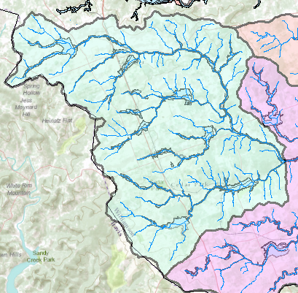
Watershed – Drainage area of a point on a stream
Rainfall
Streamflow
Connecting rainfall input with streamflow output

Slide 5
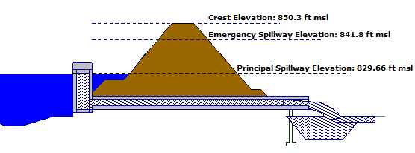
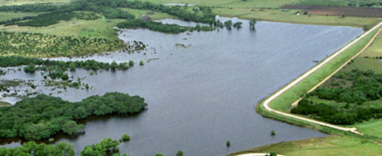
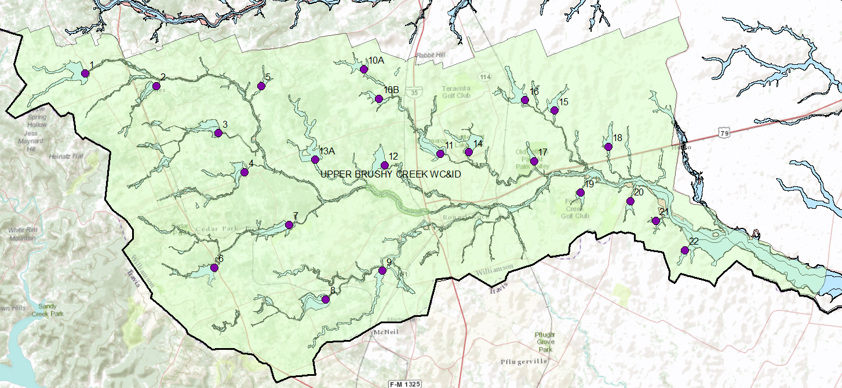
Flood Control Dams
Dam 13A
Flow with a Horizontal Water Surface

Slide 6
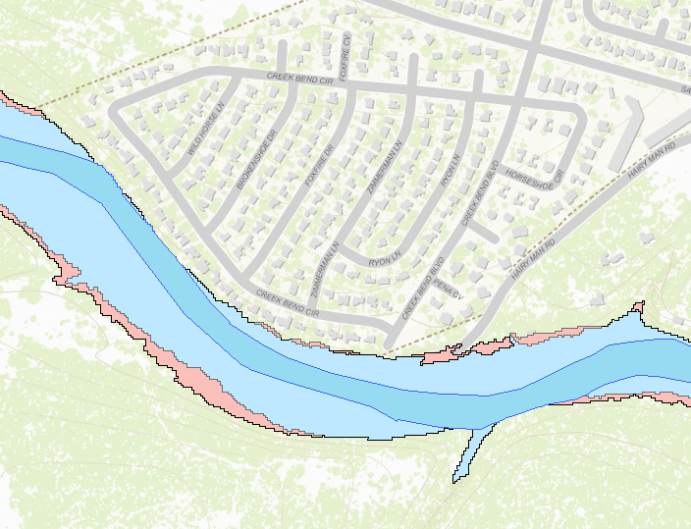

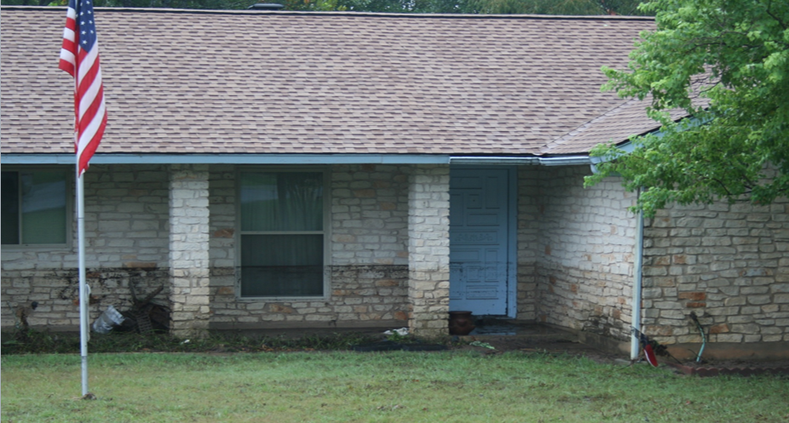

Floodplain Zones
1% chance
< 0.2% chance
Main zone of water flow
Flow with a Sloping Water Surface

Slide 7
Types of flow routing
Lumped/hydrologic
  Flow is calculated as a function of time alone at a particular location
  Governed by continuity equation and flow/storage relationship
Distributed/hydraulic
  Flow is calculated as a function of space and time throughout the system
  Governed by continuity and momentum equations

Slide 8


Hydrologic Routing
Discharge
Discharge
Inflow
Transfer
Function
Outflow
Upstream hydrograph
Downstream hydrograph
Input, output, and storage are related by continuity equation:
Q and S are unknown
Storage can be expressed as a function of I(t) or Q(t) or both
For a linear reservoir, S=kQ

Slide 9
Lumped flow routing
Three types
Level pool method (Modified Puls)
  Storage is nonlinear function of Q
Muskingum method
  Storage is linear function of I and Q
Series of reservoir models
  Storage is linear function of Q and its time derivatives

Slide 10
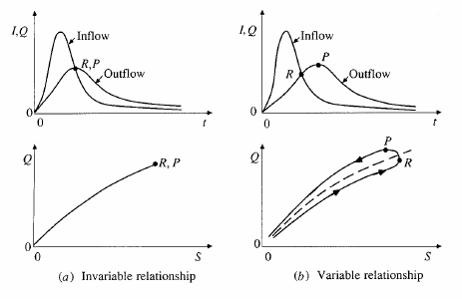
S and Q relationships

Slide 11
Level pool routing
Procedure for calculating outflow hydrograph Q(t) from a reservoir with horizontal water surface, given its inflow hydrograph I(t) and storage-outflow relationship

Slide 12
Level pool methodology
Discharge
Inflow
Outflow
Time
Storage
Unknown
Known
Need a function relating
Time
Storage-outflow function

Slide 13
Level pool methodology
Given
  Inflow hydrograph
  Q and H relationship
Steps
  Develop Q versus Q+ 2S/Δt relationship using Q/H relationship
  Compute Q+ 2S/Δt using
  Use the relationship developed in step 1 to get Q

Slide 14
Ex. 8.2.1
Given I(t)
Given Q/H
Area of the reservoir = 1 acre, and outlet diameter = 5ft

Slide 15
Ex. 8.2.1 Step 1
Develop Q versus Q+ 2S/Δt relationship using Q/H relationship

Slide 16
Step 2
Compute Q+ 2S/Δt using
At time interval =1 (j=1), I₁ = 0, and therefore Q₁ = 0 as the reservoir is empty
Write the continuity equation for the first time step, which can be used to compute Q₂

Slide 17
Step 3
Use the relationship between 2S/Δt + Q versus Q to compute Q
Use the Table/graph created in Step 1 to compute Q
What is the value of Q if 2S/Δt + Q = 60 ?
So Q₂ is 2.4 cfs
Repeat steps 2 and 3 for j=2, 3, 4… to compute Q₃, Q₄, Q₅…..

Slide 18
Ex. 8.2.1 results

Slide 19
Ex. 8.2.1 results
Outflow hydrograph
Inflow
Peak outflow intersects with the receding limb of the inflow hydrograph
Outflow

Slide 20
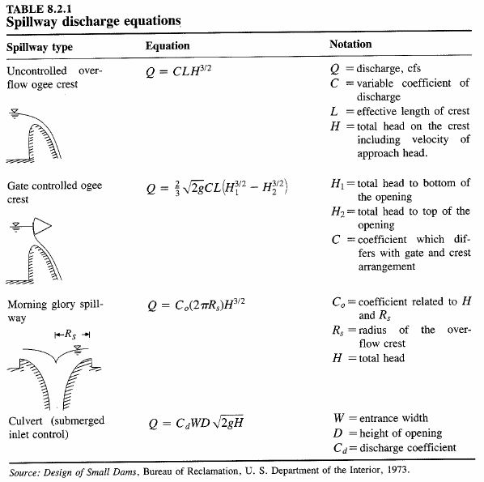
Q/H relationships
http://www.wsi.nrcs.usda.gov/products/W2Q/H&H/Tools_Models/Sites.html
Program for Routing Flow through an NRCS Reservoir

Slide 21
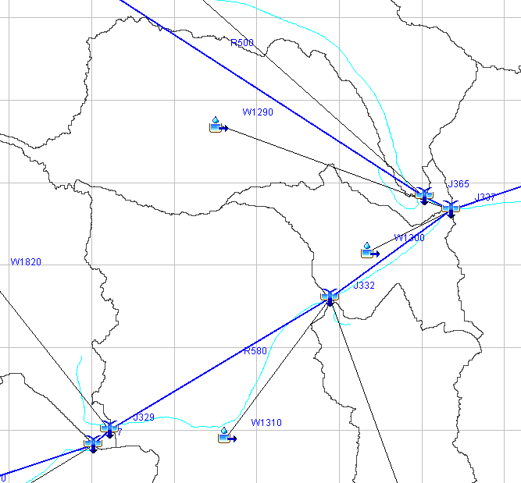
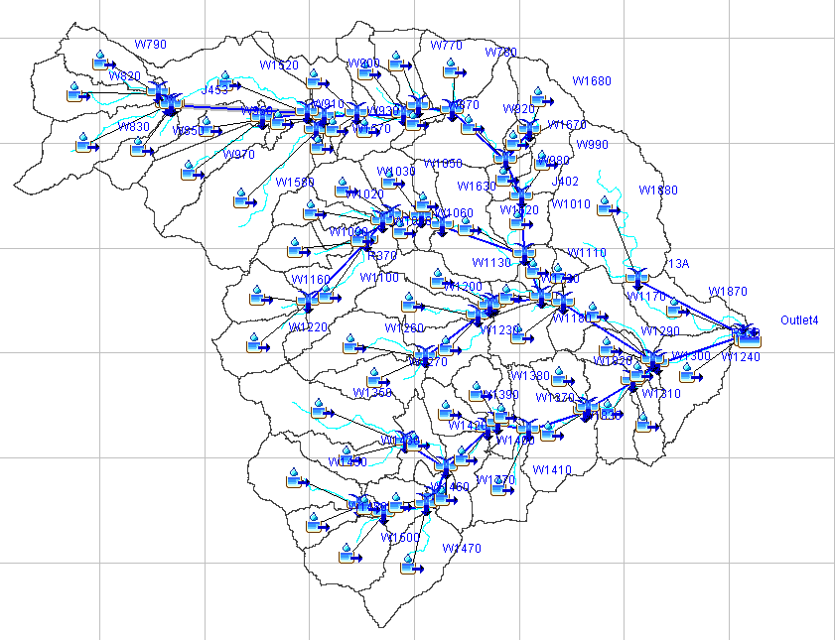
HEC-HMS Model of Brushy Creek
Walsh Dr
Dam 7

Slide 22
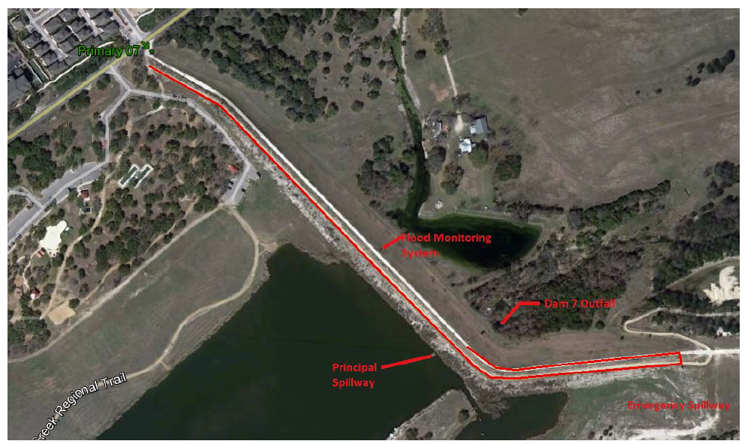
Dam 7, Upper Brushy Creek

Slide 23
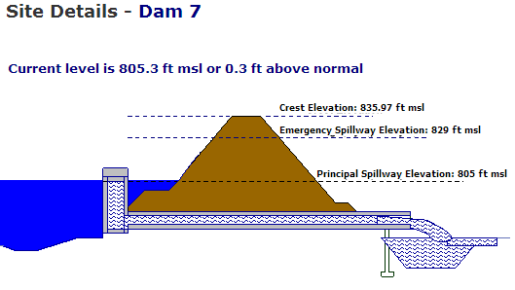
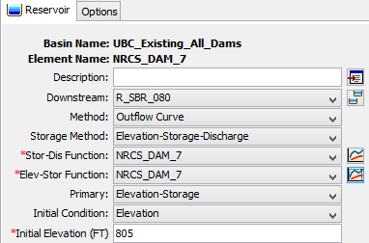
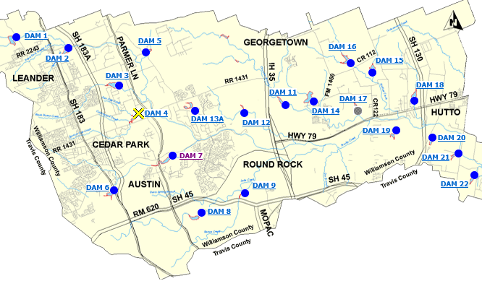
Dam 7
836 ft
829 ft
805 ft
HEC-HMS representation

Slide 24
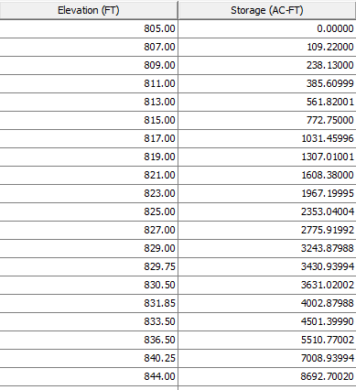
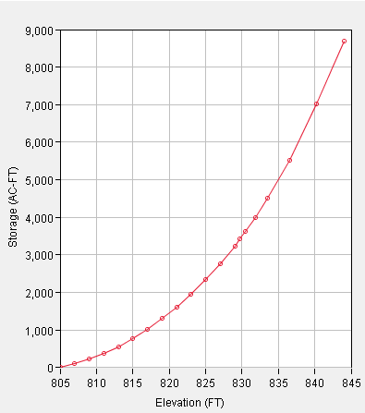
Elevation-Storage Curve, Dam 7
Top of Dam, 836
Emergency Spillway, 829

Slide 25
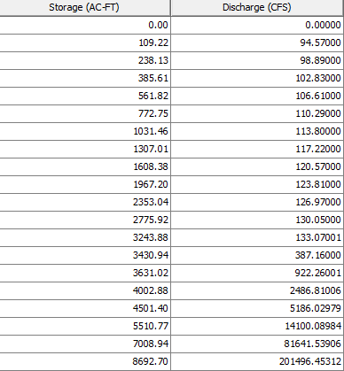
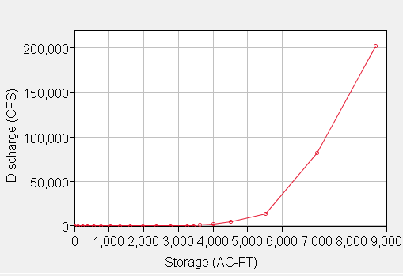
Storage-Discharge Curve, Dam 7
Emergency
Spillway, 829
Top of Dam, 836

Slide 26
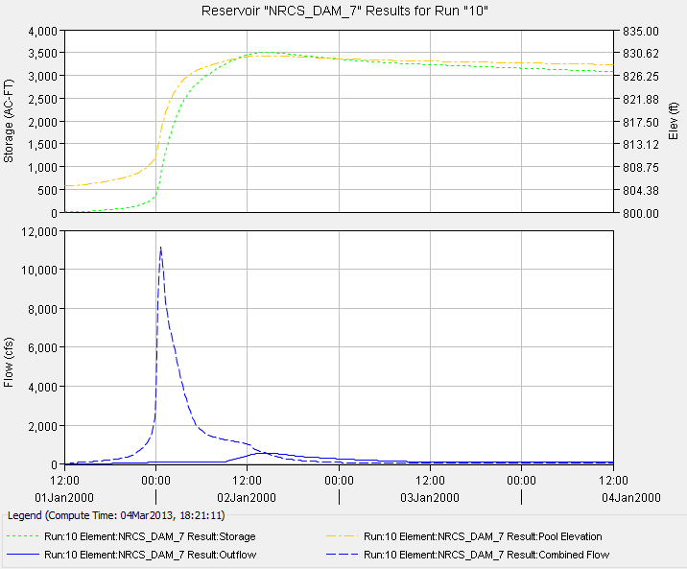
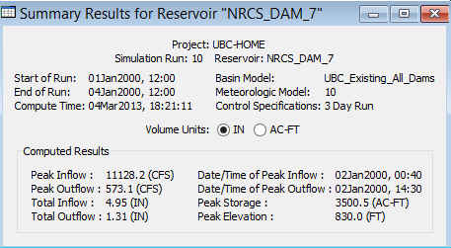
Dam 7 Hydrologic Simulation

Slide 27
Hydrologic river routing (Muskingum Method)
Wedge storage in reach
Advancing
Flood
Wave
I > Q
K = travel time of peak through the reach
X = weight on inflow versus outflow (0 ≤ X ≤ 0.5)
X = 0 ➔ Reservoir, storage depends on outflow, no wedge
X = 0.0 - 0.3 ➔ Natural stream
Receding
Flood
Wave
Q > I

Slide 28
Muskingum Method (Cont.)
Recall:
Combine:
If I(t), K and X are known, Q(t) can be calculated using above equations

Slide 29
Muskingum - Example
Given:
  Inflow hydrograph
  K = 2.3 hr, X = 0.15, Δt = 1 hour, Initial Q = 85 cfs
Find:
  Outflow hydrograph using Muskingum routing method

Slide 30
Muskingum – Example (Cont.)
C₁ = 0.0631, C₂ = 0.3442, C₃ = 0.5927

Slide 31
HEC-HMS Model of Brushy Creek
Walsh Dr
Dam 7

Slide 32
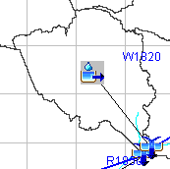
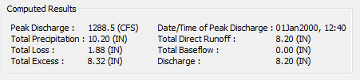
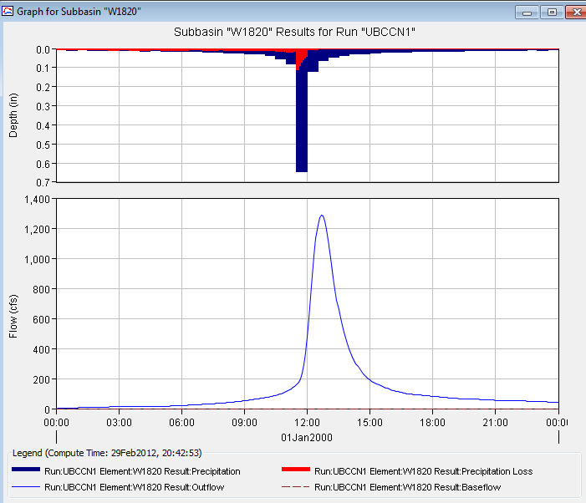
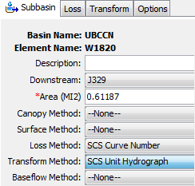
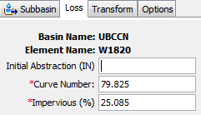
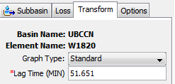
Watershed W1820

Slide 33
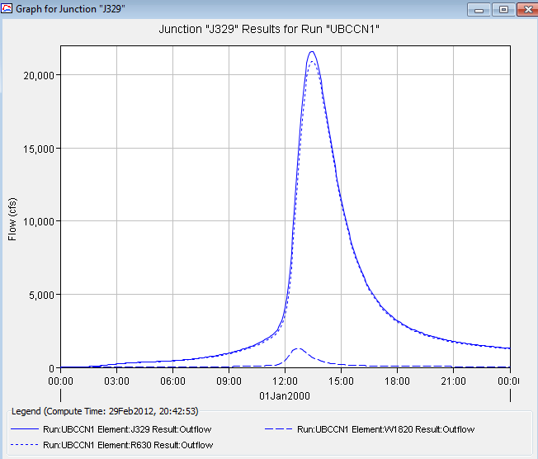
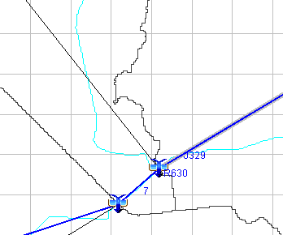
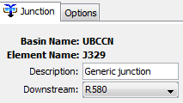
Junction J329
W1820
R580
J329
J329
W1820

Slide 34
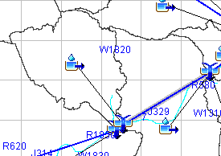

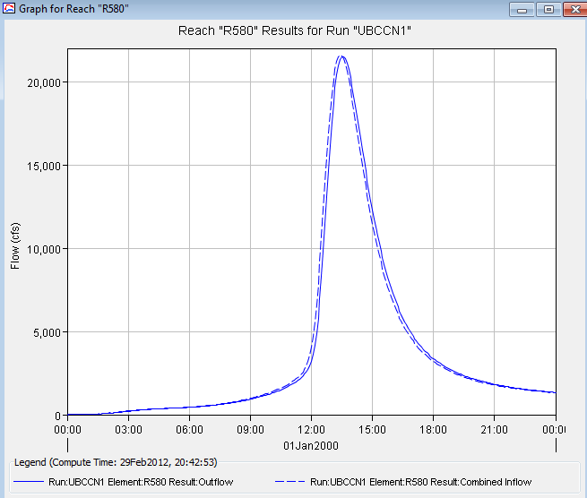
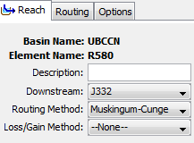
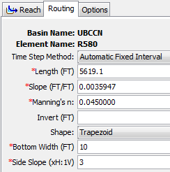
Reach R580

