Slide 1
Infiltration
Introduction
Green Ampt method
Ponding time
Reading for today: Applied Hydrology sections 4.3 and 4.4
Reading for Tuesday: Applied Hydrology Sections 5.1 to 5.6

Slide 2
Infiltration
General
  Process of water penetrating from ground into soil
  Factors affecting
    Condition of soil surface, vegetative cover, soil properties, hydraulic conductivity, antecedent soil moisture
  Four zones
    Saturated, transmission, wetting, and wetting front
θ
Saturation Zone
Transition Zone
Transmission
Zone
Wetting Zone
Wetting Front
depth

Slide 3
Infiltration
Infiltration rate, f(t)
  Rate at which water enters the soil at the surface (in/hr or cm/hr)
Cumulative infiltration, F(t)
  Accumulated depth of water infiltrating during given time period
f, F
F
f
t

Slide 4
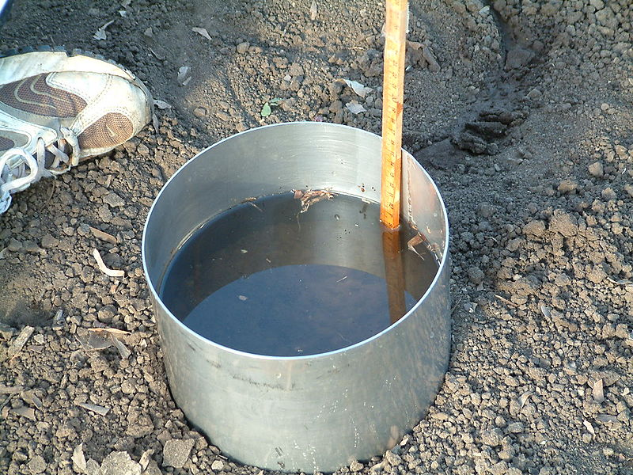
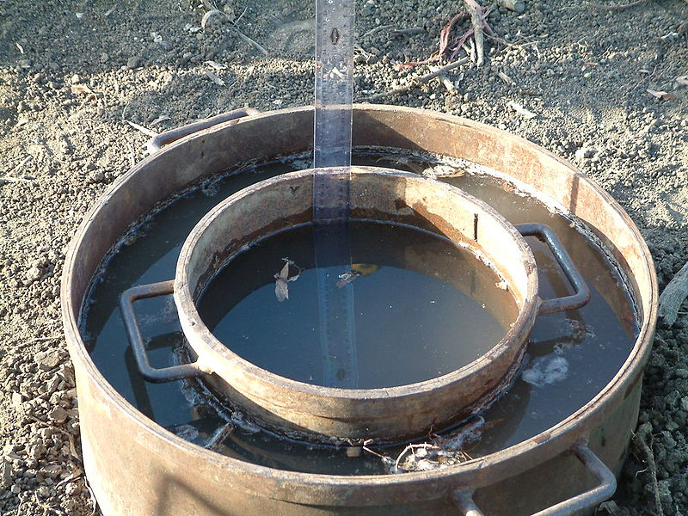
Infiltrometers
Single Ring
Double Ring
http://en.wikipedia.org/wiki/Infiltrometer

Slide 5
Infiltration Methods
Horton and Phillips
  Infiltration models developed as approximate solutions of an exact theory (Richard’s Equation)
Green – Ampt
  Infiltration model developed from an approximate theory to an exact solution

Slide 6
Green-Ampt Assumptions
= increase in moisture content as wetting front passes
Ponded Water
Ground Surface
Wetted Zone
= Suction head at “sharp” wetting front
Conductivity, K
= Wetted depth
Wetting Front
= Conductivity in wetted zone
= Depth of water ponding on surface (small)
Dry Soil

Slide 7
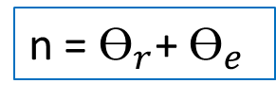
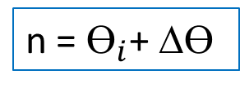
Green-Ampt Soil Water Variables
= moisture content (volume of water/total volume of soil)
Ground Surface
= initial moisture content of dry soil before infiltration happens
Wetted Zone
= increase in moisture content as wetting front passes
= residual water content of very dry soil
Wetting Front
= effective porosity
= porosity
n = $ϴ_{r}$+ $ϴ_{e}$
n = $ϴ_{i}$+ Δ$ϴ$
Dry Soil

Slide 8
Green-Ampt Parameters
(Data from Table 4.3.1)
Texture | Porosity n | Residual Porosity ϴ_{r} | Effective Porosity ϴ_{e} | Suction Head ψ (cm) | Conductivity K (cm/hr)
Sand | 0.437 | 0.020 | 0.417 | 4.95 | 11.78
Loamy Sand | 0.437 | 0.036 | 0.401 | 6.13 | 2.99
Sandy Loam | 0.453 | 0.041 | 0.412 | 11.01 | 1.09
Loam | 0.463 | 0.029 | 0.434 | 8.89 | 0.34
Silt Loam | 0.501 | 0.015 | 0.486 | 16.68 | 0.65
Sandy Clay Loam | 0.398 | 0.068 | 0.330 | 21.85 | 0.15
Clay Loam | 0.464 | 0.155 | 0.309 | 20.88 | 0.10
Silty Clay Loam | 0.471 | 0.039 | 0.432 | 27.30 | 0.10
Sandy Clay | 0.430 | 0.109 | 0.321 | 23.90 | 0.06
Silty Clay | 0.470 | 0.047 | 0.423 | 29.22 | 0.05
Clay | 0.475 | 0.090 | 0.385 | 31.63 | 0.03

Slide 9
Green-Ampt Porosity
(Data from Table 4.3.1)
0.09
0.45
ϴ_{r}
ϴ_{e}
Total porosity ~ 0.45
Clay soils retain water in ~ 20% of voids when dry
Other soils retain water in ~ 6% of voids when dry
0.03

Slide 10
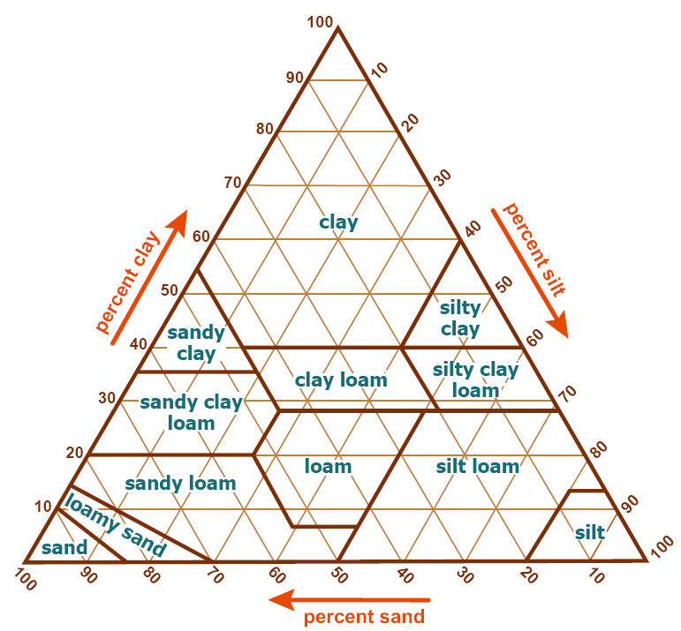
Conductivity and Suction Head
(Data from Table 4.3.1)
Conductivity, K
(cm/hr)
Sand
Loamy Sand
Sandy Loam
Silt Loam
Suction Head, ψ (cm)
Loam
Sandy Clay Loam
Clay Loam
Silty Clay Loam
Sandy Clay
Silty Clay
Clay

Slide 11
Green – Ampt Infiltration
Ponded Water
Ground Surface
Wetted Zone
Wetting Front
Dry Soil

Slide 12
Green – Ampt Infiltration (Cont.)
Ground Surface
Wetted Zone
Wetting Front
Apply finite difference to the derivative, between
  Ground surface
  Wetting front
Dry Soil

Slide 13
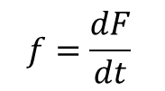
Green – Ampt Infiltration (Cont.)
f, F
F
$$f=\frac{dF}{dt}$$
and integrate over time, gives
Use
f
t
Nonlinear equation, requiring iterative solution

Slide 14
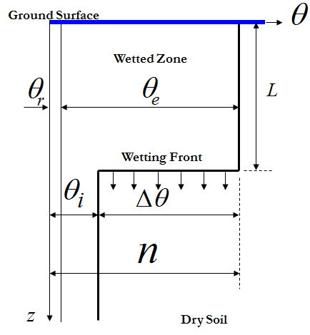
Initial Effective Saturation
Initial effective saturation 0 ≤ S_{e} ≤ 1
Effective porosity

Slide 15
Example
Determine the infiltration rate and the cumulative infiltration after 1 hour on a clay loam soil with initial effective saturation of 30%. Assume water is ponded instantaneously on the surface
Parameters:
Texture | Porosity n | Residual Porosity ϴ_{r} | Effective Porosity ϴ_{e} | Suction Head ψ (cm) | Conductivity K (cm/hr)
Clay Loam | 0.464 | 0.155 | 0.309 | 20.88 | 0.10

Slide 16
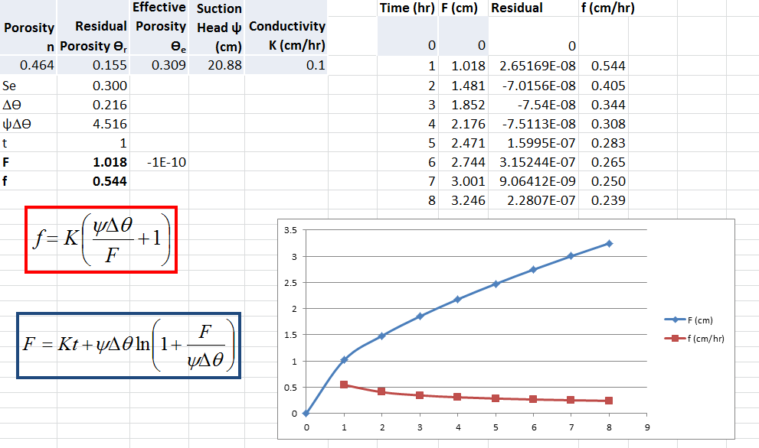
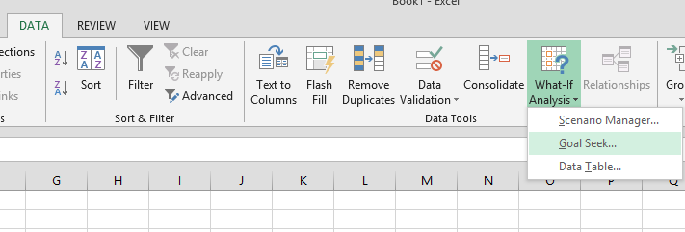
Solution
Use Excel Goal Seek under
“What If Analyis” in Data Tab

Slide 17
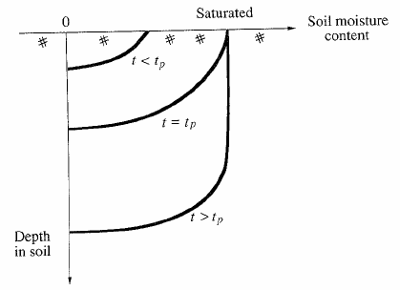
Ponding time
Elapsed time between the time rainfall begins and the time water begins to pond on the soil surface (t_{p})

Slide 18
Ponding Time
Up to the time of ponding, all rainfall has infiltrated (i = rainfall rate)
Potential
Infiltration
Infiltration rate, f
Rainfall
Actual Infiltration
Accumulated
Rainfall
Time
Cumulative
Infiltration, F
Infiltration
Time

Slide 19
Example
Clay Loam soil, 30% effective saturation, rainfall 1 cm/hr intensity
What is the ponding time, and cumulative infiltration at ponding?
How long does it take to infiltrate 2 cm of water?
What is the infiltration rate at that time?

Slide 20
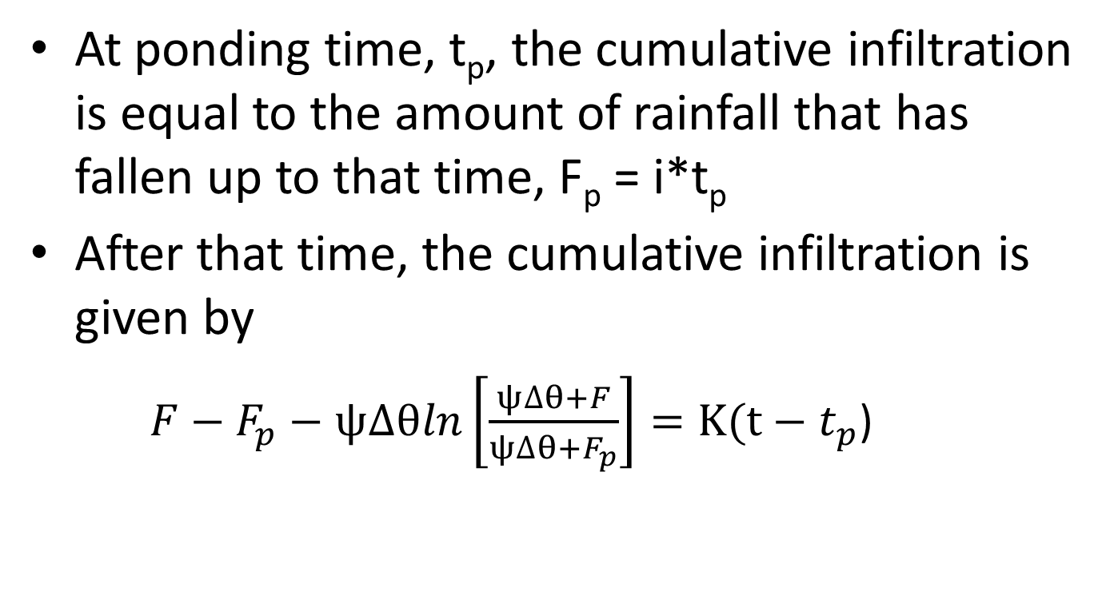
Infiltration after ponding has occured
At ponding time, t_{p}, the cumulative infiltration is equal to the amount of rainfall that has fallen up to that time, F_{p} = i*t_{p}
After that time, the cumulative infiltration is given by
  ${F−F}_{p}−ψ∆θln\left[\frac{ψ∆θ+F}{ψ∆θ+F_{p}}\right]=K(t−t_{p}$)

Slide 21
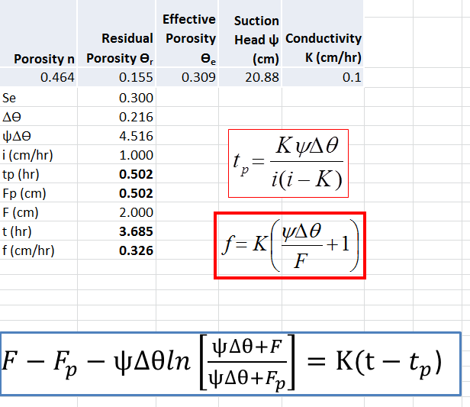
Solution

