Slide 1
CE 374K Hydrology – Lecture 1
Syllabus, sequence of topics
Hydrology as a science and as a profession
Hydrologic cycle and world water balance
Water as a physical substance
Case study of Brushy Creek watershed
Readings:
For today – Applied Hydrology and Chapter 1
For Thursday, Applied Hydrology, Sections 2.1 to 2.3

Slide 2

Hydrology as a Science
“Hydrology is the science that treats the waters of the earth, their occurrence, circulation and distribution, their chemical and physical properties, and their reaction with their environment, including their relation to living things. The domain of hydrology embraces the full life history of water on the earth”
The “Blue Book”
From “Opportunities in Hydrologic Science”, National Academies Press, 1992
http://www.nap.edu/catalog.php?record_id=1543
Has this definition evolved in recent years? Are new issues important?

Slide 3
Hydrology as a Profession
A profession is a “calling requiring specialized knowledge, which has as its prime purpose the rendering of a public service”
What hydrologists do:
  Water use – water withdrawal and instream uses
  Water Control – flood and drought mitigation
  Pollution Control – point and nonpoint sources
Have these functions changed in recent years? Are priorities different now?

Slide 4
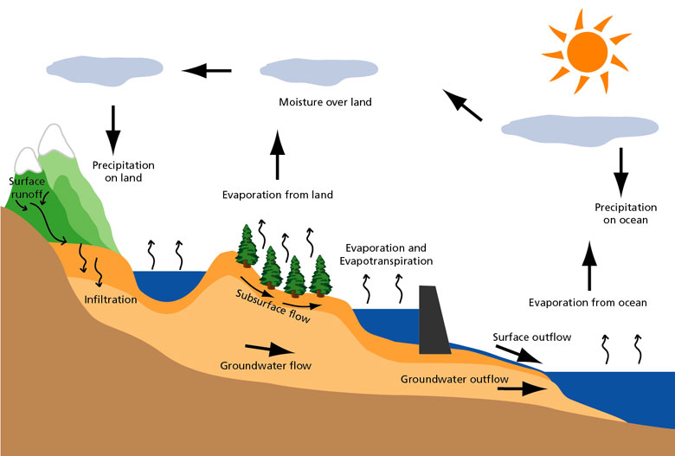
Hydrologic Cycle

Slide 5
Global water balance (volumetric)
Units are in volume per year relative to precipitation on land (119,000 km³/yr) which is 100 units
Precipitation
100
Atmospheric moisture flow 39
Precipitation
385
Evaporation
424
Evaporation
61
Surface Outflow
38
Land (148.7 km²)
(29% of earth area)
Ocean (361.3 km²)
(71% of earth area)
Subsurface Outflow
1
What conclusions can we draw from these data?

Slide 6
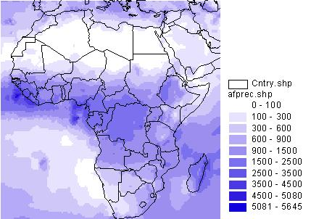
Digital Atlas of the World Water Balance
(Precipitation)
http://www.crwr.utexas.edu/gis/gishyd98/atlas/world.htm#animations

Slide 7
Global water balance
Precipitation
800 mm (31 in)
Atmospheric moisture flow 316 mm (12 in)
Precipitation
1270 mm (50 in)
Evaporation
1400 mm (55 in)
Evaporation
480 mm (19 in)
Outflow
320 mm (12 in)
Land (148.7 km²)
(29% of earth area)
(Values relative to land area)
Ocean (361.3 km²)
(71% of earth area)
What conclusions can we draw from these data?
Applied Hydrology, Table 1.1.2, p.5

Slide 8
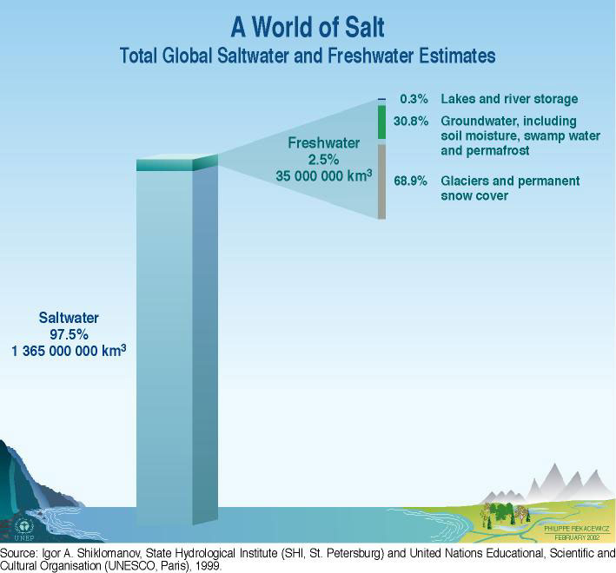
Global Water Resources
105,000 km³ or 0.0076% of total water

Slide 9
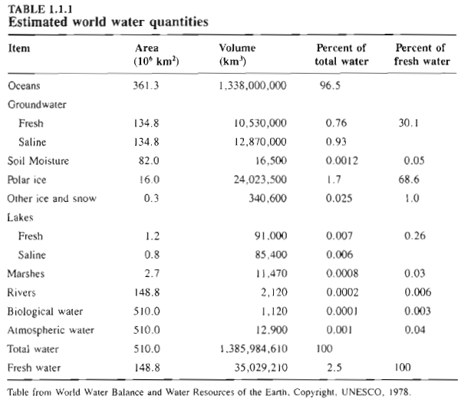

Slide 10
Residence Time
Residence time:
Average travel time for water to pass through a subsystem of the hydrologic cycle
T_{r} = S/Q
Storage/flow rate
Residence time of global atmospheric moisture (Ex. 1.1.1)
Volume (storage) of atmospheric water: 12,900 km3
Flow rate of moisture from the atmosphere as precipitation = 577,000 km³/yr
T_{r} = 12,900/577,000 = 0.022 yr = 8.2 days
One reason why weather cannot be forecast accurately more than a few days ahead!

Slide 11
Water as a Physical Substance
Earth is the only planet in our solar system where water can exist as solid, liquid and gas.
  This water “air-conditions” the earth
Human body is ~ 60% water by weight
Survival of all living systems (human, animal, plant) depends on their access to water
Water is critical!

Slide 12
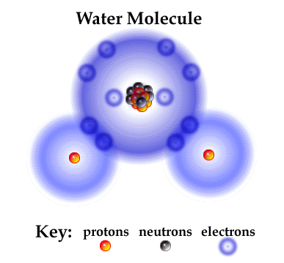
Water Molecule
Electrons desired
  First shell – 2
  Second shell – 8
  Total – 10
Electrons available:
  Hydrogen H¹ – 1
  Oxygen O¹⁶ – 8
  For H₂O – 10
http://www.brooklyn.cuny.edu/bc/ahp/SDgraphics/PSgraphics/SD.PS.LG.Water.html

Slide 13
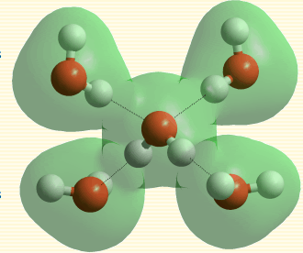
Polar Bonding
10 – 50 times weaker than covalent bonds between atoms in a molecule
Water as a solvent --more substances dissolve in greater quantities in water than in any other liquid
http://www1.lsbu.ac.uk/water/hbond.html

Slide 14
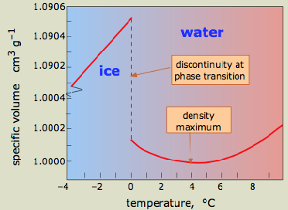
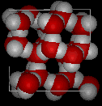
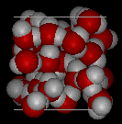
Water Density
Water as a solid (ice) is less dense than as a liquid
Maximum density is at 4°C
Ice
Water
http://www.chem1.com/acad/sci/aboutwater.html

Slide 15
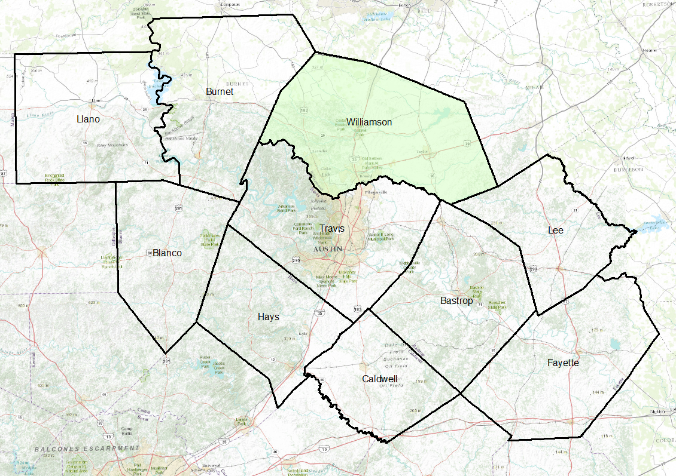
Capital Area Council of Governments (CAPCOG)
Coordinates emergency response

Slide 16
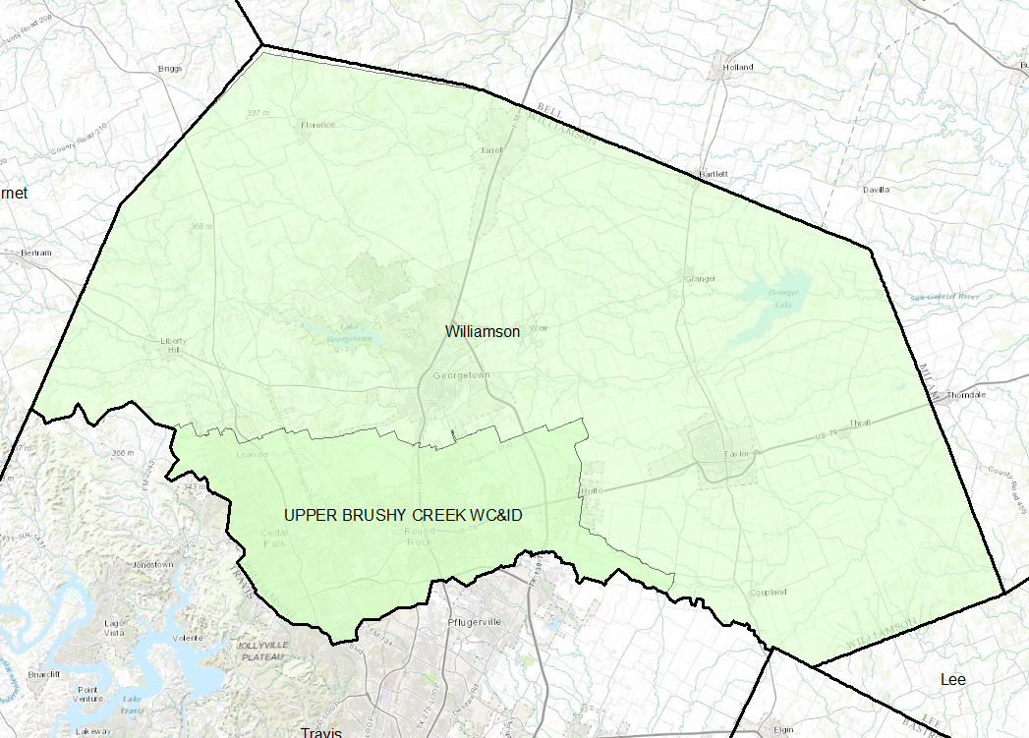
Upper Brushy Creek Water Control and Improvement District (WC&ID)

Slide 17
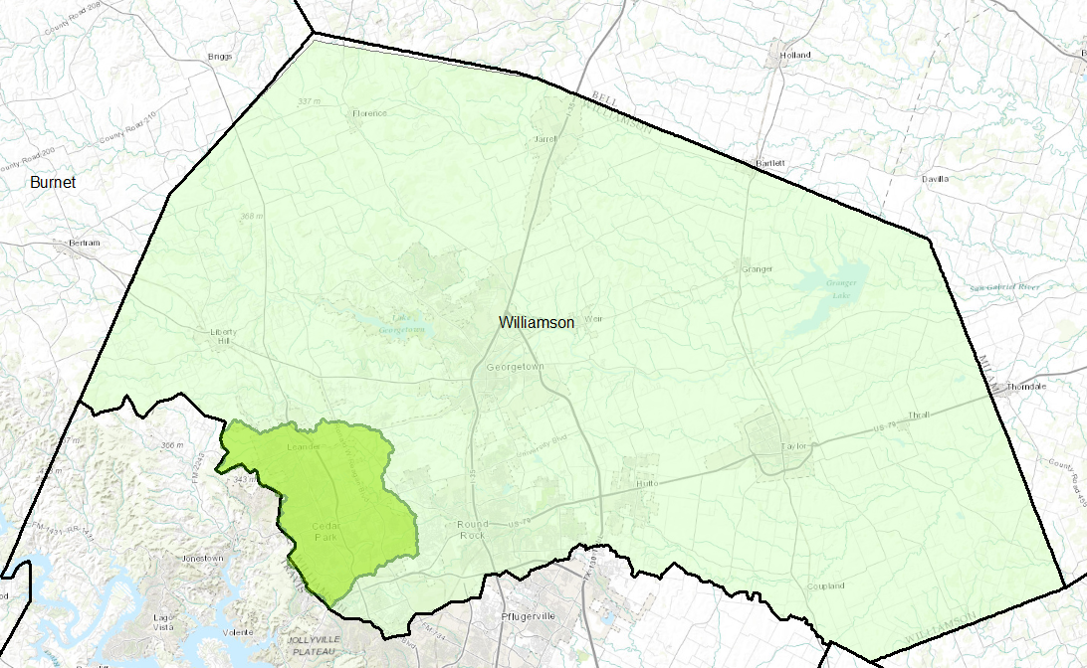
Upper Brushy Creek Watershed
Upper Brushy Creek Watershed (61.4 sq. miles)

Slide 18
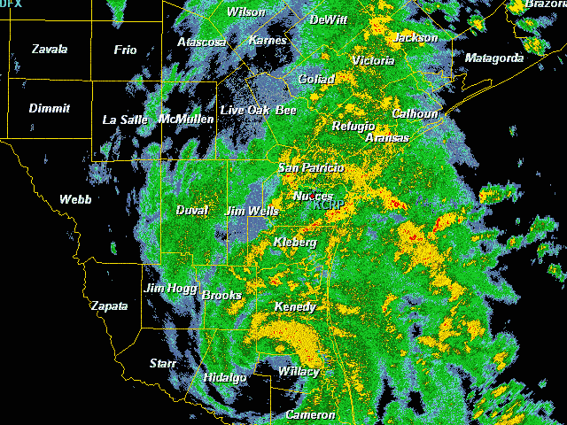
Tropical Storm Hermine,
Sept 7-8, 2010
Led to significant flooding in the Brushy Creek Watershed

Slide 19
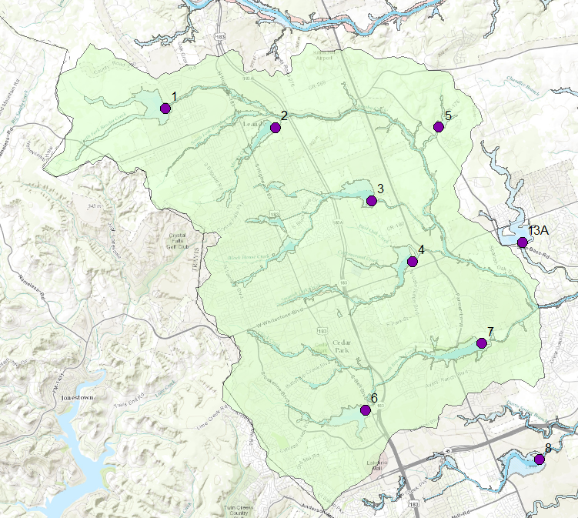
Upper Brushy Creek Dams and Floodplains
Flood Control Dam
Brushy Creek
Focus area
Dam 7

Slide 20
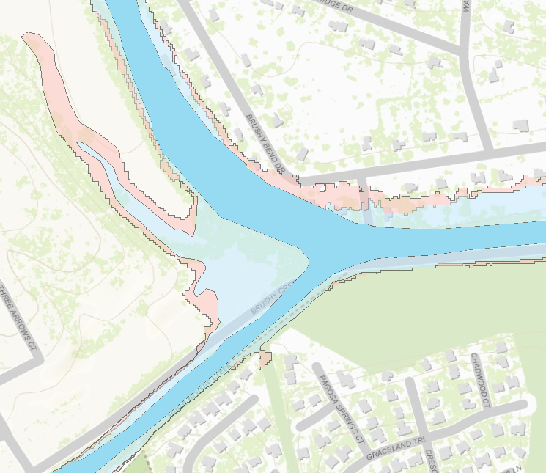
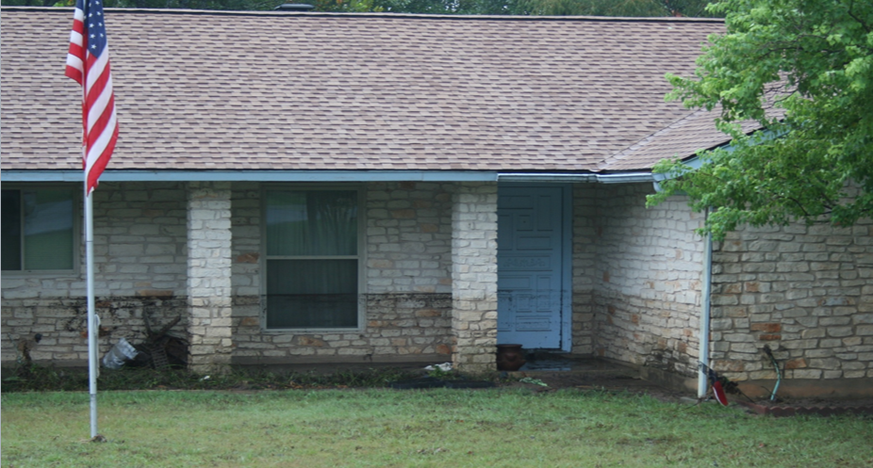


Floodplain Map
1% chance

Slide 21
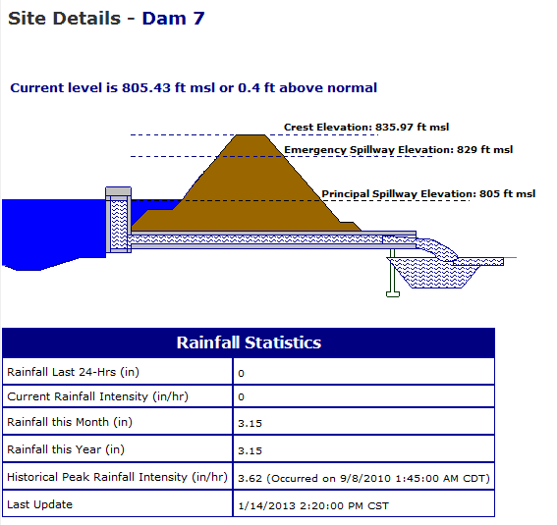
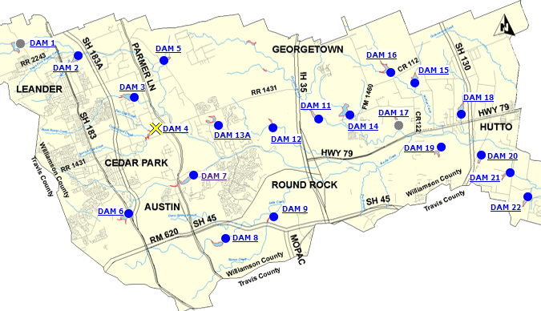
Flood Control Reservoir: Dam 7

Slide 22

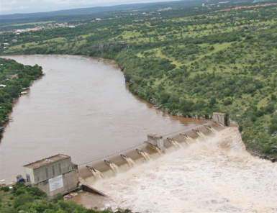
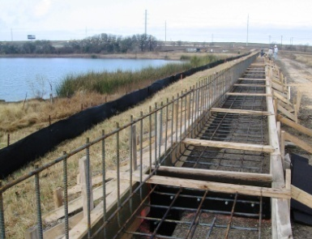
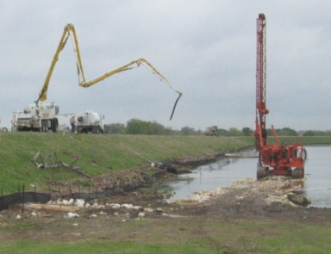
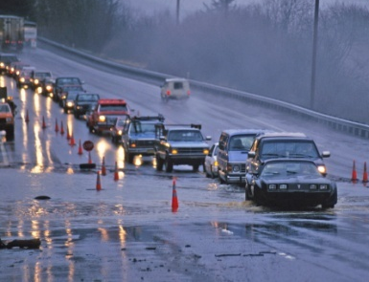
Upper Brushy Creek Water Control & Improvement District
Ruth Haberman, General Manager

Slide 23
JURISDICTIONAL BOUNDARIES
Need a watershed approach for planning

