Slide 1
CE 374K Hydrology, Lecture 2
Hydrologic Systems
Setting the context in Brushy Creek
Hydrologic systems and hydrologic models
Reynolds Transport Theorem
Continuity equation
Reading for Today – Applied Hydrology Sections 2.1 to 2.3
Reading for next Tuesday – Applied Hydrology, Sections 2.4 to 2.8

Slide 2
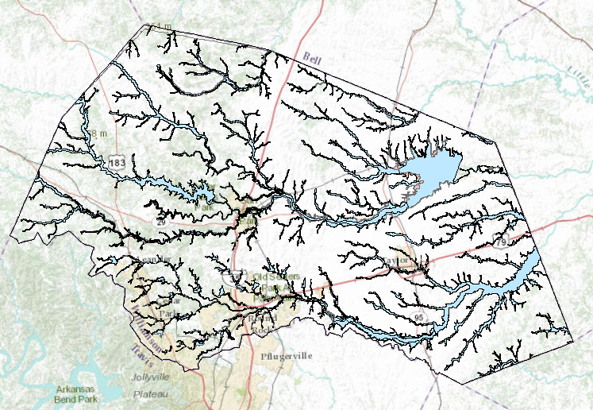
Floodplains in Williamson County
Area of County = 1135 mile²
Area of floodplain = 147 mile²
13% of county in floodplain

Slide 3
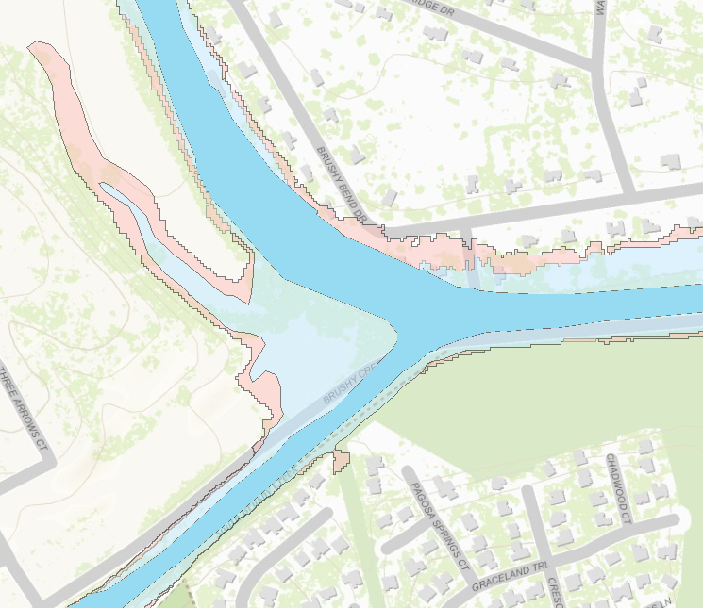
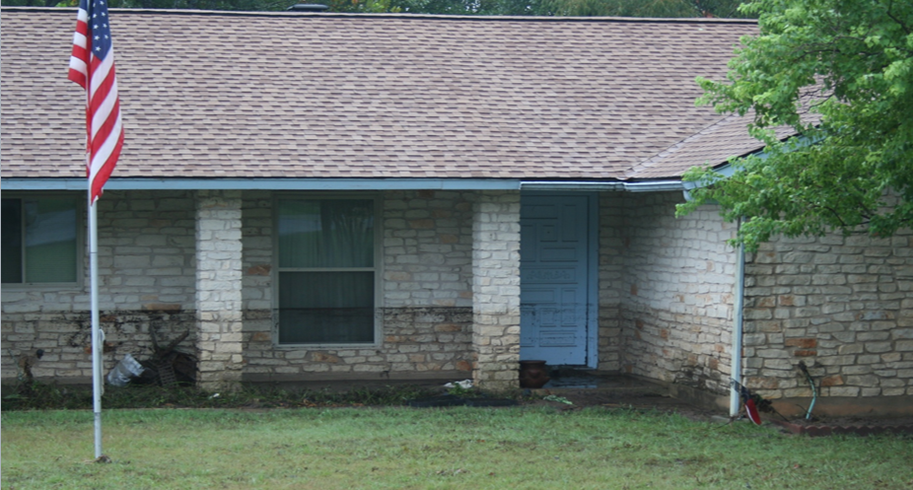


Floodplain Zones
1% chance
< 0.2% chance
Main zone of water flow
Flow with a Sloping Water Surface

Slide 4
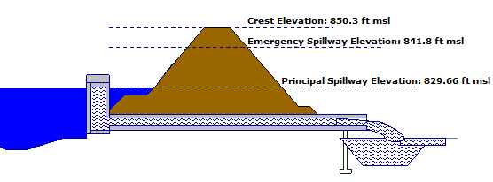
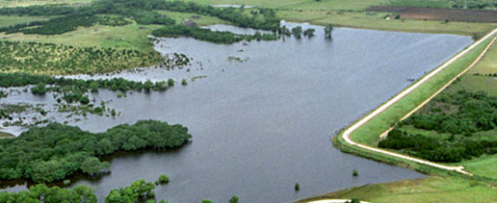
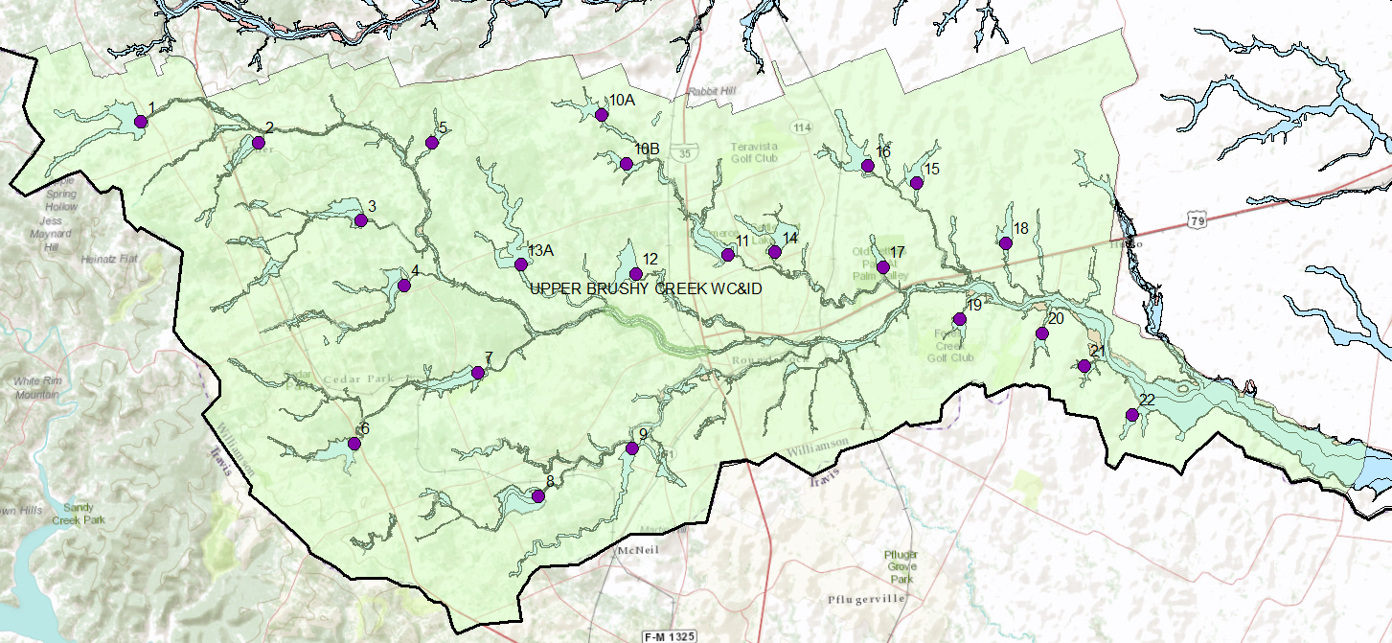
Flood Control Dams
Dam 13A
Flow with a Horizontal Water Surface

Slide 5
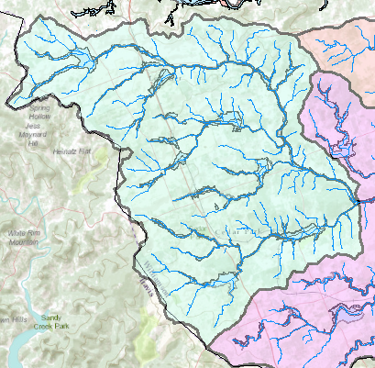
Watershed – Drainage area of a point on a stream
Rainfall
Streamflow
Connecting rainfall input with streamflow output

Slide 6
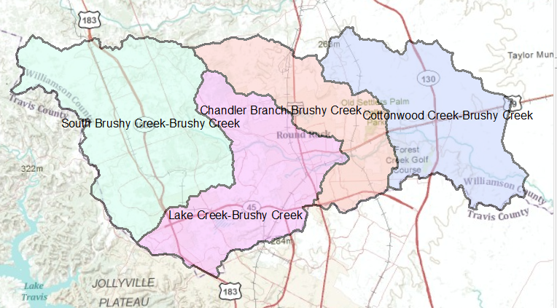
HUC-12 Watersheds for Brushy Creek

Slide 7
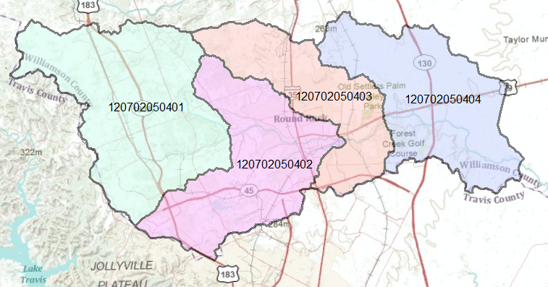
Hydrologic Unit Code
12 – 07 – 02 – 05 – 04 – 01 12-digit identifier

Slide 8
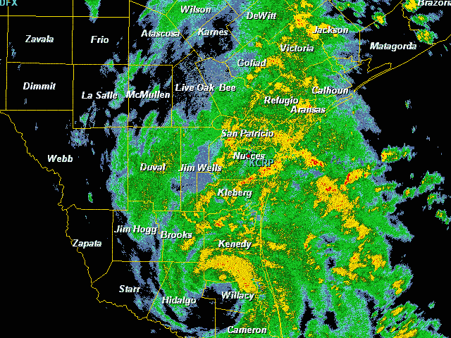
Tropical Storm Hermine,
Sept 7-8, 2010

Slide 9
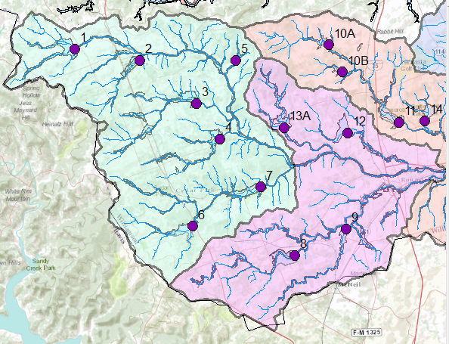

Hydrologic System
We need to understand how all these components function together
Watersheds
Reservoirs
Channels

Slide 10
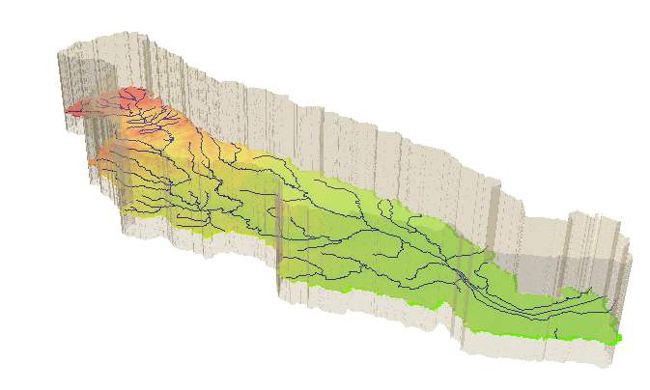
Hydrologic System
Take a watershed and extrude it vertically into the atmosphere
and subsurface, Applied Hydrology, p.7- 8
A hydrologic system is “a structure or volume in space surrounded by a boundary, that accepts water and other inputs, operates on them internally, and produces them as outputs”

Slide 11
System Transformation
Inputs, I(t)
Transformation Equation
Q(t) = Ω I(t)
Outputs, Q(t)
A hydrologic system transforms inputs to outputs
Hydrologic Processes
I(t), Q(t)
Hydrologic conditions
I(t) (Precip)
Physical environment
Q(t) (Streamflow)

Slide 12
Stochastic transformation
Inputs, I(t)
System transformation
f(randomness, space, time)
Outputs, Q(t)
Hydrologic Processes
How do we characterize
uncertain inputs, outputs
and system transformations?
I(t), Q(t)
Hydrologic conditions
Physical environment
Ref: Figure 1.4.1 Applied Hydrology

Slide 13
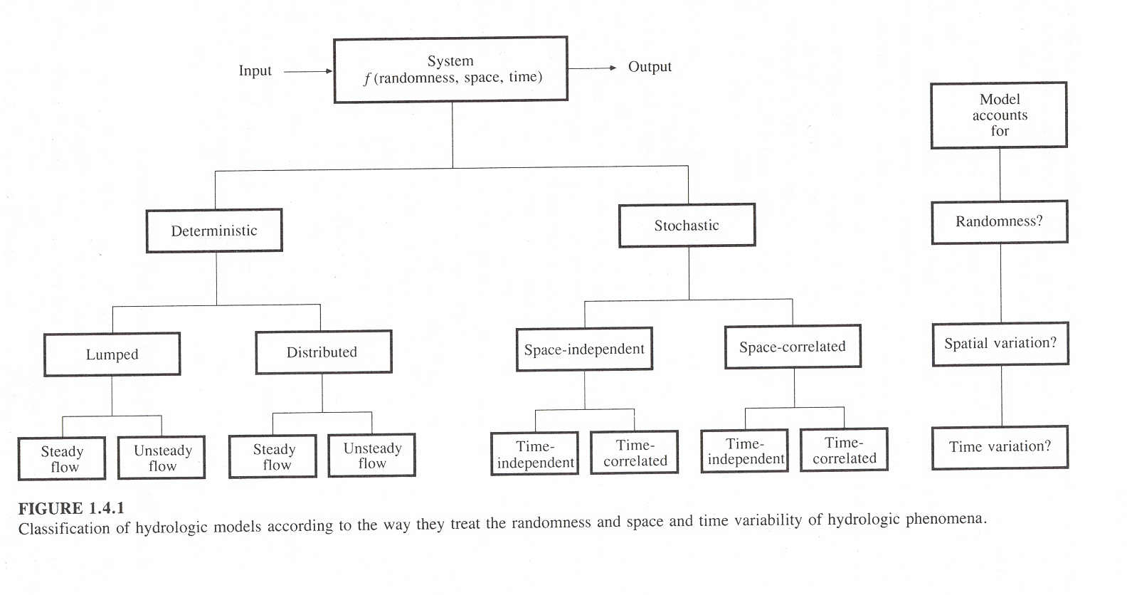
System = f(randomness, space, time)
randomness
space
time
Five dimensional problem but at most we can deal with only two or three dimensions, so which ones do we choose?

Slide 14
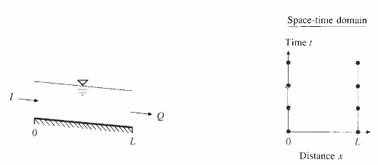
Deterministic, Lumped Steady Flow Model
I = Q
e.g. Steady flow in an open channel

Slide 15
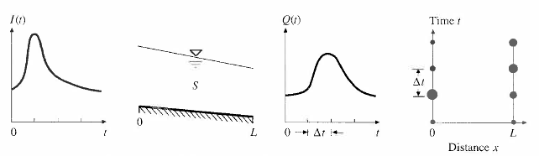
Deterministic, Lumped Unsteady Flow Model
dS/dt = I - Q
e.g. Unsteady flow through a watershed, reservoir or river channel

Slide 16
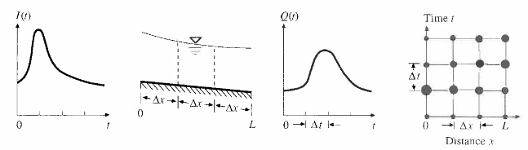
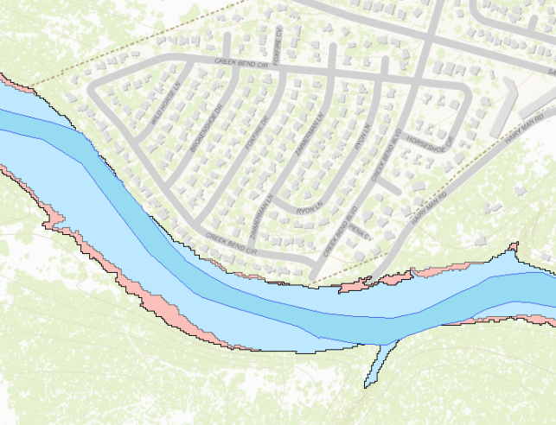
Deterministic, Distributed, Unsteady Flow Model
Stream Cross-section
e.g. Floodplain mapping

Slide 17
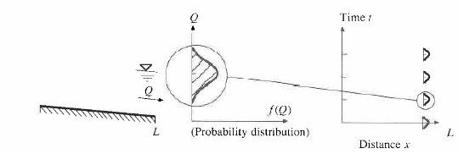
Stochastic, time-independent model
1% chance
< 0.2% chance
e.g. One hundred year flood discharge estimate at a point on a river channel

Slide 18
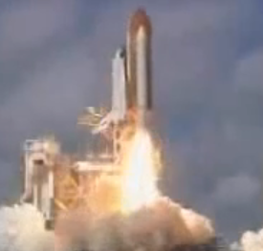
Views of Motion
Eulerian view (for fluids – e is next to f in the alphabet!)
Lagrangian view (for solids)
Fluid flows through a control volume
Follow the motion of a solid body

Slide 19
Reynolds Transport Theorem
A method for applying physical laws to fluid systems flowing through a control volume
B = Extensive property (quantity depends on amount of mass)
β = Intensive property (B per unit mass)
Total rate of
change of B in fluid system (single phase)
Rate of change of B stored within the Control Volume
Outflow of B across the Control Surface

Slide 20
Mass, Momentum Energy
 | Mass | Momentum | Energy
B | m | mv
β = dB/dm | 1 | v
dB/dt | 0
Physical Law | Conservation of mass | Newton’s Second Law of Motion | First Law of Thermodynamics

Slide 21
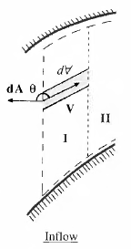
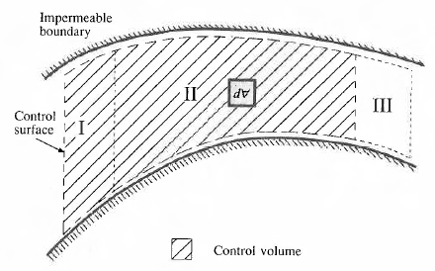
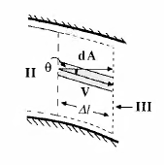
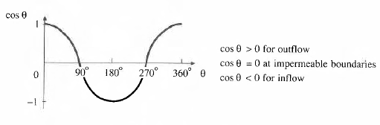

Slide 22
Reynolds Transport Theorem
Total rate of change of B in the fluid system
Rate of change of B stored in the control volume
Net outflow of B across the control surface

Slide 23
Continuity Equation
B = m; β = dB/dm = dm/dm = 1; dB/dt = 0 (conservation of mass)
ρ = constant for water
hence
or

Slide 24
Continuity equation for a watershed
Hydrologic systems are nearly always
open systems, which means that it is
difficult to do material balances on them
I(t) (Precip)
What time period do we choose
to do material balances for?
dS/dt = I(t) – Q(t)
Q(t) (Streamflow)
Closed system if

Slide 25
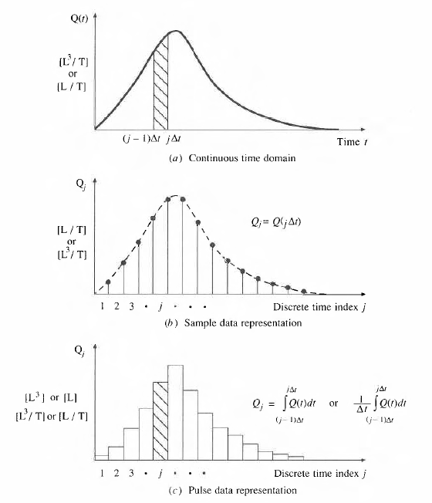
Continuous and Discrete time data
Figure 2.3.1, p. 28 Applied Hydrology
Continuous time representation
Δt
j-1
j
Sampled or Instantaneous data
(streamflow)
truthful for rate, volume is interpolated
Can we close a discrete-time water balance?
Pulse or Interval data
(precipitation)
truthful for depth, rate is interpolated

Slide 26
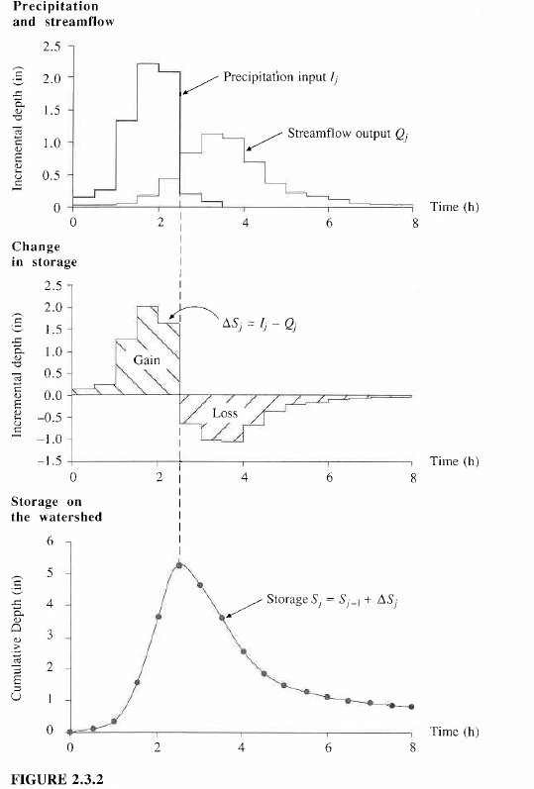
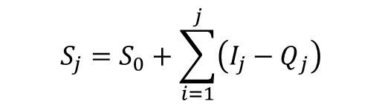
I_{j}
Continuity Equation, dS/dt = I – Q
applied in a discrete time interval [(j-1)Δt, jΔt]
Q_{j}
Δt
ΔS_{j} = I_{j} - Q_{j}
j-1
j
$$S_{j}=S_{0}+\sum_{i=1}^{j}{\left(I_{j}−Q_{j}\right)}$$
S_{j} = S_{j-1} + ΔS_{j}

Slide 27
