Slide 1
Mass, Momentum, Energy
Mass – Continuity Equation
Momentum – Manning and Darcy eqns
Energy – conduction, convection, radiation

Slide 2
Reynolds Transport Theorem
Total rate of change of B in the fluid system
Rate of change of B stored in the control volume
Net outflow of B across the control surface

Slide 3
Continuity Equation
B = m; β = dB/dm = dm/dm = 1; dB/dt = 0 (conservation of mass)
ρ = constant for water
hence
or

Slide 4
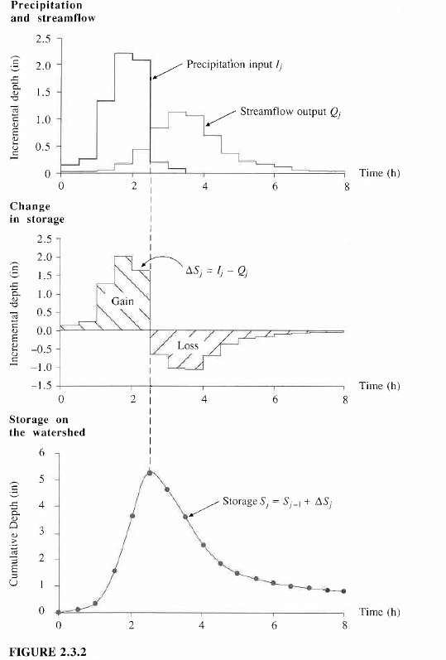
I_{j}
Q_{j}
Continuity Equation, dS/dt = I – Q
applied in a discrete time interval [(j-1)Δt, jΔt]
ΔS_{j} = I_{j} - Q_{j}
Δt
j-1
j
S_{j} = S_{j-1} + ΔS_{j}

Slide 5
Momentum
B = mv; b = dB/dm = dmv/dm = v; dB/dt = d(mv)/dt = ΣF (Newtons 2nd Law)
For steady flow
For uniform flow
so
In a steady, uniform flow

Slide 6
Energy equation of fluid mechanics
h_{f}
energy
grade line
y₁
water
surface
y₂
bed
z₁
L
z₂
Datum
Geoid
How do we relate friction slope,
to the velocity of flow?

Slide 7
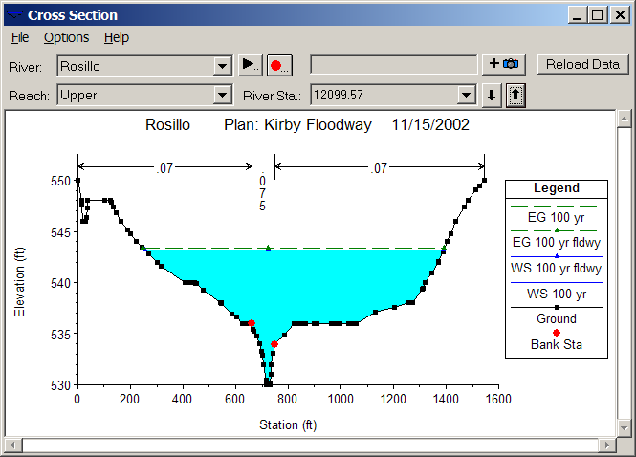
Open channel flow
Manning’s equation
Channel Roughness
Channel Geometry
Hydrologic Processes
(Open channel flow)
Hydrologic conditions
(V, S_{f})
Physical environment
(Channel n, R)

Slide 8
Subsurface flow
Darcy’s equation
q
A
q
Hydraulic conductivity
Hydrologic Processes
(Porous medium flow)
Hydrologic conditions
(q, S_{f})
Physical environment
(Medium K)

Slide 9
Comparison of flow equations
Open Channel Flow
Porous medium flow
Why is there a different power of S_{f}?

Slide 10
Energy
B = E = mv²/2 + mgz + E_{u}; β = dB/dm = v₂/2 + gz + e_{u};
dE/dt = dH/dt – dW/dt (heat input – work output) First Law of Thermodynamics
Generally in hydrology, the heat or internal energy component
(E_{u}, dominates the mechanical energy components (mv²/2 + mgz)

Slide 11
Heat energy
Energy
  Potential, Kinetic, Internal (E_{u})
Internal energy
  Sensible heat – heat content that can be measured and is proportional to temperature
  Latent heat – “hidden” heat content that is related to phase changes

Slide 12
Energy Units
In SI units, the basic unit of energy is Joule (J), where 1 J = 1 kg x 1 m/s²
Energy can also be measured in calories where 1 calorie = heat required to raise 1 gm of water by 1°C and 1 kilocalorie (C) = 1000 calories (1 calorie = 4.19 Joules)
We will use the SI system of units

Slide 13
Energy fluxes and flows
Water Volume [L³] (acre-ft, m³)
Water flow [L³/T] (cfs or m³/s)
Water flux [L/T] (in/day, mm/day)
Energy amount [E] (Joules)
Energy “flow” in Watts [E/T] (1W = 1 J/s)
Energy flux [E/L²T] in Watts/m²
Energy flow of
1 Joule/sec
Area = 1 m²

Slide 14
Internal Energy of Water
Water vapor
Water
Ice
Heat Capacity (J/kg-K) Latent Heat (MJ/kg)
Ice 2220 0.33
Water 4190 2.5
2.5/0.33 = 7.6
Water may evaporate at any temperature in range 0 – 100°C
Latent heat of vaporization consumes 7.6 times the latent heat of fusion (melting)

Slide 15
Water Mass Fluxes and Flows
Water Volume, V [L³] (acre-ft, m³)
Water flow, Q [L³/T] (cfs or m³/s)
Water flux, q [L/T] (in/day, mm/day)
Water mass [m = ρV] (Kg)
Water mass flow rate [m/T = ρQ] (kg/s or kg/day)
Water mass flux [M/L²T = ρq] in kg/m²-day
Water flux
Area = 1 m²

Slide 16
Latent heat flux
Water flux
  Evaporation rate, E (mm/day)
Energy flux
  Latent heat flux (W/m²), H_{l}
ρ = 1000 kg/m³
l_{v} = 2.5 MJ/kg
28.94 W/m² = 1 mm/day
Temp | Lv | Density | Conversion
0 | 2501000 | 999.9 | 28.94
10 | 2477300 | 999.7 | 28.66
20 | 2453600 | 998.2 | 28.35
30 | 2429900 | 995.7 | 28.00
40 | 2406200 | 992.2 | 27.63
Area = 1 m²

Slide 17
Radiation
Two basic laws
  Stefan-Boltzman Law
    R = emitted radiation (W/m2)
    ε = emissivity (0-1)
    σ = 5.67x10⁻⁸W/m2-K⁴
    T = absolute temperature (K)
  Wiens Law
    λ = wavelength of emitted radiation (m)
All bodies emit radiation
Hot bodies (sun) emit short wave radiation
Cool bodies (earth) emit long wave radiation

Slide 18
Net Radiation, R_{n}
R_{i} Incoming Radiation
R_{o} =αR_{i} Reflected radiation
= albedo (0 – 1)
R_{e}
R_{n} Net Radiation
Average value of R_{n} over the earth and
over the year is 105 W/m²

Slide 19
Net Radiation, R_{n}
H – Sensible Heat
LE – Evaporation
G – Ground Heat Flux
R_{n} Net Radiation
Average value of R_{n} over the earth and
over the year is 105 W/m²

