Slide 1
CE 394K.2 Lecture 3
Mass, Momentum, Energy
Mass – Continuity Equation
Momentum – Manning and Darcy eqns
Energy – conduction, convection, radiation
Energy Balance of the Earth
Reading for Today – Applied Hydrology Sections 2.4 to 2.8
Reading for Thursday – Applied Hydrology, Sections 3.1 to 3.2

Slide 2
Reynolds Transport Theorem
Total rate of change of B in the fluid system
Rate of change of B stored in the control volume
Net outflow of B across the control surface

Slide 3
Continuity Equation
B = m; β = dB/dm = dm/dm = 1; dB/dt = 0 (conservation of mass)
ρ = constant for water
hence
or

Slide 4
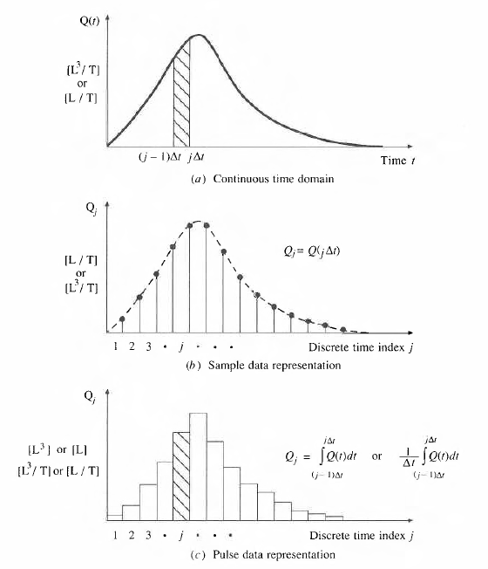
Continuous and Discrete time data
Figure 2.3.1, p. 28 Applied Hydrology
Continuous time representation
Δt
j-1
j
Sampled or Instantaneous data
(streamflow)
truthful for rate, volume is interpolated
Can we close a discrete-time water balance?
Pulse or Interval data
(precipitation)
truthful for depth, rate is interpolated

Slide 5
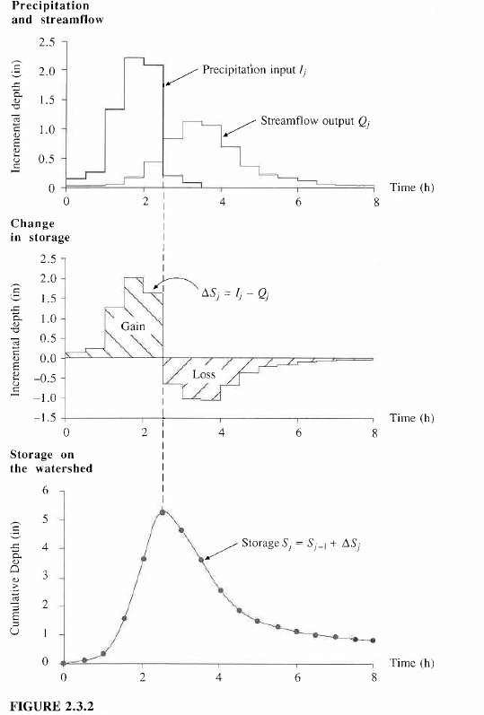
I_{j}
Q_{j}
Continuity Equation, dS/dt = I – Q
applied in a discrete time interval [(j-1)Δt, jΔt]
ΔS_{j} = I_{j} - Q_{j}
Δt
j-1
j
S_{j} = S_{j-1} + ΔS_{j}

Slide 6
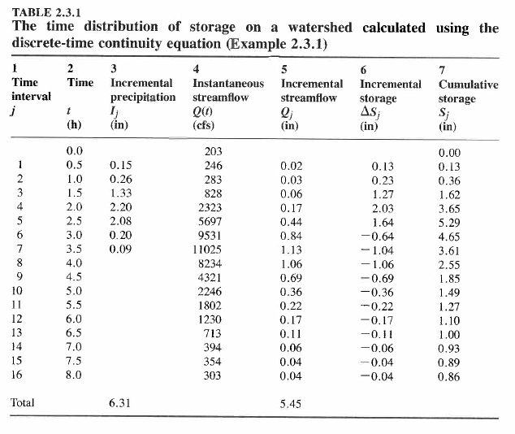

Slide 7
Momentum
B = mv; b = dB/dm = dmv/dm = v; dB/dt = d(mv)/dt = ΣF (Newtons 2nd Law)
For steady flow
For uniform flow
so
In a steady, uniform flow

Slide 8
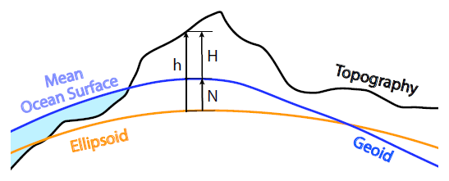
Gravity and the Geoid
The geoid is a hypothetical Earth surface that represents the mean sea level in the absence of winds, currents, and most tides. It defines the horizontal everywhere and gravity acts perpendicular to it. Water will not flow in aqueducts if the pipes are perfectly aligned along the geoid.
H = orthometric height (from geoid);
h = ellipsoidal height (from GPS – the earth as a regular shape)
N = gravity anomaly = h – H (use to get H from h)
http://www.nap.edu/catalog.php?record_id=12954

Slide 9
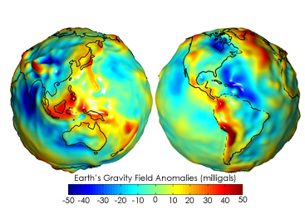
Gravity Anomaly Maps
Gravity anomaly maps show how much the Earth’s actual gravity field differs from the gravity field of a uniform, featureless Earth surface. The anomalies highlight variations in the strength of the gravitational force over the surface of the Earth.
http://earthobservatory.nasa.gov/Features/GRACE/page3.php

Slide 10
Energy equation of fluid mechanics
h_{f}
energy
grade line
y₁
water
surface
y₂
bed
z₁
L
z₂
Datum
Geoid
How do we relate friction slope,
to the velocity of flow?

Slide 11
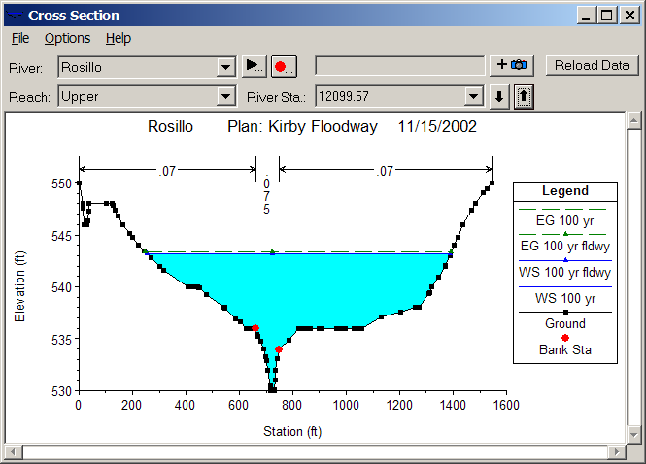
Open channel flow
Manning’s equation
Channel Roughness
Channel Geometry
Hydrologic Processes
(Open channel flow)
Hydrologic conditions
(V, S_{f})
Physical environment
(Channel n, R)

Slide 12
Subsurface flow
Darcy’s equation
q
A
q
Hydraulic conductivity
Hydrologic Processes
(Porous medium flow)
Hydrologic conditions
(q, S_{f})
Physical environment
(Medium K)

Slide 13
Comparison of flow equations
Open Channel Flow
Porous medium flow
Why is there a different power of S_{f}?

Slide 14
Energy
B = E = mv²/2 + mgz + E_{u}; β = dB/dm = v₂/2 + gz + e_{u};
dE/dt = dH/dt – dW/dt (heat input – work output) First Law of Thermodynamics
Generally in hydrology, the heat or internal energy component
(E_{u}, dominates the mechanical energy components (mv²/2 + mgz)

Slide 15
Heat energy
Energy
  Potential, Kinetic, Internal (E_{u})
Internal energy
  Sensible heat – heat content that can be measured and is proportional to temperature
  Latent heat – “hidden” heat content that is related to phase changes

Slide 16
Energy Units
In SI units, the basic unit of energy is Joule (J), where 1 J = 1 kg x 1 m/s²
Energy can also be measured in calories where 1 calorie = heat required to raise 1 gm of water by 1°C and 1 kilocalorie (C) = 1000 calories (1 calorie = 4.19 Joules)
We will use the SI system of units

Slide 17
Energy fluxes and flows
Water Volume [L³] (acre-ft, m³)
Water flow [L³/T] (cfs or m³/s)
Water flux [L/T] (in/day, mm/day)
Energy amount [E] (Joules)
Energy “flow” in Watts [E/T] (1W = 1 J/s)
Energy flux [E/L²T] in Watts/m²
Energy flow of
1 Joule/sec
Area = 1 m²

Slide 18
MegaJoules
When working with evaporation, its more convenient to use MegaJoules, MJ (J x 10⁶)
So units are
  Energy amount (MJ)
  Energy flow (MJ/day, MJ/month)
  Energy flux (MJ/m²-day, MJ/m²-month)

Slide 19
Internal Energy of Water
Water vapor
Water
Ice
Heat Capacity (J/kg-K) Latent Heat (MJ/kg)
Ice 2220 0.33
Water 4190 2.5
2.5/0.33 = 7.6
Water may evaporate at any temperature in range 0 – 100°C
Latent heat of vaporization consumes 7.6 times the latent heat of fusion (melting)

Slide 20
Water Mass Fluxes and Flows
Water Volume, V [L³] (acre-ft, m³)
Water flow, Q [L³/T] (cfs or m³/s)
Water flux, q [L/T] (in/day, mm/day)
Water mass [m = ρV] (Kg)
Water mass flow rate [m/T = ρQ] (kg/s or kg/day)
Water mass flux [M/L²T = ρq] in kg/m²-day
Water flux
Area = 1 m²

Slide 21
Latent heat flux
Water flux
  Evaporation rate, E (mm/day)
Energy flux
  Latent heat flux (W/m²), H_{l}
ρ = 1000 kg/m³
l_{v} = 2.5 MJ/kg
28.94 W/m² = 1 mm/day
Temp | Lv | Density | Conversion
0 | 2501000 | 999.9 | 28.94
10 | 2477300 | 999.7 | 28.66
20 | 2453600 | 998.2 | 28.35
30 | 2429900 | 995.7 | 28.00
40 | 2406200 | 992.2 | 27.63
Area = 1 m²

Slide 22
Radiation
Two basic laws
  Stefan-Boltzman Law
    R = emitted radiation (W/m2)
    ε = emissivity (0-1)
    σ = 5.67x10⁻⁸W/m2-K⁴
    T = absolute temperature (K)
  Wiens Law
    λ = wavelength of emitted radiation (m)
All bodies emit radiation
Hot bodies (sun) emit short wave radiation
Cool bodies (earth) emit long wave radiation

Slide 23
Net Radiation, R_{n}
R_{i} Incoming Radiation
R_{o} =αR_{i} Reflected radiation
= albedo (0 – 1)
R_{e}
R_{n} Net Radiation
Average value of R_{n} over the earth and
over the year is 105 W/m²

Slide 24
Net Radiation, R_{n}
H – Sensible Heat
LE – Evaporation
G – Ground Heat Flux
R_{n} Net Radiation
Average value of R_{n} over the earth and
over the year is 105 W/m²

Slide 25
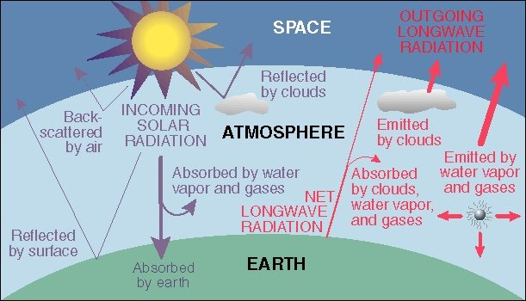
Energy Balance of Earth
20
70
100
6
6
26
4
38
15
19
21
Sensible heat flux 7
Latent heat flux 23
51
http://www.uwsp.edu/geo/faculty/ritter/geog101/textbook/energy/radiation_balance.html

Slide 26
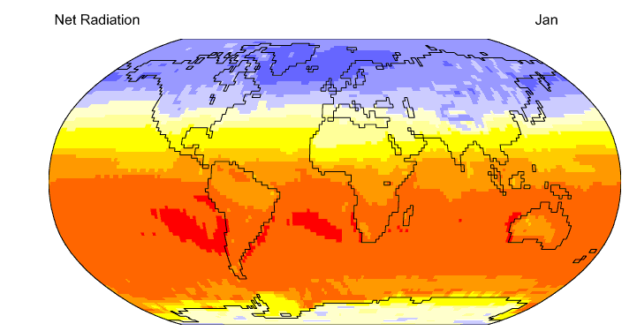

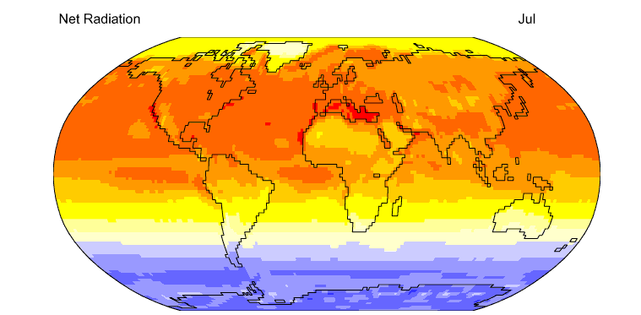
Net Radiation
http://geography.uoregon.edu/envchange/clim_animations/flash/netrad.html
Mean annual net radiation over the earth and over the year is 105 W/m²

Slide 27
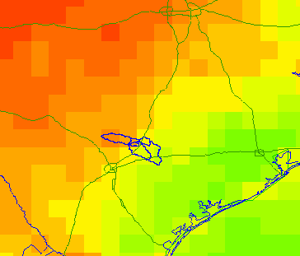
Energy Balance in the San Marcos Basin from the NARR (July 2003)
Note the very large amount of longwave radiation exchanged between land and atmosphere
Average fluxes over the day
495
61
72
112
3
310
415
Net Shortwave = 310 – 72 = 238; Net Longwave = 415 – 495 = - 80

Slide 28
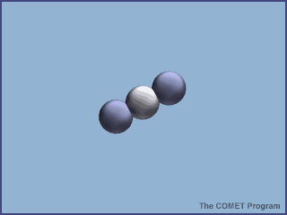
Absorption of energy by CO₂

Slide 29
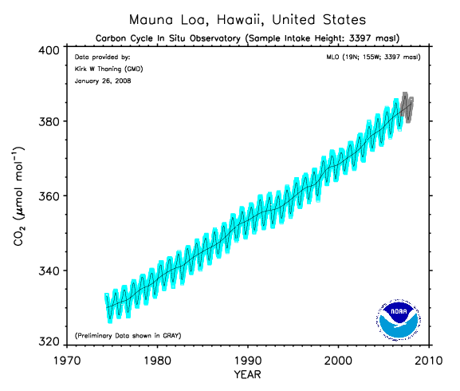
Increasing carbon dioxide in the atmosphere (from about 300 ppm in preindustrial times)
We are burning fossil carbon (oil, coal) at 100,000 times the rate it
was laid down in geologic time

