Slide 1
CE 374K Hydrology
Review for Second Exam
April 16, 2013

Slide 2
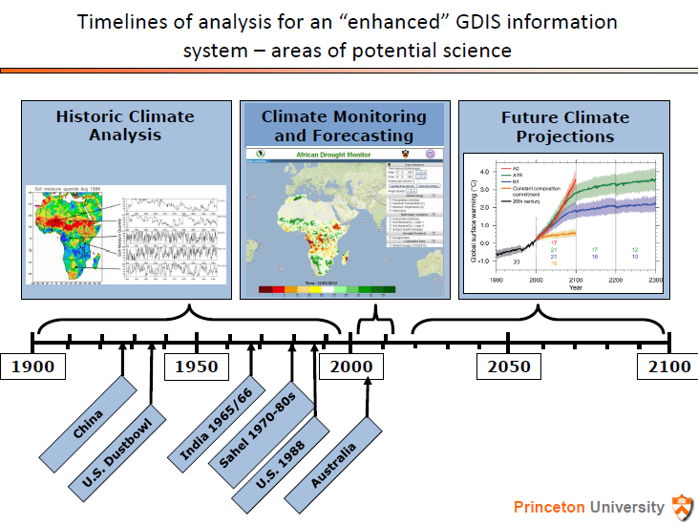
Global Drought Information System (GDIS)
(Dr Eric Wood)

Slide 3
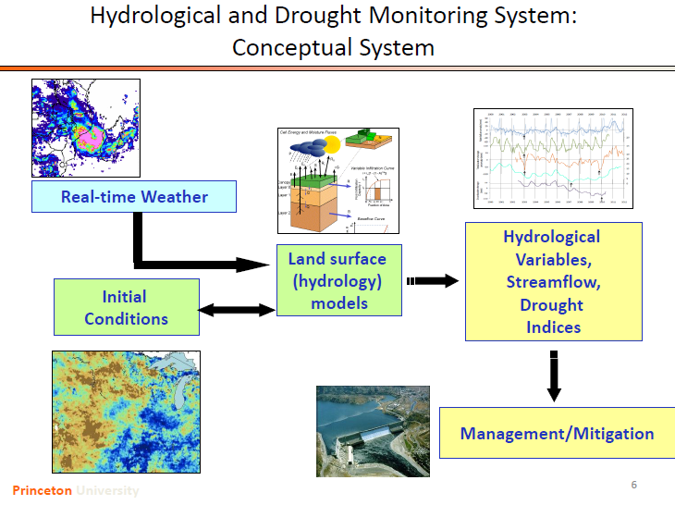

Slide 4
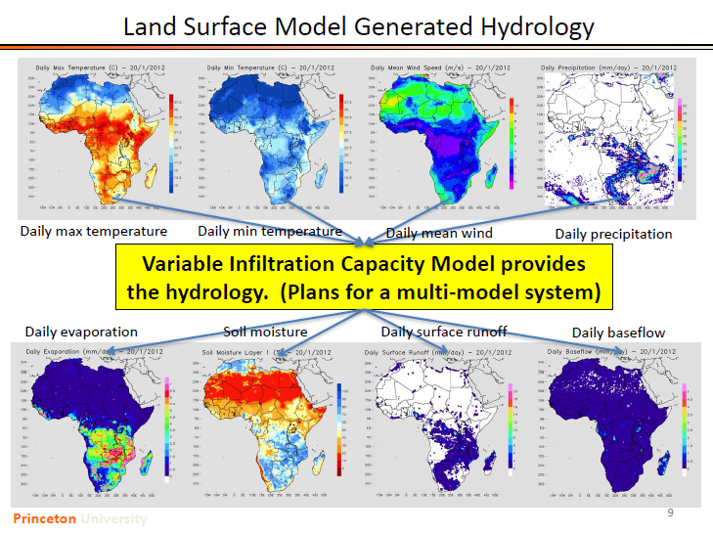

Slide 5
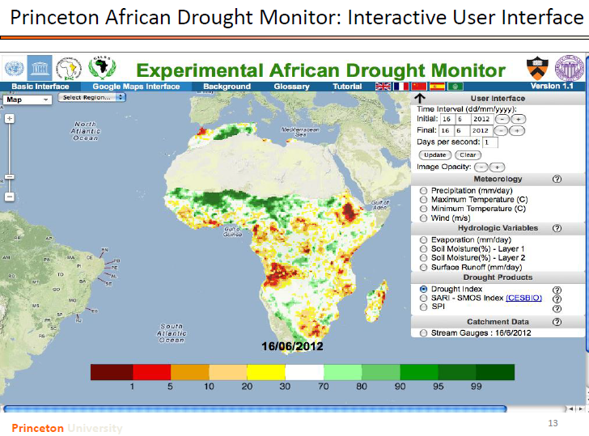
http://hydrology.princeton.edu/~justin/research/project_global_monitor/

Slide 6
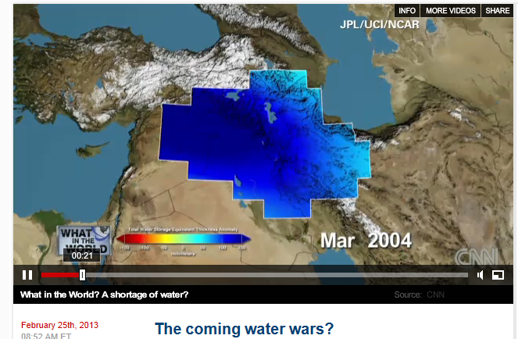
Global Water Issues
http://globalpublicsquare.blogs.cnn.com/2013/02/25/the-coming-water-wars/

Slide 7
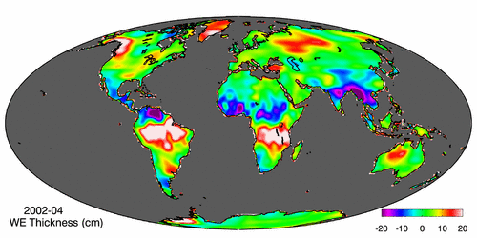
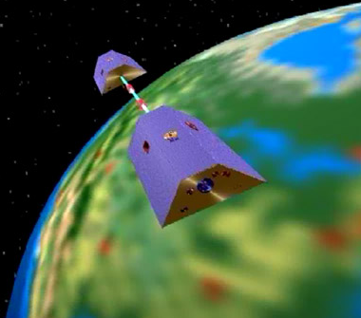
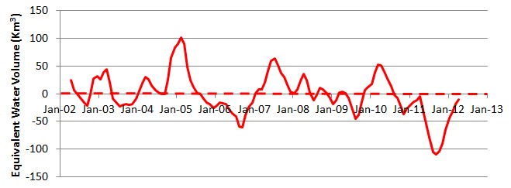
Measuring Gravity Anomaly from Space (GRACE)
Force of gravity responds to changes in water volume
Water is really heavy!
Gravity Anomaly of Texas, 2002 – 2012
Normal
In 2011, we lost 100 Km³ of water or 70 Lake Travis’s

Slide 8
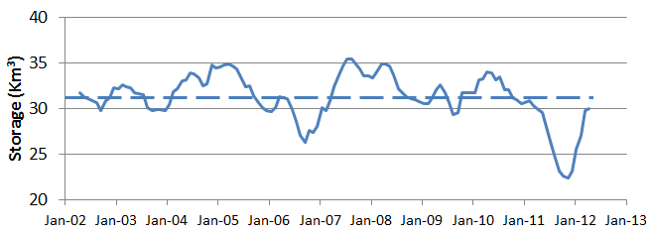

GRACE and Texas Reservoir Water Storage
Surface water reservoir storage is closely correlated with the GRACE data
Grace Satellites
Normal
In 2011 we lost 100 Km³ of water overall
Surface Water Reservoirs
Normal
In 2011 we lost 9 Km³ of water from reservoirs

Slide 9
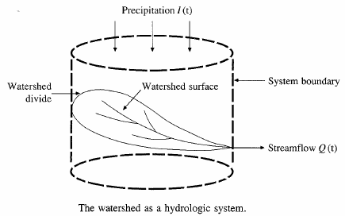






Hydrologic Analysis
Change in storage w.r.t. time = inflow - outflow
In the case of a linear reservoir, S = kQ
Transfer function for a linear system (S = kQ).

Slide 10
Proportionality and superposition
Linear system (k is constant in S = kQ)
  Proportionality
    If I₁ → Q₁ then C*I₂ → C*Q₂
  Superposition
    If I₁ → Q₁ and I₂ → Q₂, then I₁ +I₂→ Q₁ + Q₂

Slide 11
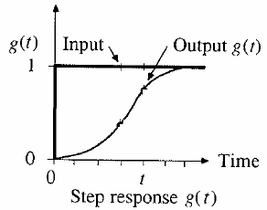
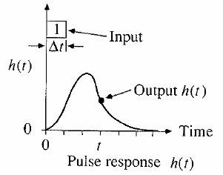
Step and pulse inputs
A unit step input is an input that goes from 0 to 1 at time 0 and continues indefinitely thereafter
A unit pulse is an input of unit amount occurring in duration Δt and 0 elsewhere.
Precipitation is a series of pulse inputs!

Slide 12
Unit Hydrograph Theory
Direct runoff hydrograph resulting from a unit depth of excess rainfall occurring uniformly on a watershed at a constant rate for a specified duration.
Unit pulse response function of a linear hydrologic system
Can be used to derive runoff from any excess rainfall on the watershed.

Slide 13
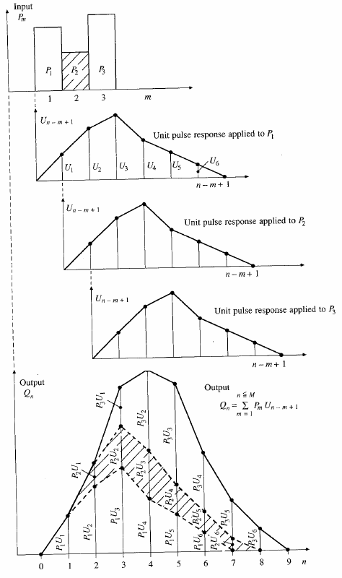
Application of convolution to the output from a linear system

Slide 14
SCS dimensionless hydrograph
Synthetic UH in which the discharge is expressed by the ratio of q to q_{p} and time by the ratio of t to T_{p}
If peak discharge and lag time are known, UH can be estimated.
T_{c}: time of concentration
C = 2.08 (483.4 in English system)
A: drainage area in km² (mi²)

Slide 15
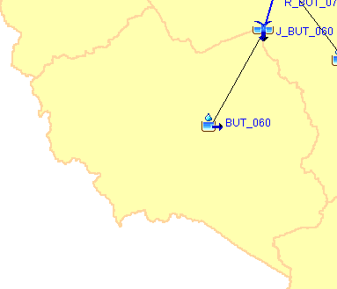
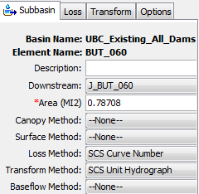
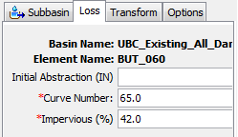
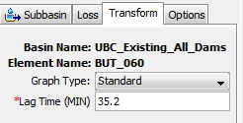
Modeling Runoff from BUT_060
How to characterize this subbasin?
How quickly does it move?
How much runoff?

Slide 16
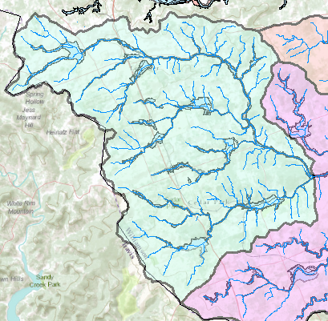
Watershed – Drainage area of a point on a stream
Rainfall
Streamflow
Connecting rainfall input with streamflow output

Slide 17
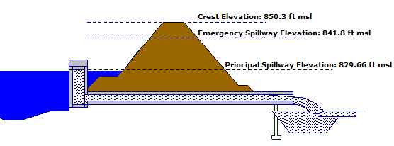
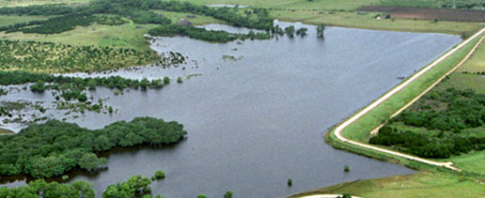
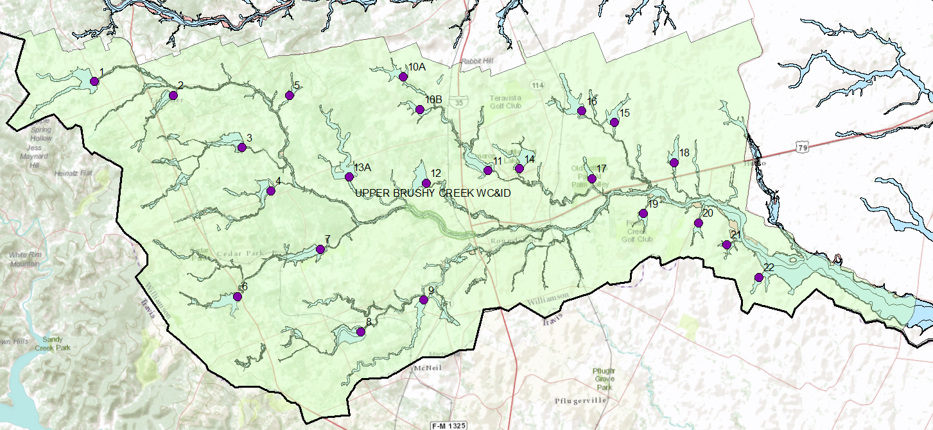
Flood Control Dams
Dam 13A
Flow with a Horizontal Water Surface

Slide 18
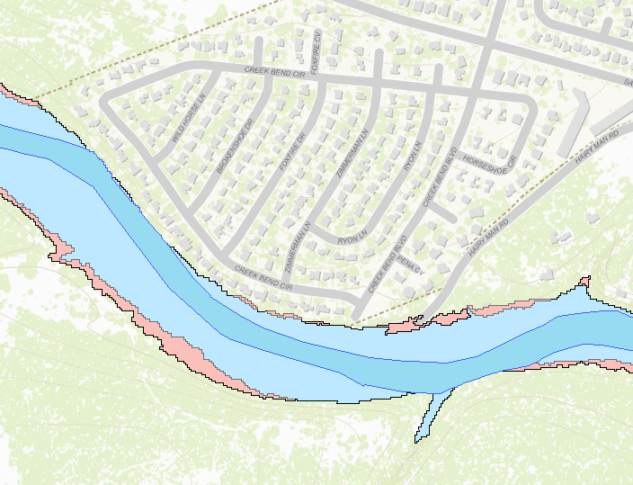

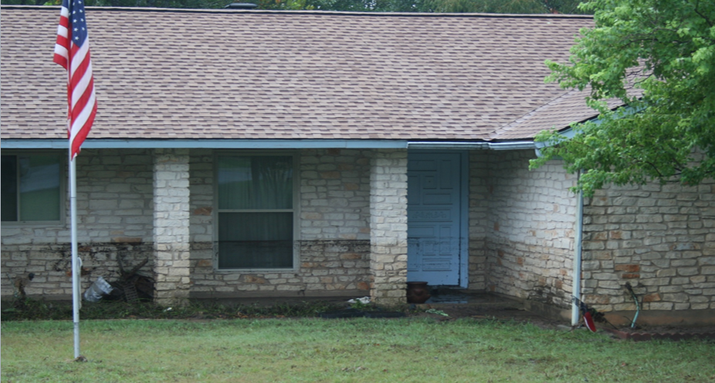

Floodplain Zones
1% chance
< 0.2% chance
Main zone of water flow
Flow with a Sloping Water Surface

Slide 19
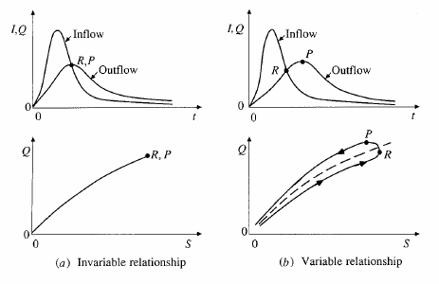
S and Q relationships

Slide 20
Level pool methodology
Discharge
Inflow
Outflow
Time
Storage
Unknown
Known
Need a function relating
Time
Storage-outflow function

Slide 21
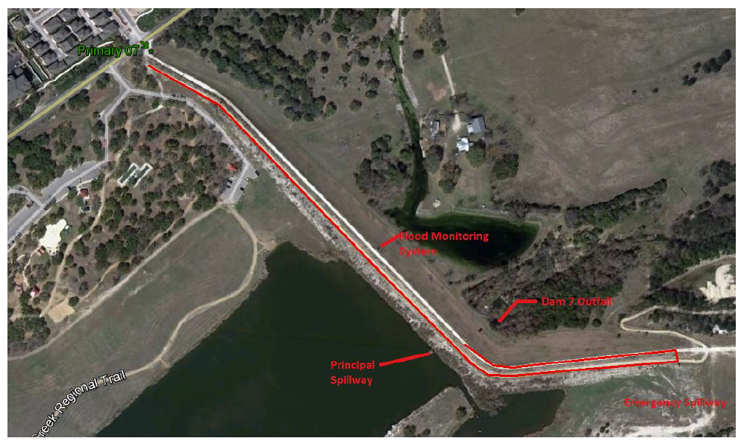
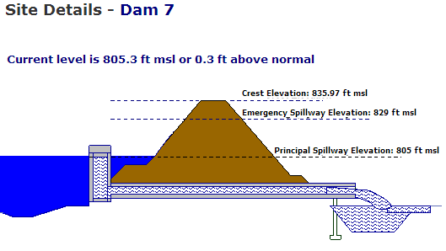
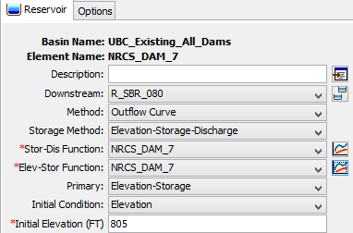
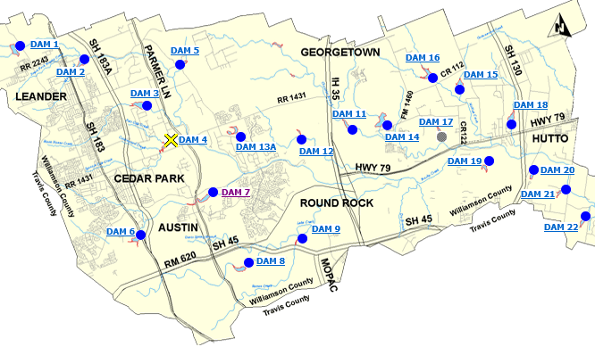
Dam 7
836 ft
829 ft
805 ft
HEC-HMS representation

Slide 22
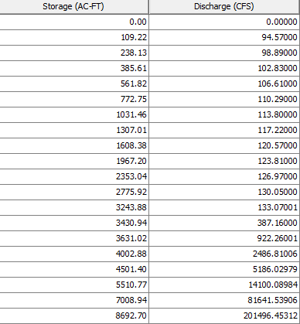
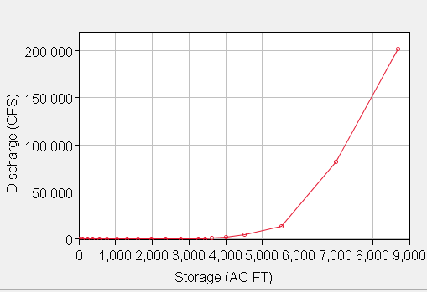
Storage-Discharge Curve, Dam 7
Emergency
Spillway, 829
Top of Dam, 836

Slide 23
Types of flow routing
Lumped/hydrologic
  Flow is calculated as a function of time alone at a particular location
  Governed by continuity equation and flow/storage relationship
Distributed/hydraulic
  Flow is calculated as a function of space and time throughout the system
  Governed by continuity and momentum equations

Slide 24
Hydrologic river routing (Muskingum Method)
Wedge storage in reach
Advancing
Flood
Wave
I > Q
K = travel time of peak through the reach
X = weight on inflow versus outflow (0 ≤ X ≤ 0.5)
X = 0 ➔ Reservoir, storage depends on outflow, no wedge
X = 0.0 - 0.3 ➔ Natural stream
Receding
Flood
Wave
Q > I

Slide 25
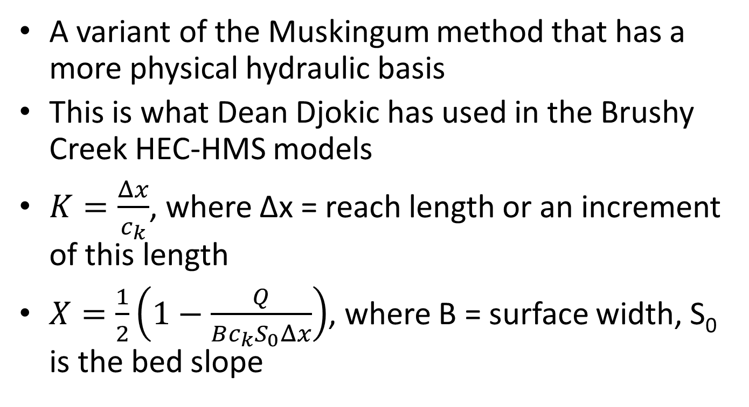
Muskingum-Cunge Method
A variant of the Muskingum method that has a more physical hydraulic basis
This is what Dean Djokic has used in the Brushy Creek HEC-HMS models
$K=\frac{Δx}{c_{k}}$, where Δx = reach length or an increment of this length
$X=\frac{1}{2}\left(1−\frac{Q}{Bc_{k}S_{0}Δx}\right)$, where B = surface width, S₀ is the bed slope

Slide 26
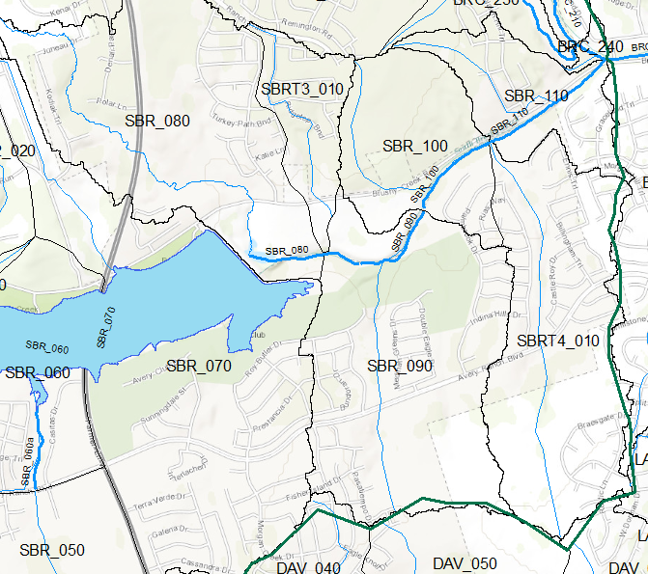
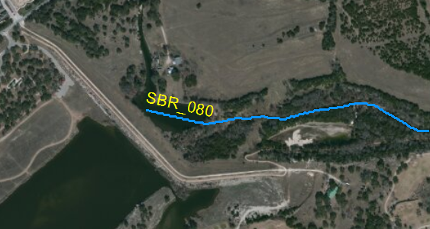
Reach SBR_080 Downstream of Dam 7
How do we route the flow through Reach SBR_080?

Slide 27
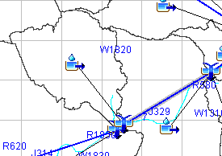

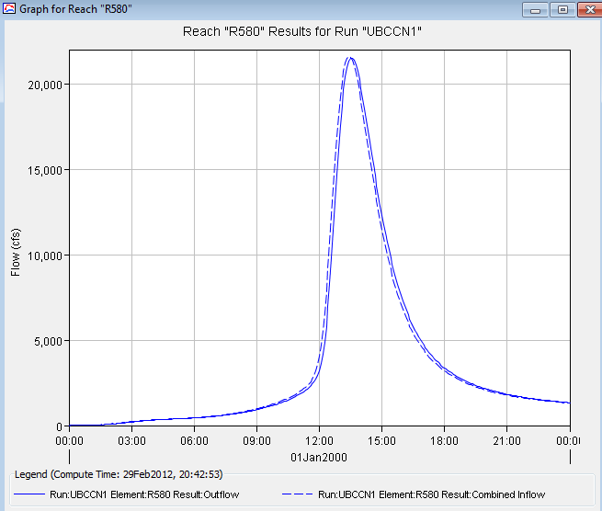
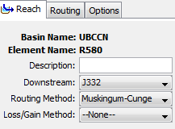
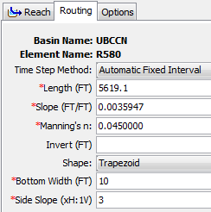
Reach R580

Slide 28
Unsteady Flow Routing in Open Channels
Flow is one-dimensional
Hydrostatic pressure prevails and vertical accelerations are negligible
Streamline curvature is small.
Bottom slope of the channel is small.
Manning’s equation is used to describe resistance effects
The fluid is incompressible

Slide 29
Momentum Equation
From Newton’s 2nd Law:
Net force = time rate of change of momentum
Sum of forces on the C.V.
Momentum stored within the C.V
Momentum flow across the C. S.

Slide 30
Momentum Equation(2)
Local acceleration term
Convective acceleration term
Pressure force term
Gravity force term
Friction force term
Kinematic Wave
Diffusion Wave
Dynamic Wave

Slide 31
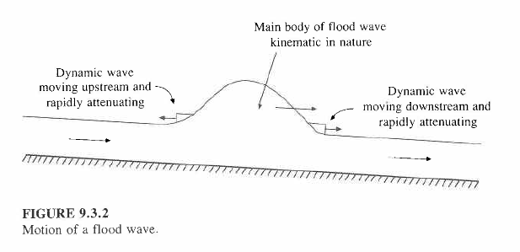
Kinematic Wave
Kinematic wave celerity, c_{k} is the speed of movement of the mass of a flood wave downstream
  Approximately, c_{k} = 5v/3 where v = water velocity

Slide 32
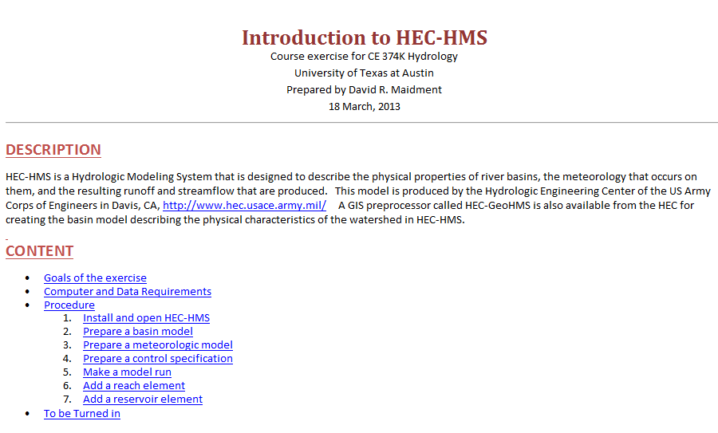
HEC-HMS
http://www.caee.utexas.edu/prof/maidment/CE374KSpr13/Hmwk5/IntroHECHMS.htm

Slide 33

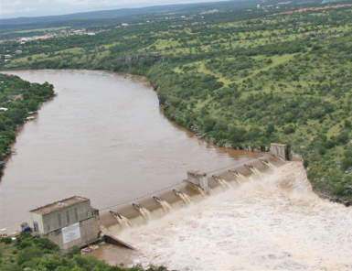
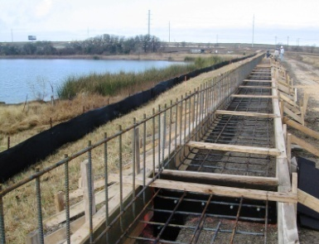
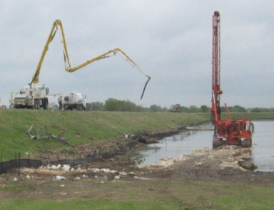
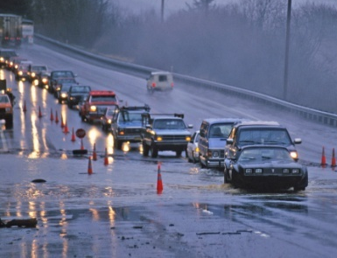
Upper Brushy Creek Water Control & Improvement District
Ruth Haberman, General Manager, UBCWCID
March 21, 2013

Slide 34
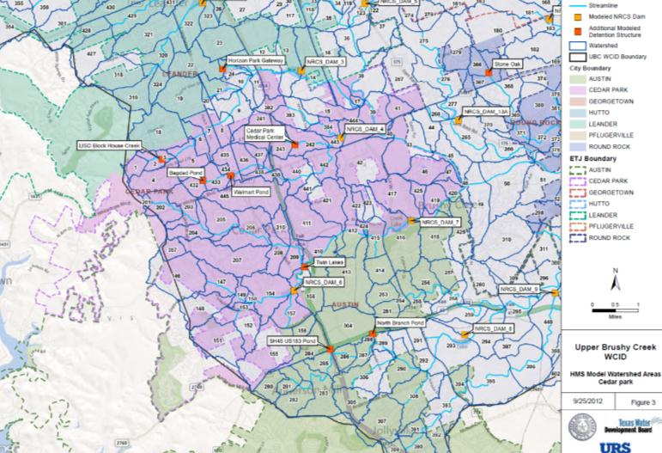
449 Watersheds

Slide 35
Hydrology: the Mindset
Hydrology = Data (Rainfall, Runoff, Land Use)
Data bad = Hydrology bad
Data good = Hydrology good
How do you test data?

Slide 36
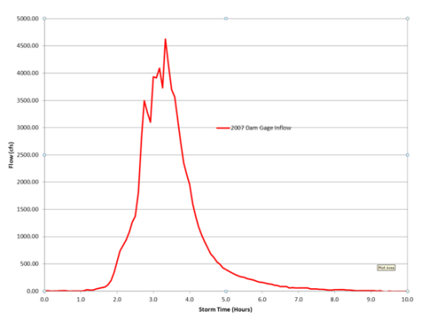
Choice of Calibration storms
The runoff hydrograph has two main parameters that define shape:
A parameter that defines how much rain runs off (runoff volume)
A parameter that defines time of peak (runoff temporal shape)

Slide 37
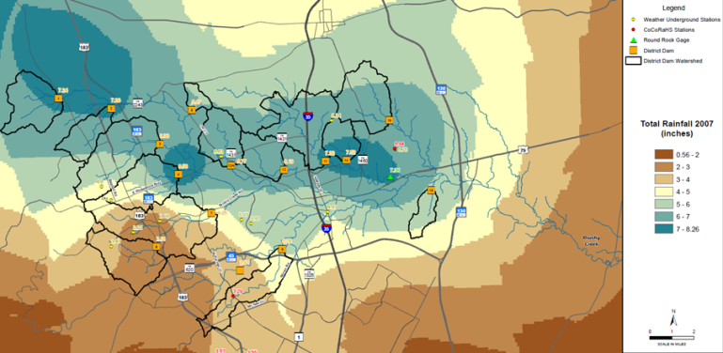
Choice of Calibration Storms: Storm of 2007
    Representative in location and time?
    Are there enough data?
      Spatially vs storm shape

Slide 38
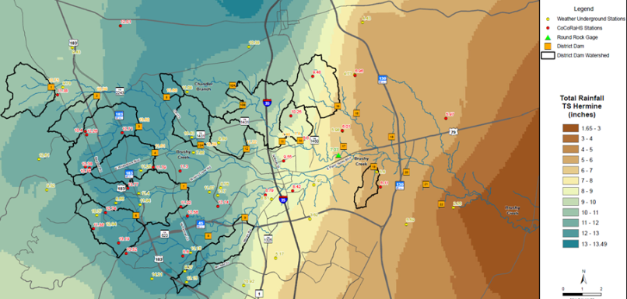
Choice of Calibration Storms: TS Hermine
    Are there enough data?
      Spatially vs storm shape

Slide 39
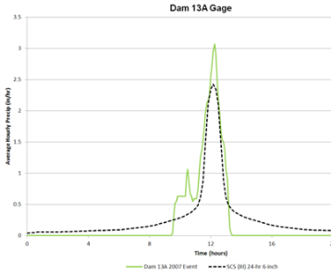
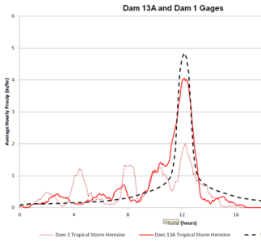
Choice of Calibration Storms
    Representative?
      In temporal shape
2007 Storm vs SCS 24 hour hyetograph
TS Hermine vs SCS 24 hour hyetograph

Slide 40
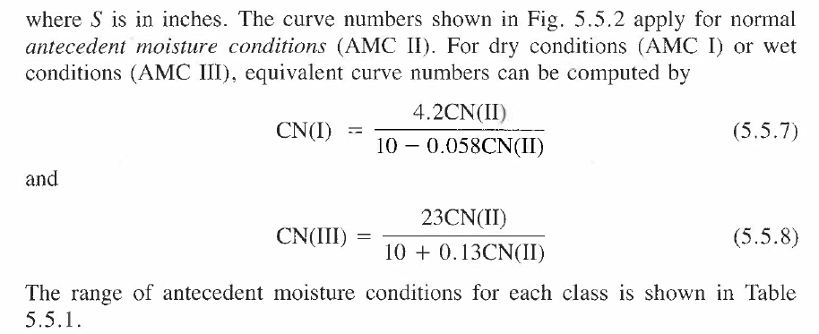



Antecedent Moisture Condition
p. 149 Applied Hydrology
http://www.wcc.nrcs.usda.gov/ftpref/wntsc/H&H/CNarchive/CNbeyond.doc

Slide 41

Labyrinth Weir

Slide 42
Random Variable
Random variable: a quantity used to represent probabilistic uncertainty
  Incremental precipitation
  Instantaneous streamflow
  Wind velocity
Random variable (X) is described by a probability distribution
Probability distribution is a set of probabilities associated with the values in a random variable’s sample space

Slide 43


Slide 44
Summary statistics
Also called descriptive statistics
  If x₁, x₂, …x_{n} is a sample then
Mean,
μ for continuous data
Variance,
σ² for continuous data
Standard deviation,
σ for continuous data
Coeff. of variation,
Also included in summary statistics are median, skewness, correlation coefficient,

Slide 45


Slide 46
Return Period
Random variable:
Threshold level:
Extreme event occurs if:
Recurrence interval:
Return Period:
  Average recurrence interval between events equalling or exceeding a threshold
If p is the probability of occurrence of an extreme event, then
or

Slide 47
Probability distributions
Normal family
  Normal, lognormal, lognormal-III
Generalized extreme value family
  EV1 (Gumbel), GEV, and EVIII (Weibull)
Exponential/Pearson type family
  Exponential, Pearson type III, Log-Pearson type III

Slide 48



Drought in Texas – US Drought Monitor
In 2011, Texas and Oklahoma had the hottest summer
ever recorded in the history of the United States
Texas 99% in drought
75% in D4
Texas 96% in drought
10% in D4
July 2011
March 2013
http://droughtmonitor.unl.edu/

Slide 49

Trends in Drought Severity in Texas
2000
2002
2004
2006
2009
2011

Slide 50


What does the longer-term future hold?
As temperatures rise, rain decreases….
Temperature is expected to rise…
whether due to natural variations or anthropogenic causes
John Nielson-Gammon, 2012; Danny Reible, 2013

Slide 51



Reservoir Levels
(Dec 17, 2012)
West Texas is in a more sustained drought
http://www.texastribune.org/library/data/texas-reservoir-levels/
Notes:
West Texas is chronically short of water – reservoirs are either dry or are drying up. Cities are building access to groundwater well fields as fast as possible. East Texas has relatively abundant water resources.

Slide 52

Drought in West Texas is chronic
1990’s
2000’s

Slide 53
Reservoirs
Odessa
Midland
San Angelo

Slide 54




Frequency Analysis using Frequency Factors
The magnitude of an extreme event can be thought of as a departure from the mean expressed as a number of standard deviations
  $x_{T}= µ+K_{T}σ$
The frequency factor, $K_{T}$, is a number in the range (-1, 5) that depends on:
  Probability distribution
  Return period, T
  Coefficient of skewness, C_{s}
f(x)
P($x≥$ x_{T})
$$K_{T}σ$$
x
$$µ$$
x_{T}

Slide 55



Example continued …
Hence
  $x_{T}= µ+K_{T}σ$
  $x_{100}=4.7546+2.8184∗0.3423=$5.7193
  $Q_{100}={10}^{5.7193}=523,969 cfs$
  or $Q_{100}=524,000 cfs$
Result from HEC-SSP

Slide 56

Flood Frequency Analysis

Slide 57


HEC-SSP

Slide 58


Additional Considerations
Expected Probability
Outliers
Confidence Limits

Slide 59
Hydrologic design level
Hydrologic design level – magnitude of the hydrologic event to be considered for the design or a structure or project.
Three approaches for determining design level
  Empirical/probabilistic
  Risk analysis
  Hydroeconomic analysis

Slide 60
Estimated Limiting Value (ELV)
Lower limit on design value – 0
Upper limit on design value – ELV
ELV – largest magnitude possible for a hydrologic event at a given location, based on the best available hydrologic information.
  Length of record
  Reliability of information
  Accuracy of analysis
Probable Maximum Precipitation (PMP) / Probable Maximum Flood (PMF)

Slide 61


Slide 62
Design Storms
Get Depth, Duration, Frequency Data for the required location
Select a return period
Convert Depth-Duration data to a design hyetograph.

Slide 63


Atlas of Depth-Duration-Frequency for Texas
Return period = 2, 5, 10, 25, 50 100, 250, 500 years
Duration = 15, 30 min, 1,2,3,6, 12 hr, 1,2,3,5,7 days
8 return periods x 12 durations = 96 maps
http://pubs.usgs.gov/sir/2004/5041/pdf/sir2004-5041.pdf

Slide 64


Depth Duration Data to Rainfall Hyetograph

Slide 65
Example 14.2.1
Determine i and P for a 20-min duration storm with 5-yr return period in Chicago
From the IDF curve for Chicago,
i = 3.5 in/hr for T_{d} = 20 min and T = 5yr
P = i x T_{d} = 3.5 x 20/60 = 1.17 in

Slide 66

SCS Method
SCS (1973) adopted method similar to DDF to develop dimensionless rainfall temporal patterns called type curves for four different regions in the US.
SCS type curves are in the form of percentage mass (cumulative) curves based on 24-hr rainfall of the desired frequency.
If a single precipitation depth of desired frequency is known, the SCS type curve is rescaled (multiplied by the known number) to get the time distribution.
For durations less than 24 hr, the steepest part of the type curve for required duraction is used

Slide 67
Example: Alternating Block Method
Find: Design precipitation hyetograph for a 2-hour storm (in 10 minute increments) in Denver with a 10-year return period 10-minute

Slide 68

Extreme Rainfall Statistics
(Tropical Storm Allison)

Slide 69

TS Allison

Slide 70


Probable Maximum Precipitation Depths
6-hour, 10 mile²
6-hour, 200 mile²

Slide 71

PMP Storm for Dam 7

