Slide 1
Review Slides for Final Exam
CE 374K Hydrology Spring 2013

Slide 2
How is new knowledge discovered?
After completing a Handbook of Hydrology, I asked myself the question: how is new knowledge discovered in hydrology?
Deduction from existing knowledge
By deduction from existing knowledge
By experiment in a laboratory
By observation of the natural environment
Experiment in a laboratory
Observation of the natural environment
Notes:
After completing a Handbook of Hydrology, I asked myself the question: how is new knowledge discovered in hydrology?
<Click> to show answers
By deduction from existing knowledge
By experiment in a laboratory
By observation of the natural environment

Slide 3
Deduction – Isaac Newton Given a set of axioms and a reasoning process, derive new principles
“The ancients divided mechanics into two parts; the rational, which proceeds accurately by demonstration; and the practical.
It occurs that mechanics is so distinguished from geometry, that what is perfectly accurate is called geometrical, what is less so, is called mechanical. Yet the errors do not come from the art but from those who practice the art.
In this sense rational mechanics will be the science of motions resulting from any forces whatsoever, and of the forces required to produce any motions, accurately proposed and demonstrated.”
Isaac Newton
Trinity College, Cambridge
8 May, 1686

Slide 4
Experiment – Henry Darcy Replicate nature in a laboratory and identify its functional processes
Experiment is the classical path of laboratory science – a simplified view of the natural world is replicated under controlled conditions
Pasteur showed that microorganisms cause disease and discovered vaccination
a foundation of scientific medicine
Laboratory experiments are more for microscale than the macroscale
hard to conduct at the global scale
“Note D is on water filtration. It includes a description of a new device that seems to simply and economically resolve the problem of filtering water to supply a large city. To obtain this result, I take into consideration the law of water flow through sand, a law that I have demonstrated experimentally.
It appears that for an identical sand, it can be assumed that the volume discharged is proportional to the head and inversely proportional to the thickness of the sand layer that the water passes through.”
Published in Paris for Imperial Corps of Bridges, Roads and Mines,1856
Notes:
Experiment is the classical path of laboratory science – a simplified view of the natural world is replicated under controlled conditions
Pasteur showed that microorganisms cause disease and discovered vaccination
a foundation of scientific medicine
Laboratory experiments are more for microscale than the macroscale
hard to conduct at the global scale

Slide 5
Observation – Charles Darwin Identification of patterns in nature by direct observation
“When on board H.M.S. Beagle, as naturalist, I was much struck with certain facts in the distribution of the inhabitants of South America, and in the geological relations of the present to the past inhabitants of that continent. These facts seemed to me to throw some light on the origin of species -- that mystery of mysteries, as it has been called by one of our greatest philosophers. On my return home, it occurred to me, in 1837, that something might perhaps be made out on this question by patiently accumulating and reflecting on all sorts of facts which could possibly have any bearing on it.
I can here give only the general conclusions at which I have arrived, with a few facts in illustration, but which, I hope, in most cases will suffice.”
Published 24 November,1859
Most accessible book of great
scientific imagination ever written

Slide 6
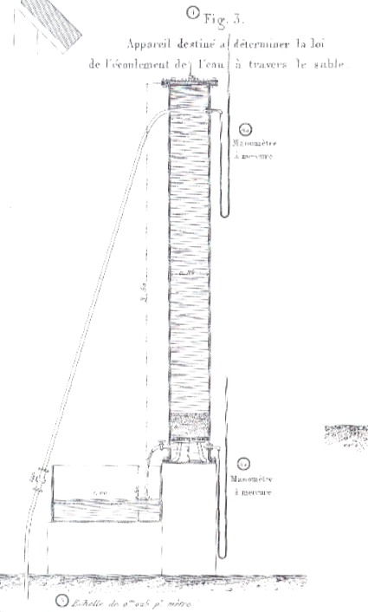
Darcy’s Law
“Thus, if we denote the thickness of the sand
layer by e, its surface area by s, atmospheric pressure by P, and the height of the water on the sand layer by h, we will have P+h for the pressure to which the upper end will be subjected. In addition, if P ± h₀ is the pressure to which the lower surface is subjected, k is a coefficient that depends on the permeability of the layer and q is the volume discharge, we have
$$q=k\frac{s}{e}\left[h+e±h_{0}\right]$$
which reduces to
$q=k\frac{s}{e}\left[h+e\right]$
when h₀ = 0 or pressure under the filter is equal to atmospheric pressure.”
P+h
Pressurized water supply in a hospital
s
e
k
Sand column is 2.3 m high
0.35m diameter
P ± h₀
q
Diagram from Plate 24
Description of experiments and equation, p. 455-459,
as part of Appendix D in the book of 506 pages.

Slide 7
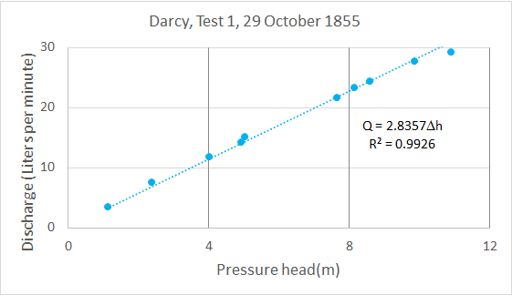
Hydraulic Conductivity in Test 1, 29 Oct 1855
Darcy’s Law:
$$Q=KA\frac{Δh}{L}$$
$A=\frac{π}{4}D^{2}$= $\frac{π}{4}{(0.35)}^{2}$ = 0.09621m²
$$K=\frac{1}{A}\frac{Q}{Δh}L=\frac{1}{0.09621}\frac{Q}{Δh}L=10.394\frac{Q}{Δh}L$$
For Test 1, Q/Δh = 2.8357, L$=0.58m$
$$K= 10.394∗2.8357 ∗0.58$$
$$=17.09\frac{L}{min−m2 }$$
$$=\underline{1.03m/hr }$$
These are reasonable numbers for “slow sand” filters
Modern “rapid sand” filters have conductivities of 5-12 m/hr
The Green-Ampt conductivity for sand is 12 cm/hr

Slide 8
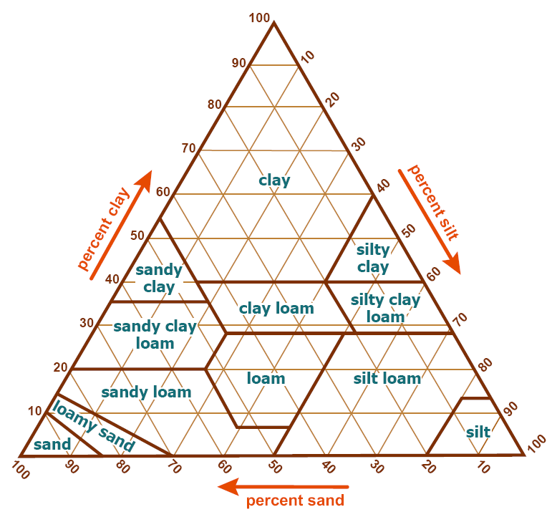
Green-Ampt Conductivity and Suction Head
Conductivity, K
(cm/hr)
Sand
Loamy Sand
Sandy Loam
Silt Loam
Suction Head, ψ (cm)
Loam
Sandy Clay Loam
Clay Loam
Silty Clay Loam
Sandy Clay
Silty Clay
Clay

Slide 9
Green-Ampt Assumptions
= increase in moisture content as wetting front passes
Ponded Water
Ground Surface
Wetted Zone
= Suction head at “sharp” wetting front
Conductivity, K
= Wetted depth
Wetting Front
= Conductivity in wetted zone
= Depth of water ponding on surface (small)
Dry Soil

Slide 10
Green – Ampt Infiltration (Cont.)
Ground Surface
Wetted Zone
Wetting Front
Apply finite difference to the derivative, between
Ground surface
Wetting front
Dry Soil

Slide 11
Green – Ampt Infiltration
Ponded Water
Ground Surface
Wetted Zone
Wetting Front
Dry Soil

Slide 12
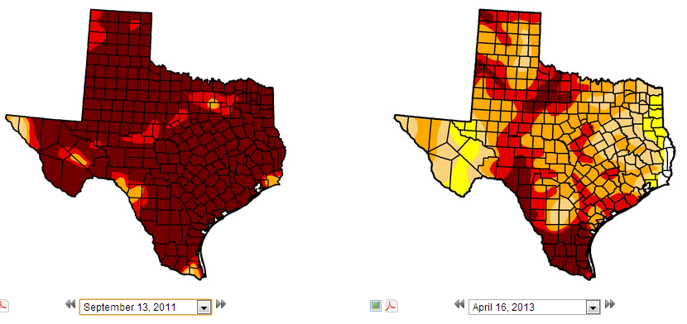
Drought in Texas – US Drought Monitor
In 2011, Texas and Oklahoma had the hottest summer
ever recorded in the history of the United States
Texas 99% in drought
87% in D4
Texas 98% in drought
12% in D4
September 2011
April 2013
http://droughtmonitor.unl.edu/

Slide 13
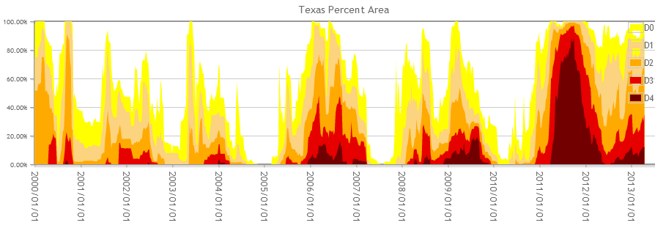
Trends in Drought Severity in Texas
2000
2002
2004
2006
2009
2011

Slide 14
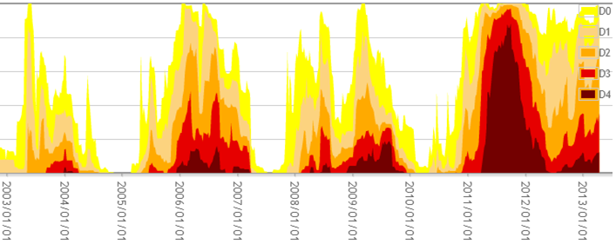
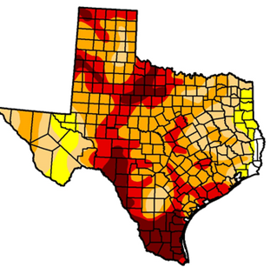
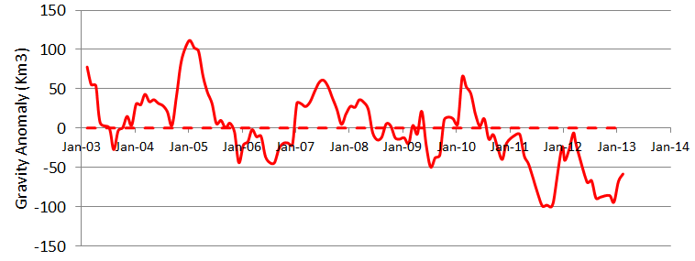
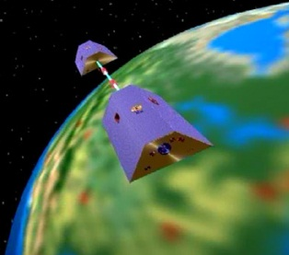
Drought and GRACE
US Drought Monitor is closely correlated with the GRACE data
US Drought
Monitor
Percent of Area in Drought
GRACE
September
2011
At peak drought, Texas had a 100 Km³ water deficit
(equivalent to 70 Lake Travis’s)

Slide 15
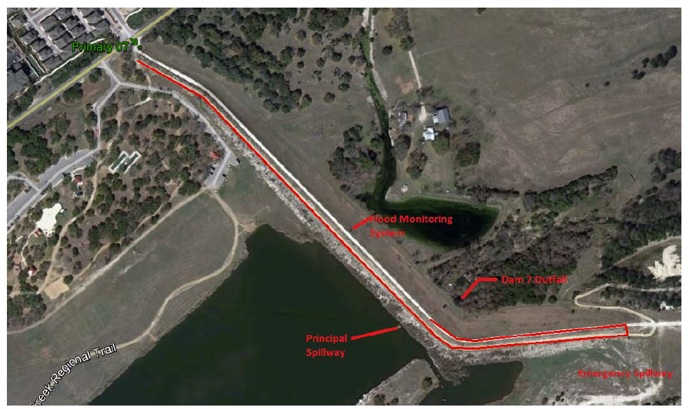
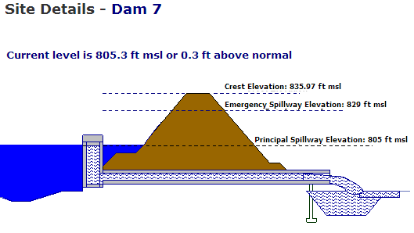
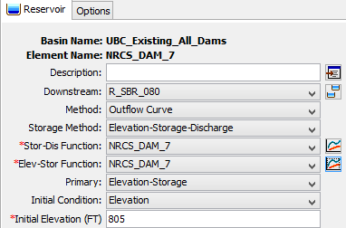
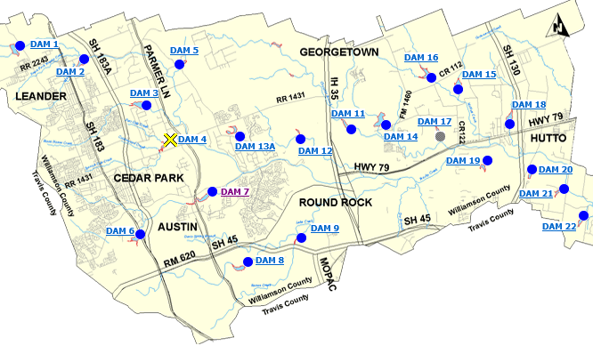
Dam 7
836 ft
829 ft
805 ft
HEC-HMS representation

Slide 16
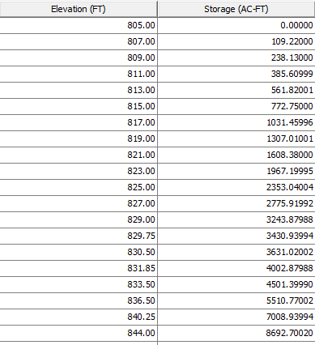
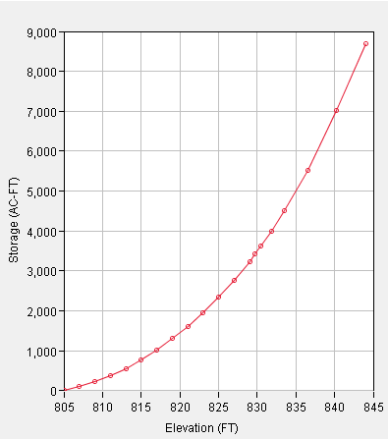
Elevation-Storage Curve, Dam 7
Top of Dam, 836
Emergency Spillway, 829

Slide 17
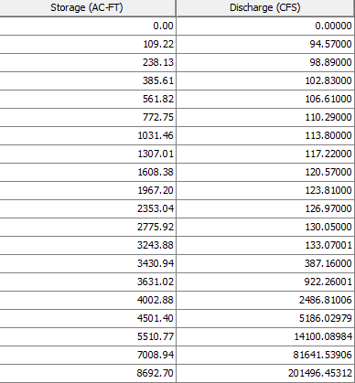
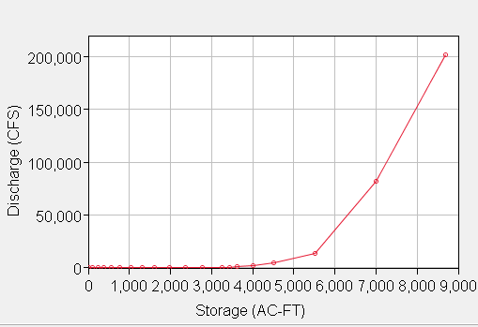
Storage-Discharge Curve, Dam 7
Emergency
Spillway, 829
Top of Dam, 836

Slide 18
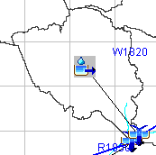
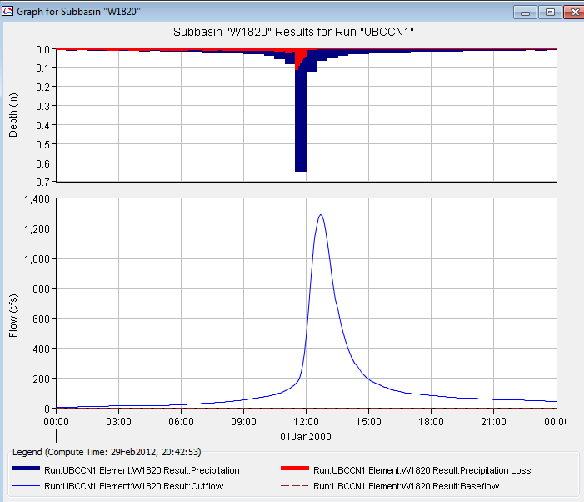
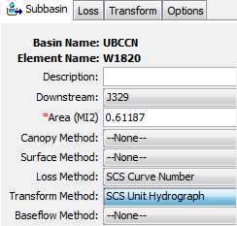
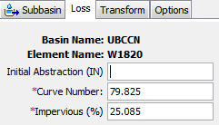
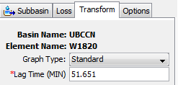
Watershed W1820

Slide 19
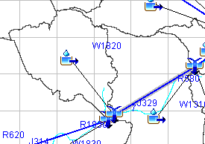
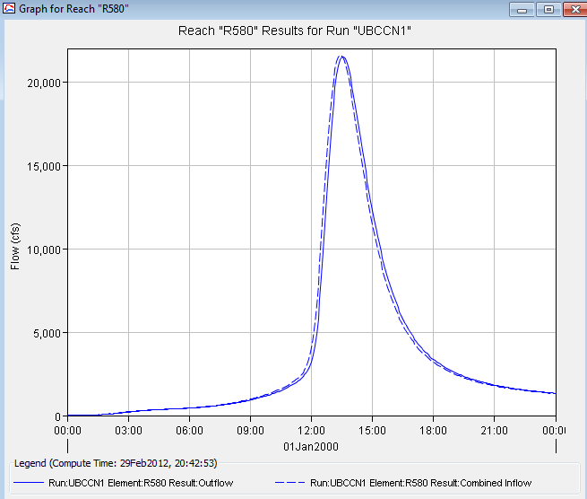
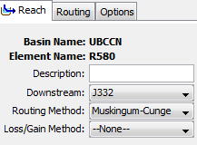
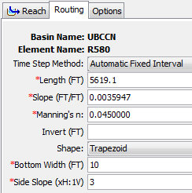
Reach R580

Slide 20
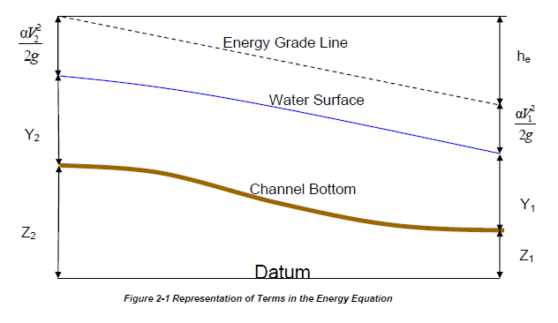
Steady Flow Solution

Slide 21
One-Dimensional Flow Computations
Cross-section
Channel centerline
and banklines
Right Overbank
Left Overbank

Slide 22
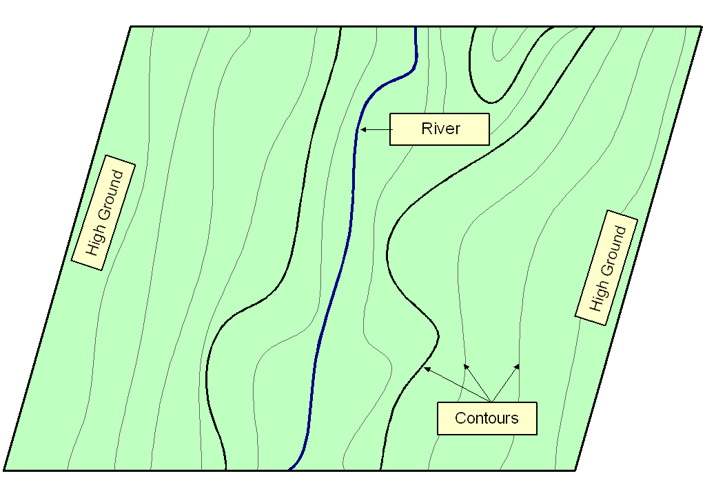
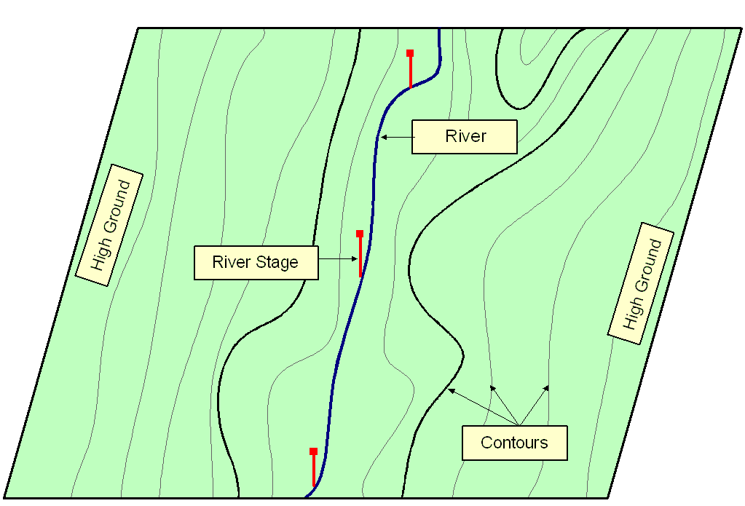
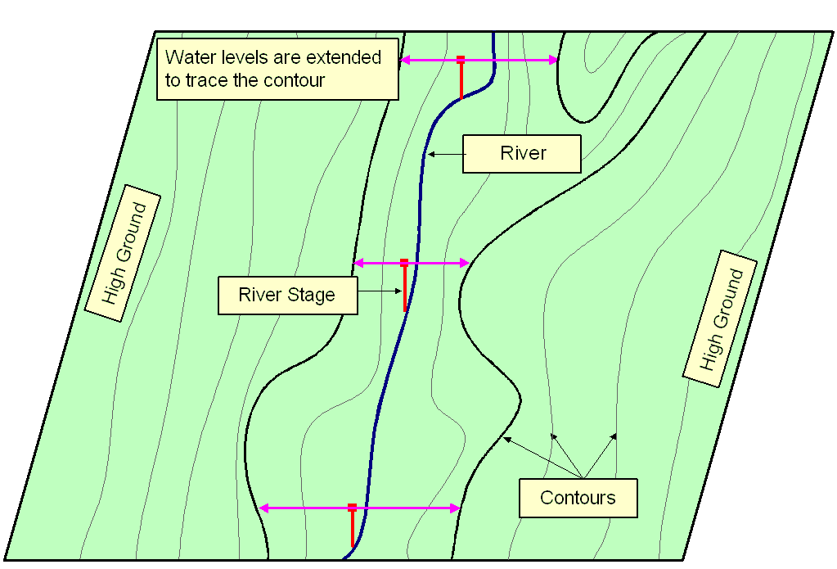
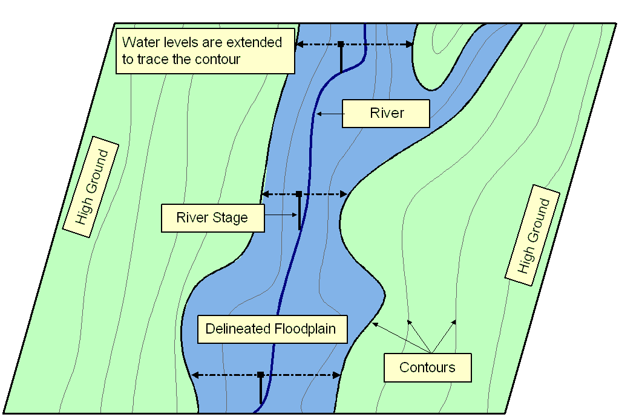
Floodplain Delineation
Notes:
Ideally should have Two D Models…... A floodplain delineation process determines inundation extent by comparing water levels with ground surface elevations. We start with a DTM or topomap. > Water levels are computed based on cross-sections. During normal condition, flow remains within the main channel, but > during flood, water spill over the bank. In these cases it’s important to extent cross-section over the floodplain. > We then bring back water levels on the topomap. > Extent water levels until hit contour of higher elevations. > Finally delineate floodplain following the contours. The accuracy largely depends on water levels and in turns on the cross-section used for computation.

Slide 23
National Flood Insurance Program
Begun in 1968
Federal government provides a national flood insurance program
Local communities regulate land development in floodplains
Requires floodplain maps
Base Flood Elevation for 100 year flood is the key
Keep building floor elevations above this level
Keep building out of 100 year inundated area

Slide 24
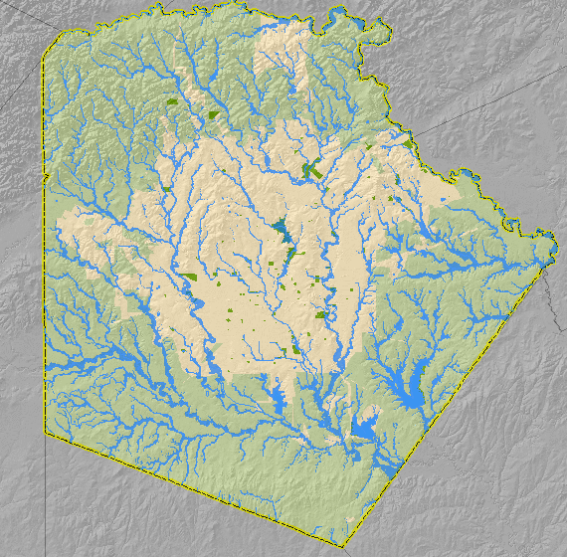
Map Showing Inundation in Bexar County, Texas

Slide 25
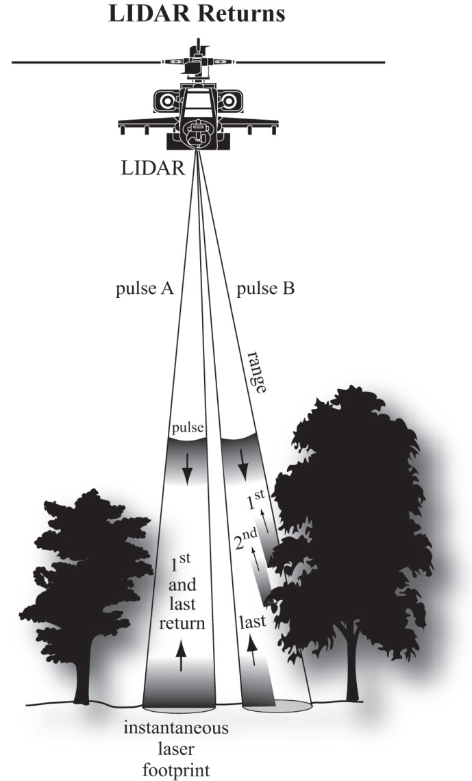
Base Elevation Data in Detail—
Light Detection and Ranging (lidar)
Lidar uses single laser pulses to see through or between the trees to create thousands of 3-D point measurements per second
Advantage: The most accurate method for mapping the bare-earth terrain in vegetated areas
Disadvantage: Poor for generation of breaklines for edges such as shorelines, tops & bottoms of stream banks,

Slide 26
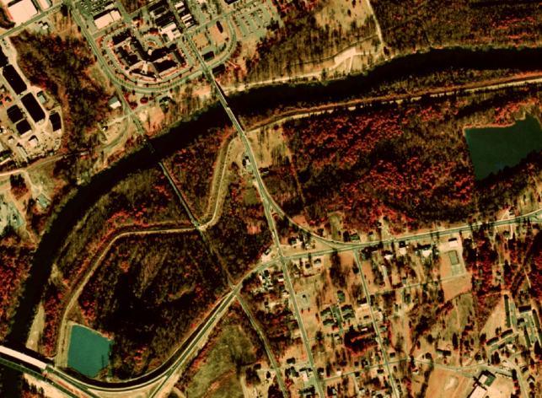
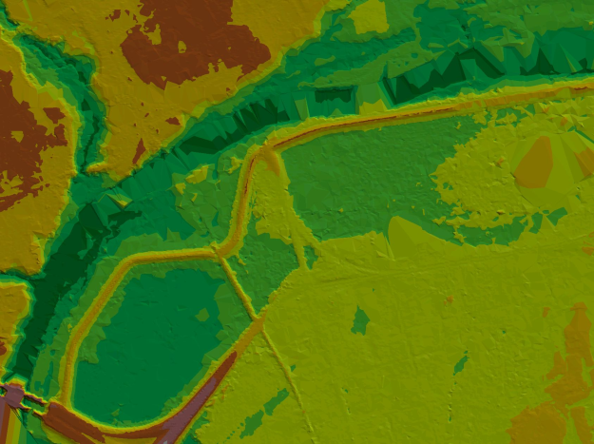
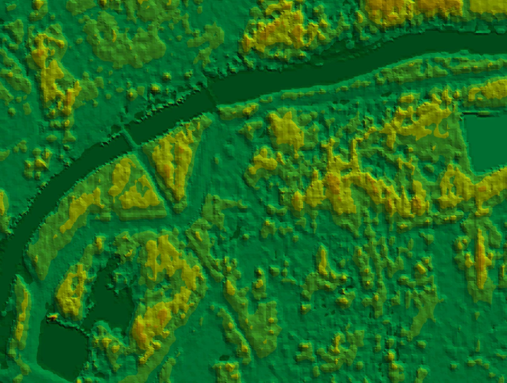
Base Elevation Data in Detail—
Strengths and Weaknesses Compared
Digital elevation model from National Elevation Dataset
Photogrammetry/digital orthophoto
Digital elevation model from lidar
Digital elevation model from IFSAR

Slide 27
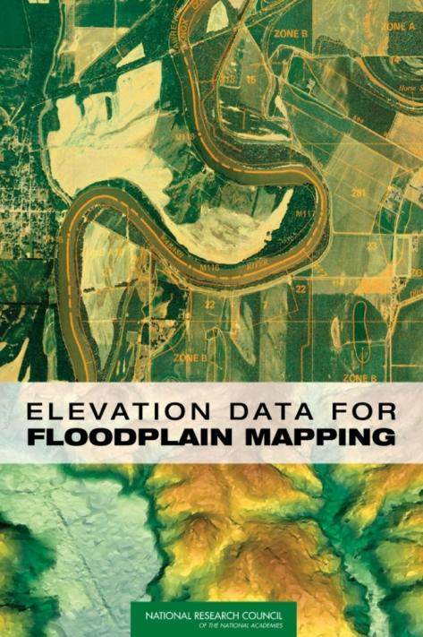
Why is Elevation for the Nation Needed?
Existing elevation data are old, and there is a large gap between their accuracy and the accuracy required for floodplain mapping
2. The required elevation mapping technology exists and has been commercially deployed such that implementing Elevation for the Nation is technically feasible with lidar.
Can Download the report the report in pdf format at National Academy Press
http://www.nap.edu/catalog.php?record_id=11829

