Slide 1
Runoff Processes
Reading: Applied Hydrology Sections 5.6 to 5.8 and Chapter 6 for Tuesday of next week

Slide 2
Runoff
Streamflow Generation
Excess Rainfall and Direct Runoff
SCS Method for runoff amount
Examples from Brushy Creek
Reading for today: Applied Hydrology sections 5.1 to 5.6
Reading for Tuesday Feb 19: Applied Hydrology Sections 5.7 and 5.8, Chapter 6
Review session for Quiz this Thursday Feb 14.

Slide 3
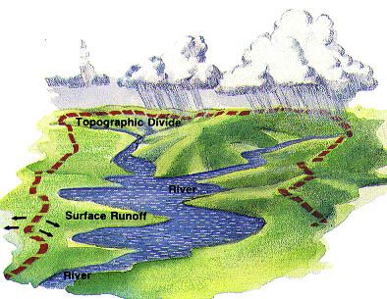
Surface water
Watershed – area of land draining into a stream at a given location
Streamflow – gravity movement of water in channels
  Surface and subsurface flow
  Affected by climate, land cover, soil type, etc.

Slide 4
Streamflow generation
Streamflow is generated by three mechanisms
  Hortonian overland flow
  Subsurface flow
  Saturation overland flow

Slide 5
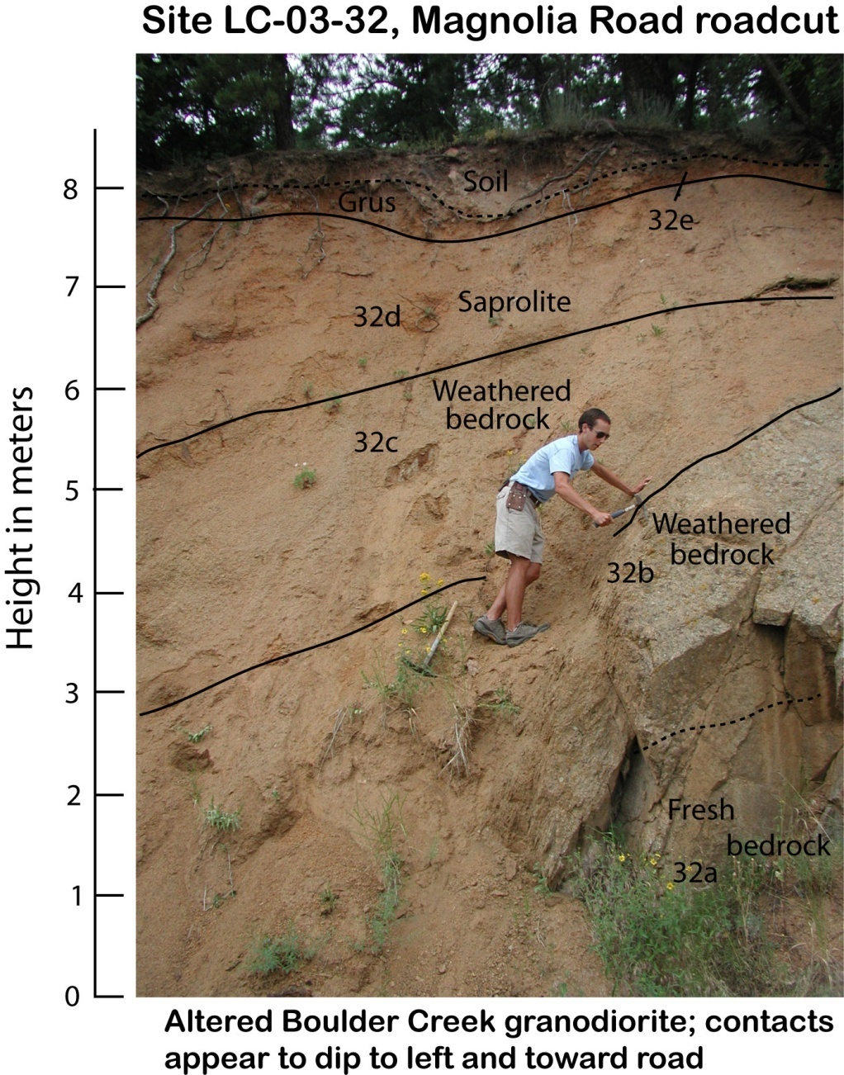
Welcome to the Critical Zone

Slide 6
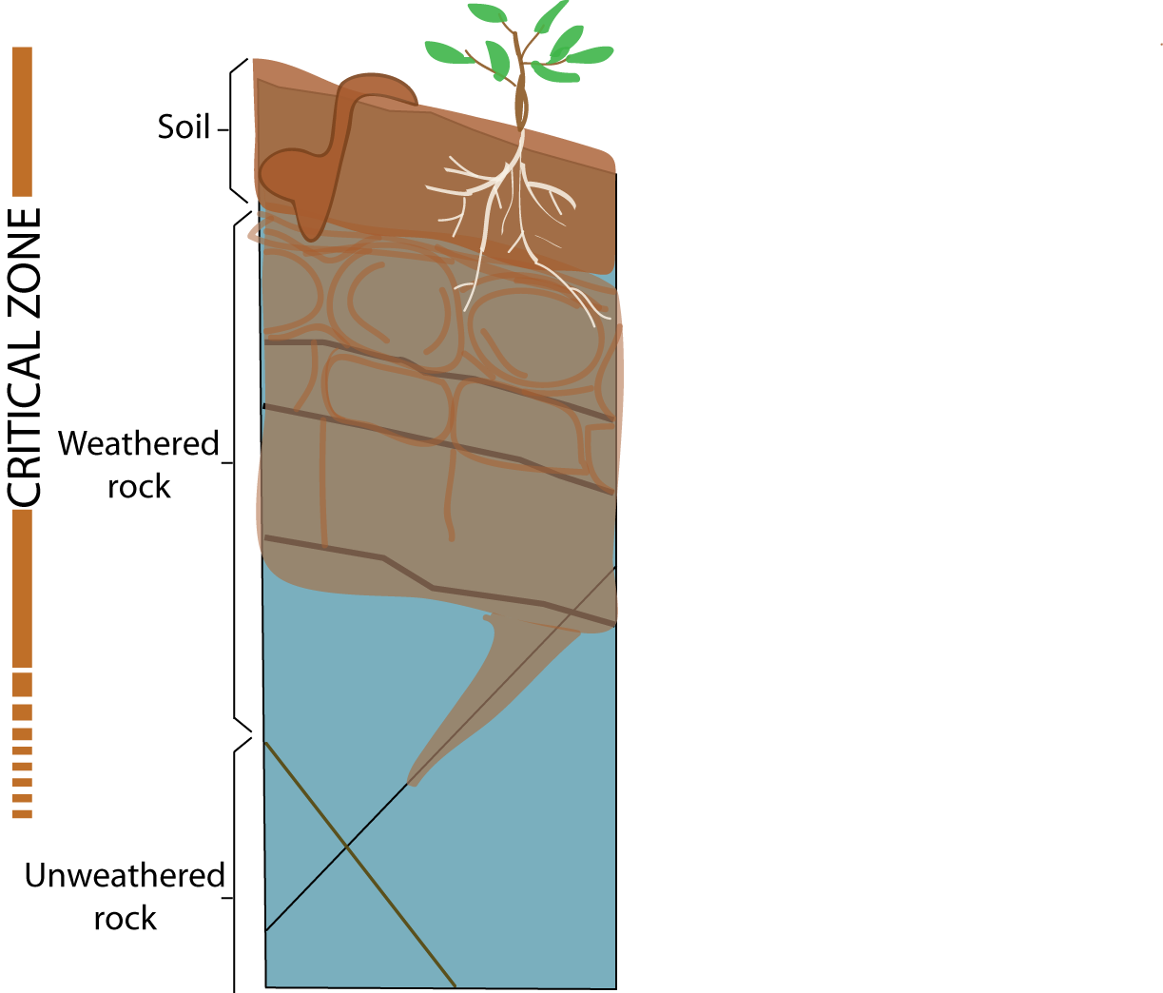
Denudation
Erosion and weathering control the extent of critical zone development
Weathering front advance

Slide 7
Critical zone architecture influences sediment sources, hydrology, water chemistry and ecology
Sediment
Water, solutes and nutrients

Slide 8
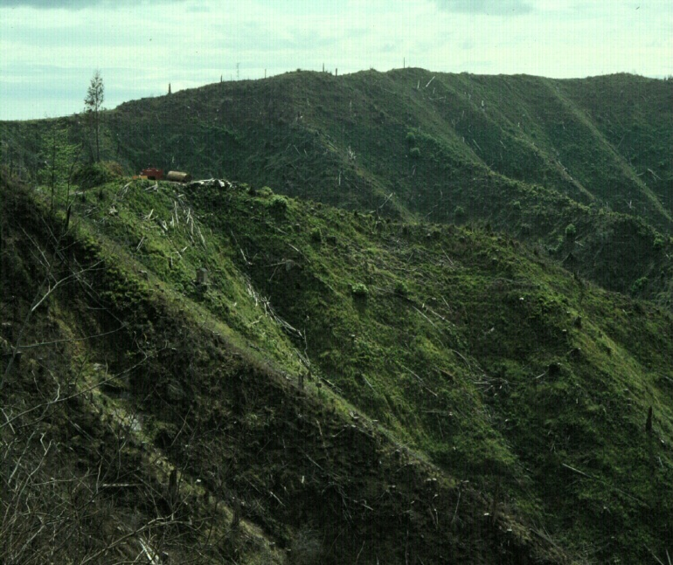
Oregon Coast Range- Coos Bay
Channel head
Anderson et al., 1997, WRR.
Montgomery et al., 1997, WRR
Torres et al., 1998, WRR

Slide 9
Hortonian Flow
Sheet flow described by Horton in 1930s
When i<f, all i is absorbed
When i > f, (i-f) results in rainfall excess
Applicable in
  impervious surfaces (urban areas)
  Steep slopes with thin soil
  hydrophobic or compacted soil with low infiltration
Rainfall, i
i > q
Infiltration, f
Later studies showed that Hortonian flow rarely occurs on vegetated surfaces in humid regions.

Slide 10
Subsurface flow
Lateral movement of water occurring through the soil above the water table
primary mechanism for stream flow generation when f>i
  Matrix/translatory flow
    Lateral flow of old water displaced by precipitation inputs
    Near surface lateral conductivity is greater than overall vertical conductivity
    Porosity and permeability higher near the ground
  Macropore flow
    Movement of water through large conduits in the soil

Slide 11
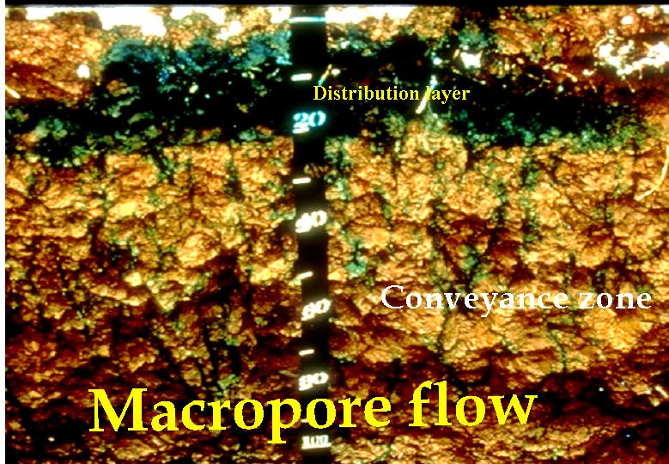
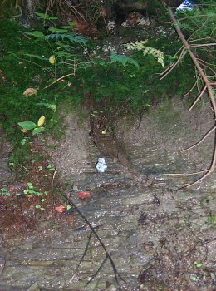
Soil macropores

Slide 12
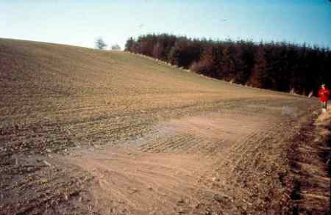
Saturation overland flow
Soil is saturated from below by subsurface flow
Any precipitation occurring over a saturated surface becomes overland flow
Occurs mainly at the bottom of hill slopes and near stream banks

Slide 13
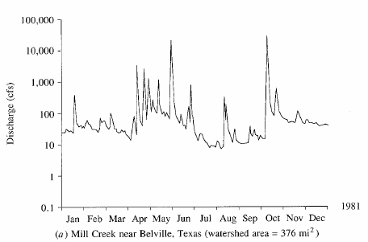
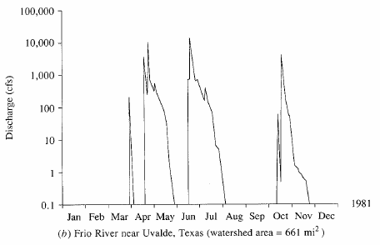
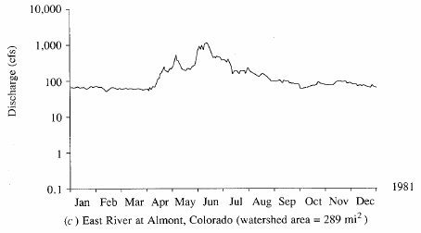
Streamflow hydrograph
Direct runoff
Graph of stream discharge as a function of time at a given location on the stream
Baseflow
Perennial river
Ephemeral river
Snow-fed River

Slide 14
Excess rainfall
Rainfall that is neither retained on the land surface nor infiltrated into the soil
Graph of excess rainfall versus time is called excess rainfall hyetograph
Direct runoff = observed streamflow - baseflow
Excess rainfall = observed rainfall - abstractions
Abstractions/losses – difference between total rainfall hyetograph and excess rainfall hyetograph

Slide 15
SCS method
Soil conservation service (SCS) method is an experimentally derived method to determine rainfall excess using information about soils, vegetative cover, hydrologic condition and antecedent moisture conditions
The method is based on the simple relationship that P_{e} = P - F_{a} – I_{a}
P_{e} is runoff depth, P is precipitation depth, F_{a} is continuing abstraction, and I_{a} is the sum of initial losses (depression storage, interception, ET)
Precipitation
Time

Slide 16
Abstractions – SCS Method
In general
After runoff begins
Potential runoff
SCS Assumption
Combining SCS assumption with P=P_{e}+I_{a}+F_{a}
Precipitation
Time

Slide 17
SCS Method (Cont.)
Experiments showed
So
Surface
  Impervious: CN = 100
  Natural: CN < 100

Slide 18
SCS Method (Cont.)
SCS Curve Numbers depend on soil conditions
Group | Minimum Infiltration Rate (in/hr) | Hydrologic Soil Group
A | 0.3 – 0.45 | High infiltration rates. Deep, well drained sands and gravels
B | 0.15 – 0.30 | Moderate infiltration rates. Moderately deep, moderately well drained soils with moderately coarse textures (silt, silt loam)
C | 0.05 – 0.15 | Slow infiltration rates. Soils with layers, or soils with moderately fine textures (clay loams)
D | 0.00 – 0.05 | Very slow infiltration rates. Clayey soils, high water table, or shallow impervious layer

Slide 19
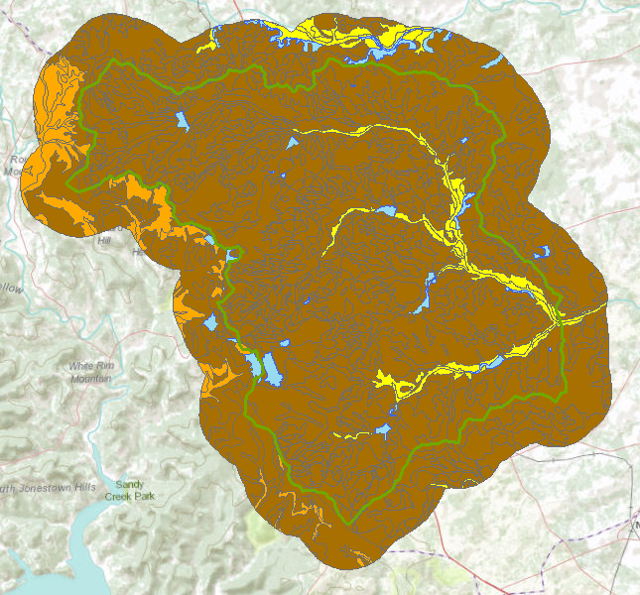

Hydrologic Soil Group in Brushy Creek
Water

Slide 20
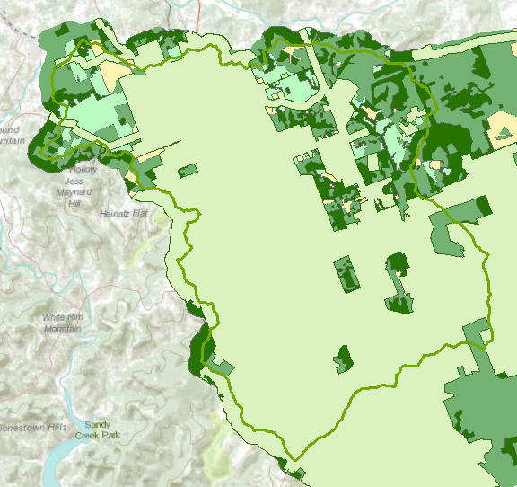

Land Cover
Interpreted from remote sensing

Slide 21
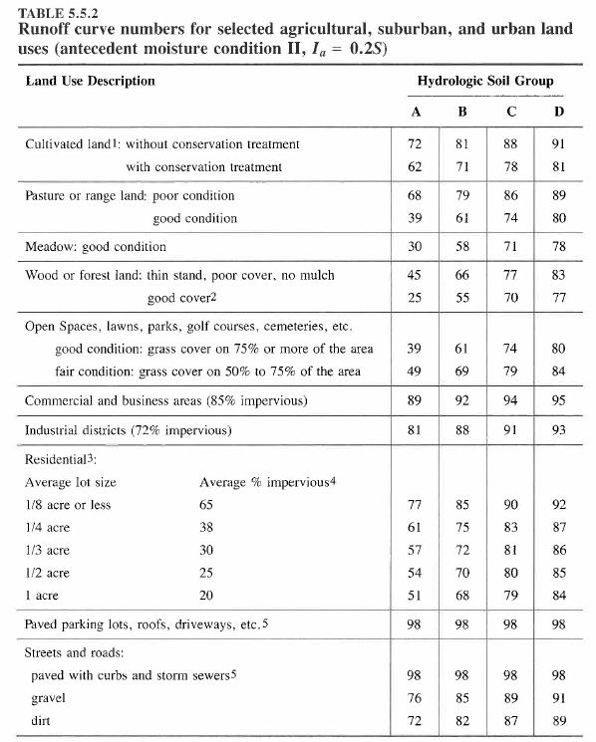
CN Table

Slide 22
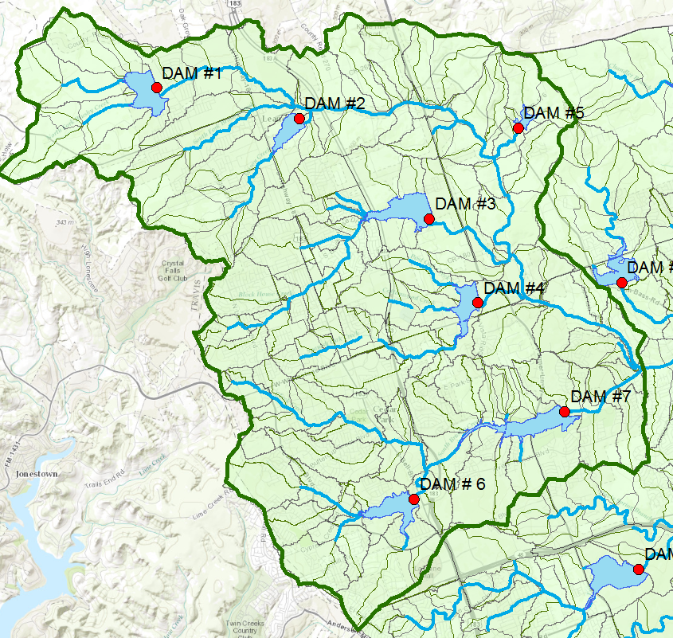
Upper Brushy Creek Watershed

Slide 23
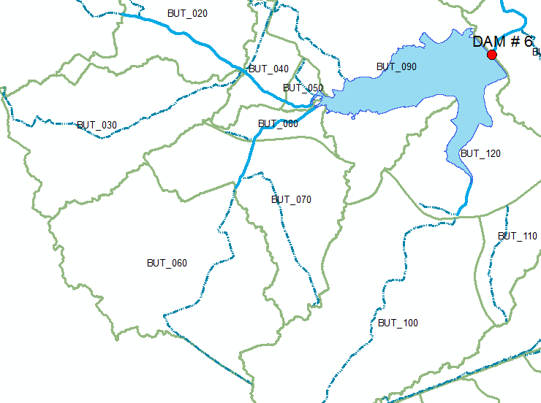
Watersheds upstream of Dam 6

Slide 24
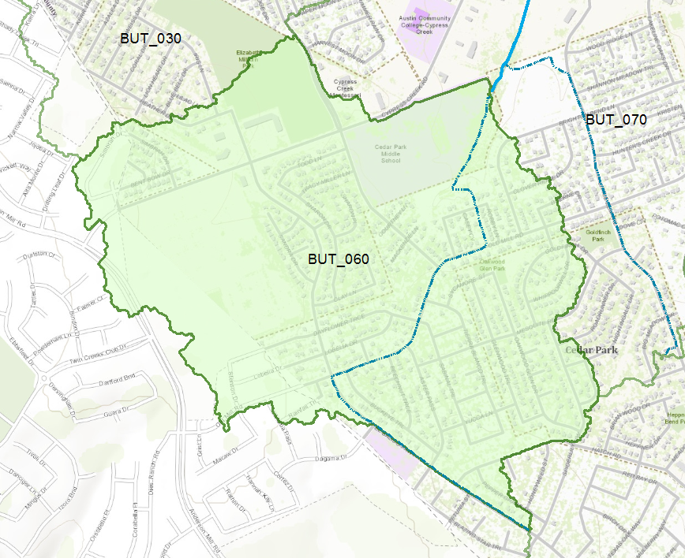
Subbasin BUT_060

Slide 25
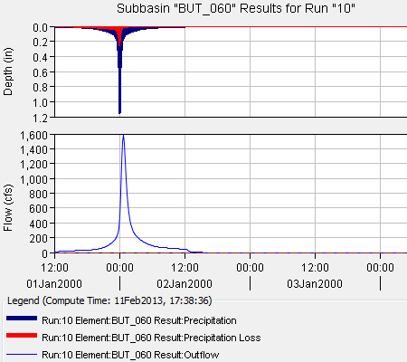
HEC-HMS simulation of Subbasin
Two questions:
How much of the precipitation becomes “losses” and how much becomes runoff
What is the time lag between the time that the rainfall occurs over the subbasin and the time the runoff appears at the outlet?

Slide 26
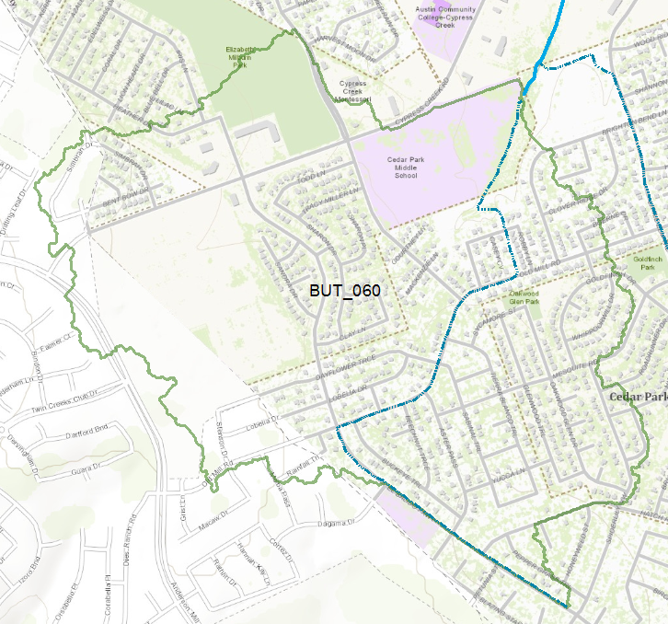
Land Use in BUT_060
Park
School

Slide 27
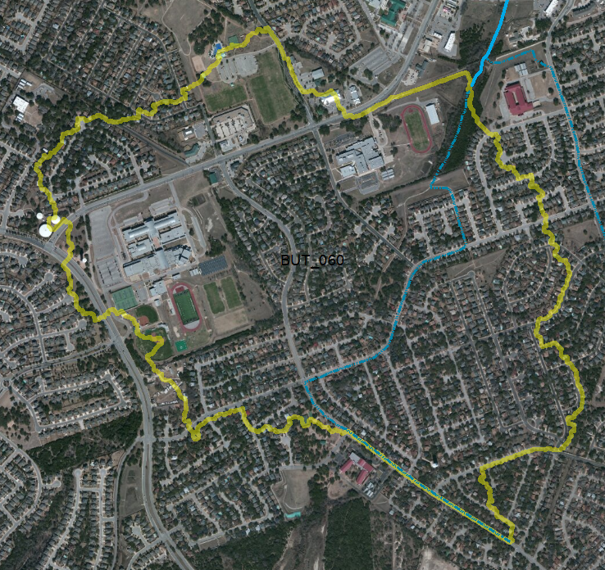
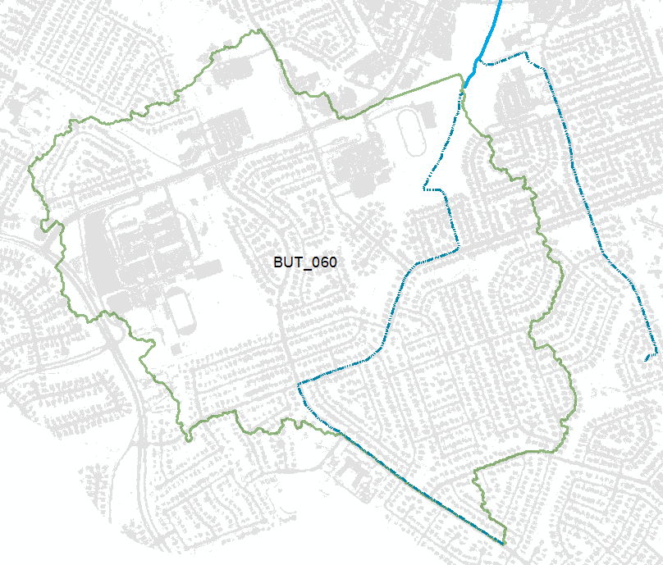
Imagery and Impervious Cover
42% of land cover is impervious

Slide 28
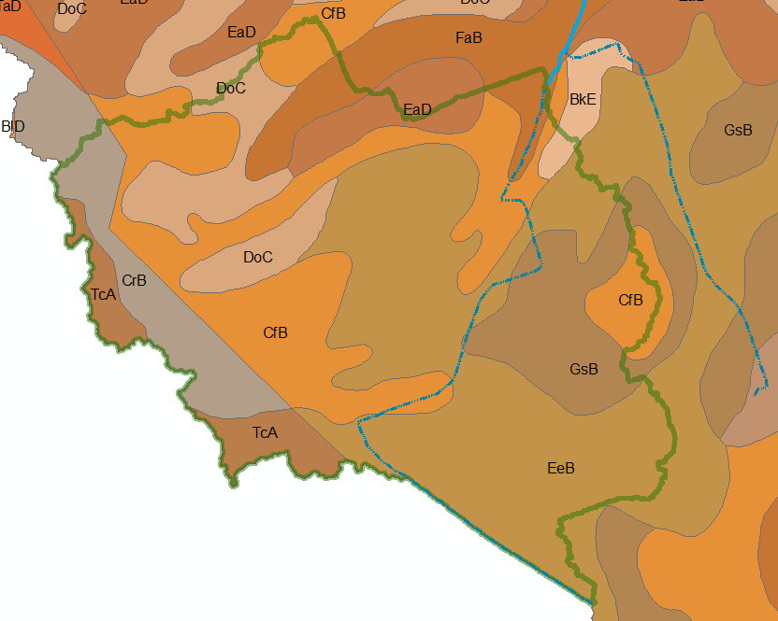
Soil Map Units
All soils in this Subbasin are classified as SCS Class D (very limited drainage)

Slide 29
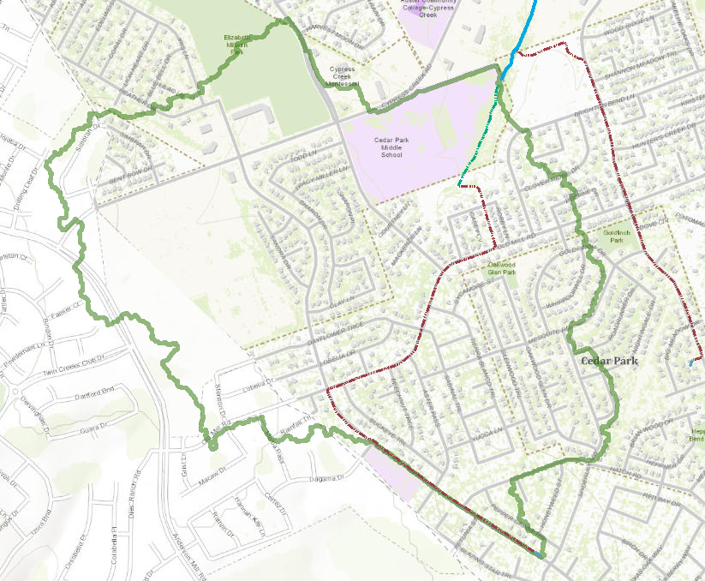

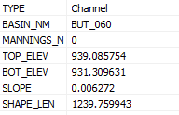
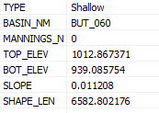
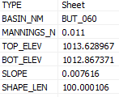
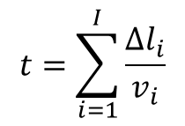
Flow along the longest path
Channel Flow
$$t=\sum_{i=1}^{I}{\frac{∆l_{i}}{v_{i}}}$$
Shallow Flow
Sheet Flow
Sum travel times over each segment

Slide 30
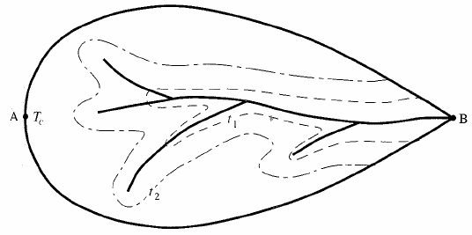
Time of Concentration
Different areas of a watershed contribute to runoff at different times after precipitation begins
Time of concentration
  Time at which all parts of the watershed begin contributing to the runoff from the basin
  Time of flow from the farthest point in the watershed
Isochrones: boundaries of contributing areas with equal time of flow to the watershed outlet

Slide 31
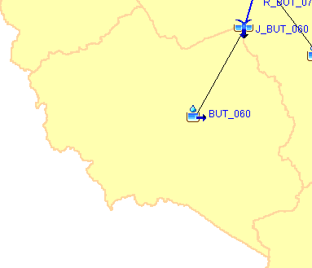
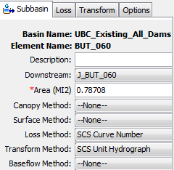
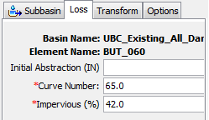
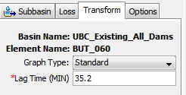
Modeling Runoff from BUT_060
How to characterize this subbasin?
How quickly does it move?
How much runoff?

