Slide 1
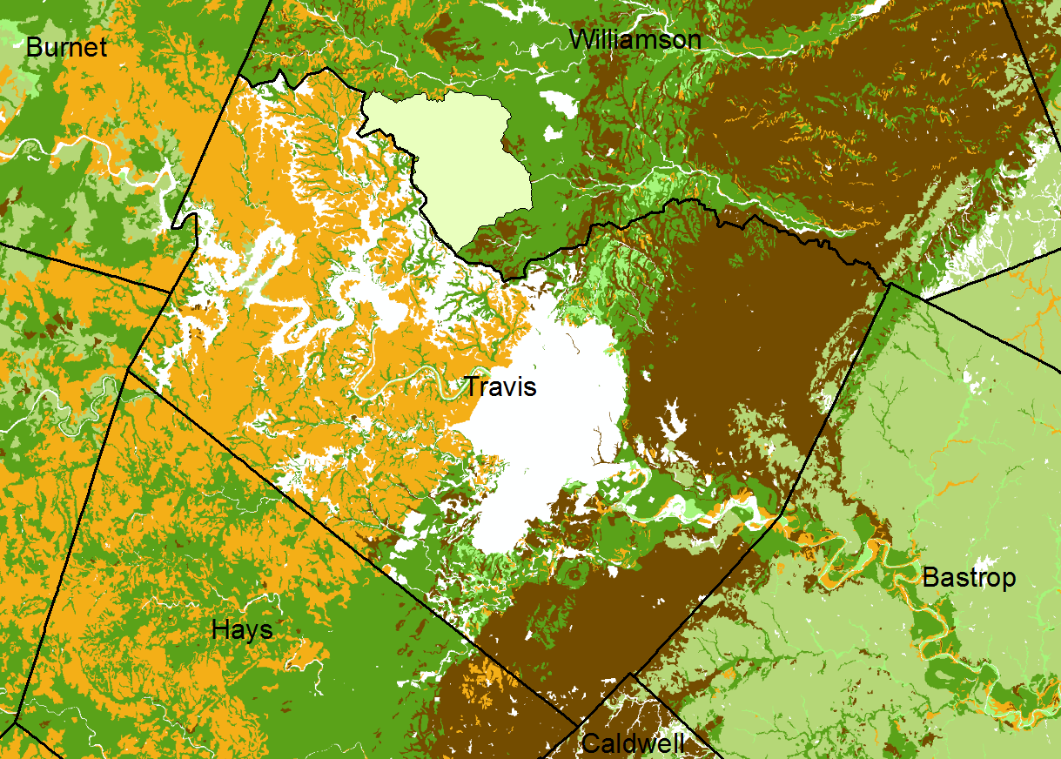
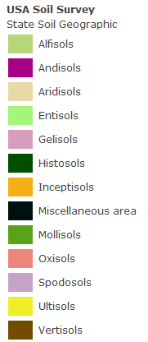
County Soil Surveys
White areas are water or impervious cover from land development
http://www.ksre.k-state.edu/kswater/images/soil_texture.htm

Slide 2
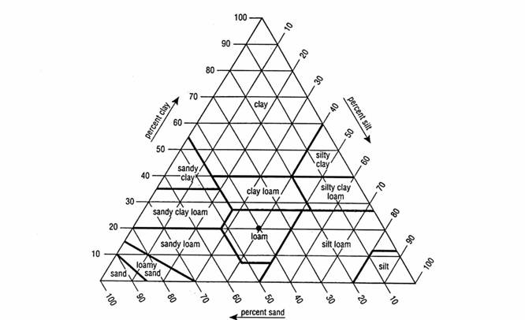
Soil Texture Triangle
A soil with 56% sand, 20% silt and 24% clay is a sandy clay loam
20% silt
Silt
Clay
Sand
24% clay
56% sand
http://www.ksre.k-state.edu/kswater/images/soil_texture.htm

