Slide 1
Drought and Texas Water Resources
David R. Maidment Center for Research in Water Resources University of Texas at Austin
A presentation made to the
Committee on International Trade & Intergovernmental Affairs Texas House of Representatives Austin, Texas
22 April 2013

Slide 2
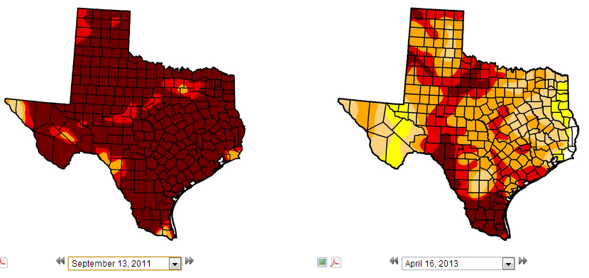
Drought in Texas – US Drought Monitor
In 2011, Texas and Oklahoma had the hottest summer
ever recorded in the history of the United States
Texas 99% in drought
87% in D4
Texas 98% in drought
12% in D4
September 2011
April 2013
http://droughtmonitor.unl.edu/

Slide 3
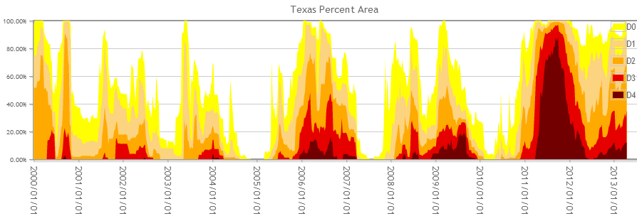
Trends in Drought Severity in Texas
2000
2002
2004
2006
2009
2011

Slide 4
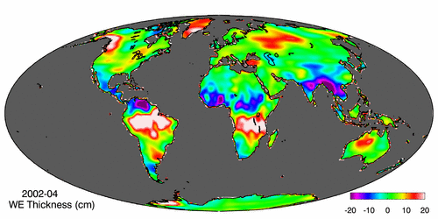
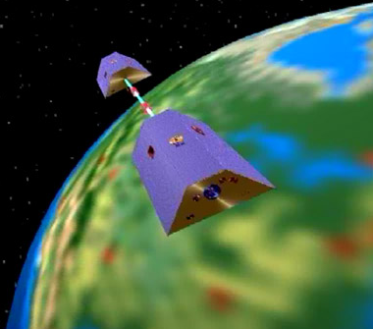
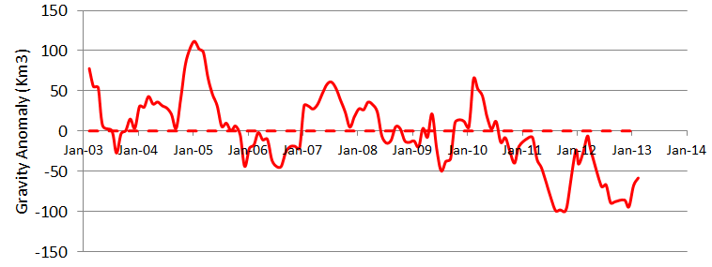
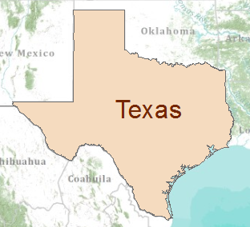
Gravity Recovery and Climate Experiment (GRACE) Force of gravity responds to changes in water volume Water is really heavy!
Gravity Anomaly of Texas, 2003 – 2013
Normal
At peak drought, Texas had a 100 Km³ water deficit
(equivalent to 70 Lake Travis’s)

Slide 5
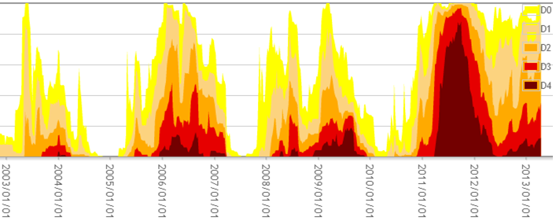
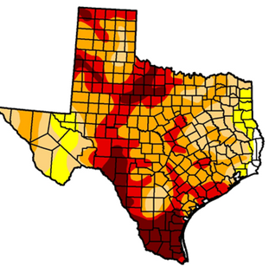
Drought and GRACE
US Drought Monitor is closely correlated with the GRACE data
US Drought
Monitor
Percent of Area in Drought
GRACE
September
2011
At peak drought, Texas had a 100 Km³ water deficit
(equivalent to 70 Lake Travis’s)

Slide 6
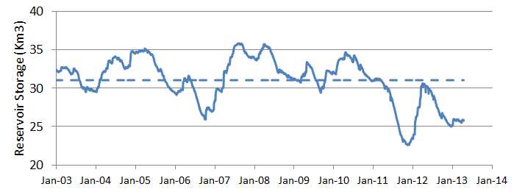
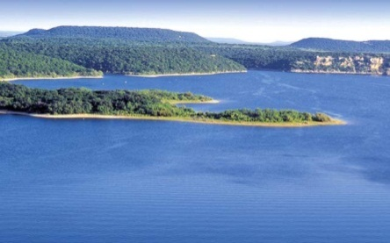
GRACE and Texas Reservoir Water Storage
Surface water reservoir storage is closely correlated with the GRACE data
Grace Satellites
Normal
At peak drought, Texas had a 100 Km³ total water deficit
(equivalent to 70 Lake Travis’s)
Surface Water Reservoirs
90% of the water deficit is in soil water and groundwater
Normal
and an 8.4 Km³ deficit in reservoir water storage

