Slide 1
Towards a Global Water Information System
David R. Maidment
Center for Research in Water Resources
University of Texas at Austin
14th Congress of the WMO Commission for Hydrology
Geneva, Switzerland | 9 November 2012
Acknowledgements: Fernando Salas, David Arctur University of Texas at Austin

Slide 2
WMO Guide to Hydrological Practices
Guide to Hydrological Practices
Volume I
Hydrology – From Measurement to Hydrological Information
Science and Measurement
Chapter 10
Data Storage, Access, and Dissemination
Guide to Hydrological Practices
Volume II
Management of Water Resources and Application of Hydrological Practices
Application and
Management
Guide to Hydrological Practices . . .
. . . WMO recommendations for National Hydrological Surveys

Slide 3
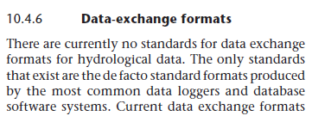
Volume 1, Chapter 10
Guide to Hydrological Practices
Volume I
Hydrology – From Measurement to Hydrological Information
Science and Measurement
Published in 2008
Last section of the last chapter of Volume I . . .
. . . this lecture provides an update since 2008

Slide 4
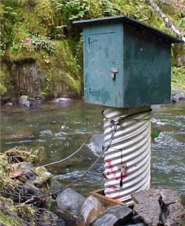
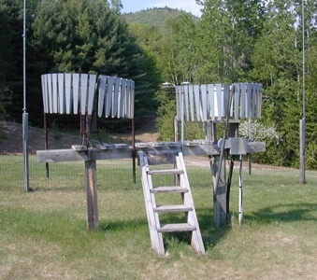
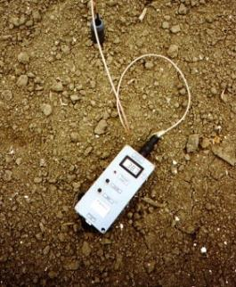
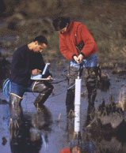
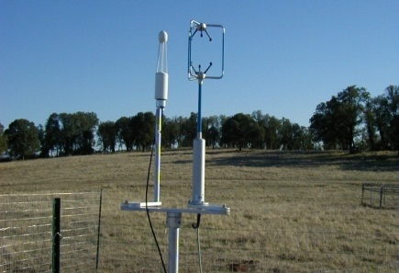
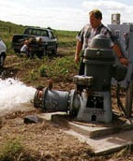
Hydrological Measurement
Water Quantity
Rainfall
Soil Water
Water Quality
Meteorology
Groundwater
Time series data at point locations

Slide 5
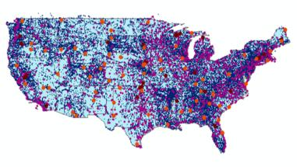
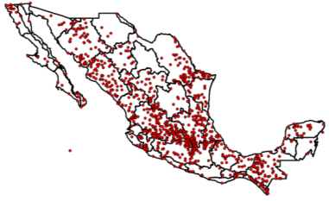
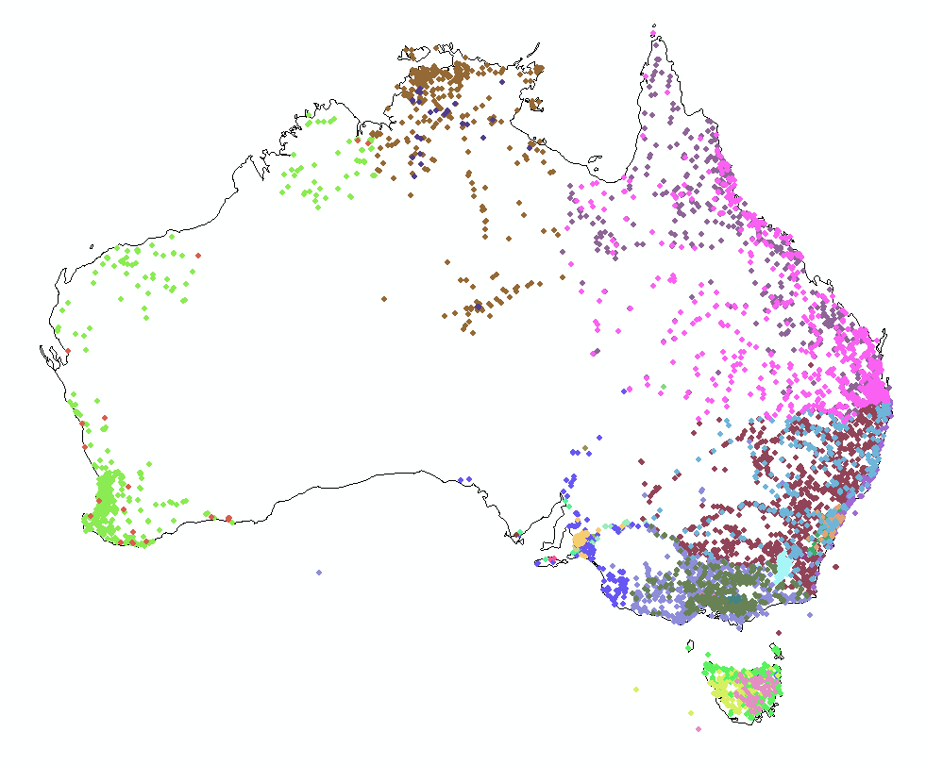
Every Country Collects These Data
WMO does
Global Water
Data Integration
United States
Mexico
Australia
Many kinds of hydrological measurements . . .
. . . this lecture focuses on streamflow

Slide 6
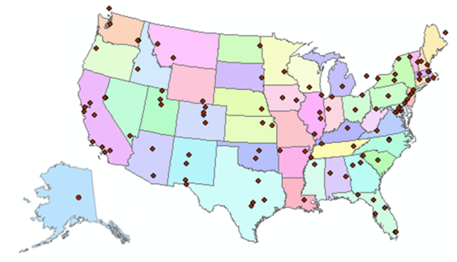
Consortium of Universities for the Advancement of Hydrologic Science, Inc.
www.cuahsi.org
CUAHSI
A consortium representing 125 US universities
Dr. Richard Hooper, President and CEO Presentation to Chy-14 on Wednesday
Supported by the National Science Foundation Earth Science Division
Advances hydrologic science in nation’s universities
Includes a Hydrologic Information System project
Invented WaterML language for water resources time series
Building an academic prototype system

Slide 7
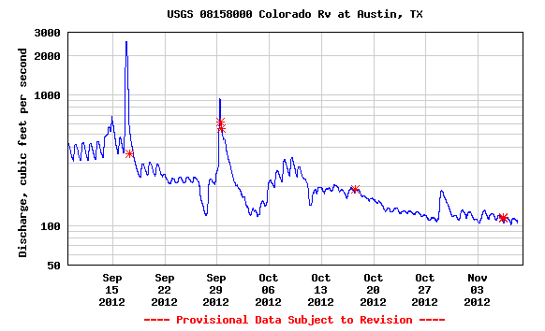
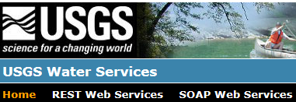
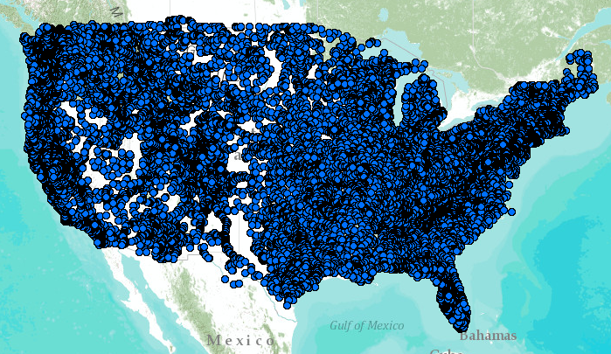
WaterML – the US Geological Survey
Water time series data on the internet
Measurement Standards
Map Standards
24/7/365 service
For daily and real-time data
. . . Operational water web services system for the United States
http://waterservices.usgs.gov/nwis/iv?sites=08158000&period=P1D&parameterCd=00060

Slide 8
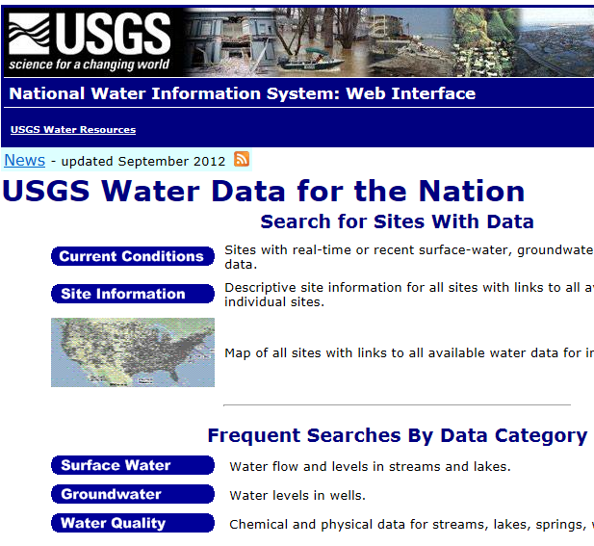
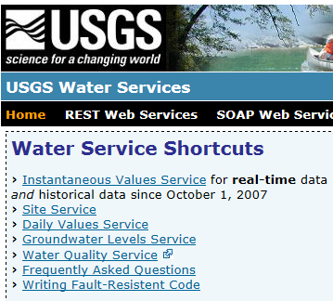
Web Pages and Web Services
Web pages deliver text and images
Web services deliver data encoded in XML
http://water.usgs.gov/
http://waterservices.usgs.gov/

Slide 9
Open Geospatial Consortium
More than 400 companies and agencies globally
. . . Internet data standards for maps and observational data

Slide 10
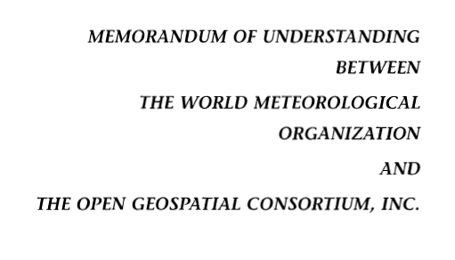
OGC/WMO Hydrology Domain Working Group
4-Year International Effort – WaterML
A time series for one variable at one location
Hydrology Domain Working Group formed
OGC observer at CHy-13
Technical Meetings Each 3 Months Four Interoperability Experiments
(Surface water, groundwater, forecasting)
Annual week-long workshops
Involvement by many countries
November 2009
Acknowledgements: OGC, WMO, GRDC, CUAHSI, BoM/CSIRO, USGS, GSC, Kisters, …….
2008
2009
2010
2011
2012
Notes:
(1) A four-year international effort has been undertaken to reconcile WaterML with international standards;
(2) This effort was initiated with the establishment of an Hydrology Domain Working Group by the Open Geospatial Consortium in September 2008;
(3) An OGC representative attended the WMO Congress of the Commission for Hydrology in 2008
(4) A formal agreement between Secretary General of WMO and President of OGC in 2009 to jointly develop standards for hydrology, climatology, oceanography and climatology;
(5) The joint OGC/WMO Hydrology Domain Working Group was supported by a large work effort, annual week-long workshops, four interoperability experiments for surface and groundwater data exchange, and participation by many countries;
(6) In June 2012, the OGC voted to adopt the revised version, WaterML2 as an international standard for exchange of water resources time series (the first such public standard that has existed);
(7) This Congress to the WMO Commission for Hydrology to whom I am speaking is considering WaterML2 for adoption as an official standard by WMO

Slide 11
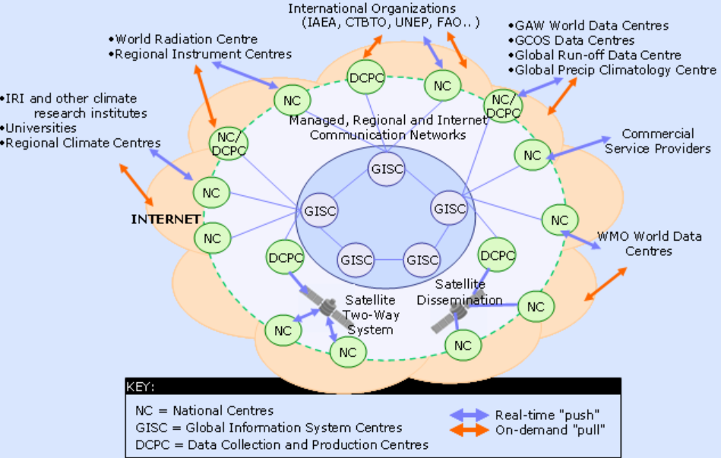
WIS – WMO Information System
Ingests data from National Centers . . .
. . . synthesized globally through communication networks

Slide 12
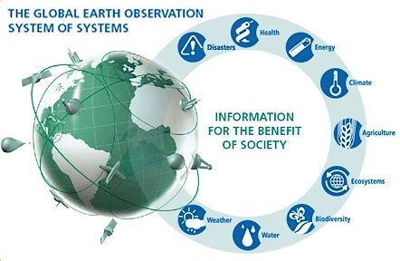
GEOSS – Global Earth Observation System of Systems
Group on Earth Observations (GEO) . . .
. . . located with WMO in Geneva

Slide 13
Geospatial and Temporal Water Data
GEOSS
WIS
Catalogs
Implementation
OGC
WMO
Standards
GIS
Water
Resources
Domains
Maps and time series . . .
. . . interoperability of connected systems

Slide 14
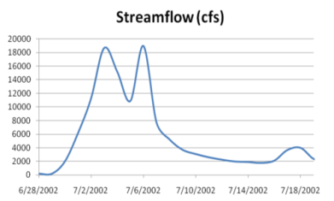
Web Services Stack for Time Series
Catalog Service for the Web with standard metadata: ISO, FGDC, ANZLIC, Dublin Core
Who?
What?
Catalog (CSW)
Time Series Services
Where? When?
Metadata (WFS)
Data (WaterML2)
CSW = OGC Catalog Service for the Web
WFS = OGC Web Feature Service for Maps
Access
Data
Existing OGC Data Services are Adequate . . .
. . . Need to Be Customized for Water Information

Slide 15
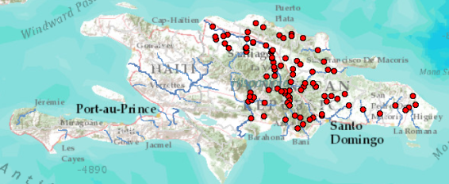
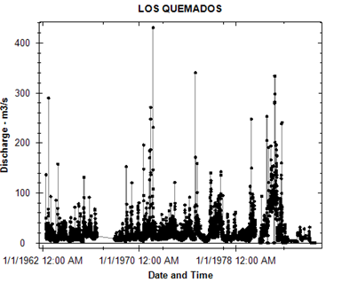
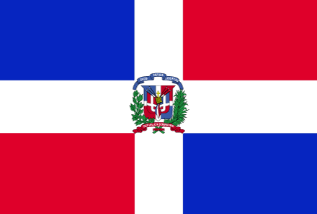
Dominican Republic, GEOSS, and WMO
Volunteered Information
Authoritative information
Catalog
Metadata
Data
WMO Information System. . .
. . . INDRHI – Dominican Republic

Slide 16
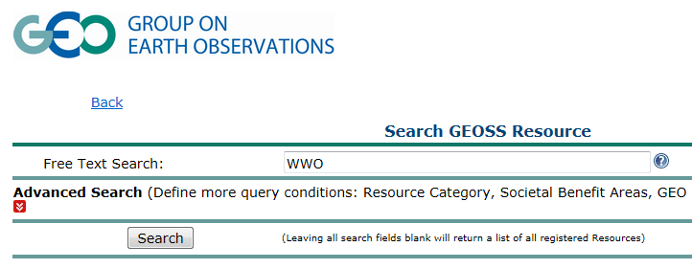
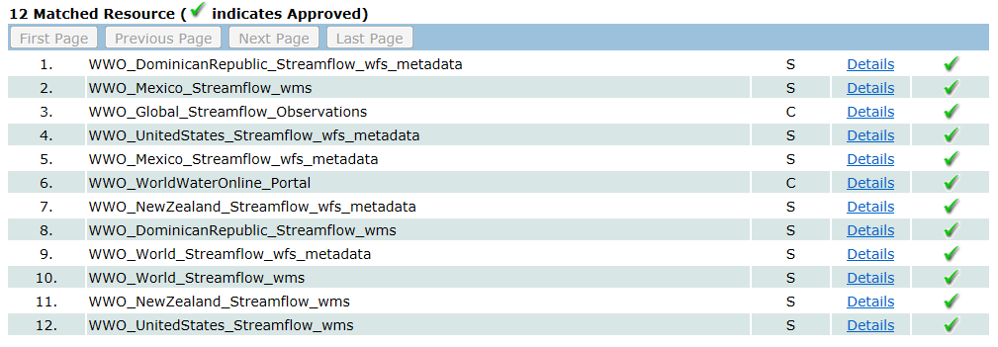
Searching GEOSS Portal
Search for water information
Find streamflow maps for countries
Streamflow map for the Dominican Republic
http://geossregistries.info/geosspub/resource_search_ns.jsp

Slide 17
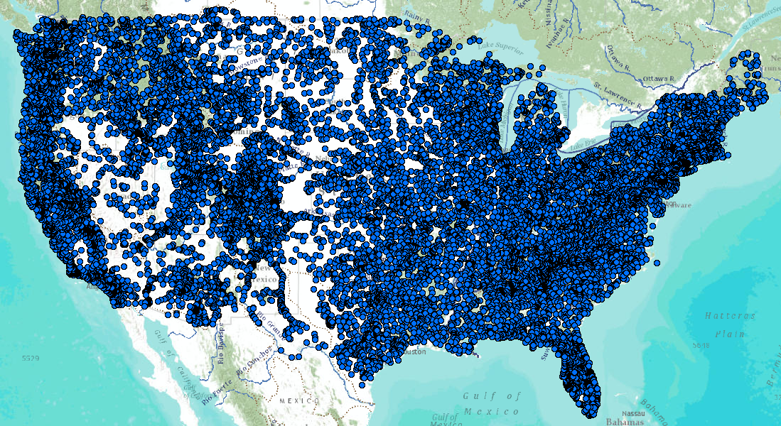
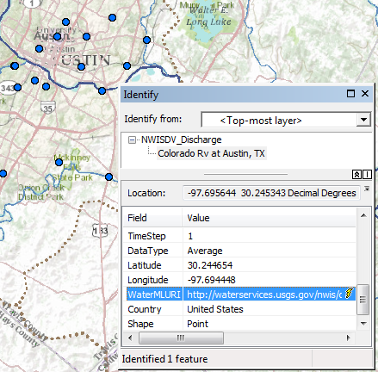
United States Services Stack
Catalog
Metadata
Data
Web Feature Service for Observation Metadata
Colorado River
at Austin, Texas
WaterML time series service for data
An attribute of each mapped observation point . . .
. . . is a web link to the WaterML data service

Slide 18
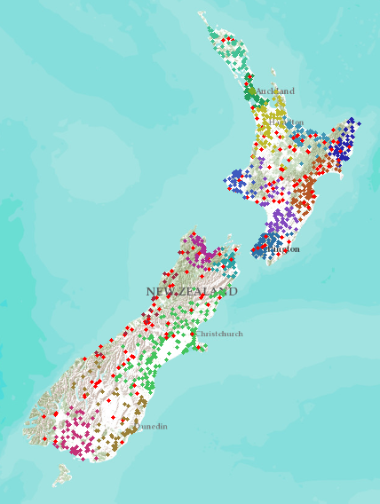
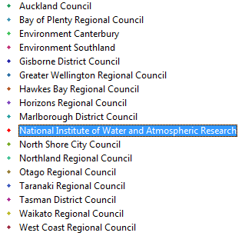
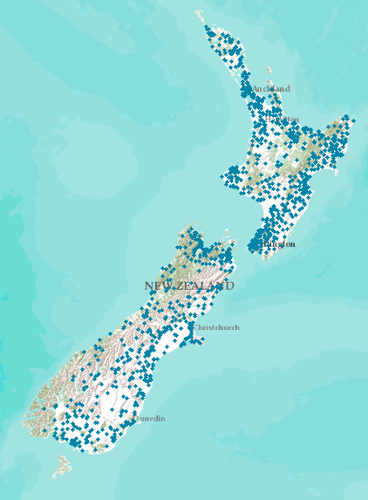
New Zealand
NIWA operates about 20% of 1300 hydrometric stations Regional authorities operate about 80% of stations
New Zealand
Water Information System
Develop a federated hydrological information infrastructure . . .
. . . linking nationally and regionally collected data

Slide 19
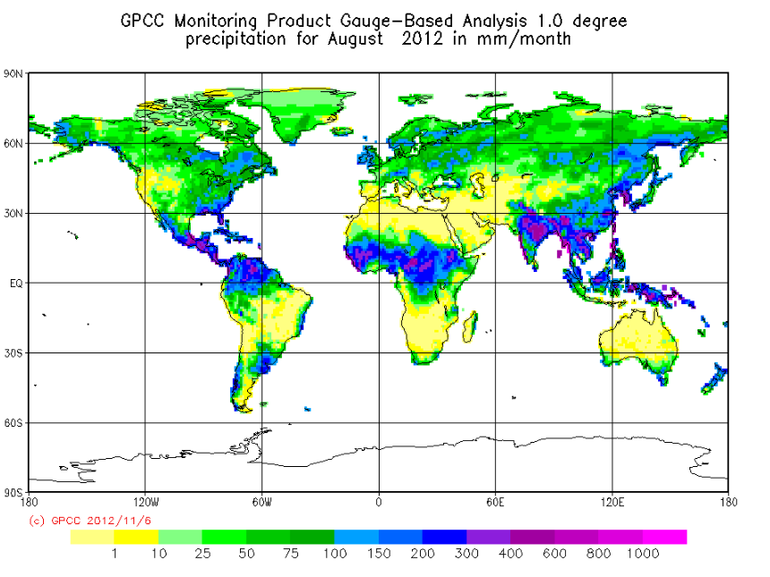
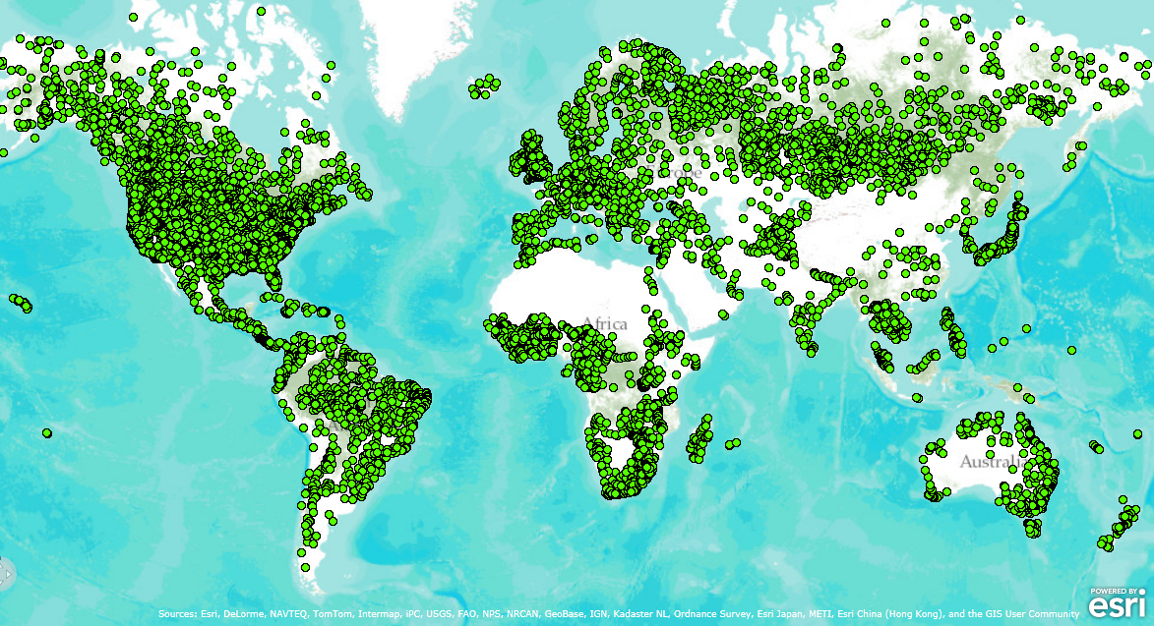
Global Data Centers – Precipitation and Runoff
Collect data from National Hydrological Surveys….
…. using water web services in the future

Slide 20
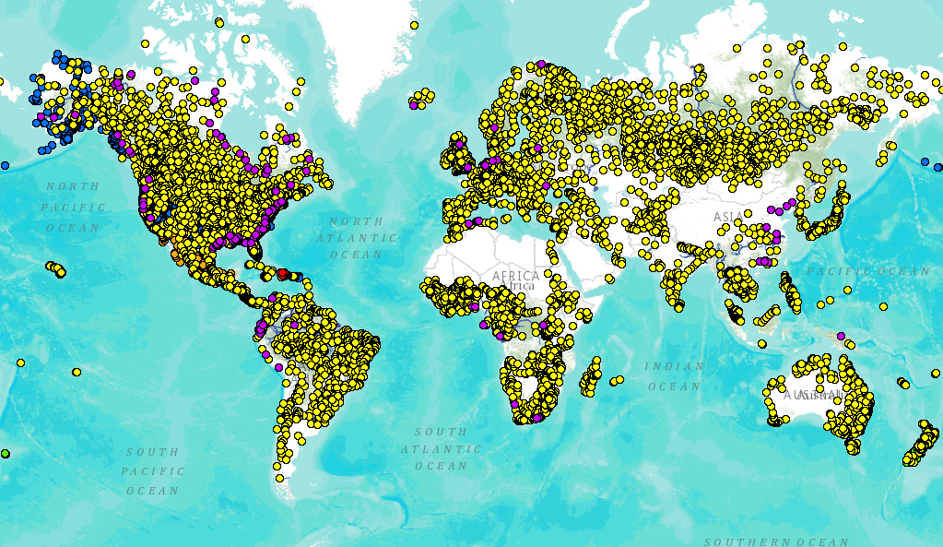
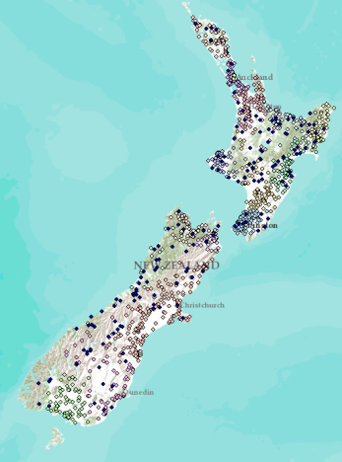
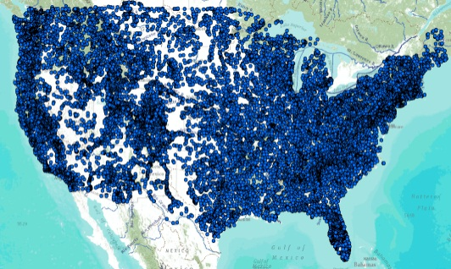
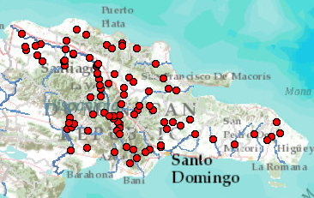
Global Streamflow Services
Building a national system federating regions . . .
. . . builds a global system federating countries
Global Runoff Data Centre
New Zealand
USA
Dominican Republic
http://www.arcgis.com/home/webmap/viewer.html?webmap=87ab07e2aba840828033e80b15fd6727

Slide 21
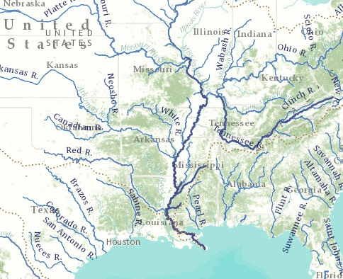
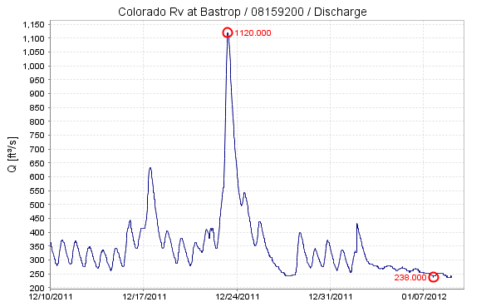
In the Future: World Water Online
Bring together water information for the whole earth
All spatial scales: global, national, regional, local
Both geospatial and temporal information
Linking data and modeling
Everything on the web
. . . a transformation of our world!
An initiative of the University of Texas at Austin . . .
. . . in collaboration with commercial and open source partners

Slide 22
Scales of Application
My house, My well, My ranch
River Basin, Aquifer
Landscape
World
Global
Assessment
Water and Climate
National
Accounting
How much water?
Regional
Management
Solving water problems
Local
Personal
How does this affect me?
A scale-independent information model for maps and observations . . .
. . . more detail as focus narrows

Slide 23
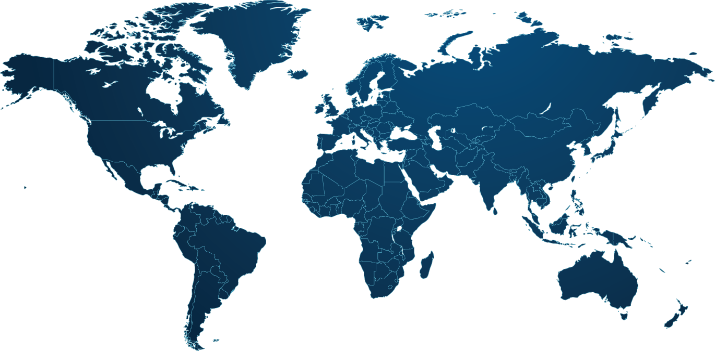
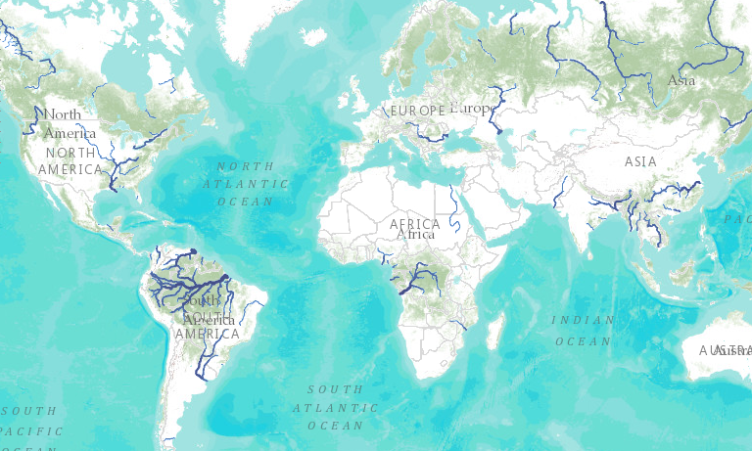
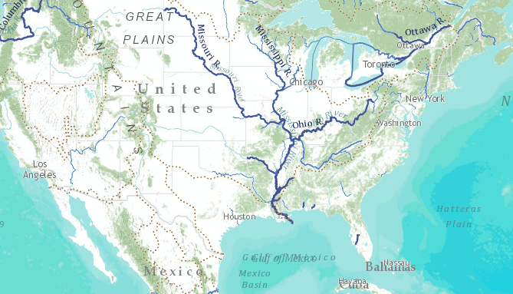
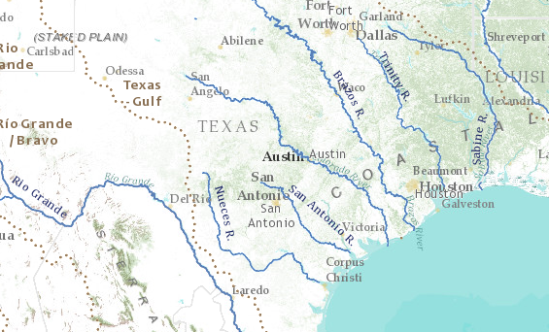
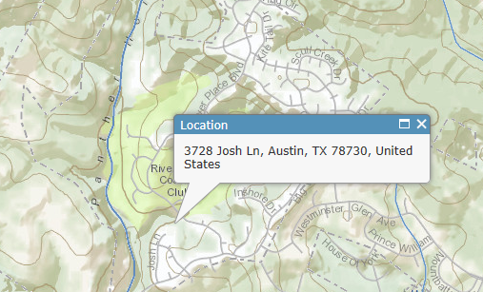
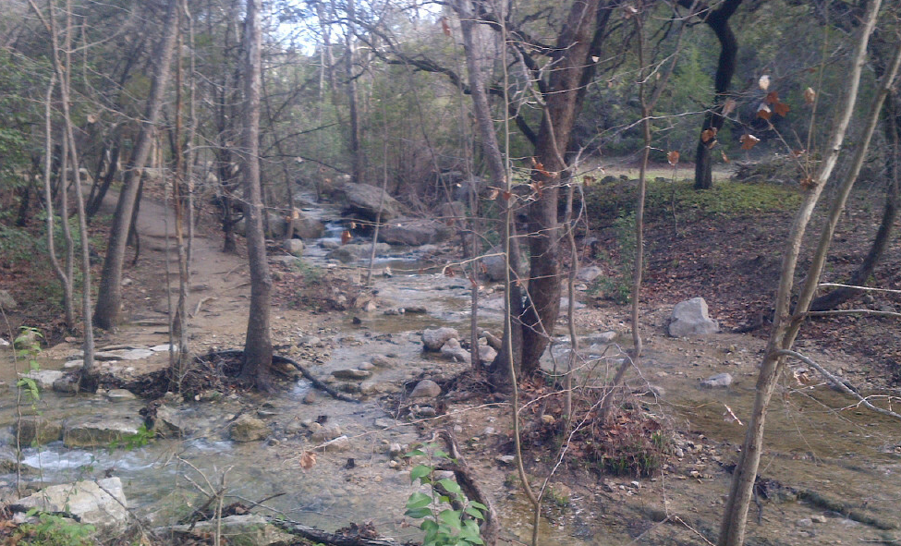
World Hydro Overlay Map
World
United States
Texas
My Home
My Stream

Slide 24
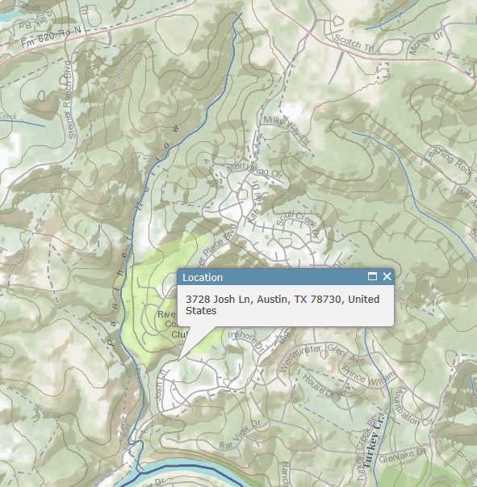
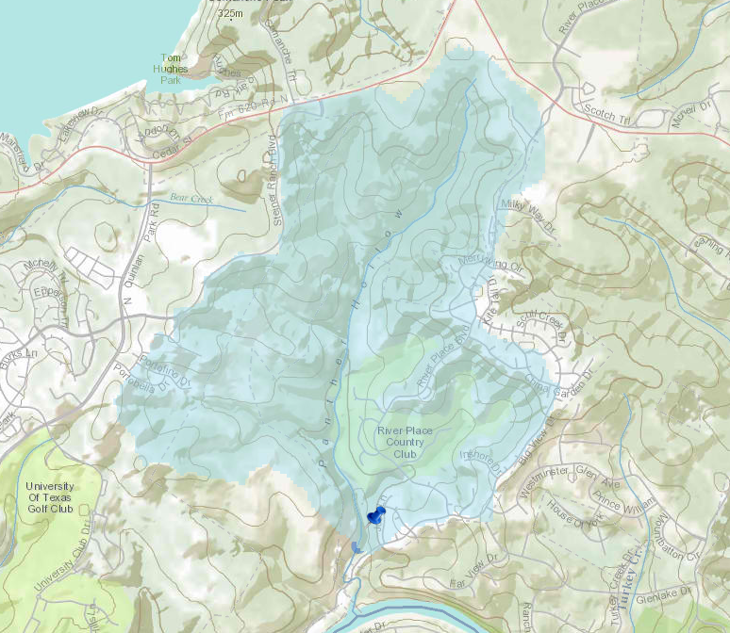
Watershed of My Stream Esri Base Map and Delineation Services
My Stream
My Watershed
Panther Hollow
My home
Delineate the watershed of any stream or river anywhere on earth

Slide 25
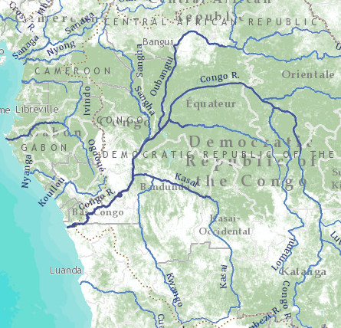
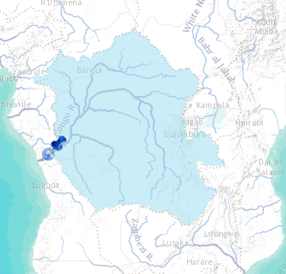
Congo River Basin Global river mapping and watershed delineation
World Hydro Overlay Map
River Basin Delineation
Delineate a watershed from any point on a river

Slide 26
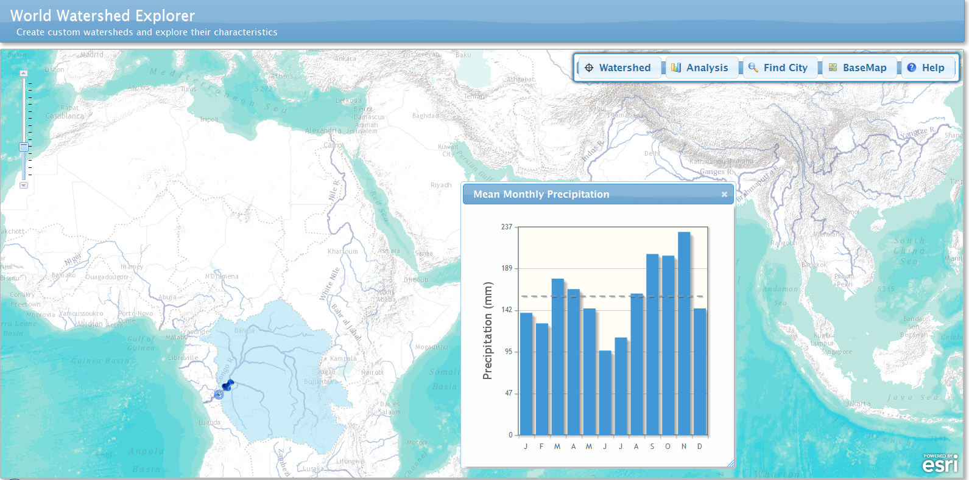
World Watershed Explorer – Congo Basin
Watershed characteristics . . .
. . . precipitation, soils, land cover, population

Slide 27
Flow in the Mississippi River Basin RAPID model, March-May 2008, 3 hour time steps
GIS data describes 1.2 million river reaches . . .
. . . simulate flow in each reach in each time step

Slide 28
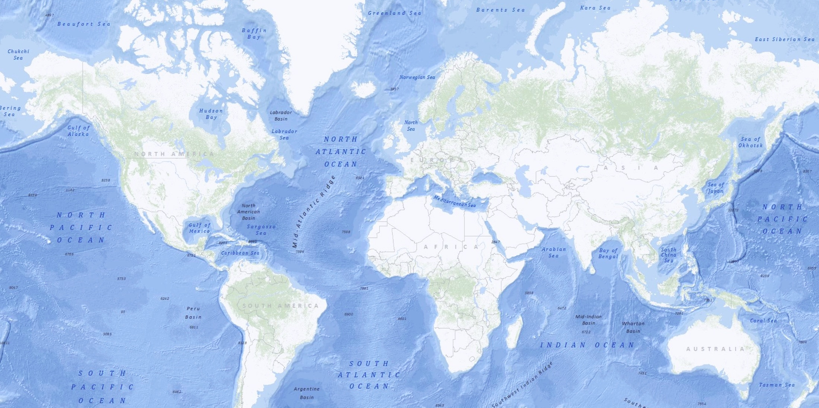
World Water Online Hydrology on the web
Watersheds
Global to Local
Maps
Models
Observations
Open Information systems include both commercial and
open source software linked by open standards

Slide 29
World Water Online Linking people everywhere with water data, maps, and models

