Slide 1
Atmospheric Water and Precipitation
Global energy balance
Atmospheric circulation
Atmospheric water vapor
Precipitation
Reading: Sections 3.1 to 3.4

Slide 2
Radiation
Basic laws
  Stefan-Boltzman Law
    R = emitted radiation (W/m²)
    T = absolute temperature (K),
    and σ = 5.67x10⁻⁸W/m²-K⁴
    with ε = emissivity (0-1)
      Water, Ice, Snow (0.95-0.99)
      Sand (0.76)
Valid for a Black body or “pure radiator”
“Gray bodies emit a proportion of the radiation of a black body

Slide 3
Net Radiation, R_{n}
R_{i} Incoming Radiation
R_{o} =αR_{i} Reflected radiation
= albedo (0 – 1)
R_{e}
R_{n} Net Radiation
Average value of R_{n} over the earth and
over the year is 105 W/m²

Slide 4
Net Radiation, R_{n}
H – Sensible Heat
LE – Evaporation
G – Ground Heat Flux
R_{n} Net Radiation
Average value of R_{n} over the earth and
over the year is 105 W/m²

Slide 5
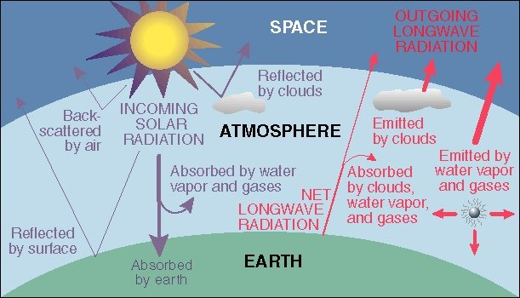
Energy Balance of Earth
20
70
100
6
6
26
4
38
15
19
21
Sensible heat flux 7
Latent heat flux 23
51
http://www.uwsp.edu/geo/faculty/ritter/geog101/textbook/energy/radiation_balance.html

Slide 6
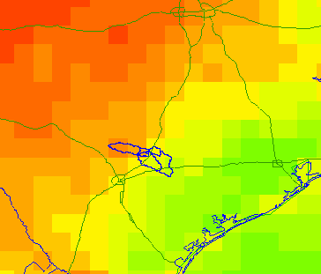
Energy Balance in the San Marcos Basin from the NARR (July 2003)
Note the very large amount of longwave radiation exchanged between land and atmosphere
Average fluxes over the day
495
61
72
112
3
310
415
Net Shortwave = 310 – 72 = 238; Net Longwave = 415 – 495 = - 80

Slide 7
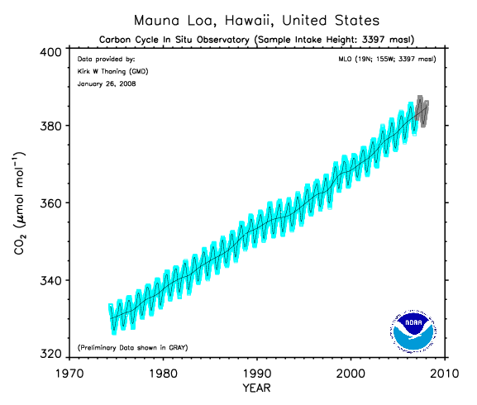
Increasing carbon dioxide in the atmosphere (from about 300 ppm in preindustrial times)
We are burning fossil carbon (oil, coal) at 100,000 times the rate it
was laid down in geologic time

Slide 8
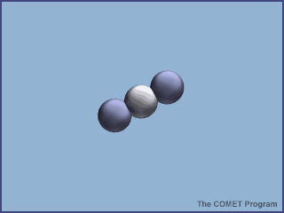
Absorption of energy by CO₂

Slide 9
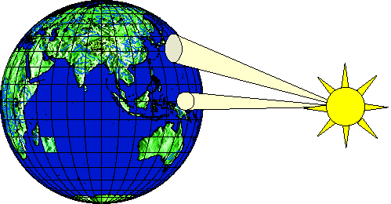
Heating of earth surface
Heating of earth surface is uneven
  Solar radiation strikes perpendicularly near the equator (270 W/m²)
  Solar radiation strikes at an oblique angle near the poles (90 W/m²)
Emitted radiation is more uniform than incoming radiation
Amount of energy transferred from equator to the poles is approximately 4 x 10⁹ MW

Slide 10
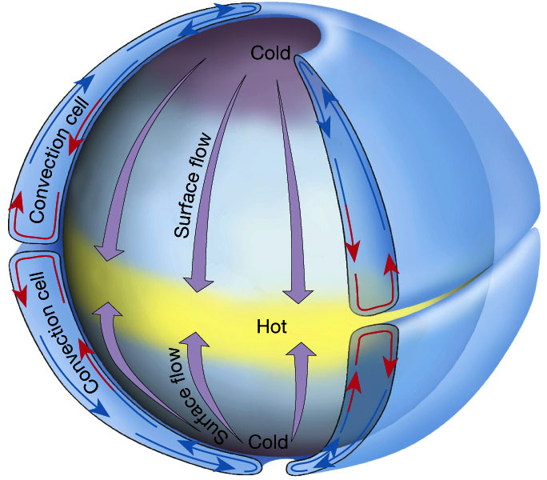
Hadley circulation
Atmosphere (and oceans) serve to transmit heat energy from the equator to the poles
Warm air rises, cool air descends creating two huge convective cells.

Slide 11
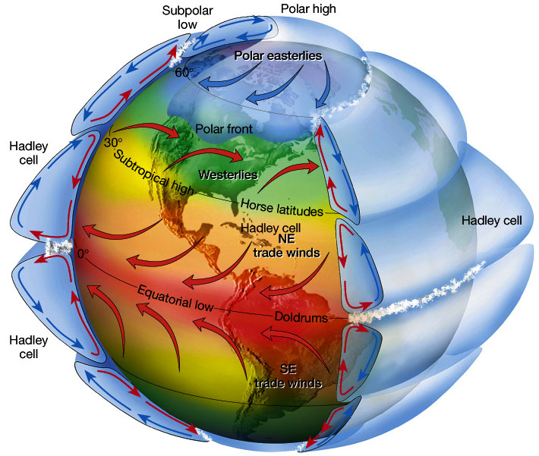
Atmospheric circulation
Circulation cells
Polar Cell
Hadley cell
Ferrel Cell
Polar cell
Ferrel Cell
Winds
Tropical Easterlies/Trades
Westerlies
Polar easterlies
Latitudes
Intertropical convergence zone (ITCZ)/Doldrums
Horse latitudes
Subpolar low
Polar high

Slide 12
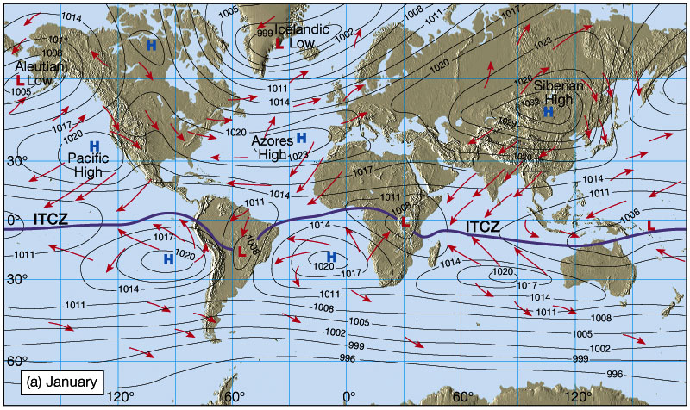
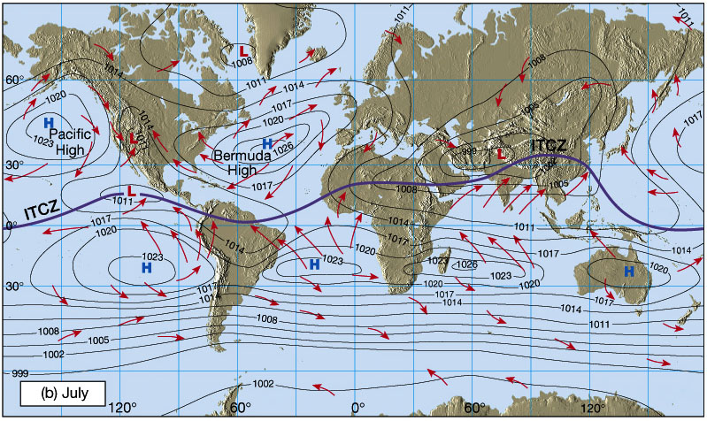
Shifting in Intertropical Convergence Zone (ITCZ)
Owing to the tilt of the Earth's axis in orbit, the ITCZ shifts north and south.
Southward shift in January
Creates wet Summers (Monsoons) and dry winters, especially in India and SE Asia
Northward shift in July

Slide 13
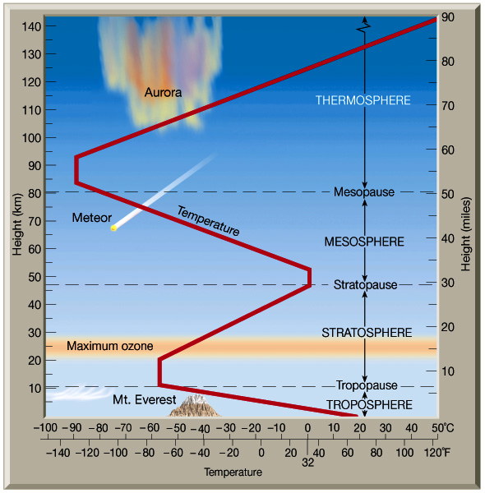
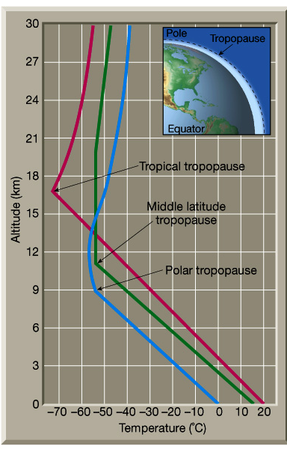
Structure of atmosphere

Slide 14
Atmospheric water
Atmospheric water exists
  Mostly as gas or water vapor
  Liquid in rainfall and water droplets in clouds
  Solid in snowfall and in hail storms
Accounts for less than 1/100,000 part of total water, but plays a major role in the hydrologic cycle

Slide 15
Water vapor
Suppose we have an elementary volume of atmosphere dV and
we want quantify how much water vapor it contains
Water vapor density
dV
m_{a} = mass of moist air
m_{v} = mass of water vapor
Air density
Atmospheric gases:
Nitrogen – 78.1%
Oxygen – 20.9%
Other gases ~ 1%
http://www.bambooweb.com/articles/e/a/Earth's_atmosphere.html

Slide 16
Specific Humidity, q_{v}
Specific humidity measures the mass of water vapor per unit mass of moist air
It is dimensionless

Slide 17
Vapor pressure, e
Vapor pressure, e, is the pressure that water vapor exerts on a surface
Air pressure, p, is the total pressure that air makes on a surface
Ideal gas law relates pressure to absolute temperature T, R_{v} is the gas constant for water vapor
0.622 is ratio of mol. wt. of water vapor to avg mol. wt. of dry air (=18/28.9)

Slide 18
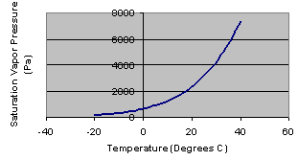
Saturation vapor pressure, e_{s}
Saturation vapor pressure occurs when air is holding all the water vapor
that it can at a given air temperature
Vapor pressure is measured in Pascals (Pa), where 1 Pa = 1 N/m²
1 kPa = 1000 Pa

Slide 19
Relative humidity, R_{h}
e_{s}
e
Relative humidity measures the percent
of the saturation water content of the air
that it currently holds (0 – 100%)

Slide 20
Dewpoint Temperature, T_{d}
e
T_{d}
T
Dewpoint temperature is the air temperature
at which the air would be saturated with its current
vapor content

Slide 21
Water vapor in an air column
We have three equations describing column:
  Hydrostatic air pressure, dp/dz = -ρ_{a}g
  Lapse rate of temperature, dT/dz = - α
  Ideal gas law, p = ρ_{a}R_{a}T
Combine them and integrate over column to get pressure variation elevation
2
Column
Element, dz
1

Slide 22
Precipitable Water
In an element dz, the mass of water vapor is dm_{p}
Integrate over the whole atmospheric column to get precipitable water,m_{p}
m_{p}/A gives precipitable water per unit area in kg/m²
2
Column
Element, dz
1
Area = A

Slide 23
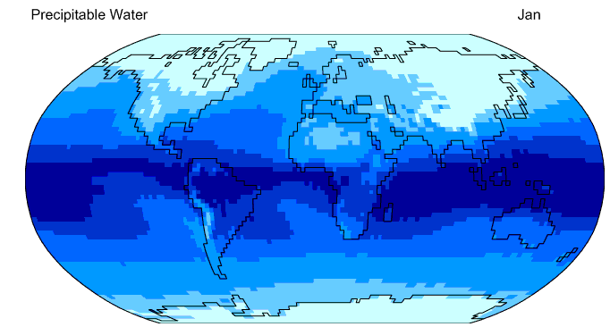
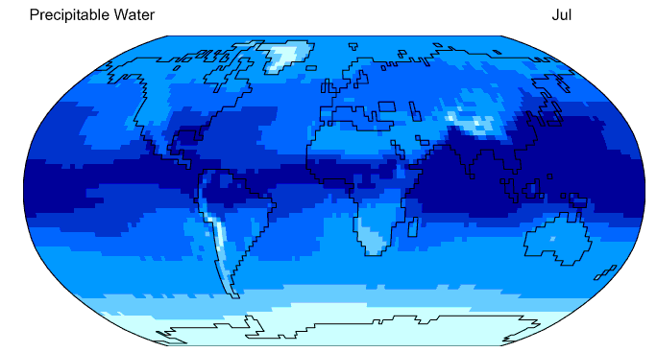

Precipitable Water
http://geography.uoregon.edu/envchange/clim_animations/flash/pwat.html
Frontal rainfall in the winter
Thunderstorm rainfall in the summer
25 mm precipitable water divides frontal from thunderstorm rainfall

Slide 24
Precipitation
Precipitation: water falling from the atmosphere to the earth.
  Rainfall
  Snowfall
  Hail, sleet
Requires lifting of air mass so that it cools and condenses.

Slide 25
Mechanisms for air lifting
Frontal lifting
Orographic lifting
Convective lifting

Slide 26
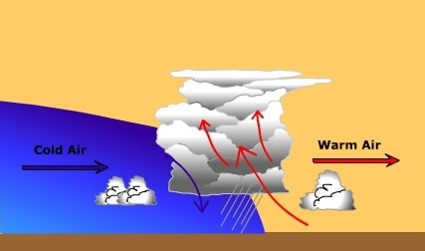
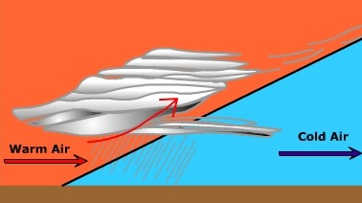
Frontal Lifting
Boundary between air masses with different properties is called a front
Cold front occurs when cold air advances towards warm air
Warm front occurs when warm air overrides cold air
Cold front (produces cumulus cloud)
Cold front (produces stratus cloud)

Slide 27
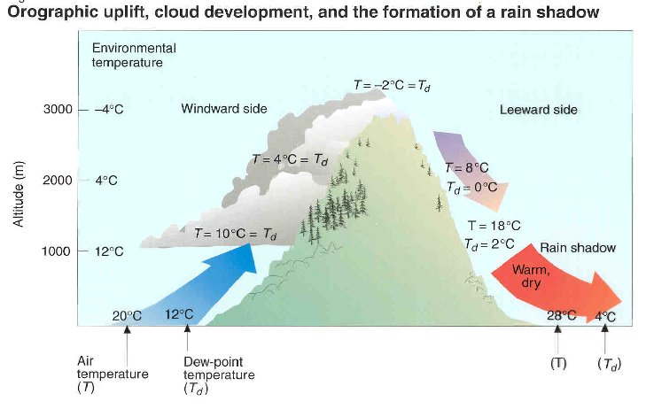
Orographic lifting
Orographic uplift occurs when air is forced to rise because of the physical presence of elevated land.

Slide 28
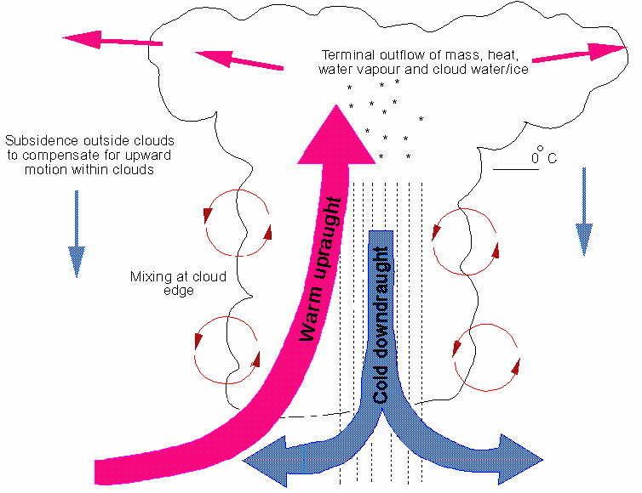
Convective lifting
Convective precipitation occurs when the air near the ground is heated by the earth’s warm surface. This warm air rises, cools and creates precipitation.
Hot earth surface

Slide 29
Condensation
Condensation is the change of water vapor into a liquid. For condensation to occur, the air must be at or near saturation in the presence of condensation nuclei.
Condensation nuclei are small particles or aerosol upon which water vapor attaches to initiate condensation. Dust particulates, sea salt, sulfur and nitrogen oxide aerosols serve as common condensation nuclei.
Size of aerosols range from 10⁻³ to 10 μm.

Slide 30

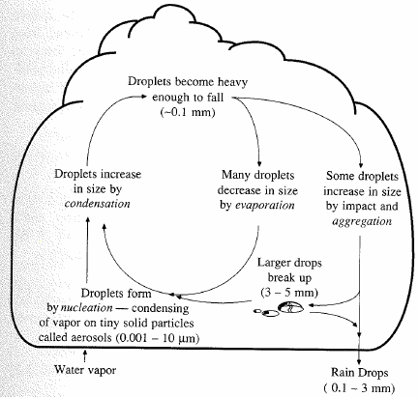
Precipitation formation
Lifting cools air masses so moisture condenses
Condensation nuclei
  Aerosols
  water molecules attach
Rising & growing
  0.5 cm/s sufficient to carry 10 μm droplet
  Critical size (~0.1 mm)
  Gravity overcomes and drop falls

Slide 31
Forces acting on rain drop
Three forces acting on rain drop
  Gravity force due to weight
  Buoyancy force due to displacement of air
  Drag force due to friction with surrounding air
D
F_{b}
F_{d}
F_{d}
F_{g}

Slide 32
Terminal Velocity
Terminal velocity: velocity at which the forces acting on the raindrop are in equilibrium.
If released from rest, the raindrop will accelerate until it reaches its terminal velocity
D
F_{b}
F_{d}
F_{d}
F_{g}
At standard atmospheric pressure (101.3 kpa) and temperature (20ºC), ρ_{w} = 998 kg/m3 and ρ_{a} = 1.20 kg/m3
V
Raindrops are spherical up to a diameter of 1 mm
For tiny drops up to 0.1 mm diameter, the drag force is specified by Stokes law

Slide 33
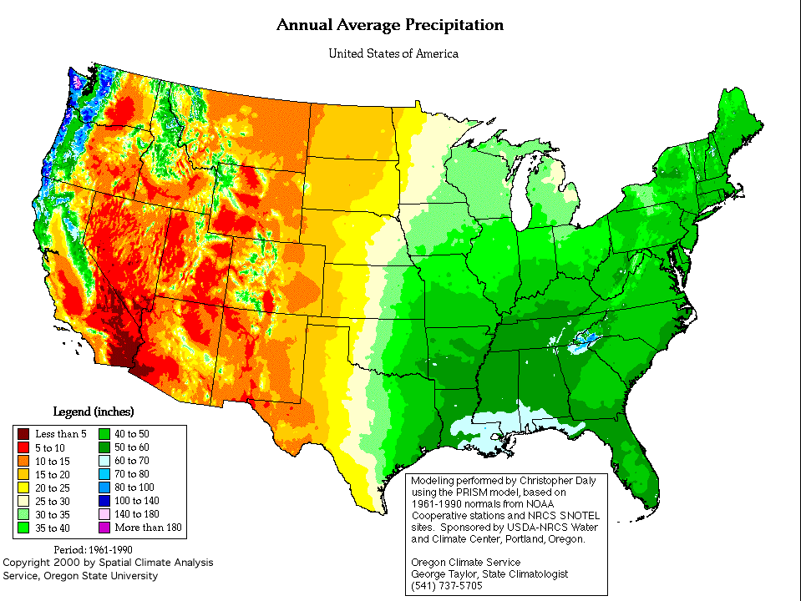
Rainfall patterns in the US

Slide 34
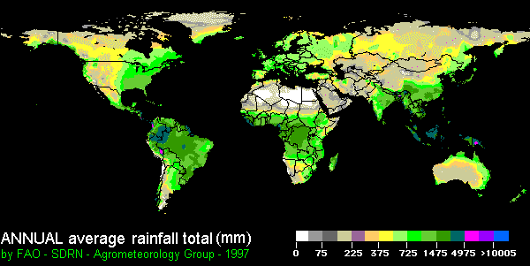
Global precipitation pattern

Slide 35
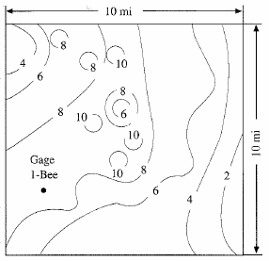
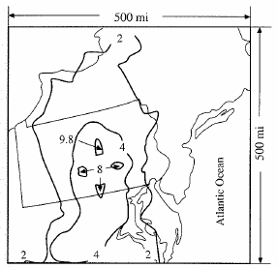
Spatial Representation
Isohyet – contour of constant rainfall
Isohyetal maps are prepared by interpolating rainfall data at gaged points.
Austin, May 1981
Wellsboro, PA 1889

Slide 36
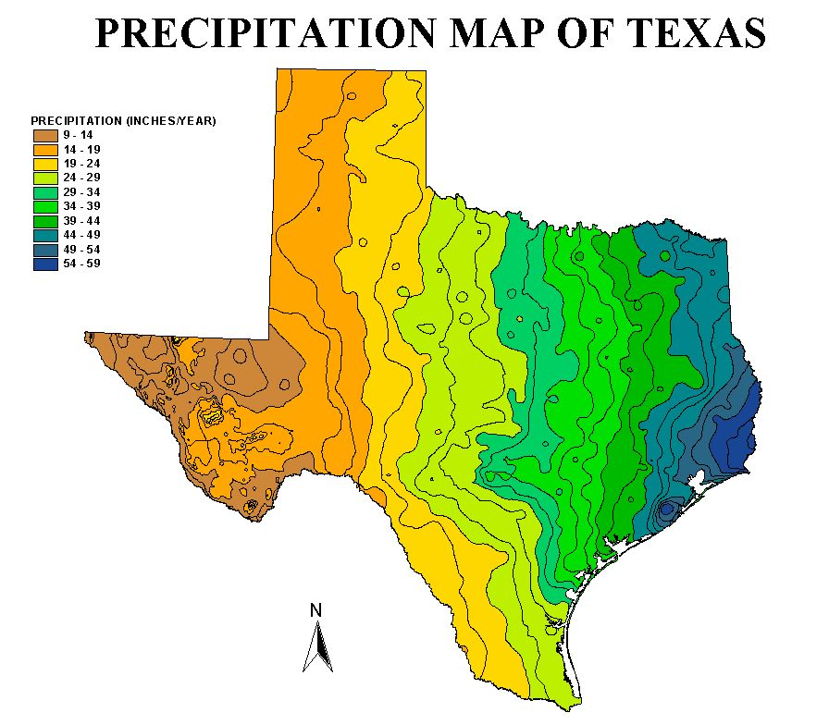
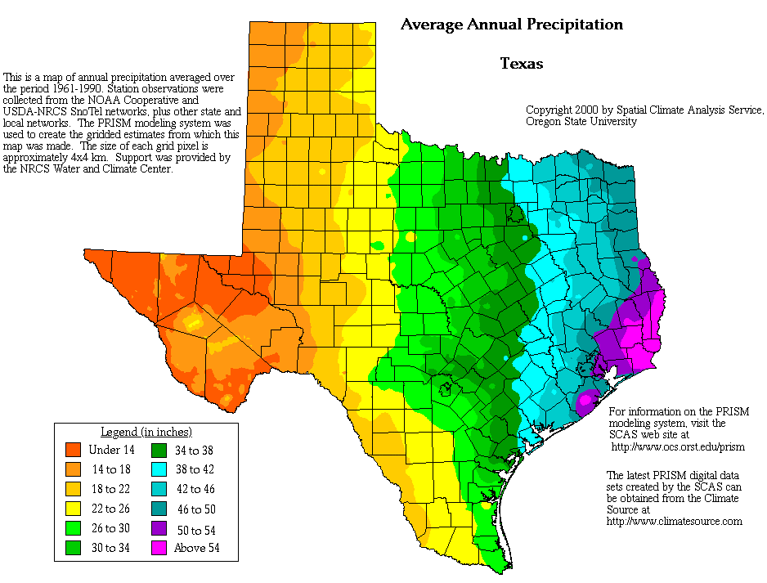
Texas Rainfall Maps

Slide 37
Temporal Representation
Rainfall hyetograph – plot of rainfall depth or intensity as a function of time
Cumulative rainfall hyetograph or rainfall mass curve – plot of summation of rainfall increments as a function of time
Rainfall intensity – depth of rainfall per unit time

Slide 38
Rainfall Depth and Intensity

Slide 39
Incremental Rainfall
Rainfall Hyetograph

Slide 40
Cumulative Rainfall
Rainfall Mass Curve

Slide 41
Arithmetic Mean Method
Simplest method for determining areal average
P₁ = 10 mm
P₂ = 20 mm
P₃ = 30 mm
P₁
P₂
P₃
Gages must be uniformly distributed
Gage measurements should not vary greatly about the mean

Slide 42
Thiessen polygon method
Any point in the watershed receives the same amount of rainfall as that at the nearest gage
Rainfall recorded at a gage can be applied to any point at a distance halfway to the next station in any direction
Steps in Thiessen polygon method
  Draw lines joining adjacent gages
  Draw perpendicular bisectors to the lines created in step 1
  Extend the lines created in step 2 in both directions to form representative areas for gages
  Compute representative area for each gage
  Compute the areal average using the following formula
P₁
A₁
P₂
A₂
P₃
A₃
P₁ = 10 mm, A₁ = 12 Km²
P₂ = 20 mm, A₂ = 15 Km²
P₃ = 30 mm, A₃ = 20 km²

Slide 43
Isohyetal method
Steps
  Construct isohyets (rainfall contours)
  Compute area between each pair of adjacent isohyets (A_{i})
  Compute average precipitation for each pair of adjacent isohyets (p_{i})
  Compute areal average using the following formula
10
20
P₁
A₁=5 , p₁ = 5
A₂=18 , p₂ = 15
P₂
A₃=12 , p₃ = 25
P₃
30
A₄=12 , p₃ = 35

Slide 44
Inverse distance weighting
Prediction at a point is more influenced by nearby measurements than that by distant measurements
The prediction at an ungaged point is inversely proportional to the distance to the measurement points
Steps
  Compute distance (d_{i}) from ungaged point to all measurement points.
  Compute the precipitation at the ungaged point using the following formula
P₁=10
P₂= 20
d₁=25
d₂=15
P₃=30
d₃=10
p

Slide 45

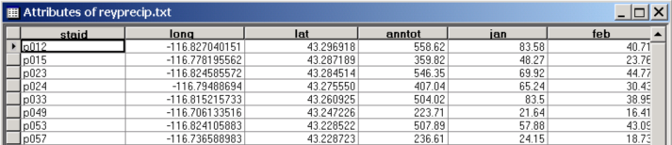
Rainfall interpolation in GIS
Data are generally available as points with precipitation stored in attribute table.

Slide 46
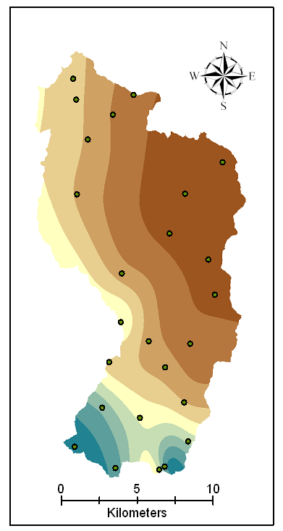
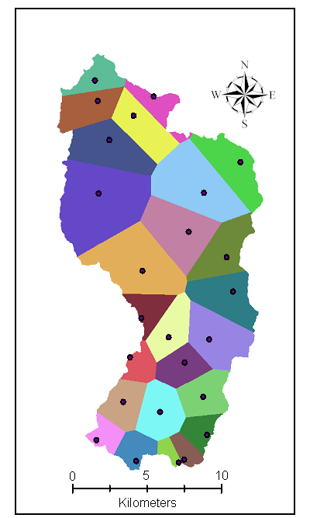
Rainfall maps in GIS
Nearest Neighbor “Thiessen” Polygon Interpolation
Spline Interpolation

Slide 47
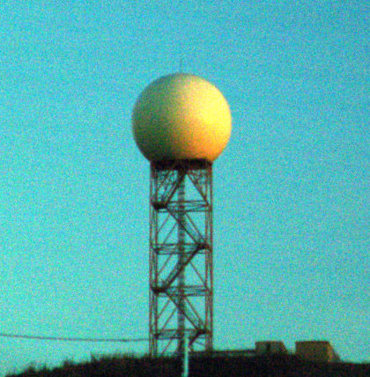

NEXRAD
NEXt generation RADar: is a doppler radar used for obtaining weather information
A signal is emitted from the radar which returns after striking a rainfall drop
Returned signals from the radar are analyzed to compute the rainfall intensity and integrated over time to get the precipitation
NEXRAD Tower
Working of NEXRAD

Slide 48
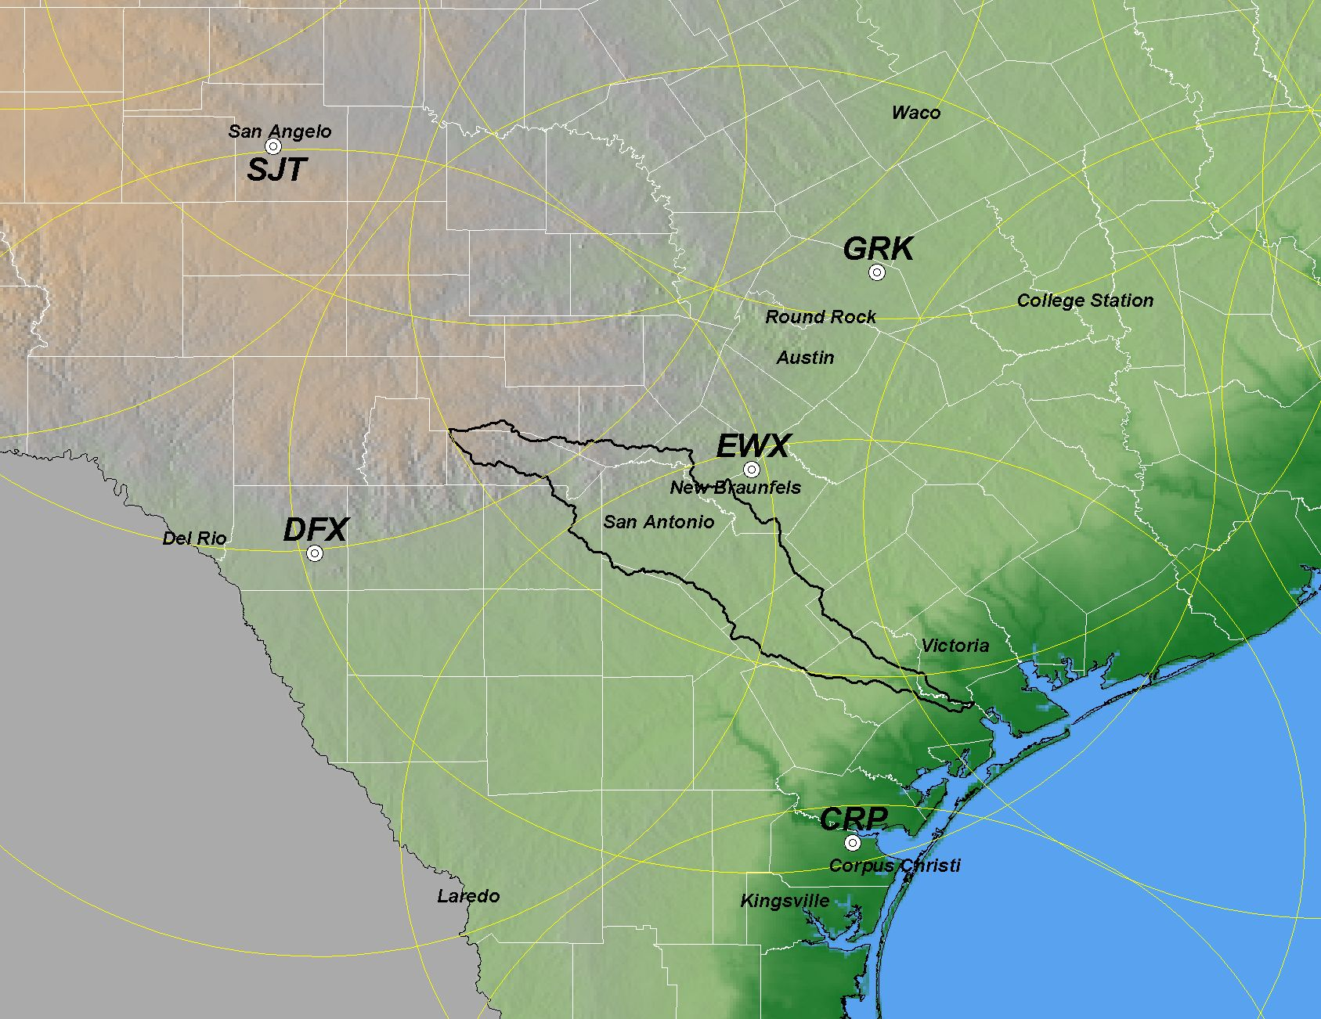
NEXRAD WSR-88D Radars in Central Texas
(Weather Surveillance Radar-1988 Doppler) scanning range = 230 km
NEXRAD Products:
Stage I: Just Radar
Stage II: gages, satellite, and surface temperature
Stage III: Continuous mosaic from radar overlaps
EWX – NEXRAD Radar in New Braunfels
Source: PBS&J, 2003
Notes:
One of the strong motivation points for integration is the availability of
good quality precipitation estimates at higher temporal and spatial resolutions to feed engineering models!!
In particular the NEXRAD products of the NWS that now provide “true spatial realizations of rainfall fields”
With historical and real time sources

Slide 49
NEXRAD data
NOAA’s Weather and Climate Toolkit (JAVA viewer)
  http://www.ncdc.noaa.gov/oa/wct/
West Gulf River Forecast Center
  http://www.srh.noaa.gov/wgrfc/
National Weather Service Precipitation Analysis
  http://www.srh.noaa.gov/rfcshare/precip_analysis_new.php

