Slide 1
Design Flows
Reading: Applied Hydrology, Sec 15-1 to 15-5

Slide 2
Hydrologic design
For water control
  Mitigation of adverse effects of high flows or floods
  Design flows for conveyance structures (storm sewers, drainage channels) and regulation structures (detention basins, reservoirs)
For water use
  Management of water resources to meet human needs and conservation of natural life
  Determination of storage capacity

Slide 3
Design flow computations
Methods
  Rational method
  Modified Rational Method
  SCS-TR55 Method

Slide 4
Rational Method
Used to find peak flows for storm sewers
  If a rainfall of i intensity begins instantly and continues indefinitely, the rate of runoff will increase until the time of concentration (t_{c}).
Assumptions
  Peak runoff rate at the outlet is a function of the average rainfall rate during t_{c} (peak runoff does not result from a more intense storm of shorter duration during which only a portion of the watershed is contributing to the runoff)
  t_{c} employed is the time for runoff to flow from the farthest point in the watershed to the inflow point of the sewer being designed
  Rainfall intensity is constant throughout the storm duration

Slide 5
Rational Formula
The rational formula is given by:
Q = peak discharge in cfs which occurs at t_{c}
i = rainfall intensity in in/hr (duration used to compute i = t_{c})
A = watershed area in acres
C = runoff coefficient (0 ≤C ≤ 1)
An urban area consisting of sub-areas with different surface characteristics
Composite rational equation
j = number of sub-catchments drained by a sewer

Slide 6
Runoff Coefficient C
C is the most difficult variable to accurately determine in the rational method
The fraction of rainfall that will produce peak flow depends on:
  Impervious cover
  Slope
  Surface detention
  Interception
  Infiltration
  Antecedent moisture conditions

Slide 7
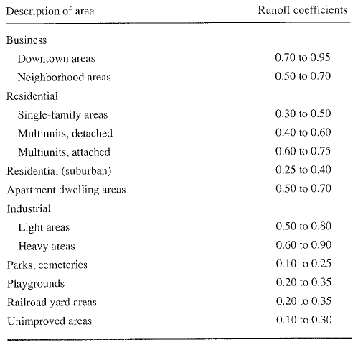
C based on land use

Slide 8
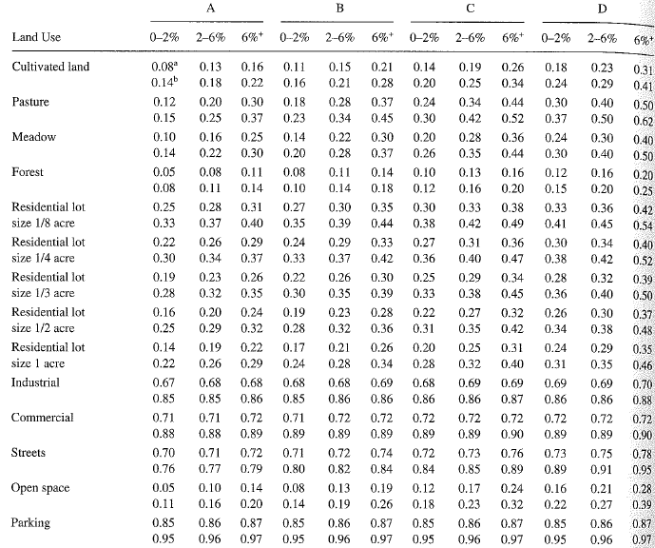
C values based on soil groups

Slide 9
Rainfall intensity i
i: rainfall rate in in/hr
i is selected based on rainfall duration and return period
  duration is equal to the time of concentration, t_{c}
  return period varies depending on design standards
t_{c} = sum of inlet time (t_{o}) and flow time (t_{f}) in the upstream sewers connected to the outlet
L_{i} is the length of the i^{th} pipe along the flow path and V_{i} is the flow velocity in the pipe.

Slide 10
Pipe capacity for storm sewers
Assumption: pipe is flowing full under gravity
Manning or Darcy-Weisbach equation is applicable
Manning’s equation
Valid for Q in cfs and D in feet. For SI units (Q in m³/s and D in m), replace 2.16 with 3.21.
Darcy-Weisbach equation
Equation is valid for both SI and English system as long as the units are consistent

Slide 11
Example 15.1.1
Given T_{d} =10 min, C = 0.6, ground elevations at the pipe ends (498.43 and 495.55 ft), length = 450 ft, Manning n = 0.015, i=120T^{0.175}/(T_{d} + 27), compute flow, pipe diameter and flow time in the pipe

Slide 12
Example with composite C
A
Compute t_{c} and peak flow at D for i = 3.2 in/hr
B
C
D
Reach | Description of flow | C | Slope (%) | Length (ft) | Area (acre)
A-B | Natural channel | 0.41 | 4.5 | 300 | 8
B-C | Natural channel | 0.85 | 3 | 540 | 20
C-D | Storm drain (n = 0.015, D = 3 ft) | 0.81 | 1.2 | 500 | 10

Slide 13
Solution
Compute t_{c} for AB and BC using Kirpich formula in the text (Table 15.1.2)
For CD, compute velocity by Manning’s equation and t_{c} = length/velocity

Slide 14
Modified rational method
Extension of rational method for rainfalls lasting longer than the time of concentration
Can be used to develop hydrographs for storage design, rather than just flood peaks
Can be used for the preliminary design of detention storage for watersheds up to 20 or 30 acres

Slide 15
Modified rational method equation
The hydrograph produced by modified rational method is a trapezoid with duration of rising and falling limb equal to t_{c}.
Hydrograph for a basin with t_{c} = 10 min and rainfall duration = 30 min will look like the following:
T_{d} = 30 min
Q
t_{c}
t_{c}
t

Slide 16
Application of modified rational method
Determine the critical duration (T_{d}) and volume (V_{s}) for the design storm that will require maximum storage under future developed conditions
Q_{A} (cfs) is pre-development peak discharge, A is watershed area (acres), C is runoff coefficient, T_{p} = t_{c} (min), and T_{d} is in min
Q_{p} is the future peak discharge associated with T_{d}

Slide 17
Ex. 15.4.1
Rainfall-intensity-duration equation is given as i=96.6/(T_{d}+13.9), compute T_{d} for a 25 acre watershed with C = 0.825. The allowable pre-development discharge is 18 cfs, and t_{c} for pre- and post-development are 40 and 20 min, respectively.
A = 96.6, b = 13.9, Q_{A} = 18 cfs, T_{p} = 20 min, A = 25 acre, C = 0.825
T_{d} = 27.23 min

Slide 18
Ex. 15.4.2
Determine the maximum detention storage if γ = 2
Detention storage is given by,
The volume of runoff after development = Q_{p}*T_{d} = 79, 140 ft³. Therefore, 53746/79140 = 68% of runoff will be stored in the proposed detention pond.

Slide 19
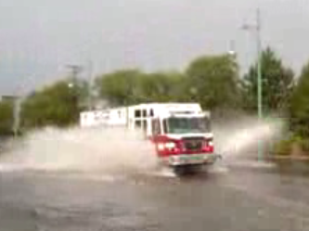
Situational Awareness for Flash Flooding

Slide 20
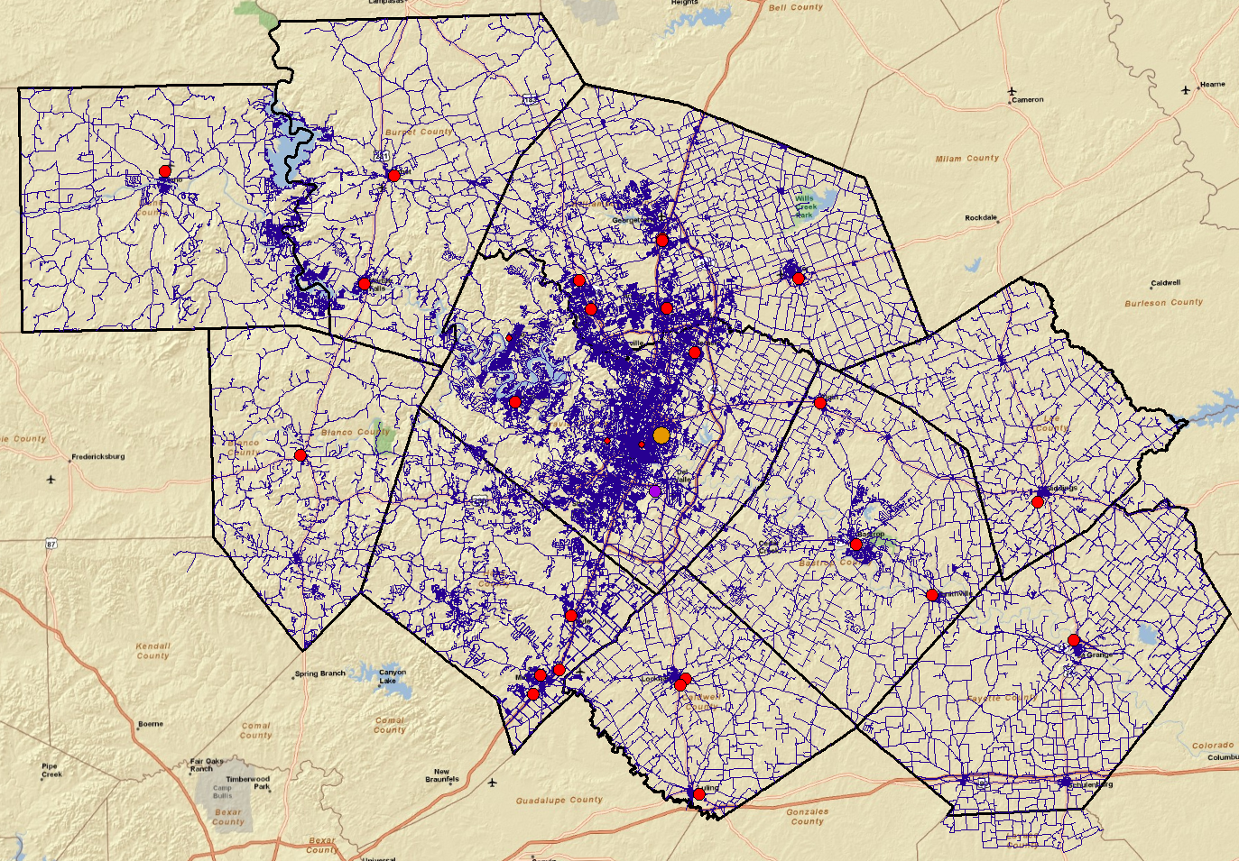
Emergency Response System (CAPCOG)

Slide 21
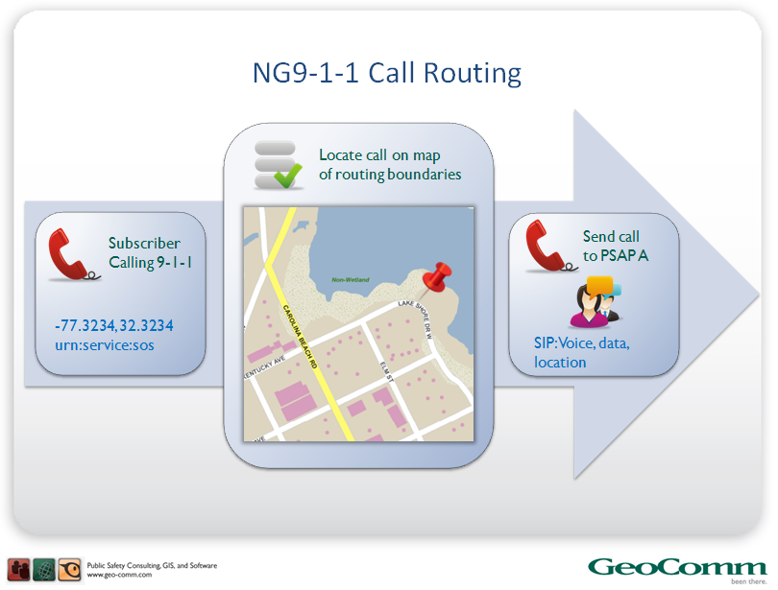
ESInet – Emergency Services Internet Network
Next Generation 911
Geographic location by coordinates
Slide from: John Brosowsky
Product Development Director, GeoComm

Slide 22
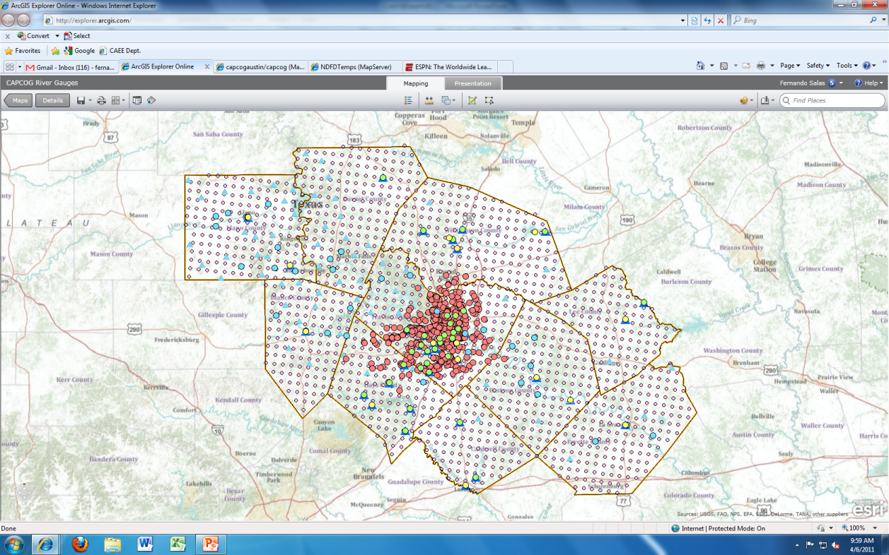
Water Web Services Hub for CAPCOG
USGS
LCRA
COA
NWS
NDFD

Slide 23
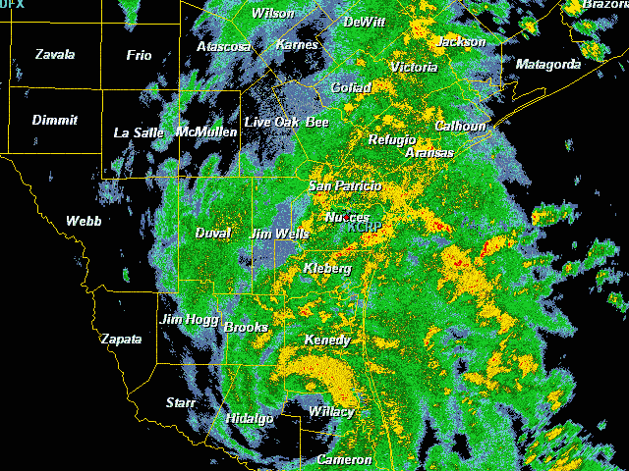
Tropical Storm Hermine,
Sept 7-8, 2010

Slide 24
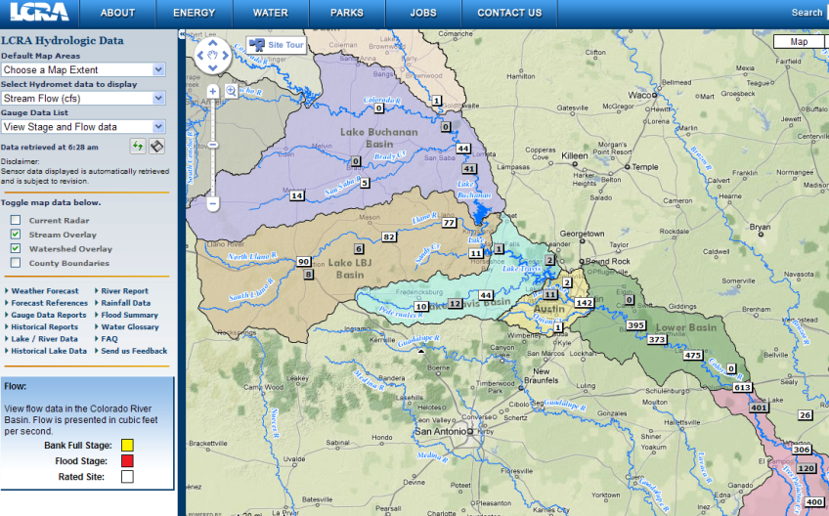
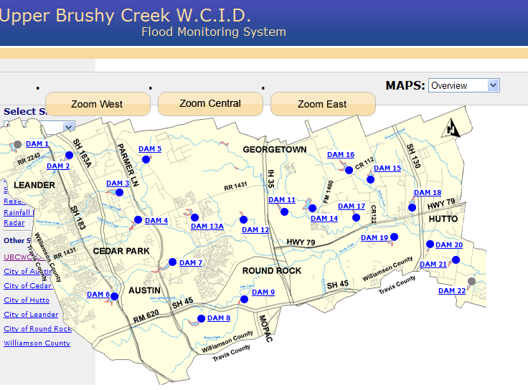
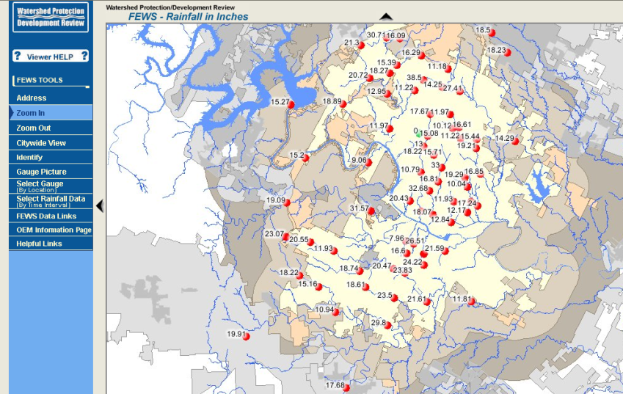
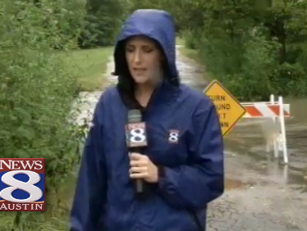
Local Information during Tropical Storm Hermine
(7-8 Sept 2010)
Upper Brushy Creek (Round Rock)
LCRA
http://hydromet.lcra.org
http://ubcwcid.org/Overview/Overview.aspx?id=1
TV
City of Austin
http://coagis1.ci.austin.tx.us/website/COAViewer_fews/viewer.htm

Slide 25
Internet Communications
We are all connected
Information Consumers
 | People | Media | Local Government | Federal Government
People
Media
Local Government
Federal Government
Information Producers
Web services can play an important role in this……

Slide 26
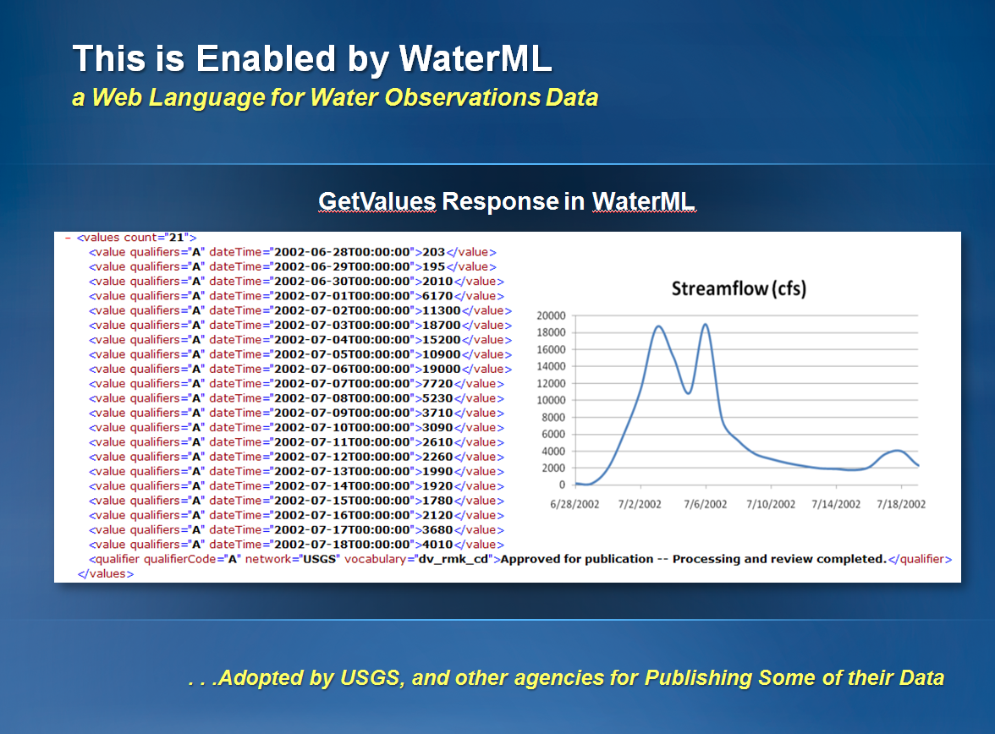
http://waterservices.usgs.gov/nwis/iv?sites=08158000&period=P7D&parameterCd=00060

Slide 27
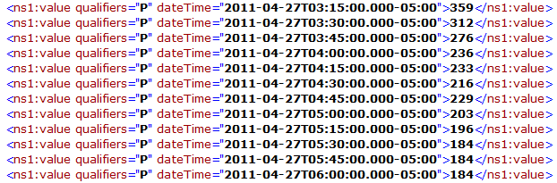
Colorado River at Austin
I accessed this WaterML service at 7:10AM
http://waterservices.usgs.gov/nwis/iv?sites=08158000&period=P7D&parameterCd=00060
And got back these flow data from USGS which are up to 6:00AM Central time

Slide 28
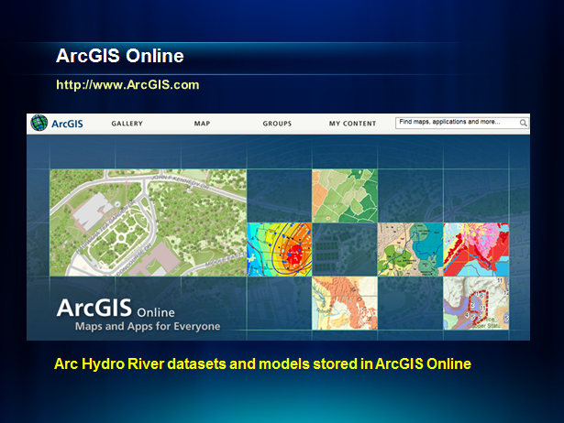

Slide 29

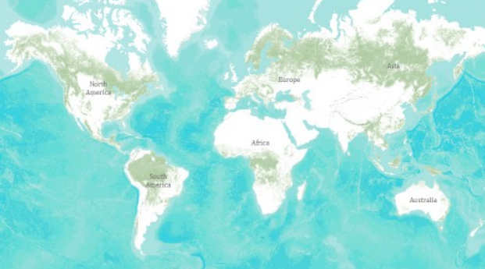
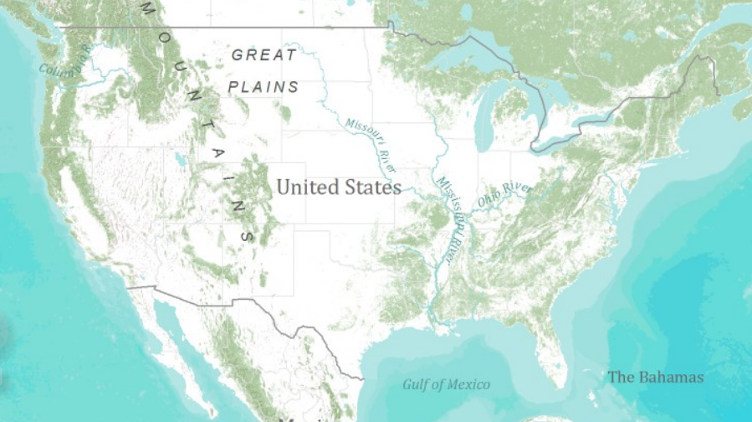
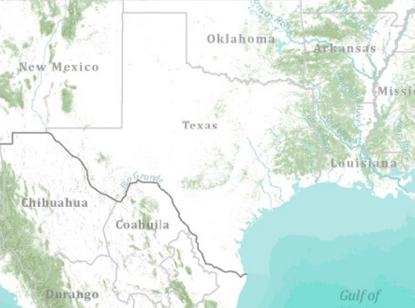
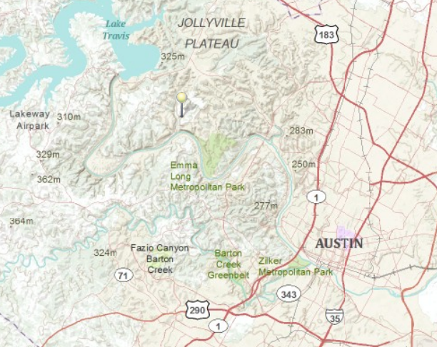
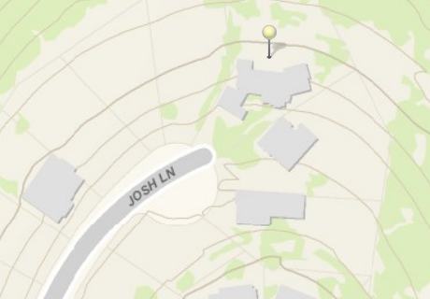
World
United States
Texas
Austin
Home

Slide 30
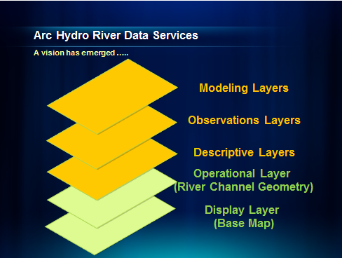

Slide 31
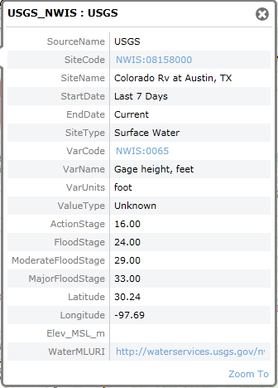

Observation Data Services
Provide real-time data services
  Streamflow, stage, precipitation
  Independent of WaterML version
Feed appropriate models with forcing data
  Land-surface models
  HMS, RAS

Slide 32
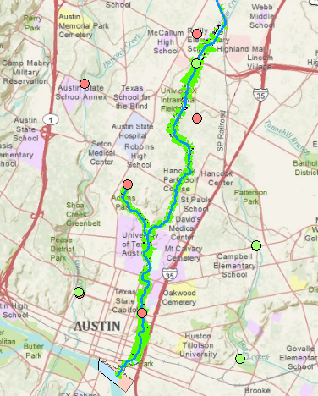
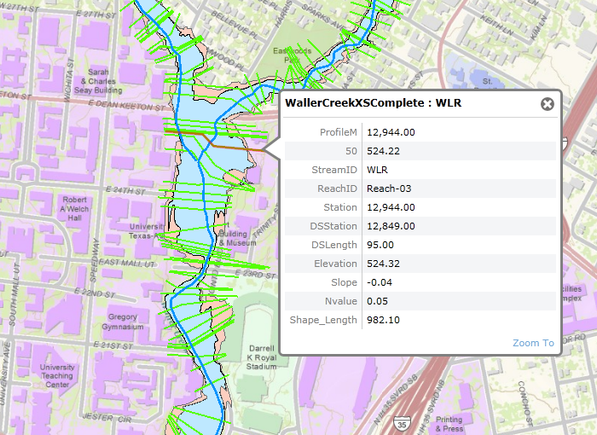
River Channel Data Services
Convey inputs necessary for hydraulic models to run
  Connectivity, length, slope, N

Slide 33
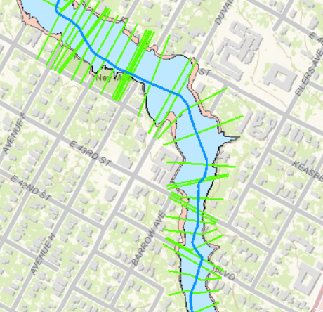
River Channel Data Services
http://explorer.arcgis.com/?open=ad7c4dbe299a458ca52b9caa725a2d4d

Slide 34


IBM is collaborating with UT….
…. to help build a Smarter Planet

Slide 35
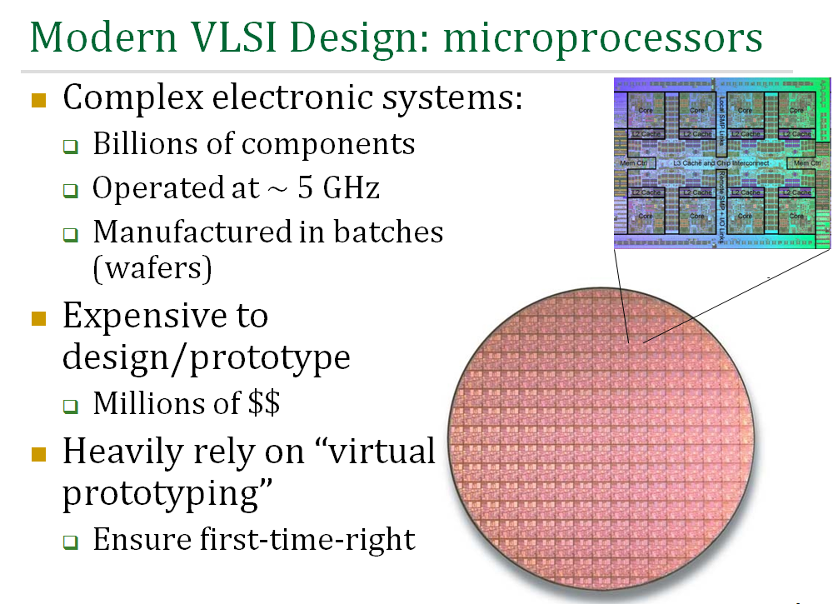

Slide 36
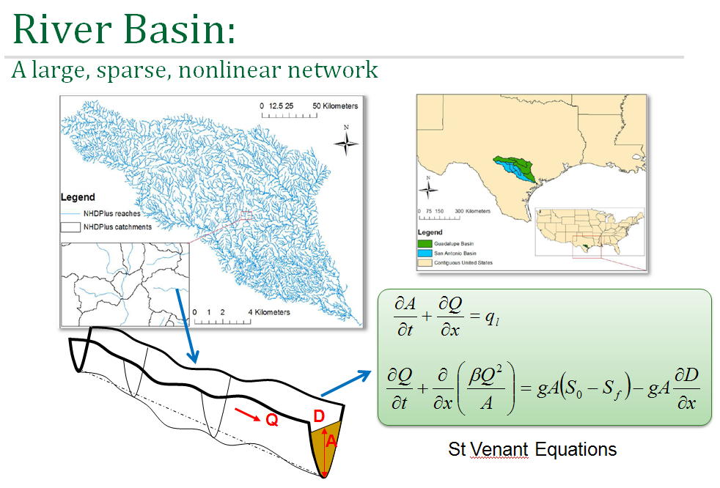
Research Question: Can VLSI simulation models…..
….. be adapted to apply to river networks?

Slide 37
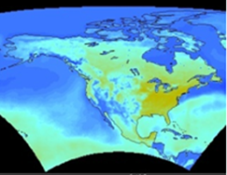










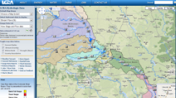


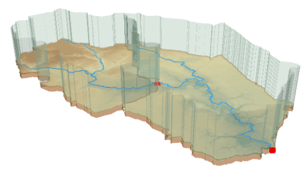

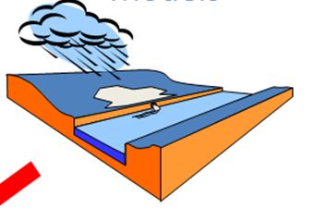

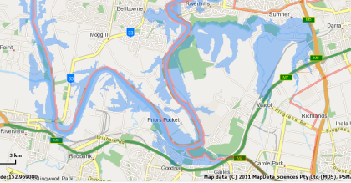
Web Services HUB
Outputs
Inputs
Web Services HUB
Data
Services
(WaterML)
USGS
Data
Services
(WaterML)
LCRA
COA
Mapping
Services
NWS
Mapping
Services
NDFD
Data and Mapping
Services
Modeling
Services
Flood Mapping
Services
Models
Maps

