Slide 1
Hydrologic Design and Design Storms
Reading: Applied Hydrology Sections 13-1, 13-2
14-1 to 14-4

Slide 2
Hydrologic design
Water control
  Peak flows, erosion, pollution, etc.
Water management
  Domestic and industrial use, irrigation, instream flows, etc
Tasks
  Determine design inflow
  Route the design inflow
  Find the output
    check if it is sufficient to meet the demands (for management)
    Check if the outflow is at safe level (for control)

Slide 3
Hydrologic design scale
Hydrologic design scale – range in magnitude of the design variable within which a value must be selected
Design considerations
  Safety
  Cost
Do not design small structures for large peak values (not cost effective)
Do not design large structures for small peak values (unsafe)
Balance between safety and cost.

Slide 4
Estimated Limiting Value (ELV)
Lower limit on design value – 0
Upper limit on design value – ELV
ELV – largest magnitude possible for a hydrologic event at a given location, based on the best available hydrologic information.
  Length of record
  Reliability of information
  Accuracy of analysis
Probable Maximum Precipitation (PMP) / Probable Maximum Flood (PMF)

Slide 5
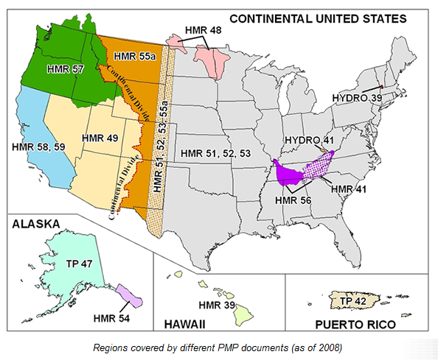
Probable Maximum Precipitation
Most recent report 1999
http://www.nws.noaa.gov/oh/hdsc/studies/pmp.html

Slide 6
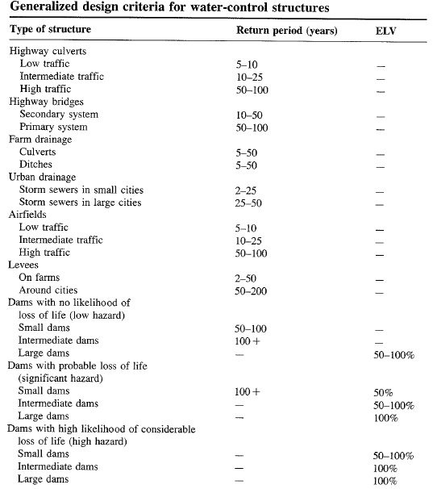

Slide 7
TxDOT Recommendations

Slide 8
Hydrologic design level
Hydrologic design level – magnitude of the hydrologic event to be considered for the design or a structure or project.
Three approaches for determining design level
  Empirical/probabilistic
  Risk analysis
  Hydroeconomic analysis

Slide 9
Empirical/Probabilitic
P(most extreme event of last N years will be exceeded once in next n years)
P(largest flood of last N years will be exceeded in n=N years) = 0.5
Drought lasting m years is worst in N year record. What is the probability that a worse drought will occur in next n years?
  # sequences of length m in N years = N-m+1
  # sequences of length m in n years = n-m+1

Slide 10
Example 13.2.1
If the critical drought of the record, as determined from 40 yrs of data, lasted 5 yrs, what is the chance that a more severe drought will occur during the next 20 yrs?
Solution:
N = 40, m = 5 and n = 20

Slide 11
Risk Analysis
Uncertainty in hydrology
  Inherent - stochastic nature of hydrologic phenomena
  Model – approximations in equations
  Parameter – estimation of coefficients in equations
Consideration of Risk
  Structure may fail if event exceeds T–year design magnitude
  R = P(event occurs at least once in n years)
    Natural inherent risk of failure

Slide 12
Example 13.2.2
Expected life of culvert = 10 yrs
Acceptable risk of 10 % for the culvert capacity
Find the design return period
What is the chance that the culvert designed for an event of 95 yr return period will have its capacity exceeded at least once in 50 yrs?
The chance that the capacity will not be exceeded during the next 50 yrs is 1-0.41 = 0.59

Slide 13
Hydroeconomic Analysis
Probability distribution of hydrologic event and damage associated with its occurrence are known
As the design period increases, capital cost increases, but the cost associated with expected damages decreases.
In hydroeconomic analysis, find return period that has minimum total (capital + damage) cost.

Slide 14
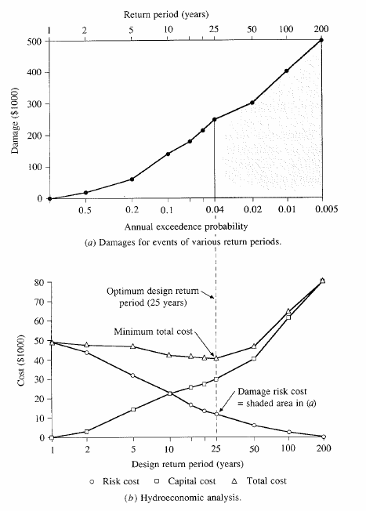

Slide 15
Design Storms
Get Depth, Duration, Frequency Data for the required location
Select a return period
Convert Depth-Duration data to a design hyetograph.

Slide 16
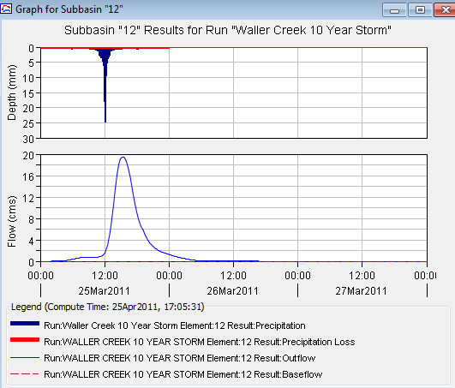
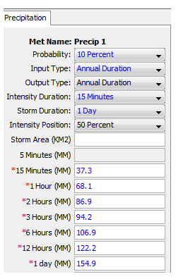
Depth Duration Data to Rainfall Hyetograph

Slide 17

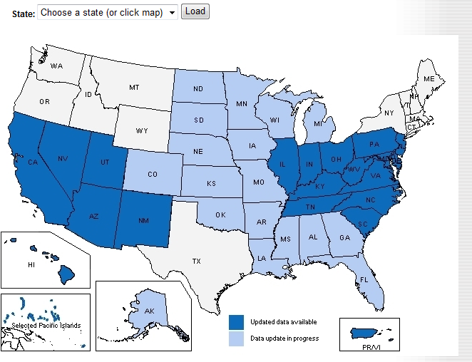
http://hdsc.nws.noaa.gov/hdsc/pfds/index.html

Slide 18
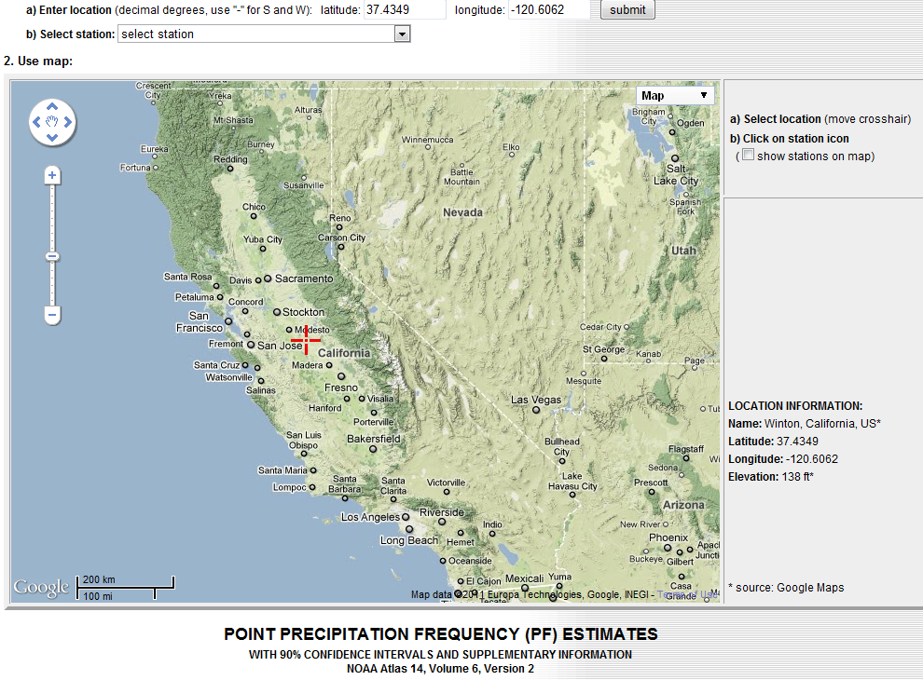
An example of precipitation frequency estimates for a location in California
37.4349 N
120.6062 W

Slide 19
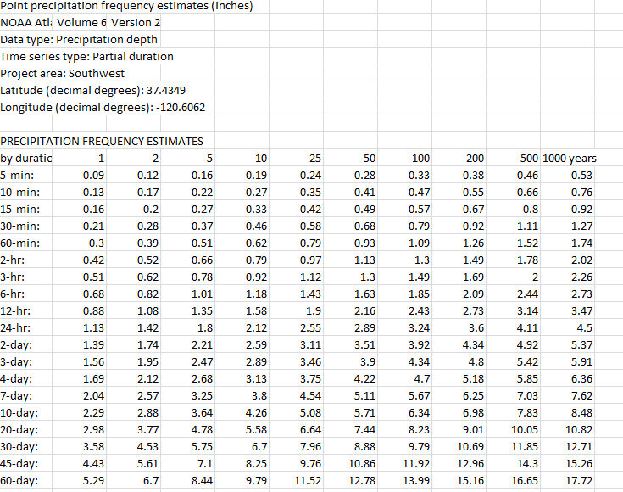
Results of Precip Frequency Query

Slide 20
TP 40
Hershfield (1961) developed isohyetal maps of design rainfall and published in TP 40.
TP 40 – U. S. Weather Bureau technical paper no. 40. Also called precipitation frequency atlas maps or precipitation atlas of the United States.
  30mins to 24hr maps for T = 1 to 100
Web resources for TP 40 and rainfall frequency maps
  http://www.tucson.ars.ag.gov/agwa/rainfall_frequency.html
  http://www.erh.noaa.gov/er/hq/Tp40s.htm
  http://hdsc.nws.noaa.gov/hdsc/pfds/

Slide 21
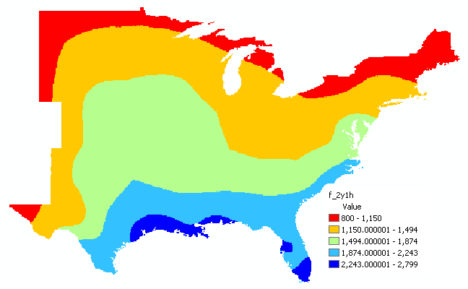
2yr-60min precipitation GIS map

Slide 22
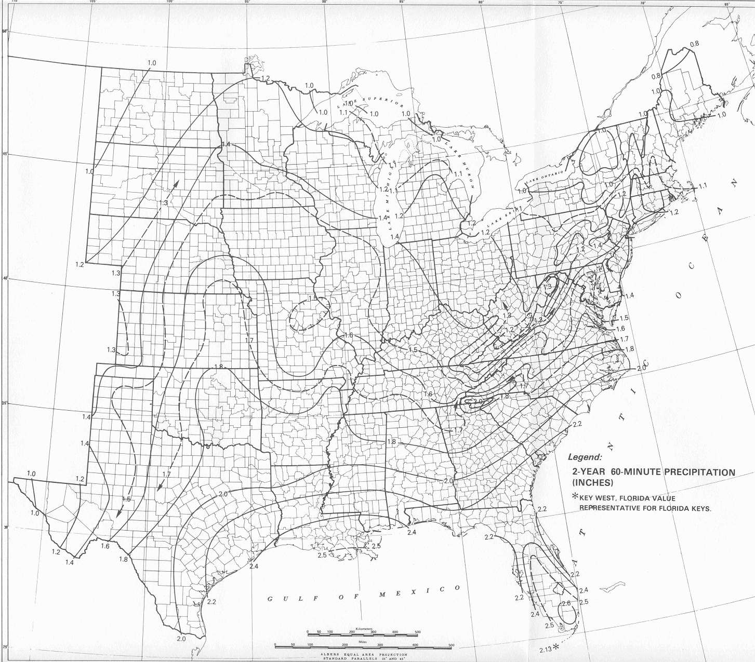
2yr-60min precipitation map
This map is from HYDRO 35 (another publication from NWS) which supersedes TP 40

Slide 23
Design aerial precipitation
Point precipitation estimates are extended to develop an average precipitation depth over an area
Depth-area-duration analysis
  Prepare isohyetal maps from point precipitation for different durations
  Determine area contained within each isohyet
  Plot average precipitation depth vs. area for each duration

Slide 24
Depth-area curve
(World Meteorological Organization, 1983)

Slide 25
Depth (intensity)-duration-frequency
DDF/IDF – graph of depth (intensity) versus duration for different frequencies
  TP 40 or HYDRO 35 gives spatial distribution of rainfall depths for a given duration and frequency
  DDF/IDF curve gives depths for different durations and frequencies at a particular location
  TP 40 or HYDRO 35 can be used to develop DDF/IDF curves
Depth (P) = intensity (i) x duration (T_{d})

Slide 26
IDF curve

Slide 27
Example 14.2.1
Determine i and P for a 20-min duration storm with 5-yr return period in Chicago
From the IDF curve for Chicago,
i = 3.5 in/hr for T_{d} = 20 min and T = 5yr
P = i x T_{d} = 3.5 x 20/60 = 1.17 in

Slide 28
Equations for IDF curves
IDF curves can also be expressed as equations to avoid reading from graphs
i is precipitation intensity, T_{d} is the duration, and c, e, f are coefficients that vary for locations and different return periods
This equation includes return period (T) and has an extra coefficient (m)

Slide 29
Example 14.2.4
Using IDF curve equation, determine 10-yr 20-min design rainfall intensities for Denver
From Table 14.2.3 in the text, c = 96.6, e = 0.97, and f = 13.9
Similarly, i = 4.158 and 2.357 in/hr for T_{d} = 10 and 30 min, respectively

Slide 30
IDF curves for Austin
Source: City of Austin, Watershed Management Division

Slide 31
Design Precipitation Hyetographs
Most often hydrologists are interested in precipitation hyetographs and not just the peak estimates.
Techniques for developing design precipitation hyetographs
  SCS method
  Triangular hyetograph method
  Using IDF relationships (Alternating block method)

Slide 32
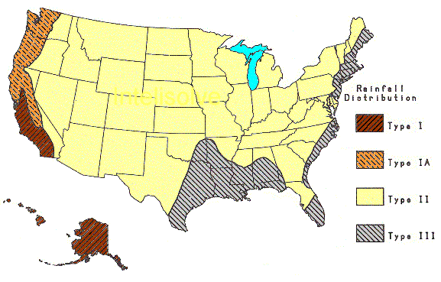
SCS Method
SCS (1973) adopted method similar to DDF to develop dimensionless rainfall temporal patterns called type curves for four different regions in the US.
SCS type curves are in the form of percentage mass (cumulative) curves based on 24-hr rainfall of the desired frequency.
If a single precipitation depth of desired frequency is known, the SCS type curve is rescaled (multiplied by the known number) to get the time distribution.
For durations less than 24 hr, the steepest part of the type curve for required duraction is used

Slide 33
SCS type curves for Texas (II&III)
SCS 24-Hour Rainfall Distributions |  |  |  | SCS 24-Hour Rainfall Distributions
T (hrs) | Fraction of 24-hr rainfall |  |  | T (hrs) | Fraction of 24-hr rainfall
 | Type II | Type III |  |  | Type II | Type III
0.0 | 0.000 | 0.000 |  | 11.5 | 0.283 | 0.298
1.0 | 0.011 | 0.010 |  | 11.8 | 0.357 | 0.339
2.0 | 0.022 | 0.020 |  | 12.0 | 0.663 | 0.500
3.0 | 0.034 | 0.031 |  | 12.5 | 0.735 | 0.702
4.0 | 0.048 | 0.043 |  | 13.0 | 0.772 | 0.751
5.0 | 0.063 | 0.057 |  | 13.5 | 0.799 | 0.785
6.0 | 0.080 | 0.072 |  | 14.0 | 0.820 | 0.811
7.0 | 0.098 | 0.089 |  | 15.0 | 0.854 | 0.854
8.0 | 0.120 | 0.115 |  | 16.0 | 0.880 | 0.886
8.5 | 0.133 | 0.130 |  | 17.0 | 0.903 | 0.910
9.0 | 0.147 | 0.148 |  | 18.0 | 0.922 | 0.928
9.5 | 0.163 | 0.167 |  | 19.0 | 0.938 | 0.943
9.8 | 0.172 | 0.178 |  | 20.0 | 0.952 | 0.957
10.0 | 0.181 | 0.189 |  | 21.0 | 0.964 | 0.969
10.5 | 0.204 | 0.216 |  | 22.0 | 0.976 | 0.981
11.0 | 0.235 | 0.250 |  | 23.0 | 0.988 | 0.991
 |  |  |  | 24.0 | 1.000 | 1.000

Slide 34
SCS Method Steps
Given T_{d} and frequency/T, find the design hyetograph
  Compute P/i (from DDF/IDF curves or equations)
  Pick a SCS type curve based on the location
  If T_{d} = 24 hour, multiply (rescale) the type curve with P to get the design mass curve
    If T_{d} is less than 24 hr, pick the steepest part of the type curve for rescaling
  Get the incremental precipitation from the rescaled mass curve to develop the design hyetograph

Slide 35
Example – SCS Method
Find - rainfall hyetograph for a 25-year, 24-hour duration SCS Type-III storm in Harris County using a one-hour time increment
a = 81, b = 7.7, c = 0.724 (from Tx-DOT hydraulic manual)
Find
  Cumulative fraction - interpolate SCS table
  Cumulative rainfall = product of cumulative fraction * total 24-hour rainfall (10.01 in)
  Incremental rainfall = difference between current and preceding cumulative rainfall
TxDOT hydraulic manual is available at:
http://manuals.dot.state.tx.us/docs/colbridg/forms/hyd.pdf

Slide 36
SCS – Example (Cont.)
If a hyetograph for less than 24 needs to be prepared, pick time intervals that include the steepest part of the type curve (to capture peak rainfall). For 3-hr pick 11 to 13, 6-hr pick 9 to 14 and so on.

Slide 37
Triangular Hyetograph Method
T_{d}: hyetograph base length = precipitation duration
t_{a}: time before the peak
r: storm advancement coefficient = t_{a}/T_{d}
t_{b}: recession time = T_{d} – t_{a} = (1-r)T_{d}
t_{a}
t_{b}
Rainfall intensity, i
h
T_{d}
Time
Given T_{d} and frequency/T, find the design hyetograph
  Compute P/i (from DDF/IDF curves or equations)
  Use above equations to get t_{a}, t_{b}, T_{d} and h (r is available for various locations)

Slide 38
Triangular hyetograph - example
Find - rainfall hyetograph for a 25-year, 6-hour duration in Harris County. Use storm advancement coefficient of 0.5.
a = 81, b = 7.7, c = 0.724 (from Tx-DOT hydraulic manual)
3 hr
3 hr
Rainfall intensity, in/hr
2.24
6 hr
Time

Slide 39
Alternating block method
Given T_{d} and T/frequency, develop a hyetograph in Δt increments
  Using T, find i for Δt, 2Δt, 3Δt,…nΔt using the IDF curve for the specified location
  Using i compute P for Δt, 2Δt, 3Δt,…nΔt. This gives cumulative P.
  Compute incremental precipitation from cumulative P.
  Pick the highest incremental precipitation (maximum block) and place it in the middle of the hyetograph. Pick the second highest block and place it to the right of the maximum block, pick the third highest block and place it to the left of the maximum block, pick the fourth highest block and place it to the right of the maximum block (after second block), and so on until the last block.

Slide 40
Example: Alternating Block Method
Find: Design precipitation hyetograph for a 2-hour storm (in 10 minute increments) in Denver with a 10-year return period 10-minute

