Slide 1
Engineers Without Borders
Greater Austin
Sieykin, Panama
Clean Water & Health Project
March 22, 2011

Slide 2
Engineers Without Borders-USA
Vision
A world in which the communities we serve have the capacity to sustainably meet their basic human needs, and that our members have enriched global perspectives through the innovative professional educational opportunities that the EWB-USA program provides.
Mission
EWB-USA supports community-driven development programs worldwide by collaborating with local partners to design and implement sustainable engineering projects, while creating transformative experiences and responsible leaders.

Slide 3
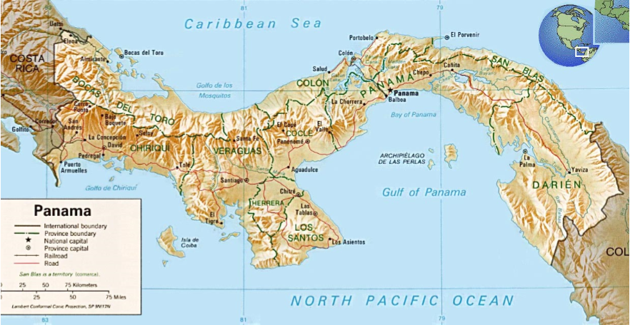
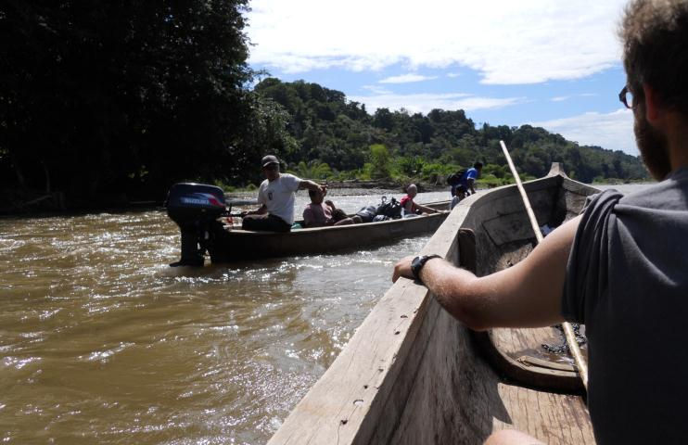
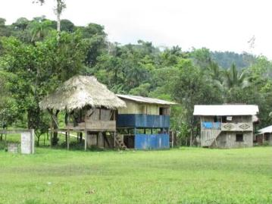
Location in Panama
Sieykin

Slide 4
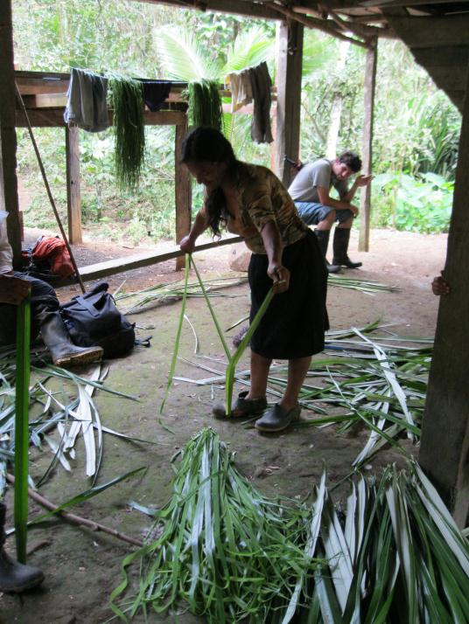
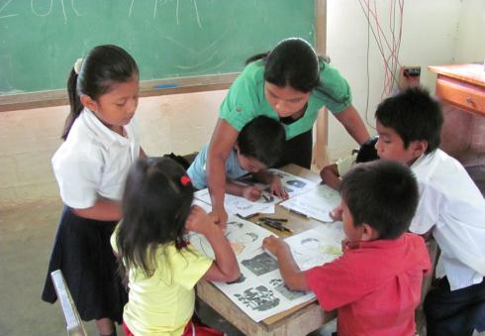
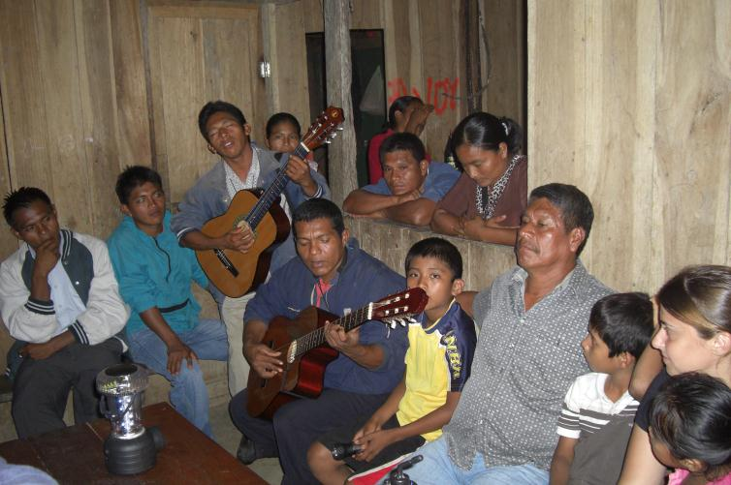
Naso People
Indigenous Tribe
  3300 people
  11 communities
Language
  Naso
  Spanish
Livelihood
  Subsistence Farmers
  Artisan crafts

Slide 5
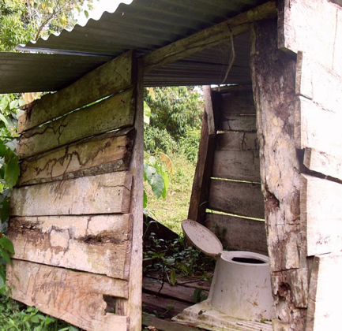
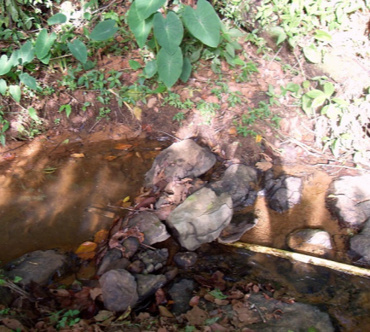
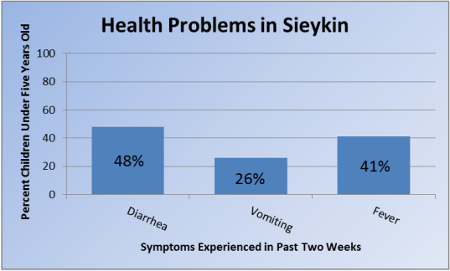
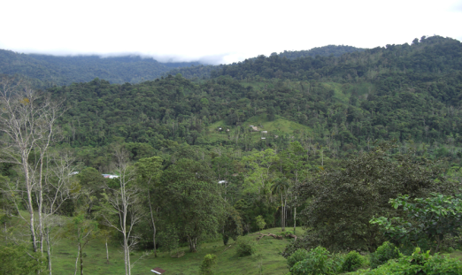
Sieykin Need
Lack potable water
Poor sanitation
No electicity, roads or infrastructure
Health concerns

Slide 6
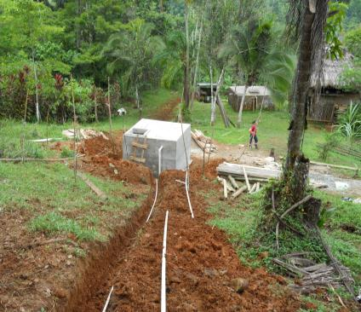
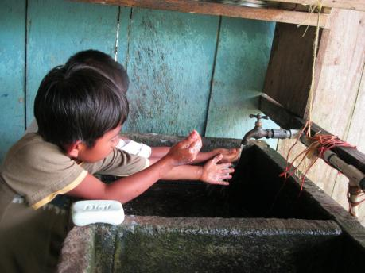
Project Goal
Improve quality of life by reducing waterborne diseases and improving hygiene.
Potable Water Storage & Distribution System
Health & Hygiene Education Campaign
Need picture here

Slide 7
Project Timeline
Project Founded
Spring 2008
Implementation I
July/August 2010
  Community identified
  Initiated communication with Sieykin
  Implement Potable Water Storage & Distribution System
  Health Education
Assessment I
January 2009
Assessment III
January 2011
  Community Assessment
  Project Feasibility
  Water Testing & Surveying Sieykin Arriba
  Health Education
Assessment II
August 2009
Implementation II
July 2011
  Water Testing & Surveying of Central Sector
  Health Education
  Implement Potable Water system for Sieykin Arriba
  Health Education

Slide 8
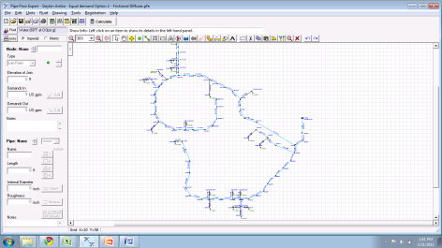
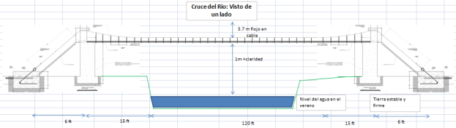
This semester…
Design a potable water system for Sieykin Arriba
  Design spring box
  Hydraulic modeling
  Storage
  Bridging

Slide 9
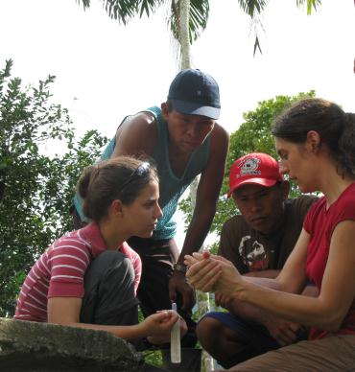
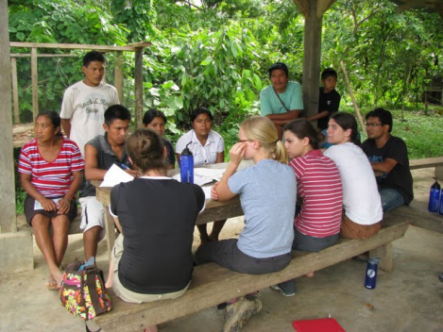
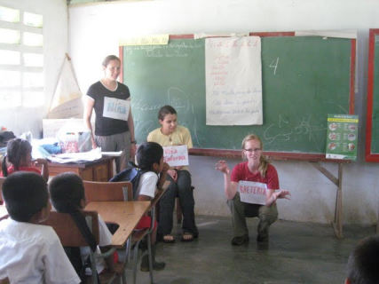
This semester…
Education Campaign
  New health education activities for kids
  Capacity building activities for adults
  Develop water committee and improve community organization

Slide 10
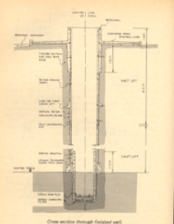
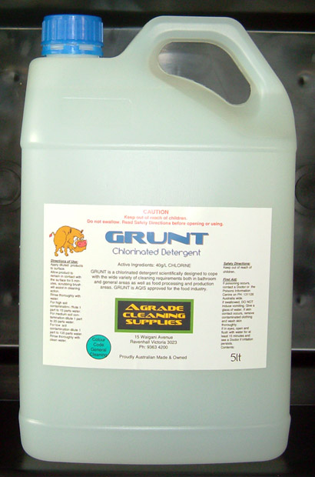
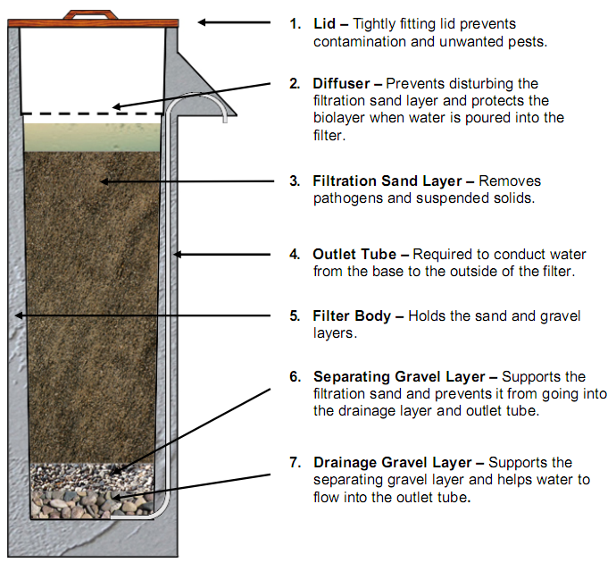
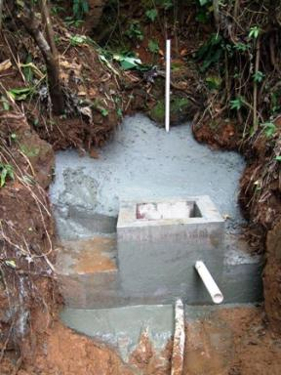
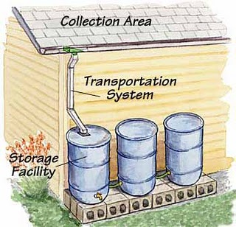
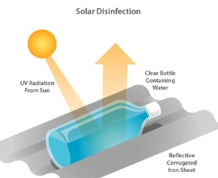
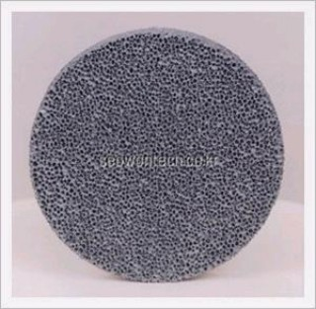
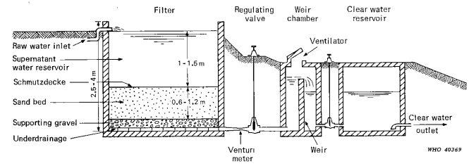
Source Alternatives
Slow Sand Filter
Bio-Sand Filter
Solar Disinfection
Ceramic Filters
Chlorination
Rainwater Harvesting
Hand-Dug Well
Spring Box

Slide 11
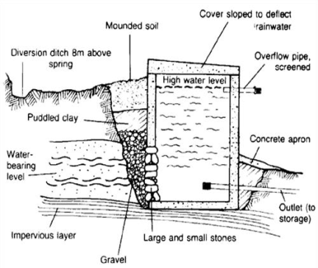
Preferred Alternative: Spring Box

Slide 12
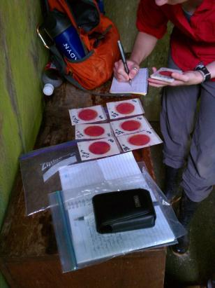
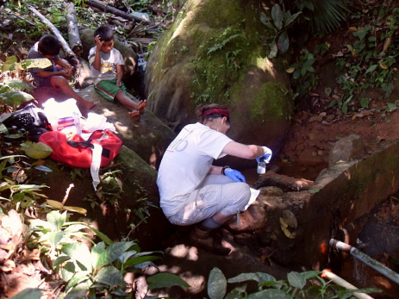
Water Testing
pH
Hardness
Alkalinity
Nitrates/Nitrites
Ammonium
Phosphates
Arsenic
Turbidity
Total coliforms
E. coli

Slide 13
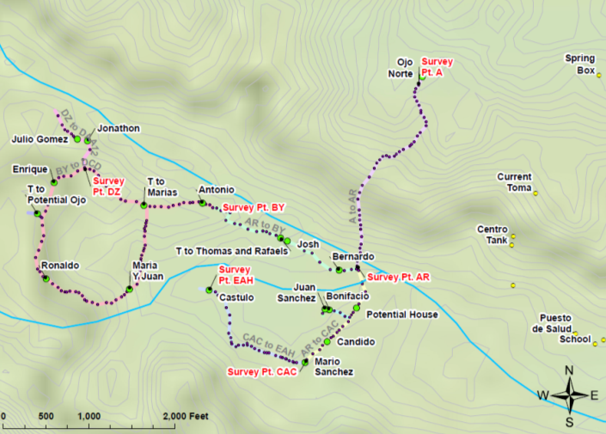
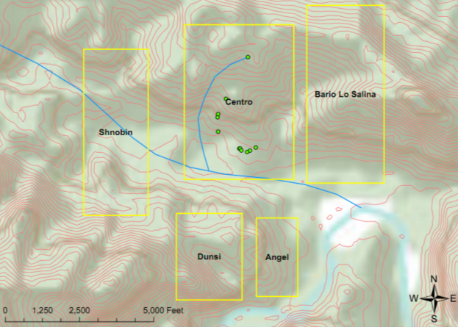
Map of Community

Slide 14
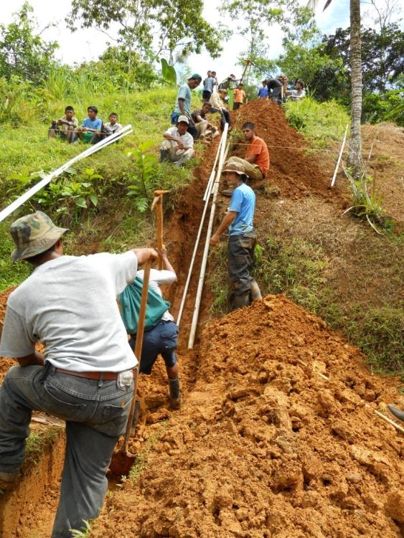
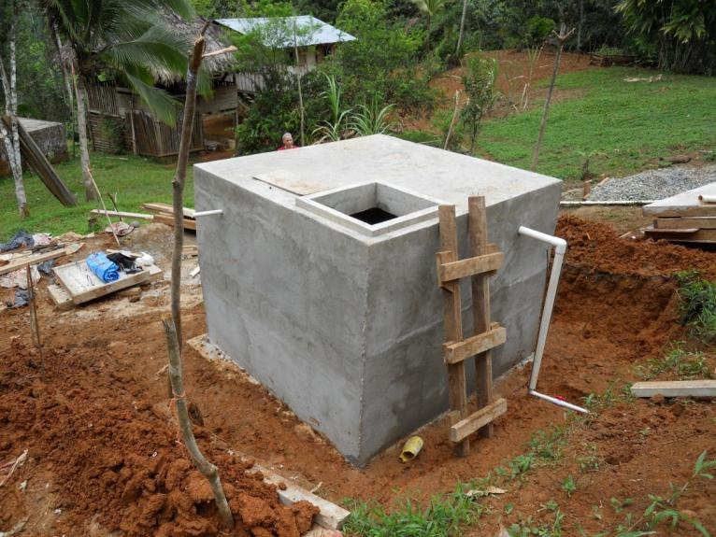
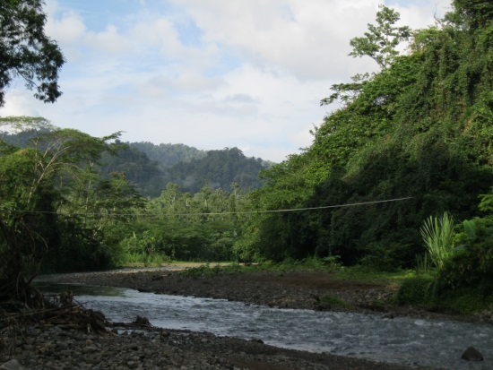
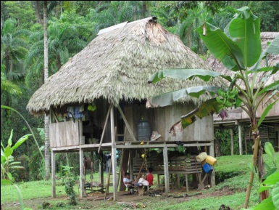
System Schematic
Spring box
Elev. = 1,000 ft.
Potable source line
~ 1,500 ft. PVC pipe
Potable tank
Elev. = 930 ft.
Bridges
~ 150 ft. span
Service lines
~ 13,500 ft. each (~1” main line)
Users
Elev. = 600-870 ft.

Slide 15
Demand – Water Use Assumptions
Community members are used to having access to large amounts of water
We wanted to avoid causing large changes in behavior
Two demand groups (daily consumption):
  Potable-Only: 50 L/p (WHO “intermediate”)
  Full Demand: 150 L/p (WHO “optimal”)

Slide 16

Demand – Population Calculations
$P_{t}=P_{i}e^{rt}$, Population growth formula
  t = 15 yr; EWB requires 15-year sustainability
  r = 2.0% yr⁻¹
    CIA World Fact Book reports 1.4% for Panama
  P_{i} = 79 people for Arriba sector
    47 in “potable-only group”
    32 in “full demand group”
$P_{total}=79e^{0.02(15)}=107 people$
  $P_{potable}=47e^{0.02(15)}=64 people$
  $P_{full}=32e^{0.02(15)}=43 people$

Slide 17

Demand – Daily Demand Calculations
$Q_{potable}=\left(64 p\right)\left(50\frac{L}{pd}\right)=3200\frac{L}{d}$
$Q_{full}=\left(43 p\right)\left(150\frac{L}{pd}\right)=6450\frac{L}{d}$
$Q_{total}=3200\frac{L}{d}+6450\frac{L}{d}=9650\frac{L}{d}$

Slide 18
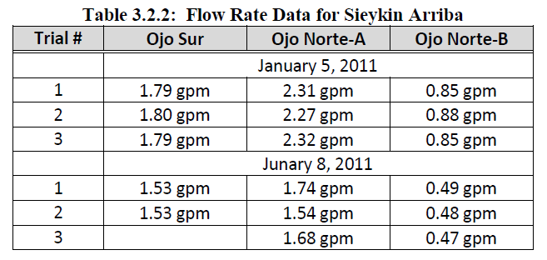
Potable Water Supply
Source: Global Precipitation Climatology Center (GPCC)

Slide 19
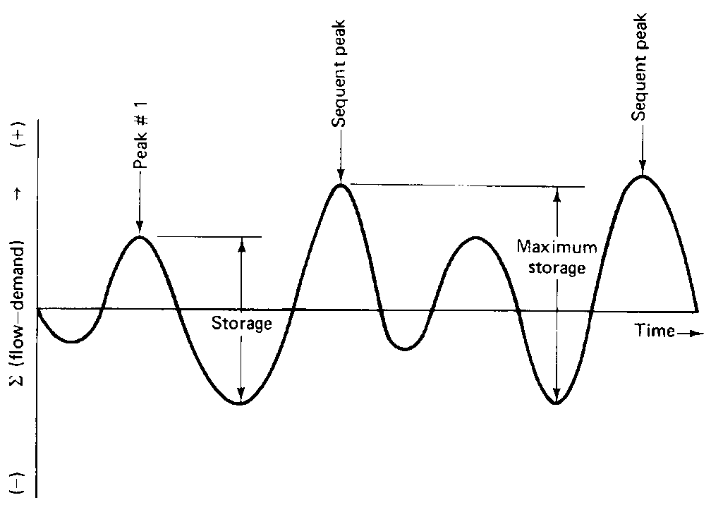

Sizing the Tank
Sequent Peak Method
  $K_{t}=\left\{\begin{aligned}{demand}_{t}−{inflow}_{t}+K_{t−1} If {demand}_{t}−{inflow}_{t}+K_{t−1}≥0 \\ 0 If {demand}_{t}−{inflow}_{t}+K_{t−1}<0\end{aligned}\right.$

Slide 20
Sizing the Tank

Slide 21

Distribution System – Hydraulic Model
Pipeflow Expert
Inputs
The internal size, internal roughness and length of each pipe.
The elevation of each pipe join point (node).
The In-flow and the Out-flow at each join point (if applicable).
The elevation, liquid level and surface pressure data for each tank.
Outputs
  Solves energy equation throughout system
  Flow and pressure drop through system

Slide 22
Model Inputs
1-inch Sch. 40 PVC mainline, 0.5-inch Sch. 40 branches
  Specifics:
    Internal Roughness, Internal Diameter, Length of Pipe
Elevation data from survey
Average daily demand of 0.13 gpm to all users
Minor losses where appropriate
  Safety Factor

Slide 23
Distribution System – House Elevations
Notes:
Do we have source of this chart? I don’t know if it makes sense to have a line chart here. Probably just a scatter plot would be better.

Slide 24

Distribution System – Hydraulic Model

Slide 25
Alternative Designs
Option 1
Tank at sufficient elevation to provide clean water for all
Only frictional losses in the pipeline and minor losses to reduce system energy
Option 2
Same concept as option 1 – two houses at extreme elevations excluded
  Enrique, Juan y Flores

Slide 26
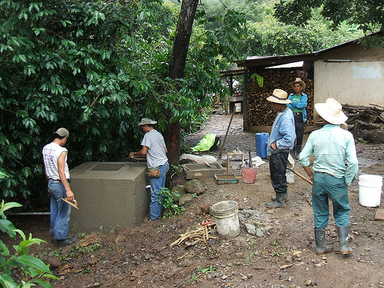
Alternative Designs
Option 3
Reduce pressure to lower elevation houses
Frictional diffuser
Option 4
Reduce pressure to lower elevation houses
Break pressure tank

Slide 27
Model Output

Slide 28
Preferred Option (Option 3)
Frictional Diffuser
  High K-value fitting
  Simple to build
  Achieve reasonable pressures for all users
Frictional
Diffuser
Storage Tank

Slide 29
Obstacles Encountered
Language/Cultural Differences
  Not enough Spanish speakers
  Indirect communication
  Unaware of community politics
Community Organization
  Loose power structure
  Lack of follow through

Slide 30
Obstacles Encountered
Difficult to convey information through village
  Word of mouth is slower than Twitter!
Working strategies
  Did not like to split up
  Focused on one task at a time
  Preferred large concentrated efforts

Slide 31
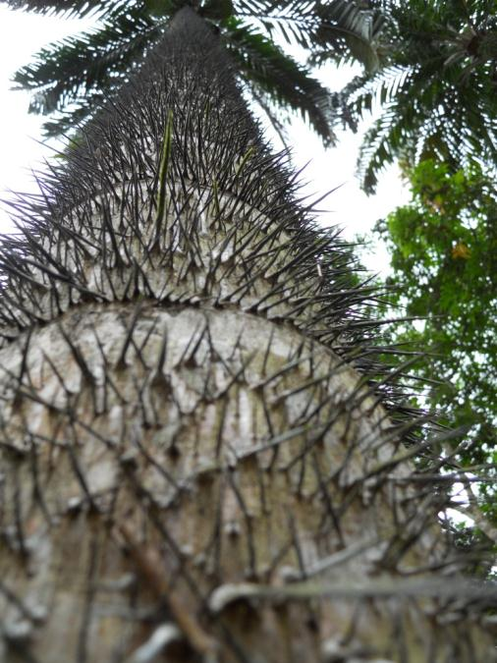
Obstacles Encountered
Transporting Materials
  No motorized transport
  Few animals
Trenching/Soil
  Dense, sticky clay soil
  High water table
Climate
  Rain, rain and more rain
  Hot and humid
  Everything bites!

Slide 32
Project Highlights
Central sector has reliable potable water
Cases of diarrhea, vomiting, and fever reduced from 50-60 per month to just 5!
Have valuable information for future implementations
EWB team made positive relationships with each other and with the community
Very rewarding personal experience

Slide 33
What we’re doing now…
Submitted our Alternatives Analysis and Preliminary (30%) Design documents last week
Submitting Final Design documents in 3 weeks
Present to Technical Advisory Committee in May
Finalize logistics through May and June
Travel for Implementation II in July 2011

Slide 34
What we’ll be doing in the future…
Three additional sectors lack potable water
  Assessment trips during winter breaks
  Implement phases III, IV, and V during summers

Slide 35

Questions???

Slide 36
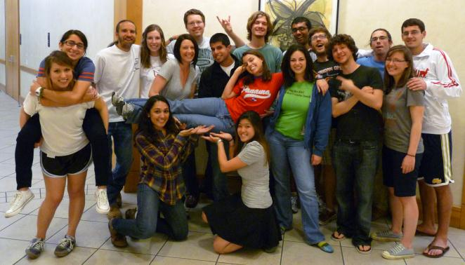
EWB - Greater Austin
Panama Project Meetings
  Tuesdays @ 7pm
  ACES 2.402
Greater Austin Happy Hours
  Third Thursdays @ 6pm
  Spiderhouse
For more information:
www.ewbgreateraustin.org
  panama@ewbgreateraustin.org

