Slide 1
Evaporation
What is evaporation?
How is evaporation measured?
How is evaporation estimated?
Reading: Applied Hydrology Sections 3.5 and 3.6
With assistance from Dan Siegel and Marcy Litvak

Slide 2
Evaporation
What is evaporation?
How is evaporation measured?
How is evaporation estimated?

Slide 3
Evaporation
  Evaporation – process by which liquid water becomes water vapor
  Transpiration – process by which liquid water passes from liquid to vapor through plant metabolism
  Evapotranspiration – evaporation through plants and trees, and directly from the soil and land surface
  Potential Evaporation – evaporation from an open water surface or from a well-watered grass surface

Slide 4
Factors Influencing Evaporation
Energy supply for vaporization (latent heat)
  Solar radiation
Transport of vapor away from evaporative surface
  Wind velocity over surface
  Specific humidity gradient above surface
Vegetated surfaces
  Supply of moisture to the surface
  Evapotranspiration (ET)
    Potential Evapotranspiration (PET) – moisture supply is not limited
Net radiation
u
Air Flow
Evaporation

Slide 5
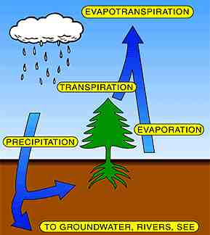
Evapotranspiration (ET)
Over land surfaces, we cannot distinguish between water vapor that evaporated from the soil and water vapor that was transpired through plants

Slide 6
Evaporation
What is evaporation?
How is evaporation measured?
How is evaporation estimated?

Slide 7
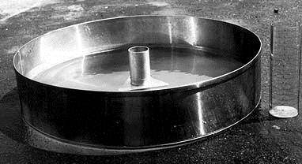
Evaporation from an Open Water Surface
Simplest form of evapotranspiration
  This is the amount of water lost from lakes and reservoirs
  Often estimating by measuring the loss from a National Weather Service Class A pan
This is referred to as Potential Evapotranspiration (ET_{p}) because it is the maximum potential rate of ET under the given meteorological conditions

Slide 8
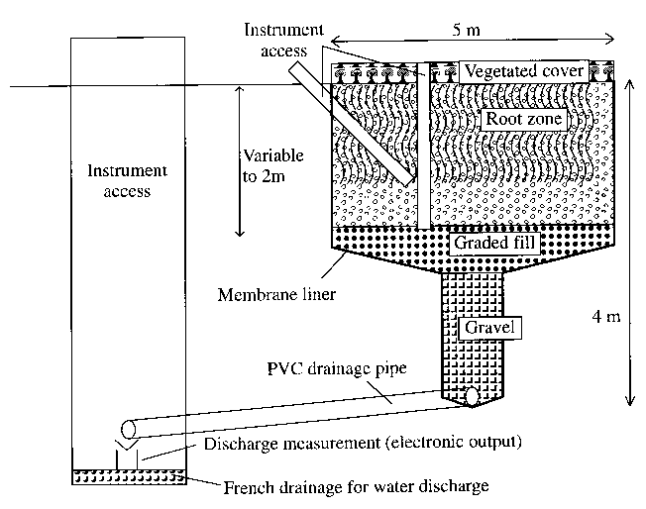
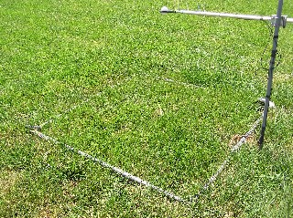
Lysimeters
Measurement of evapotranspiration

Slide 9
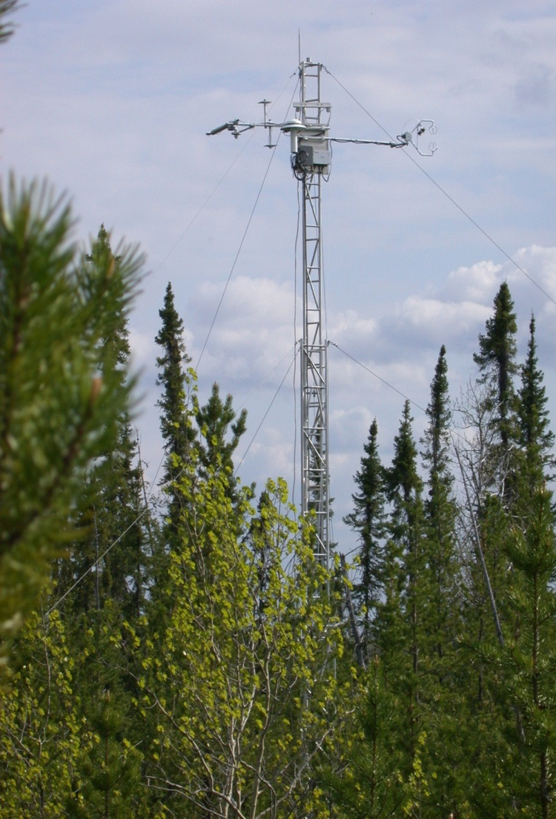
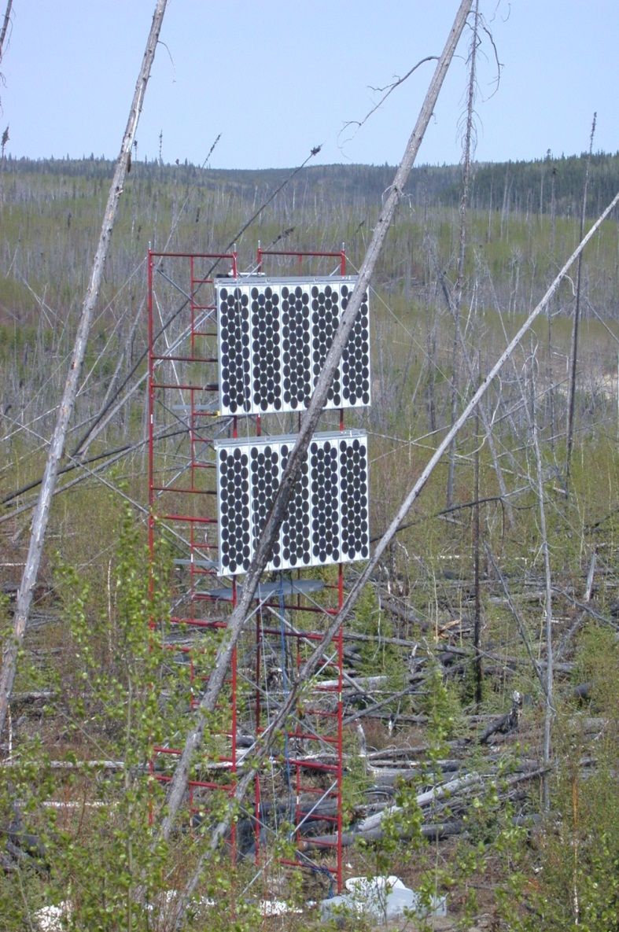
Flux Towers (Marcy Litvak)

Slide 10
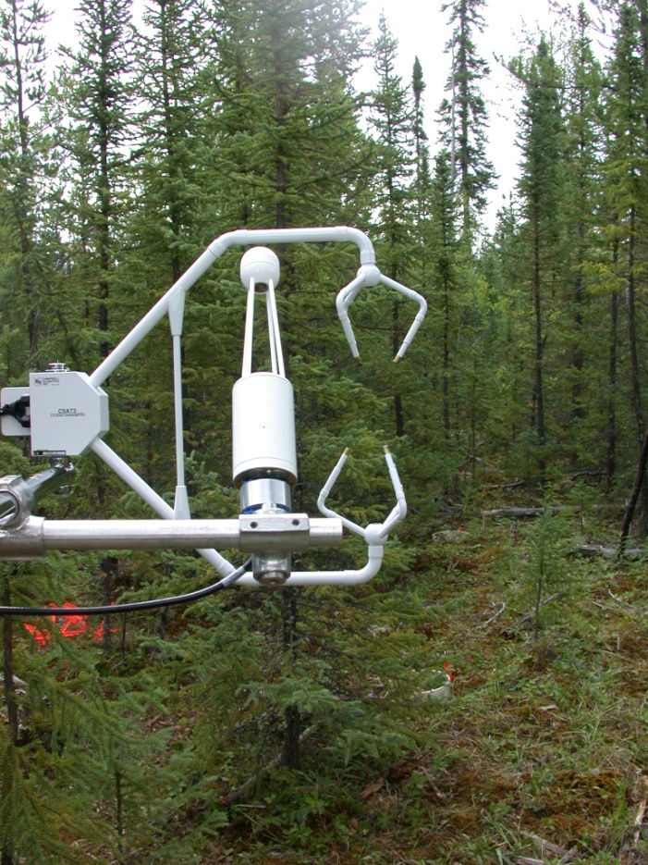
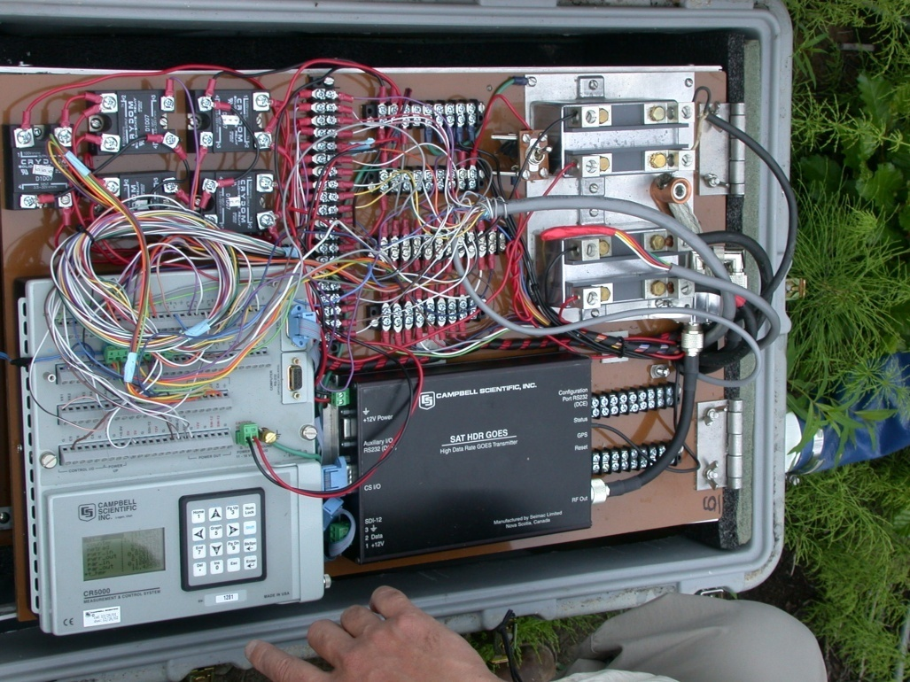
Flux tower instruments
Notes:
The eddy correlation technique is very simple in theory, but quite difficult to put into practice. A major problem has been availability of sufficiently fast instruments to measure the fluctuating signals. Unless an instrument has a sufficiently fast response and logging time to resolve the fastest eddies contributing to the turbulent flux, this portion of the flux will not be recorded. Another effect of slow logging is that the faster eddies may fold around the
Ultrasonic Doppler anemometers are normally used to measure the three components of wind. These instruments are easily fast enough to resolve turbulence under most practical conditions, - they have maximum response and reporting frequencies up to around 100 Hz. The problem with such anemometers tends to be designing logging systems fast enough to log the data.
The potential difficulty in designing working Eddy Covariance systems is often in finding the right instrument to detect the variable of interest to be correlated with the vertical wind fluctuations (the scalar variable). Some instruments simply are not fast enough, for example the DMPS (see section 7), and many chemiluminescent analysers. Also, measuring certain gases is fundamentally problematic, as some ("sticky") gases can adhere to the inside of inlet lines before reaching the analyser. This damps the signal, giving the same problem as a poor frequency response instrument (although without the frequency folding).
The final factor affecting response time of eddy covariance systems is the size of the sensor. Eddies smaller than the size of the transducer array of the anemometer cannot be detected effectively. This places an upper frequency limit on response according to Taylor’s hypothesis (see section 4.1). The effect of this limit has not been observed in measurements referred this work.
The frequency required for the Eddy Covariance method depends upon the mean eddy size at the sensors. This is a function of surface roughness length z0 (see section 4.2.4) and measurement height z. Specifically, larger values of z0 give larger mean eddy sizes and ease the frequency requirements for the system. Equally, larger values of z (larger measurement heights) give larger mean eddy sizes, having the same effect.

Slide 11
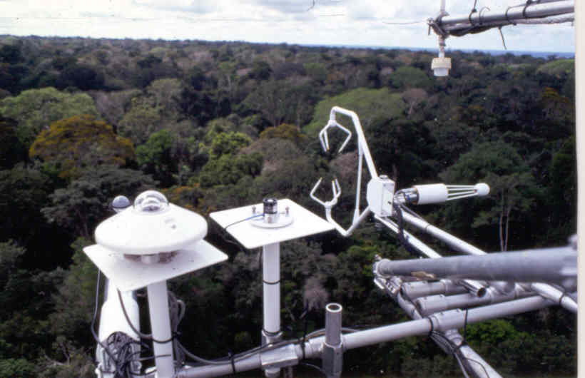
Flux tower instruments
3-D Sonic anemometer
Quantum
sensor
Pyrronometer
IRGA
Net radiometer

Slide 12
Air Temperature at 1m and 10m
Freeman Ranc Flux Tower (Marcy Litvak)

Slide 13
Vapor Pressure and Saturated Vapor Pressure (kPa)

Slide 14
Relative Humidity at 1m and 10m
Average = 0.71
Average = 0.61

Slide 15
Wind Speed (m/s)

Slide 16
Net Radiation (W/m²)

Slide 17
ET -Eddy covariance method
Measurement of vertical transfer of water vapor driven by convective motion
Directly measure flux by sensing properties of eddies as they pass through a measurement level on an instantaneous basis
Statistical tool

Slide 18
Basic Theory
Instantaneous
Perturbation from
The mean
Instantaneous
signal
Time averaged property
All atmospheric entities show short-period fluctuations about their long term mean value
Notes:
All atmospheric entities show short-period fluctuations about their longer term mean value
Overbar indicates time-averaged property
Prime signifies instantaneous deviation from the mean, positive indicates above the mean

Slide 19
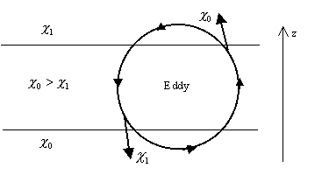
Turbulent mixing
Propterties carried by eddies:
Mass, density ρ
Vertical velocity w
Volumetric content q_{v}
Temperature T
Notes:
Eddy mixes air from above downwards, and from below upwards
Concentration of entity is greater below, as it is mixed upwards causes a positive perturbation

Slide 20
Sensible Heat Flux (W/m²)

Slide 21
Latent Heat Flux (W/m²)

Slide 22
Evaporation (mm/day)
Average = 3.15 mm/day

Slide 23
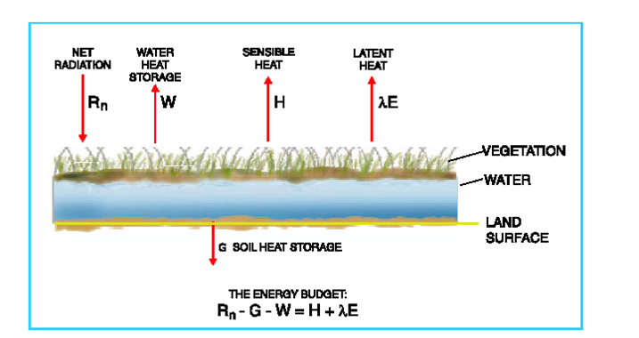
Energy Balance Method
Can directly measure these variables
How do you partition
H and λE??

Slide 24
Evaporation
What is evaporation?
How is evaporation measured?
How is evaporation estimated?

Slide 25

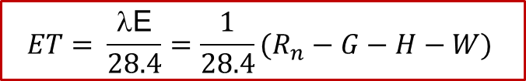

Energy Balance Method
$$\text{}$$
$$\frac{28.4 \text{W} }{m^{2} }×\frac{J/s}{W}×\frac{1 g}{2450 J}×\frac{3600 s}{ 1 hr}×\frac{24 hr}{1 day}×\frac{m^{3}}{1000 kg}×\frac{1 kg}{1000 g}×\frac{1000 mm}{1 m}=1 \frac{mm}{day}$$
$$ρ﷮w$$
$$ET= \frac{\text{λ}\text{E}}{28.4}=\frac{1}{28.4}(R_{n}−G−H−W)$$
The maximum radiative evaporation rate E_{r} = $\frac{R_{n}}{28.4}$

Slide 26
Velocity Profile
Determining momentum transfer requires knowing velocity profile
Flow of air over land or water – log velocity profile
Von Karman constant
Roughness height
Shear velocity
Wall shear stress
Velocity gradient

Slide 27
Aerodynamic Method
Include transport of vapor away from water surface as function of:
  Humidity gradient above surface
  Wind speed across surface
Upward vapor flux
Upward momentum flux
Net radiation
Air Flow
Evaporation

Slide 28
Aerodynamic Method
Log-velocity profile
Momentum flux
Net radiation
Air Flow
Z
Evaporation
u
Thornthwaite-Holzman Equation

Slide 29
Aerodynamic Method
Often only available at 1 elevation
Simplifying
Net radiation
Air Flow
Evaporation

Slide 30
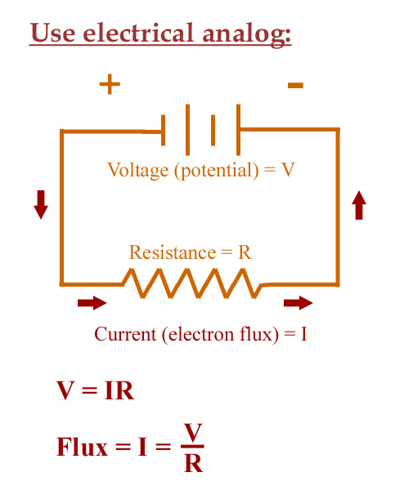
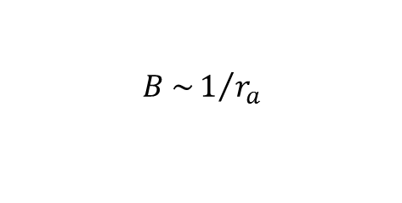
What is B?
Imagine ET as an electrical analog
The potential difference V = (e_{as} – e_{a})
The resistance of the atmosphere to heat transfer is r_{a}
ET, the flux, is analogous to the current, so
ET = V / R = (e_{as} – e_{a})/r_{a}
Thus
$$B \sim 1/{r_{a}}$$

Slide 31
Combined Method
Evaporation is calculated by
  Aerodynamic method
    Energy supply is not limiting
  Energy method
    Vapor transport is not limiting
Normally, both are limiting, so use a combination method
Priestley & Taylor

Slide 32
Example
Use Combo Method to find Evaporation
  Elev = 2 m,
  Press = 101.3 kPa,
  Wind speed = 3 m/s,
  Net Radiation = 200 W/m2,
  Air Temp = 25 degC,
  Rel. Humidity = 40%,

Slide 33
Example (Cont.)
Use Combo Method to find Evaporation
  Elev = 2 m,
  Press = 101.3 kPa,
  Wind speed = 3 m/s,
  Net Radiation = 200 W/m2,
  Air Temp = 25 degC,
  Rel. Humidity = 40%,

Slide 34
Example (Cont.)
Use Combo Method to find Evaporation
  Elev = 2 m,
  Press = 101.3 kPa,
  Wind speed = 3 m/s,
  Net Radiation = 200 W/m2,
  Air Temp = 25 degC,
  Rel. Humidity = 40%,

Slide 35
Example
Use Priestly-Taylor Method to find Evaporation rate for a water body
  Net Radiation = 200 W/m2,
  Air Temp = 25 degC,
Priestly & Taylor

Slide 36
Methods of Estimating Actual ET
Penman-Monteith
Crop Coefficients
Lysimeters
Flux Towers
Satellites

Slide 37

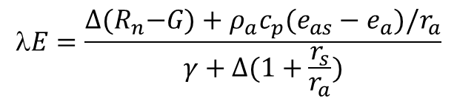
Penman-Monteith Equation
$$E=\frac{∆{(R}_{n}−G)+ρ_{a}c_{p}(e_{as}−e_{a})/r_{a}}{γ+∆(1+\frac{r_{s}}{r_{a}})}$$
A surface resistance term r_{s} is added to Combined Method to account for soil and vegetation’s tendency to hold onto water
r_{s} varies based on vegetation cover and soil moisture content
$r_{a}=\frac{{\ln\left(\frac{z}{z_{o}}\right)}^{2}}{k^{2}u}$
  The wind speed is u at height z
  The wind speed is 0 at height z_{o}, which is called the surface roughness
  k=0.41 is the Van Karman constant

Slide 38
Crop Coefficients
Multiply reference crop ET by a Crop Coefficient and a Soil Coefficient
http://www.ext.colostate.edu/pubs/crops/04707.html

Slide 39
Conduction of mass, momentum and energy
Flux is proportional to the gradient of a potential
Momentum flux (laminar flow)
Newton’s law of viscosity
Mass flux
Fick’s law of diffusion
Energy flux
Fourier’s law of heat conduction
μ is dynamic viscosity, D is diffusion coefficient, and k is heat conductivity. Dynamic viscosity (μ) is related to kinematic viscosity (ν) as μ = ρ ν
The direction of transport of extensive properties is transverse to the direction of flow.

Slide 40
Convection
Energy transfer through the action of turbulent eddies or mass movement of fluids with different velocities.
Turbulence – mechanism causing greater rate of exchange of mass, energy, and momentum than molecular exchanges
Unlike conduction, convection requires flowing fluid
Eg. Convection causes vertical air circulation in which warm air rises and cool air sinks, resulting in vertical transport and mixing of atmospheric properties

Slide 41
Convection of mass, momentum and energy
Momentum flux (turbulent flow)
K_{m} is momentum diffusivity or eddy viscosity
Mass flux
K_{w} is mass diffusivity
Energy flux
K_{h} is heat diffusivity
K_{m} is 4-6 orders of magnitude greater than ν.
τ_{turb} is the dominant momentum transfer in surface water flow and air flow.
The direction of transport of extensive properties is transverse to the direction of flow.

Slide 42
Potential Evapotranspiration
Multiply reference crop ET by a Crop Coefficient and a Soil Coefficient
http://www.ext.colostate.edu/pubs/crops/04707.html

Slide 43
Resources on the web
Evaporation maps from NWS climate prediction center
  http://www.cpc.ncep.noaa.gov/soilmst/e.shtml
Climate maps from NCDC
  http://www.nndc.noaa.gov/cgi-bin/climaps/climaps.pl
Evapotranspiration variability in the US
  http://geochange.er.usgs.gov/sw/changes/natural/et/

