Slide 1
Geographic Information Systems in Hydrology
Presented by Dr. Tim Whiteaker
The University of Texas at Austin
3 May, 2011

Slide 2
Outline
What is GIS
Data Types
Data Models
Data Sources
Software

Slide 3
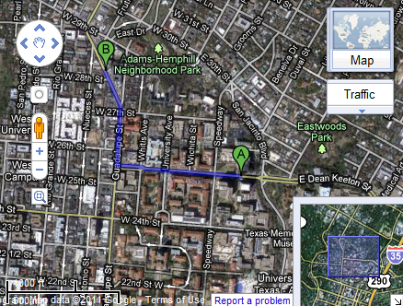
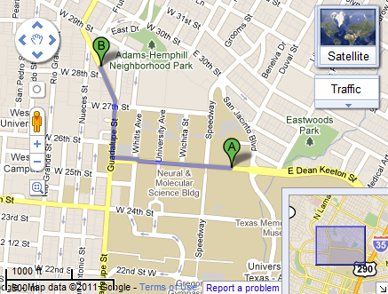
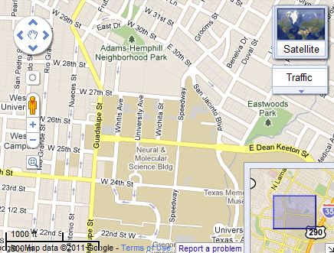
Geographic Information Systems (GIS)
A GIS consists of software, data, and services for visualizing and analyzing spatially referenced information.
Notes:
Google Maps is an example of a GIS. The map gives you a pretty picture, but the features in the map are smart. The roads know how long it takes to travel along them and which other roads they are connected to, allowing the software to compute directions and travel times. The map consists of different layers, and I can swap out the background map for satellite imagery while still keeping the roads and street names visible.

Slide 4
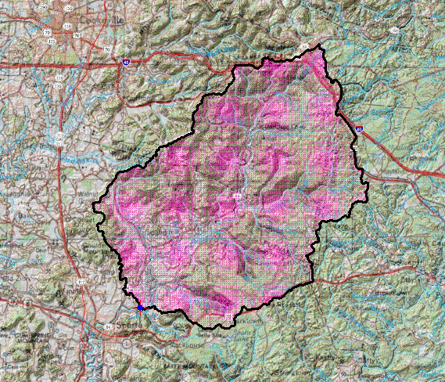
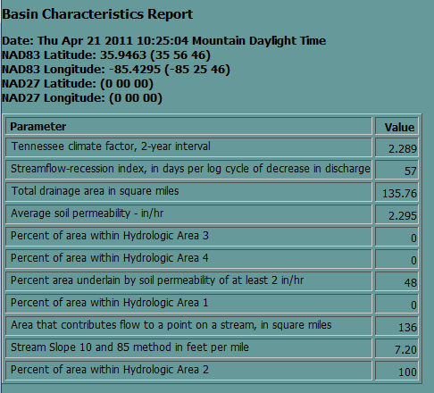
StreamStats http://water.usgs.gov/osw/streamstats
Notes:
StreamStats is a GIS application for hydrology

Slide 5
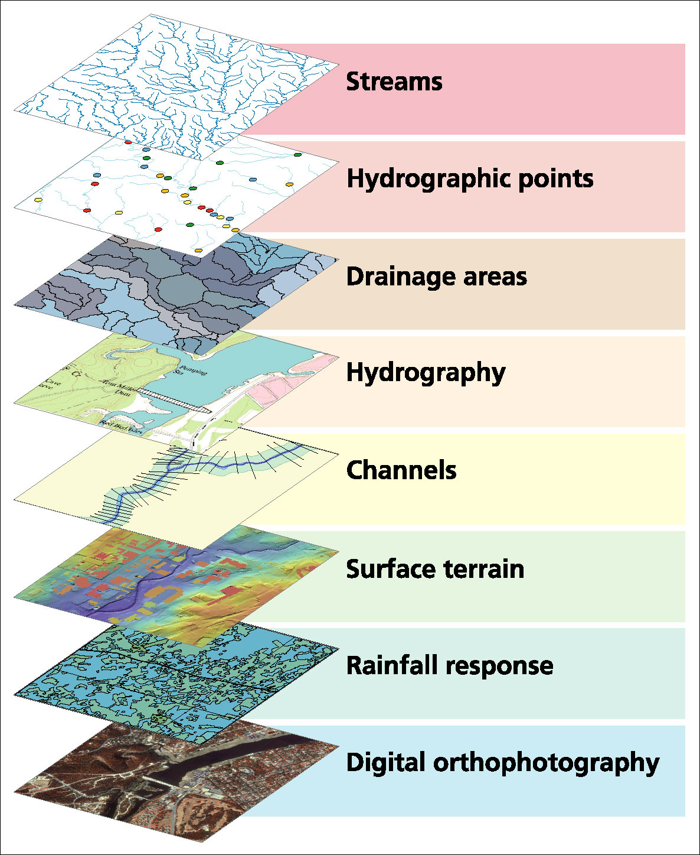
GIS uses an information model based on inventory of data layers

Slide 6
Spatial Data: Vector format
(x₁,y₁)
Point - a pair of x and y coordinates
vertex
Line - a sequence of points
Node
Polygon - a closed set of lines
Notes:
DRM

Slide 7
Some Vector Hydrology Layers
Vector data: point, line or polygon features

Slide 8
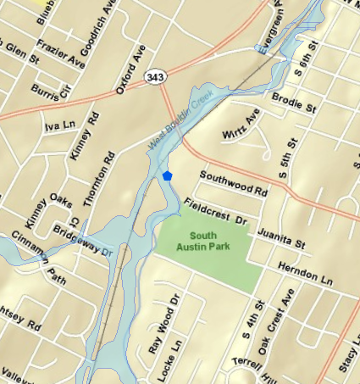
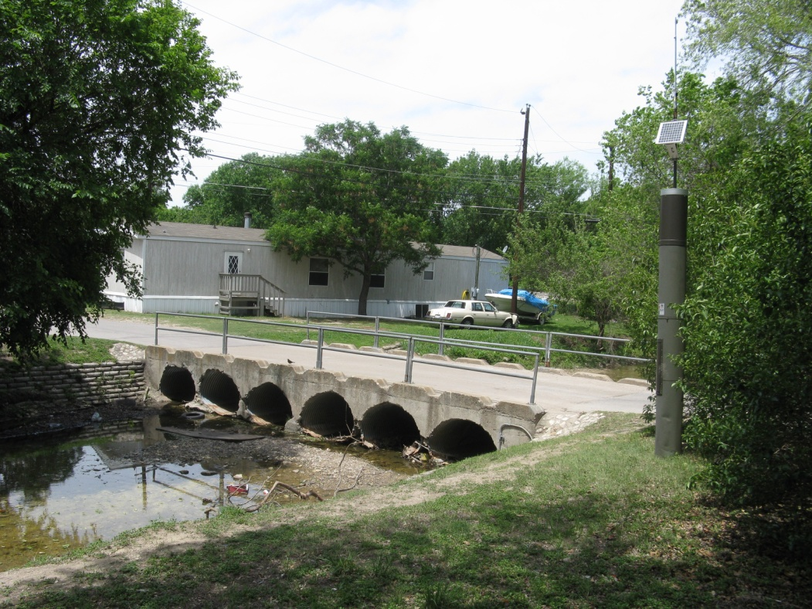
Austin’s Flood Early Warning System (FEWS)
FEWS Gage measuring water level and rainfall at a low water crossing
Image: Susan Janek, City of Austin

Slide 9
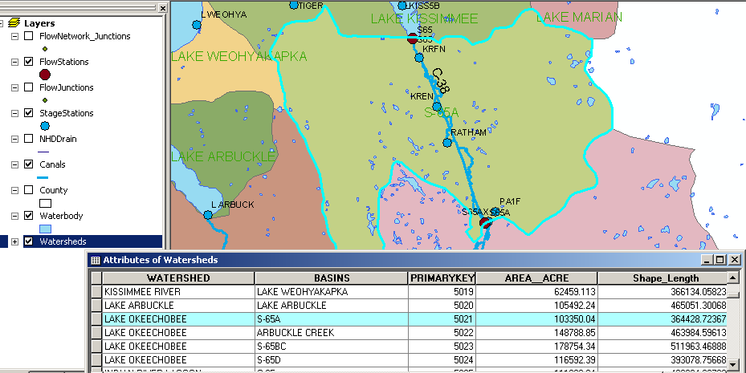
Attributes of a Selected Feature

Slide 10
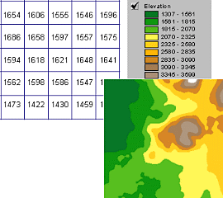
A raster is a matrix of identically-sized square cells. Each cell holds a numeric value that measures an attribute (like elevation) for that unit of space.
Spatial Data: Raster format

Slide 11
Raster Properties
Cell size
Number
of
rows
NODATA cell
(X,Y)
Number of Columns

Slide 12
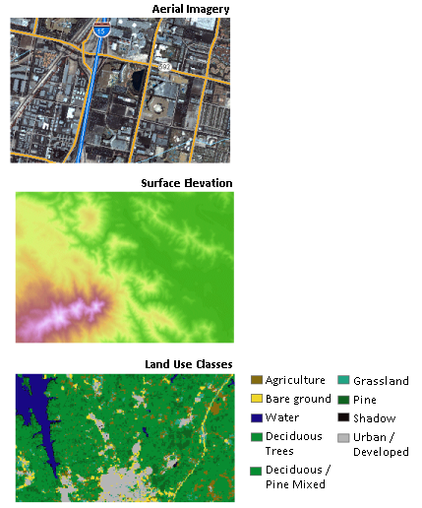

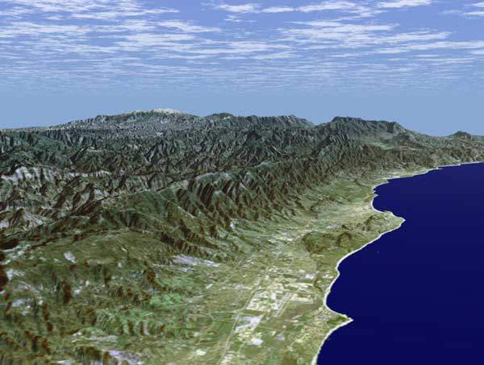
Some Raster Layers
Santa Barbara, California

Slide 13
Raster Calculator
Example
5
6
Precipitation
-
Losses (Evaporation, Infiltration)
=
Runoff
Cell by cell evaluation of mathematical functions
7
6
-
3
3
2
4
=
2
3
5
2

Slide 14
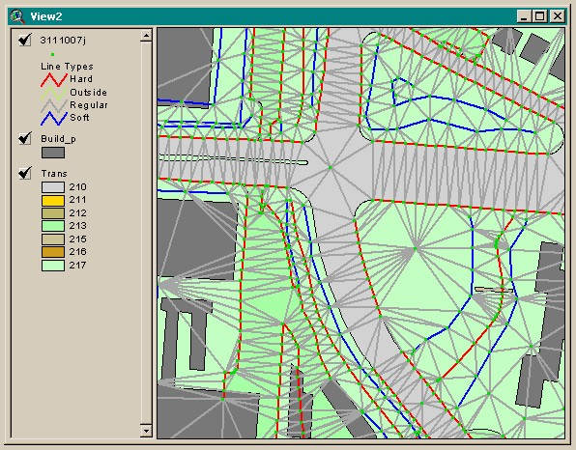
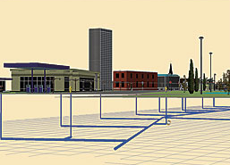
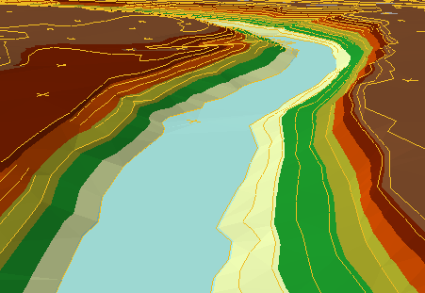
3D Data Types
Multipatch
Triangulated Irregular Network (TIN)

Slide 15
Linking Geographic Information Systems and Water Resources
Water
Resources
GIS

Slide 16
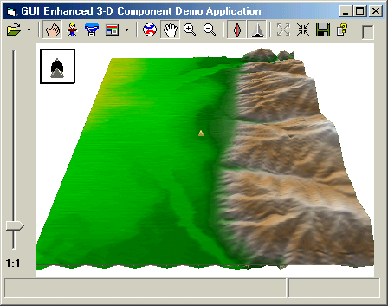

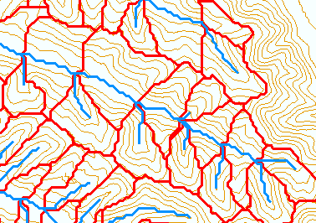
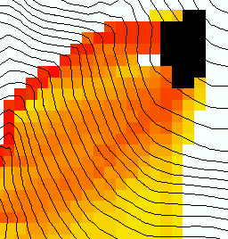
Terrain Processing: Computing Watersheds from Elevation Data
Raw DEM
Pit Removal (Filling)
Channels, Watersheds, Flow Related Terrain Information
Flow Field
Notes:
This slide shows the general model for deriving flow field related derivative surfaces from digital elevation data. The input is a raw digital elevation model, generally elevation values on a grid. This is basic information used to derive further hydrology related spatial fields that enrich the information content of this basic data. The first step is to remove sinks, either by filling, or carving. Then a flow field is defined. This enables the calculation of flow related terrain information. My focus has been on flow related information working within this framework. I try to leave other GIS functionality, like radiation exposure, line of sight analyses and visualization to others. I have distributed my software in ways that it easily plugs in to mainstream systems, such as ArcGIS to enhance ease of use.

Slide 17
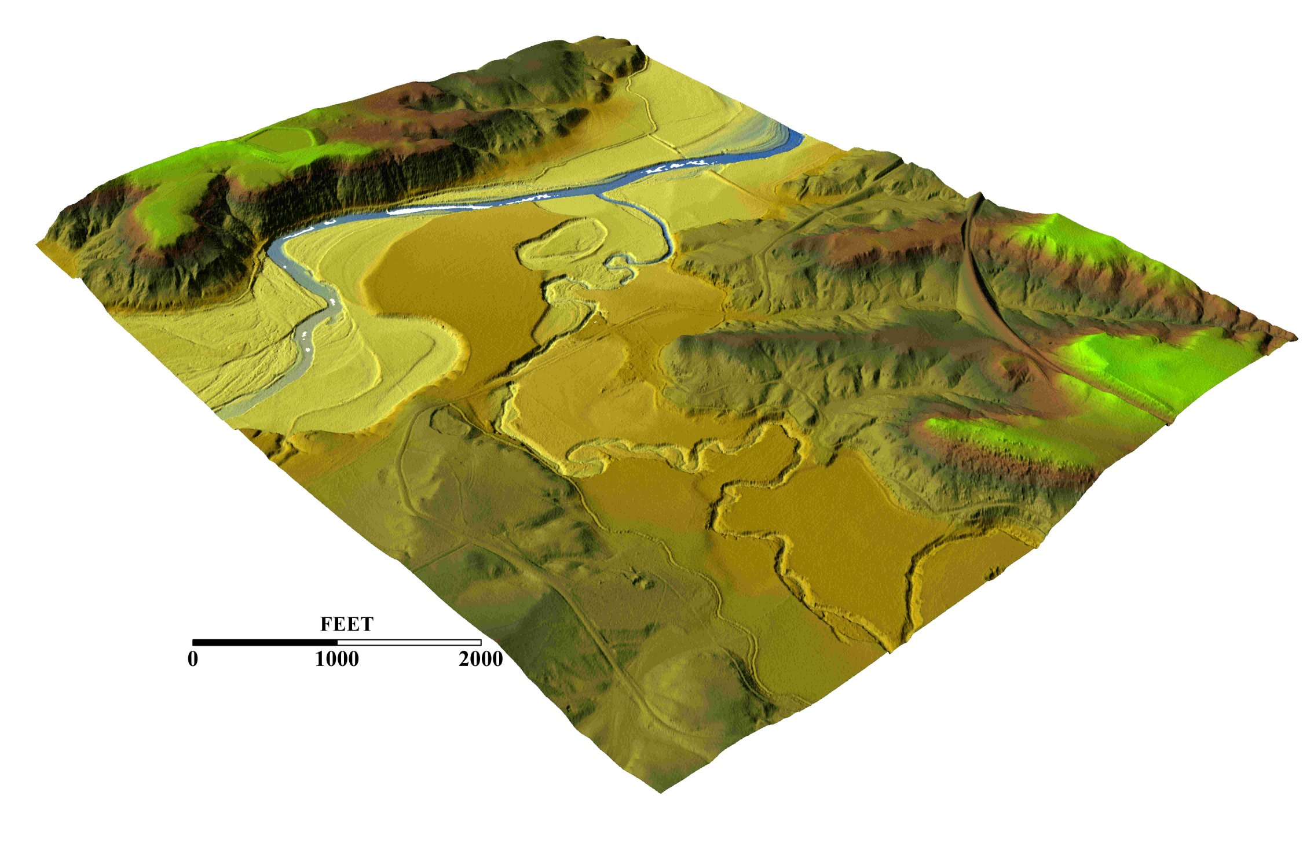
3-D detail of the Tongue river at the WY/Mont border from LIDAR.
Roberto Gutierrez
University of Texas at Austin

Slide 18
Hydrologic Slope
- Direction of Steepest Descent
30
30
80
74
63
80
74
63
69
67
56
69
67
56
60
52
48
60
52
48
Slope:
(67-48)/(30*(2^0.5)) = 0.45
(67-52)/30 = 0.50

Slide 19
Eight Direction Pour Point Model
32
64
128
16
1
8
4
2
Value indicates direction of flow

Slide 20
32
64
128
Flow Direction Grid
16
1
8
4
2
2
2
4
4
8
1
2
4
8
4
4
1
2
4
8
2
4
4
4
4
1
2
1
4
16

Slide 21
Grid Network

Slide 22
Flow Accumulation Grid.
Area draining in to a grid cell
0
0
0
0
0
0
0
0
0
0
0
2
2
2
0
0
2
2
2
0
0
0
10
0
1
0
0
1
0
10
1
0
0
14
0
1
0
0
0
14
0
4
1
19
1
0
4
1
1
19

Slide 23
Stream Network for 10 cell Threshold Drainage Area
Flow Accumulation
>= 10 Cell Threshold
0
0
0
0
0
0
0
0
0
0
0
2
2
2
0
0
2
2
2
0
0
0
10
0
1
0
0
1
0
10
1
0
0
14
0
1
0
0
0
14
0
4
1
19
1
0
4
1
1
19

Slide 24
Watershed Draining to Outlet

Slide 25
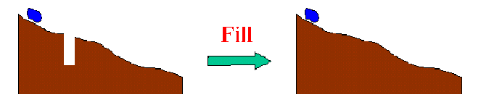
The Pit Removal Problem
DEM creation results in artificial pits in the landscape
A pit is a set of one or more cells which has no downstream cells around it
Unless these pits are removed they become sinks and isolate portions of the watershed
Pit removal is first thing done with a DEM

Slide 26


Pit Filling
Increase elevation until the pit drains to a neighbor

Slide 27
“Burning In” the Streams
• Take a mapped stream network and a DEM
• Make a grid of the streams
• Raise the off-stream DEM cells by an arbitrary elevation
increment
• Produces "burned in" DEM streams = mapped streams
+
=

Slide 28
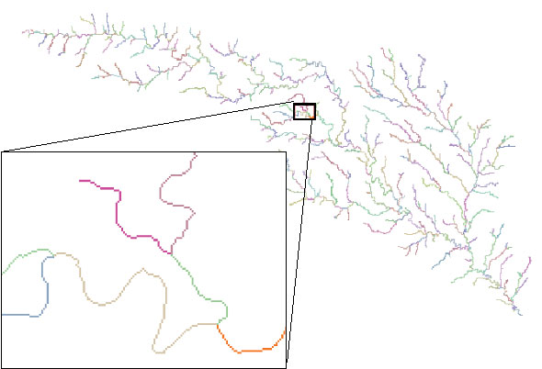
Stream Segments
201
172
202
203
206
204
209
Each link has a unique identifying number

Slide 29
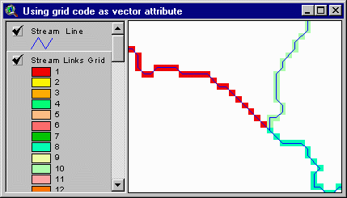
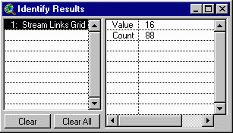
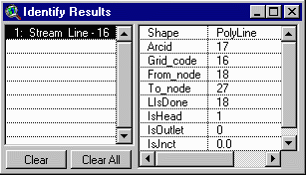
Vectorized Streams Linked Using Grid Code to Cell Equivalents
Vector
Streams
Grid
Streams

Slide 30
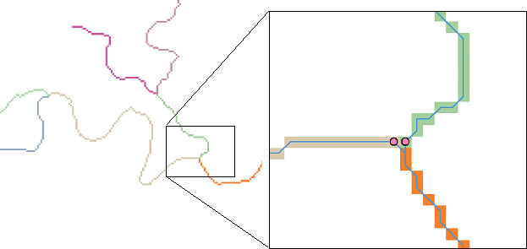
DrainageLines are drawn through the centers of cells on the stream links. DrainagePoints are located at the centers of the outlet cells of the catchments

Slide 31
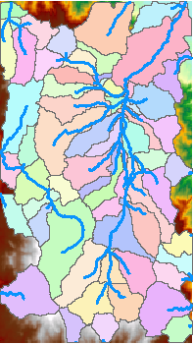
Catchments
For every stream segment, there is a corresponding catchment
Catchments are a tessellation of the landscape through a set of physical rules

Slide 32
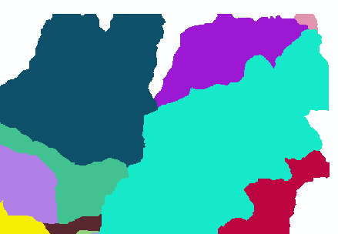
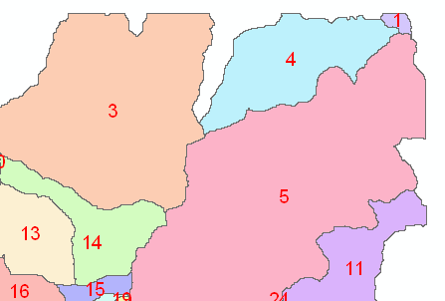
Raster Zones and Vector Polygons
One to one connection
DEM GridCode
Catchment GridID
4
3
5
Raster Zones
Vector Polygons

Slide 33
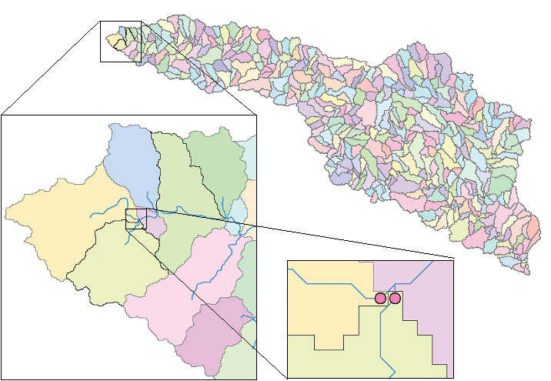
Catchments, DrainageLines and DrainagePoints of the San Marcos basin

Slide 34
Summary of Key Processing Steps
[DEM Reconditioning]
Pit Removal (Fill Sinks)
Flow Direction
Flow Accumulation
Stream Definition
Stream Segmentation
Catchment Grid Delineation
Raster to Vector Conversion (Catchment Polygon, Drainage Line, Catchment Outlet Points)

Slide 35
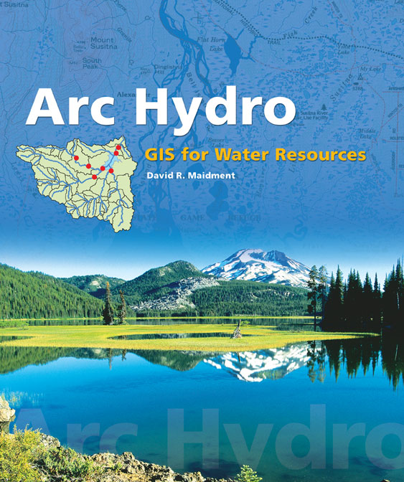
Arc Hydro: GIS for Water Resources
Published in 2002, now in revision for Arc Hydro II
Arc Hydro
  An ArcGIS data model for water resources
  Arc Hydro toolset for implementation
  Framework for linking hydrologic simulation models
The Arc Hydro data model and
application tools are in the public
Domain.

Slide 36
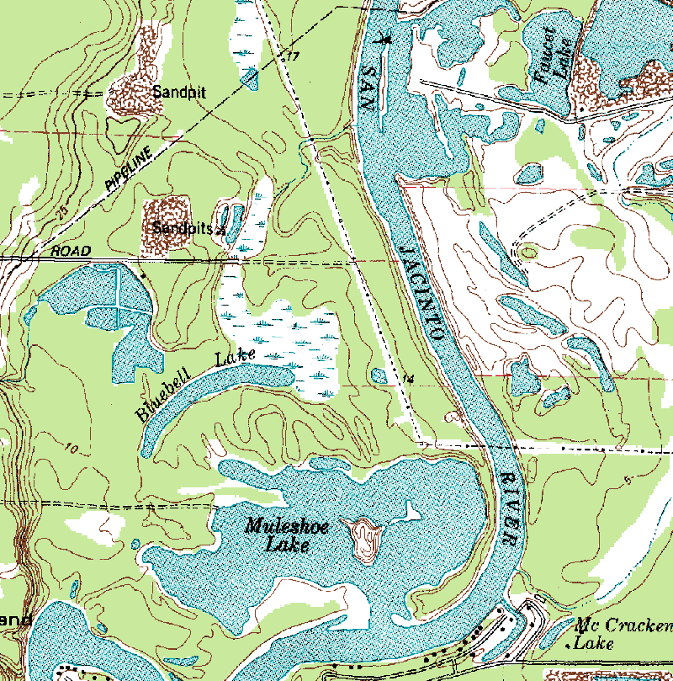
Arc Hydro — Hydrography
The blue lines on maps

Slide 37
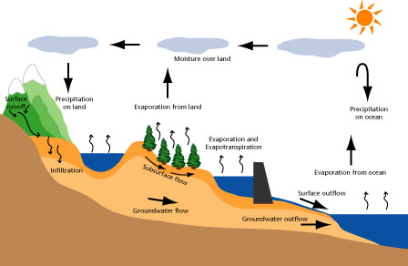
Arc Hydro — Hydrology
The movement of water through the hydrologic system

Slide 38
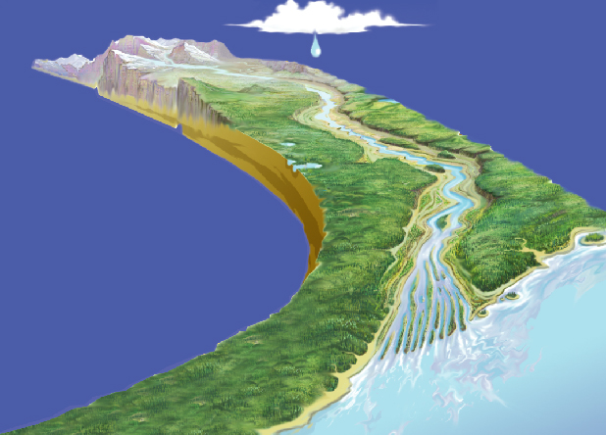
Tracing Path of Water Movement
Relationships between
features linked by HydroID

Slide 39
Arc Hydro Components
Drainage System
Hydro Network
Flow
Time
Time Series
Hydrography
Channel System

Slide 40
Arc Hydro Framework
Watersheds
Waterbody
Streams
Hydro Points
Notes:
The Arc Hydro Framework is a simplified version of the full Arc Hydro data model designed for an entry level user who just wants to put together a basic data set for streams, watersheds, waterbodies and hydro points like stream gages and water quality monitoring points

Slide 41

Network Definition
A network is a set of edges and junctions that are topologically connected to each other.

Slide 42
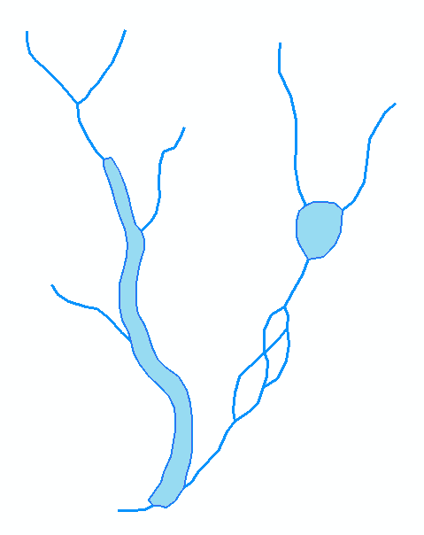
Hydrologic Networks
Hydrologic data includes:
  Single-line streams
  Double-line streams
  Braided streams
  Manmade channel systems
  Waterbodies

Slide 43
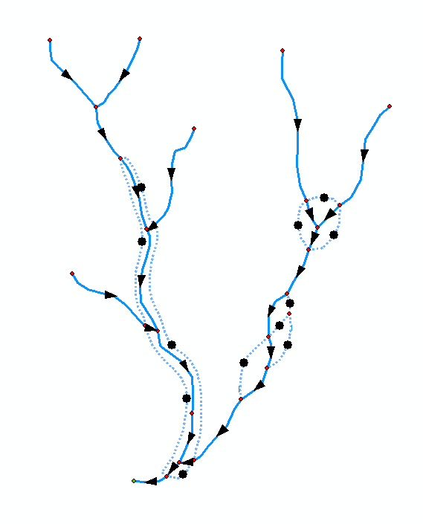
Network Flow Direction
Enable flow in flow-paths
Disable flow in shorelines
Sink
Flow direction is known

Slide 44
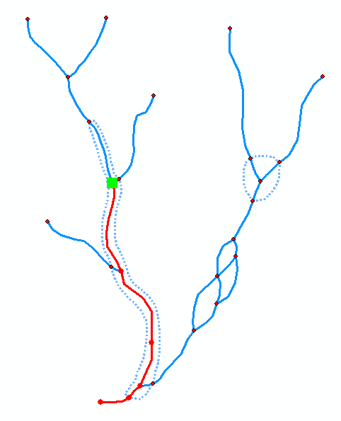
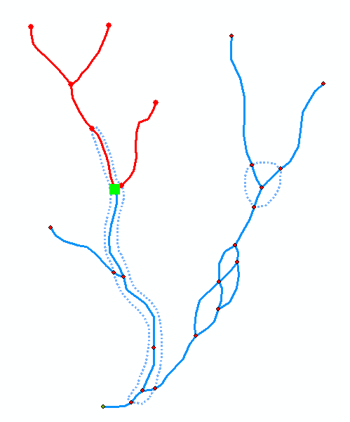
Network Tracing
Trace Upstream
Trace Downstream

Slide 45
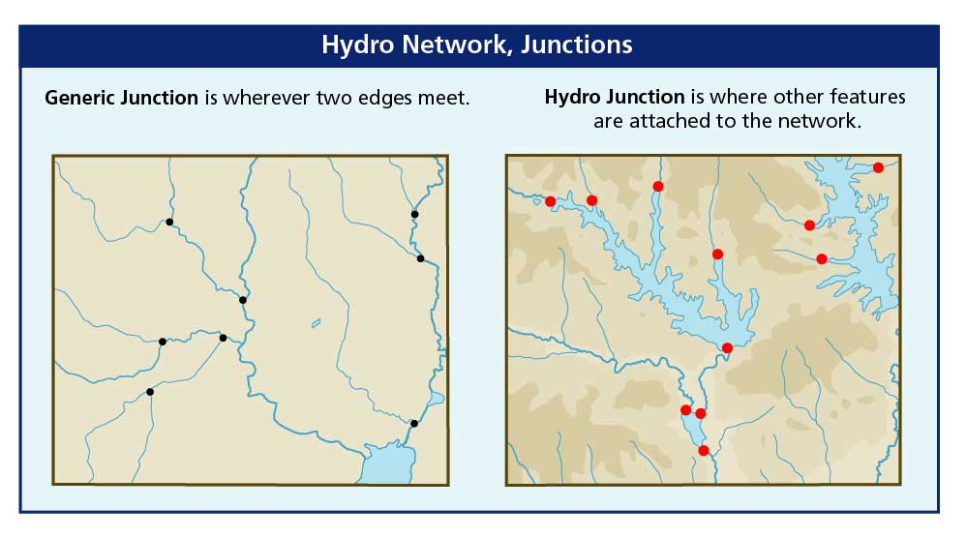
Hydro Network Junctions

Slide 46
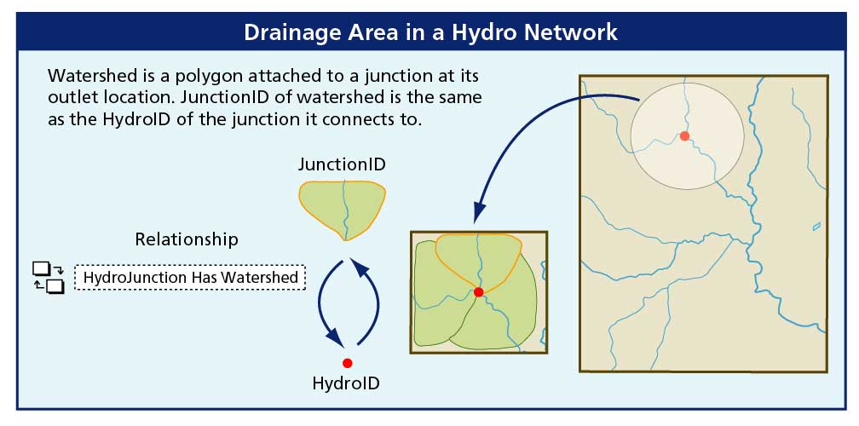
Connecting Drainage Areas
using Relationships

Slide 47
Space-time datasets

Slide 48
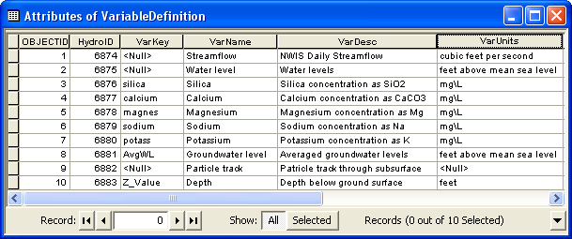
Variable Definition table
Catalog of time varying parameters (e.g. streamflow, water levels, concentrations, etc.)
Each variable is indexed with a HydroID

Slide 49
TimeSeries table
Each measurement is indexed by space, time, and type
Space = FeatureID
Time = TsTime
Type = VarID
VarID provides information on the variable

Slide 50
Time series views
We can “slice” through the data cube to get specific views of the data
Where?
What?
Where and What?
Query by location
(FeatureID = 2791)
Query by type
(VarID = 6875)
Query by location and type
(FeatureID = 2791 VarID = 6875)
TsTime
TsTime
TsTime
2791
FeatureID
FeatureID
2791
FeatureID
6875
6875
VarID
VarID
VarID

Slide 51
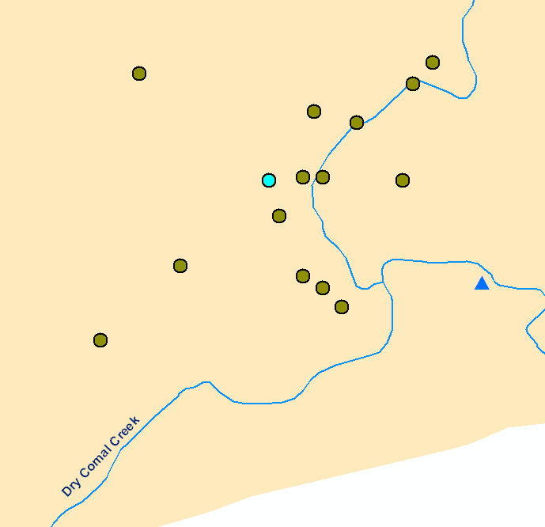
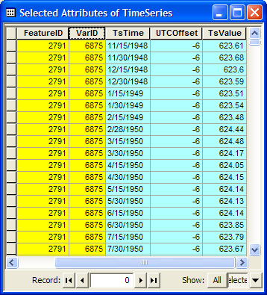
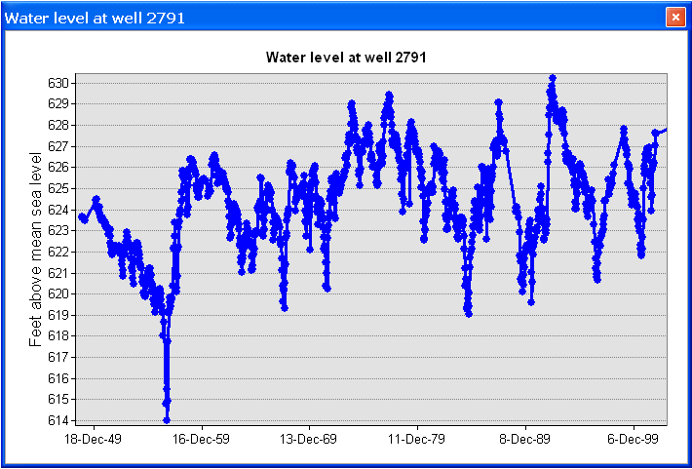
Time series views
Create a plot of time series related to a feature
Get all the data of VarID 6875 measured at Feature 2791
Well HydroID = 2791

Slide 52
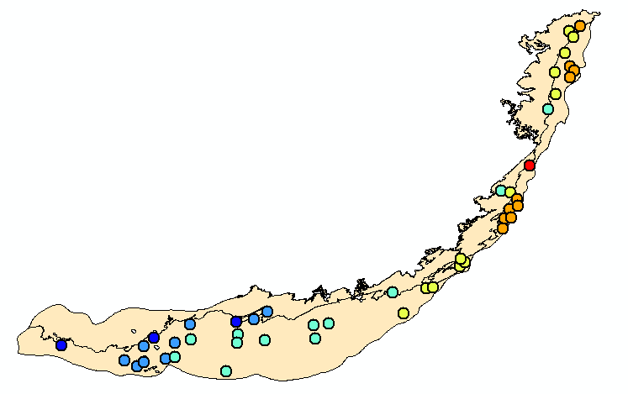
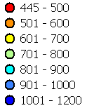
Time series views
Water level in the Edwards Aquifer in 1/1999
TsTime
TsTime
1/1991
FeatureID
FeatureID
6875
VarID
VarID

Slide 53
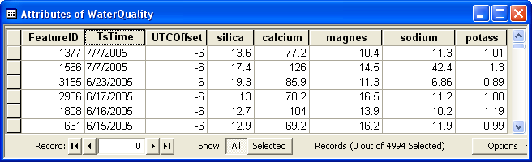
Multi-variable time series
Multiple variables recorded simultaneously at the same location
Example – water quality parameters
Indexed by location (FeatureID), and time (TsTime)
Relationship to the VariableDefinition table is through the VarKey
Variables (VarKey)

Slide 54
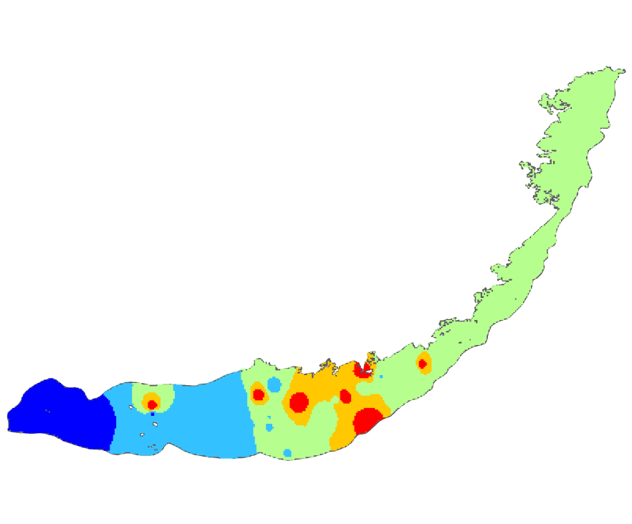
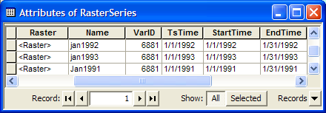

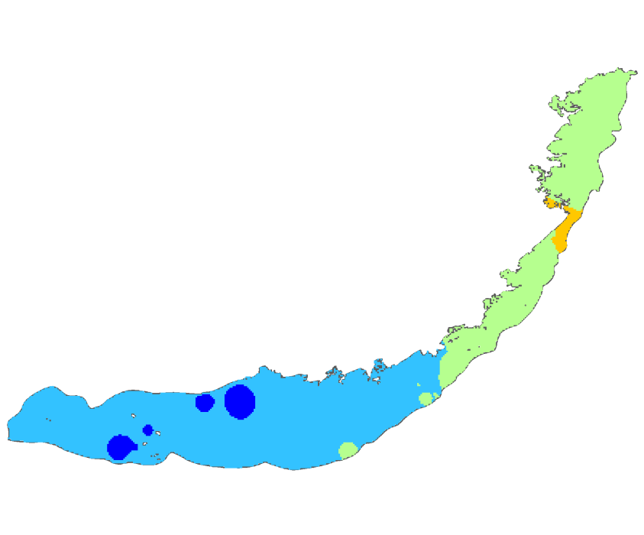
Raster Series
Raster datasets indexed by time
Each raster represents a continuous surface describing a variable for a given time
January 1991
January 1992
January 1993

Slide 55
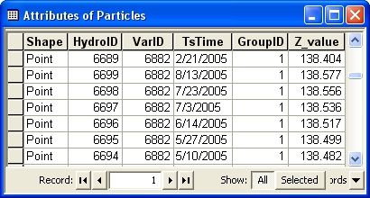


Feature Series
A collection of features indexed by time
Example of particle tracks
Features are indexed by VarID, TsTime, and GroupID
Each group of features creates a track over time

Slide 56

Arc Hydro Groundwater Book
2011

Slide 57
Arc Hydro Data Model
  General model for representing water resources, including surface water components and groundwater components centered on a common framework
Surface water
Groundwater
Network
Geology
Arc Hydro
Framework
Drainage
Boreholes
Hydrography
Hydrostratigraphy
Channel
Simulation
Temporal
Notes:
When we released the first draft of AHGW for review, we got back comments that asked for tighter integration of the surface water data model and the groundwater data model.
We redesigned both data models to be structured around an Arc Hydro Framework (in green in the center).
Then the data models were broken into components that represent a specific aspect or type of datasets.
The temporal component deals with managing temporal data, and is shared by both data models. E.g., you can store surface water and groundwater time series in the same tables, and apply the same tools to map data.
You don’t have to implement all components, if you are dealing only with simulation model you just implement the simulation component.

Slide 58
Components
Framework – Surface water features, wells, and aquifers
Temporal – Representation of time series data
Geology – Representation of data from geologic maps
Boreholes – Borehole log table and 3D description of borehole lines and contact points
Hydrostratigraphy – 2D and 3D description of hydrogeologic units
Simulation – Representation of groundwater simulation models

Slide 59

Framework
Notes:
On the left feature classes from the surface water data model – hydrography (points, lines, polygons) – the “Blue Lines” on maps.
Aquifer and Well features
Time Series – tabular structure for managing time series related with spatial features.
Time series are related to monitoring points and to wells.
The graph shows the change in water levels and streamflow.

Slide 60
Components
Framework – Surface water features, wells, and aquifers
Temporal – Representation of time series data
Geology – Representation of data from geologic maps
Boreholes – Borehole log table and 3D description of borehole lines and contact points
Hydrostratigraphy – 2D and 3D description of hydrogeologic units
Simulation – Representation of groundwater simulation models

Slide 61
Components
Framework – Surface water features, wells, and aquifers
Temporal – Representation of time series data
Geology – Representation of data from geologic maps
Boreholes – Borehole log table and 3D description of borehole lines and contact points
Hydrostratigraphy – 2D and 3D description of hydrogeologic units
Simulation – Representation of groundwater simulation models

Slide 62
Geology
Representation of data from geologic maps
Simplified data model – not comprehensive geologic map design

Slide 63
Components
Framework – Surface water features, wells, and aquifers
Temporal – Representation of time series data
Geology – Representation of data from geologic maps
Boreholes – Borehole log table and 3D description of borehole lines and contact points
Hydrostratigraphy – 2D and 3D description of hydrogeologic units
Simulation – Representation of groundwater simulation models

Slide 64

BoreholeLog table
Combining the well geometry (x, y) and the vertical data stored in the BoreholeLog table we can describe a set of 3D geometries (x, y, z)
Notes:
The Well feature gives the 2D location (X, Y coordinates).
Vertical borehole data are related to the well via the HydroID – WellID relationship.
The example shows data stored in the BoreholeLog table representing hydrostratigraphy.
You can see that a set of hydrogeologic picks (elevation is given by TopElev) have the same WellID – pointing to well 3266.
The top left figure shows the stratigraphy in a conceptual diagram.

Slide 65




3D features (BorePoints and BoreLines)
From the tabular data we create 3D features that can be viewed in ArcScene.
Notes:
From the tabular data we can create 3D features that can be visualized in ArcScene.
On the left – BorePoints (3D points) representing hydrogeologic picks (top of a formation)
On the right – BoreLine features representing hydrostratigraphy as 3D intervals (3D line features).

Slide 66
Components
Framework – Surface water features, wells, and aquifers
Temporal – Representation of time series data
Geology – Representation of data from geologic maps
Boreholes – Borehole log table and 3D description of borehole lines and contact points
Hydrostratigraphy – 2D and 3D description of hydrogeologic units
Simulation – Representation of groundwater simulation models

Slide 67

GeoSections
Notes:
GeoSections represent 3D panels (“slices”) of the subsurface.
GeoSections are represented as multipatch features (3D features) that can be rendered in ArcScene.
The GeoSection features shown here are from a subsurface model near Roseville California.
The sections were created by “slicing” a set of “stacked” rasters. Each raster represents the top of a hydrogeologic unit.

Slide 68

2D Cross Sections
Notes:
The XS2D component is used to create 2D cross sections in ArcMap.
The cross sections are displayed in “special” data frames.
To create a 2D cross section in ArcMap – we transform the Y coordinate to a Z coordinate.
Also, in many cases we apply an exaggeration factor to better visualize the data.

Slide 69

GeoRasters
Notes:
GeoRasters – store rasters in a raster catalog
Rasters can be indexed with a HGUID ( hydrogeologic unit identifier).
We also index with a HorizonID – gives the sequence of deposition from bottom to top.
Cataloging the rasters enables us to use tools to create 3D features - cross sections, volumes.

Slide 70

GeoVolumes
Notes:
GeoVolume - represents hydrogeologic units as 3D elements.
GeoVolumes are 3D multipatches.
Can be built with SA tools by filling between rasters in a GeoRaster catalog.

Slide 71
Components
Framework – Surface water features, wells, and aquifers
Temporal – Representation of time series data
Geology – Representation of data from geologic maps
Boreholes – Borehole log table and 3D description of borehole lines and contact points
Hydrostratigraphy – 2D and 3D description of hydrogeologic units
Simulation – Representation of groundwater simulation models

Slide 72
Simulation Feature Data Set
Notes:
On top of the simulation component a custom data model for representing MODFLOW models have been developed.
We call this the MODFLOW Data Model – will expand at the later parts of the course.
The simulation component includes 5 feature classes:
Boundary for giving the spatial location and orientation of the model
Cell2D and Node2D represent a 2D model mesh/grid, or one layer in a 3D model.
Cell3D and Node3D represent 3D models meshes/grids.
The CellIndex table is used to associate cells and nodes of the model based on the I, J, and K indices. It is part of the MODFLOW Data Model.

Slide 73
GIS Data Sources

Slide 74
Useful Links
TNRIS - http://www.tnris.state.tx.us/
USGS - http://water.usgs.gov/maps.html
ArcGIS.com - http://www.arcgis.com/
Geodata.gov - http://www.geodata.gov/
Dr. Maidment’s links (from his home page)
  http://www.caee.utexas.edu/prof/maidment/gishydro/docs/websites/othr_web.htm

Slide 75


Watersheds of the US
2-digit water resource regions
8-digit HUC watersheds

Slide 76
Watershed Hierarchy
Digit #
2
4
6
8 HUC
10
12
NHDPlus

Slide 77


River networks shown
for 8-digit HUC watersheds
http://nhd.usgs.gov/

Slide 78


NHDPlus Reach Catchments ~ 3km²
Average reach length = 2km
2.3 million reaches for continental US
About 1000 reach catchments in each 8-digit HUC

Slide 79

NHDPlus Reach Attributes
Slope
Elevation
Mean annual flow
  Corresponding velocity
Drainage area
% of upstream drainage area in different land uses
Stream order

Slide 80

HydroSheds derived from SRTM
http://hydrosheds.cr.usgs.gov/

Slide 81


Slide 82



1:250,000 Scale Soil Information
http://www.ncgc.nrcs.usda.gov/products/datasets/statsgo/
Notes:
State Soil Geographic

Slide 83

SSURGO:
County Level
Digital Soil Maps
1:24,000 scale
soil information
http://www.ncgc.nrcs.usda.gov/products/datasets/ssurgo/
Notes:
Survey Soil Geographic

Slide 84


SSURGO for Travis County
103 soil map units described by 7530 polygons of average area 35.37 ha (87 acres)

Slide 85


National Land Cover Dataset
Get the data:
http://seamless.usgs.gov/

Slide 86


PRISM Mean Annual Precipitation
http://www.wcc.nrcs.usda.gov/climate/prism.html
Notes:
Parameter-elevation Regressions on Independent Slopes Model. Monthly, too.

Slide 87


http://www.daymet.org/
Notes:
daily surfaces of temperature, precipitation, humidity, and radiation

Slide 88



CUAHSI-HIS
http://his.cuahsi.org
56 public services
18,000+ variables
1.88+ million sites
23.3 million series
Referencing 5.1 billion data values

Slide 89
GIS Software

Slide 90


Slide 91

ArcMap
View and
edit data
Analyze data
(Geoprocessing)
Create
maps

Slide 92

ArcCatalog
Graphical
previews
View data
(like Windows Explorer)
Tables
Metadata

Slide 93


ArcToolbox
Tools for commonly used tasks
Map Projections

Slide 94

Geoprocessing
Toolbox tools linked together using the model builder to automate data processing

Slide 95

Desktop, Server, Web
Desktop GIS

Slide 96


World Topographic Base Map
Cartographic map built from GIS data
With content added by the City of Austin

Slide 97

ArcGIS.com

Slide 98

Google Earth 3D With Terrain

Slide 99
HydroDesktop (DotSpatial)
http://hydrodesktop.codeplex.com/

Slide 100
Where Is GIS Going?
Cloud
  Basemaps
  Online operational layers
  Processing services (watershed delineation)
Mobile
Volunteered geographic information
Sharing
Mashups

Slide 101





















Web Services HUB
Outputs
Inputs
Web Services HUB
Data
Services
(WaterML)
USGS
Data
Services
(WaterML)
LCRA
COA
Mapping
Services
NWS
Mapping
Services
NDFD
Data and Mapping
Services
Modeling
Services
Flood Mapping
Services
Models
Maps

Slide 102



ArcGIS Resource Centers http://resources.arcgis.com
Desktop
Help

Slide 103

Hydro Resource Center
http://resources.arcgis.com/content/hydro/

Slide 104

Data.CRWR Blog
http://data.crwr.utexas.edu/blog/

