Slide 1
Some recent trends….
David R. Maidment
Center for Research in Water Resources
University of Texas at Austin

Slide 2
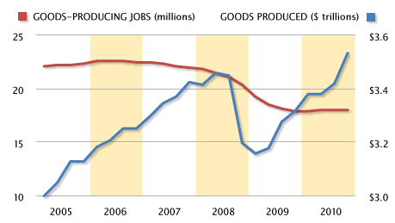
US Labor Productivity in Manufacturing
GDP ($ trillions)
US 14.6
China 5.7
Japan 5.4
Germany 3.3
http://www.msnbc.msn.com/id/41415001/ns/business-stocks_and_economy/
…. increased production with 4 million fewer jobs

Slide 3
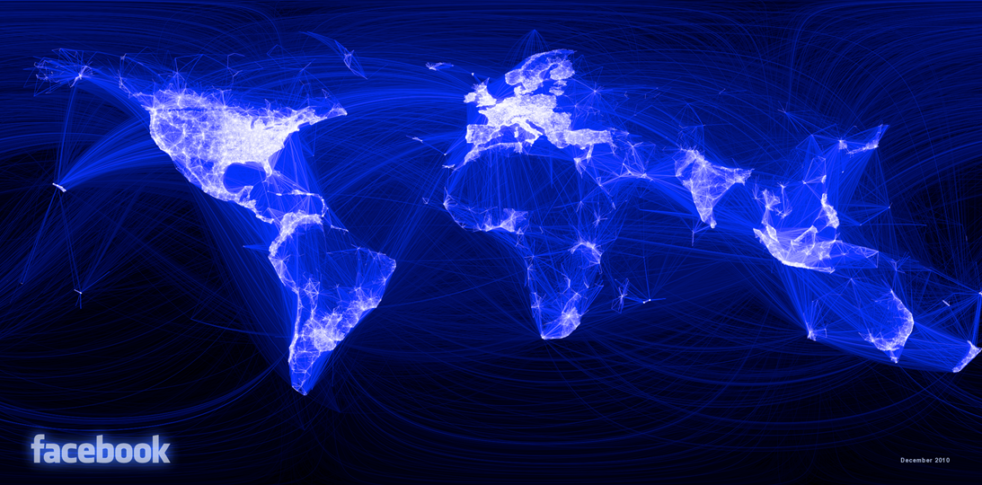
Visualizing Friendship – Facebook Connections
http://www.facebook.com/notes/facebook-engineering/visualizing-friendships/469716398919
… people are being connected

Slide 4
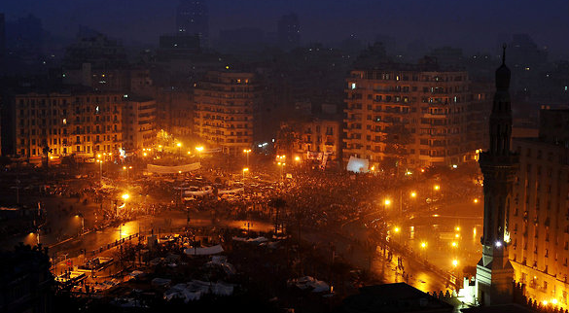
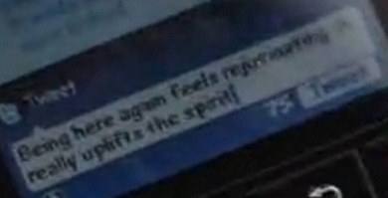
Social Media Helped to Foster a Revolt
Tahrir Square Cairo
Pictures: NY Times, MSNBC
…. Twitter and Facebook play a key role

Slide 5
HuffPost has 200 employees and 6000 bloggers who write for free ….
…. aggregating content from other web service providers
…. It was sold to AOL on February 7, 2011, for $315 million

Slide 6
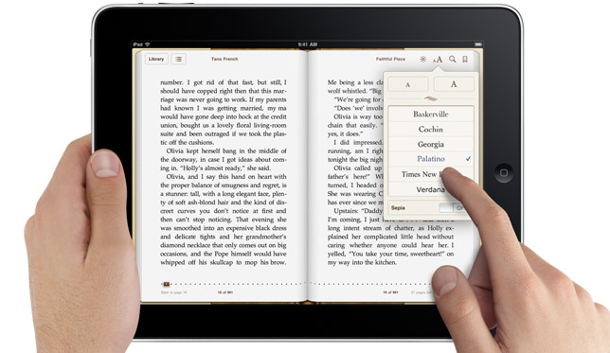
iPad Book Reader
…. will electronic books be the norm in the future?

Slide 7
Hand-Held Devices
Give information to them?
Obtain information from them?
Harvesting and filtering twitter feeds?
Posting information to online maps?

Slide 8
Information in Hydrology
Hydrology is an observational discipline
Data are a key input
Efficient use of information technology is a key to engineering productivity
Smarter engineering
Information is going electronic
Paperless engineering
Virtual workplaces are growing
Electronically networked communities

