Slide 1
CE 394K.2 Hydrology, Lecture 2
Hydrologic Systems
Hydrologic systems and hydrologic models
How to apply physical laws to fluid systems
Intrinsic and extrinsic properties of fluids
Reynolds Transport Theorem
Continuity equation
Reading – Applied Hydrology, Sections 1.2 to 1.5 and 2.1 to 2.3

Slide 2
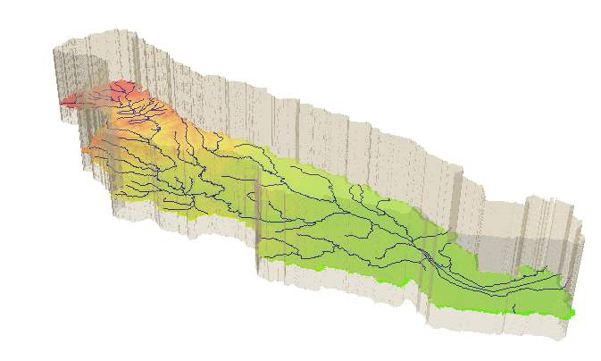
Hydrologic System
Take a watershed and extrude it vertically into the atmosphere
and subsurface, Applied Hydrology, p.7- 8
A hydrologic system is “a structure or volume in space surrounded by a boundary, that accepts water and other inputs, operates on them internally, and produces them as outputs”

Slide 3
System Transformation
Inputs, I(t)
Transformation Equation
Q(t) = Ω I(t)
Outputs, Q(t)
A hydrologic system transforms inputs to outputs
Hydrologic Processes
I(t), Q(t)
Hydrologic conditions
I(t) (Precip)
Physical environment
Q(t) (Streamflow)

Slide 4
Stochastic transformation
Inputs, I(t)
System transformation
f(randomness, space, time)
Outputs, Q(t)
Hydrologic Processes
How do we characterize
uncertain inputs, outputs
and system transformations?
I(t), Q(t)
Hydrologic conditions
Physical environment
Ref: Figure 1.4.1 Applied Hydrology

Slide 5
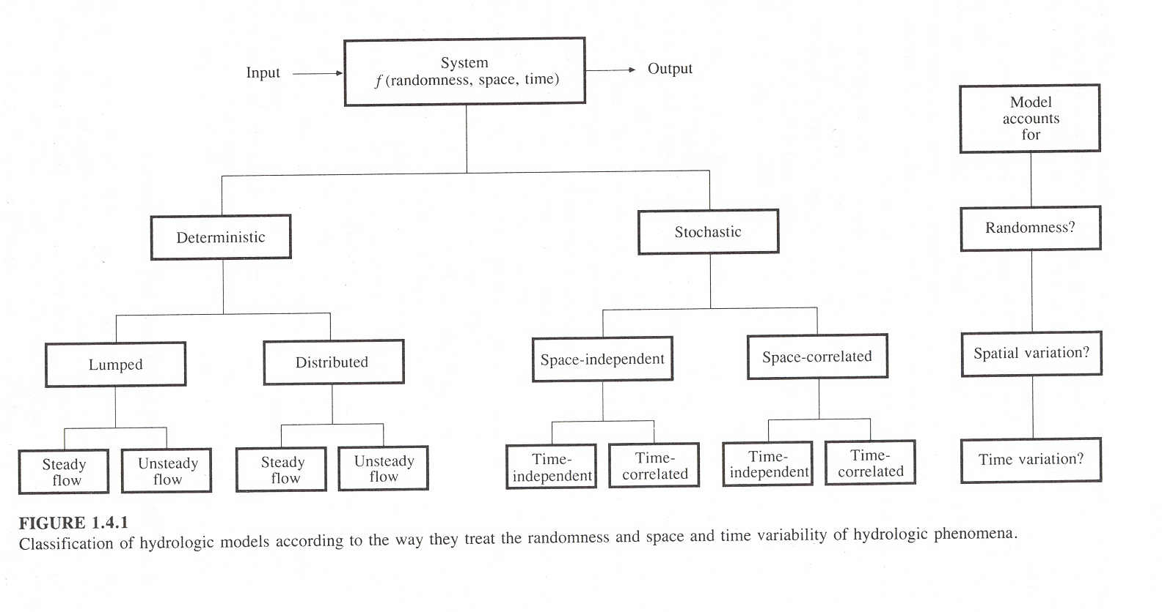

Slide 6
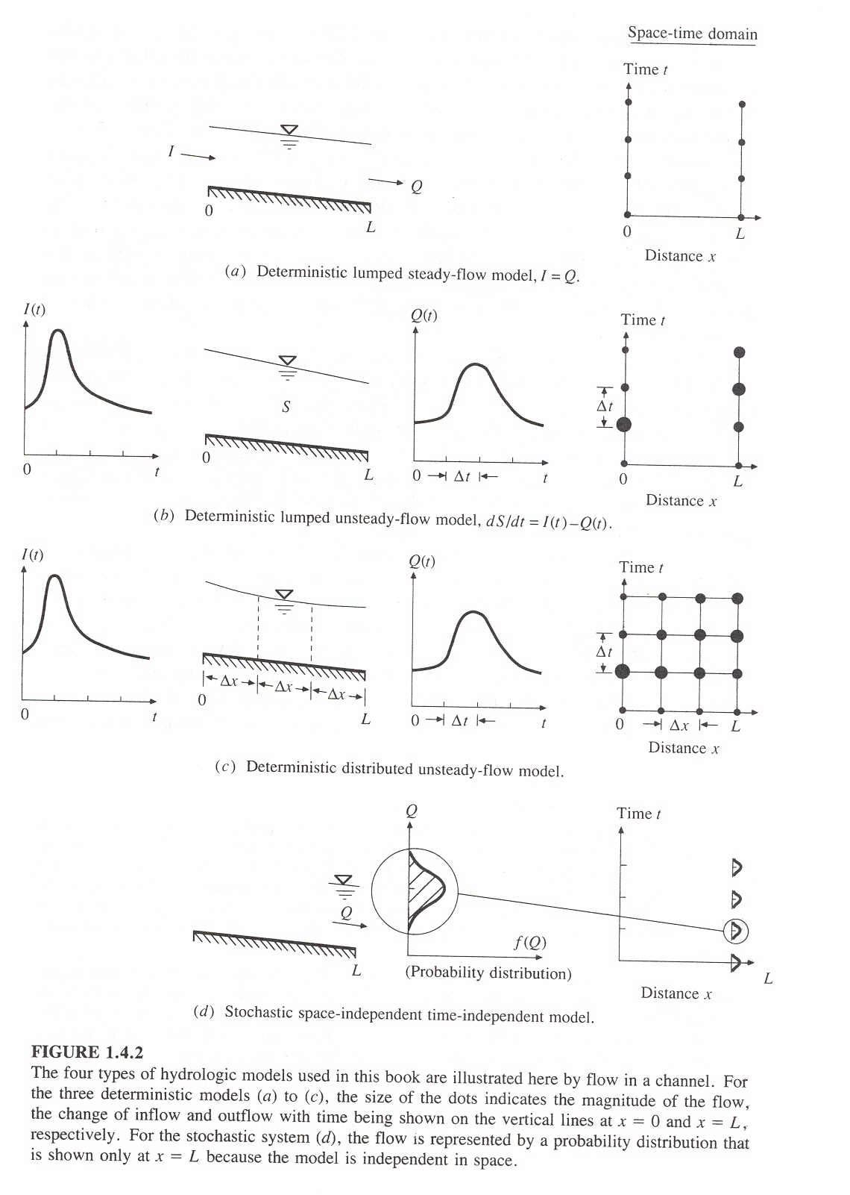

Slide 7
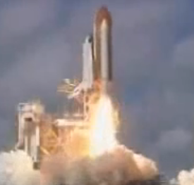
Views of Motion
Eulerian view (for fluids – e is next to f in the alphabet!)
Lagrangian view (for solids)
Fluid flows through a control volume
Follow the motion of a solid body

Slide 8
Reynolds Transport Theorem
A method for applying physical laws to fluid systems flowing through a control volume
B = Extensive property (quantity depends on amount of mass)
β = Intensive property (B per unit mass)
Total rate of
change of B in fluid system (single phase)
Rate of change of B stored within the Control Volume
Outflow of B across the Control Surface

Slide 9
Mass, Momentum Energy
 | Mass | Momentum | Energy
B | m | mv
β = dB/dm | 1 | v
dB/dt | 0
Physical Law | Conservation of mass | Newton’s Second Law of Motion | First Law of Thermodynamics

Slide 10
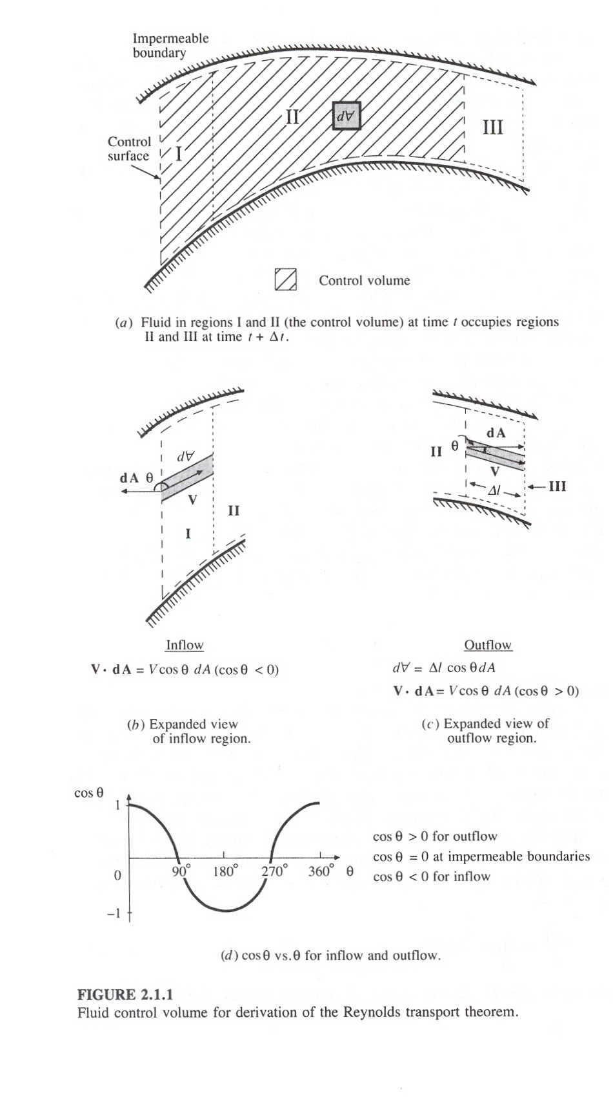

Slide 11
Reynolds Transport Theorem
Total rate of change of B in the fluid system
Rate of change of B stored in the control volume
Net outflow of B across the control surface

Slide 12
Continuity Equation
B = m; b = dB/dm = dm/dm = 1; dB/dt = 0 (conservation of mass)
ρ = constant for water
hence
or

Slide 13
Continuity equation for a watershed
Hydrologic systems are nearly always
open systems, which means that it is
difficult to do material balances on them
I(t) (Precip)
What time period do we choose
to do material balances for?
dS/dt = I(t) – Q(t)
Q(t) (Streamflow)
Closed system if

Slide 14
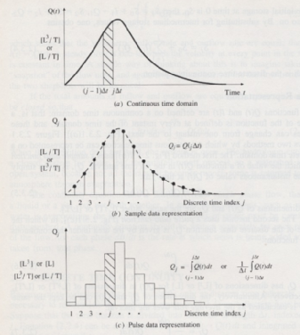
Continuous and Discrete time data
Figure 2.3.1, p. 28 Applied Hydrology
Continuous time representation
Sampled or Instantaneous data
(streamflow)
truthful for rate, volume is interpolated
Can we close a discrete-time water balance?
Pulse or Interval data
(precipitation)
truthful for depth, rate is interpolated

Slide 15
