Slide 1
Introduction to Low Impact Development
Michael Barrett, Ph.D., P.E.
Center for Research in Water Resources

Slide 2
Water Quality Legislation
1886 Rivers and Harbor Act
Refuse Act
1948 Federal Water Pollution Control Act passed by Congress
Individual states given responsibility to reduce water pollution
Limited federal authority
Did not prohibit polluting activities, set standards, or limit new sources of pollution

Slide 3
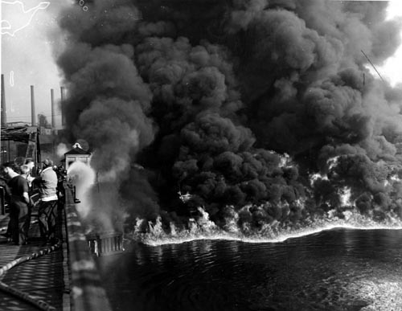
Cuyahoga River, Cleveland

Slide 4
More Legislation
1972 Clean Water Act prohibits any discharge of pollutants without NPDES permit
Fishable and swimmable
Federal permits required
1985 goal of meeting water quality standards
1987 Clean Water Act amended to require permits for stormwater discharges
2003 NPDES Phase II permits required

Slide 5
Common Impairments
Constituent/Parameter | Number of Water Bodies Impaired
Bacteria | 405
Low Dissolved Oxygen Concentration | 125
Salinity | 79
Mercury | 64
PCBs | 44

Slide 7
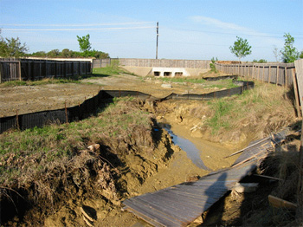
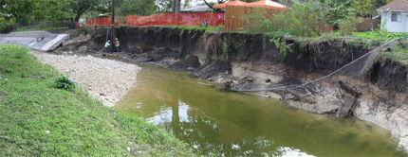
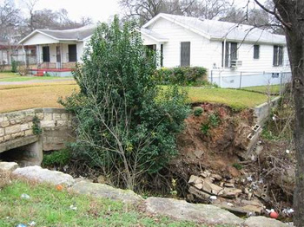
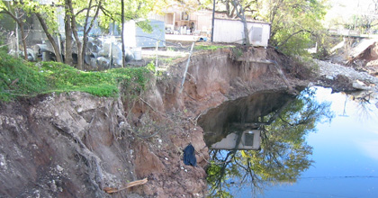
Channel Degradation
Bear Creek
Fort Branch
ShoalCreek
Boggy Creek

Slide 8
Pre-development vs. Post-development

Slide 9
Hill Country Hydrology
Pre-development Hydrology
5% of rainfall becomes runoff
5% of rainfall infiltrates to groundwater
90% of rainfall back to the atmosphere via ET
Post-development Hydrology (100% IC)
90% of rainfall becomes runoff
0% infiltrates
10% lost to ET

Slide 10
Best Management Practices
Every man for himself
End-of-pipe
Fewer facilities to manage, inspect, and maintain
Little volume control
Little redundancy
Onsite
Low Impact Development (LID)
Maintain pre-development hydrology
Enhance ecosystem services
Lower cost
More facilities

Slide 11
Filter System – Lamar & Loop 360

Slide 12
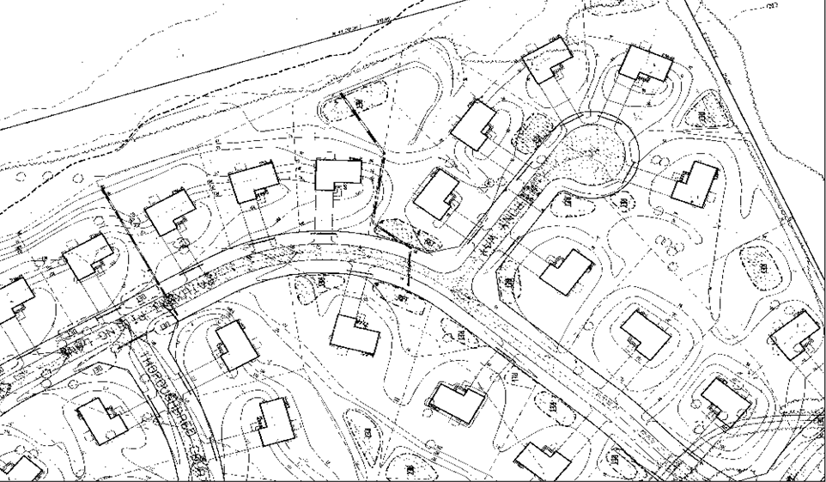

Slide 13
EPA Regulations
Recently adopted nationwide standard for construction site runoff (280 NTU)
Requires monitoring of construction runoff
Currently considering nationwide rule for post-construction BMP performance
Recent rule for federal facilities requires retention of 95th percentile storm
Draft permit for DC requires retention of 90th percentile storm
Goal of nationwide rule is to maintain “natural hydrologic conditions”
Draft Rule September 2011
Final Rule November 2012

Slide 14
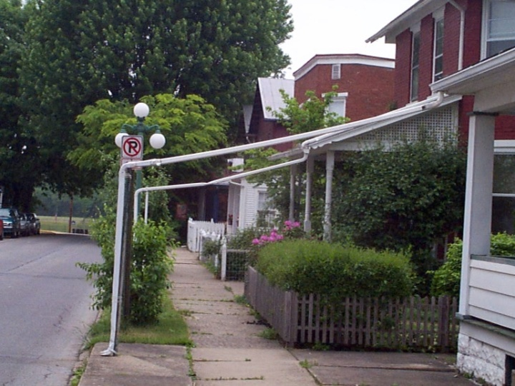
Low Impact Development (LID)
Hydrology as the organizing principal
Disconnect impervious cover
Increase Time of Concentration
Infiltration
Evapotranspiration
Mimic natural hydrologic cycle
Clean storm water passively

Slide 15
LID Toolbox (Green Infrastructure)
Green Roofs
Rainwater Harvesting
Planter Boxes
Rain Gardens/Bioretention (biofiltration)
Vegetated Swales and Filter Strips
Porous Pavement

Slide 16
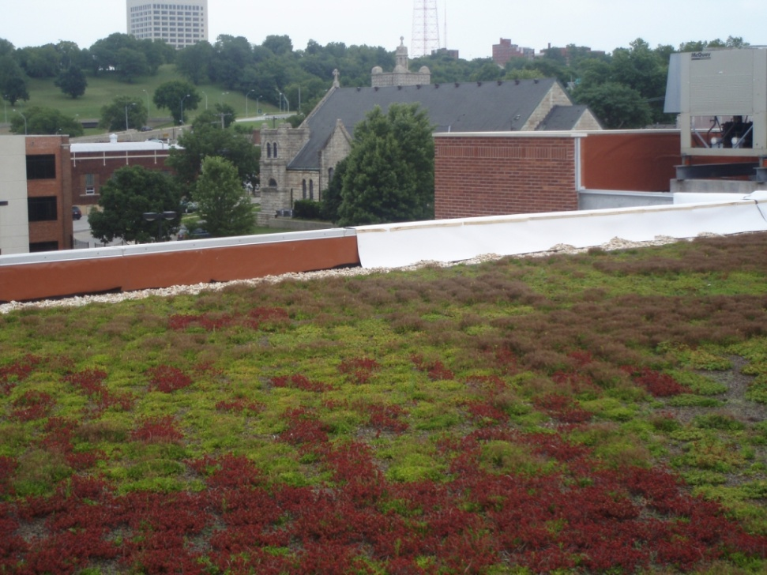
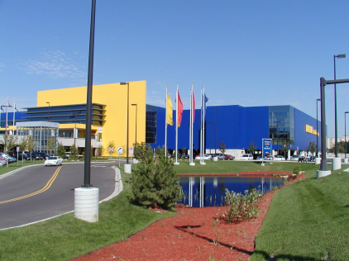
LID from Rooftops to Roadways
David Dods, URS Corp. Overland Park, Kansas
913-344-1022

Slide 17
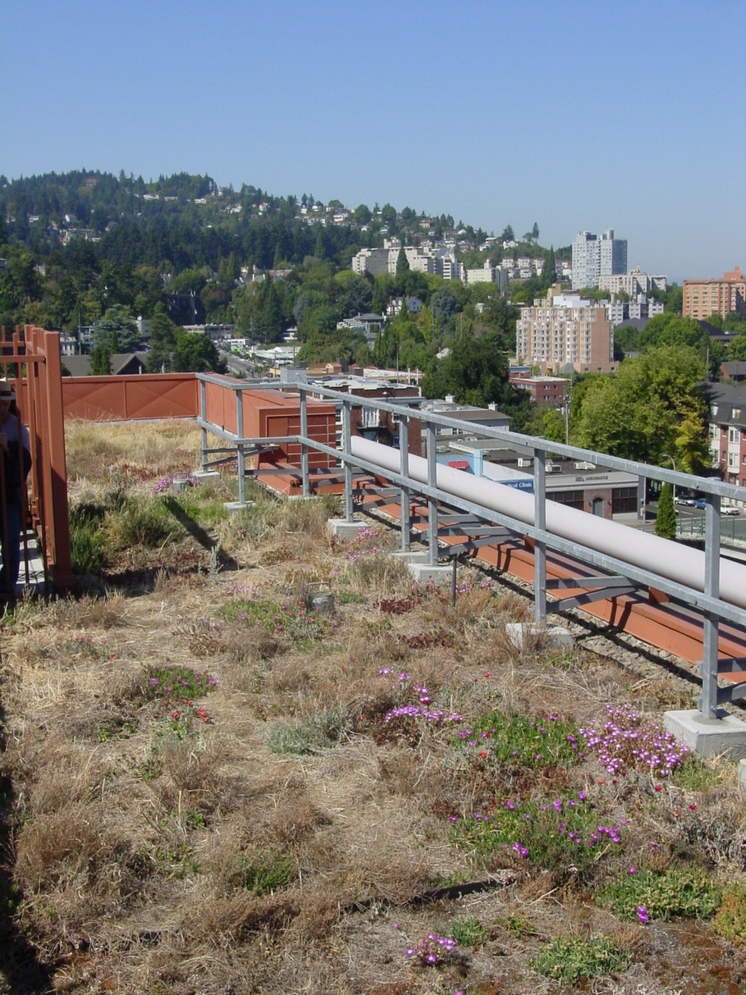
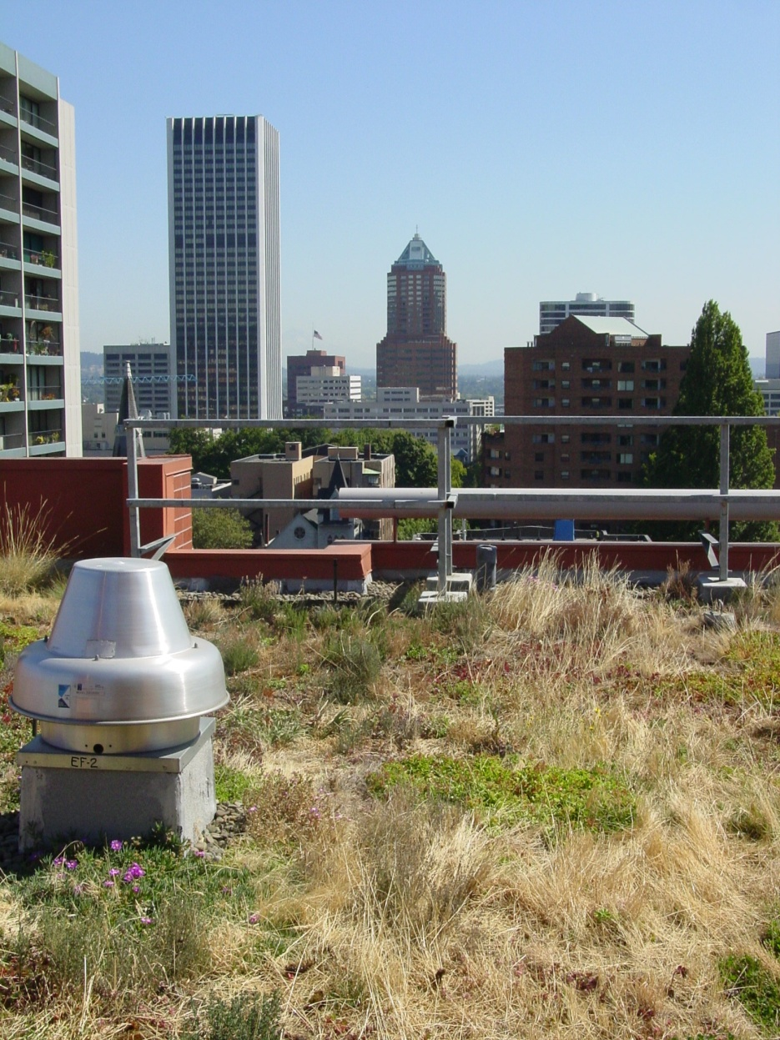
Green Roofs Portland

Slide 18
Green Roof Boulevard Brewing, Kansas City, MO
Photo: David Dods

Slide 19
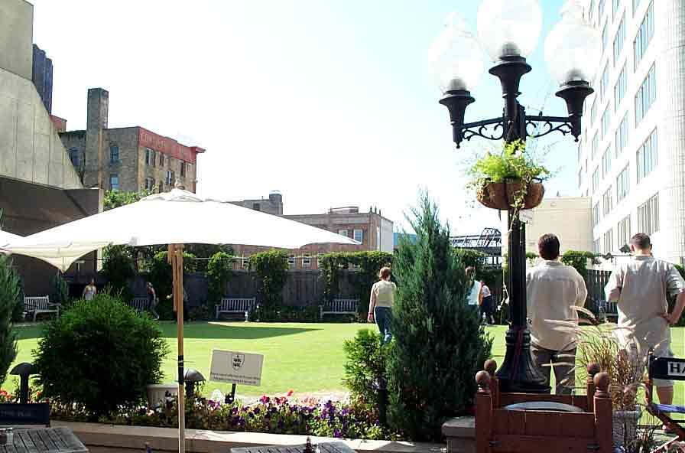
Green Roof, Britt’s Pub, Minneapolis
Photo Courtesy of Rusty Schmidt

Slide 20
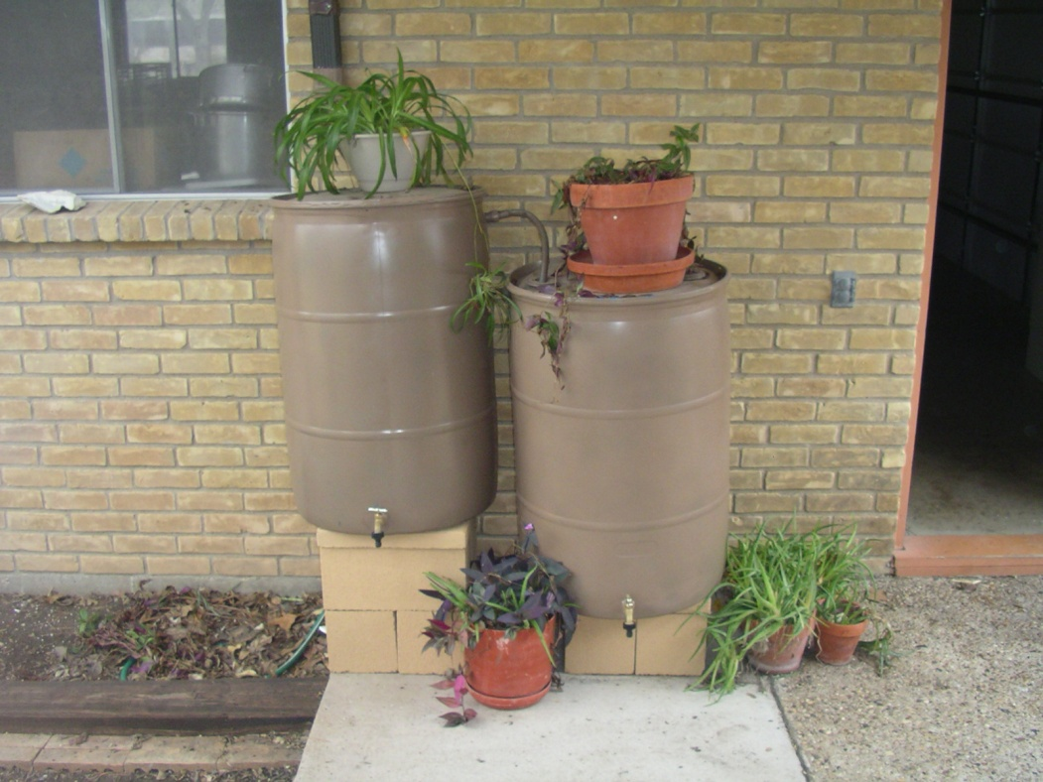
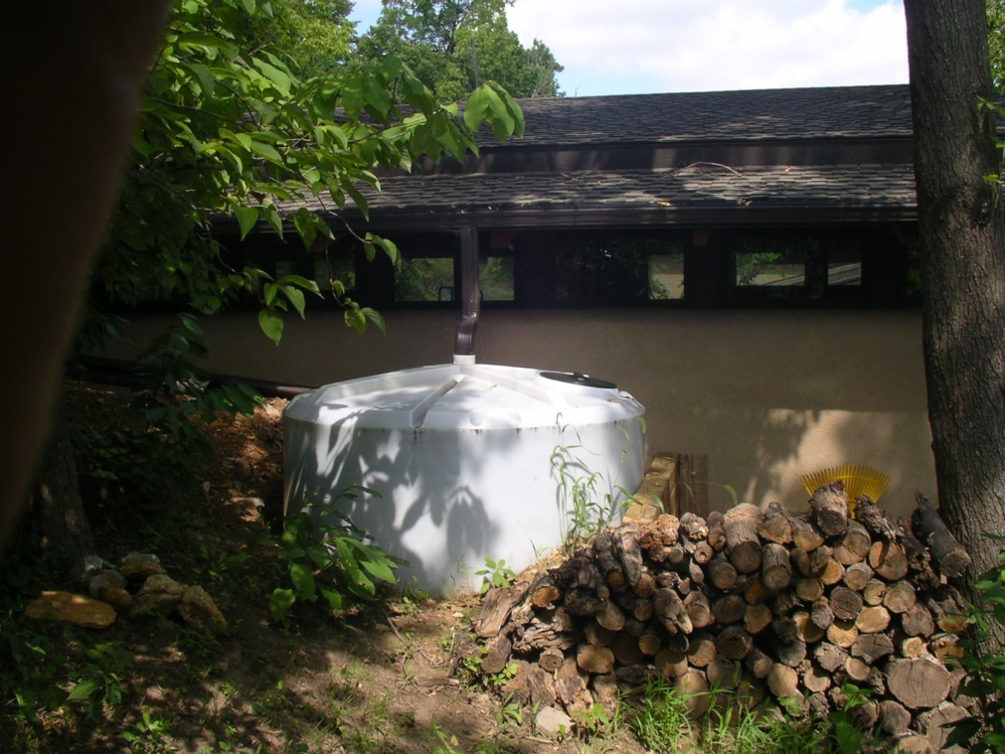
Rainwater Harvesting
Photos: David Dods

Slide 21
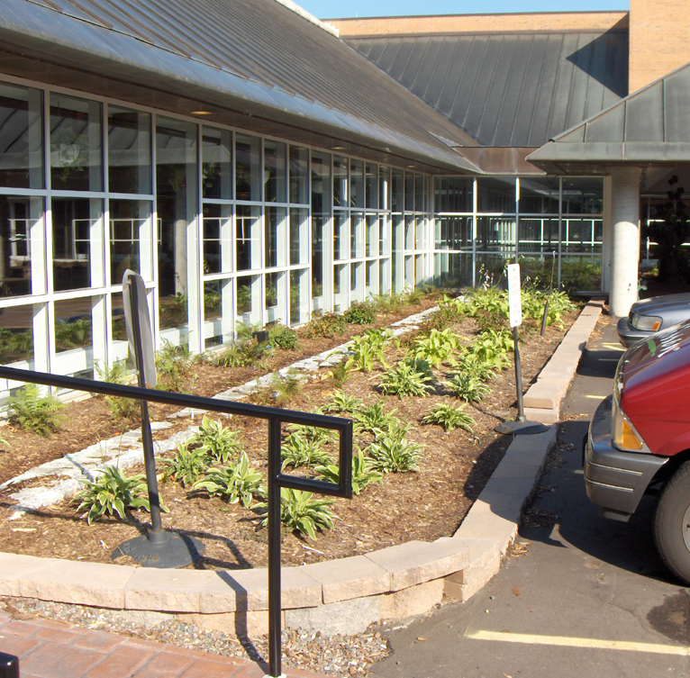
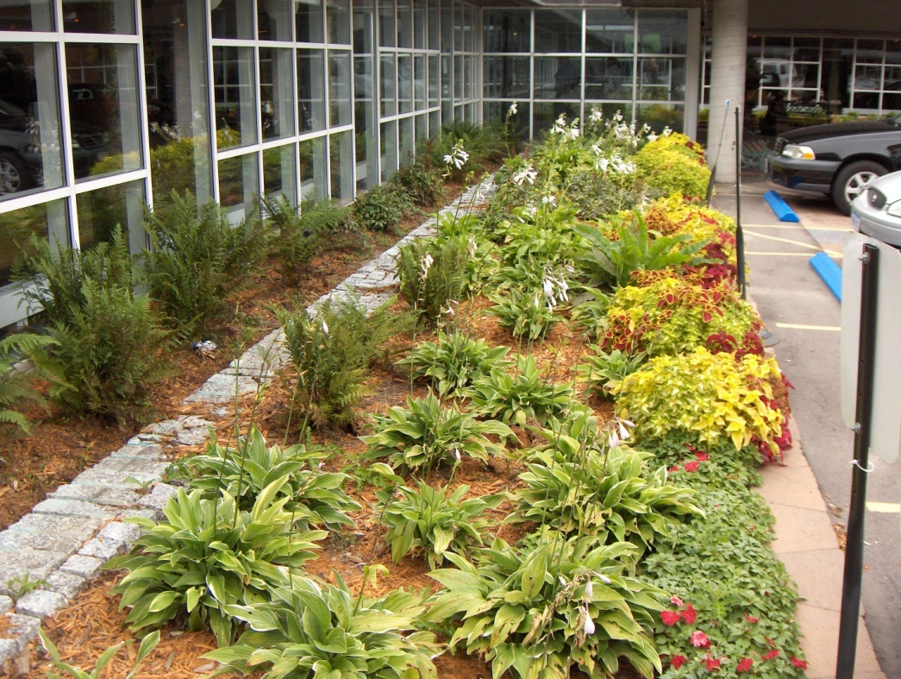
Flow-Through Planter Box for Hotel Roof Runoff
Photos: Rusty Schmidt

Slide 22
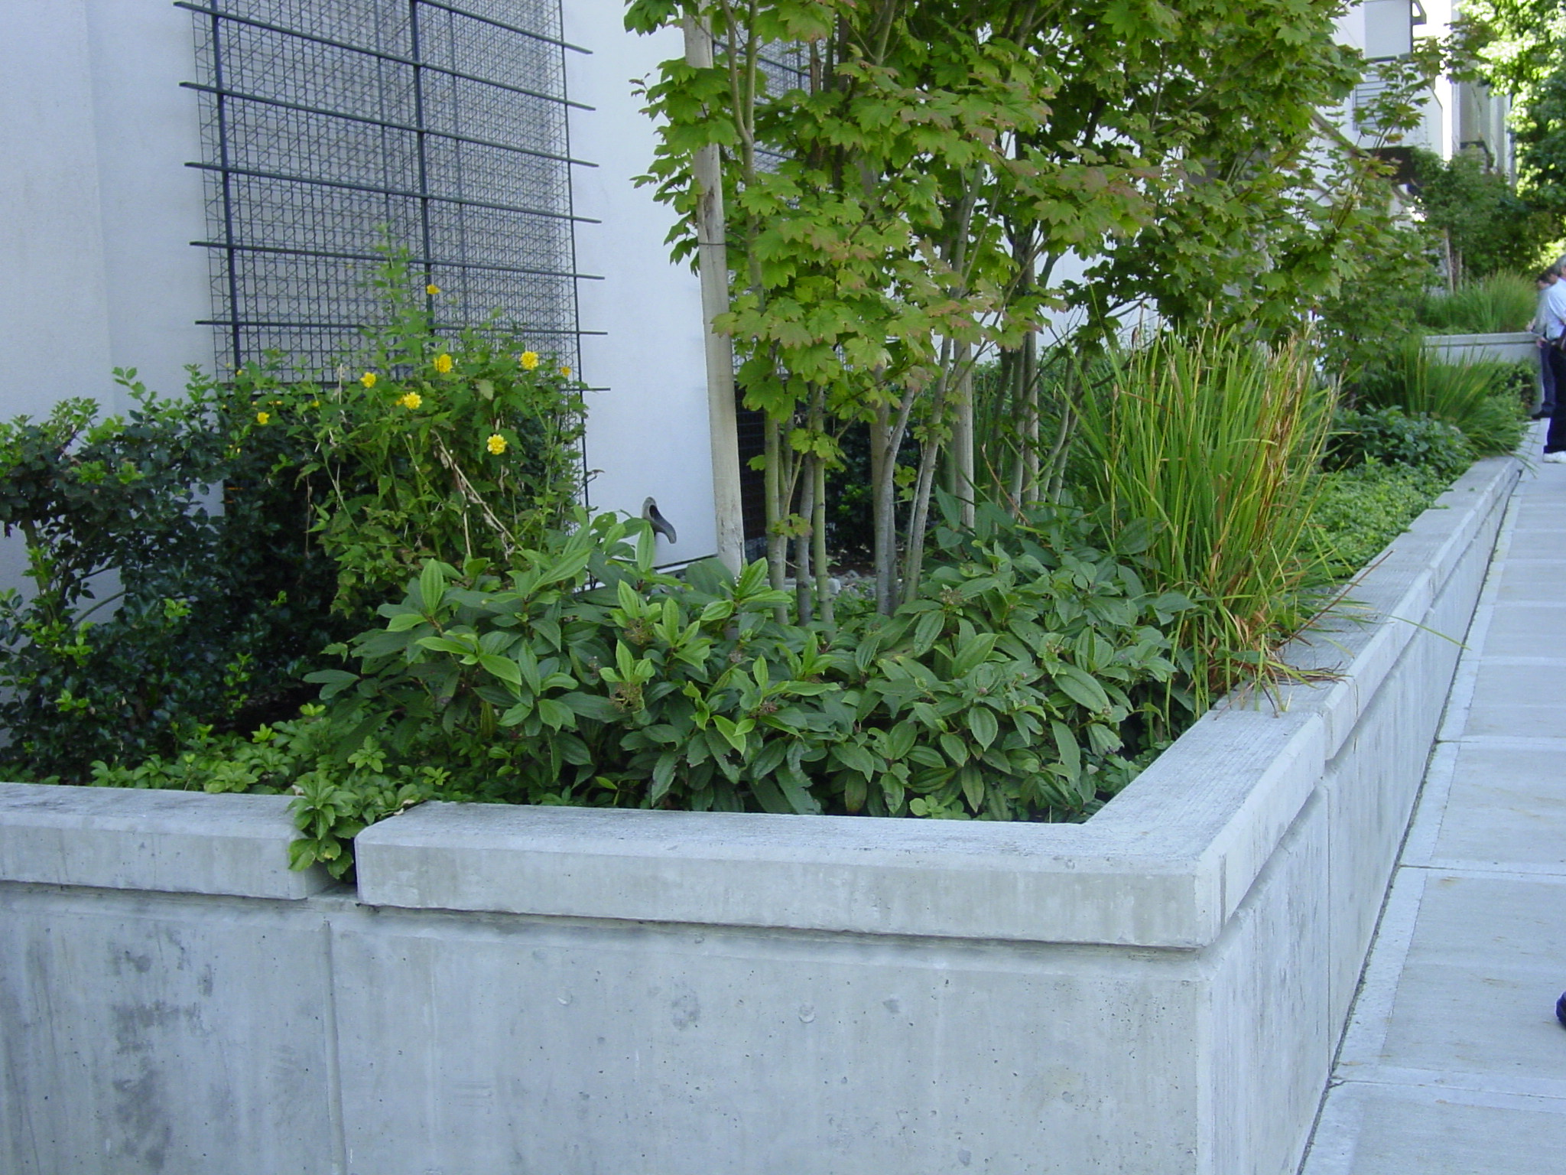
Planter Box Pilot Test for
Philadelphia Row Houses
Photo: Tony Federici

Slide 23
Bioretention/Rain Gardens

Slide 24
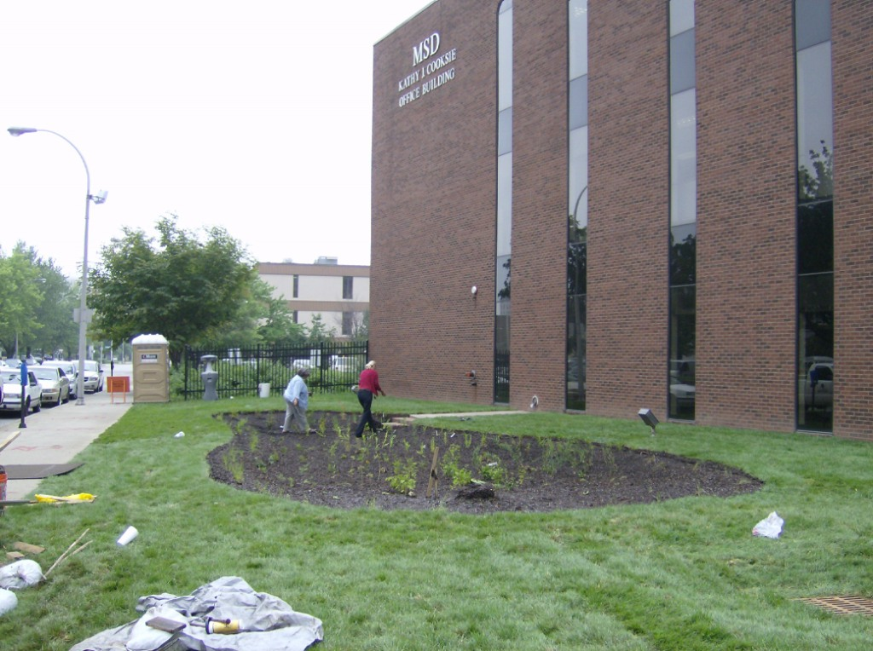
Louisville, KY MSD HQ
Rain Garden Demonstration Project
Photograph: URS

Slide 25
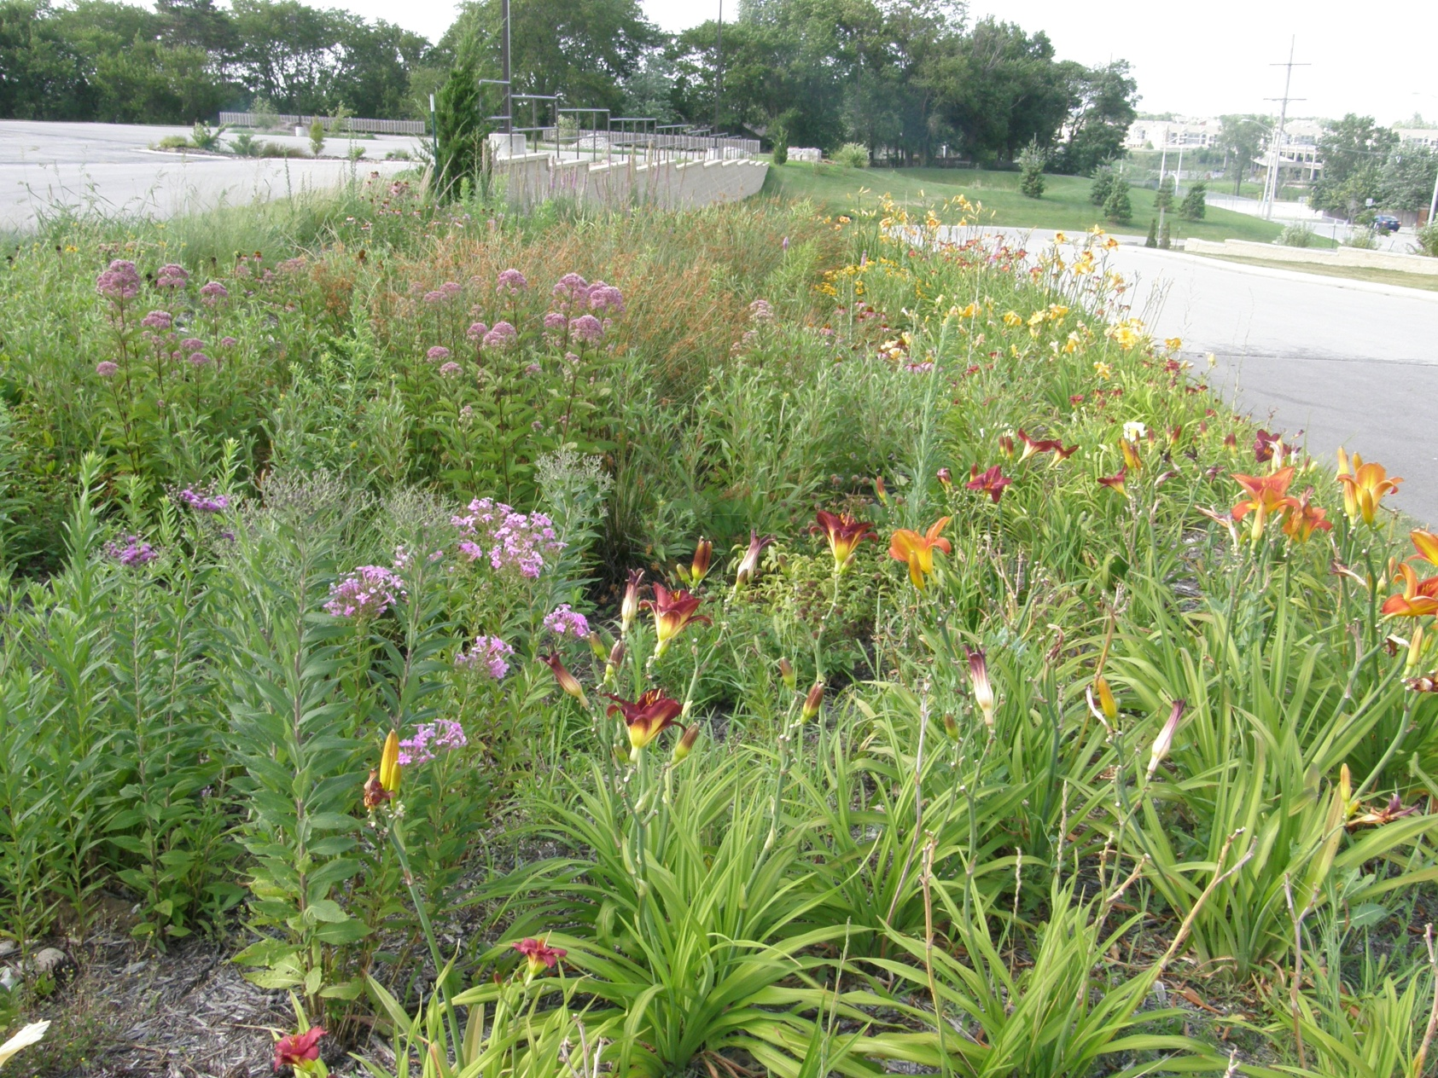
Parking Lot Edge Rain Garden
Design: Carla Dods; Photo: David Dods

Slide 26
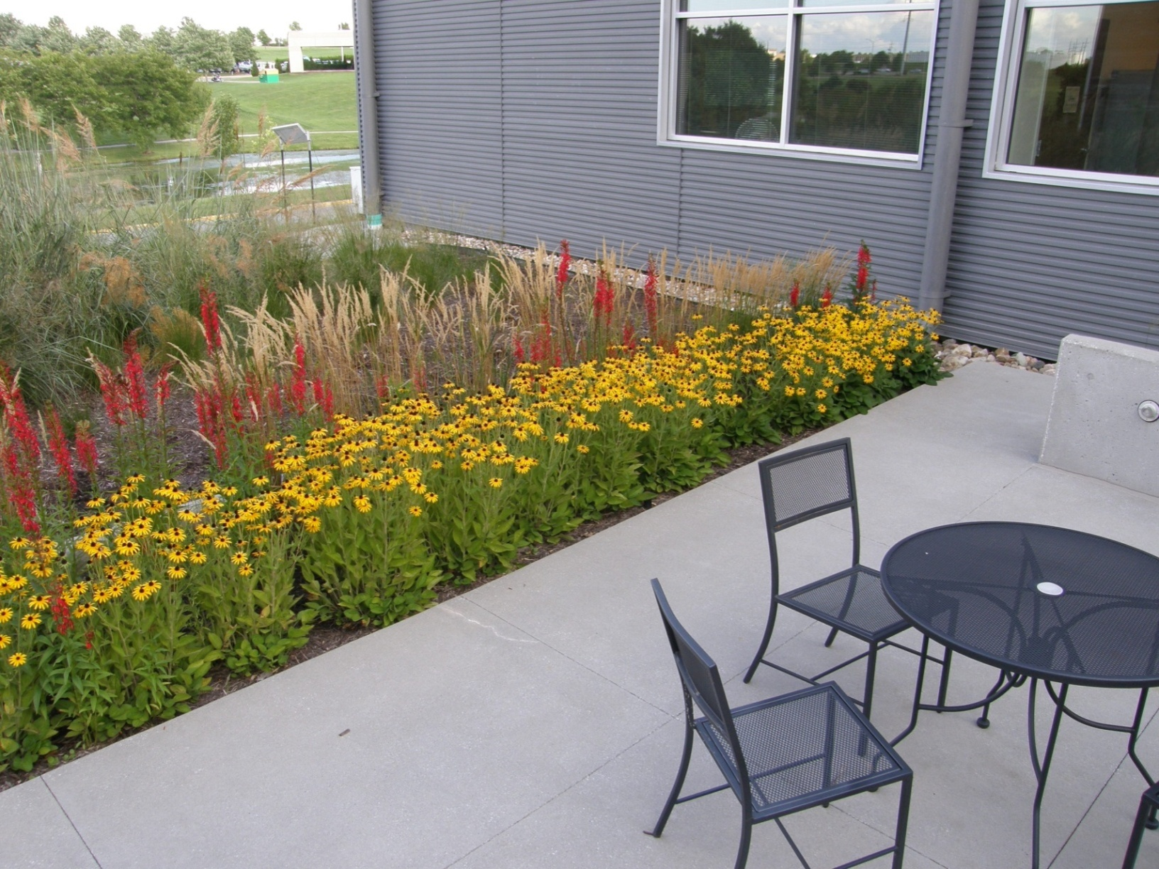
Patio Downspouts to Rain Garden
Design: BNIM Architects, Photo: David Dods

Slide 27
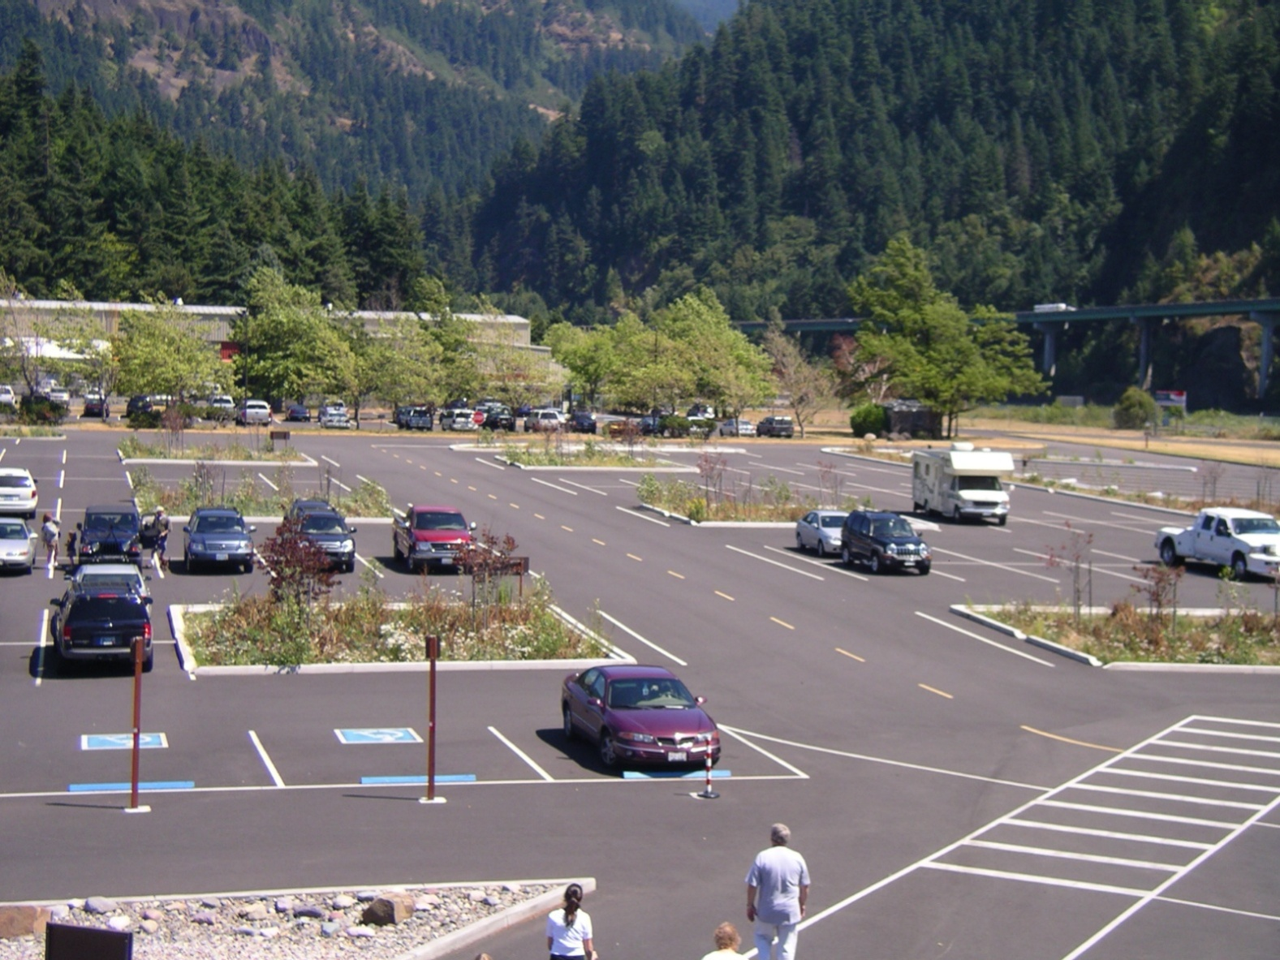
Parking Lot Islands
Photo: David Dods

Slide 28
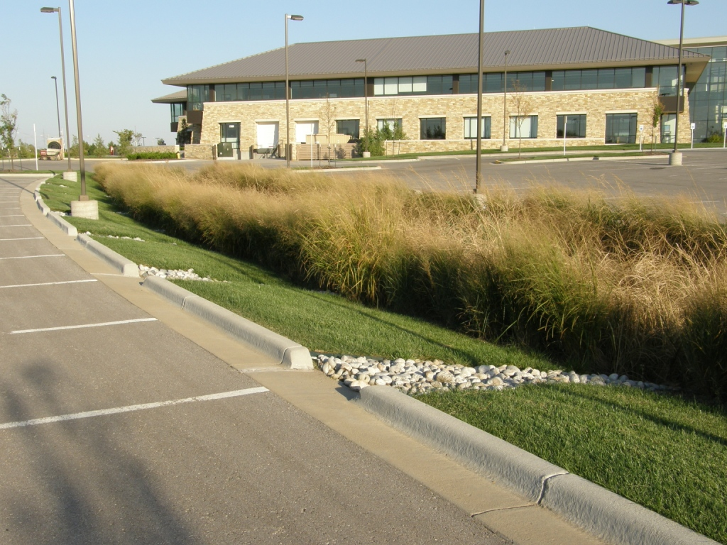
Parking Lot Island
Photo: David Dods

Slide 29
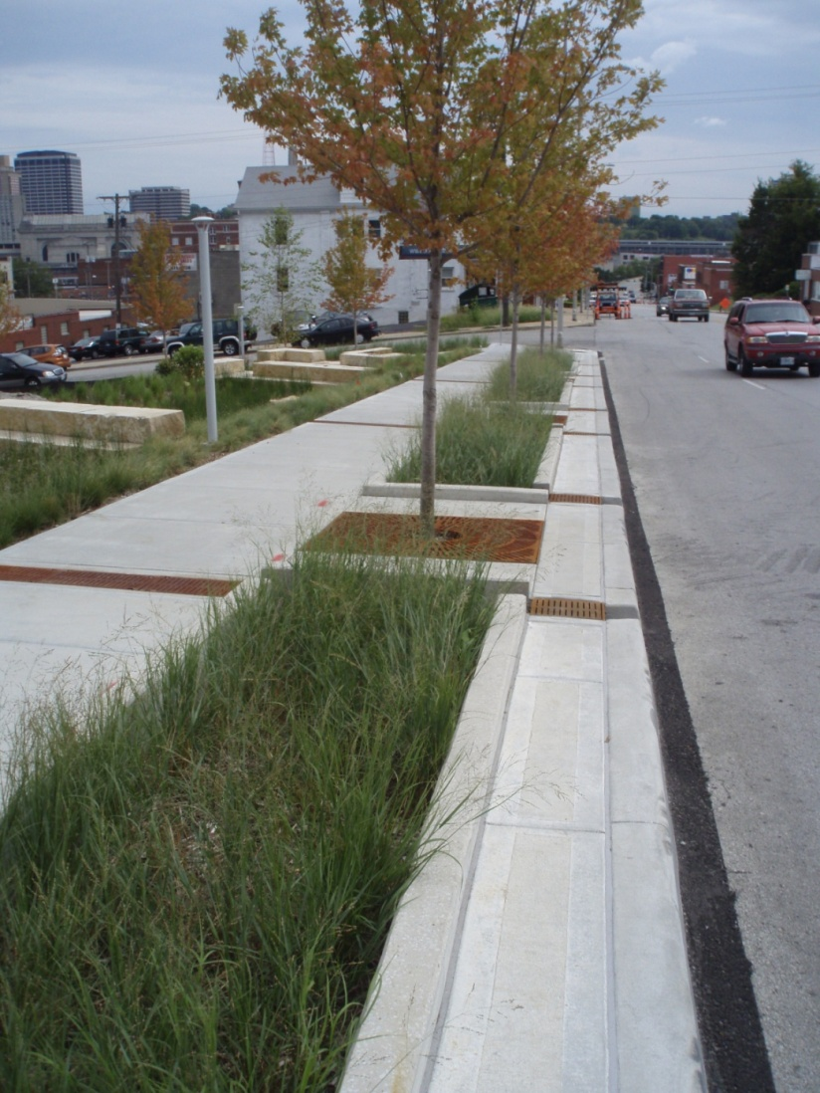
Kansas City
Design: Patti Banks Assoc.; Photo: David Dods

Slide 30
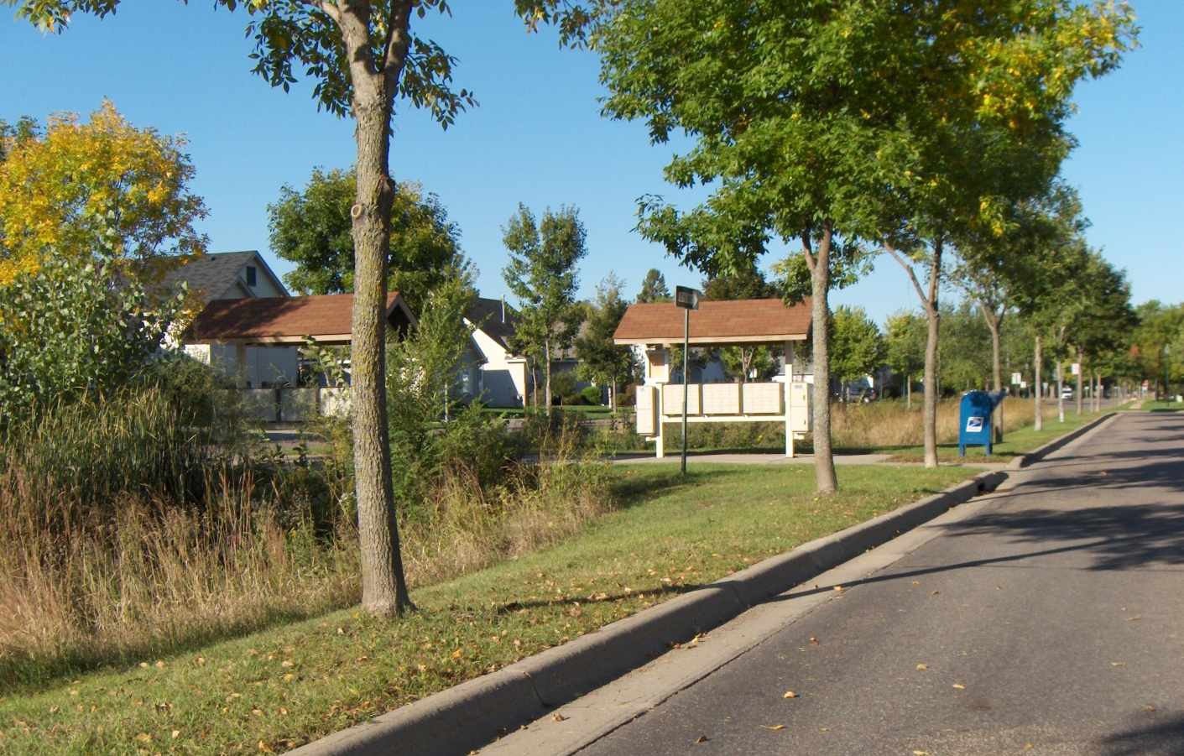
Street Median Rain Garden
Photo: Rusty Schmidt

Slide 31
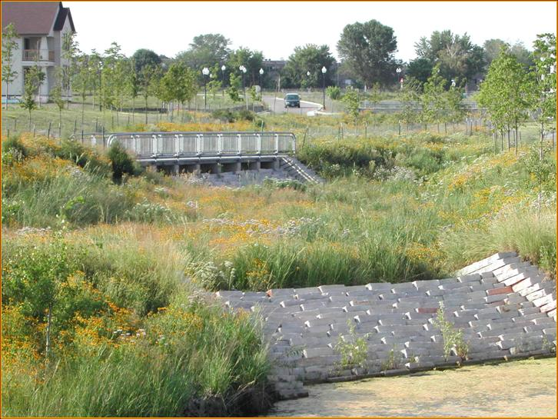
Neighborhood Scale
Photograph: Rusty Schmidt
Notes:
Political Will

Slide 32
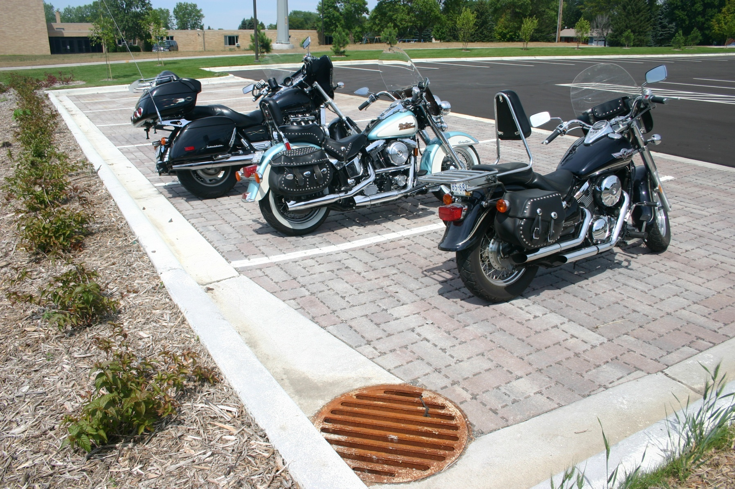
Pervious Pavers
Photo: Kurt Leuthold, Barr Engineering

Slide 34
Porous Asphalt

Slide 35
Reliant Stadium Parking

Slide 36
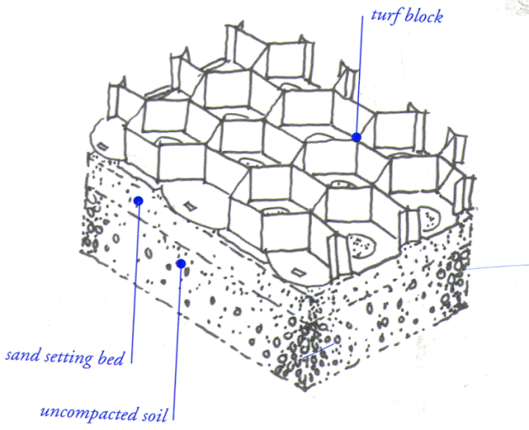
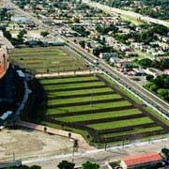
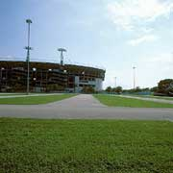

Slide 37
MoPac at Walnut Creek

Slide 38
Natural Vegetated Buffers

Slide 39
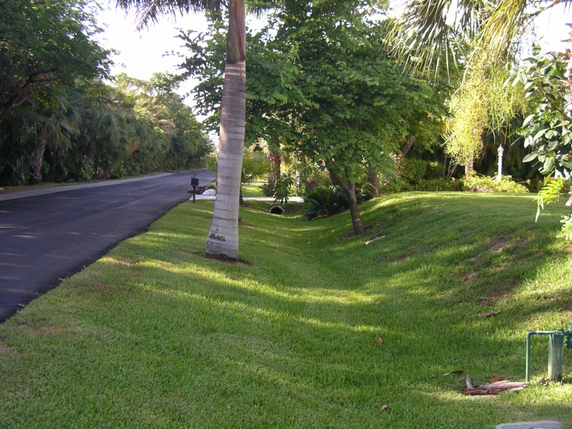
Grass Swale
Photos: David Dods

Slide 40
Orlando Swale

Slide 41
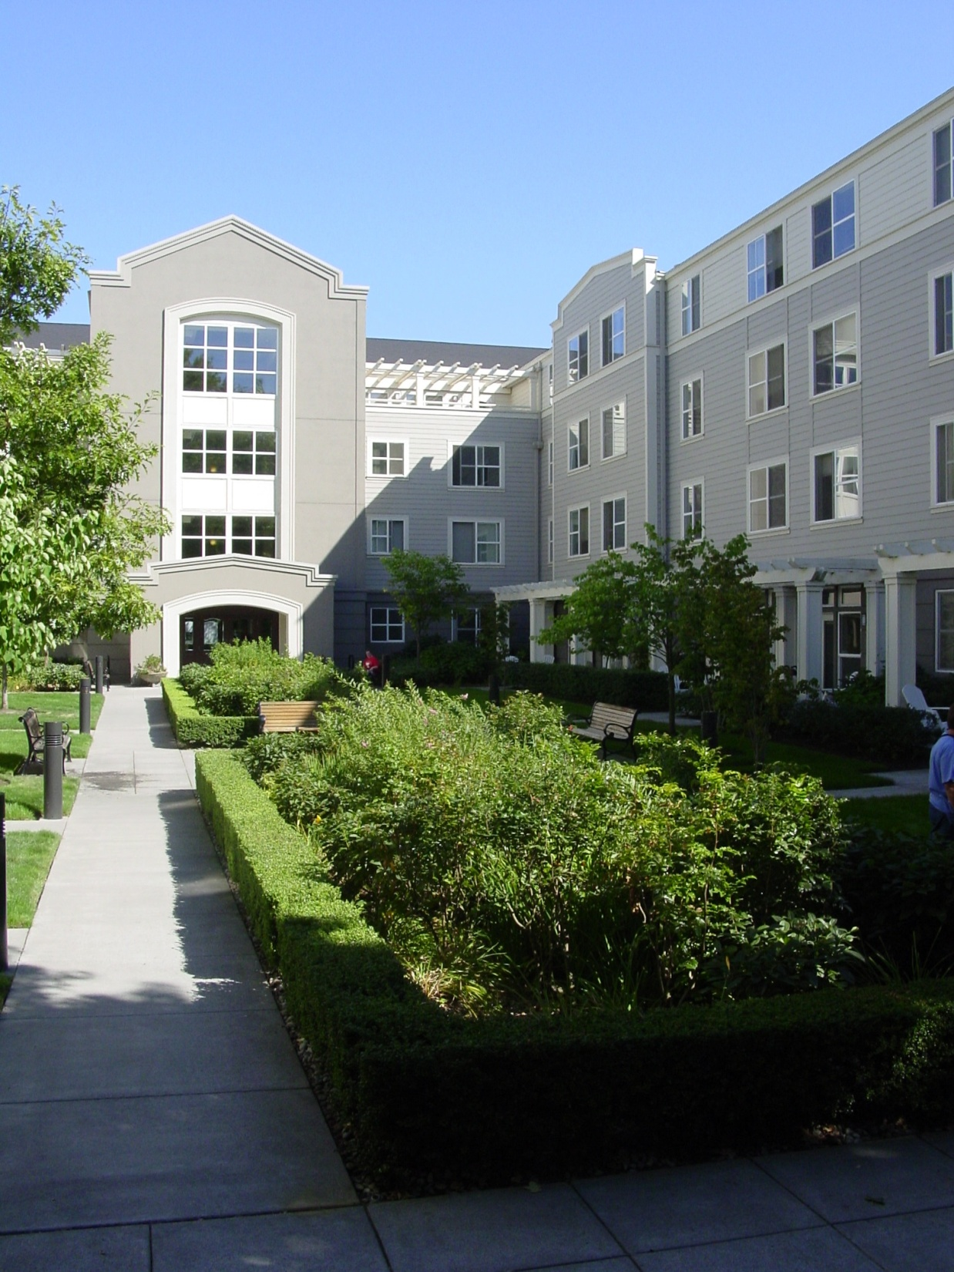
Portland LID

Slide 42
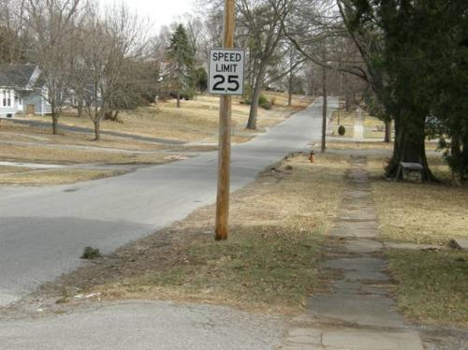
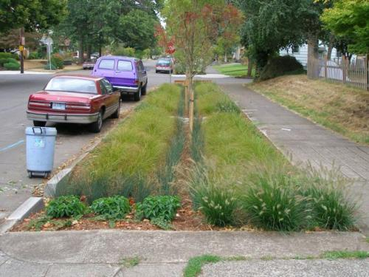
Residential Street Retrofit
Kansas City Green Solutions Pilot Project
Existing Street
Proposed Retrofit
Photos: David Dods; City of Portland, OR
Notes:
David Dods
Installed in the public right-of-way throughout the project area
Not on private property
Locations for the proposed green solutions were specifically placed in order to capture stormwater runoff, keeping it out of the sewer system
Trees that are considered dead, damaged and dangerous, or prone to disease will be removed and replaced
Forrest Decker-City Forester
42

Slide 43
LID Advantages
Less expensive to build
Infrastructure protection
More attractive
Pollutant reduction
Ecosystem services

Slide 44
Constraints to Adoption
Local land development codes
Developer resistance
Lack of design experience
Need for multi-disciplinary team (engineer, architect, landscape architect)
Lack of software to evaluate performance of proposed designs
Concern about maintenance

Slide 45
Questions?

