Slide 1
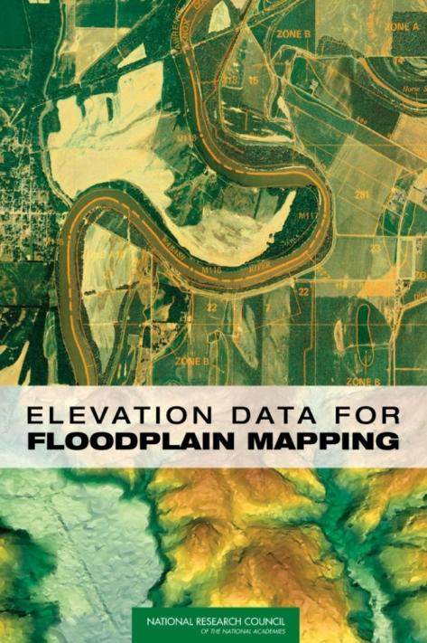
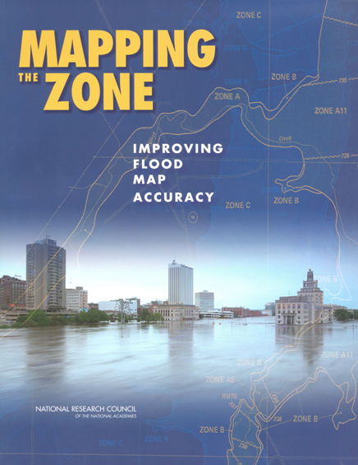
Mapping Flood Risk
Presented by David R. Maidment
Director, Center for Research in Water Resources, University of Texas at Austin
Distinguished Lecture presented at
University of South Carolina
March 18, 2011

Slide 2
Mapping Flood Risk
The vision – digital flood risk maps for the nation
The issues – cost, accuracy, data
The studies – two reports from National Academy of Sciences
Assessment – where are we now?

Slide 3
Mapping Flood Risk
The vision – digital flood risk maps for the nation
The issues – cost, accuracy, data
The studies – two reports from National Academy of Sciences
Assessment – where are we now?

Slide 4
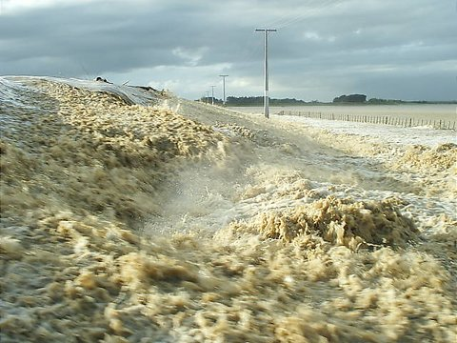
Flood Hazard
Flooding is by far the largest natural hazard facing people
Causes two-thirds of all declared federal disasters
Threat to life (more than 1000 deaths in Katrina)

Slide 5
National Flood Insurance Program
Started in 1968 and administered by FEMA
Based on agreement between federal and local government
Federal government provides flood insurance
Local government regulates land use to minimize flood risk
Federal Government
(Flood insurance, flood mapping)
Local Government (Cities, Counties)
Floodplain regulation

Slide 6
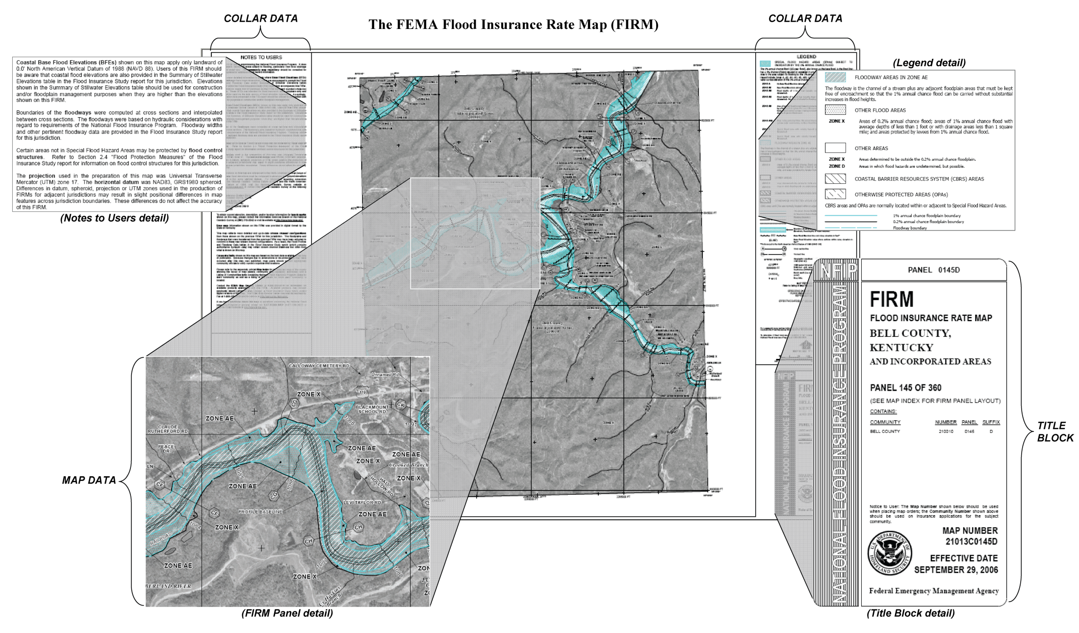
Flood Insurance Rate Map (FIRM)
Flood Hazard Zone
≥ 1% chance of flooding in any year

Slide 7
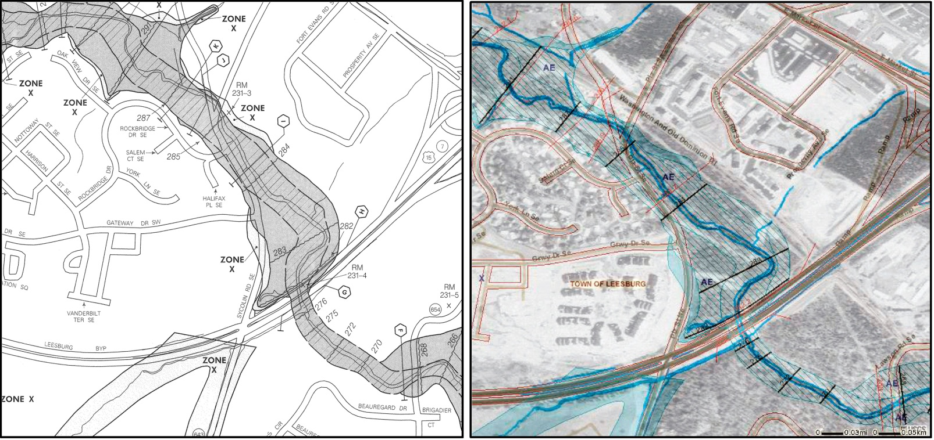
Digital Flood Insurance Rate Map (DFIRM)
Old, paper FIRM
New, digital (D)FIRM
The ideal DFIRM: more accurate than paper FIRM, more flexible to use and update, more versatile for community use

Slide 8
(x,y)
(z)

Slide 9
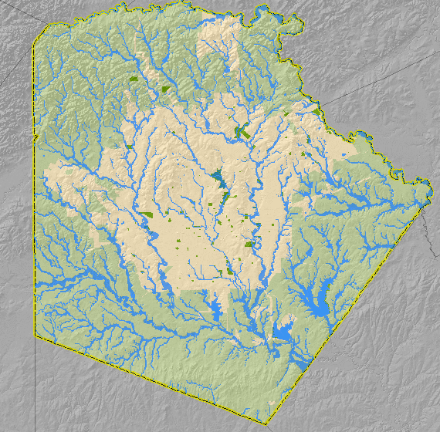
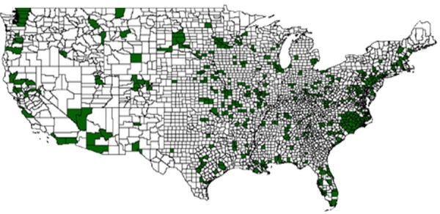
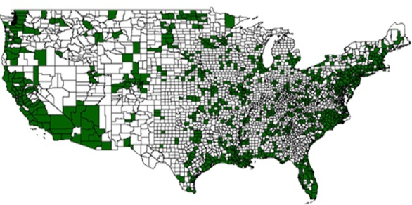
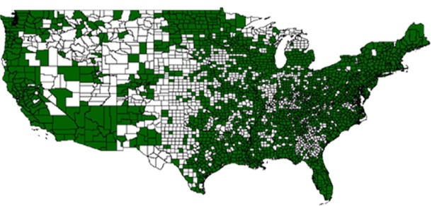
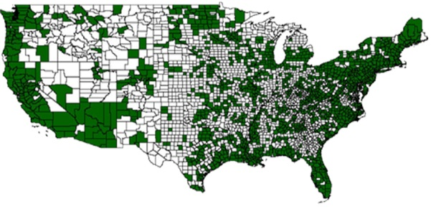
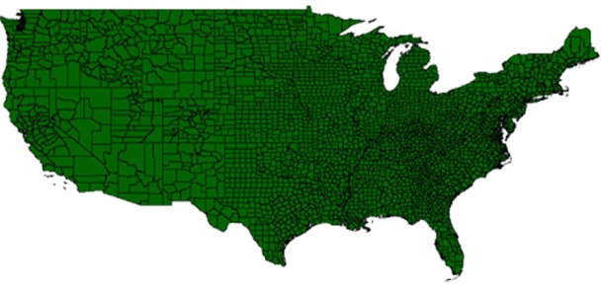
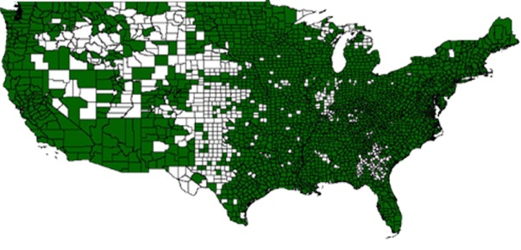
FEMA Map Modernization
Example: Floodplain map for Bexar County, Texas, (San Antonio)
Goal: National coverage of digital floodplain maps
2006
2004
2005
2007
2009
2008
More than $1 billion spent to achieve this…..
…. said to be the largest civilian mapping program in the world

Slide 10
Mapping Flood Risk
The vision – digital flood risk maps for the nation
The issues – cost, accuracy, data
The studies – two reports from National Academy of Sciences
Assessment – where are we now?

Slide 11
Issues with Map Modernization
Cost for national digital flood mapping is much greater than $1 billion
Emphasis was on extending coverage with “adequate” flood maps rather than on map quality
Basemap data were questioned – how can you get good flood maps coming out if input data is inaccurate?

Slide 12
Map Mod MidCourse Correction (2005)
Rather than attempting to cover all the nation with updated flood maps, FEMA decided to focus on 65% of the nation’s land area containing 92% of the population
FEMA implemented a floodplain boundary standard which ensures alignment of flood map with existing topographic data
NRC Mapping Sciences Committee begins to consider flood mapping

Slide 13
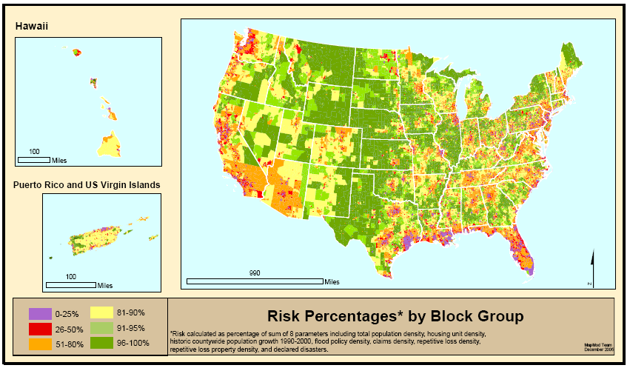
Where is Flood Risk the Greatest?
Based on population, repetitive flood losses, declared disasters
Notes:
Risk here is where floods and people are in general proximity (or will be)
Risk parameters for block groups
Population, population growth, housing units
Claims, repetitive losses, policies
Flood Disaster declarations (From county distribution)
We aggregate this information to a FEMA Regional level and allocate the majority of the appropriated map mod funding to the Regions who work with their state and local partners to develop flood production schedules at the county level.
All of this is explained in great detail in the Multi-Year Flood Hazard Identification Plan, which is published at least once a year.
Hard around the edges and somewhat softer in the middle.

Slide 14
Floodplain Boundary Standard
Compares ground elevation at floodplain boundary and computed flood elevation
This does not verify the elevation data
Not good
Good
Standards were introduced to meet criticism about map quality

Slide 15
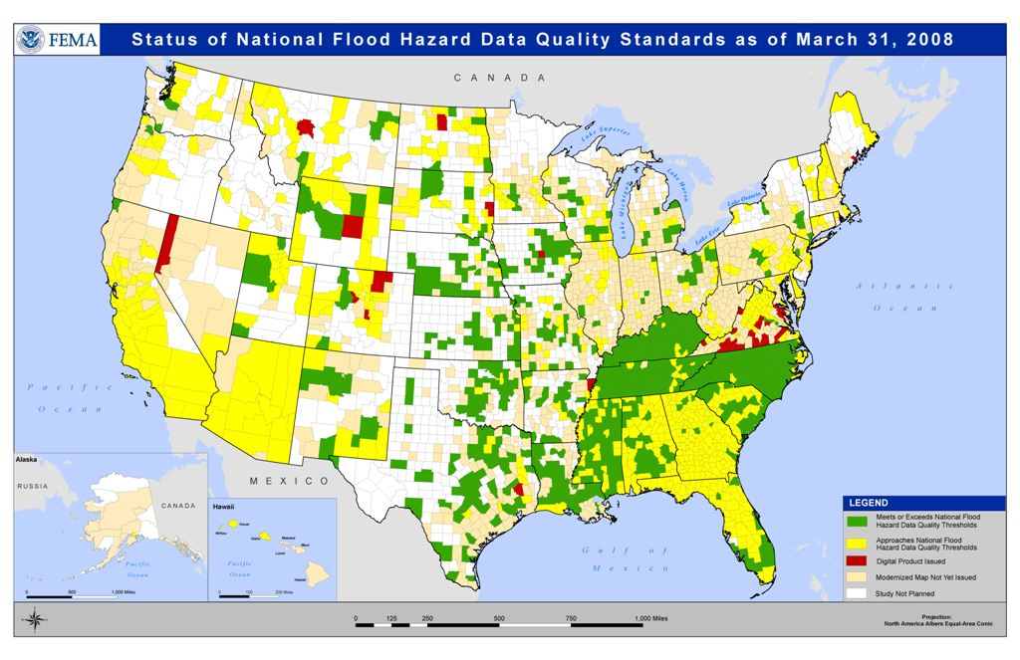
What had been achieved by 2008
Meets standards
Approaches standards

Slide 16
Mapping Flood Risk
The vision – digital flood risk maps for the nation
The issues – cost, accuracy, data
The studies – two reports from National Academy of Sciences
Assessment – where are we now?

Slide 17
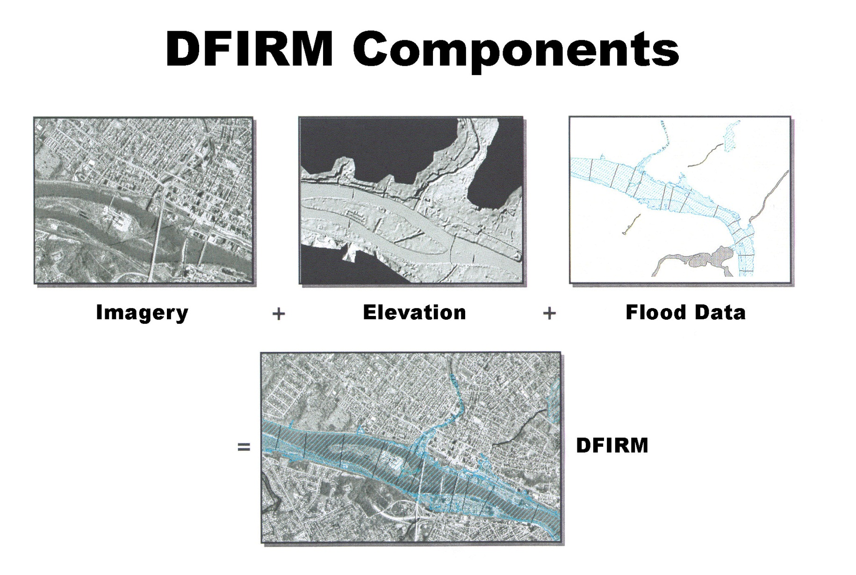
2007 National Research Council Study:
Basemap Inputs for Floodplain Mapping
‘Base map information’
*
This study addressed the technologies producing Imagery and Elevation data components of the DFIRM
Study was prompted by questions from the Senate Appropriations Committee

Slide 18
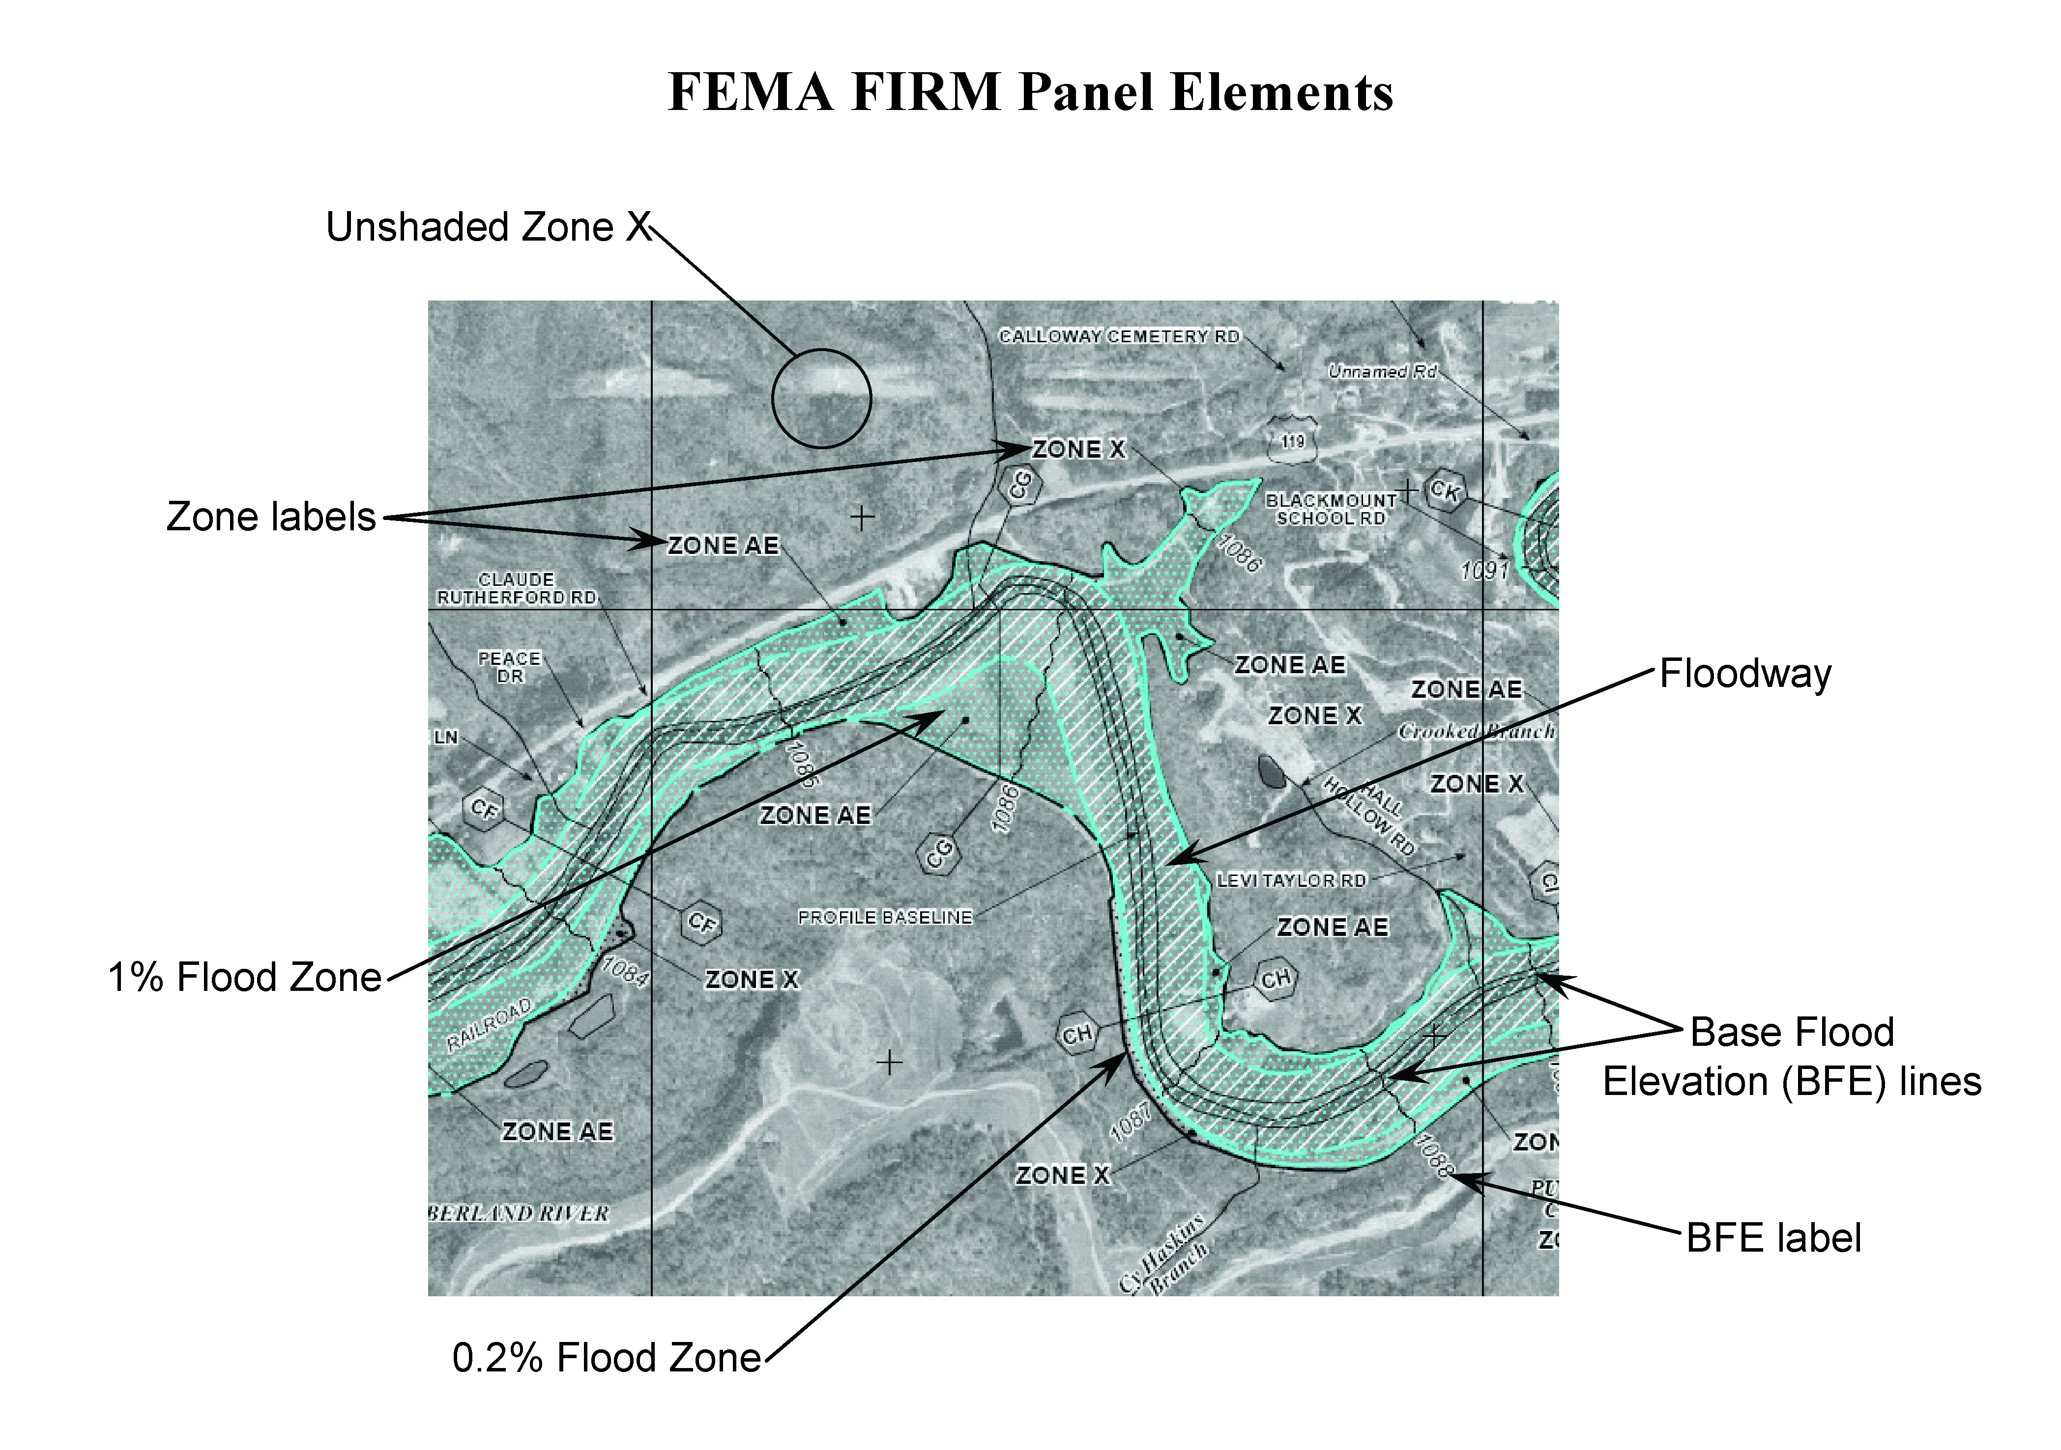
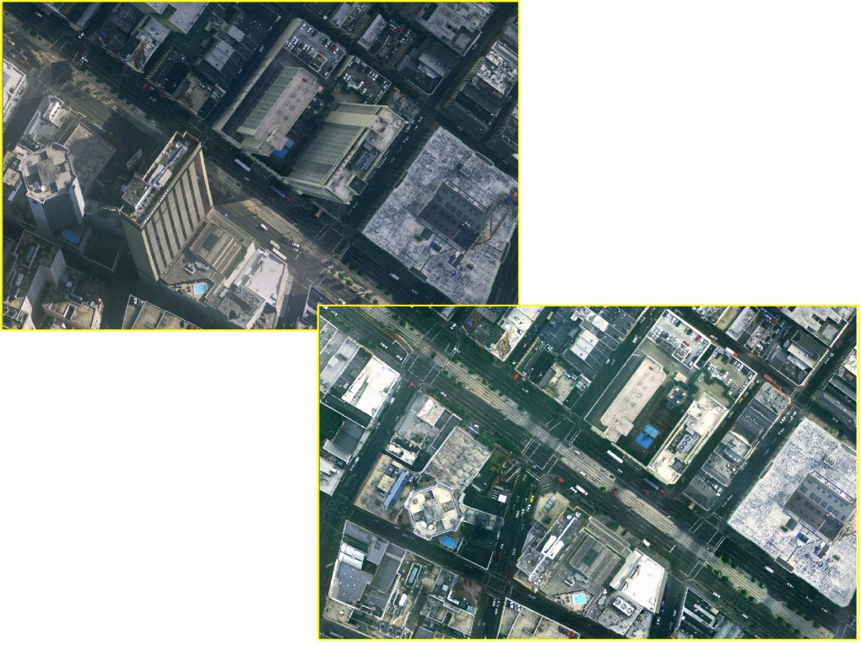
Base Imagery
Digital orthophotos show two-dimensional features like roads, buildings, vegetation, and rivers,
Photogrammetry is mature
Orthophotos are the ideal base imagery for FEMA Map Modernization purposes

Slide 19
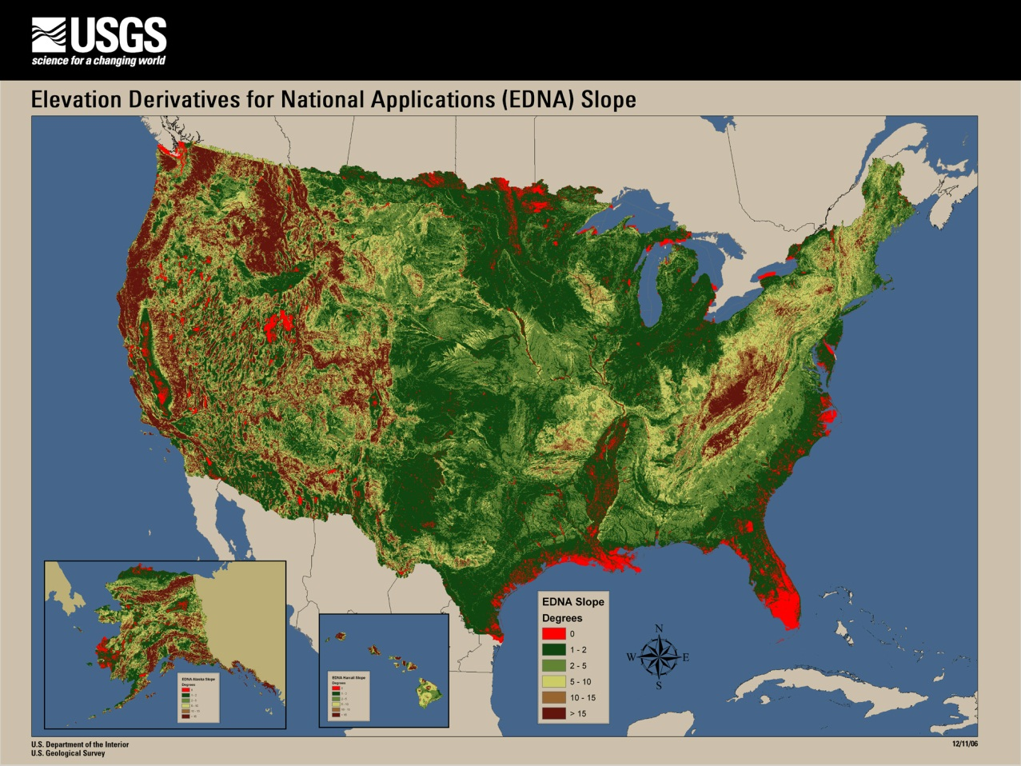
National Elevation Dataset
Slope map of the U.S. gives approximate scope of a national elevation program
Conversion of contours on 1:24,000 topographic maps to a 30m grid in continental United States
Root Mean Square error of national elevation data is 2.34 m (8 ft)
FEMA flood map standards call for error 17 -- 35cm (0.6 --1.2 ft)
11% of the continental US and Alaska has zero slope in the current National Elevation Dataset, much of which is in high-risk,
coastal flooding areas.
Slope Map of continental US

Slide 20
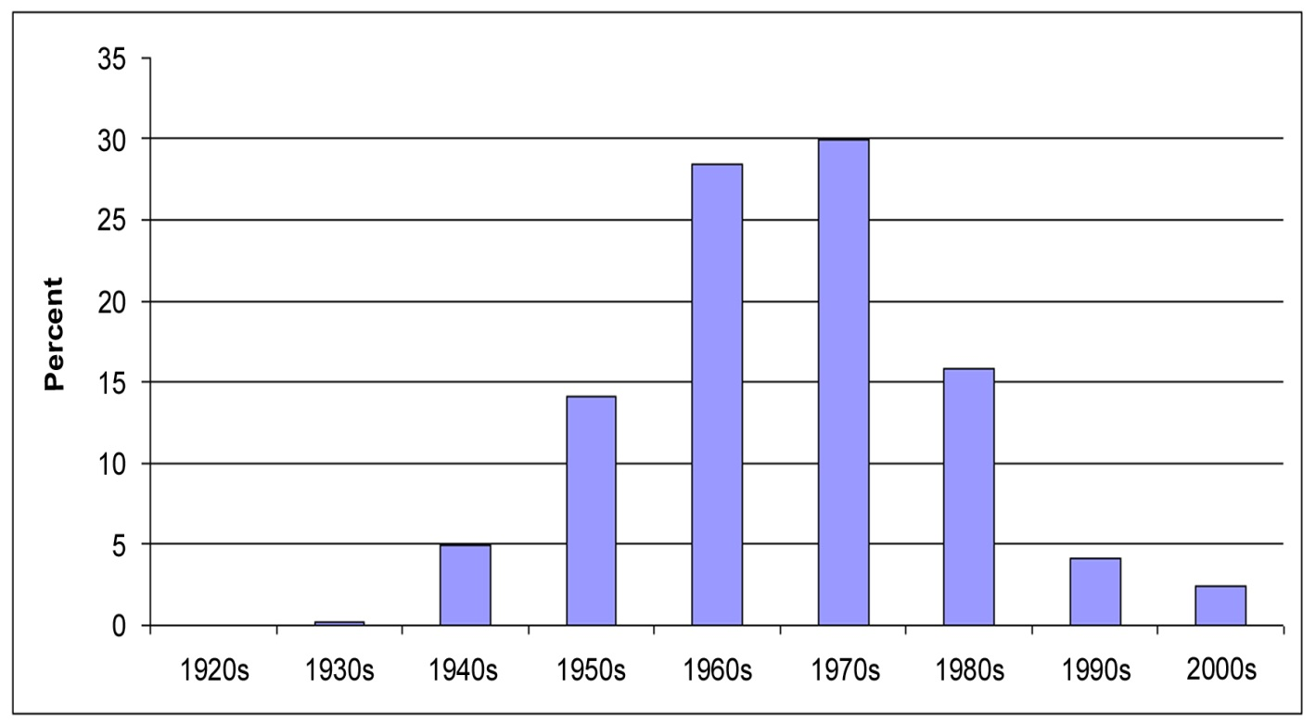
Elevation for the Nation
Age of USGS topographic maps in the
National Elevation Dataset (NED)
Terrain data in USGS topographic maps are on average 35 years old and flood mapping requires data that are either collected or considered for updating within the last 7 years.
Existing elevation data are thus ~ 1/10 accuracy and about 5 times older than needed for the flood mapping task.

Slide 21
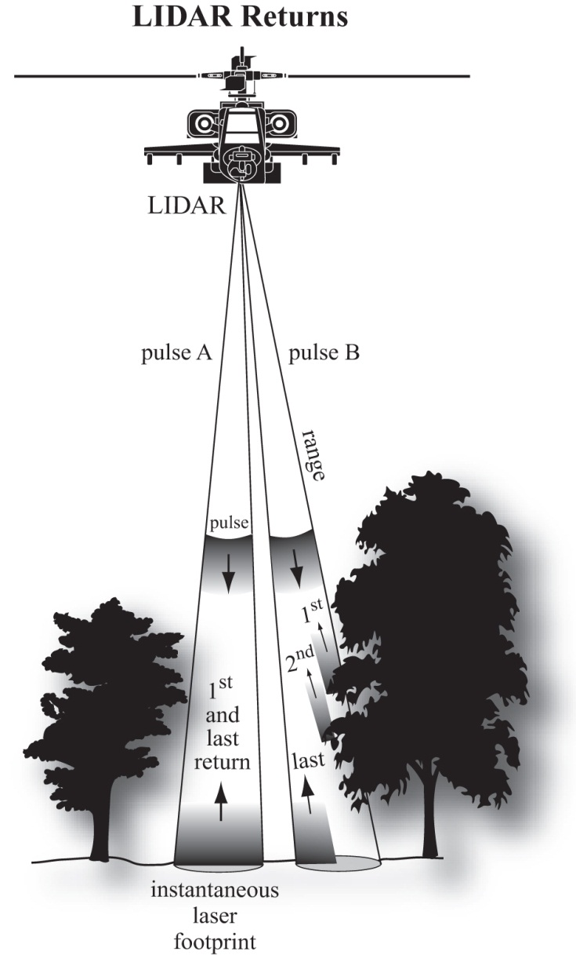
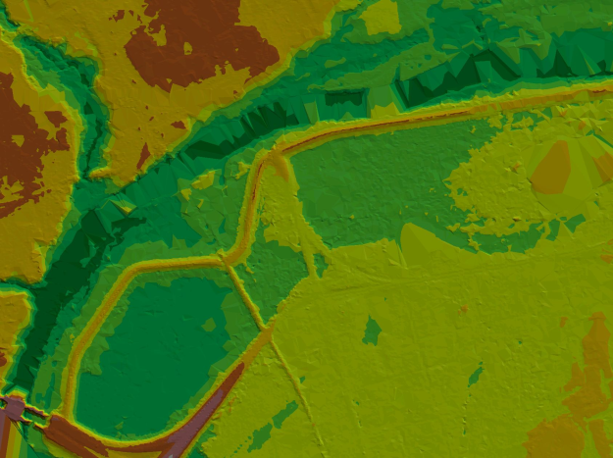
Light Detection and Ranging (lidar)
Lidar uses single laser pulses to see through or between the trees to create thousands of 3-D point measurements per second
Digital elevation model from National Elevation Dataset
Digital elevation model from lidar

Slide 22
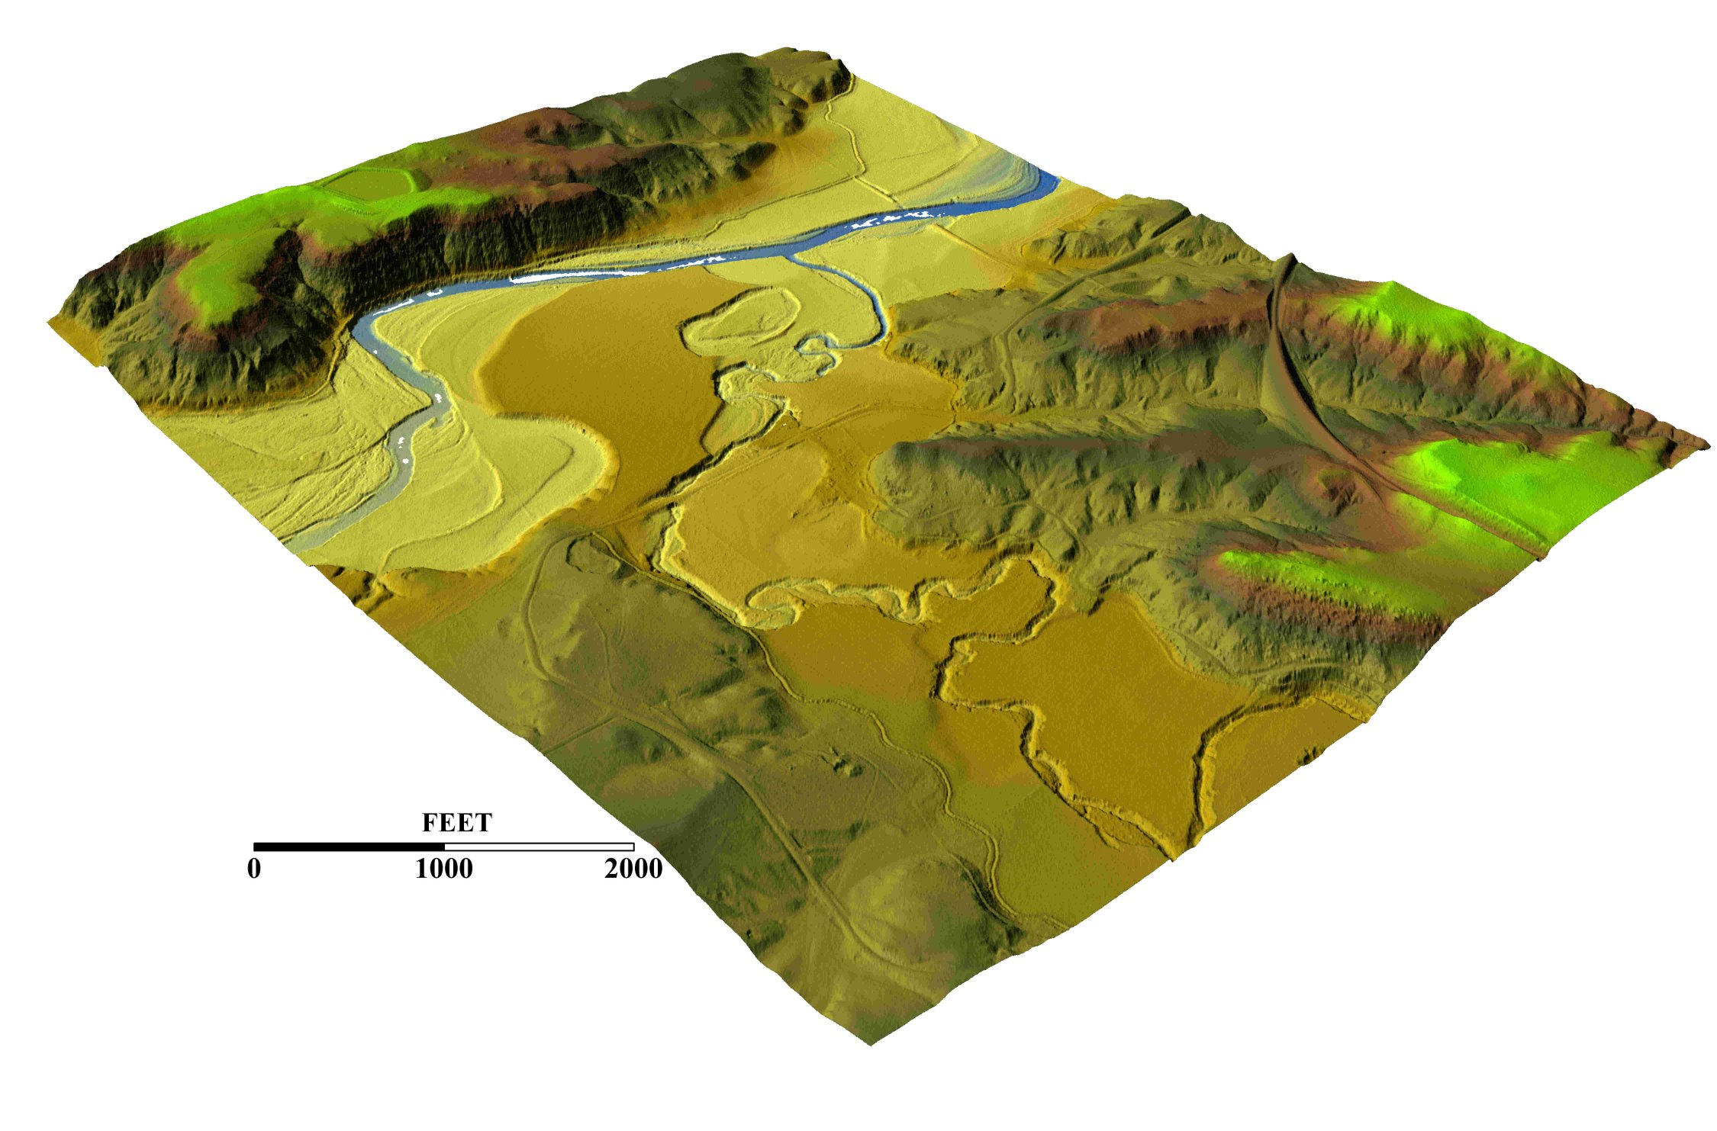
LIDAR Land Elevation Mapping
Image: Roberto Gutierrez, UT Center for Space Research

Slide 23
Conclusions from 2007 Study
Basemap imagery is fine for floodplain mapping
Existing elevation data have about 1/10 accuracy needed for floodplain mapping and are too old
A new elevation coverage of the nation is needed
Most likely technology to produce this is Lidar
Cost for national coverage ~ $500-600 million
We need “Elevation for the Nation”

Slide 24
2009 National Research Council Study
Sponsored by FEMA and NOAA
Examined tradeoffs between cost and accuracy of flood mapping
Detailed case studies in North Carolina
Riverine and coastal flooding

Slide 25
North Carolina Case Studies http://www.ncfloodmaps.com/program_review.htm
Economics
H&H
Studies done for the NRC Committee by the North Carolina Floodplain Mapping Program (NCFMP)
Mountains of Western NC
Rolling hills of Piedmont
Flat coastal plain
H&H and Economics
(H&H = Hydrology and Hydraulics)

Slide 26
One River Reach studied in detail in each region (each reach 5-7 miles long)

Slide 27
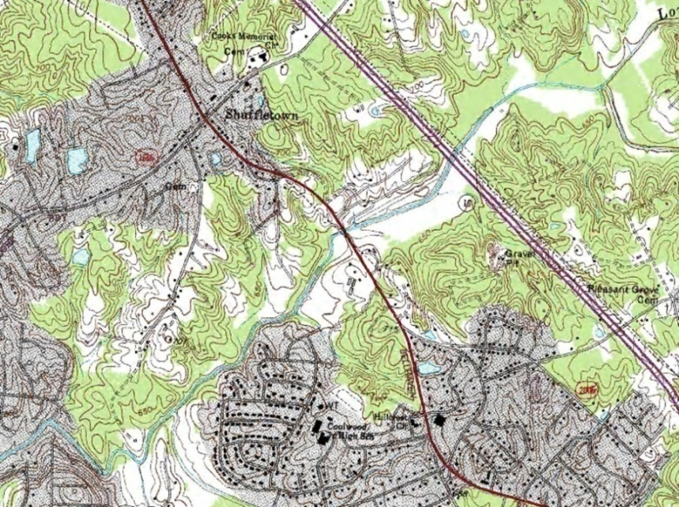
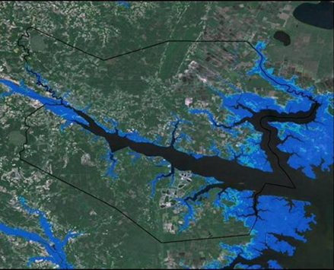
Terrain Data for Case Studies
USGS DEMs (30m)
NCFPM Lidar (3m)

Slide 28
NED - Lidar | Feet
Mean | -2.0
Standard deviation | 17.5
Maximum | 89.7
Minimum | -139.3
NED is higher
(green)
Lidar is higher
(purple)

Slide 29
NED is higher
(green)
NED - Lidar | Feet
Mean | 14.7
Standard deviation | 15.6
Maximum | 81.5
Minimum | - 46.0
An elevation “bust”
Systematic and random errors

Slide 30
NED - Lidar | Feet
Mean | 0.5
Standard deviation | 3.9
Maximum | 34.8
Minimum | -25.3

Slide 32
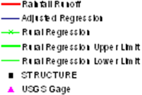
Effect on Base Flood Elevation of Hydrologic Methods (Long Creek, Mecklenburg County)
Hydrologic methods define how large is the flood discharge

Slide 33
Effect on BFE of variation in hydraulic methods and terrain data (Long Creek)
Approximate Study using NED
21 ft
Hydraulic methods define how high is the Base Flood Elevation

Slide 34
Approximate Study BFE Profiles
Approximate - Lidar
Approximate - NED
Misalignment (100 – 200 ft) of mapped 2D planimetric streamline with NED 3D elevation data

Slide 35
Alignment of planimetrics and
elevation data really matters

Slide 36
Defining Uncertainty in Base Flood Elevation Long term records of extreme stages recorded at USGS gages
At each gage the peak stage is recorded for each year along with the peak flow – do a frequency analysis of these.

Slide 37
Frequency Analysis of Stage Heights at 31 gages
6
7
8
21 gages in NC
Is pitted FL landscape different?
All gages have at least 20 years record
(average is 54 years)
10 gages in FL

Slide 38
Swannanoa River at Biltmore, NC (78 years of record)
Base flood discharge
Discharge (cfs)
T = 100 years
Annual Exceedence Probability
Produced using the Corps HEC-SSP Program (Bulletin 17-B standard procedure)

Slide 39
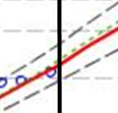
Swannanoa River at Biltmore, NC (78 years of record)
95% CL
5% CL
Stage (ft)
Sampling error =
T = 100 years
Annual Exceedence Probability
Uncertainty in BFE = Uncertainty in 100-year stage height

Slide 40
Sampling Error of 100-year Stage Heights
Outlier (skewed frequency curve)
No systematic variation in sampling error by
drainage area or topographic region
Sampling Error (ft)
Average = 1.06 ft
Drainage Area (Sq miles)

Slide 41
Uncertainty in Base Flood Elevation
95% CL
BFE and Base Stage Height differ by a constant amount (gage datum – geodetic datum)
This doesn’t affect uncertainty of statistical variation of sample data around the 100-year estimate
Average value of sample error at 30 of 31 gage sites is 1.06 ft
A Lower Bound on the uncertainty of the BFE is a standard error of estimate of approximately one foot
5% CL
Base Stage Height
BFE, h
Gage datum
Geodetic datum

Slide 42
Uncertainty in Floodplain Boundary Location
dw/dh = Run/Rise
Lateral channel slope is calculated on HEC-RAS cross-sections at the point of intersection of water surface with land surface (left and right banks) and averaged for all cross-sections in the reach
County | Lateral slope (%) | Run/rise (ft)
Ahoskie Creek | 2.4 | 42
Long Creek | 9.8 | 10
Swannanoa River | 12.9 | 8
w
dh
h
dw
A Lower Bound on the uncertainty of the floodplain boundary location ranges from approximately 8ft in the mountains to approximately 40 ft in the coastal plain

Slide 43
Conclusions from 2009 NRC Study
There are hydrologic, hydraulic and terrain data uncertainties
Accuracy of land elevation is single largest factor governing accuracy of flood elevation
Inherent uncertainty in base flood elevation is ~ 1 foot
Flood mapping needs LIDAR data!

Slide 44
Mapping Flood Risk
The vision – digital flood risk maps for the nation
The issues – cost, accuracy, data
The studies – two reports from National Academy of Sciences
Assessment – where are we now?

Slide 48
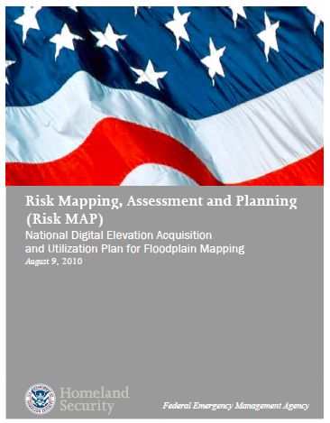
National Digital Elevation Acquisition Plan (2010)
FEMA was directed by Congress to develop a National Digital Elevation Acquisition and Utilization plan
FEMA will acquire new elevation data
FEMA anticipates a $20 million annual investment over 5 year period
This is the largest single investment in elevation data acquisition in the nation

Slide 49
Conclusions
Digital flood mapping is a worthy national investment
FEMA Map Modernization has created a flood mapping industry and has matured Lidar elevation measurement technology
Single largest factor affecting accurate flood elevation is accurate land elevation mapping
Academic review can lead to a significant shift in national policy

