Slide 1
CE 394K.2
Mass, Momentum, Energy
Begin with the Reynolds Transport Theorem
Mass – continuity equation
Momentum – Manning and Darcy eqns
Energy – conduction, convection, radiation
Reading: Applied Hydrology Sections 2.3 to 2.8

Slide 2
Reynolds Transport Theorem
Total rate of change of B in the fluid system
Rate of change of B stored in the control volume
Net outflow of B across the control surface

Slide 3
Continuity Equation
B = m; b = dB/dm = dm/dm = 1; dB/dt = 0 (conservation of mass)
ρ = constant for water
hence
or

Slide 4
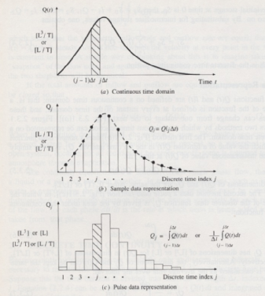
Continuous and Discrete time data
Figure 2.3.1, p. 28 Applied Hydrology
Continuous time representation
http://waterservices.usgs.gov/nwis/iv?sites=08158000&period=P7D&parameterCd=00060
Sampled or Instantaneous data
(streamflow)
truthful for rate, volume is interpolated
Can we close a discrete-time water balance?
Pulse or Interval data
(precipitation)
truthful for depth, rate is interpolated

Slide 5
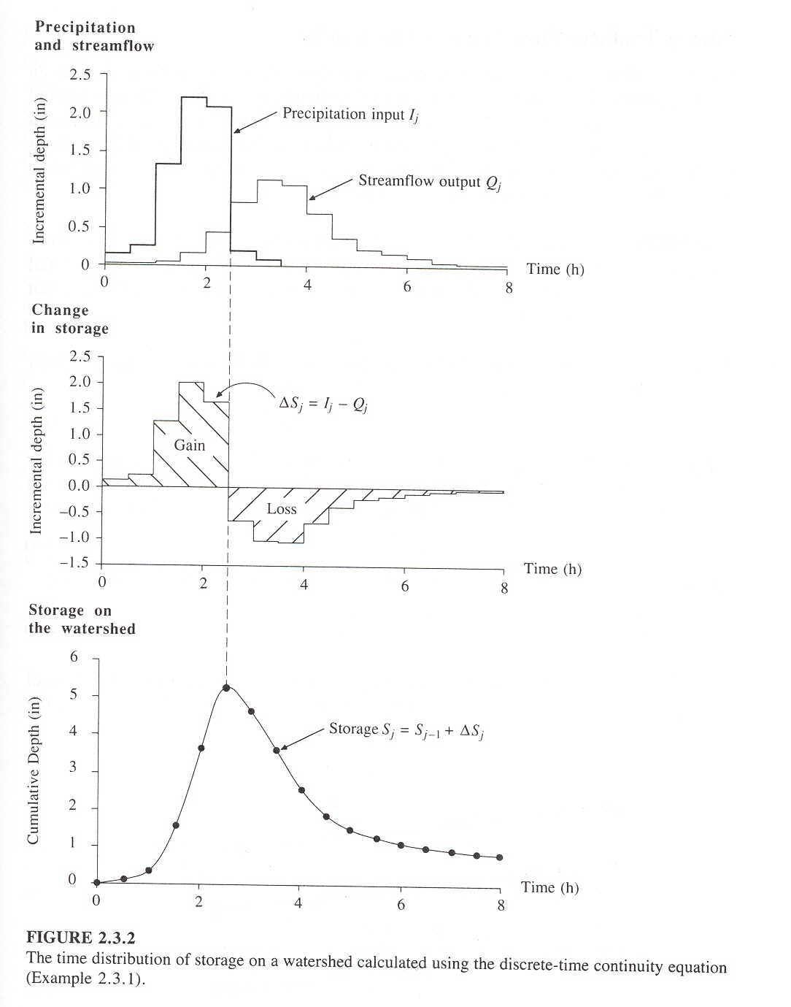

Slide 6
Momentum
B = mv; b = dB/dm = dmv/dm = v; dB/dt = d(mv)/dt = ΣF (Newtons 2nd Law)
For steady flow
For uniform flow
so
In a steady, uniform flow

Slide 7
Surface and Groundwater Flow Levels are related to Mean Sea Level
Mean Sea Level is a surface of constant
gravitational potential called the Geoid
Sea surface
Ellipsoid
Earth surface
Geoid

Slide 8
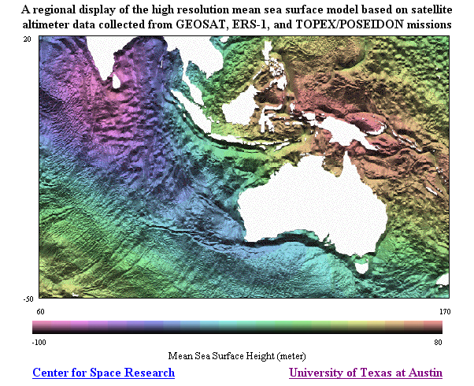
http://www.csr.utexas.edu/ocean/mss.html

Slide 9
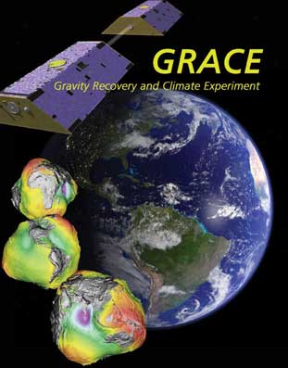
GRACE Mission
Gravity Recovery And Climate Experiment
http://www.csr.utexas.edu/grace/
Creating a new map of the earth’s gravity field every 30 days
Water Mass of Earth
http://www.csr.utexas.edu/grace/gallery/animations/measurement/measurement_qt.html

Slide 10
Vertical Earth Datums
A vertical datum defines elevation, z
NGVD29 (National Geodetic Vertical Datum of 1929)
NAVD88 (North American Vertical Datum of 1988)
takes into account a map of gravity anomalies between the ellipsoid and the geoid

Slide 11
Energy equation of fluid mechanics
h_{f}
energy
grade line
y₁
water
surface
y₂
bed
z₁
L
z₂
Datum
How do we relate friction slope,
to the velocity of flow?

Slide 12
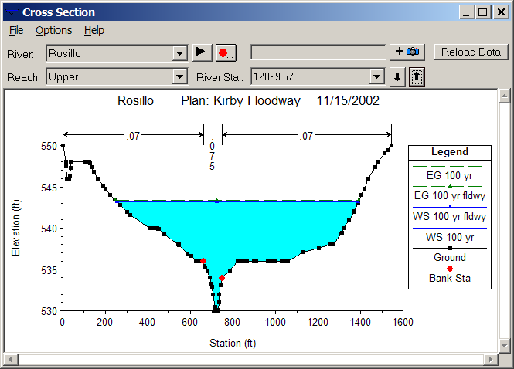
Open channel flow
Manning’s equation
Channel Roughness
Channel Geometry
Hydrologic Processes
(Open channel flow)
Hydrologic conditions
(V, S_{f})
Physical environment
(Channel n, R)

Slide 13
Subsurface flow
Darcy’s equation
q
A
q
Hydraulic conductivity
Hydrologic Processes
(Porous medium flow)
Hydrologic conditions
(q, S_{f})
Physical environment
(Medium K)

Slide 14
Comparison of flow equations
Open Channel Flow
Porous medium flow
Why is there a different power of S_{f}?

Slide 15
Energy
B = E = mv²/2 + mgz + E_{u}; β = dB/dm = v₂/2 + gz + e_{u};
dE/dt = dH/dt – dW/dt (heat input – work output) First Law of Thermodynamics
Generally in hydrology, the heat or internal energy component
(E_{u}, dominates the mechanical energy components (mv²/2 + mgz)

Slide 16
Heat energy
Energy
  Potential, Kinetic, Internal (E_{u})
Internal energy
  Sensible heat – heat content that can be measured and is proportional to temperature
  Latent heat – “hidden” heat content that is related to phase changes

Slide 17
Energy Units
In SI units, the basic unit of energy is Joule (J), where 1 J = 1 kg x 1 m/s²
Energy can also be measured in calories where 1 calorie = heat required to raise 1 gm of water by 1°C and 1 kilocalorie (C) = 1000 calories (1 calorie = 4.19 Joules)
We will use the SI system of units

Slide 18
Energy fluxes and flows
Water Volume [L³] (acre-ft, m³)
Water flow [L³/T] (cfs or m³/s)
Water flux [L/T] (in/day, mm/day)
Energy amount [E] (Joules)
Energy “flow” in Watts [E/T] (1W = 1 J/s)
Energy flux [E/L²T] in Watts/m²
Energy flow of
1 Joule/sec
Area = 1 m²

Slide 19
MegaJoules
When working with evaporation, its more convenient to use MegaJoules, MJ (J x 10⁶)
So units are
  Energy amount (MJ)
  Energy flow (MJ/day, MJ/month)
  Energy flux (MJ/m²-day, MJ/m²-month)

Slide 20
Internal Energy of Water
Water vapor
Water
Ice
Heat Capacity (J/kg-K) Latent Heat (MJ/kg)
Ice 2220 0.33
Water 4190 2.5
2.5/0.33 = 7.6
Water may evaporate at any temperature in range 0 – 100°C
Latent heat of vaporization consumes 7.6 times the latent heat of fusion (melting)

Slide 21
Water Mass Fluxes and Flows
Water Volume, V [L³] (acre-ft, m³)
Water flow, Q [L³/T] (cfs or m³/s)
Water flux, q [L/T] (in/day, mm/day)
Water mass [m = ρV] (Kg)
Water mass flow rate [m/T = ρQ] (kg/s or kg/day)
Water mass flux [M/L²T = ρq] in kg/m²-day
Water flux
Area = 1 m²

Slide 22
Latent heat flux
Water flux
  Evaporation rate, E (mm/day)
Energy flux
  Latent heat flux (W/m²), H_{l}
ρ = 1000 kg/m³
l_{v} = 2.5 MJ/kg
28.94 W/m² = 1 mm/day
Area = 1 m²

Slide 23
Radiation
Two basic laws
  Stefan-Boltzman Law
    R = emitted radiation (W/m2)
    ε = emissivity (0-1)
    σ = 5.67x10⁻⁸W/m2-K⁴
    T = absolute temperature (K)
  Wiens Law
    λ = wavelength of emitted radiation (m)
All bodies emit radiation
Hot bodies (sun) emit short wave radiation
Cool bodies (earth) emit long wave radiation

Slide 24
Net Radiation, R_{n}
R_{i} Incoming Radiation
R_{o} =αR_{i} Reflected radiation
= albedo (0 – 1)
R_{e}
R_{n} Net Radiation
Average value of R_{n} over the earth and
over the year is 105 W/m²

Slide 25
Net Radiation, R_{n}
H – Sensible Heat
LE – Evaporation
G – Ground Heat Flux
R_{n} Net Radiation
Average value of R_{n} over the earth and
over the year is 105 W/m²

Slide 26
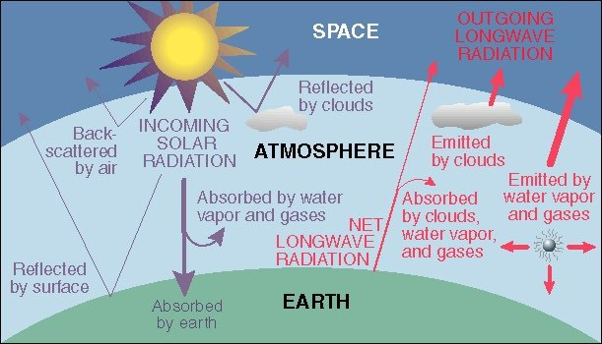
Energy Balance of Earth
20
70
100
6
6
26
4
38
15
19
21
Sensible heat flux 7
Latent heat flux 23
51
http://www.uwsp.edu/geo/faculty/ritter/geog101/textbook/energy/radiation_balance.html

Slide 27
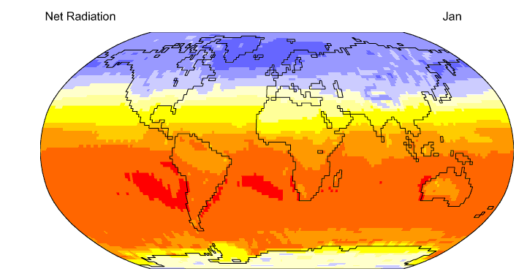

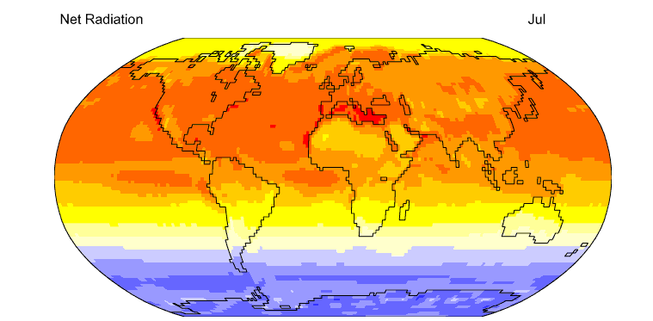
Net Radiation
http://geography.uoregon.edu/envchange/clim_animations/flash/netrad.html
Mean annual net radiation over the earth and over the year is 105 W/m²

