Slide 1
Assessment of Economic Benefits of the North Carolina Floodplain Mapping Program
Hydrologic and Hydraulic Case Studies
Adapted from a Presentation to NRC Committee on FEMA Flood Maps
January 14, 2008
by Thomas Langan, P.E., CFM
North Carolina Floodplain Mapping Program
Notes:
test

Slide 2
Purpose
Assess impacts to 100-yr water surface elevations (WSELs) and special flood hazard areas boundaries by changing:
  Physiographic region
  Hydrologic modeling methodology
  Hydraulic study type (Primary Goal)
  Topographic data source

Slide 3
Site Selection Criteria
Physiographic Regions – Coastal, Piedmont, Mountains
  Should be in or near County w/ GIS building footprints
Hydrologic Methodology
  All locations should have stream gage
  One County with a rainfall runoff model
  Suburban/Rural land use
Hydraulic Study Type
  Existing detail study (DS) HEC-RAS model
    20 years of peak and average daily discharge record
Topography
  NC LiDAR or Equivalent Accuracy (2 ½ -ft contour)

Slide 4
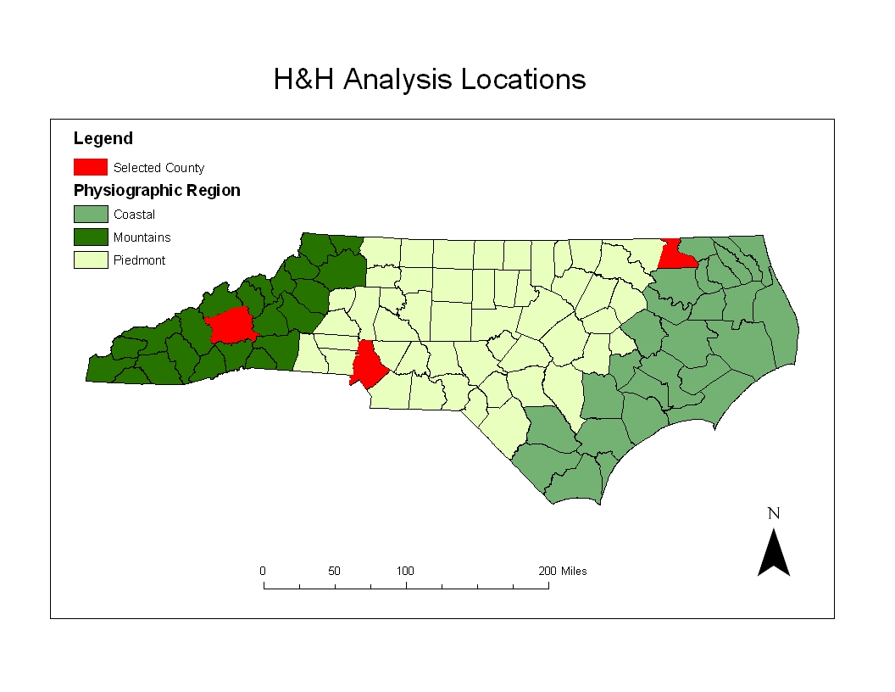

Slide 5
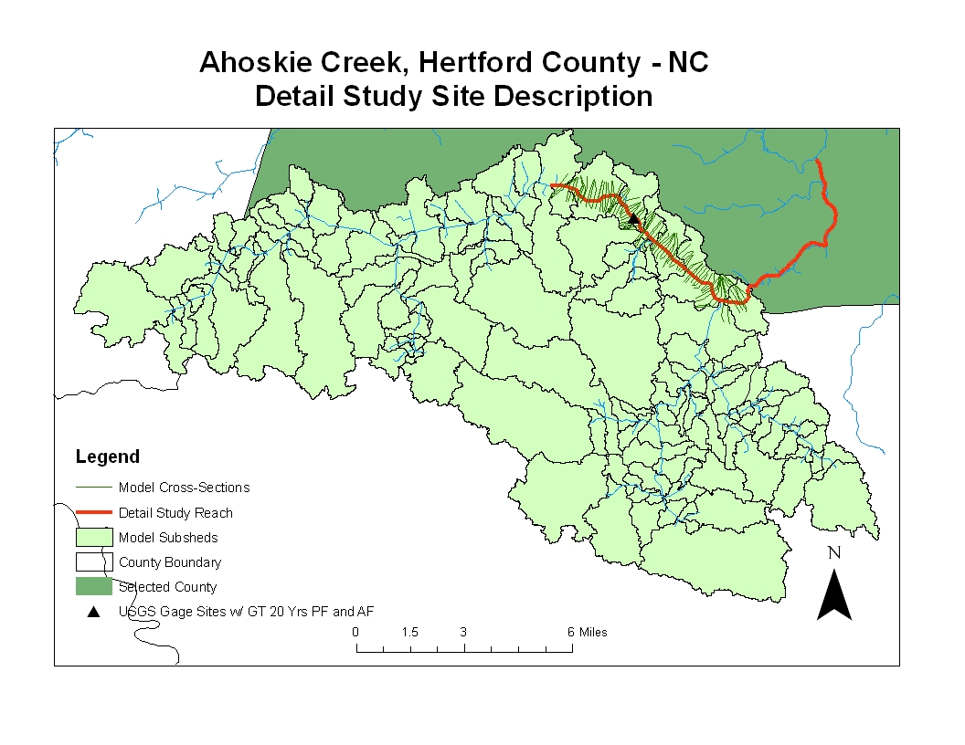
Length (mi) | 7.1
XSs | 80
Average XS Spacing | 472
Structures | 6
US Drainage Area (mi²) | 60
DS Drainage Area (mi²) | 136 (7545 cfs)

Slide 6
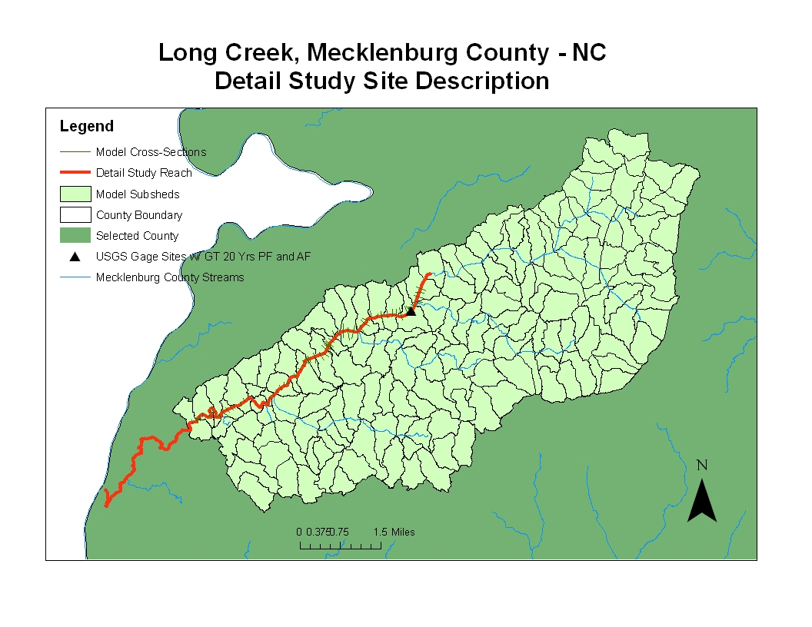
Length (mi) | 5.7
XSs | 66
Average XS Spacing | 459
Structures | 4
US Drainage Area (mi²) | 8
DS Drainage Area (mi²) | 32 (4394 cfs)

Slide 7
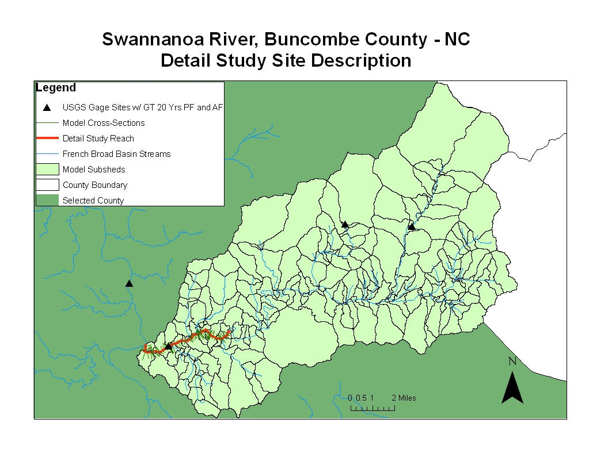
Length (mi) | 4.8
XSs | 59
Average XS Spacing | 496
Structures | 9
US Drainage Area (mi²) | 108
DS Drainage Area (mi²) | 133 (19710 cfs)

Slide 8
Analytical Approach
Physiographic Region
Variables
Hydrologic Methodology
Hydraulic Study Type
Topography
Hydrology
Hydraulics
Analyses
Floodplain Mapping
Statistics

Slide 9
Hydrologic Methodology
Flow estimate methods
  Rainfall-runoff (RR) – HEC-1 or HEC-HMS
  LPIII Weighted Adjusted Regional Regression (ADJREG)
  Rural Regional Regression (REG)
    Upper and Lower Limit of the Standard Error of Prediction of Regional Regression (REGUP & REGLOW) (+/- 42% Coast, Piedmont, Mountains - +/- 47%)
Parameters varied for only DS model runs and for 100-yr return period

Slide 10
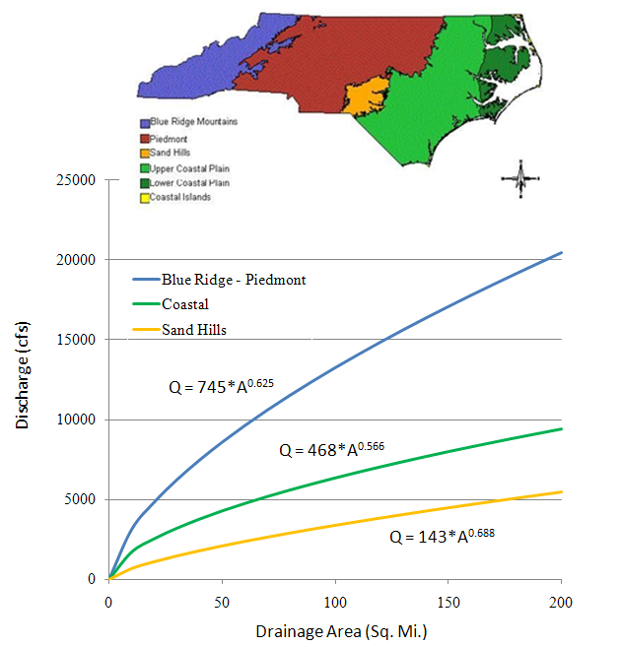
USGS Regional Regression Equations
Blue Ridge - Piedmont
Coastal Plain
For a 100 square mile drainage area, the 100-year flood discharge estimate is
13,250 cfs in the Blue Ridge-Piedmont,
6340 cfs in the coastal plain,
3400 cfs in the Sand Hills.
Sand Hills
95% Confidence interval is
+/- 42-47% of the estimated flow

Slide 11
Bottom of Bridge Deck
WSEL
14-ft
Downstream

Slide 13
15-ft

Slide 15
19-ft

Slide 17
Conclusions
All hydrologic methods are calibrated to results from frequency analysis at USGS gages so gage analysis drives results
Main effect is produced by stretching USGS regression equation results out to their limits (not realistic actually)
Varying hydrologic methods changes elevation by 1-2 ft

Slide 18
Analytical Results
Water Surface Elevation Profiles
Hydraulic Study Type

Slide 20
Changes SFHA

Slide 25
Conclusions
Uncertainty induced by changing the terrain data dominates other hydraulic model uncertainties
There is a huge effect of terrain data uncertainty in the in the Long Creek example in Charlotte, NC
  Floodplain derived from the LIDAR data is underground when viewed on the National Elevation Dataset!

