Slide 1
CE 374K Hydrology
Review for First Exam
February 15, 2011

Slide 2

Hydrology as a Science
“Hydrology is the science that treats the waters of the earth, their occurrence, circulation and distribution, their chemical and physical properties, and their reaction with their environment, including their relation to living things. The domain of hydrology embraces the full life history of water on the earth”
The “Blue Book”
From “Opportunities in Hydrologic Science”, National Academies Press, 1992
http://www.nap.edu/catalog.php?record_id=1543
Has this definition evolved in recent years? Are new issues important?

Slide 3
Hydrology as a Profession
A profession is a “calling requiring specialized knowledge, which has as its prime purpose the rendering of a public service”
What hydrologists do:
  Water use – water withdrawal and instream uses
  Water Control – flood and drought mitigation
  Pollution Control – point and nonpoint sources
Have these functions changed in recent years? Are priorities different now?

Slide 4
Global water balance (volumetric)
Units are in volume per year relative to precipitation on land (119,000 km³/yr) which is 100 units
Precipitation
100
Atmospheric moisture flow 39
Precipitation
385
Evaporation
424
Evaporation
61
Surface Outflow
38
Land (148.7 km²)
(29% of earth area)
Ocean (361.3 km²)
(71% of earth area)
Subsurface Outflow
1
What conclusions can we draw from these data?

Slide 5
Global water balance
Precipitation
800 mm (31 in)
Atmospheric moisture flow 316 mm (12 in)
Precipitation
1270 mm (50 in)
Evaporation
1400 mm (55 in)
Evaporation
480 mm (19 in)
Outflow
320 mm (12 in)
Land (148.7 km²)
(29% of earth area)
(Values relative to land area)
Ocean (361.3 km²)
(71% of earth area)
What conclusions can we draw from these data?
Applied Hydrology, Table 1.1.2, p.5

Slide 6
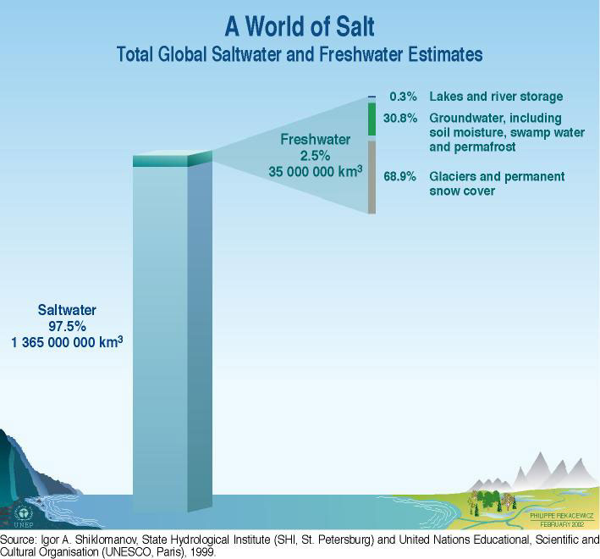
Global Water Resources
105,000 km³ or 0.0076% of total water

Slide 7
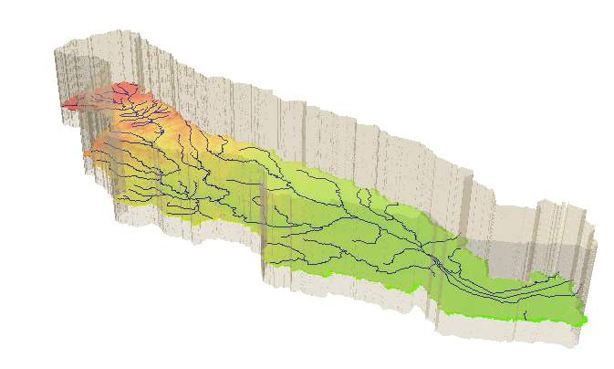
Hydrologic System
Take a watershed and extrude it vertically into the atmosphere
and subsurface, Applied Hydrology, p.7- 8
A hydrologic system is “a structure or volume in space surrounded by a boundary, that accepts water and other inputs, operates on them internally, and produces them as outputs”

Slide 8
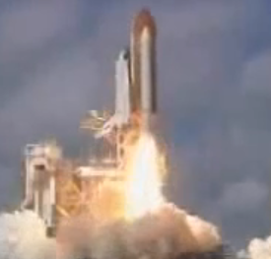
Views of Motion
Eulerian view (for fluids – e is next to f in the alphabet!)
Lagrangian view (for solids)
Fluid flows through a control volume
Follow the motion of a solid body

Slide 9
Reynolds Transport Theorem
A method for applying physical laws to fluid systems flowing through a control volume
B = Extensive property (quantity depends on amount of mass)
β = Intensive property (B per unit mass)
Total rate of
change of B in fluid system (single phase)
Rate of change of B stored within the Control Volume
Outflow of B across the Control Surface

Slide 10
Mass, Momentum Energy
 | Mass | Momentum | Energy
B | m | mv
β = dB/dm | 1 | v
dB/dt | 0
Physical Law | Conservation of mass | Newton’s Second Law of Motion | First Law of Thermodynamics

Slide 11
Continuity Equation
B = m; b = dB/dm = dm/dm = 1; dB/dt = 0 (conservation of mass)
ρ = constant for water
hence
or

Slide 12
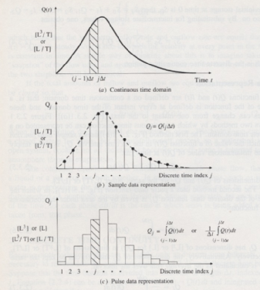
Continuous and Discrete time data
Figure 2.3.1, p. 28 Applied Hydrology
Continuous time representation
http://waterservices.usgs.gov/nwis/iv?sites=08158000&period=P7D&parameterCd=00060
Sampled or Instantaneous data
(streamflow)
truthful for rate, volume is interpolated
Can we close a discrete-time water balance?
Pulse or Interval data
(precipitation)
truthful for depth, rate is interpolated

Slide 13
Momentum
B = mv; b = dB/dm = dmv/dm = v; dB/dt = d(mv)/dt = ΣF (Newtons 2nd Law)
For steady flow
For uniform flow
so
In a steady, uniform flow

Slide 14
Energy equation of fluid mechanics
h_{f}
energy
grade line
y₁
water
surface
y₂
bed
z₁
L
z₂
Datum
How do we relate friction slope,
to the velocity of flow?

Slide 15
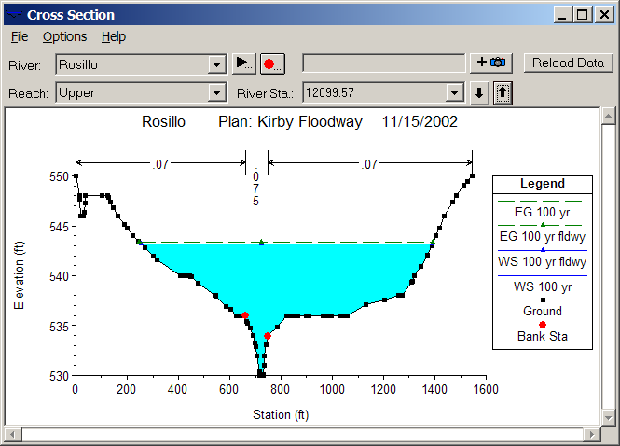
Open channel flow
Manning’s equation
Channel Roughness
Channel Geometry
Hydrologic Processes
(Open channel flow)
Hydrologic conditions
(V, S_{f})
Physical environment
(Channel n, R)

Slide 16
Subsurface flow
Darcy’s equation
q
A
q
Hydraulic conductivity
Hydrologic Processes
(Porous medium flow)
Hydrologic conditions
(q, S_{f})
Physical environment
(Medium K)

Slide 17
Internal Energy of Water
Water vapor
Water
Ice
Heat Capacity (J/kg-K) Latent Heat (MJ/kg)
Ice 2220 0.33
Water 4190 2.5
2.5/0.33 = 7.6
Water may evaporate at any temperature in range 0 – 100°C
Latent heat of vaporization consumes 7.6 times the latent heat of fusion (melting)

Slide 18
Radiation
Basic laws
  Stefan-Boltzman Law
    R = emitted radiation (W/m²)
    T = absolute temperature (K),
    and σ = 5.67x10⁻⁸W/m²-K⁴
    with ε = emissivity (0-1)
      Water, Ice, Snow (0.95-0.99)
      Sand (0.76)
Valid for a Black body or “pure radiator”
“Gray bodies emit a proportion of the radiation of a black body

Slide 19
Net Radiation, R_{n}
R_{i} Incoming Radiation
R_{o} =αR_{i} Reflected radiation
= albedo (0 – 1)
R_{e}
R_{n} Net Radiation
Average value of R_{n} over the earth and
over the year is 105 W/m²

Slide 20
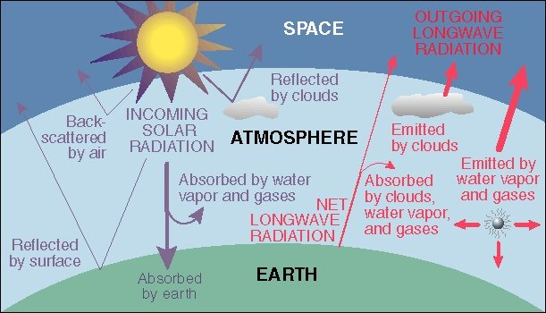
Energy Balance of Earth
20
70
100
6
6
26
4
38
15
19
21
Sensible heat flux 7
Latent heat flux 23
51
http://www.uwsp.edu/geo/faculty/ritter/geog101/textbook/energy/radiation_balance.html

Slide 21
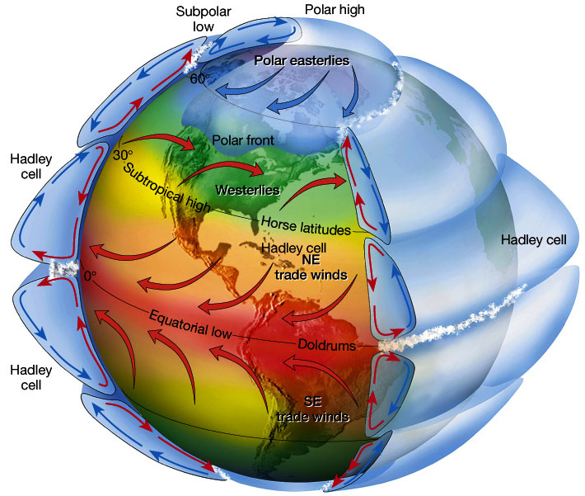
Atmospheric circulation
Circulation cells
Polar Cell
Hadley cell
Ferrel Cell
Polar cell
Ferrel Cell
Winds
Tropical Easterlies/Trades
Westerlies
Polar easterlies
Latitudes
Intertropical convergence zone (ITCZ)/Doldrums
Horse latitudes
Subpolar low
Polar high

Slide 22
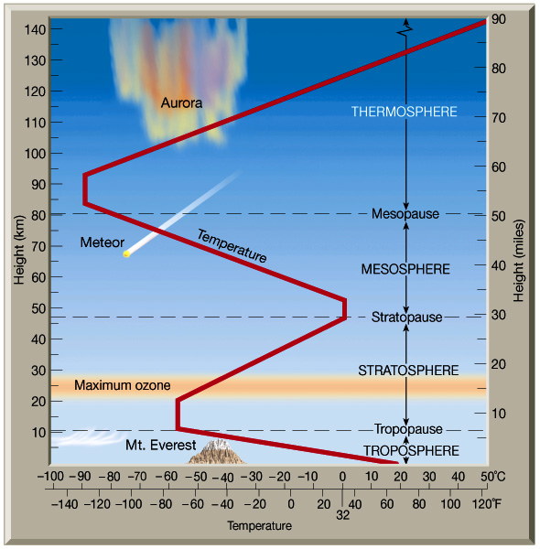
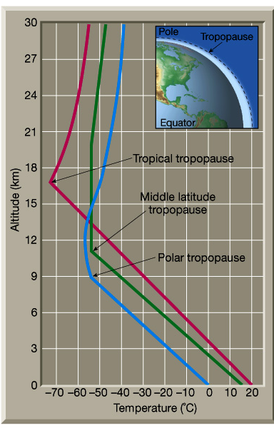
Structure of atmosphere

Slide 23
Specific Humidity, q_{v}
Specific humidity measures the mass of water vapor per unit mass of moist air
It is dimensionless

Slide 24
Vapor pressure, e
Vapor pressure, e, is the pressure that water vapor exerts on a surface
Air pressure, p, is the total pressure that air makes on a surface
Ideal gas law relates pressure to absolute temperature T, R_{v} is the gas constant for water vapor
0.622 is ratio of mol. wt. of water vapor to avg mol. wt. of dry air (=18/28.9)

Slide 25
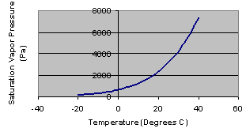
Saturation vapor pressure, e_{s}
Saturation vapor pressure occurs when air is holding all the water vapor
that it can at a given air temperature
Vapor pressure is measured in Pascals (Pa), where 1 Pa = 1 N/m²
1 kPa = 1000 Pa

Slide 26
Relative humidity, R_{h}
e_{s}
e
Relative humidity measures the percent
of the saturation water content of the air
that it currently holds (0 – 100%)

Slide 27
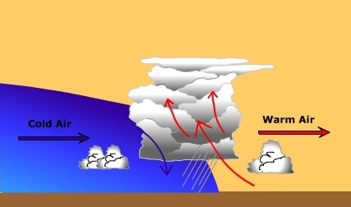
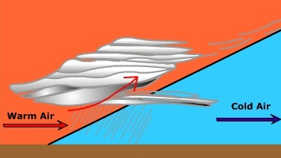
Frontal Lifting
Boundary between air masses with different properties is called a front
Cold front occurs when cold air advances towards warm air
Warm front occurs when warm air overrides cold air
Cold front (produces cumulus cloud)
Cold front (produces stratus cloud)

Slide 28
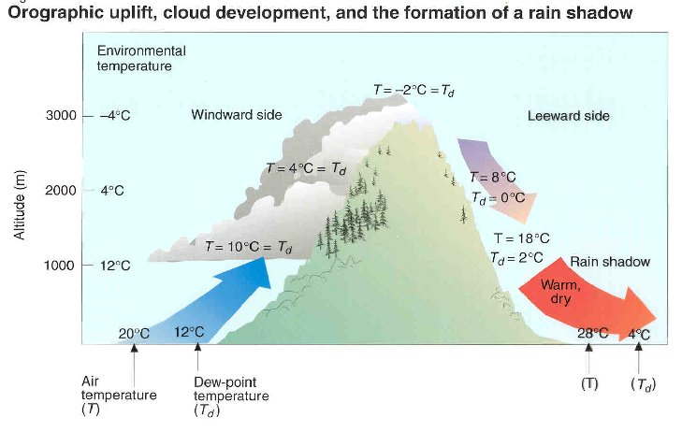
Orographic lifting
Orographic uplift occurs when air is forced to rise because of the physical presence of elevated land.

Slide 29
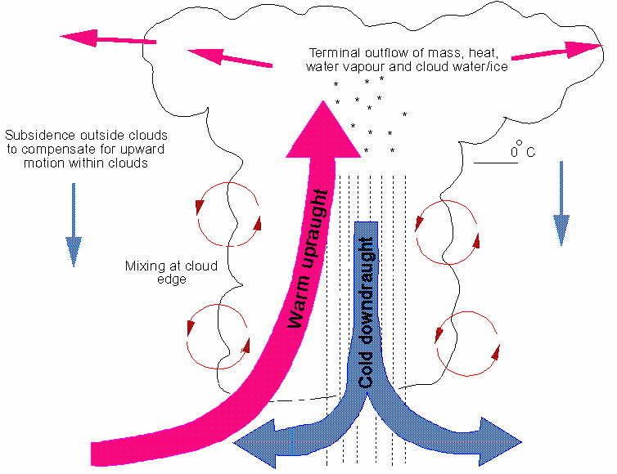
Convective lifting
Convective precipitation occurs when the air near the ground is heated by the earth’s warm surface. This warm air rises, cools and creates precipitation.
Hot earth surface

Slide 30
Terminal Velocity
Terminal velocity: velocity at which the forces acting on the raindrop are in equilibrium.
If released from rest, the raindrop will accelerate until it reaches its terminal velocity
D
F_{b}
F_{d}
F_{d}
F_{g}
At standard atmospheric pressure (101.3 kpa) and temperature (20ºC), ρ_{w} = 998 kg/m3 and ρ_{a} = 1.20 kg/m3
V
Raindrops are spherical up to a diameter of 1 mm
For tiny drops up to 0.1 mm diameter, the drag force is specified by Stokes law

Slide 31
Incremental Rainfall
Rainfall Hyetograph

Slide 32
Cumulative Rainfall
Rainfall Mass Curve

Slide 33
Evaporation
  Evaporation – process by which liquid water becomes water vapor
  Transpiration – process by which liquid water passes from liquid to vapor through plant metabolism
  Evapotranspiration – evaporation through plants and trees, and directly from the soil and land surface
  Potential Evaporation – evaporation from an open water surface or from a well-watered grass surface

Slide 34
ET -Eddy covariance method
Measurement of vertical transfer of water vapor driven by convective motion
Directly measure flux by sensing properties of eddies as they pass through a measurement level on an instantaneous basis
Statistical tool

Slide 35
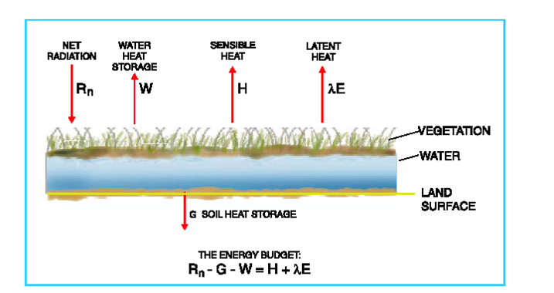
Energy Balance Method
Can directly measure these variables
How do you partition
H and λE??

Slide 36

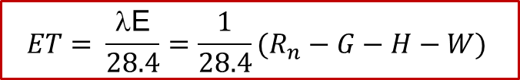

Energy Balance Method
$$\text{}$$
$$\frac{28.4 \text{W} }{m^{2} }×\frac{J/s}{W}×\frac{1 g}{2450 J}×\frac{3600 s}{ 1 hr}×\frac{24 hr}{1 day}×\frac{m^{3}}{1000 kg}×\frac{1 kg}{1000 g}×\frac{1000 mm}{1 m}=1 \frac{mm}{day}$$
$$ρ﷮w$$
$$ET= \frac{\text{λ}\text{E}}{28.4}=\frac{1}{28.4}(R_{n}−G−H−W)$$
The maximum radiative evaporation rate E_{r} = $\frac{R_{n}}{28.4}$

Slide 37
Aerodynamic Method
Often only available at 1 elevation
Simplifying
Net radiation
Air Flow
Evaporation

Slide 38
Combined Method
Evaporation is calculated by
  Aerodynamic method
    Energy supply is not limiting
  Energy method
    Vapor transport is not limiting
Normally, both are limiting, so use a combination method
Priestley & Taylor

Slide 39
Example
Use Priestly-Taylor Method to find Evaporation rate for a water body
  Net Radiation = 200 W/m2,
  Air Temp = 25 degC,
Priestly & Taylor

Slide 40
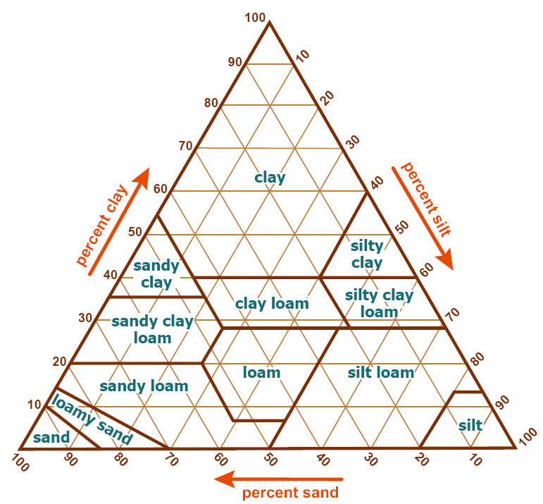
Soil Texture
Triangle
Source: USDA Soil
Survey Manual Chapter 3

Slide 41
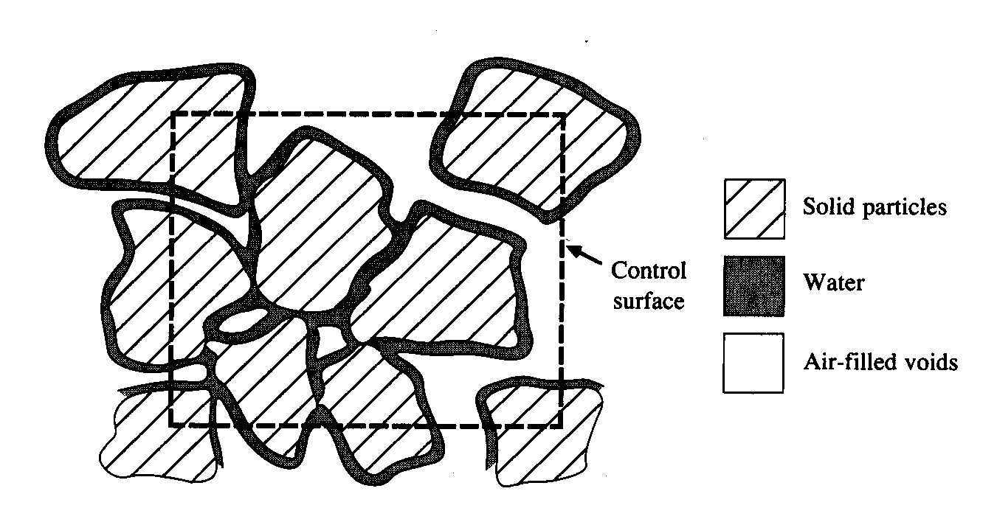
Soil Water Content
Soil Water Content

Slide 42
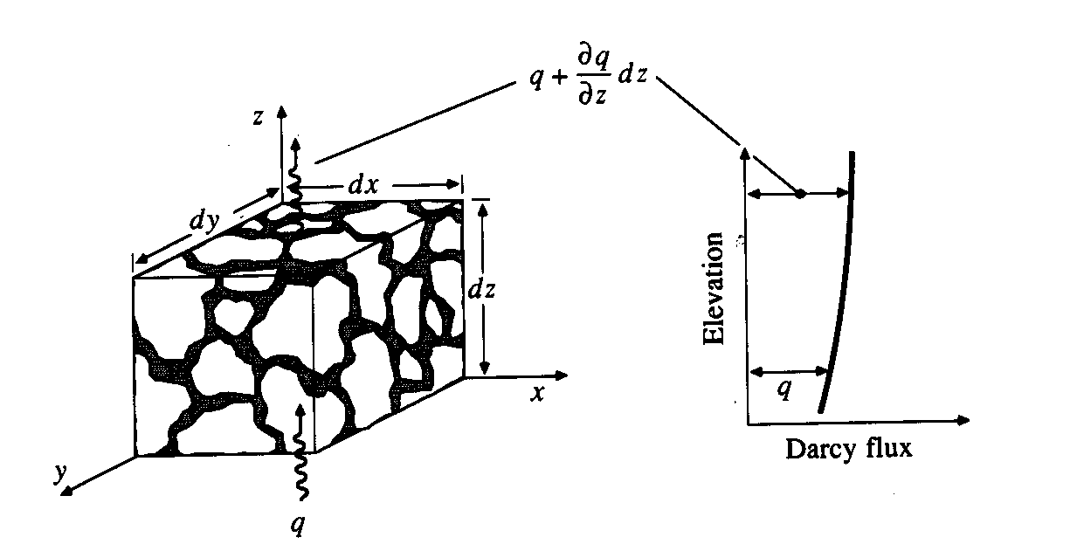
Soil Water Flux, q
q = Q/A

Slide 43
Soil Water Tension, ψ
Measures the suction head of the soil water
Like p/γ in fluid mechanics but its always a suction (negative head)
Three key variables in soil water movement
  Flux, q
  Water content, θ
  Tension, ψ
Total energy head = h
z=0
z₁
q₁₂
z₂

Slide 44
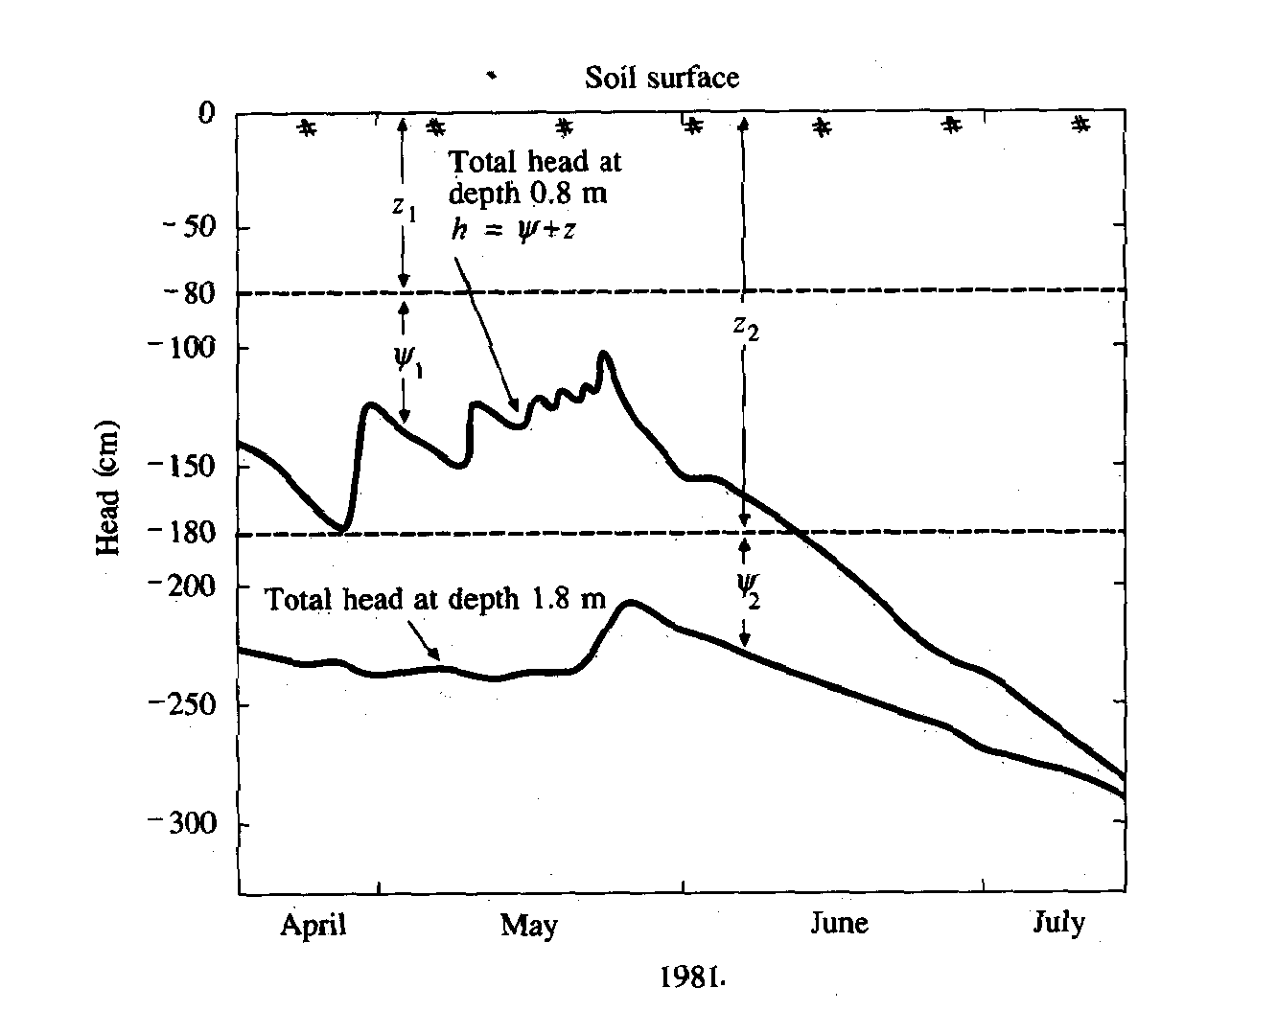

Slide 45
Richard’s Equation
Recall
  Darcy’s Law
  Total head
So Darcy becomes
Richard’s eqn is:
Soil water diffusivity

Slide 46
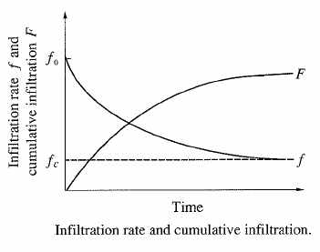
Infiltration
Infiltration rate
  Rate at which water enters the soil at the surface (in/hr or cm/hr)
Cumulative infiltration
  Accumulated depth of water infiltrating during given time period

Slide 47
Green – Ampt Infiltration
Ponded Water
Ground Surface
Wetted Zone
Wetting Front
Dry Soil

Slide 48
Green – Ampt Infiltration (Cont.)
Ground Surface
Wetted Zone
Wetting Front
Apply finite difference to the derivative, between
  Ground surface
  Wetting front
Dry Soil

Slide 49
Green – Ampt Infiltration (Cont.)
Ground Surface
Wetted Zone
Wetting Front
Dry Soil
Nonlinear equation, requiring iterative solution.

Slide 50
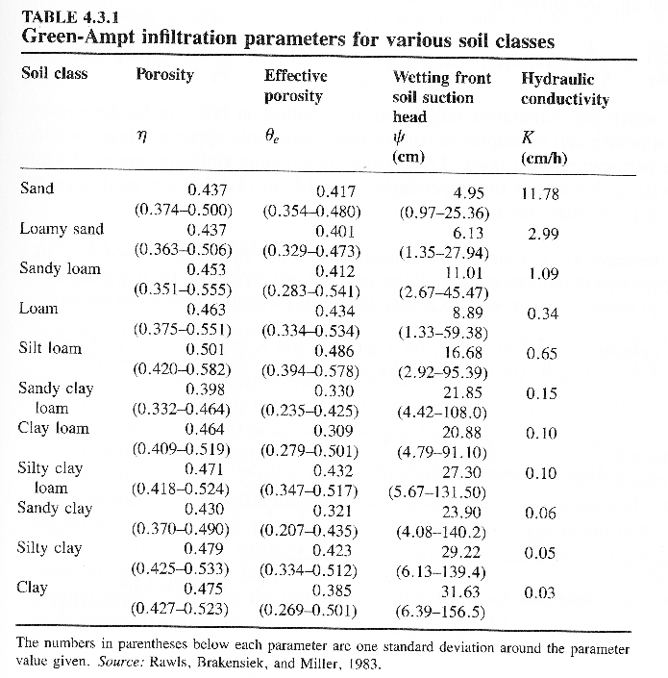

Slide 51
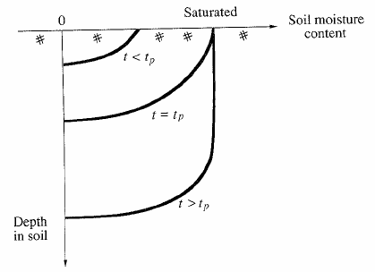
Ponding time
Elapsed time between the time rainfall begins and the time water begins to pond on the soil surface (t_{p})

Slide 52
Ponding Time
Up to the time of ponding, all rainfall has infiltrated (i = rainfall rate)
Potential
Infiltration
Infiltration rate, f
Rainfall
Actual Infiltration
Accumulated
Rainfall
Time
Cumulative
Infiltration, F
Infiltration
Time

