Slide 1
CE 374K Hydrology
Review for Second Exam
April 14, 2011

Slide 2
Hortonian Flow
Sheet flow described by Horton in 1930s
When i<f, all i is absorbed
When i > f, (i-f) results in rainfall excess
Applicable in
  impervious surfaces (urban areas)
  Steep slopes with thin soil
  hydrophobic or compacted soil with low infiltration
Rainfall, i
i > q
Infiltration, f
Later studies showed that Hortonian flow rarely occurs on vegetated surfaces in humid regions.

Slide 3
Subsurface flow
Lateral movement of water occurring through the soil above the water table
primary mechanism for stream flow generation when f>i
  Matrix/translatory flow
    Lateral flow of old water displaced by precipitation inputs
    Near surface lateral conductivity is greater than overall vertical conductivity
    Porosity and permeability higher near the ground
  Macropore flow
    Movement of water through large conduits in the soil

Slide 4
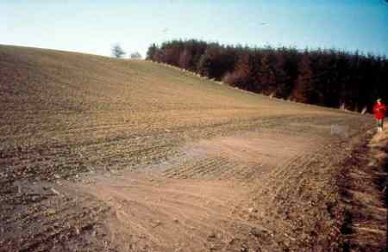
Saturation overland flow
Soil is saturated from below by subsurface flow
Any precipitation occurring over a saturated surface becomes overland flow
Occurs mainly at the bottom of hill slopes and near stream banks

Slide 5
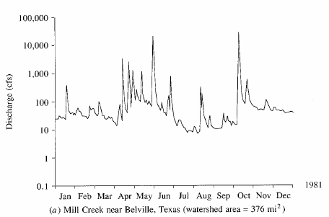
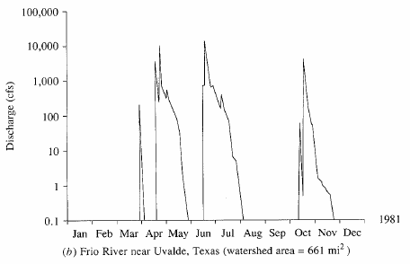
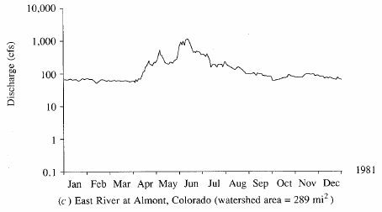
Streamflow hydrograph
Direct runoff
Graph of stream discharge as a function of time at a given location on the stream
Baseflow
Perennial river
Ephemeral river
Snow-fed River

Slide 6
Excess rainfall
Rainfall that is neither retained on the land surface nor infiltrated into the soil
Graph of excess rainfall versus time is called excess rainfall hyetograph
Direct runoff = observed streamflow - baseflow
Excess rainfall = observed rainfall - abstractions
Abstractions/losses – difference between total rainfall hyetograph and excess rainfall hyetograph

Slide 7
φ-index method
Goal: pick Δt, and adjust value of M to satisfy the equation
Steps
  Estimate baseflow
  DRH = streamflow hydrograph – baseflow
  Compute r_{d}, r_{d} = V_{d}/watershed area
  Adjust M until you get a satisfactory value of φ
  ERH = R_{m} - φΔt

Slide 8
SCS method
Soil conservation service (SCS) method is an experimentally derived method to determine rainfall excess using information about soils, vegetative cover, hydrologic condition and antecedent moisture conditions
The method is based on the simple relationship that P_{e} = P - F_{a} – I_{a}
P_{e} is runoff volume, P is precipitation volume, F_{a} is continuing abstraction, and I_{a} is the sum of initial losses (depression storage, interception, ET)
Precipitation
Time

Slide 9
Abstractions – SCS Method
In general
After runoff begins
Potential runoff
SCS Assumption
Combining SCS assumption with P=P_{e}+I_{a}+F_{a}
Precipitation
Time

Slide 10
SCS Method (Cont.)
Experiments showed
So
Surface
  Impervious: CN = 100
  Natural: CN < 100

Slide 11
Example - SCS Method - 1
Rainfall: 5 in.
Area: 1000-ac
Soils:
  Class B: 50%
  Class C: 50%
Antecedent moisture: AMC(II)
Land use
  Residential
    40% with 30% impervious cover
    12% with 65% impervious cover
  Paved roads: 18% with curbs and storm sewers
  Open land: 16%
    50% fair grass cover
    50% good grass cover
  Parking lots, etc.: 14%

Slide 12
Example (SCS Method – 1, Cont.)
 | Hydrologic Soil Group
 | B |  |  | C
Land use | % | CN | Product | % | CN | Product
Residential (30% imp cover) | 20 | 72 | 14.40 | 20 | 81 | 16.20
Residential (65% imp cover) | 6 | 85 | 5.10 | 6 | 90 | 5.40
Roads | 9 | 98 | 8.82 | 9 | 98 | 8.82
Open land: good cover | 4 | 61 | 2.44 | 4 | 74 | 2.96
Open land: Fair cover | 4 | 69 | 2.76 | 4 | 79 | 3.16
Parking lots, etc | 7 | 98 | 6.86 | 7 | 98 | 6.86
Total | 50 |  | 40.38 | 50 |  | 43.40
CN values come from Table 5.5.2

Slide 13
SCS Method (Cont.)
S and CN depend on antecedent rainfall conditions
Normal conditions, AMC(II)
Dry conditions, AMC(I)
Wet conditions, AMC(III)

Slide 14
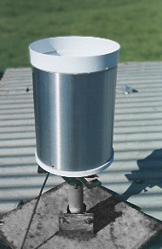
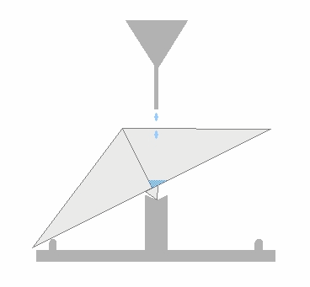
Precipitation Station
Tipping Bucket Raingage
  The gauge registers precipitation (rainfall) by counting small increments of rain collected.
  When rain falls into the funnel it runs into a container divided into two equal compartments by a partition
  When a specified amount of rain has drained from the funnel the bucket tilts the opposite way.
  The number and rate of bucket movements are counted and logged electronically.

Slide 15
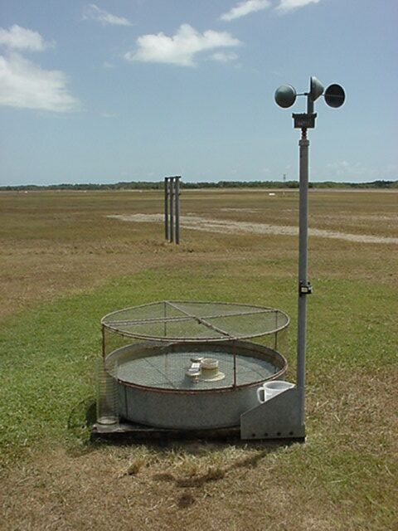
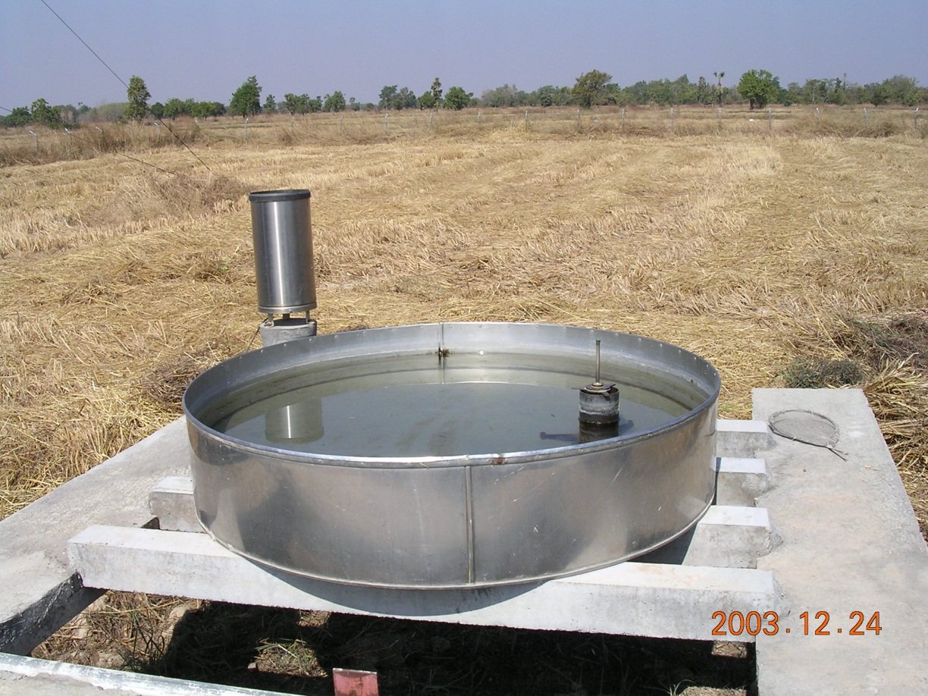
Evaporation pan

Slide 16
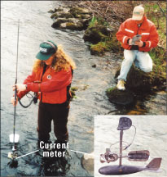
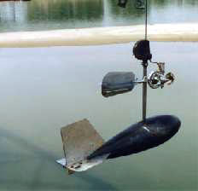
Measuring streamflow

Slide 17
Stream Flow Rate
Water Surface
Height
above
bed
Depth
Averaged
Velocity
Velocity
Velocity profile in stream
Discharge at a cross-section

Slide 18
Rating Curve
It is not feasible to measure flow daily.
Rating curves are used to estimate flow from stage data
Rating curve defines stage/streamflow relationship
http://nwis.waterdata.usgs.gov/nwis/measurements/?site_no=08158000

Slide 19
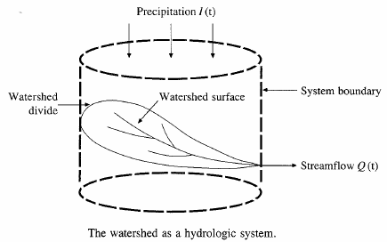






Hydrologic Analysis
Change in storage w.r.t. time = inflow - outflow
In the case of a linear reservoir, S = kQ
Transfer function for a linear system (S = kQ).

Slide 20
Proportionality and superposition
Linear system (k is constant in S = kQ)
  Proportionality
    If I₁ → Q₁ then C*I₂ → C*Q₂
  Superposition
    If I₁ → Q₁ and I₂ → Q₂, then I₁ +I₂→ Q₁ + Q₂

Slide 21
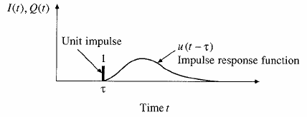
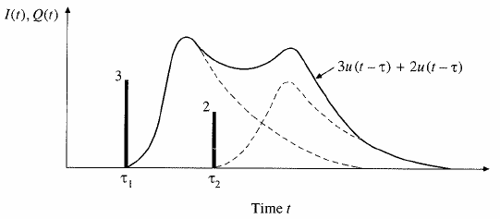
Impulse response function
Impulse input: an input applied instantaneously (spike) at time τ and zero everywhere else
An unit impulse at τ produces as unit impulse response function u(t-τ)
Principle of proportionality and superposition

Slide 22
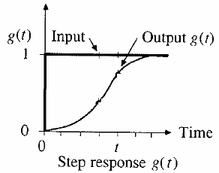
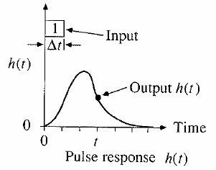
Step and pulse inputs
A unit step input is an input that goes from 0 to 1 at time 0 and continues indefinitely thereafter
A unit pulse is an input of unit amount occurring in duration Δt and 0 elsewhere.
Precipitation is a series of pulse inputs!

Slide 23
Unit Hydrograph Theory
Direct runoff hydrograph resulting from a unit depth of excess rainfall occurring uniformly on a watershed at a constant rate for a specified duration.
Unit pulse response function of a linear hydrologic system
Can be used to derive runoff from any excess rainfall on the watershed.

Slide 24
Unit hydrograph assumptions
Assumptions
  Excess rainfall has constant intensity during duration
  Excess rainfall is uniformly distributed on watershed
  Base time of runoff is constant
  Ordinates of unit hydrograph are proportional to total runoff (linearity)
  Unit hydrograph represents all characteristics of watershed (lumped parameter) and is time invariant (stationarity)

Slide 25
Discrete Convolution
Continuous
Discrete
Q is flow, P is precipitation and U is unit hydrograph
M is the number of precipitation pulses, n is the number of flow rate intervals
The unit hydrograph has N-M+1 pulses

Slide 26
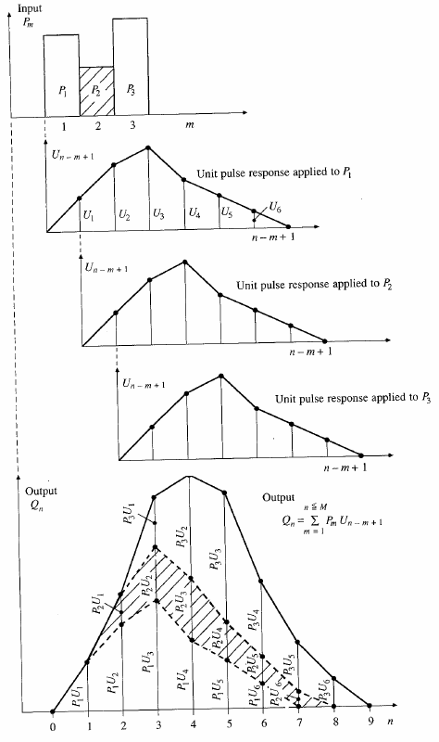
Application of convolution to the output from a linear system

Slide 27
SCS dimensionless hydrograph
Synthetic UH in which the discharge is expressed by the ratio of q to q_{p} and time by the ratio of t to T_{p}
If peak discharge and lag time are known, UH can be estimated.
T_{c}: time of concentration
C = 2.08 (483.4 in English system)
A: drainage area in km² (mi²)

Slide 28
Flow Routing
Q
Procedure to determine the flow hydrograph at a point on a watershed from a known hydrograph upstream
As the hydrograph travels, it
  attenuates
  gets delayed
t
Q
t
Q
t
Q
t

Slide 29
Hydrologic Routing
Discharge
Discharge
Inflow
Transfer
Function
Outflow
Upstream hydrograph
Downstream hydrograph
Input, output, and storage are related by continuity equation:
Q and S are unknown
Storage can be expressed as a function of I(t) or Q(t) or both
For a linear reservoir, S=kQ

Slide 30
Level pool methodology
Discharge
Inflow
Outflow
Time
Storage
Unknown
Known
Need a function relating
Time
Storage-outflow function

Slide 31
Level pool methodology
Given
  Inflow hydrograph
  Q and H relationship
Steps
  Develop Q versus Q+ 2S/Δt relationship using Q/H relationship
  Compute Q+ 2S/Δt using
  Use the relationship developed in step 1 to get Q

Slide 32
Hydrologic river routing (Muskingum Method)
Wedge storage in reach
Advancing
Flood
Wave
I > Q
K = travel time of peak through the reach
X = weight on inflow versus outflow (0 ≤ X ≤ 0.5)
X = 0 ➔ Reservoir, storage depends on outflow, no wedge
X = 0.0 - 0.3 ➔ Natural stream
Receding
Flood
Wave
Q > I

Slide 33
Muskingum Method (Cont.)
Recall:
Combine:
If I(t), K and X are known, Q(t) can be calculated using above equations

Slide 34
Types of flow routing
Lumped/hydrologic
  Flow is calculated as a function of time alone at a particular location
  Governed by continuity equation and flow/storage relationship
Distributed/hydraulic
  Flow is calculated as a function of space and time throughout the system
  Governed by continuity and momentum equations

Slide 35
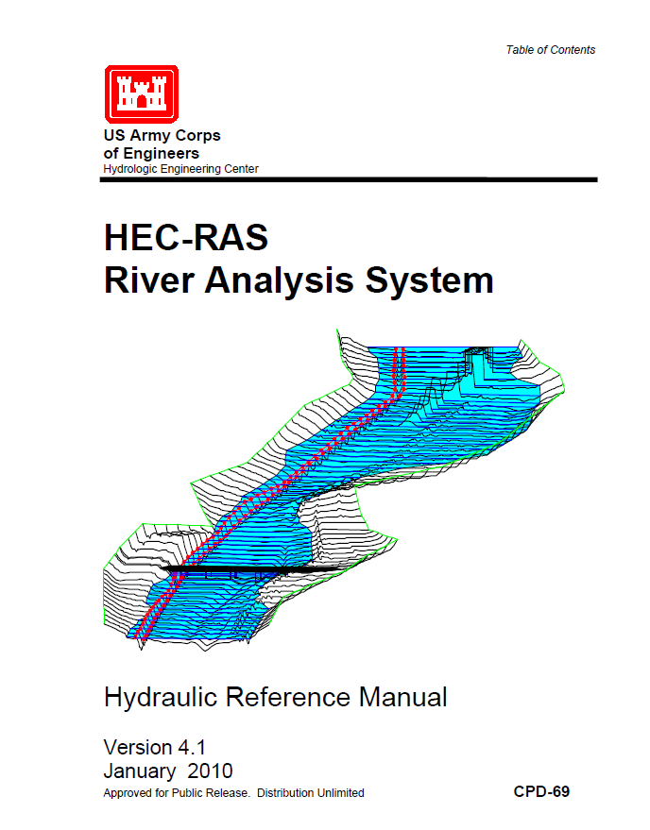
Hydraulic Routing in Rivers
Reference: HEC-RAS Hydraulic Reference Manual, Version 4.1, Chapters 1 and 2
Reading: HEC-RAS Manual pp. 2-1 to 2-12
Applied Hydrology, Sections 10-1 and 10-2
http://www.hec.usace.army.mil/software/hec-ras/documents/HEC-RAS_4.1_Reference_Manual.pdf

Slide 36
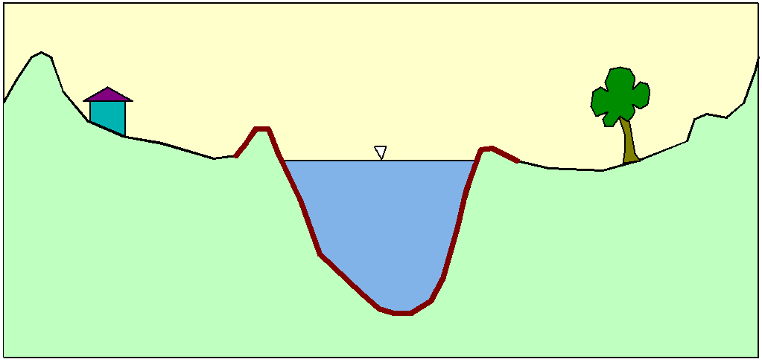
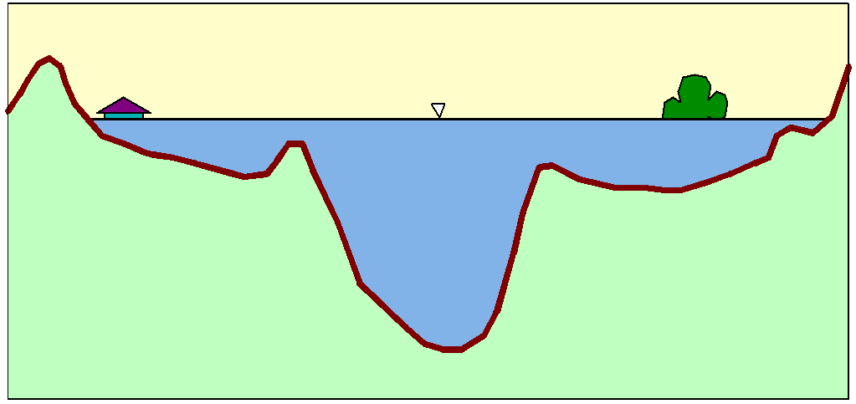
Flood Inundation

Slide 37
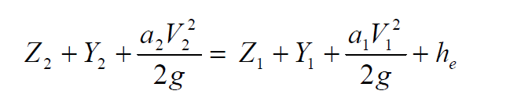
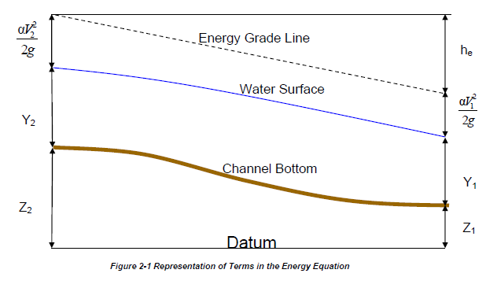
Steady Flow Solution

Slide 38
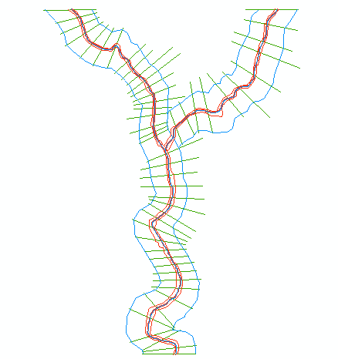
One-Dimensional Flow Computations
Cross-section
Channel centerline
and banklines
Right Overbank
Left Overbank

Slide 39
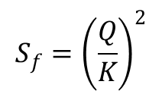
Solving Steady Flow Equations
Q is known throughout reach
All conditions at (1) are known, Q is known
Select h₂
compute Y₂, V₂, K₂, S_{f}, h_{e}
Using energy equation (A), compute h₂
Compare new h₂ with the value assumed in Step 2, and repeat until convergence occurs
(A)
h₂
h₁
(2)
(1)
$$S_{f}={\left(\frac{Q}{K}\right)}^{2}$$

Slide 40
Flow Computations
Reach 3
Reach 2
Start at the downstream end (for subcritical flow)
Treat each reach separately
Compute h upstream, one cross-section at a time
Use computed h values to delineate the floodplain
Reach 1

Slide 41
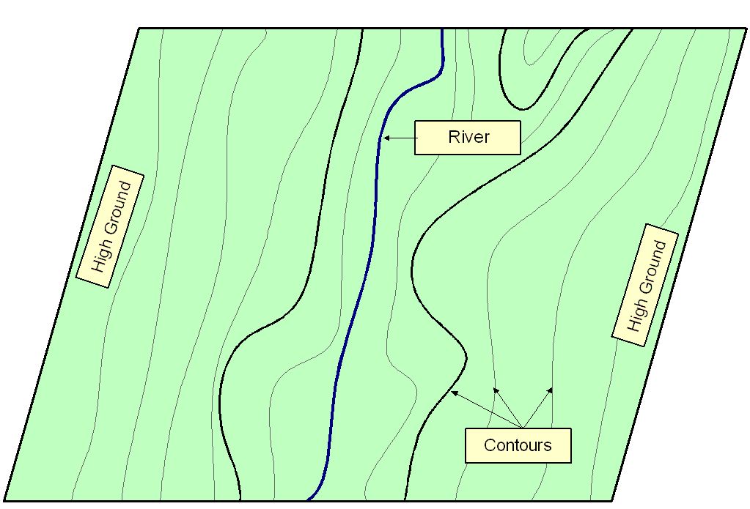
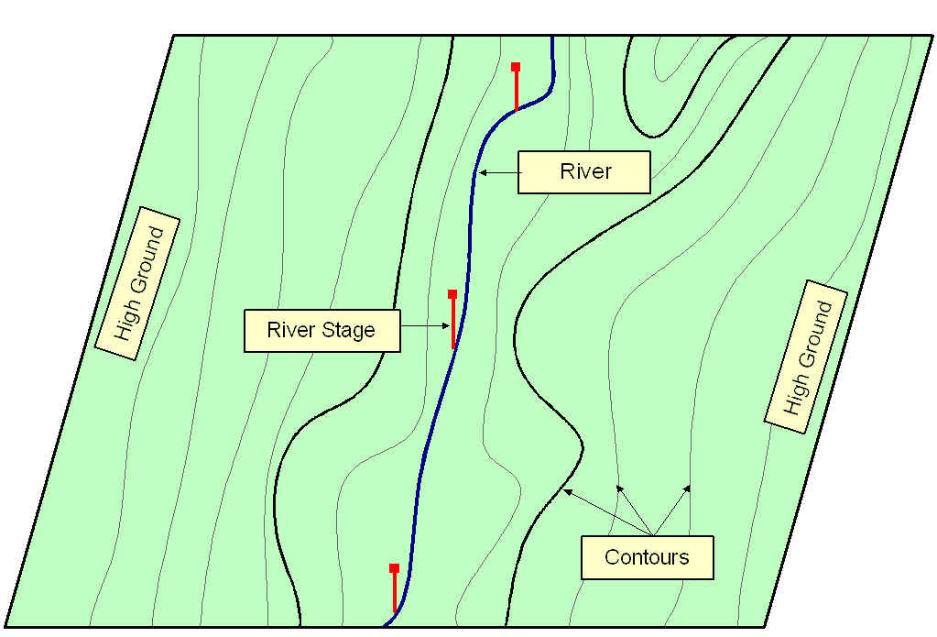
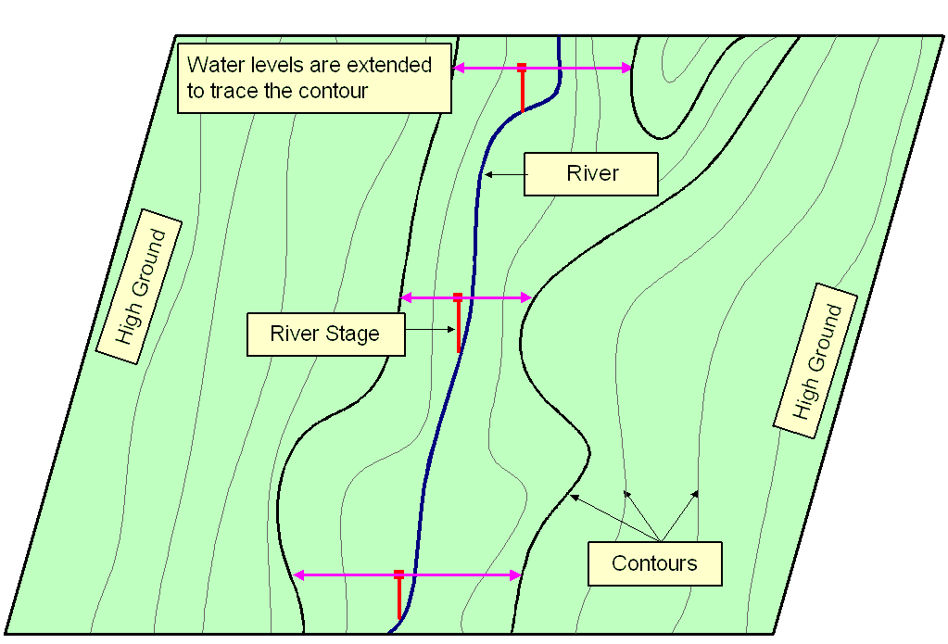
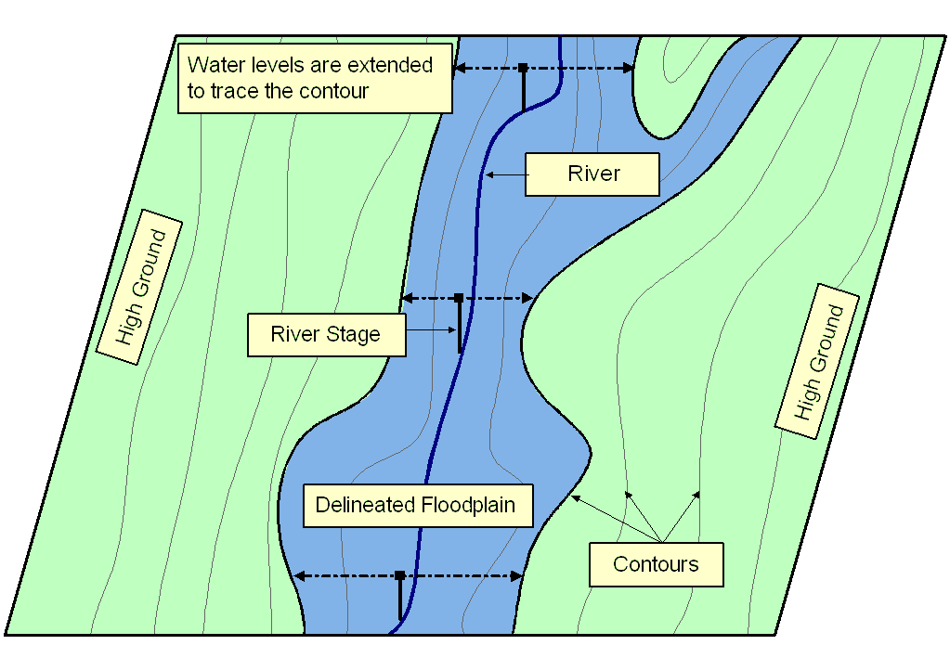
Floodplain Delineation
Notes:
Ideally should have Two D Models…... A floodplain delineation process determines inundation extent by comparing water levels with ground surface elevations. We start with a DTM or topomap. > Water levels are computed based on cross-sections. During normal condition, flow remains within the main channel, but > during flood, water spill over the bank. In these cases it’s important to extent cross-section over the floodplain. > We then bring back water levels on the topomap. > Extent water levels until hit contour of higher elevations. > Finally delineate floodplain following the contours. The accuracy largely depends on water levels and in turns on the cross-section used for computation.

Slide 42
Unsteady Flow Routing in Open Channels
Flow is one-dimensional
Hydrostatic pressure prevails and vertical accelerations are negligible
Streamline curvature is small.
Bottom slope of the channel is small.
Manning’s equation is used to describe resistance effects
The fluid is incompressible

Slide 43
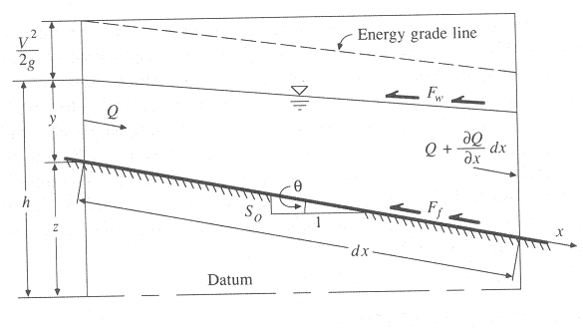
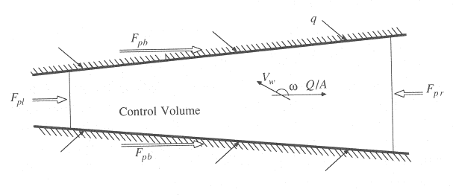
Continuity Equation
Q = inflow to the control volume
q = lateral inflow
Rate of change of flow with distance
Outflow from the C.V.
Change in mass
Elevation View
Reynolds transport theorem
Plan View

Slide 44
Momentum Equation
From Newton’s 2nd Law:
Net force = time rate of change of momentum
Sum of forces on the C.V.
Momentum stored within the C.V
Momentum flow across the C. S.

Slide 45
Momentum Equation(2)
Local acceleration term
Convective acceleration term
Pressure force term
Gravity force term
Friction force term
Kinematic Wave
Diffusion Wave
Dynamic Wave

Slide 46
Momentum Equation (3)
Steady, uniform flow
Steady, non-uniform flow
Unsteady, non-uniform flow

Slide 47


Mapping Flood Risk
Presented by David R. Maidment
Director, Center for Research in Water Resources, University of Texas at Austin
Distinguished Lecture presented at
University of South Carolina
March 18, 2011

Slide 48
National Flood Insurance Program
Started in 1968 and administered by FEMA
Based on agreement between federal and local government
Federal government provides flood insurance
Local government regulates land use to minimize flood risk
Federal Government
(Flood insurance, flood mapping)
Local Government (Cities, Counties)
Floodplain regulation

Slide 49
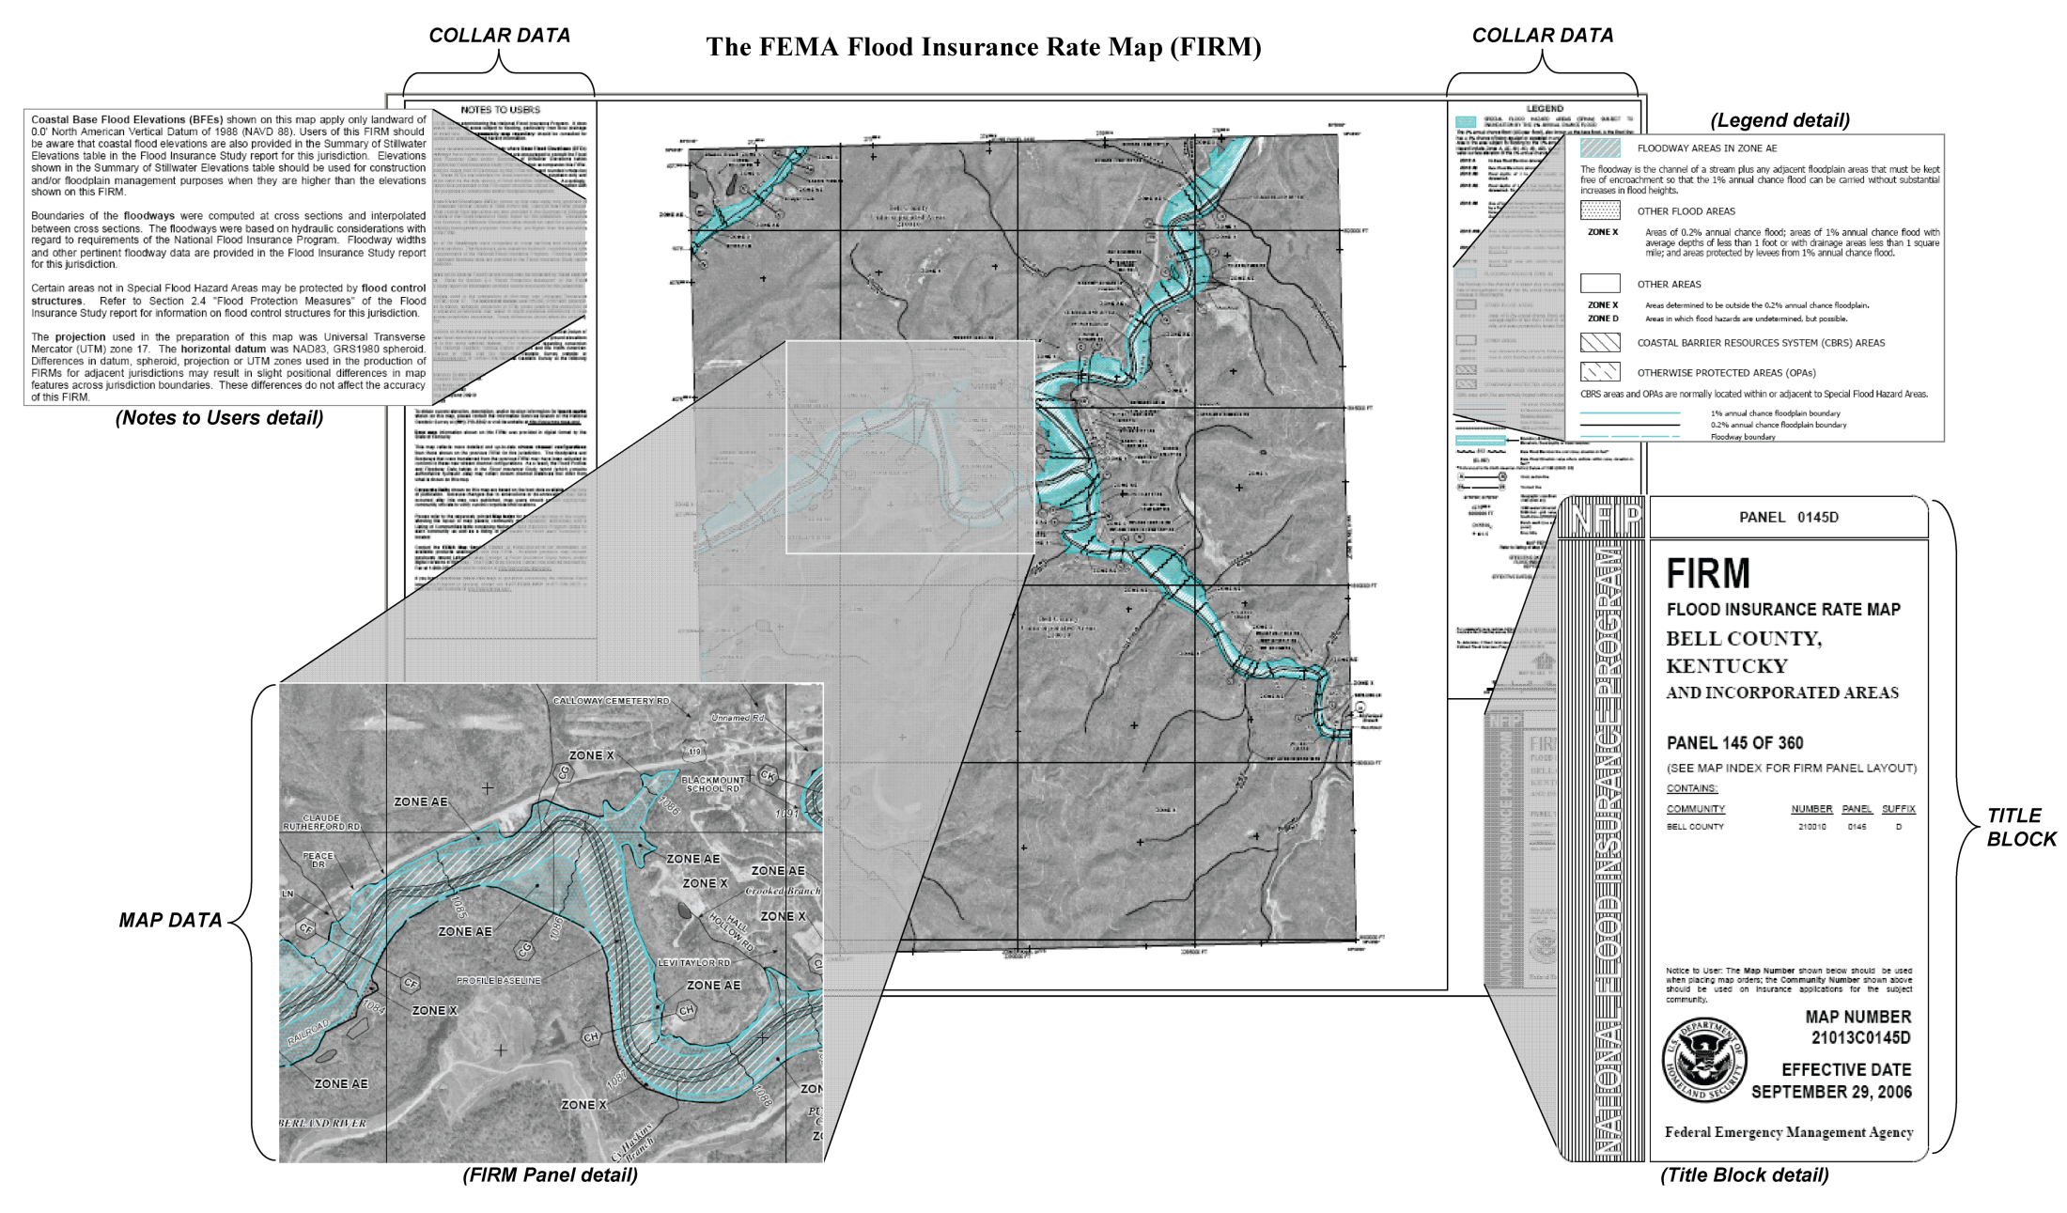
Flood Insurance Rate Map (FIRM)
Flood Hazard Zone
≥ 1% chance of flooding in any year

Slide 50
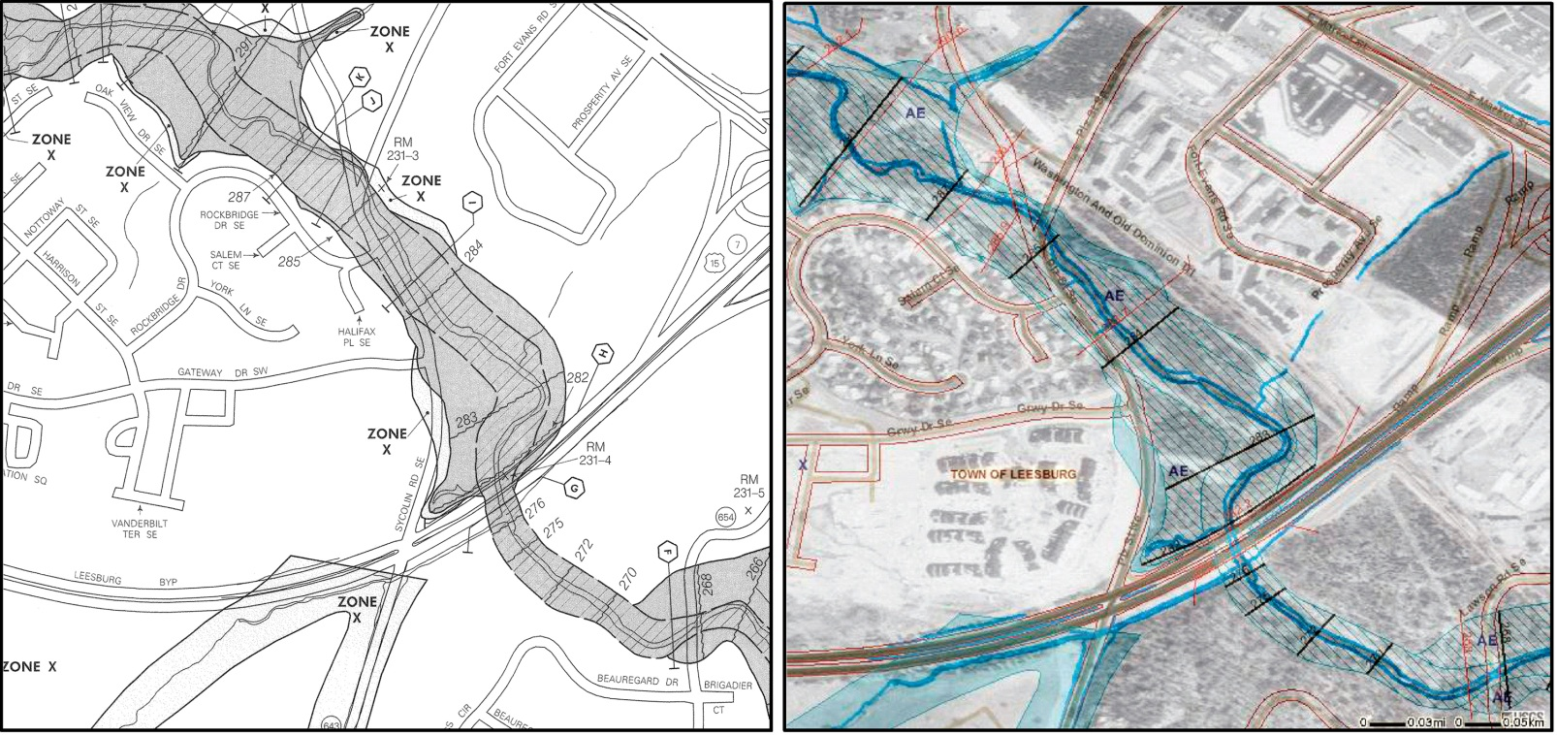
Digital Flood Insurance Rate Map (DFIRM)
Old, paper FIRM
New, digital (D)FIRM
The ideal DFIRM: more accurate than paper FIRM, more flexible to use and update, more versatile for community use

Slide 51
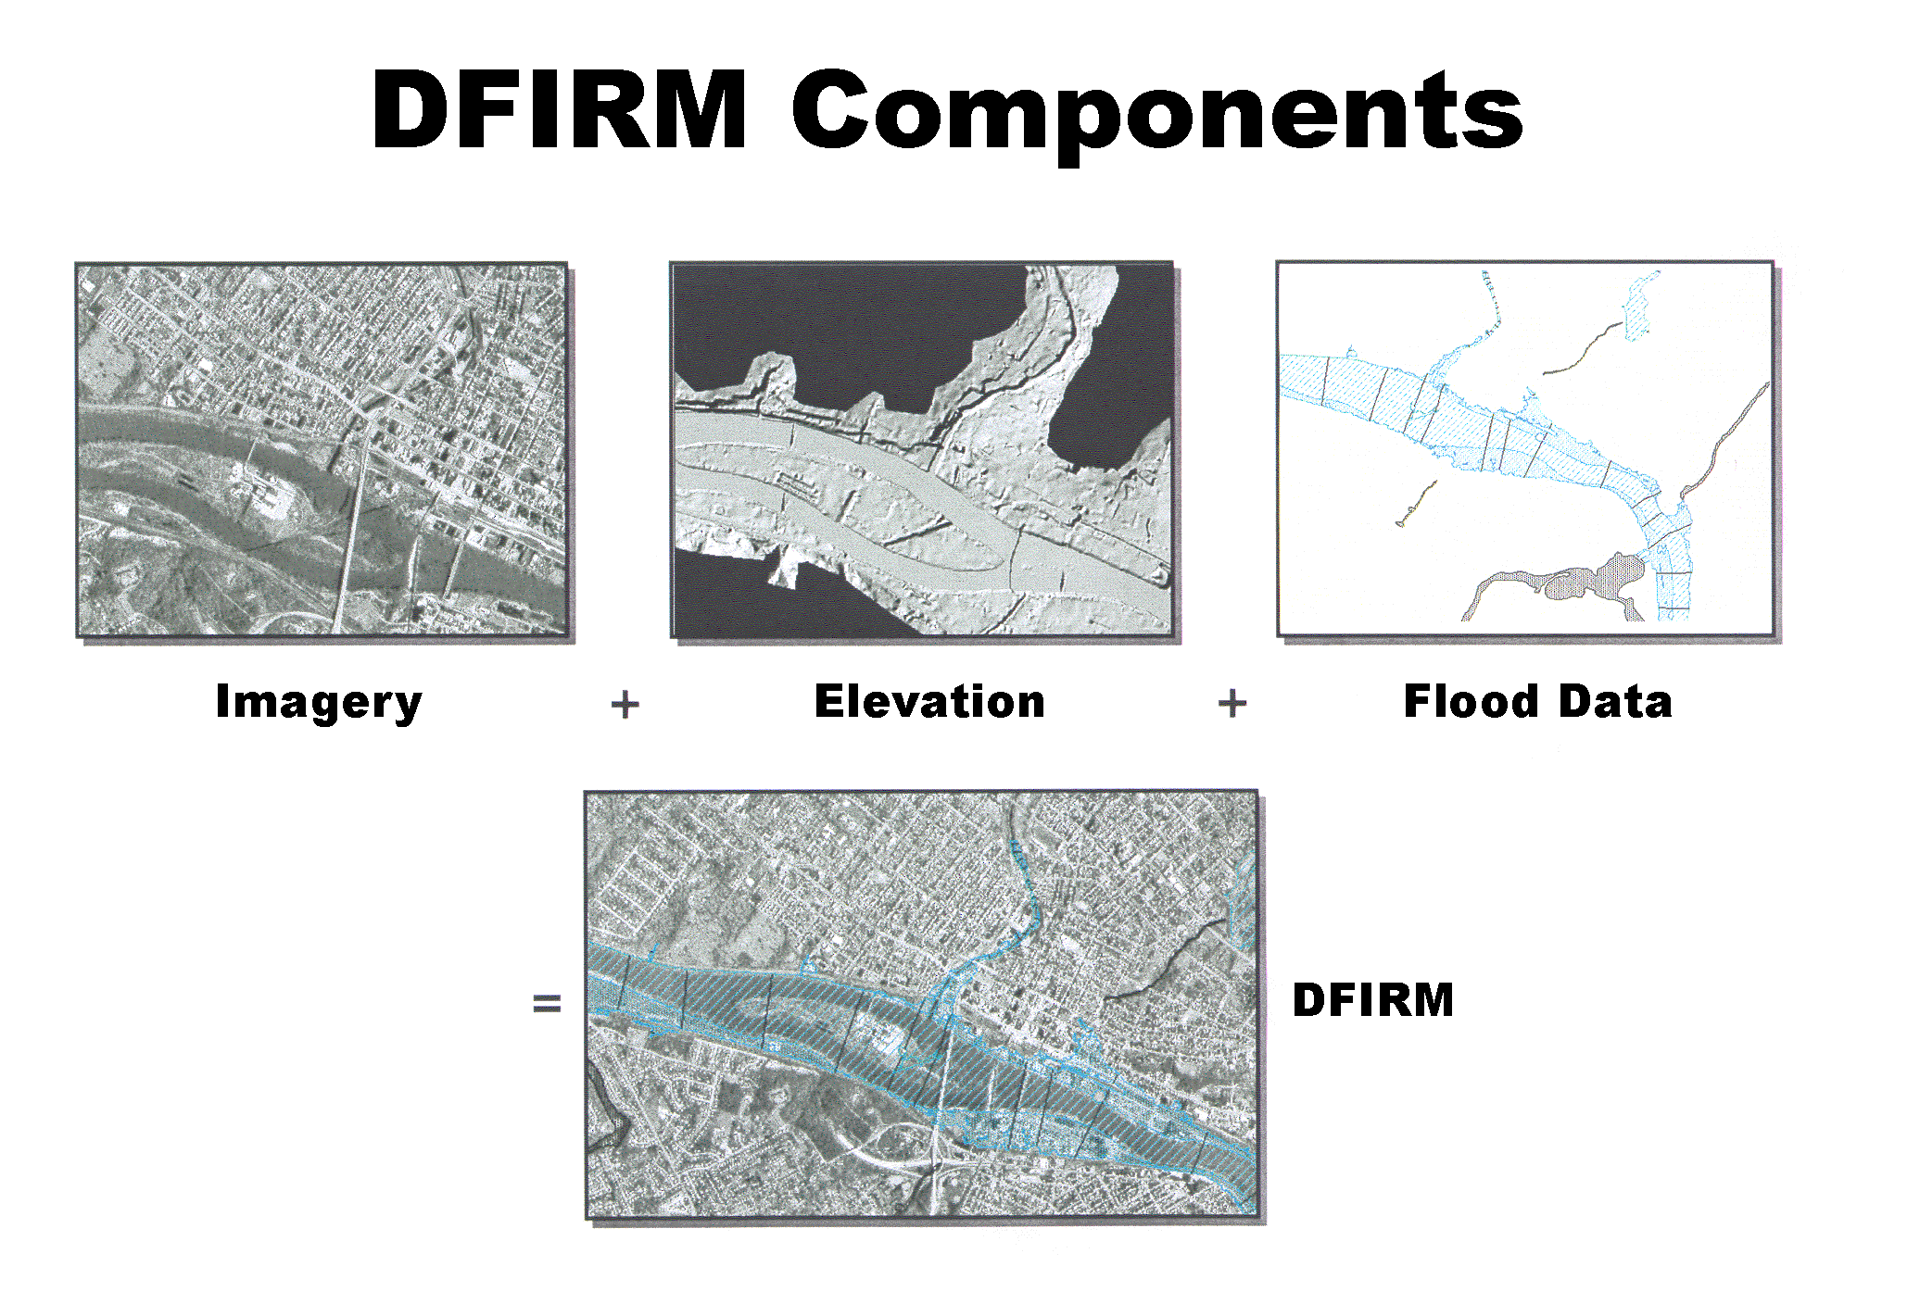
(x,y)
(z)

Slide 52
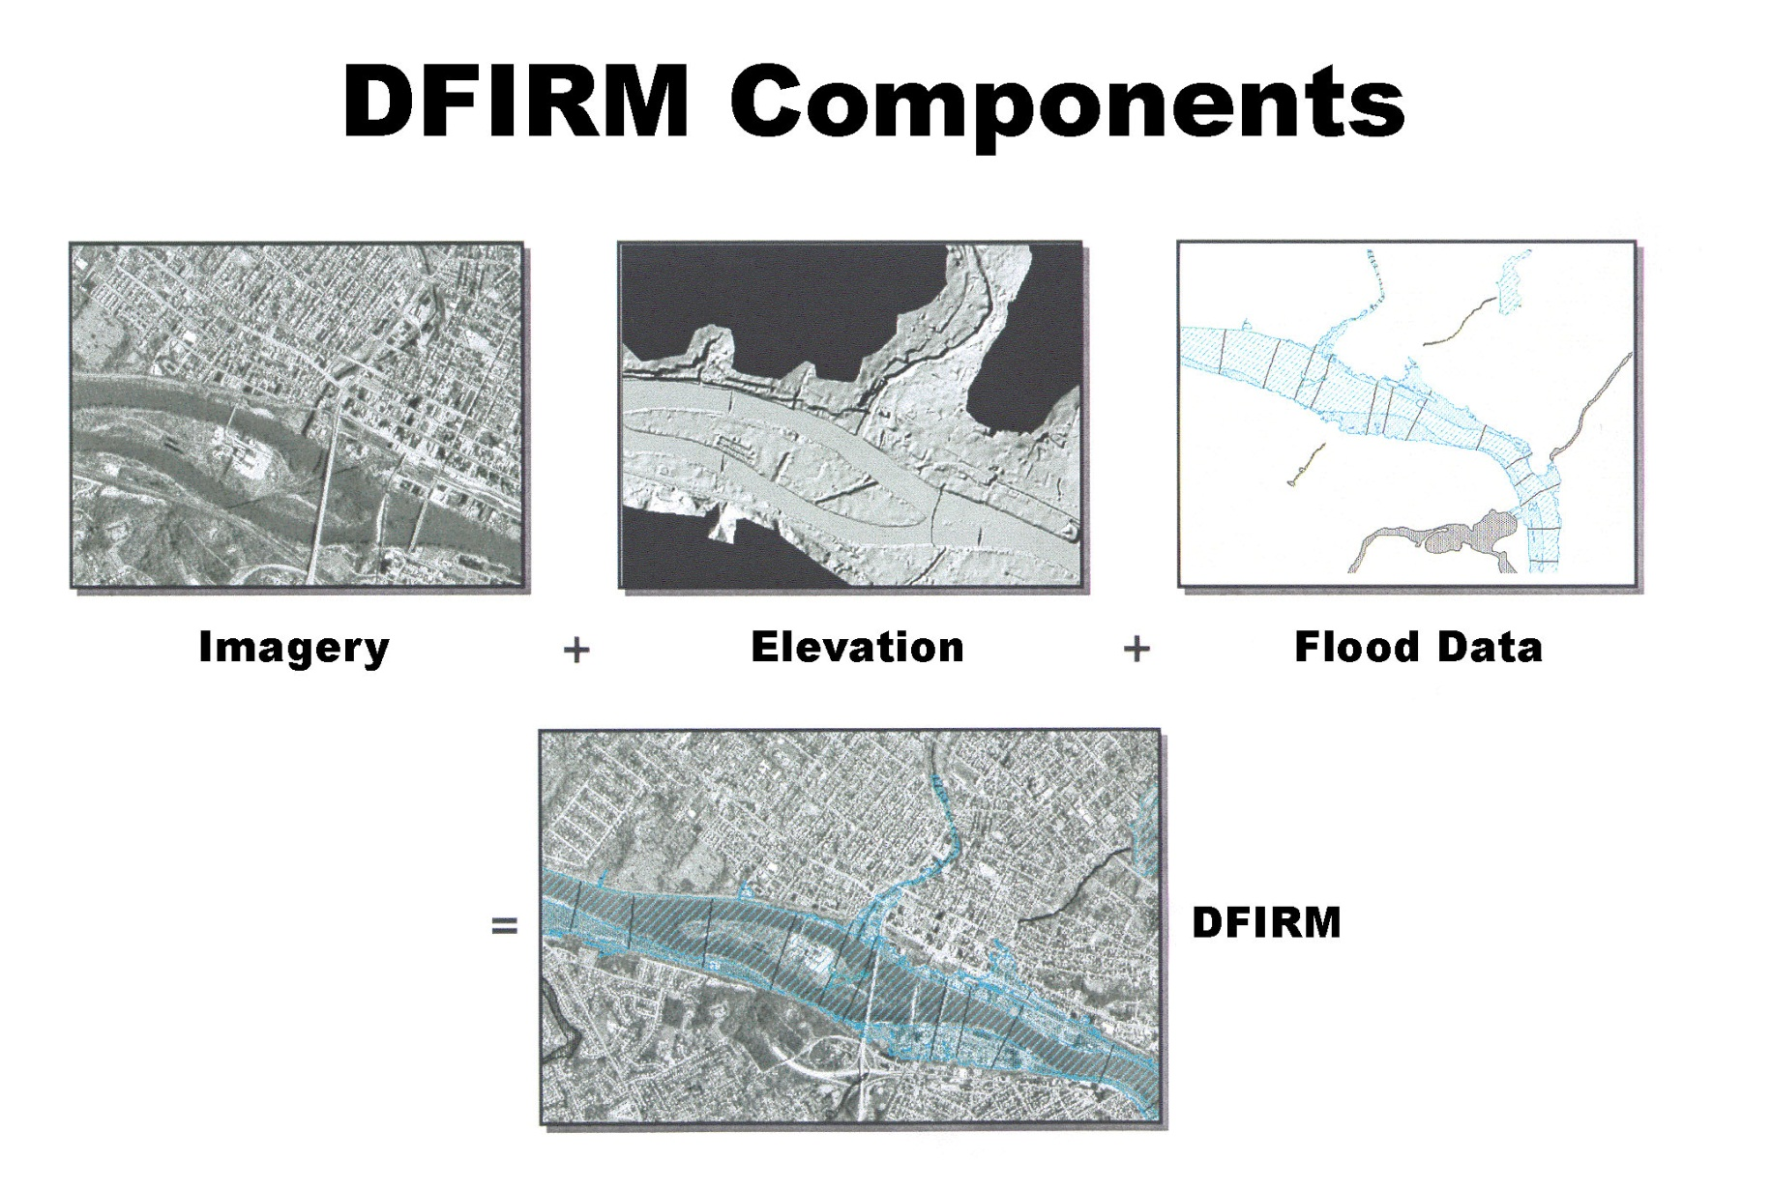
2007 National Research Council Study:
Basemap Inputs for Floodplain Mapping
‘Base map information’
*
This study addressed the technologies producing Imagery and Elevation data components of the DFIRM
Study was prompted by questions from the Senate Appropriations Committee

Slide 53
Conclusions from 2007 Study
Basemap imagery is fine for floodplain mapping
Existing elevation data have about 1/10 accuracy needed for floodplain mapping and are too old
A new elevation coverage of the nation is needed
Most likely technology to produce this is Lidar
Cost for national coverage ~ $500-600 million
We need “Elevation for the Nation”

Slide 54
2009 National Research Council Study
Sponsored by FEMA and NOAA
Examined tradeoffs between cost and accuracy of flood mapping
Detailed case studies in North Carolina
Riverine and coastal flooding

Slide 55
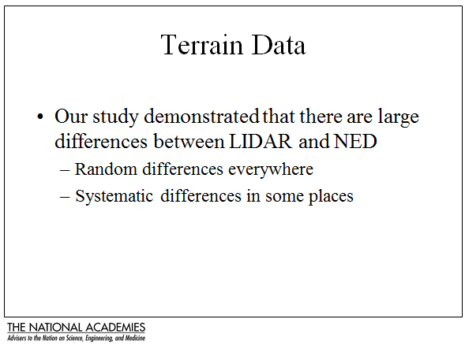

Slide 56
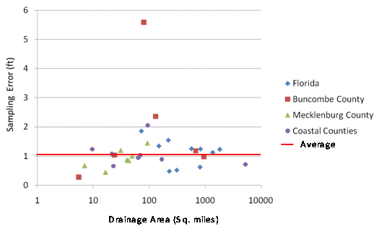
Sampling Error of 100-year Stage Heights
Outlier (skewed frequency curve)
No systematic variation in sampling error by
drainage area or topographic region
Sampling Error (ft)
Average = 1.06 ft
Drainage Area (Sq miles)

Slide 57
Conclusions from 2009 NRC Study
There are hydrologic, hydraulic and terrain data uncertainties
Accuracy of land elevation is single largest factor governing accuracy of flood elevation
Inherent uncertainty in base flood elevation is ~ 1 foot
Flood mapping needs LIDAR data!

Slide 58
Random Variable
Random variable: a quantity used to represent probabilistic uncertainty
  Incremental precipitation
  Instantaneous streamflow
  Wind velocity
Random variable (X) is described by a probability distribution
Probability distribution is a set of probabilities associated with the values in a random variable’s sample space

Slide 59
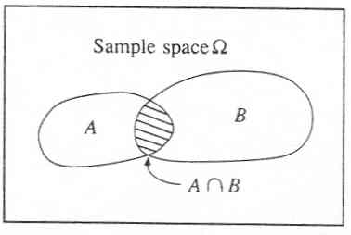

Slide 60
Summary statistics
Also called descriptive statistics
  If x₁, x₂, …x_{n} is a sample then
Mean,
μ for continuous data
Variance,
σ² for continuous data
Standard deviation,
σ for continuous data
Coeff. of variation,
Also included in summary statistics are median, skewness, correlation coefficient,

Slide 61
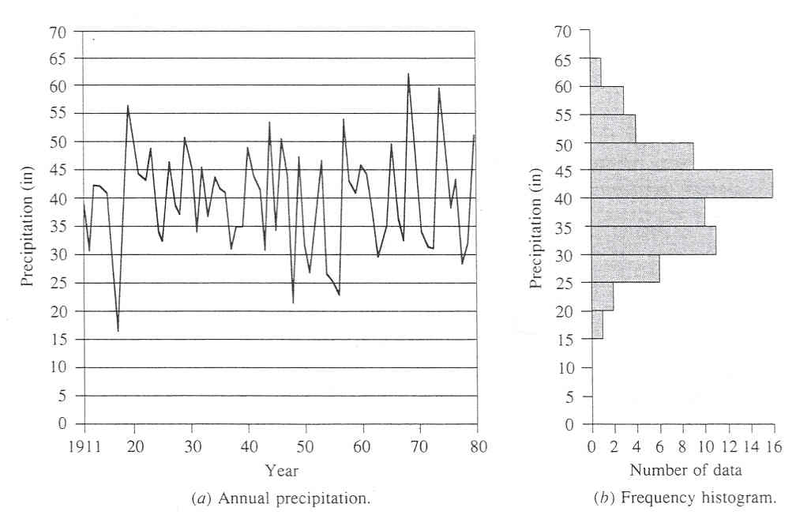

Slide 62
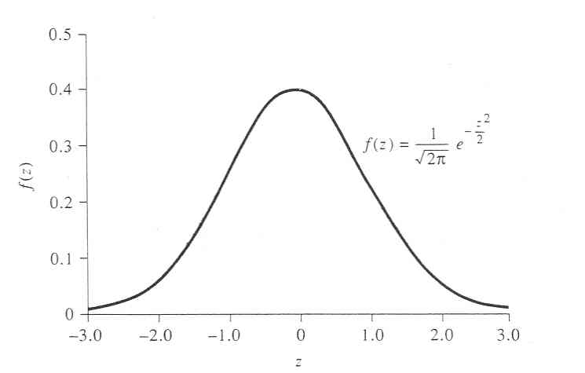

Slide 63
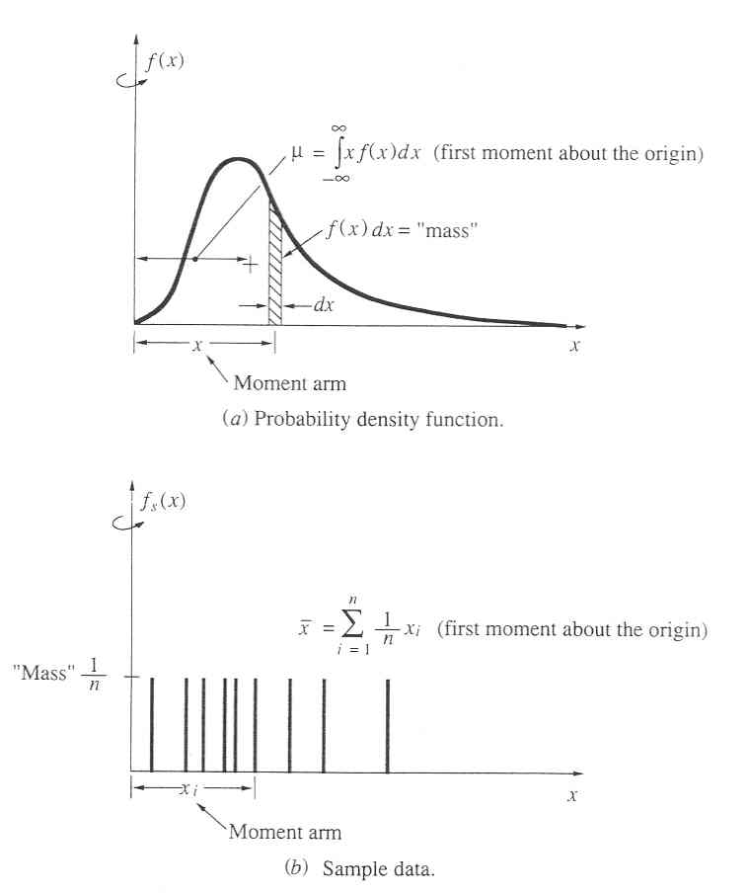

Slide 64
Return Period
Random variable:
Threshold level:
Extreme event occurs if:
Recurrence interval:
Return Period:
  Average recurrence interval between events equalling or exceeding a threshold
If p is the probability of occurrence of an extreme event, then
or

Slide 65
Probability distributions
Normal family
  Normal, lognormal, lognormal-III
Generalized extreme value family
  EV1 (Gumbel), GEV, and EVIII (Weibull)
Exponential/Pearson type family
  Exponential, Pearson type III, Log-Pearson type III

Slide 66
Frequency Factors
Once a distribution has been selected and its parameters estimated, then how do we use it?
Chow proposed using:
where
f_{X}(x)
x

