Slide 1
St Venant Equations
Reading: Sections 9.1 – 9.2

Slide 2
Types of flow routing
Lumped/hydrologic
  Flow is calculated as a function of time alone at a particular location
  Governed by continuity equation and flow/storage relationship
Distributed/hydraulic
  Flow is calculated as a function of space and time throughout the system
  Governed by continuity and momentum equations

Slide 3
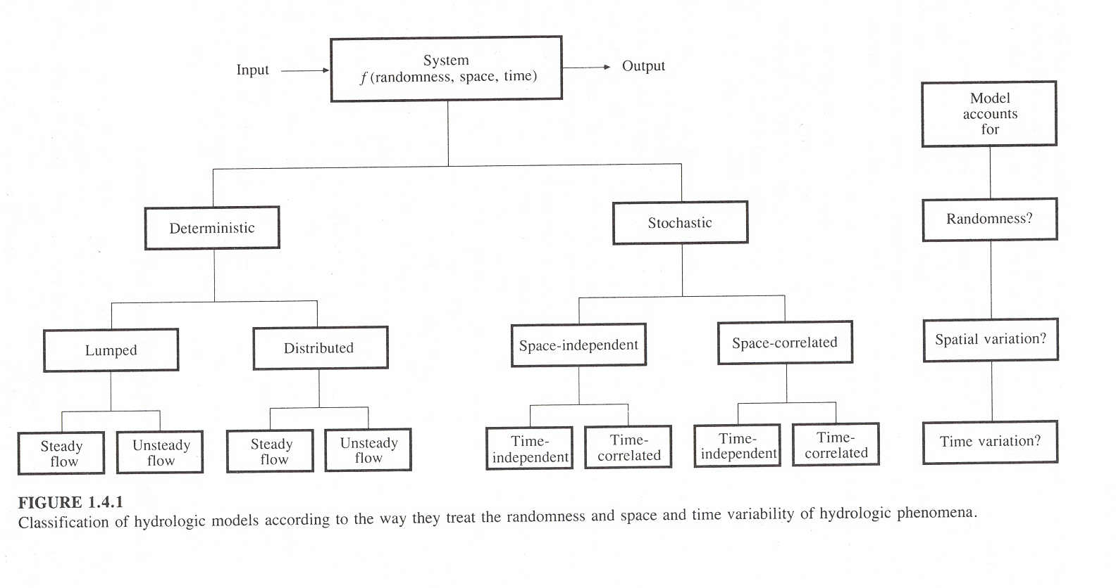

Slide 4
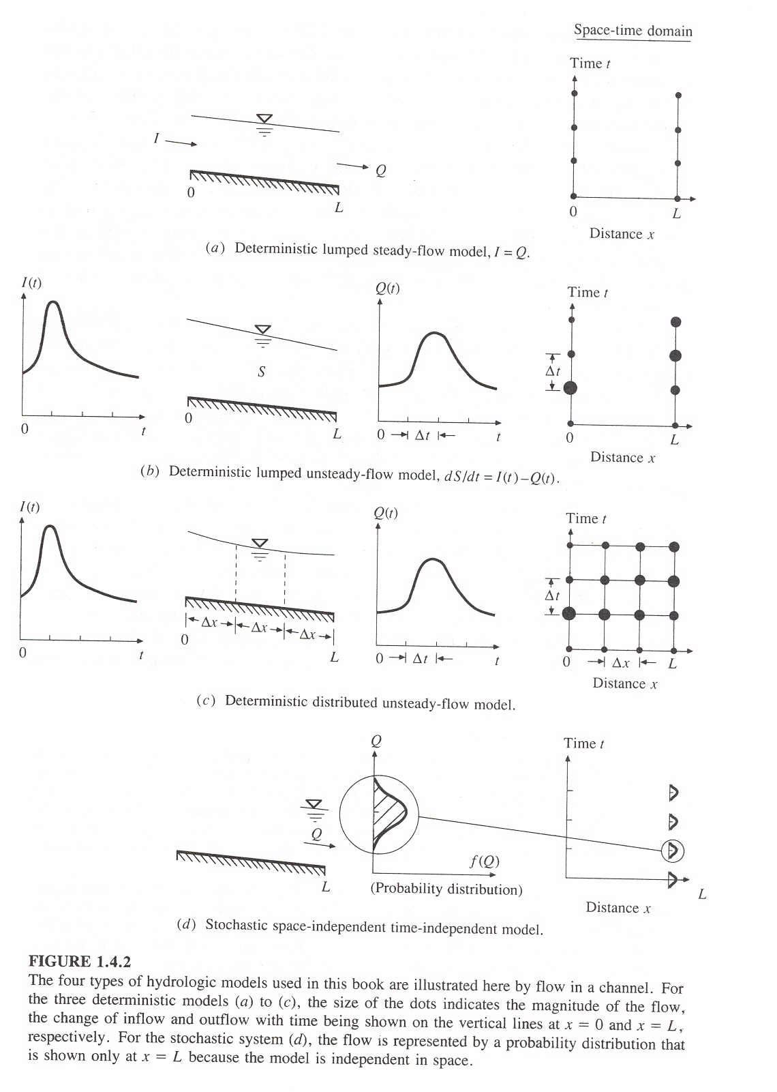

Slide 5
Distributed Flow routing in channels
Distributed Routing
St. Venant equations
  Continuity equation
  Momentum Equation
What are all these terms, and where are they coming from?

Slide 6
Assumptions for St. Venant Equations
Flow is one-dimensional
Hydrostatic pressure prevails and vertical accelerations are negligible
Streamline curvature is small.
Bottom slope of the channel is small.
Manning’s equation is used to describe resistance effects
The fluid is incompressible

Slide 7
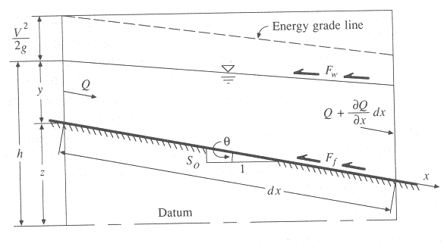
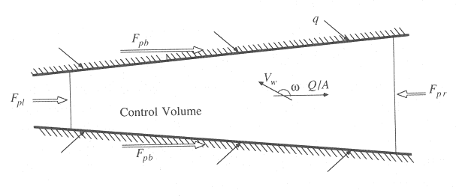
Continuity Equation
Q = inflow to the control volume
q = lateral inflow
Rate of change of flow with distance
Outflow from the C.V.
Change in mass
Elevation View
Reynolds transport theorem
Plan View

Slide 8
Continuity Equation (2)
Conservation form
Non-conservation form (velocity is dependent variable)

Slide 9
Momentum Equation
From Newton’s 2nd Law:
Net force = time rate of change of momentum
Sum of forces on the C.V.
Momentum stored within the C.V
Momentum flow across the C. S.

Slide 10
Forces acting on the C.V.
F_{g} = Gravity force due to weight of water in the C.V.
F_{f} = friction force due to shear stress along the bottom and sides of the C.V.
F_{e} = contraction/expansion force due to abrupt changes in the channel cross-section
F_{w} = wind shear force due to frictional resistance of wind at the water surface
F_{p} = unbalanced pressure forces due to hydrostatic forces on the left and right hand side of the C.V. and pressure force exerted by banks
Elevation View
Plan View

Slide 11

Momentum Equation
Sum of forces on the C.V.
Momentum stored within the C.V
Momentum flow across the C. S.

Slide 12
Momentum Equation(2)
Local acceleration term
Convective acceleration term
Pressure force term
Gravity force term
Friction force term
Kinematic Wave
Diffusion Wave
Dynamic Wave

Slide 13
Momentum Equation (3)
Steady, uniform flow
Steady, non-uniform flow
Unsteady, non-uniform flow

