Slide 1
Hydrologic Statistics
04/04/2006
Reading: Chapter 11, Sections 12-1 and 12-2 of Applied Hydrology

Slide 2
Probability
A measure of how likely an event will occur
A number expressing the ratio of favorable outcome to the all possible outcomes
Probability is usually represented as P(.)
  P (getting a club from a deck of playing cards) = 13/52 = 0.25 = 25 %
  P (getting a 3 after rolling a dice) = 1/6

Slide 3
Random Variable
Random variable: a quantity used to represent probabilistic uncertainty
  Incremental precipitation
  Instantaneous streamflow
  Wind velocity
Random variable (X) is described by a probability distribution
Probability distribution is a set of probabilities associated with the values in a random variable’s sample space

Slide 4
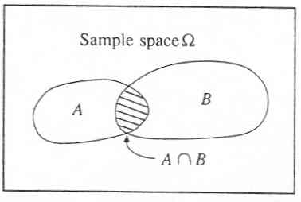

Slide 5
Sampling terminology
Sample: a finite set of observations x₁, x₂,….., x_{n} of the random variable
A sample comes from a hypothetical infinite population possessing constant statistical properties
Sample space: set of possible samples that can be drawn from a population
Event: subset of a sample space
Example
  Population: streamflow
  Sample space: instantaneous streamflow, annual maximum streamflow, daily average streamflow
  Sample: 100 observations of annual max. streamflow
  Event: daily average streamflow > 100 cfs

Slide 6
Summary statistics
Also called descriptive statistics
  If x₁, x₂, …x_{n} is a sample then
Mean,
μ for continuous data
Variance,
σ² for continuous data
Standard deviation,
σ for continuous data
Coeff. of variation,
Also included in summary statistics are median, skewness, correlation coefficient,

Slide 7
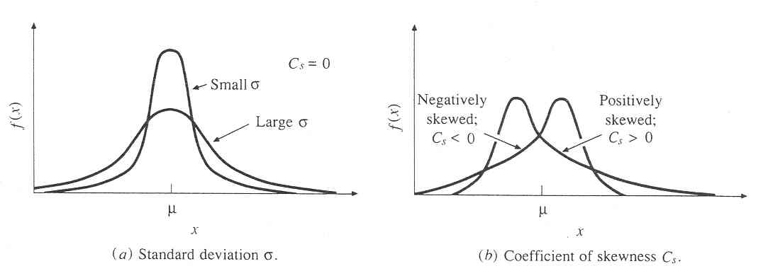

Slide 8
Graphical display
Time Series plots
Histograms/Frequency distribution
Cumulative distribution functions
Flow duration curve

Slide 9
Time series plot
Plot of variable versus time (bar/line/points)
Example. Annual maximum flow series
Colorado River near Austin

Slide 10
Histogram
Plots of bars whose height is the number n_{i}, or fraction (n_{i}/N), of data falling into one of several intervals of equal width
Interval = 50,000 cfs
Interval = 25,000 cfs
Interval = 10,000 cfs
Dividing the number of occurrences with the total number of points will give Probability Mass Function

Slide 11
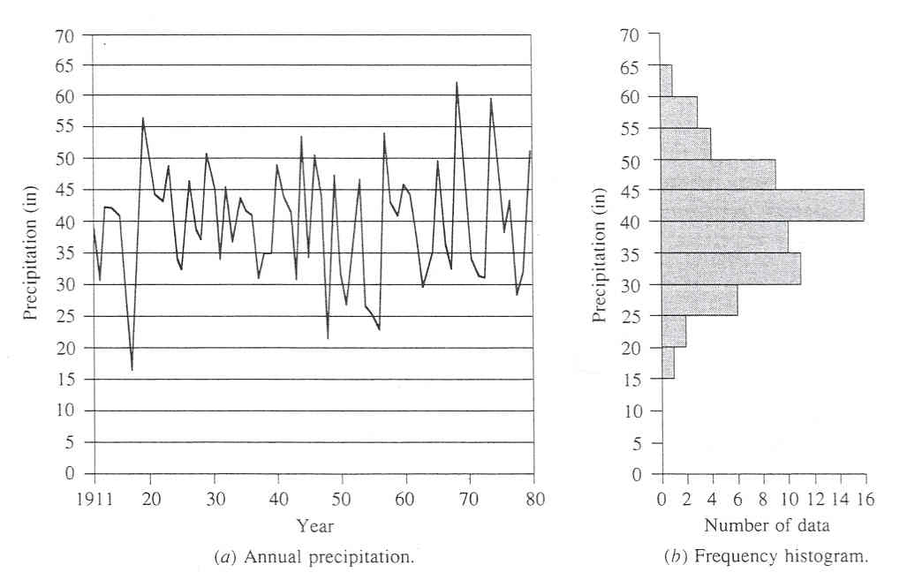

Slide 12
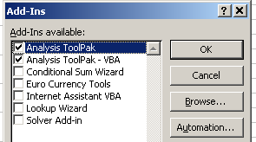
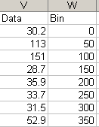
Using Excel to plot histograms
1) Make sure Analysis Tookpak is added in Tools.
This will add data analysis command in Tools
2) Fill one column with the data, and another with the intervals (eg. for 50 cfs interval, fill 0,50,100,…)
3) Go to Tools→Data Analysis→Histogram
4) Organize the plot in a presentable form (change fonts, scale, color, etc.)

Slide 13
Probability density function
Continuous form of probability mass function is probability density function
pdf is the first derivative of a cumulative distribution function

Slide 14
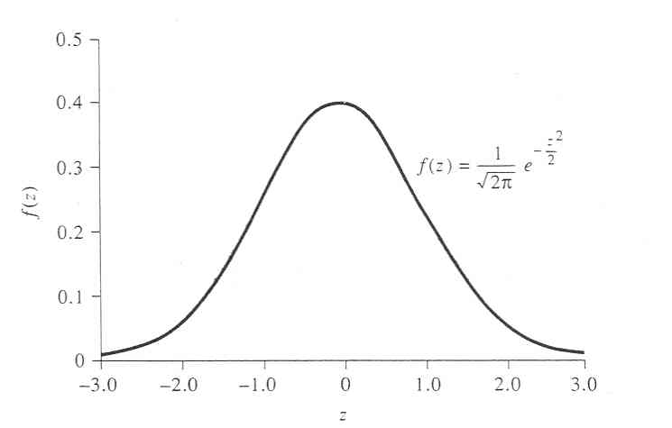

Slide 15
Cumulative distribution function
Cumulate the pdf to produce a cdf
Cdf describes the probability that a random variable is less than or equal to specified value of x
P (Q ≤ 50000) = 0.8
P (Q ≤ 25000) = 0.4

Slide 16
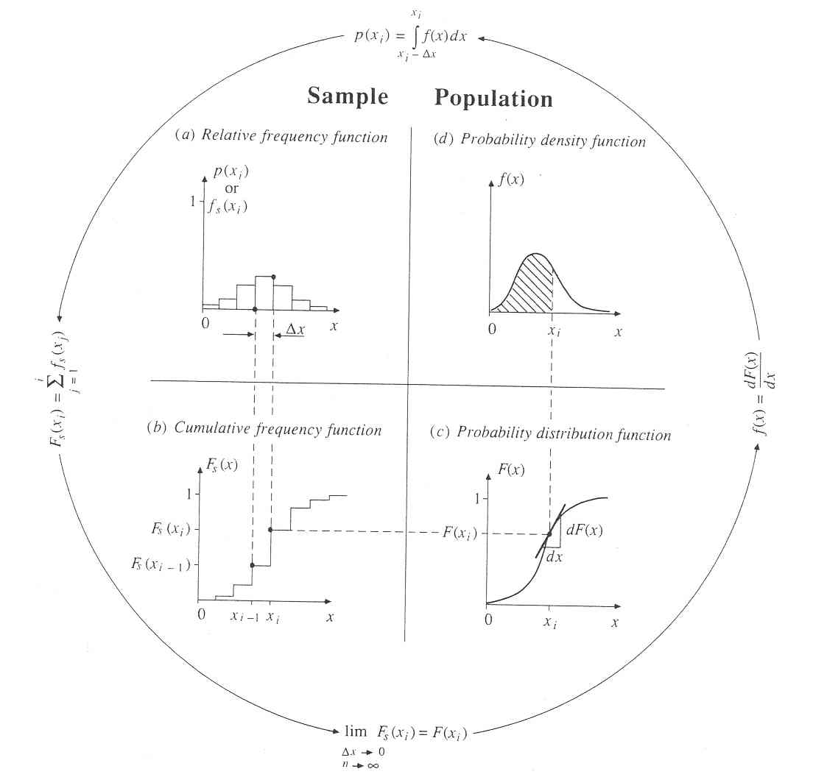

Slide 17
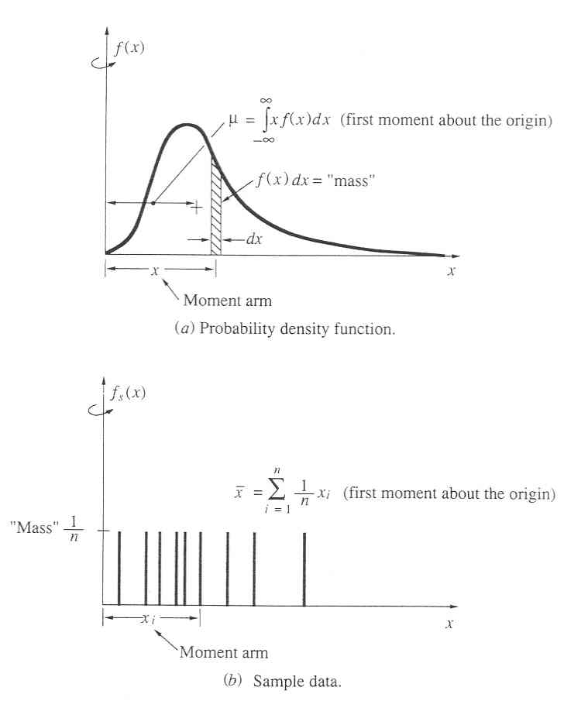

Slide 18
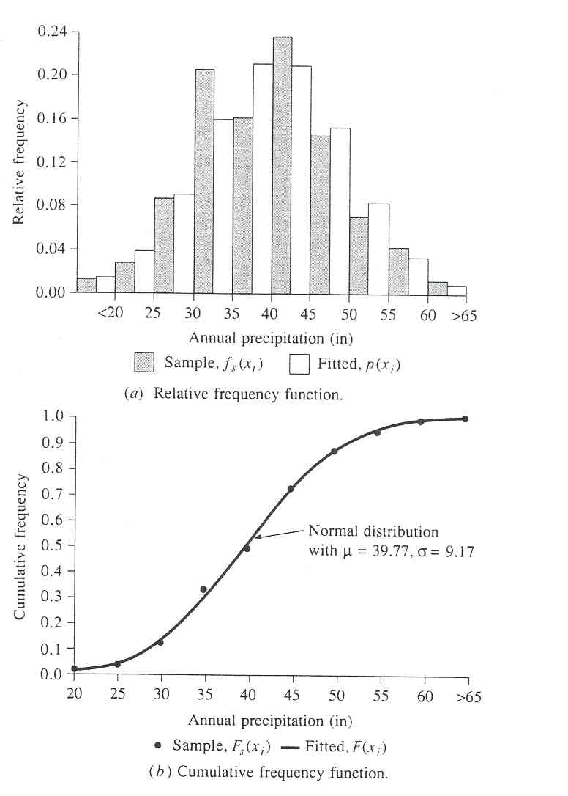

Slide 19
Hydrologic extremes
Extreme events
  Floods
  Droughts
Magnitude of extreme events is related to their frequency of occurrence
The objective of frequency analysis is to relate the magnitude of events to their frequency of occurrence through probability distribution
It is assumed the events (data) are independent and come from identical distribution

Slide 20
Return Period
Random variable:
Threshold level:
Extreme event occurs if:
Recurrence interval:
Return Period:
  Average recurrence interval between events equalling or exceeding a threshold
If p is the probability of occurrence of an extreme event, then
or

Slide 21
More on return period
If p is probability of success, then (1-p) is the probability of failure
Find probability that (X ≥ x_{T}) at least once in N years.

Slide 22
Hydrologic data series
Complete duration series
  All the data available
Partial duration series
  Magnitude greater than base value
Annual exceedance series
  Partial duration series with # of values = # years
Extreme value series
  Includes largest or smallest values in equal intervals
    Annual series: interval = 1 year
    Annual maximum series: largest values
    Annual minimum series : smallest values

Slide 23
Return period example
Dataset – annual maximum discharge for 106 years on Colorado River near Austin
x_{T} = 200,000 cfs
No. of occurrences = 3
2 recurrence intervals in 106 years
T = 106/2 = 53 years
If x_{T} = 100, 000 cfs
7 recurrence intervals
T = 106/7 = 15.2 yrs
P( X ≥ 100,000 cfs at least once in the next 5 years) = 1- (1-1/15.2)⁵ = 0.29

Slide 24
Probability distributions
Normal family
  Normal, lognormal, lognormal-III
Generalized extreme value family
  EV1 (Gumbel), GEV, and EVIII (Weibull)
Exponential/Pearson type family
  Exponential, Pearson type III, Log-Pearson type III

Slide 25
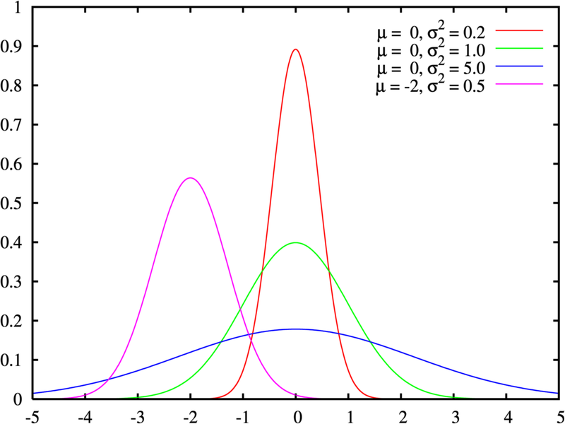
Normal distribution
Central limit theorem – if X is the sum of n independent and identically distributed random variables with finite variance, then with increasing n the distribution of X becomes normal regardless of the distribution of random variables
pdf for normal distribution
μ is the mean and σ is the standard deviation
Hydrologic variables such as annual precipitation, annual average streamflow, or annual average pollutant loadings follow normal distribution

Slide 26
Standard Normal distribution
A standard normal distribution is a normal distribution with mean (μ) = 0 and standard deviation (σ) = 1
Normal distribution is transformed to standard normal distribution by using the following formula:
z is called the standard normal variable

Slide 27
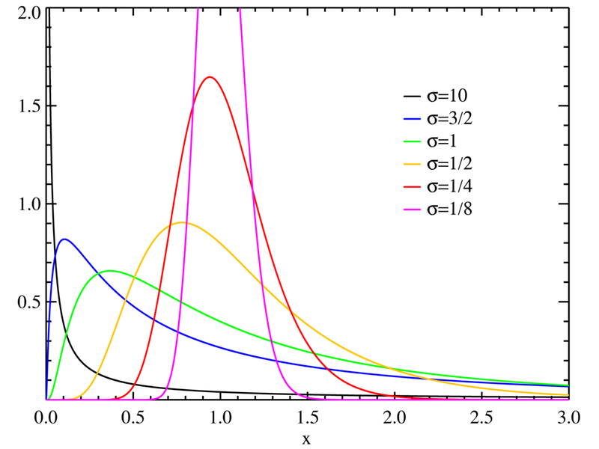
Lognormal distribution
If the pdf of X is skewed, it’s not normally distributed
If the pdf of Y = log (X) is normally distributed, then X is said to be lognormally distributed.
Hydraulic conductivity, distribution of raindrop sizes in storm follow lognormal distribution.

Slide 28
Extreme value (EV) distributions
Extreme values – maximum or minimum values of sets of data
Annual maximum discharge, annual minimum discharge
When the number of selected extreme values is large, the distribution converges to one of the three forms of EV distributions called Type I, II and III

Slide 29
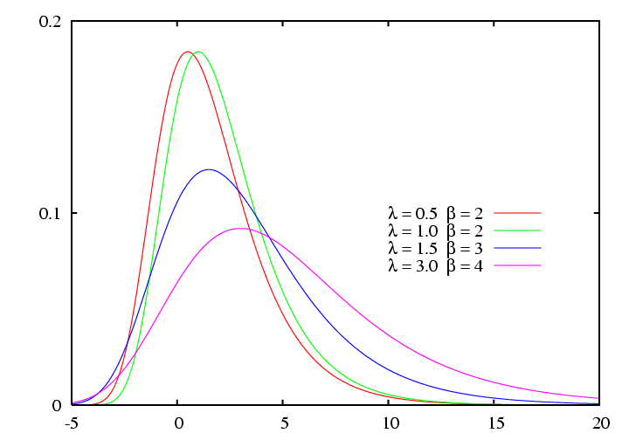
EV type I distribution
If M₁, M₂…, M_{n} be a set of daily rainfall or streamflow, and let X = max(Mi) be the maximum for the year. If M_{i} are independent and identically distributed, then for large n, X has an extreme value type I or Gumbel distribution.
Distribution of annual maximum streamflow follows an EV1 distribution

Slide 30
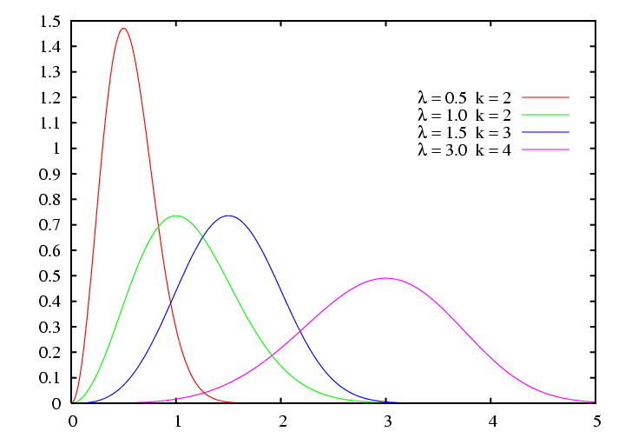
EV type III distribution
If W_{i} are the minimum streamflows in different days of the year, let X = min(W_{i}) be the smallest. X can be described by the EV type III or Weibull distribution.
Distribution of low flows (eg. 7-day min flow) follows EV3 distribution.

Slide 31
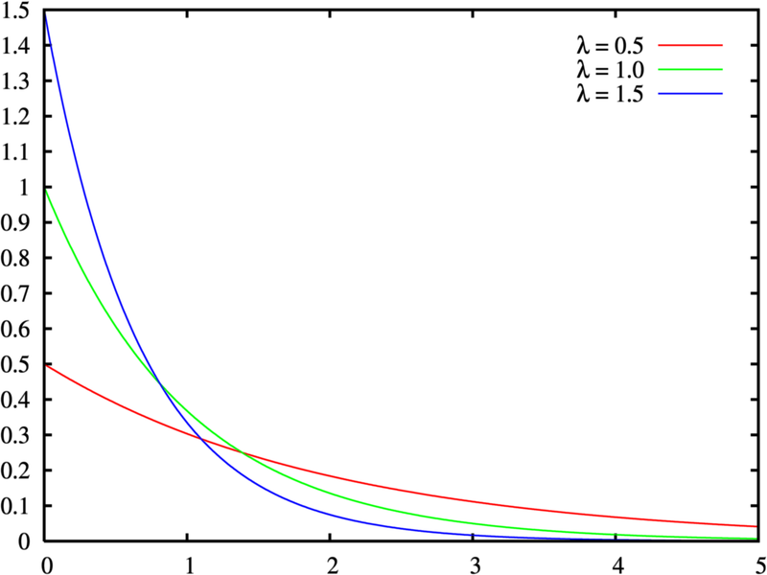
Exponential distribution
Poisson process – a stochastic process in which the number of events occurring in two disjoint subintervals are independent random variables.
In hydrology, the interarrival time (time between stochastic hydrologic events) is described by exponential distribution
Interarrival times of polluted runoffs, rainfall intensities, etc are described by exponential distribution.

Slide 32
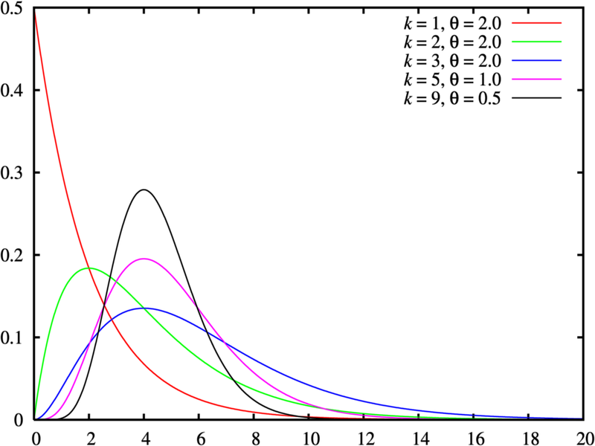
Gamma Distribution
The time taken for a number of events (β) in a Poisson process is described by the gamma distribution
Gamma distribution – a distribution of sum of β independent and identical exponentially distributed random variables.
Skewed distributions (eg. hydraulic conductivity) can be represented using gamma without log transformation.

Slide 33
Pearson Type III
Named after the statistician Pearson, it is also called three-parameter gamma distribution. A lower bound is introduced through the third parameter (ε)
It is also a skewed distribution first applied in hydrology for describing the pdf of annual maximum flows.

Slide 34
Log-Pearson Type III
If log X follows a Person Type III distribution, then X is said to have a log-Pearson Type III distribution

