Slide 1
Unit Hydrograph
Reading: Sections 7.1-7.3, 7.5, 7.7,

Slide 2
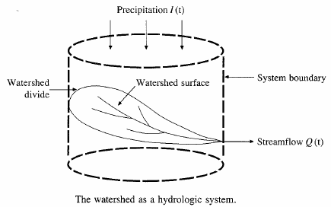






Hydrologic Analysis
Change in storage w.r.t. time = inflow - outflow
In the case of a linear reservoir, S = kQ
Transfer function for a linear system (S = kQ).

Slide 3
Proportionality and superposition
Linear system (k is constant in S = kQ)
  Proportionality
    If I₁ → Q₁ then C*I₂ → C*Q₂
  Superposition
    If I₁ → Q₁ and I₂ → Q₂, then I₁ +I₂→ Q₁ + Q₂

Slide 4
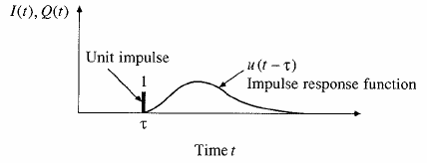
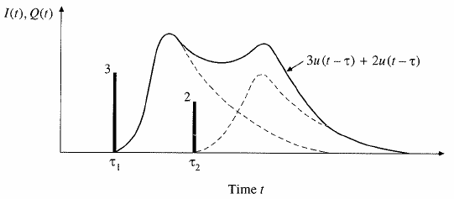
Impulse response function
Impulse input: an input applied instantaneously (spike) at time τ and zero everywhere else
An unit impulse at τ produces as unit impulse response function u(t-τ)
Principle of proportionality and superposition

Slide 5
Convolution integral
For an unit impulse, the response of the system is given by the unit impulse response function u(t-τ)
An impulse of 3 units produces the 3u(t-τ)
If I(τ) is the precipitation intensity occurring for a time period of dτ, the response of the system (direct runoff) is I(τ)u(t-τ)dτ
The complete response due to the input function I(τ) is given by convolution integral
Response of a linear system is the sum (convolution) of the responses to inputs that have happened in the past.

Slide 6
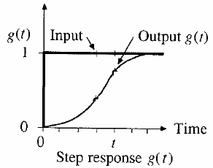
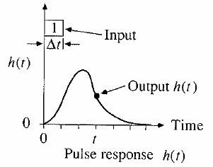
Step and pulse inputs
A unit step input is an input that goes from 0 to 1 at time 0 and continues indefinitely thereafter
A unit pulse is an input of unit amount occurring in duration Δt and 0 elsewhere.
Precipitation is a series of pulse inputs!

Slide 7
Unit Hydrograph Theory
Direct runoff hydrograph resulting from a unit depth of excess rainfall occurring uniformly on a watershed at a constant rate for a specified duration.
Unit pulse response function of a linear hydrologic system
Can be used to derive runoff from any excess rainfall on the watershed.

Slide 8
Unit hydrograph assumptions
Assumptions
  Excess rainfall has constant intensity during duration
  Excess rainfall is uniformly distributed on watershed
  Base time of runoff is constant
  Ordinates of unit hydrograph are proportional to total runoff (linearity)
  Unit hydrograph represents all characteristics of watershed (lumped parameter) and is time invariant (stationarity)

Slide 9
Discrete Convolution
Continuous
Discrete
Q is flow, P is precipitation and U is unit hydrograph
M is the number of precipitation pulses, n is the number of flow rate intervals
The unit hydrograph has N-M+1 pulses

Slide 10
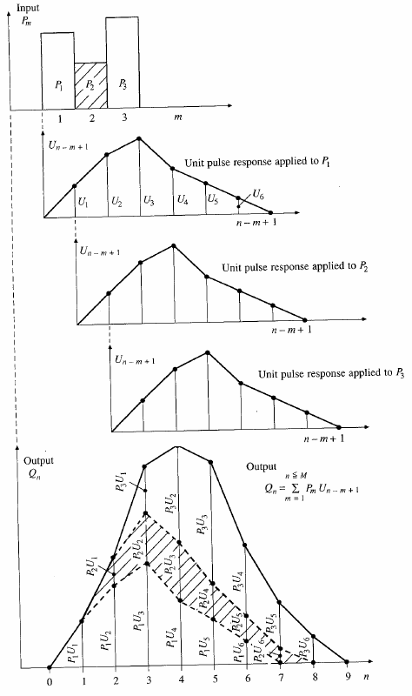
Application of convolution to the output from a linear system

Slide 11
Time – Area Relationship
Isochrone of
Equal time to outlet
Area
Excess Rainfall
0
5
10
15
20
Time, t
Time, t

Slide 12
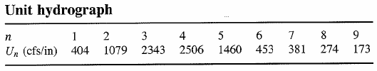
Application of UH
Once a UH is derived, it can be used/applied to find direct runoff and stream flow hydrograph from other storm events.
Given:
P₁ = 2 in, P₂ = 3 in and P₃ = 1 in, baseflow = 500 cfs and watershed area is 7.03 mi². Given the Unit Hydrograph below, determine the streamflow hydrograph
Ex. 7.5.1

Slide 13
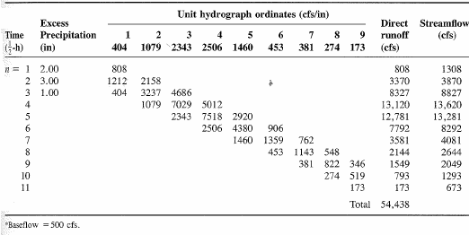
7.5.1 solution (cont’d)
See another example at: http://www.egr.msu.edu/~northco2/BE481/UHD.htm

Slide 14
Gauged and ungauged watersheds
Gauged watersheds
  Watersheds where data on precipitation, streamflow, and other variables are available
Ungauged watersheds
  Watersheds with no data on precipitation, streamflow and other variables.

Slide 15
Need for synthetic UH
UH is applicable only for gauged watershed and for the point on the stream where data are measured
For other locations on the stream in the same watershed or for nearby (ungauged) watersheds, synthetic procedures are used.

Slide 16
Synthetic UH
Synthetic hydrographs are derived by
  Relating hydrograph characteristics such as peak flow, base time etc. with watershed characteristics such as area and time of concentration.
  Using dimensionless unit hydrograph
  Based on watershed storage

Slide 17
SCS dimensionless hydrograph
Synthetic UH in which the discharge is expressed by the ratio of q to q_{p} and time by the ratio of t to T_{p}
If peak discharge and lag time are known, UH can be estimated.
T_{c}: time of concentration
C = 2.08 (483.4 in English system)
A: drainage area in km² (mi²)

Slide 18
Ex. 7.7.3
Construct a 10-min SCS UH. A = 3.0 km² and T_{c} = 1.25 h
0.833 h
q
7.49 m3/s.cm
Multiply y-axis of SCS hydrograph by q_{p} and x-axis by T_{p} to get the required UH, or construct a triangular UH
t
2.22 h

