Slide 1
Evaluating river cross section for SPRINT: Guadalupe and San Antonio River Basins
Alfredo Hijar
Flood Forecasting

Slide 2
Outline
Introduction
Hydraulic geometry, hydraulic routing models, channel cross section extraction
Reliable channel cross section approximation
Boundary conditions – Noah Land Surface Model
Results
Future work

Slide 3
Introduction
Importance of understanding river networks.
Floods are a major problem in the US.
Potential hydropower plants.
Watershed management (sediment control, habitats).
Notes:
Floods are a major problem in the US, every year

Slide 4
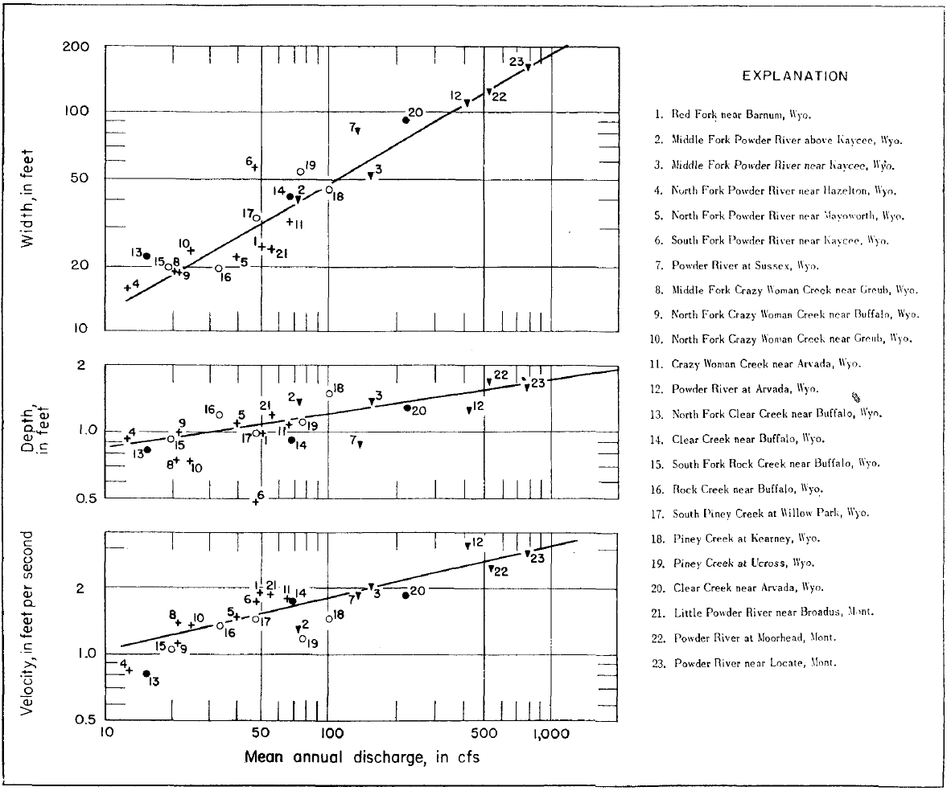
Hydraulic Geometry
Leopold (1953) introduced power law relationship between hydraulic variables.
w = aQ^{b}
d = cQ^{f}
v = kQ^{m}
w, d, and v change with discharges of equal frequency.
These discharges increase with drainage area.
Notes:
Downstream hydraulic geometry: when using the same frequency of discharge or mean annual discharge, there is relationship between width, depth, vel and that discharge/drainage area.
Idea extracted from hydraulic geometry to approximate XS sections.

Slide 5
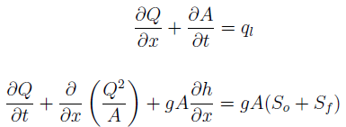
Hydraulic/Distributed flow routing
Flow is computed as a function of time and space.
1D unsteady flow equations – Saint Venant equations (1893).
  Governed by continuity and momentum equations
2 Equations, 2 variables (Q, A).
Channel geometry – A(h).
Notes:
Hydraulic flow routing recommended for unsteady flow.
There are fully dynamic SV eq. and also simple forms of SVE such as kinematic or diffusion wave equation.
Full dynamic SVE require channel data, lateral inflows or boundary conditions, initial conditions, friction slope (manning n or roughness), and energy gradient slope (So).
Hydraulic routing serves as a tool for flood forecasting.

Slide 6
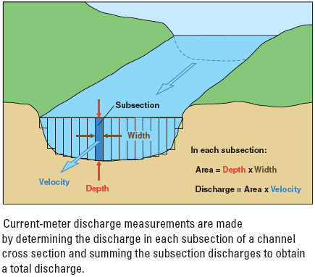
Hydraulic/Distributed flow routing
Data requirements for hydraulic routing models:
  Channel cross section geometry – level of detail?
  Channel friction – Calibration
  Lateral inflows or boundary conditions – hydrological models
Tool for flood forecasting & watershed management.
Notes:
For several studies, simpler cross sections are assumed. Either rectangular or XS with vertically varying widths based on hydraulic geometry relationships.
Triangular or rectangular XS approximations can lead to improvements in flow simulations using hydraulic routing models (orlandini and rosso 1998, mejia 2011).

Slide 7
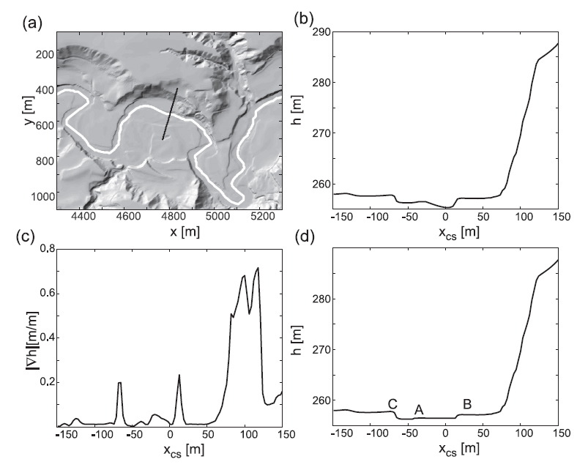
Channel cross section extraction
Software tools are been developed to extract spatial features from DEM or LiDAR datasets.
Extraction from ASTER GDEM.
  Triangular & Synthetic XS.
Extracted XS present similar results to surveyed/bathymetric data.
New Software for XS extraction: GeoNet.

Slide 8
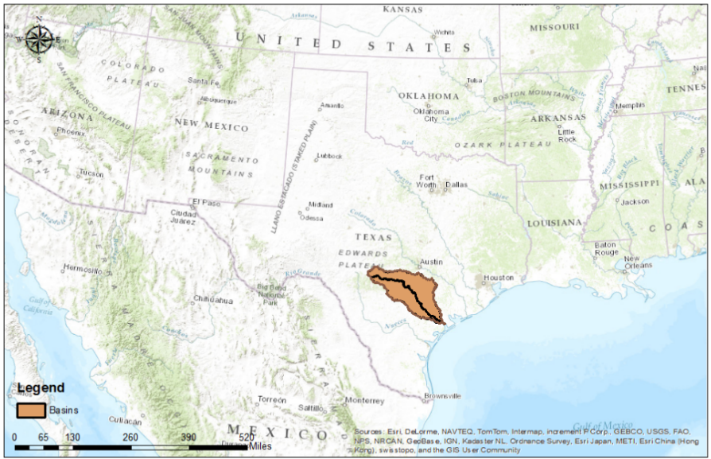
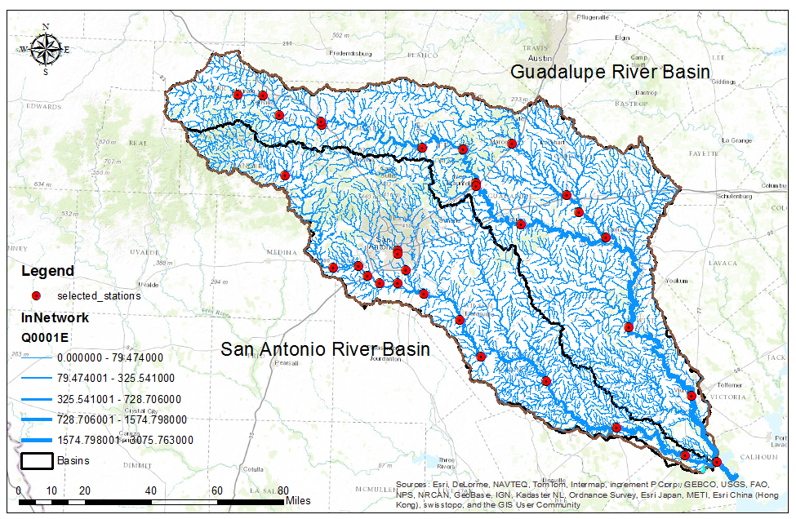
Study Area
5,000 streams.
1,500 “source” nodes.
≈ 30 active USGS streamflow stations
Notes:
5195 streams. Each stream has one catchment area.
Studies before from rapid.
Not so many dams

Slide 9
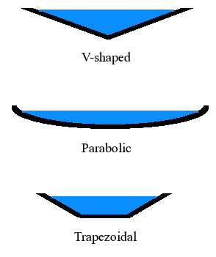
Reliable cross section approximation
Shape of cross section of river channels is a function of:
  Flow
  Sediments
  Bed Material
Most river cross sections tend to have:
  Trapezoidal/rectangular,
  Rectangular, or
  Parabolic forms.

Slide 10
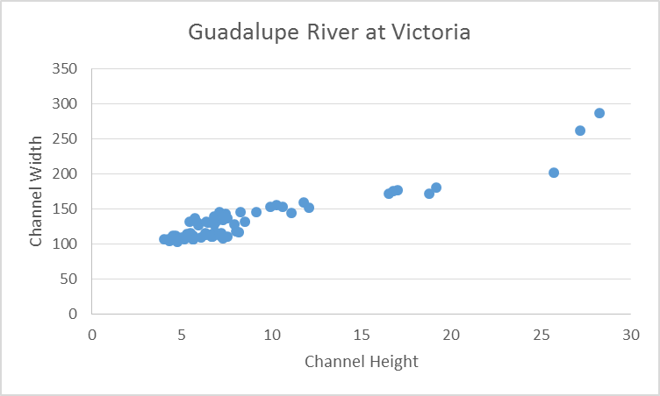
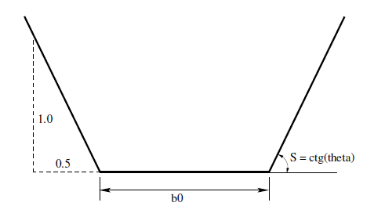
Reliable cross section approximation
USGS streamflow stations:
  Channel top width (ft)
  Gage height (ft)/Channel mean depth (ft)
Hypothesis:
  Trapezoidal XS
Floodplain
Notes:
Stage height is usually take at the deepest point in the stream channel.

Slide 11
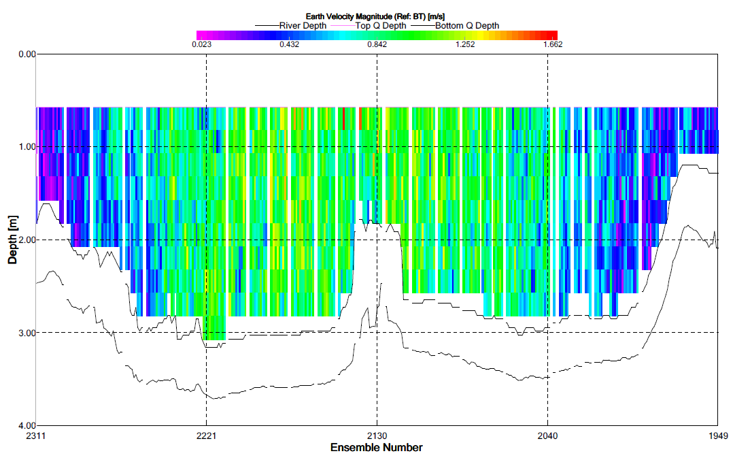
Reliable cross section approximation
Channel top width (ft)
Channel mean depth (ft)
Area in blue = Area in red

Slide 12
USGS Streamflow Measurement Stations
≈ 25 USGS stations.
Data collected from 2007 to 2010.
Simulation year: 2010.
Rating Curve should be the same for data.

Slide 13
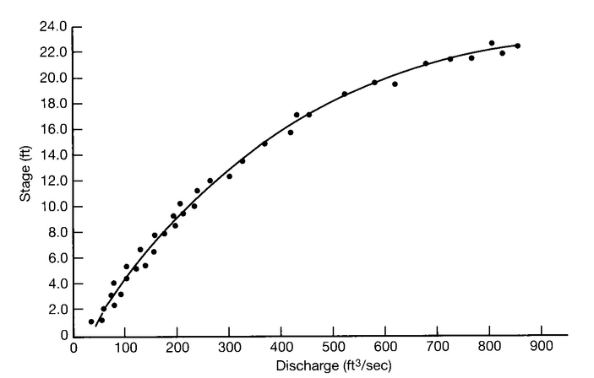
Rating Curve
Graph of channel discharge vs. stage height.
Different Rating curves imply a change in channel XS.
  Storms
  Artificial changes

Slide 14
Reliable cross section approximation
Plot data on scatter plot.
Detect trends or shifts in the data.
Kendall Correlation Coefficient (tau) – monotonic trend.
  Kendall correlation coefficient varies between 0.1 to 0.5.
Pearson Correlation Coefficient (r) – linear relationship.
  r values higher than 0.5.

Slide 15
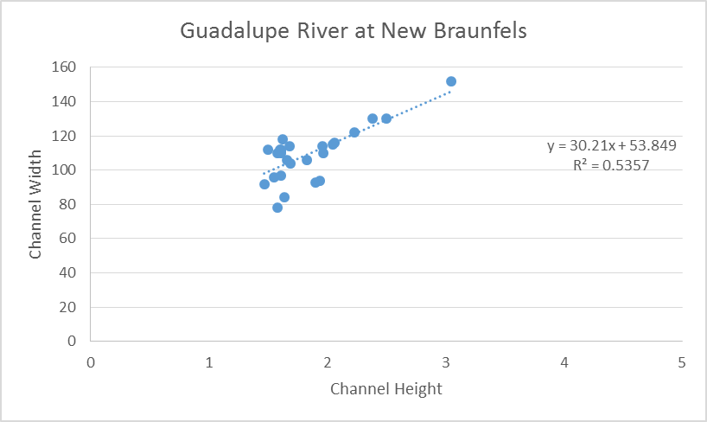
Reliable cross section approximation
Develop a linear regression model:
  Determine parameters: intercept (b₀) and slope (b₁)
  Determine significance of slope (b₁) – t statistics
  Compute residuals
  Examine residuals distribution
  Plot residuals vs. time or space
Channel bottom width
Channel side wall slope

Slide 16
Reliable cross section approximation

Slide 17
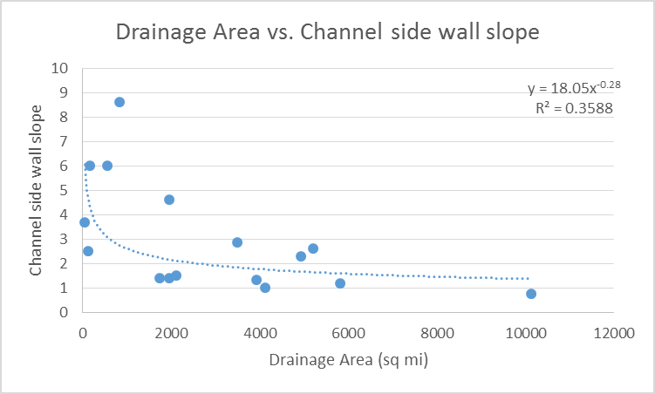
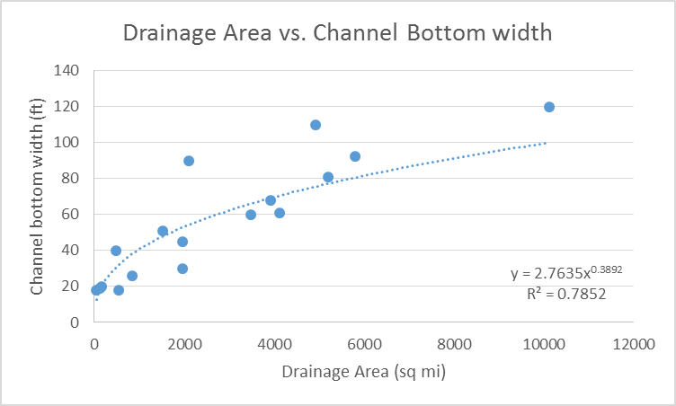
Reliable cross section approximation

Slide 18
Boundary conditions – Lateral inflows
River network – NHDPlus V.2.
  COMID, slope, areas, divergence, topological connection, length, etc.
Noah (LSM) provides lateral inflow to river network.
  Surface runoff
  Subsurface runoff

Slide 19
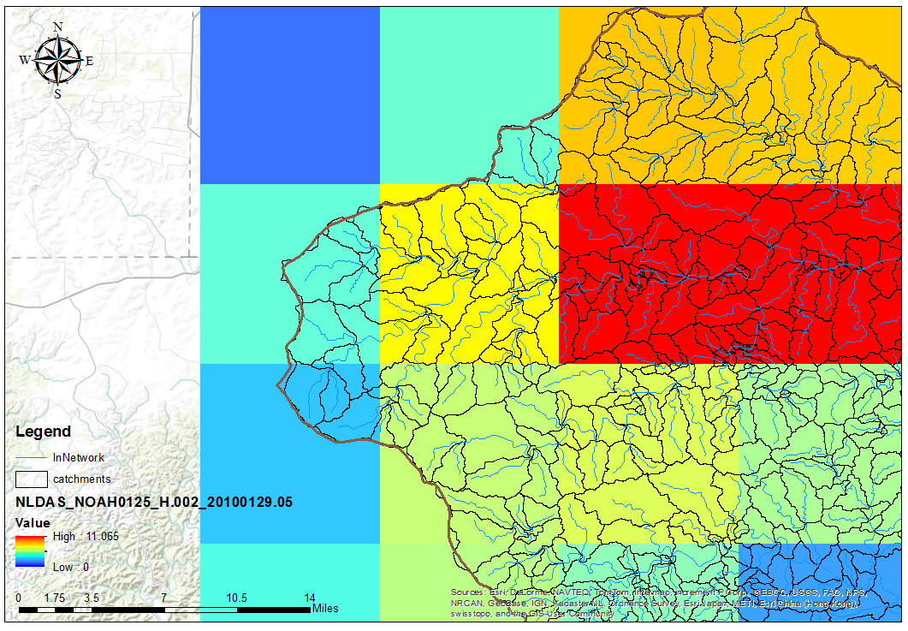
Boundary conditions – Lateral inflows
5,000 catchment areas – km².
Runoff data hourly for year 2010 – mm/hr.
Lateral inflow = CA * Runoff

Slide 20
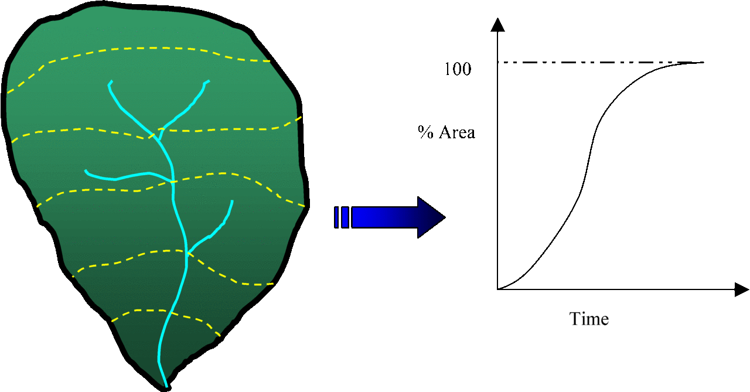
Hydraulic Flow Routing Complexities
Supercritical and Subcritical Mixed Flows
SPRINT can not handle supercritical flows at the junction nodes.
Lateral flow calculation produces flow peaks – no time of concentration.
Notes:
The time it takes for runoff to travel from the most
hydraulically distant point in the watershed to a
point of interest.

Slide 21
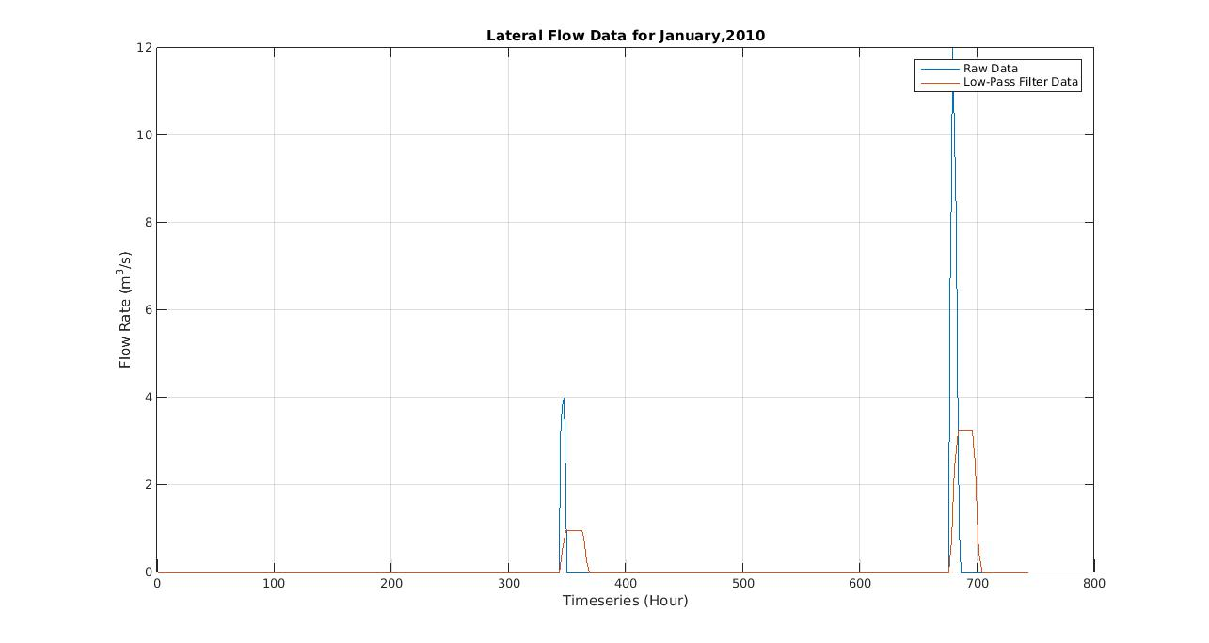


Hydraulic Flow Routing Complexities
Flow peaks up to 100 m³/s.
Unstable and convergence failure – SPRINT.
Low-pass filter – 1st order.
Mass conservation.

Slide 22
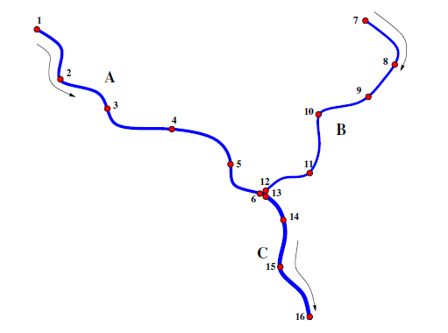
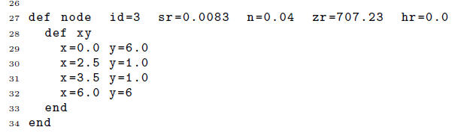
Simulation Program for River Networks (SPRINT)
Fully dynamic Saint-Venant Equations.
Channel network, geometry, forcing terms (initial conditions) and boundary conditions are specified as a “NETLIST”.
At each node, “A” and “Q” are computed by solving the Saint Venant Eq.
Notes:
A topological checking on the connectivity of the river network,

Slide 23
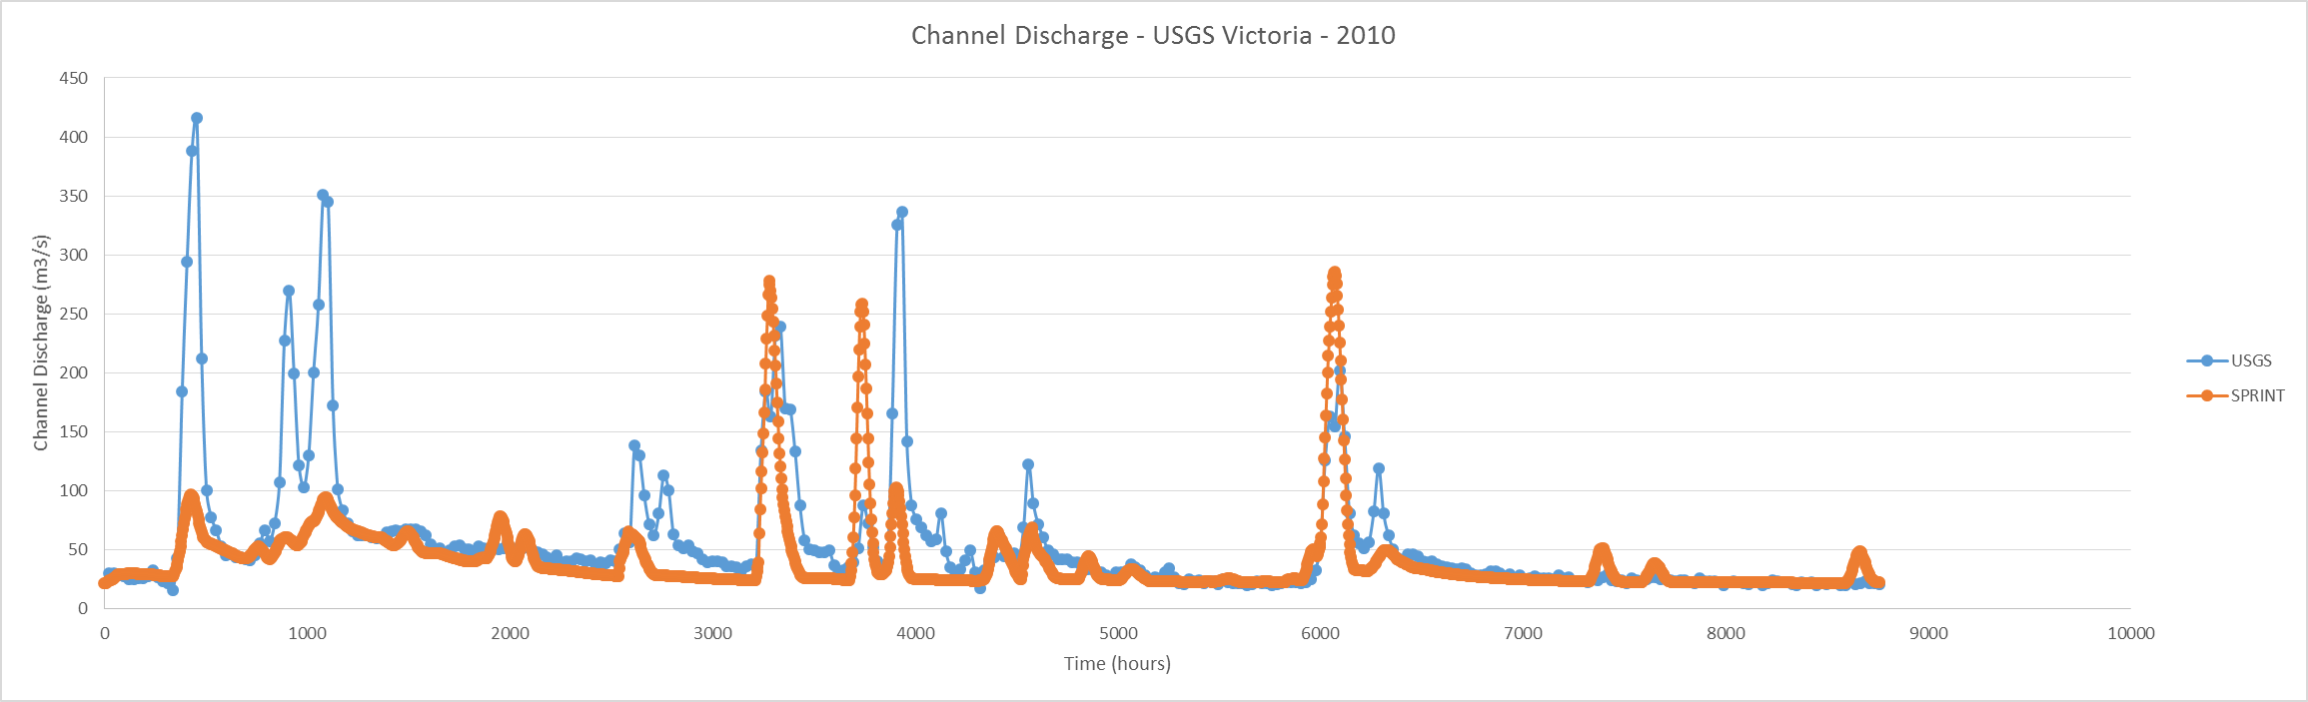
Results – SPRINT 2010

Slide 24
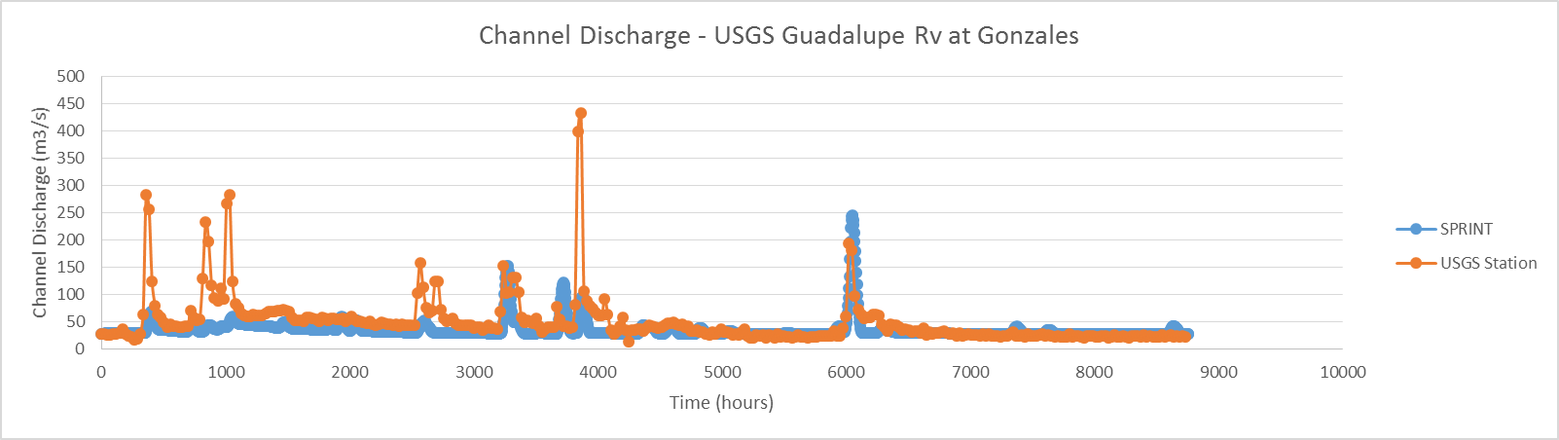
Results

Slide 25
Conclusions & Future Work
Trapezoidal cross section approximation provides acceptable results.
Spin-up time ≈ first 2 to 3 months.
Noah provides acceptable lateral inflows – 10km x 10km grids.
Calibration for Manning’s n (0.05 for all reaches) – PEST.
Use GeoNet for XS extraction and run SPRINT - 10m DEM.
Use finer grids 3km x 3km LSM – WRF-Hydro models.

