Slide 1
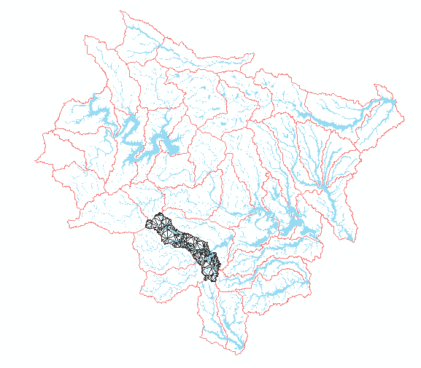
Onion creek catchment modeling using PIHM
By,
Harish Sangireddy
PhD Candidate
The University of Texas at Austin

Slide 2
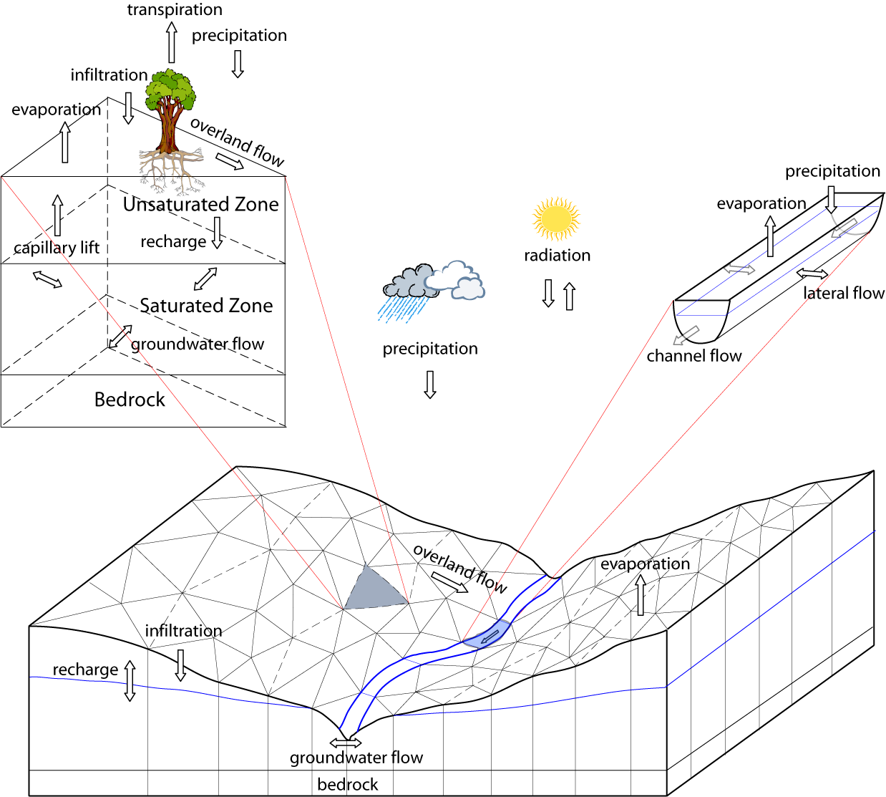
What is PIHM?
Penn State Integrated Hydrologic Modeling system
It is a distributed hydrologic model that incorporates
  Channel routing
  Surface overland flow
  Subsurface flow
  Snow melt
  Evapotranspiration
via a semi-discrete approach with FVM.

Slide 3
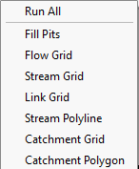
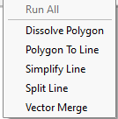
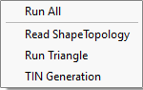
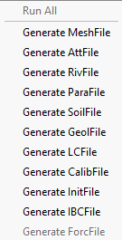

Procedural framework of PIHM
Raster processing
Vector processing
TIN generation ( domain decomposition)
Data model loader
  mesh, att, riv, para, soil, geol, LC, Init, calib, Forc
Run PIHM
Information visualization
  Temporal
  Spatial

Slide 4
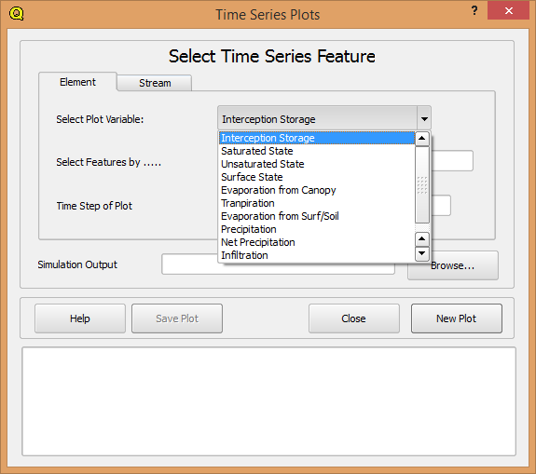
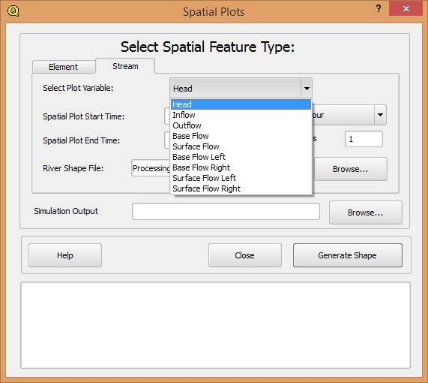
Outputs from PIHM
Time series plots
Spatial plots
Saturated state, unsaturated state
Evaporation from Canopy
Transpiration, and Infiltration
Inflow, Outflow, Base flow, Surface flow

Slide 5
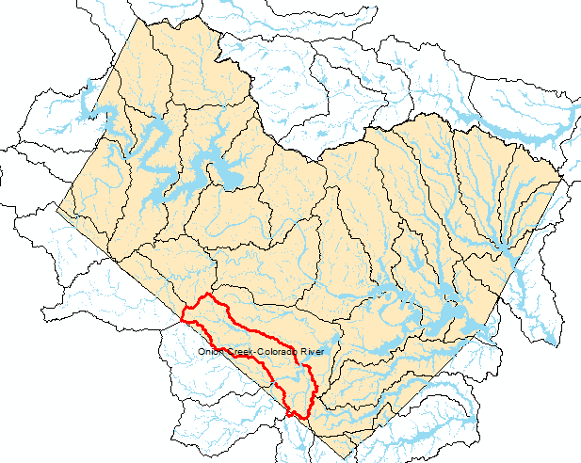
Onion Creek
Travis County
Catchment Attributes | Catchment attribute values
HUC_8 | 12090205
HUC_10 | 1209020504
HUC_12 | 120902050407
HUC_10_Name | Onion creek – Colorado River
HUC_12_Name | Slaughter creek – onion creek
Catchment area in square meters | 238860.9755

Slide 6
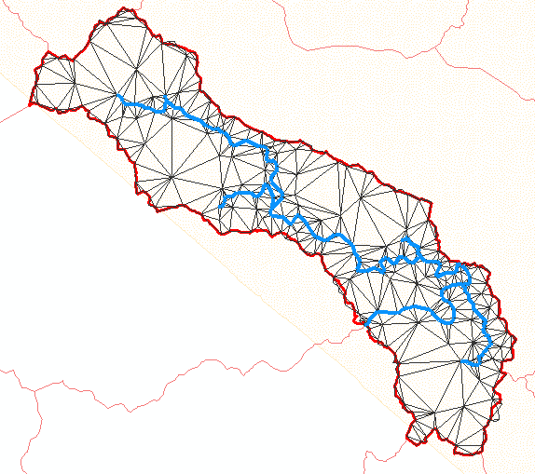
Onion creek
30 m DEM used
After pit filling was performed, an area threshold of 7588 m^2 was suggested by PIHM to create stream lines
Subsequently the vector processing was done and the TIN was generated for the entire Onion creek.
The forcing data for this experiment is from 2005 - 2009

Slide 7
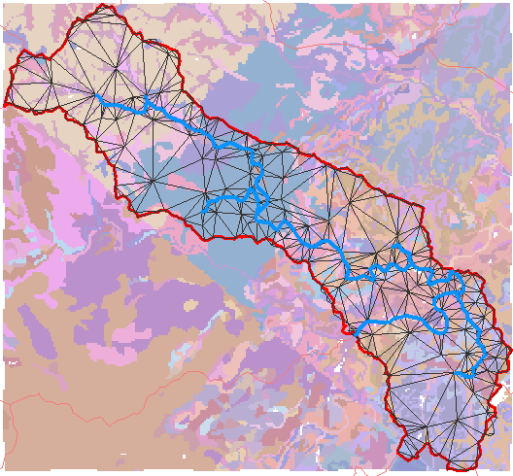
Onion creek
Geology
30 m DEM used
After pit filling was performed, an area threshold of 7588 m^2 was suggested by PIHM to create stream lines
Subsequently the vector processing was done and the TIN was generated for the entire Onion creek.

Slide 8
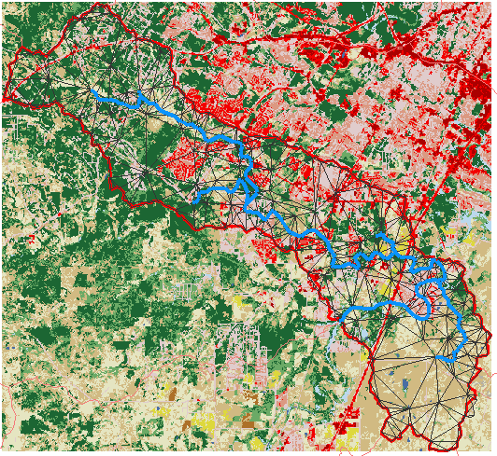
Onion creek
Land cover
30 m DEM used
After pit filling was performed, an area threshold of 7588 m^2 was suggested by PIHM to create stream lines
Subsequently the vector processing was done and the TIN was generated for the entire Onion creek.

Slide 9
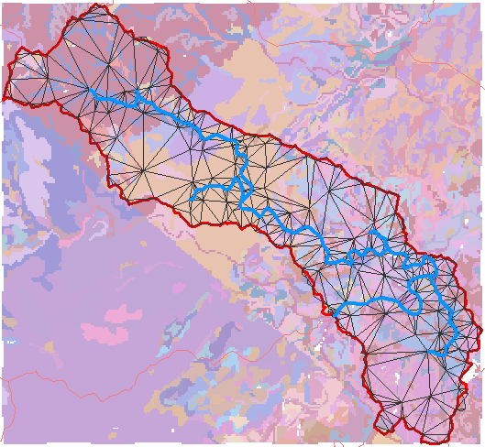
Onion creek
Soil type
30 m DEM used
After pit filling was performed, an area threshold of 7588 m^2 was suggested by PIHM to create stream lines
Subsequently the vector processing was done and the TIN was generated for the entire Onion creek.

Slide 10
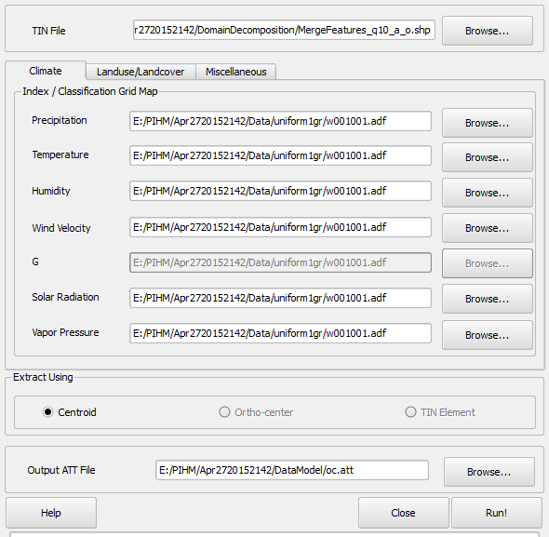
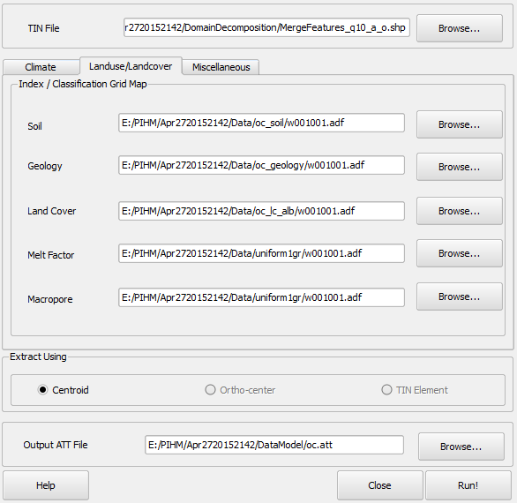
Model settings
Uniform climate conditions used
The soil, geology, land cover of HUC 12 was used

Slide 11
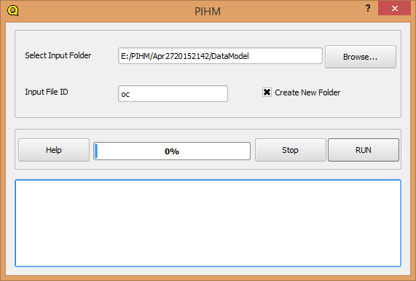
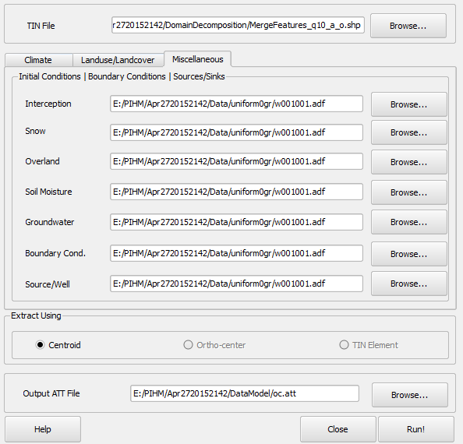
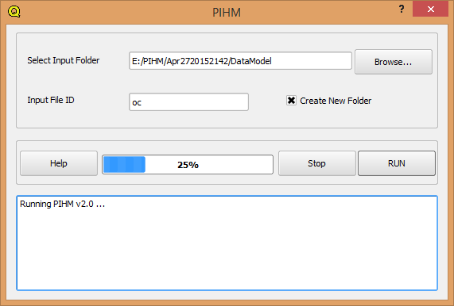
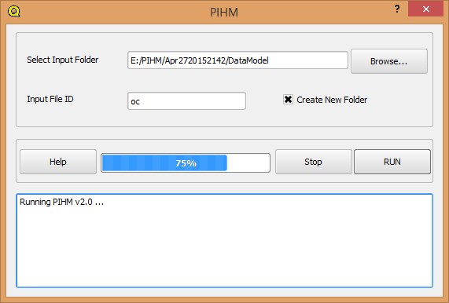
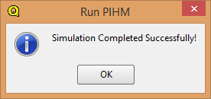
Model settings
Initial conditions were set to zero

Slide 12
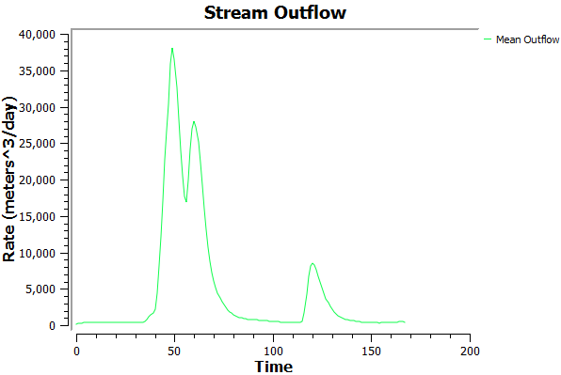
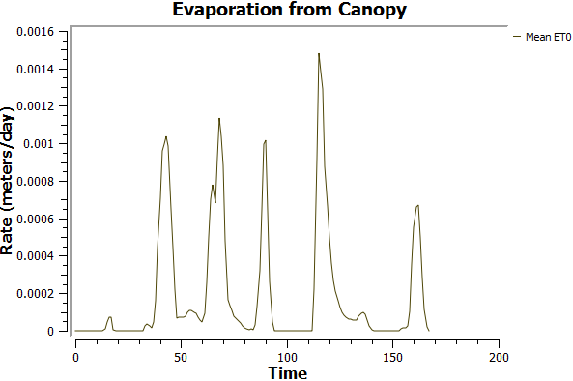
Time series visualization from PIHM outputs
Diurnal signal
Simulated over a 7 day period
Uniform distribution of climate variables assumed.

Slide 13
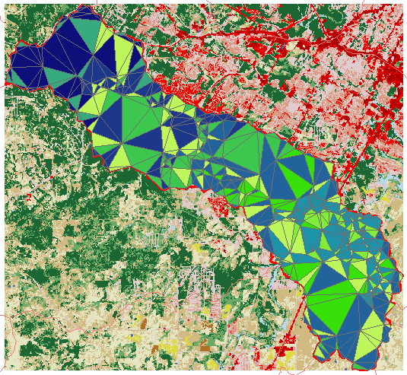
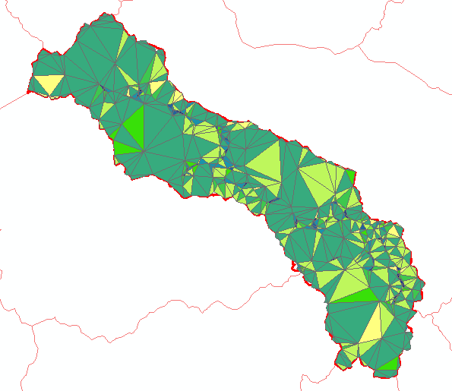
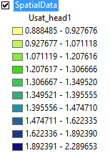
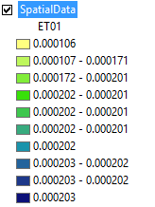
Spatial data visualization
Evapotranspiration
Unsaturated zone head
Correlates well with the land cover

Slide 14
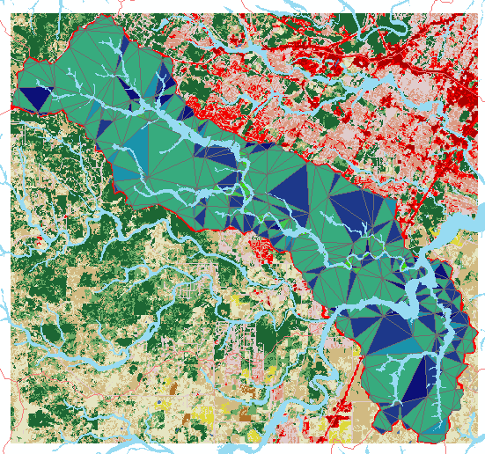
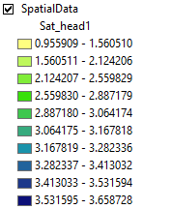
Saturate zones mapped with warning zones
Good spatial correlation between saturated zones identified by the PIHM model, and the warning zones from FEMA, even when the soil and geology characteristics are not accurate representation of the region.

Slide 15
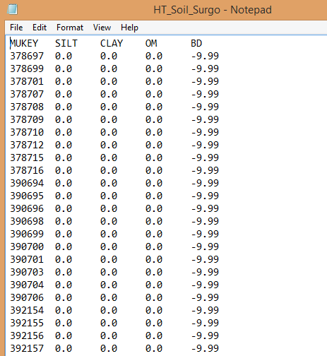
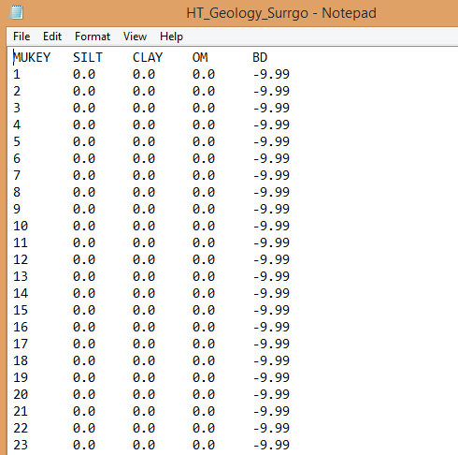
Caveats of this experiment
In order to run PIHM, the soil characteristics requires a compilation of the silt %, sand %, and clay % of each soil type in the HUC12.
Similarly the geology input file for PIHM needs information about the hydraulic conductivity, porosity, Van Genuchten soil parameters and some more.
The data preprocessor shipped with PIHM source code does not convert the raw data to data format as required the PIHM correctly always for soil and geology type.
Hence the first few runs of the PIHM model failed.
Although the soil and geology data was available for this region, the results that I present do not accurately represent the soil and geology characteristics of the onion creek. I was only able to find the silt %, sand %, and clay % of a few mukey ids only.

Slide 16
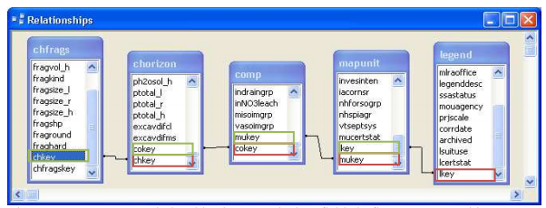
Conclusions and Future work
I adjusted the shell scripts for PIHM to make it run on windows machine.
The preprocessor to PIHM cannot handle large time series as it runs out of memory. Hence simulations using more than 4 years of forcing data are difficult to run now.
By changing the soil and geology parameters, we can get better estimates of outflow.
Also the vector processing needs some manual intervention to make the TIN appropriately.
I am going to use the SSURGO tables chorizon to get the real estimates of silt, clay and sand percentages for each mukey and re-run the PIHM model again.

