Slide 1
Model Calibration and Forecast Error for NFIE-Hydro
A Progress Report
By
Corey Van Dyk

Slide 2
Model Calibration
Determine set of HUC-12 basins for sensitivity analysis
  Basin characteristics
    Size of stream (average/base flow discharge)
    Land use
    Drainage density
    Climate (annual precipitation, evaporation)
  Recent meteorological history
Model Parameter Estimation Experiment (MOPEX) would be used to help determine these basins
Basins would be picked so that sets could be compared while only one parameter changes significantly

Slide 3
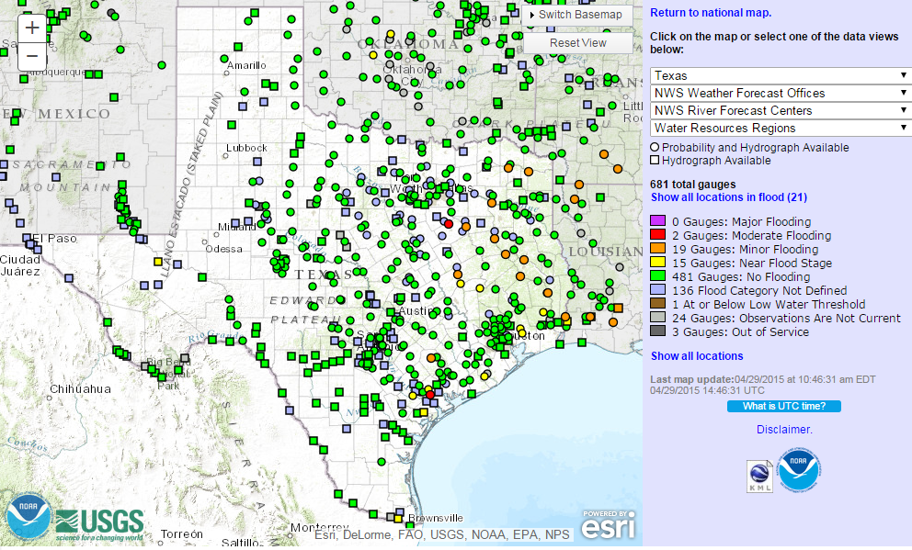
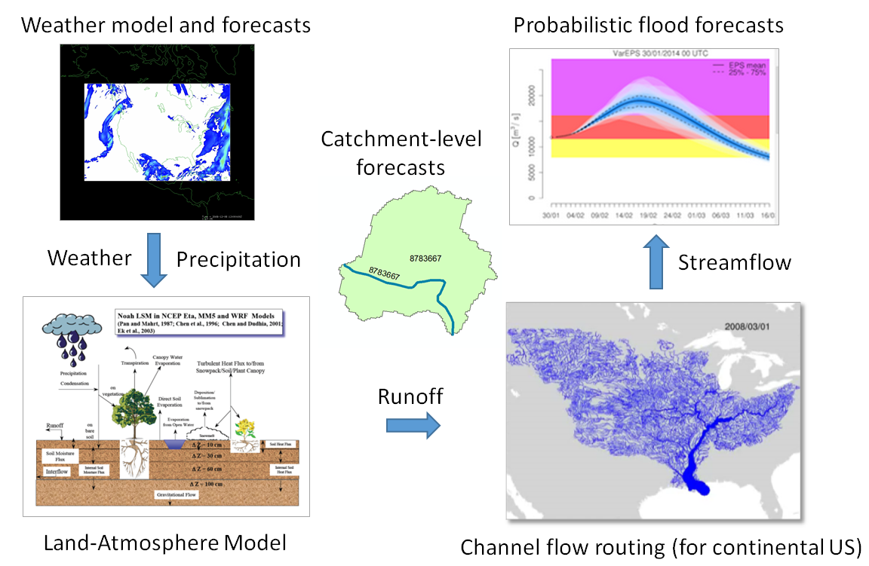
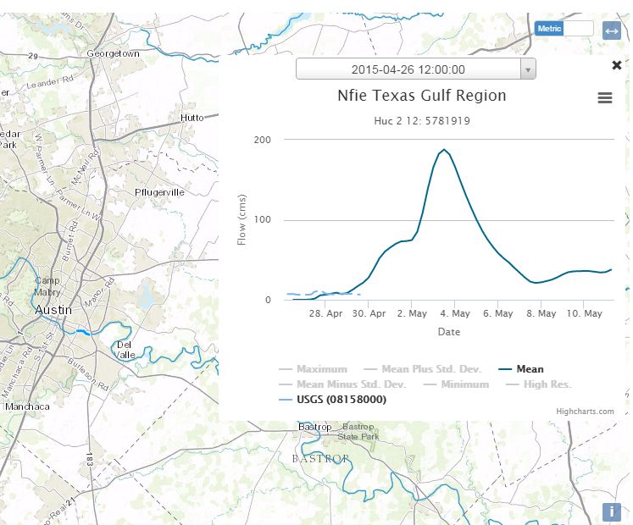
Assessing Predictive Models
NWS
NFIE
ECMWF (Tethys)

Slide 4
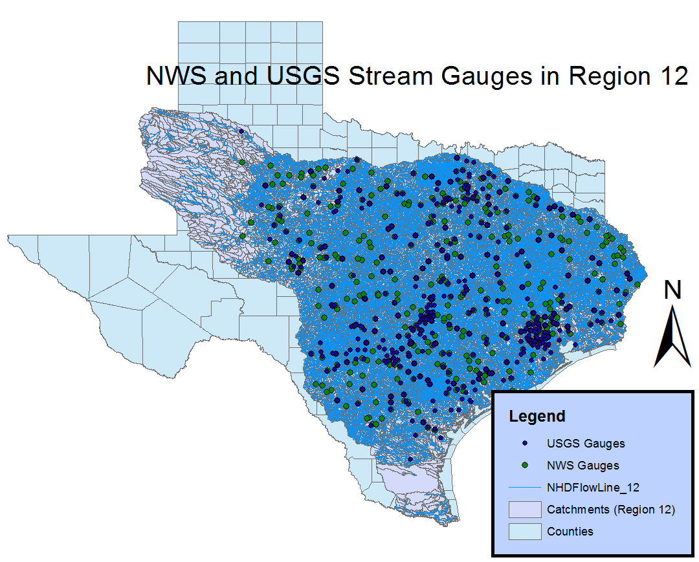
Coverage
NWS: 447
USGS: 413

Slide 6
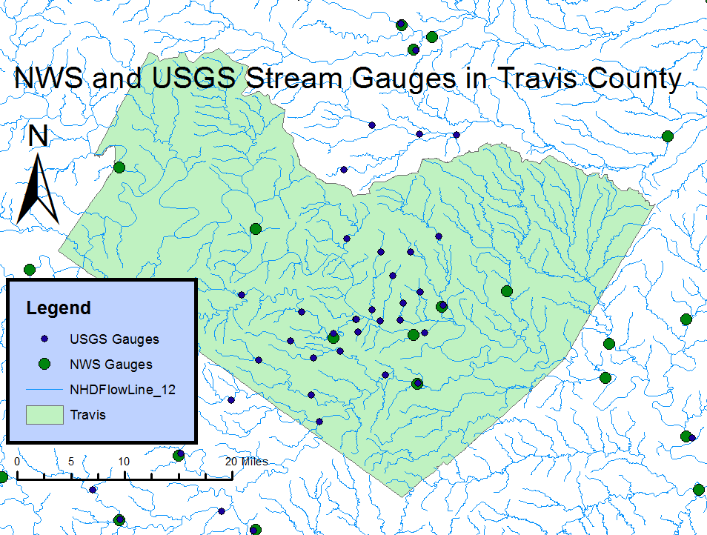
Error Comparison - Gages

Slide 7
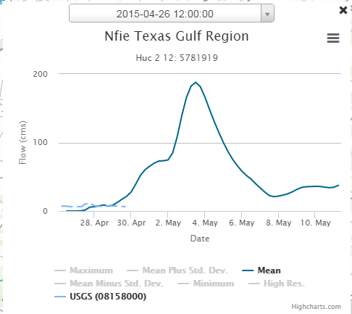
Error Comparison - ECMWF
Dating problem with ECMWF/Tethys

Slide 8
Error Comparison - NFIE
Download, analyze NetCDF files for NFIE predictions
Determine association between gages to river reach in the model
Extract flow from reach for comparison

Slide 9
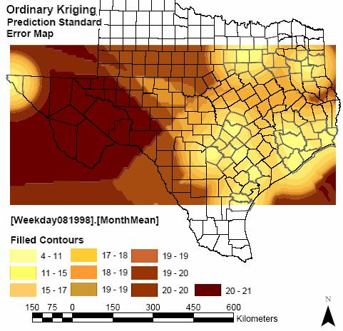
Error Maps
Compare error between models
Compare error within model
  Shows where weaknesses are
Gookyoung Heo

Slide 10
Questions?

