Slide 1
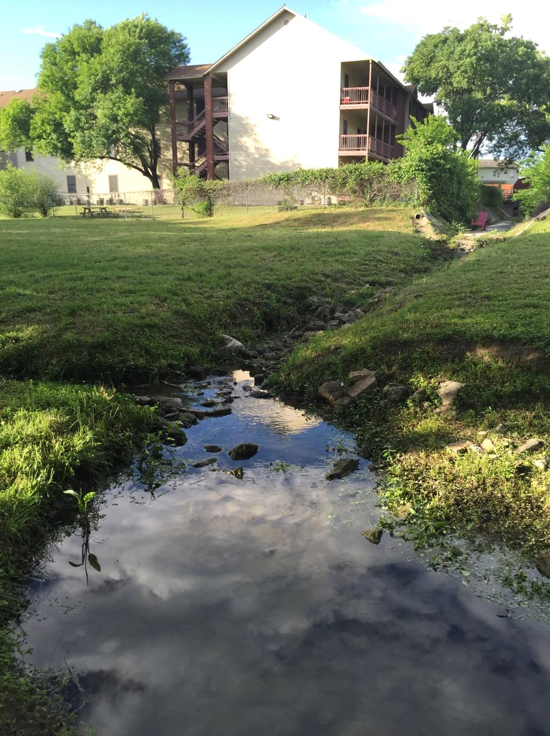
Using GeoNet 2.0 for feature identification in an urban environment
by
Anna Kladzyk
CE397 Flood Forecasting
Term Project
May 4th, 2015

Slide 2
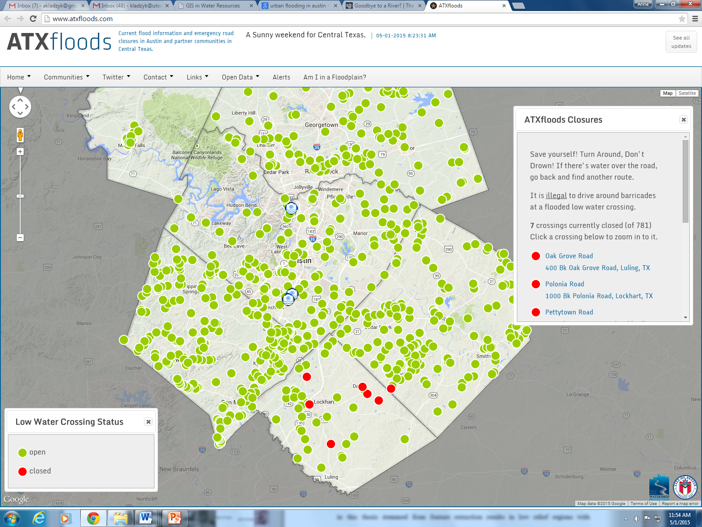
How can the GeoNet feature extraction tool support the NFIE?
→Quick, reliable extraction of potential urban flow paths
1
Image: http://www.atxfloods.com/

Slide 3
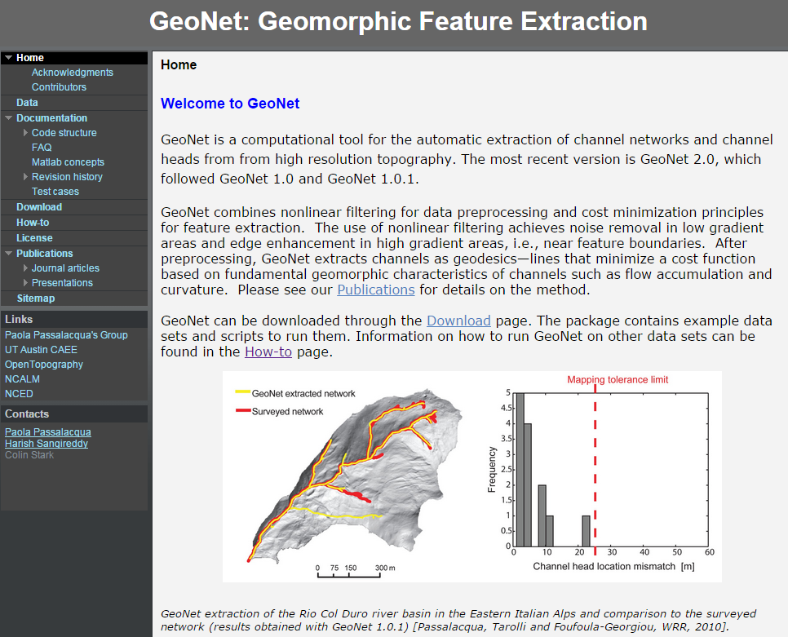
What is GeoNet?
https://sites.google.com/site/geonethome/
An open-source, automatic tool for extracting channel features from high resolution topography data
2

Slide 4
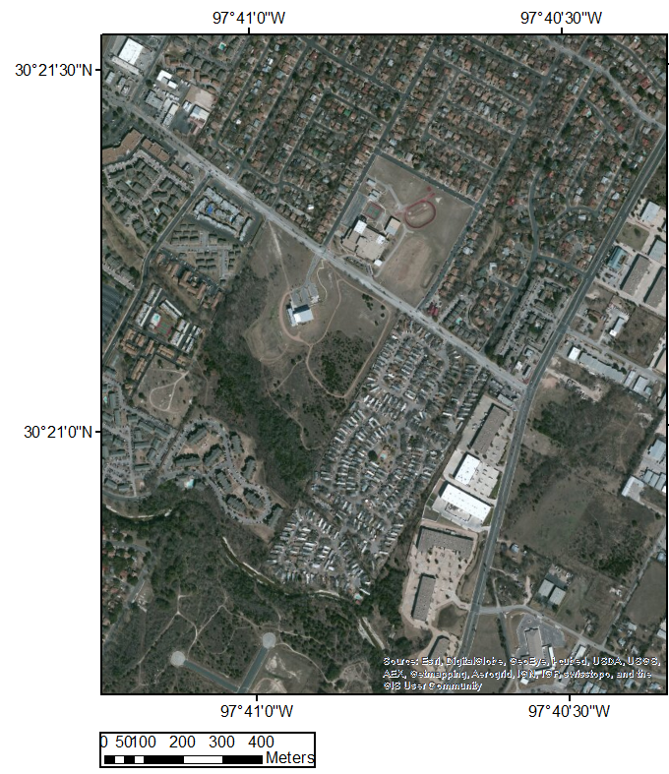
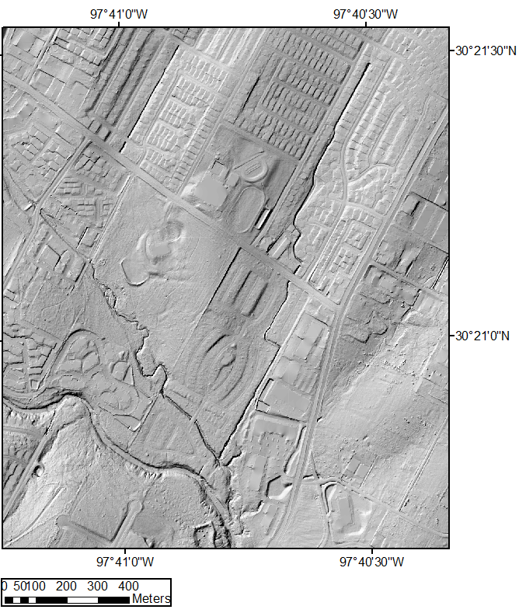
Data & Study Site
3

Slide 5
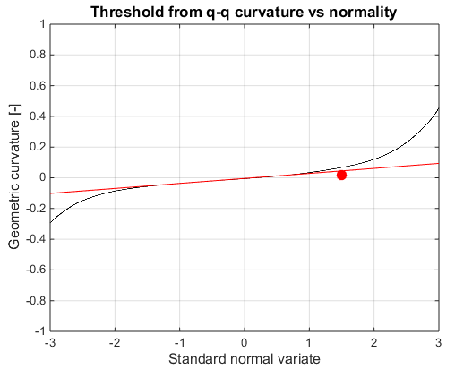
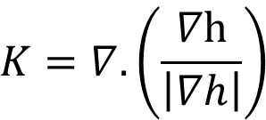

Methods: GeoNet Curvature Options
Laplacian curvature
Channels
$$γ=∇^{2}h$$
Diffusive portion of the landscape
Geometric curvature
$$K=∇.\left(\frac{∇h}{\left|∇h\right|}\right)$$
Ridges
4

Slide 6
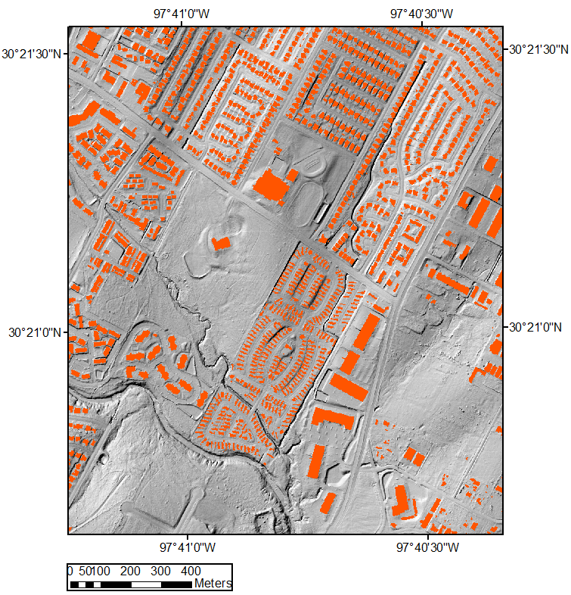
Methods: MatLab-based GeoNet
Building mask used to prevent routing of flow across the buildings
Median filter + Geometric K
5

Slide 7
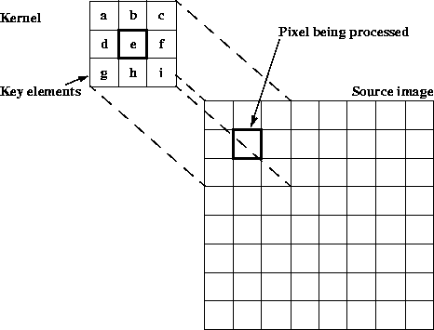
Methods: Low pass median filter
Applied to landscapes with engineered features in MatLab-based GeoNet [Sangireddy et al., in review]
Size of filtering kernel (box) set by user
Suggested size is road width (9-15 m) [Hughes et al., 2004]. I tested:
  16 m
  32 m
  48 m
6
Image: http://www2.hs-fulda.de/caelabor/inhalte/java/j3d/j3d_seminar/19/JAI%20Guide%20von%20Sun/Image-enhance.doc.anc5.gif

Slide 8
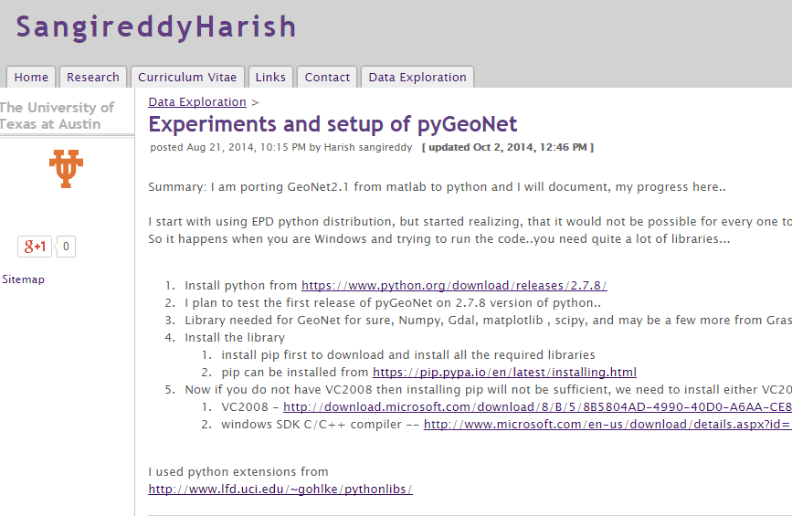
Methods: Python-based GeoNet
https://sites.google.com/site/sangireddyharish/data-exploration/experimentsandsetupofpygeonet
No building mask
Laplacian K
Geometric K
7

Slide 9
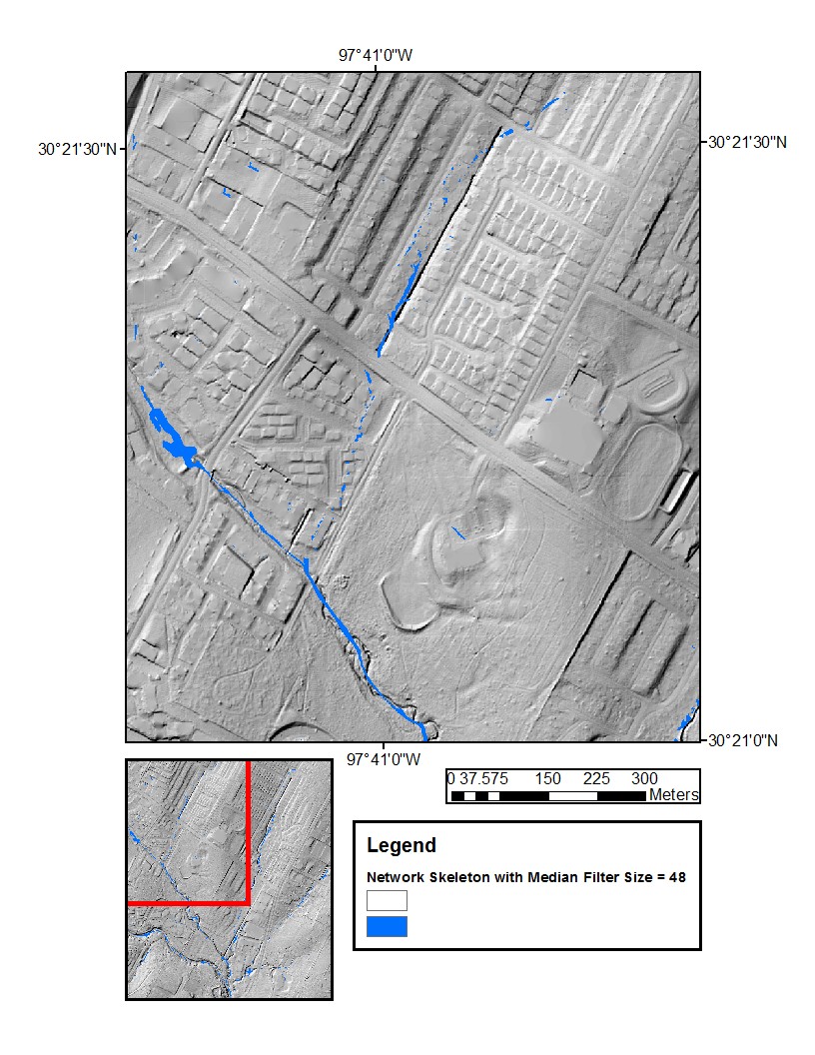
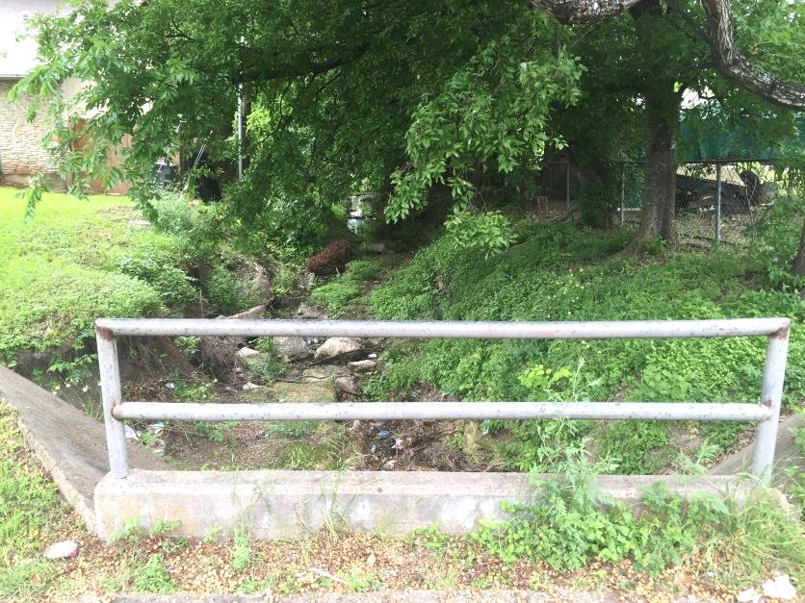
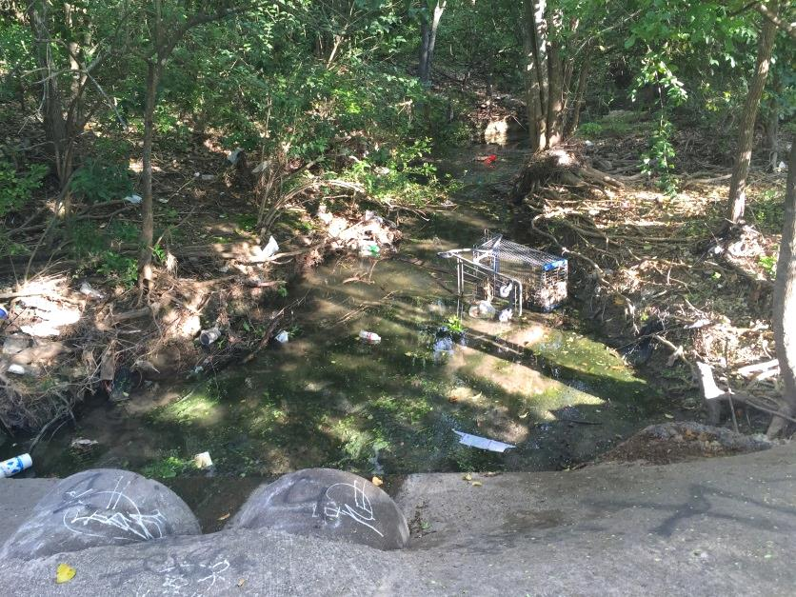
Field Work: Two Sites
a
a
b
b
8

Slide 10
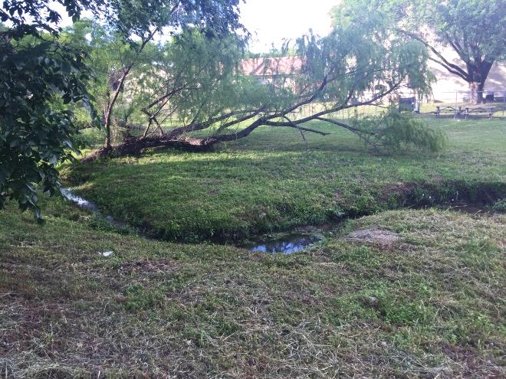
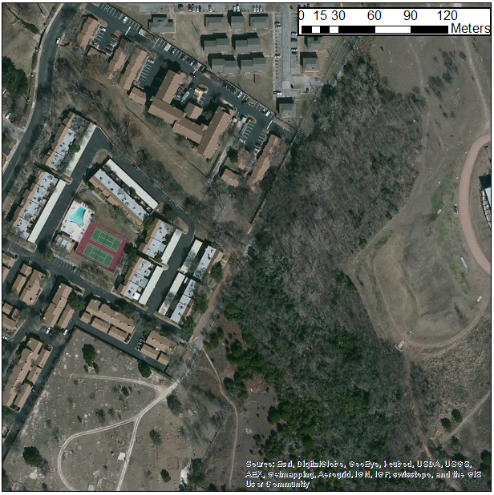
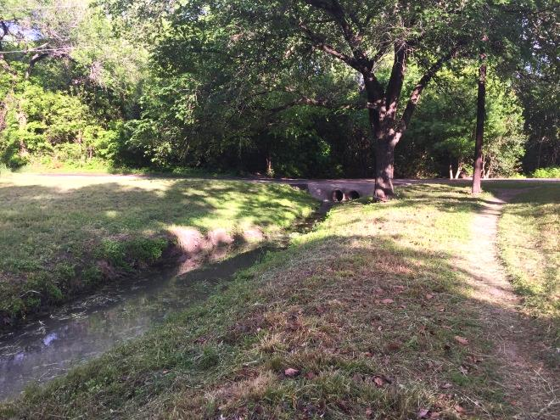
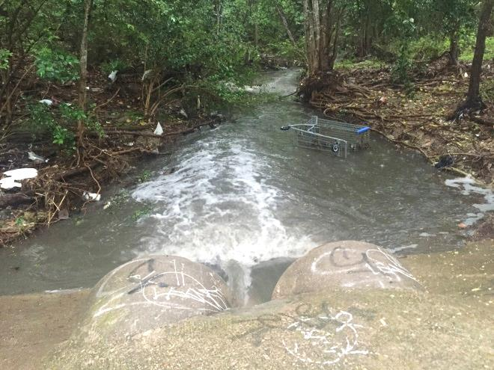
Site B
9

Slide 11
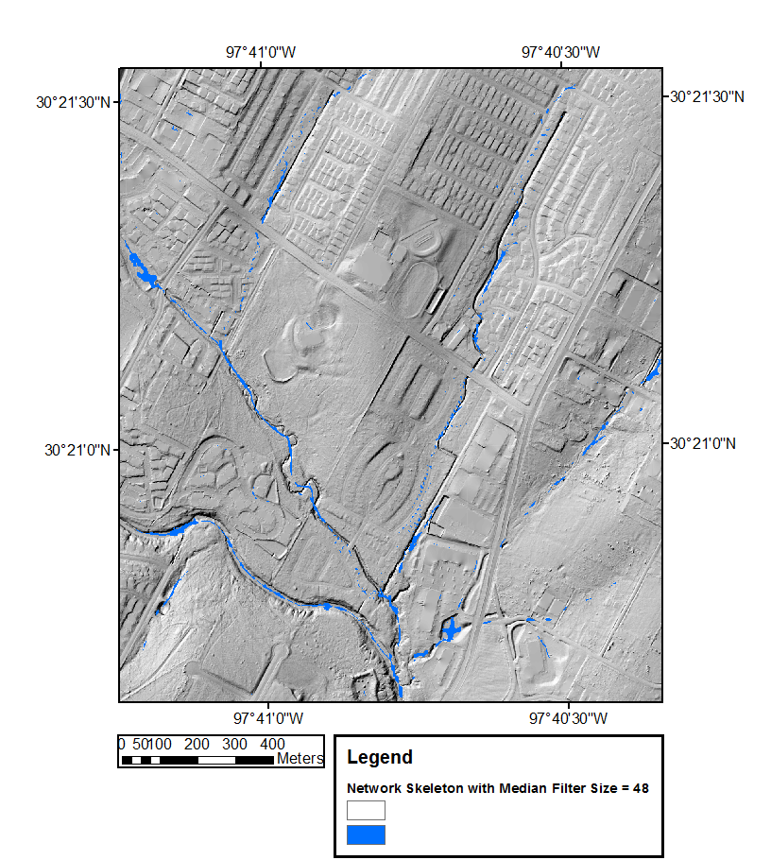
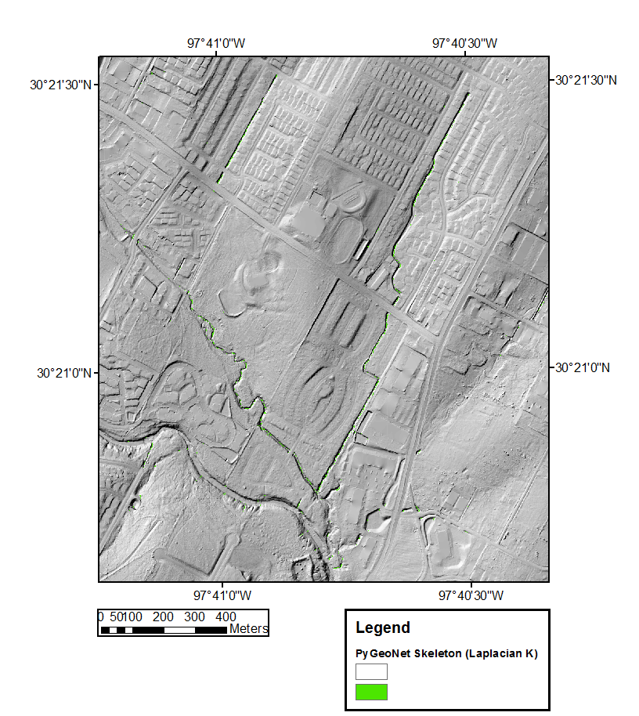
Results (best of): 1 m resolution DEMs
MatLab-based GeoNet
Python-based GeoNet
10

Slide 12
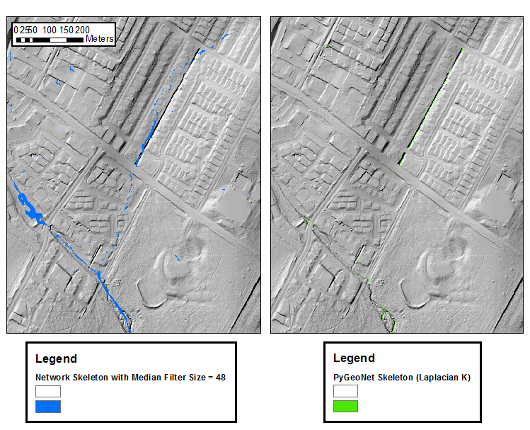
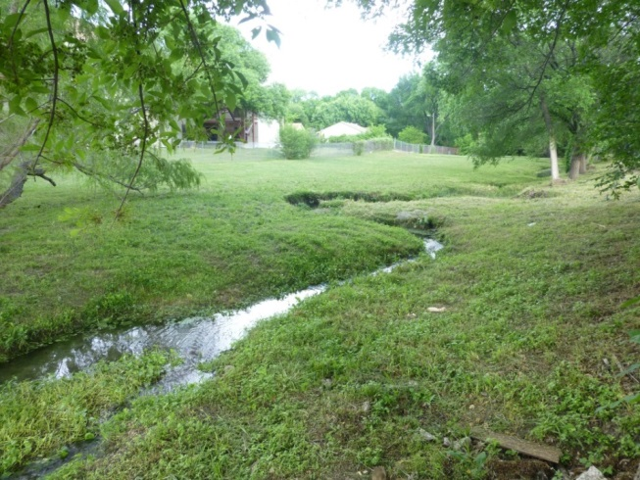
Results: Detailed view of sites A and B
a
a
Median filter+Geometric K preserves natural channel features
Laplacian K preserves engineered channel features
b
b
11

Slide 13
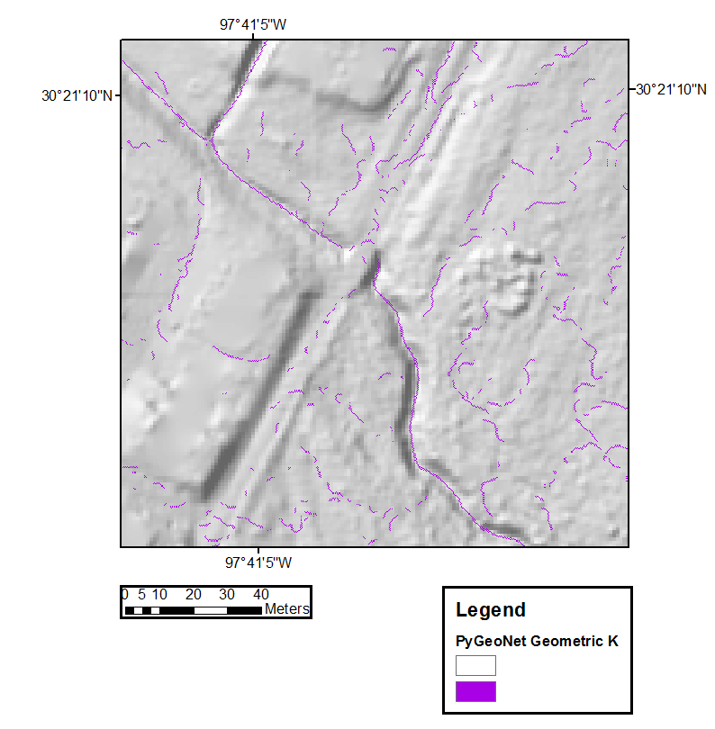
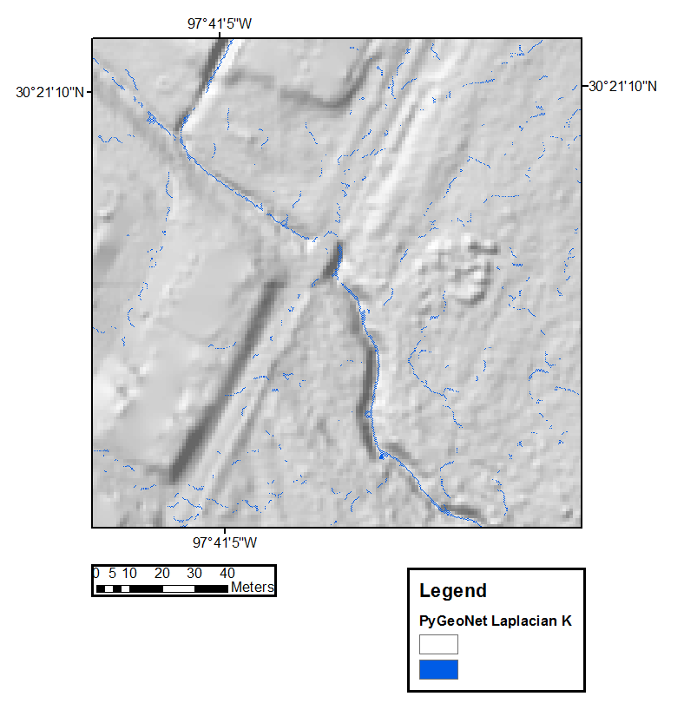
PyGeoNet Results: 0.3 m resolution DEMs
12

Slide 14
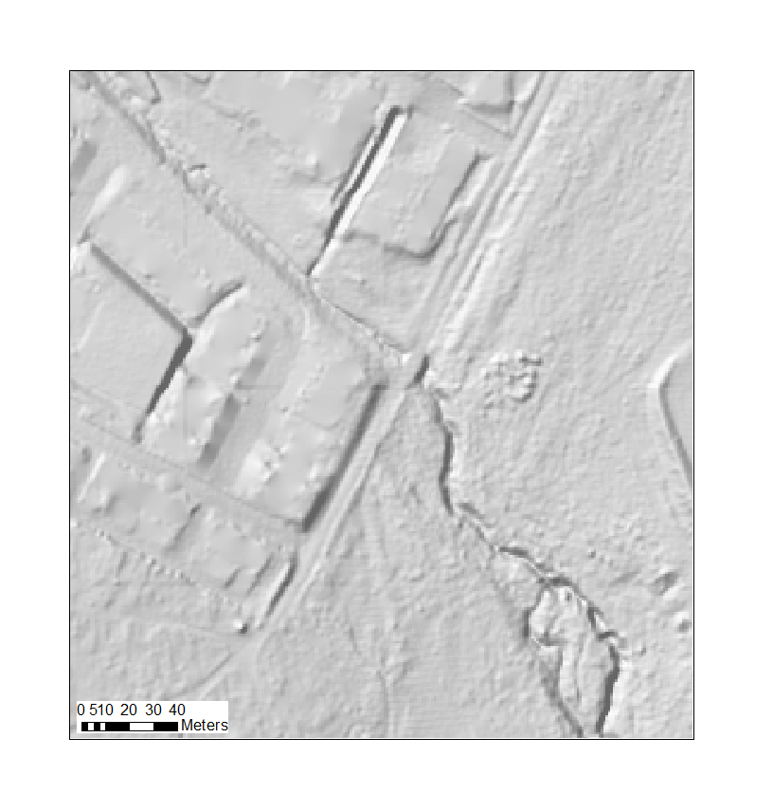
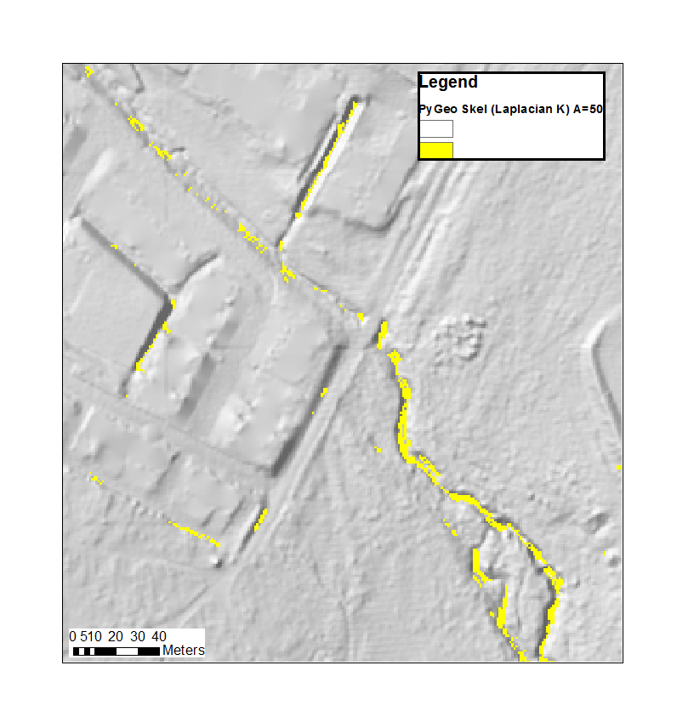
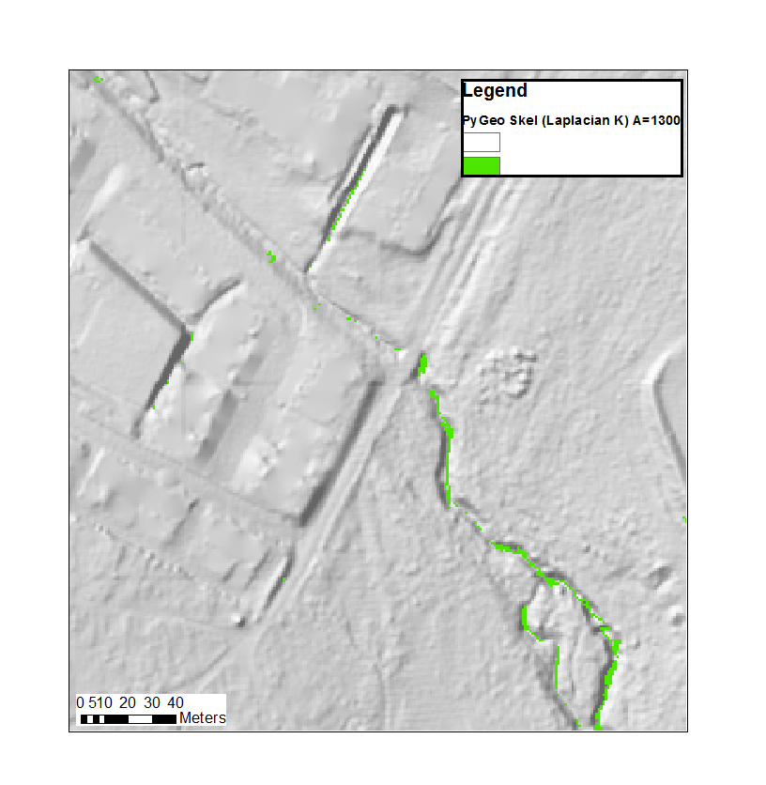
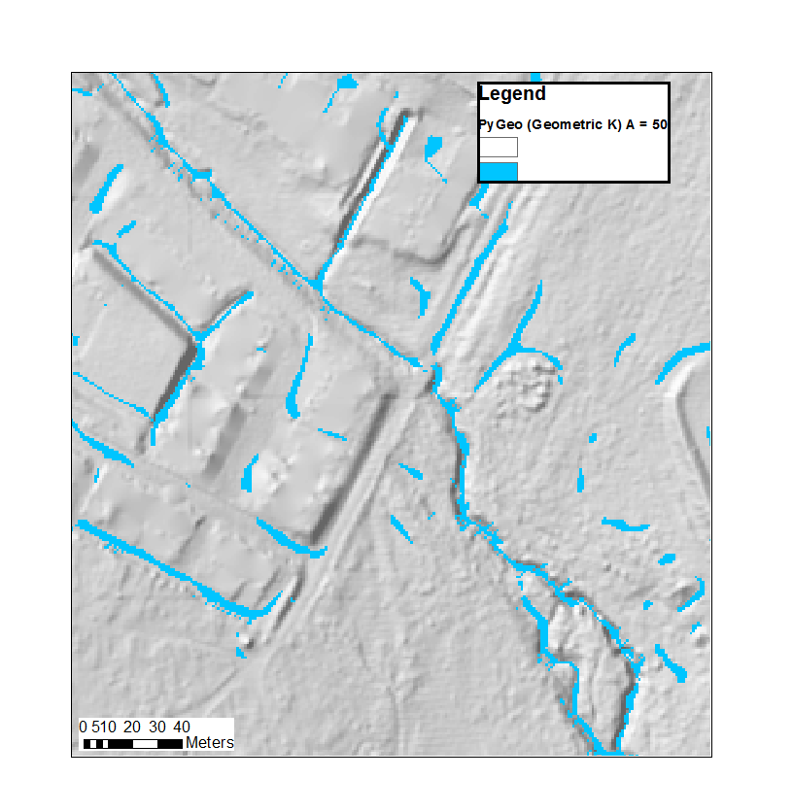
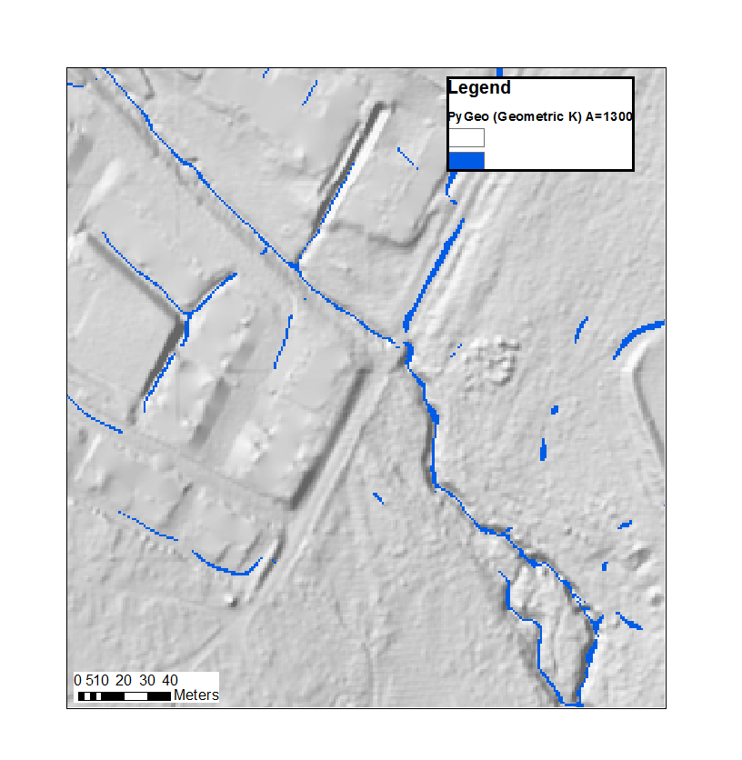
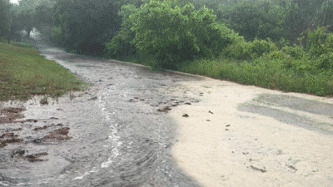
Extracting storm flow paths
13

Slide 15
Discussion & Conclusions
Road width x 3 worked best for median filter kernel size
Geometric K more successfully extracts natural flow paths, whereas Laplacian K more successfully extracts engineered flow paths
Utilization of 0.3 resolution data in GeoNet needs further work
Assigning a low flow accumulation area threshold may help extract ephemeral storm flow paths
14

Slide 16
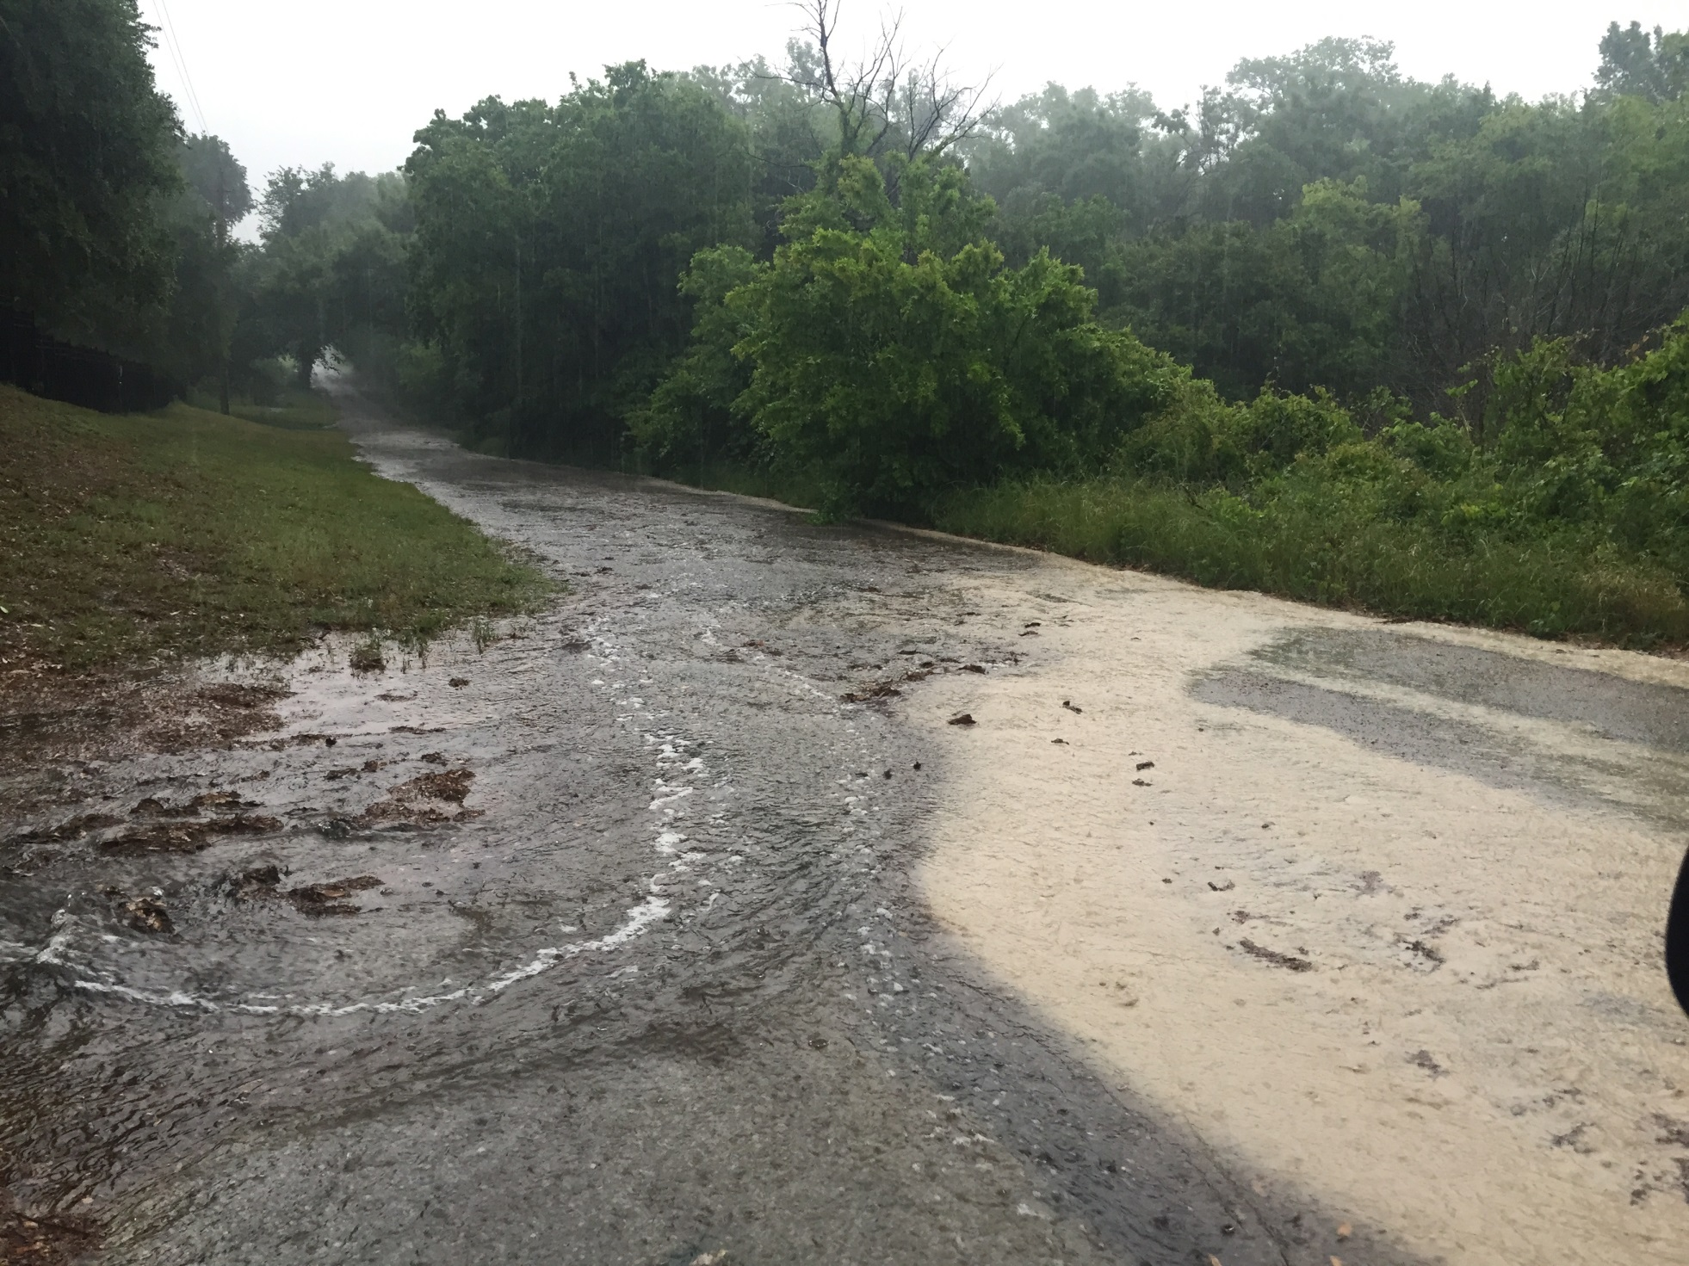
Thanks!
Questions?

