Slide 1

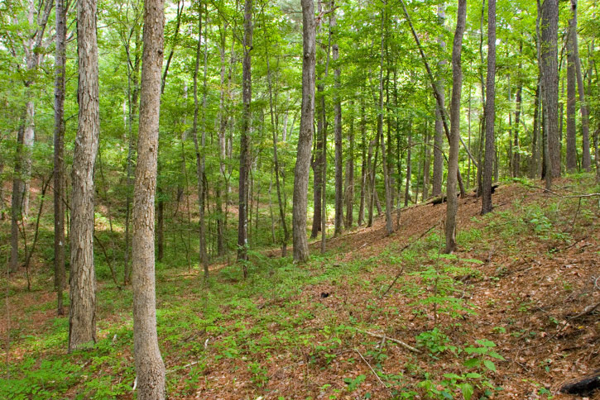


Quantifying the effect of land use on flood severity
Alicia Sendrowski
May 4, 2015
Alicia Sendrowski

Slide 2
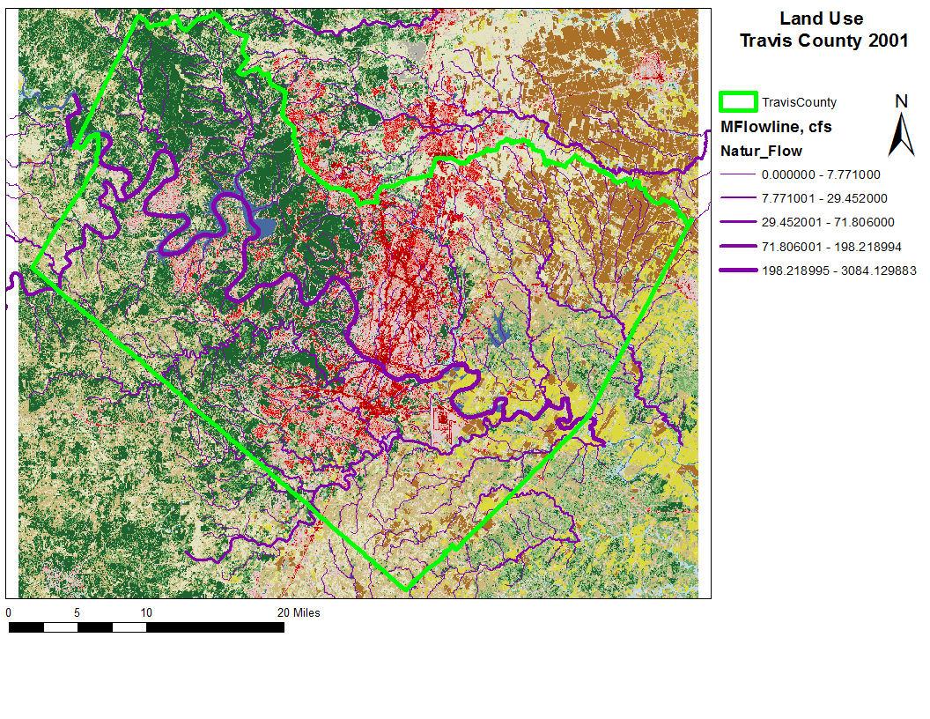
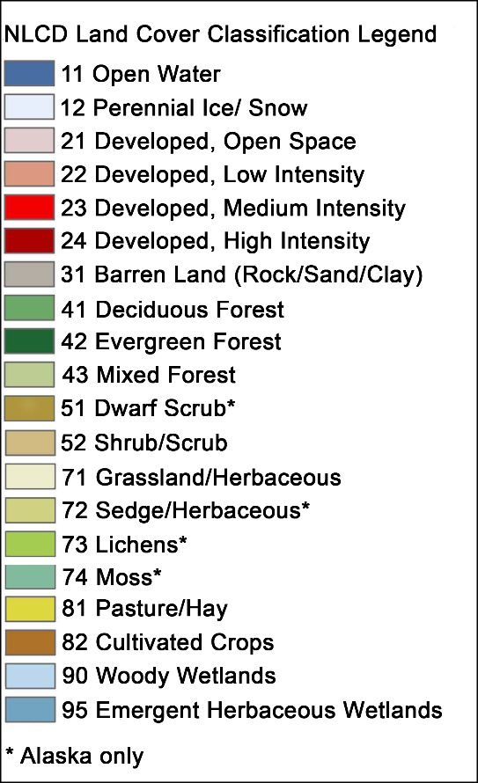

Slide 3
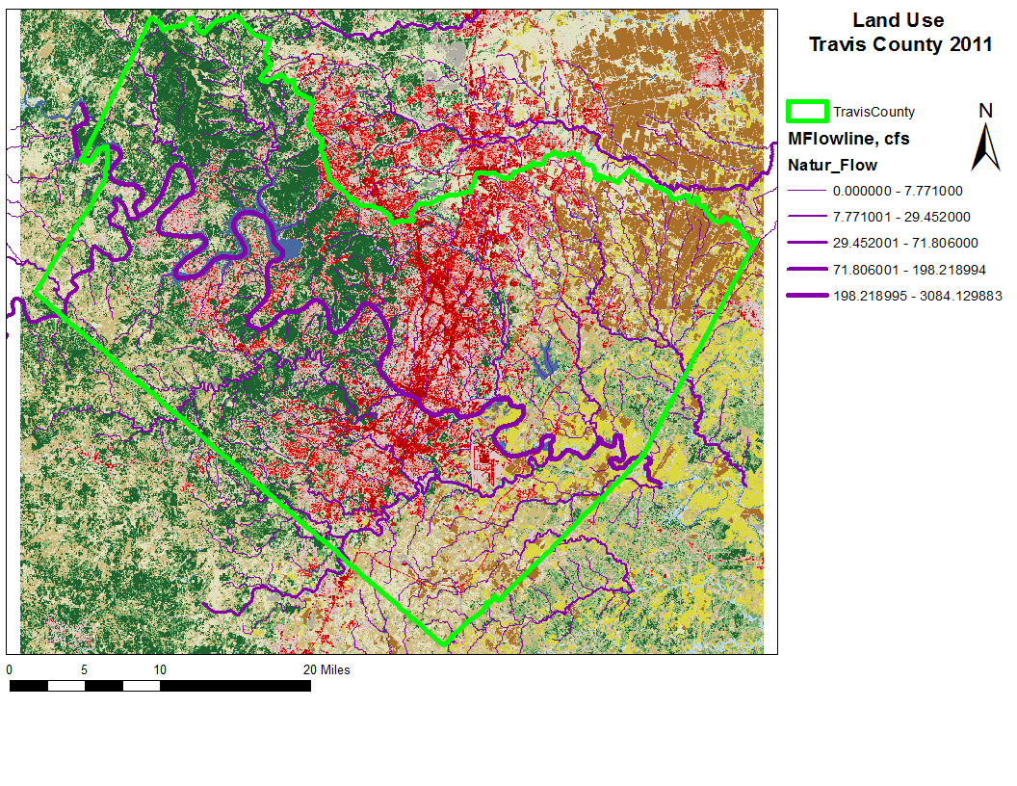

Slide 4
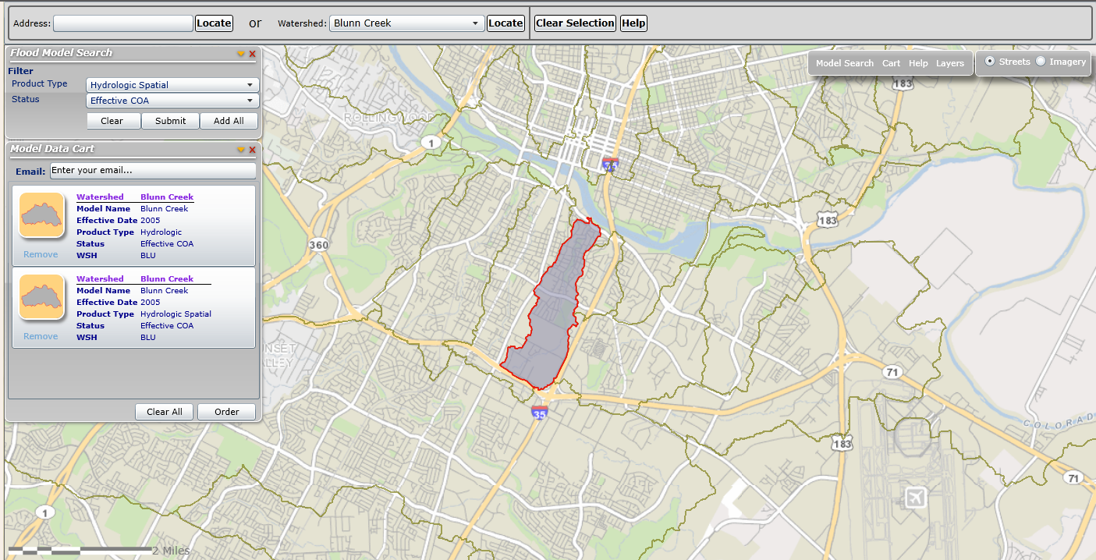
City of Austin Flood Modeling
Developed HEC-HMS Model for watersheds in Travis County

Slide 5
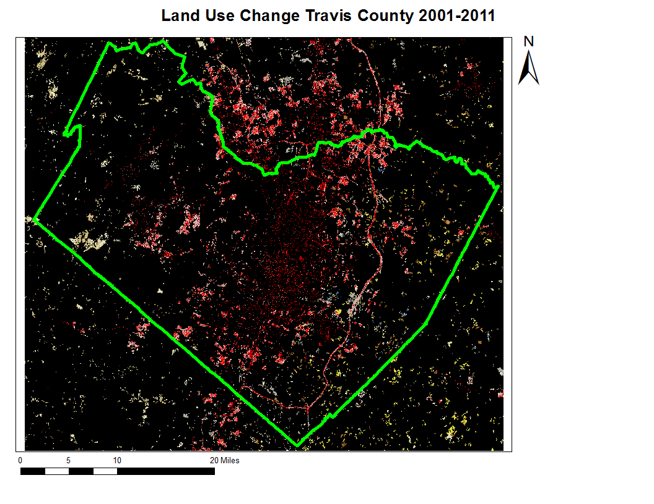

Slide 6
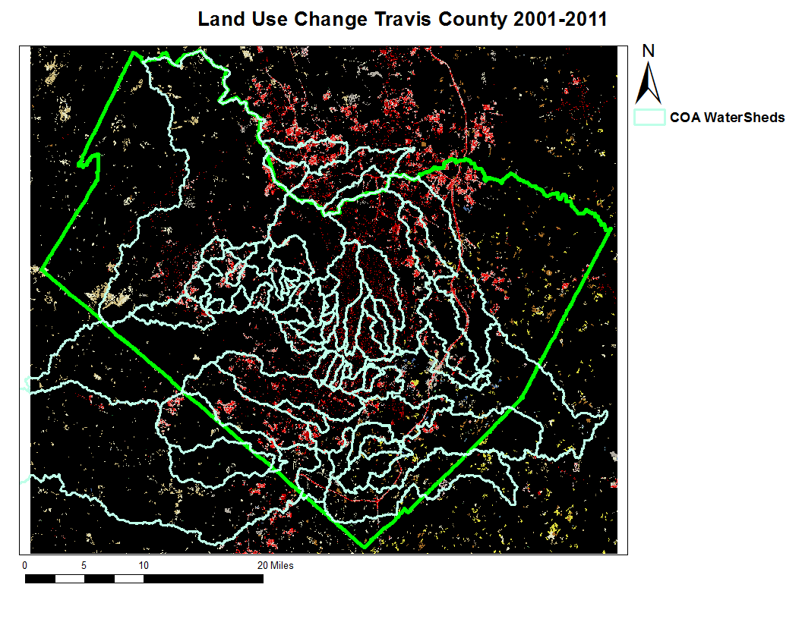

Slide 7
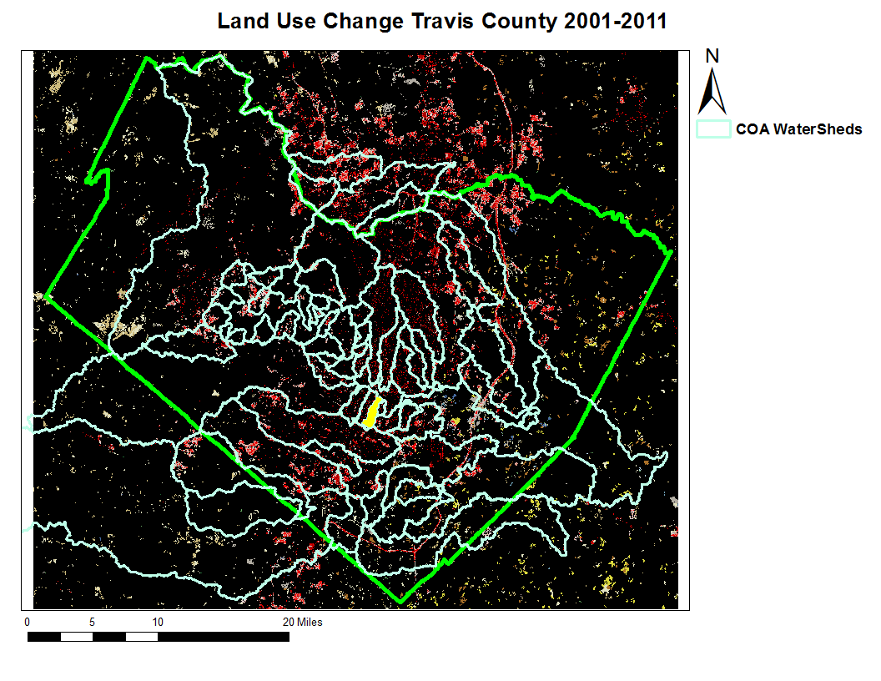
Blunn Creek Watershed

Slide 8
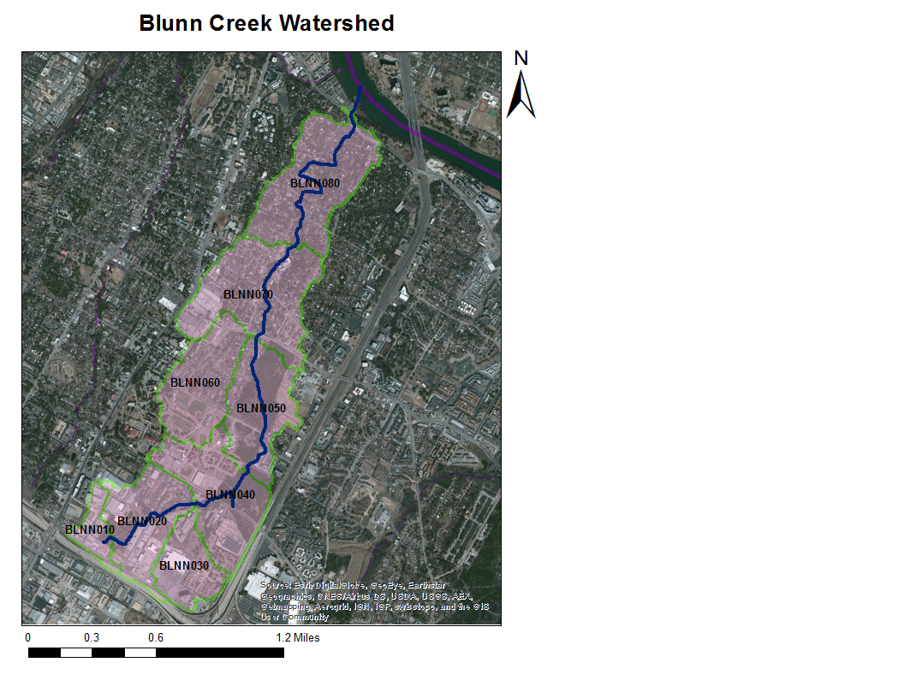
Subbasin | Area, Sqr Miles
80 | 0.23
70 | 0.238
40 | 0.186
30 | 0.095
60 | 0.156
50 | 0.158
20 | 0.152
10 | 0.043
Total | 1.258
“Take a hike along Blunn Creek to open the door of your imagination to a prehistoric Austin when active volcanoes dotted the landscape and gigantic sea creatures inhabited a shallow ocean environment.”
-COA Creek Information

Slide 9
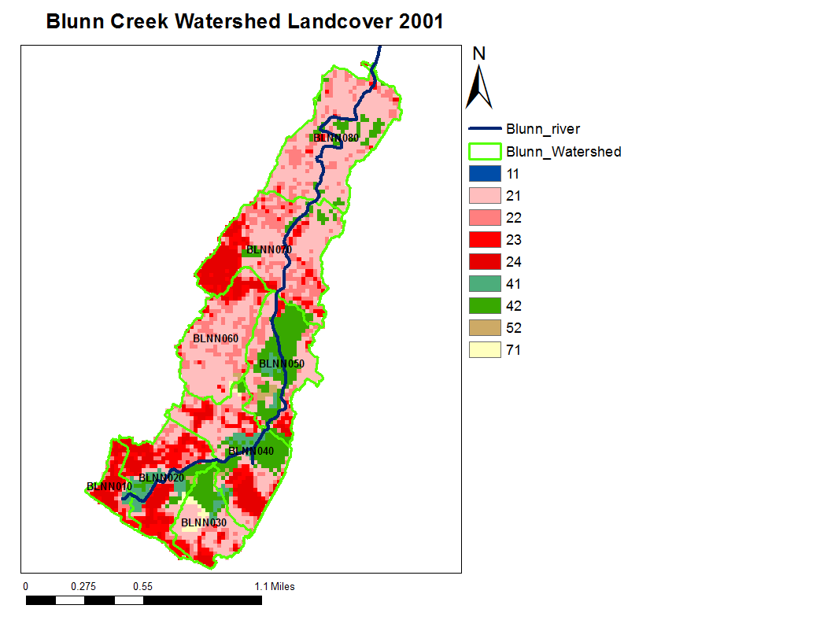
Open Water
Developed, Open Space
Developed, Low Intensity
Developed, Medium Intensity
Developed, High Intensity
Deciduous Forest
Evergreen Forest
Shrub/Scrub
Grassland/Herbaceous
Subbasin | %Impervious
80 | 21.2%
70 | 54.8%
60 | 41.3%
50 | 21.5%
40 | 39.0%
30 | 26.9%
20 | 61.6%
10 | 87.7%
Total | 41%

Slide 10
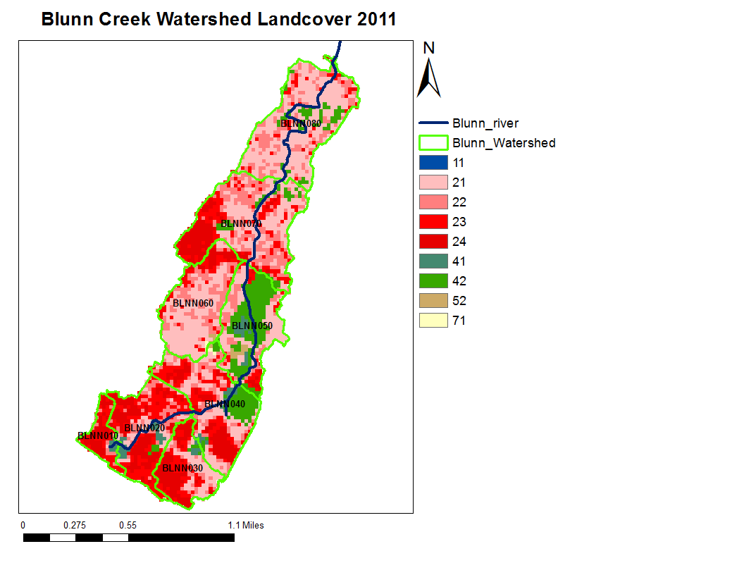
Open Water
Developed, Open Space
Developed, Low Intensity
Developed, Medium Intensity
Developed, High Intensity
Deciduous Forest
Evergreen Forest
Shrub/Scrub
Grassland/Herbaceous
Subbasin | %Impervious
80 | 30.0%
70 | 61.7%
60 | 47.1%
50 | 23.2%
40 | 55.5%
30 | 71.6%
20 | 81.9%
10 | 91.2%
Total | 56%

Slide 11
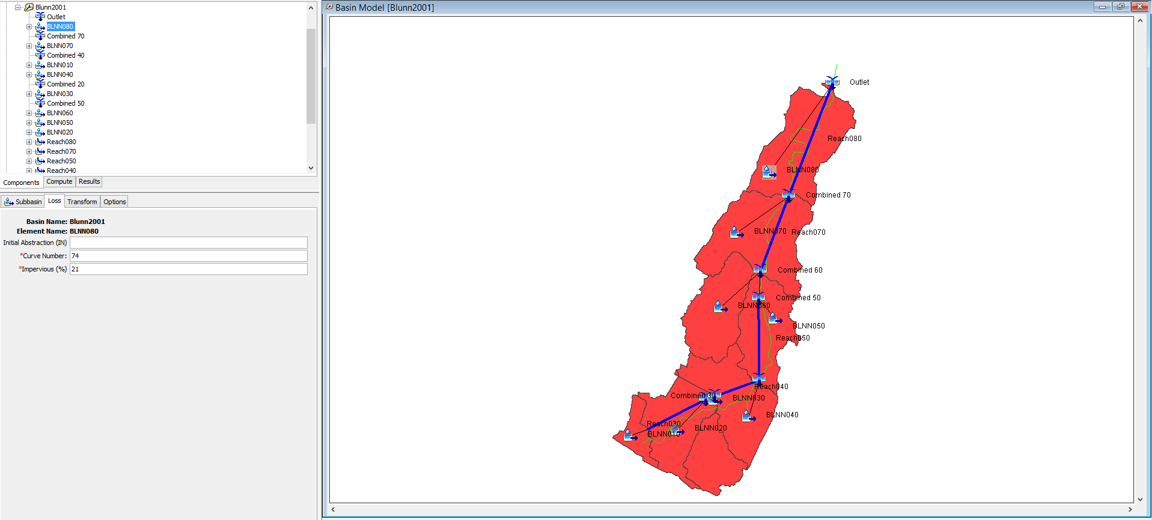
Run HEC-HMS for 2001 and 2011 on Blunn Creek
Use %impervious cover as inputs
Look at outflow from two different storm events
-10 Year Storm
-100 Year Storm
Use the SCS Method for storm design

Slide 12
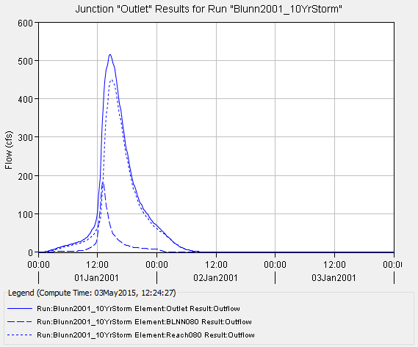
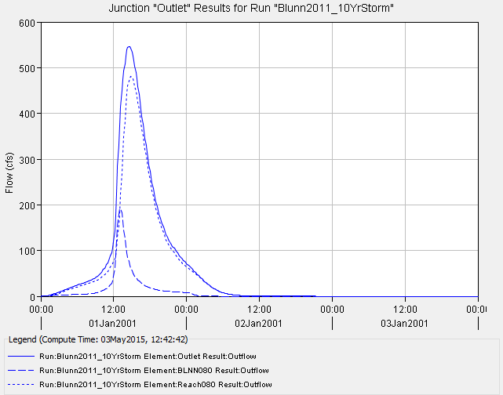
Results: 10 Year Storm, Precipitation = 6.1 Inches
2001, 41% Impervious
2011, 56% Impervious
Peak Discharge: 515.9 cfs
Peak Discharge: 545.8 cfs
5.75% Increase

Slide 13
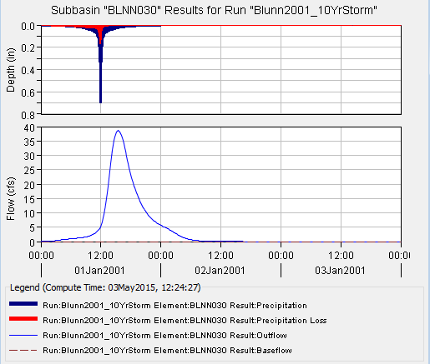
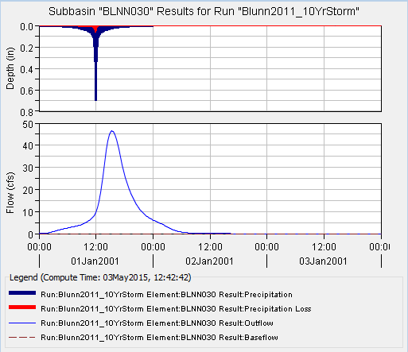
Results for Blunn Creek Subbasin 30, 10 Yr Storm
2001, 27% Impervious Cover
2011, 71% Impervious Cover
Peak Discharge: 38.6 cfs
Peak Discharge: 46.4 cfs
20.2% Increase

Slide 14
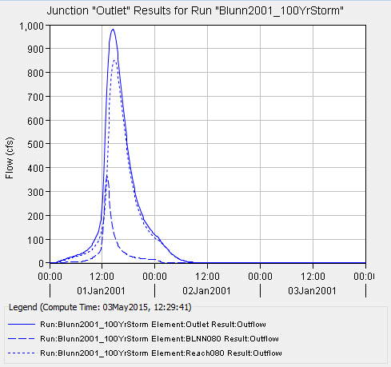
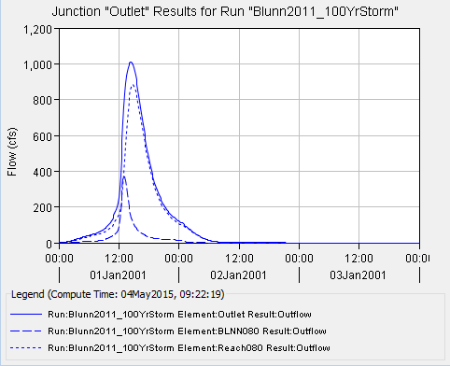
Results: 100 Year Storm, Precipitation = 10.2 Inches
2001, 41% Impervious
2011, 56% Impervious
Peak Discharge: 979.9 cfs
Peak Discharge: 1011.8 cfs
3.26% Increase

Slide 15
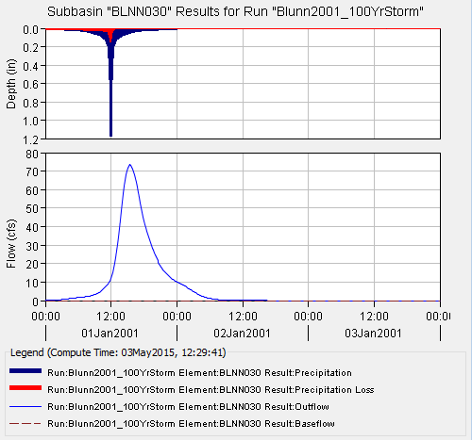
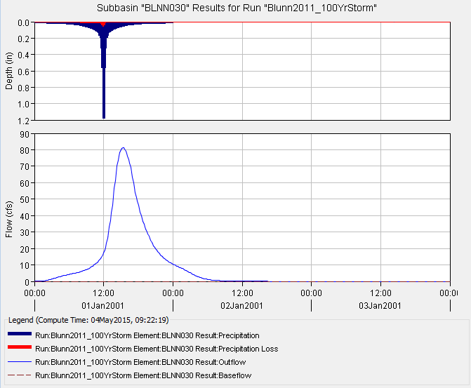
Results for Blunn Creek Subbasin 30, 100Yr Storm
2001, 27% Impervious Cover
2011, 71% Impervious Cover
Peak Discharge: 73.6 cfs
Peak Discharge: 81.1 cfs
10.2% Increase

Slide 16
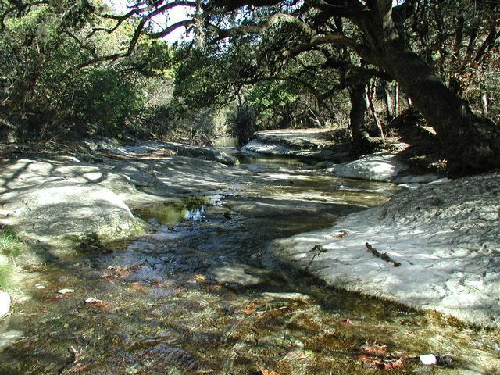
Conclusions
Increase in impervious surface leads to quantified increase in outflow discharge
Combined for all watersheds across Travis County would likely increase outflow values
Need to correct for new curve number and lag time for more accurate results

