Slide 1
NFIE-Response in
Travis County, TX
Presented by, Cassandra Fagan
May 6, 2015

Slide 2
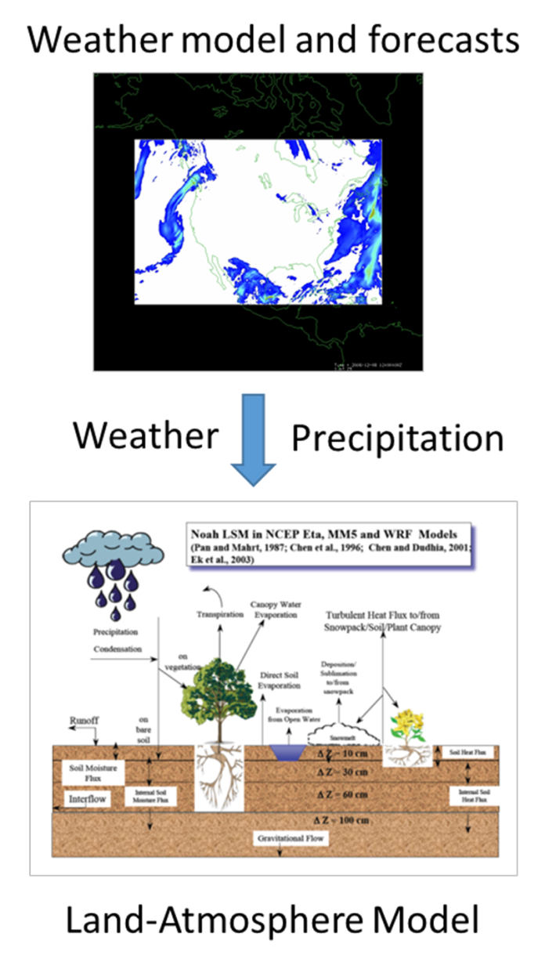
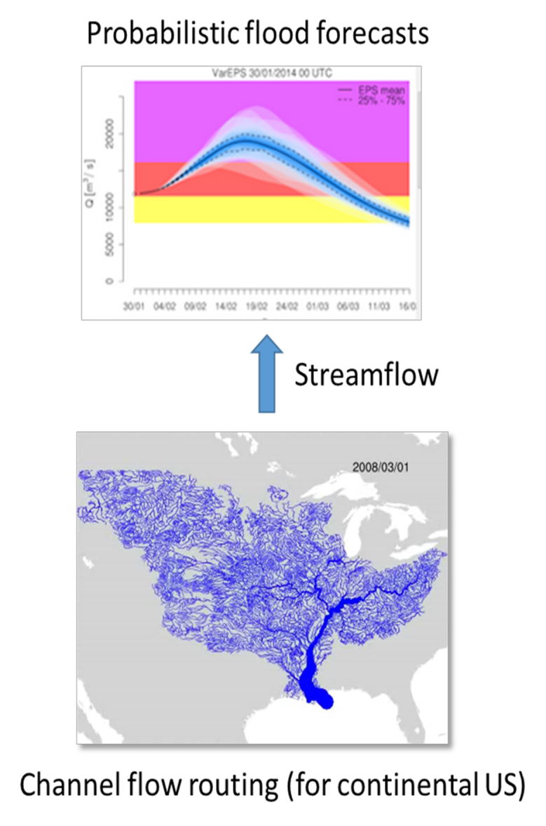
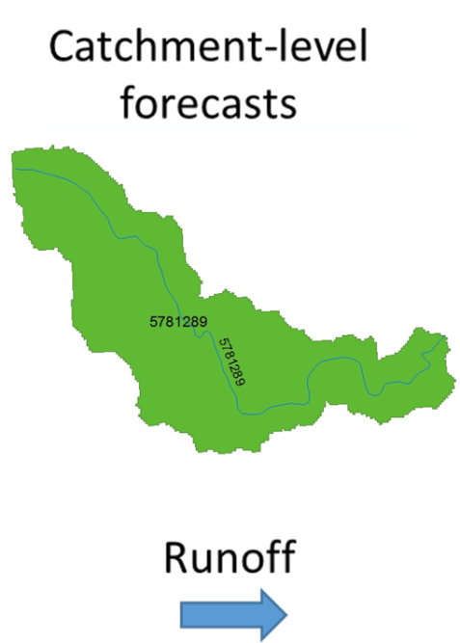
NFIE Components:
Notes:
As we learned in class the NFIE uses forcing's from the atmospheric model HRR (High Resolution Rapid Refresh weather model describing the atmospheric circulation) to input into the WRF-Hydro land-surface model to converts precipitation to runoff on the land surface and Rapid to route flows through NHD Plus streams at the continental scale for the entire United States.

Slide 3
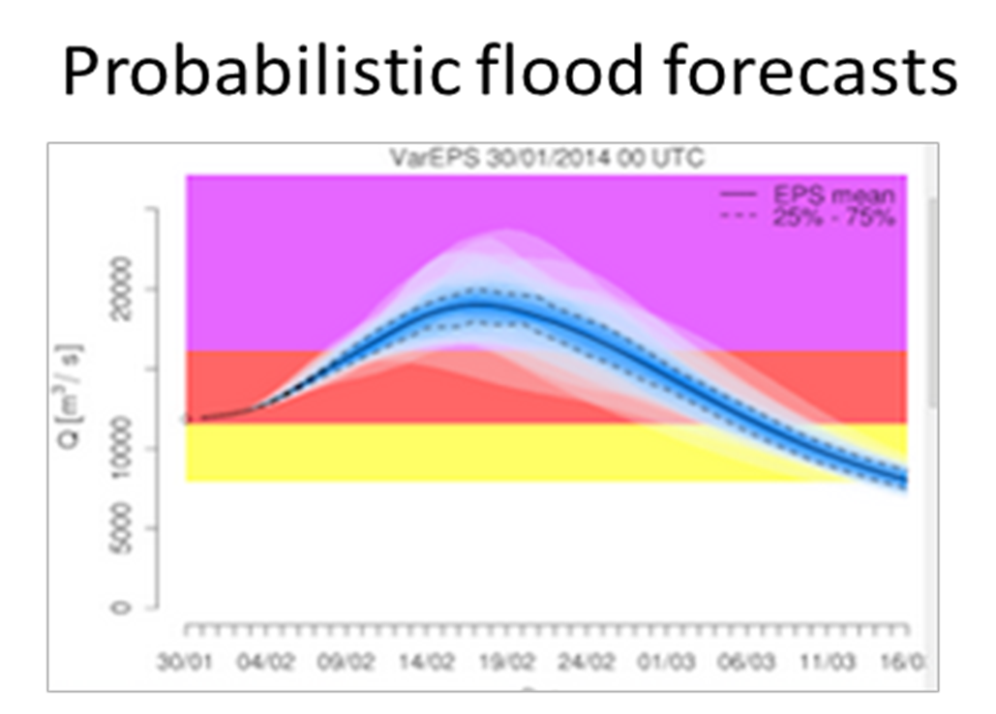
Connecting NFIE Flood Forecasts to Roadway Flooding
Rating Curve at Low Water Crossing
Notes:
My research explored connecting NFIE flood forecasts to roadway flooding conditions rating curves at low water crossings. Given a flow from the flood forecast on an NHD Plus reach and a rating curve for a culvert on that reach, the headwater elevation at the low water crossing can be interpreted. Where headwater is the height above the center of the culvert, if the distance from the roadway to the center of the culvert is known flooding on a low water crossing can be predicted. As long as HW elevations are geodetic elevations.

Slide 4
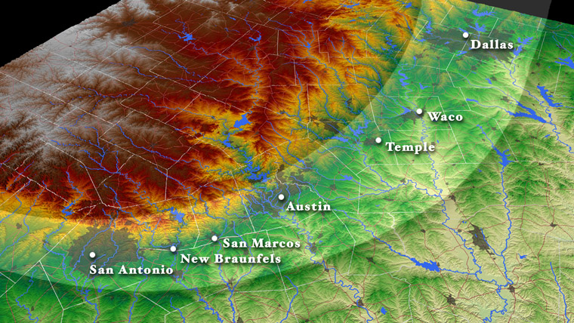
Flash Flood Alley
Notes:
Travis County is located in an area in Texas nicknamed “Flash Flood Alley”. NOOA an event is considered a flash floods if flooding occurs within 6-hours of the originating event ie. Damn break, precipitation event, storage failure. Texas leads the Nation in flood related deaths and this is mainly due to the high frequency of flash floods that the state experiences. he Austin Watershed Department reported that since 1960, there have been 60 deaths from flash floods in Travis County with75% of these fatalities occurring in vehicles. “Turn around don’t drown” campaign reminding drivers not to drive through flooded roadways, and in particular low water crossings. The transportation sector and the NFIE-Response are connected in this way – flood prone infrastructure connected to NFIE

Slide 5
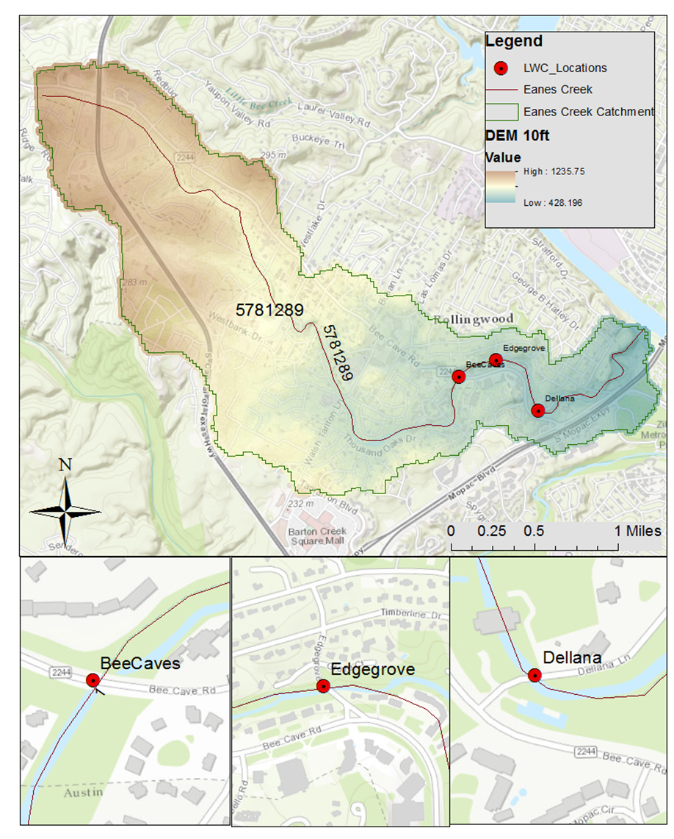
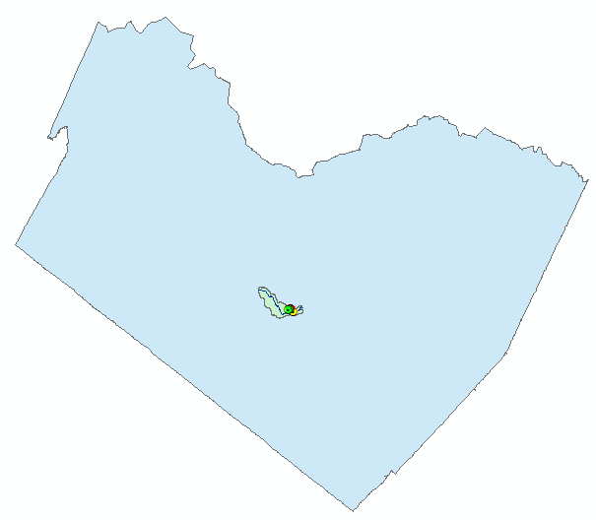
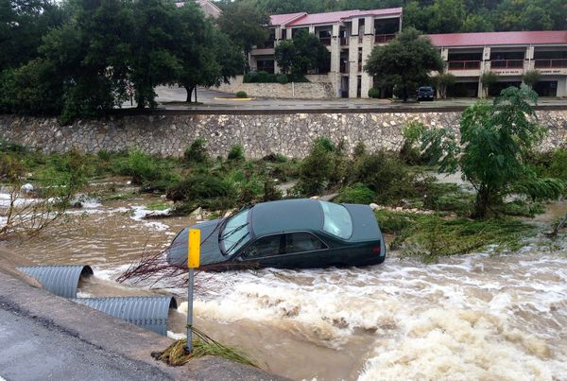
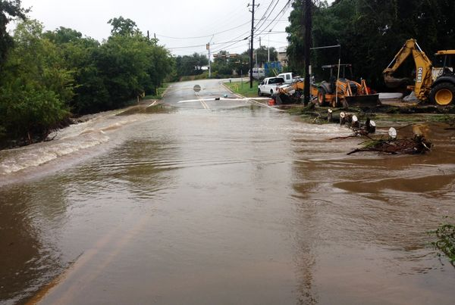
Rollingwood, TX Low Water Crossings
Travis County
Notes:
Three low water crossing along Eanes Creek, COMID 5781289 in the NHDPlus Dataset, were selected for this case study. Eanes Creek, nicknamed “Dry Creek” because water is rarely flowing, is prone to flash flooding.

Slide 6
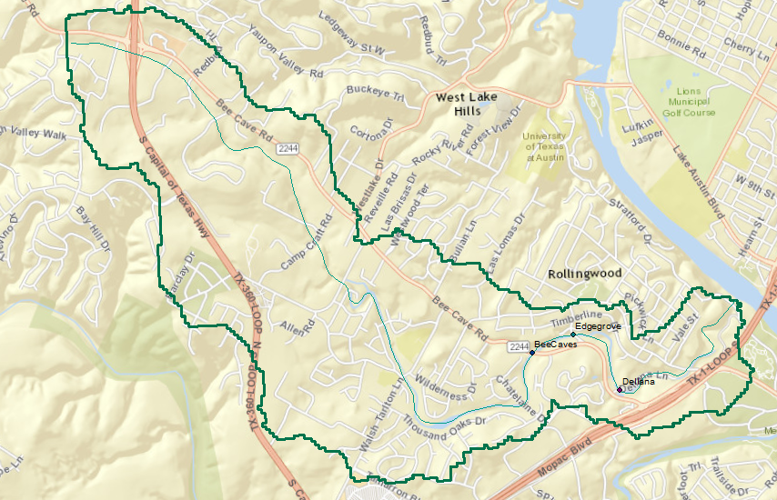
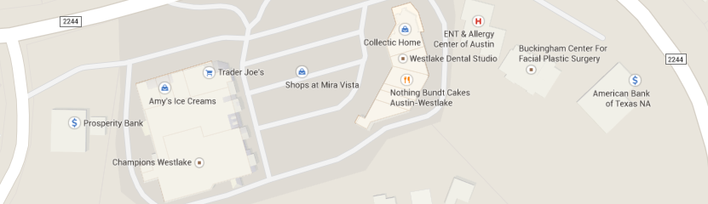
Importance of these roadways
New Development on Bee Caves Road
Notes:
These roadways are important pieces of the transportation network
Bee Caves Road FM (Farm to Market road) 2244
Edgrove Drive

Slide 7
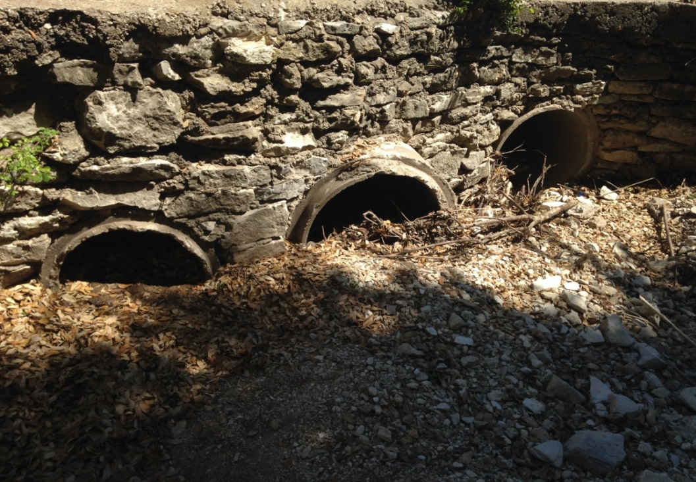
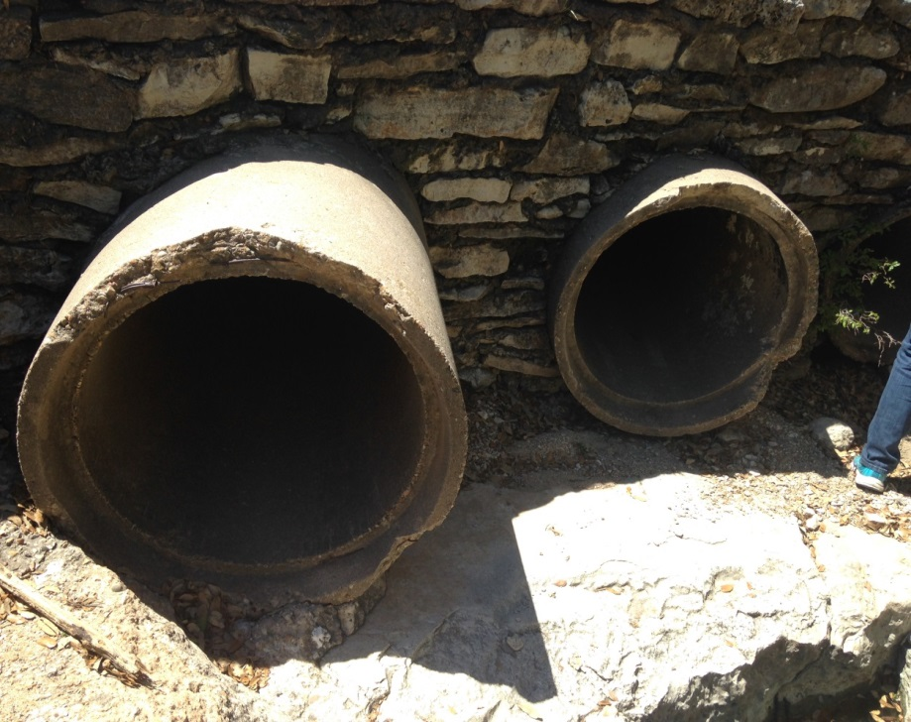
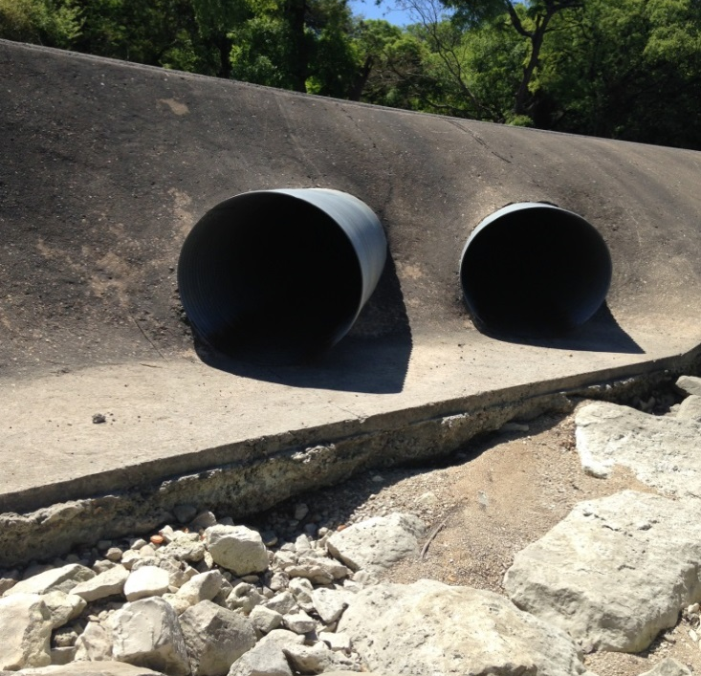
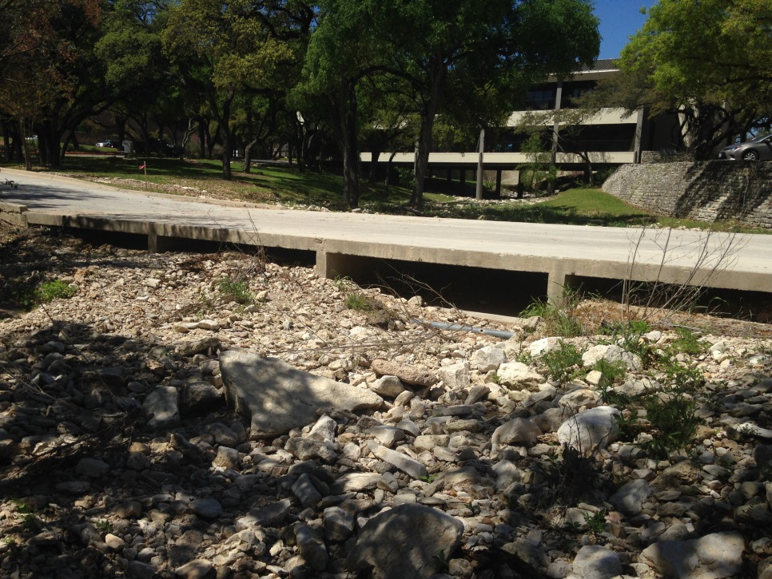
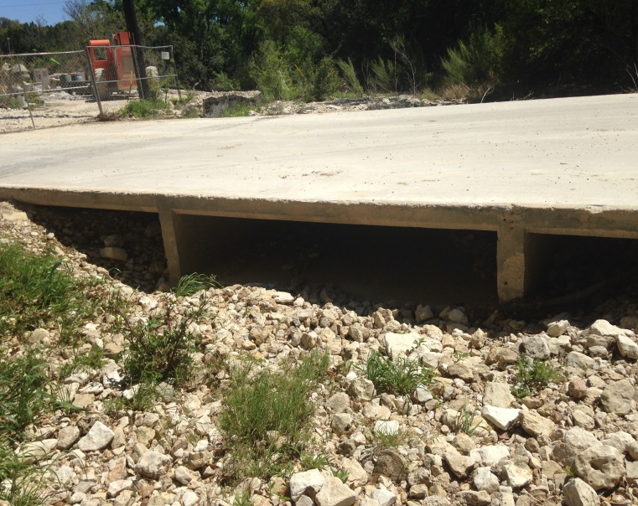
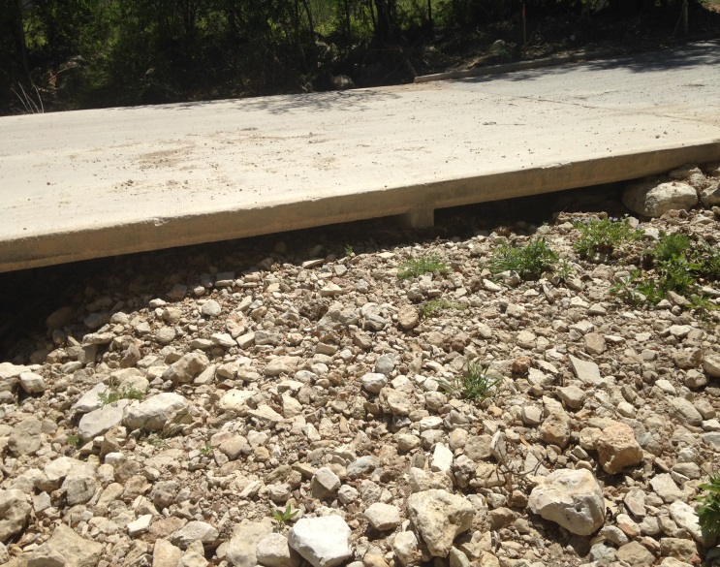
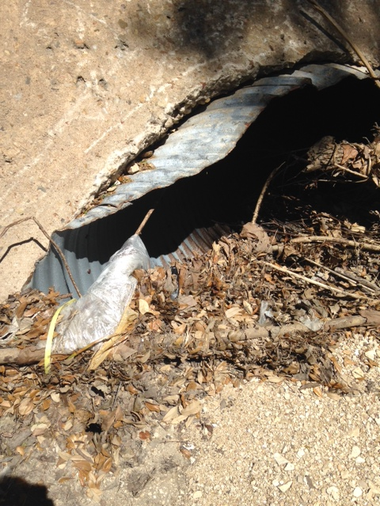
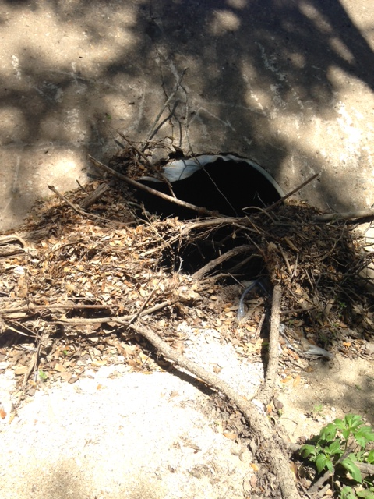
Survey:
Culverts were in poor condition and in need of maintenance
Inlet versus Outlet Conditions
Eanes Creek at Bee Caves Road Low Water Crossing
Eanes Creek at Edgegrove Drive Low Water Crossing
Eanes Creek at Dellana Lane Low Water Crossing
Inlets
Outlets
Notes:
Routine maintenance is very important for culvert because debris will accumulate around inlets during storm events. If these are not cleared regularly the culverts will not be able to convey design flow during storm events. The survey found the culverts for this case study in degraded condition.

Slide 8
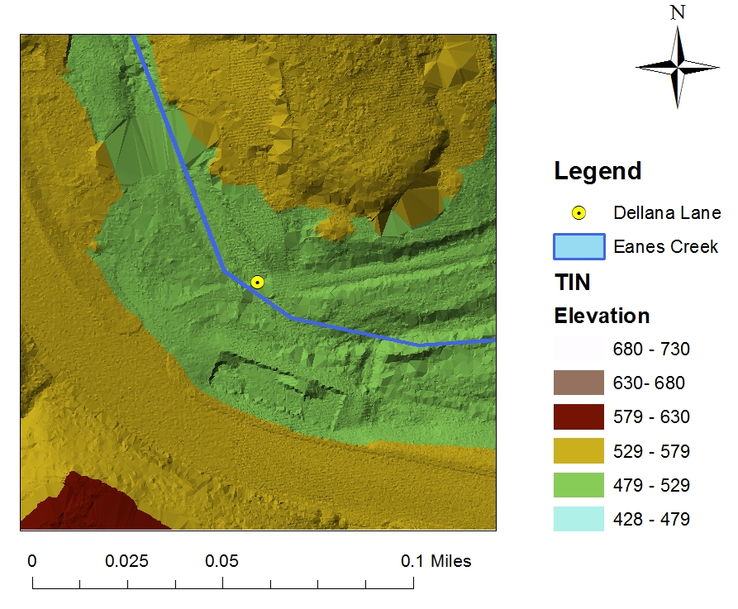
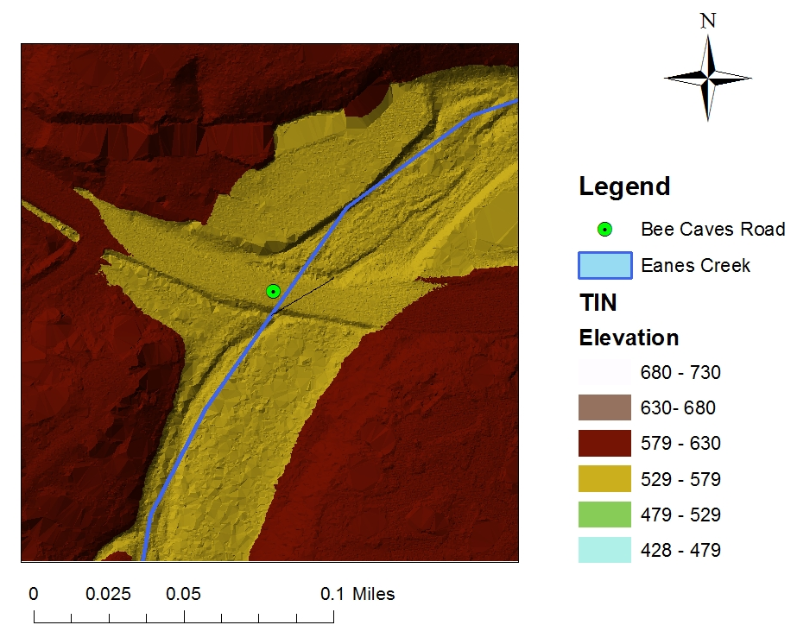
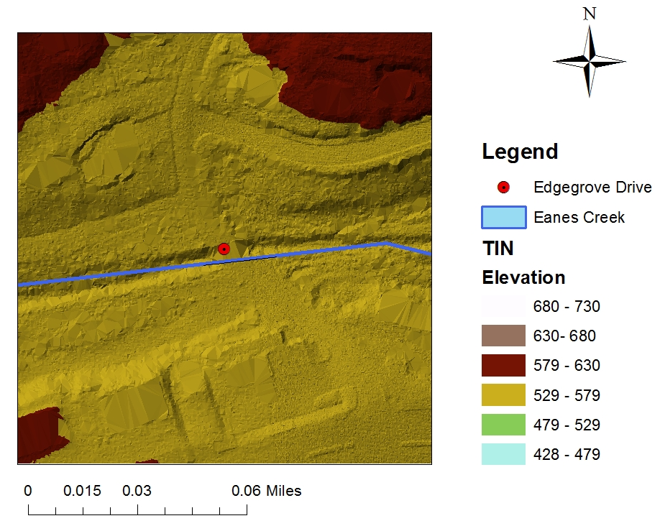
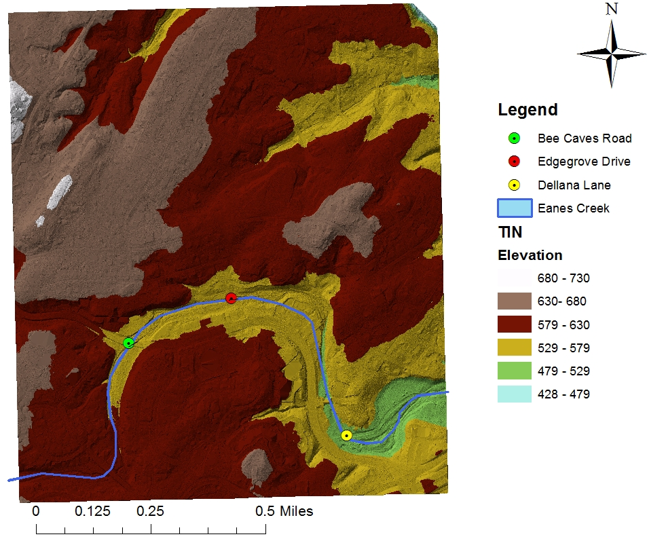
LiDAR Dataset to TIN
Road Type: | 2 Lanes each direction
Road Classification: | Major Arterial
AADT2010 : | 32,144

Slide 9
Two Methods of Generating a Rating Curve in CulvertMaster:
Quick Calculator
Analysis
Maximum headwater elevation is the flooding threshold
Benefit: Fewer data points required
Drawbacks: Constant road elevation assumed
Only one culvert size can be analyzed
Enter station elevations across roadway – flooding threshold
Overtopping of roadway modeled as a broad crested weir
Benefit: Calculates rating curve of road
LWCs with various culvert sizes can be analyzed
Drawback: More data required

Slide 10
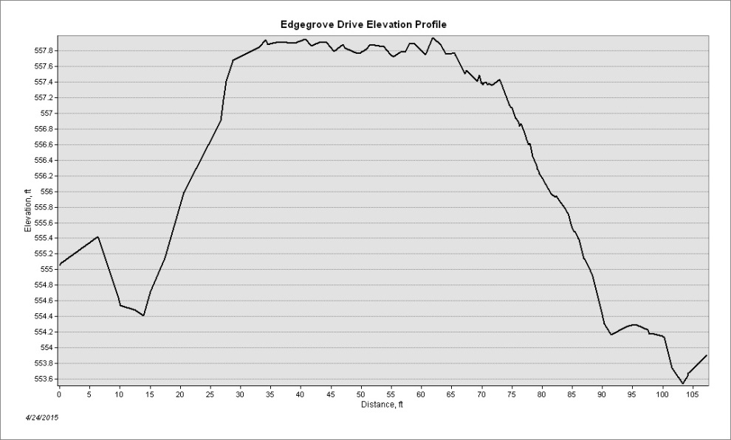
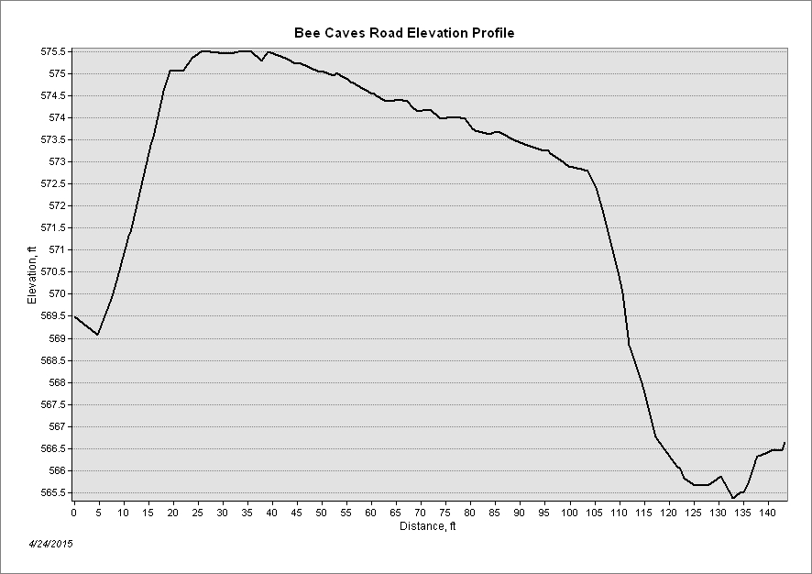
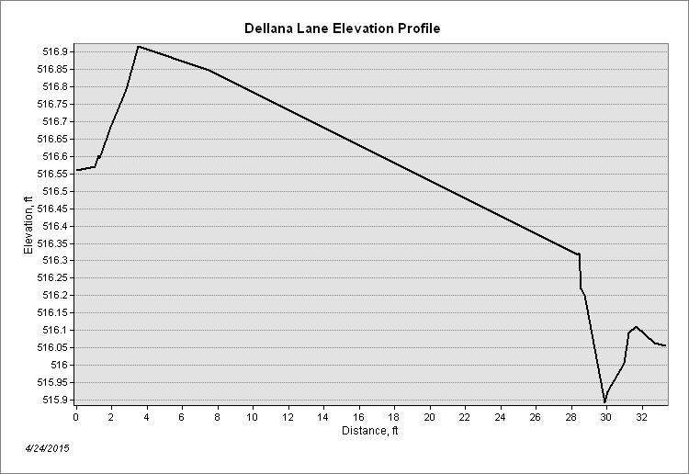
Road Profiles

Slide 11
Eanes Creek Cross Sections

Slide 12
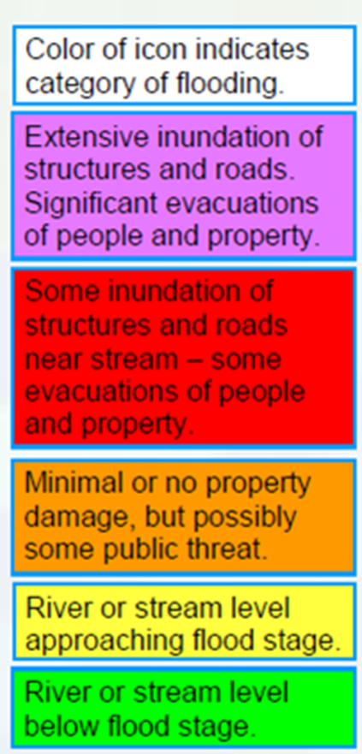
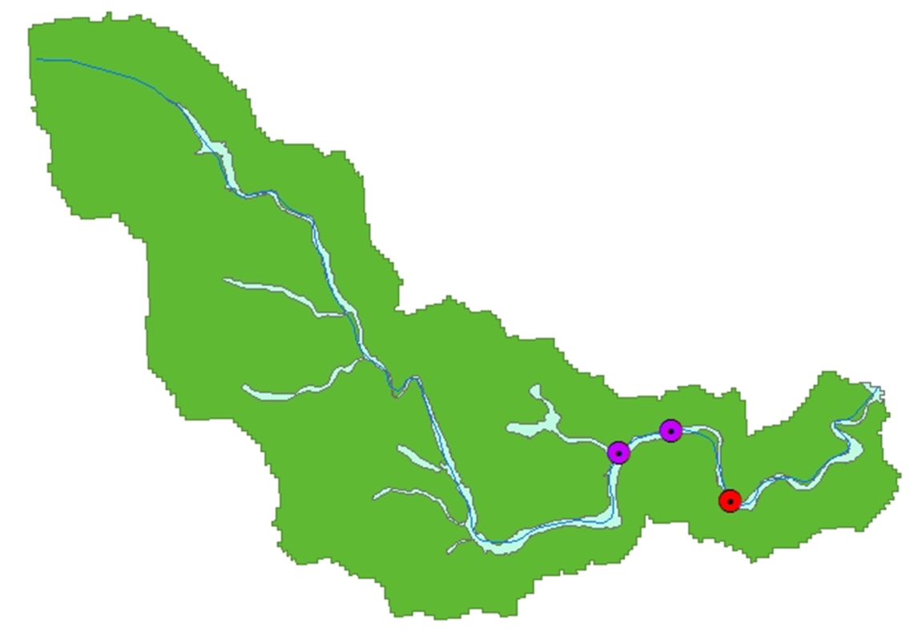
Color assigned to culvert locations according to risk provided from streamflow forecast & rating curve

Slide 13
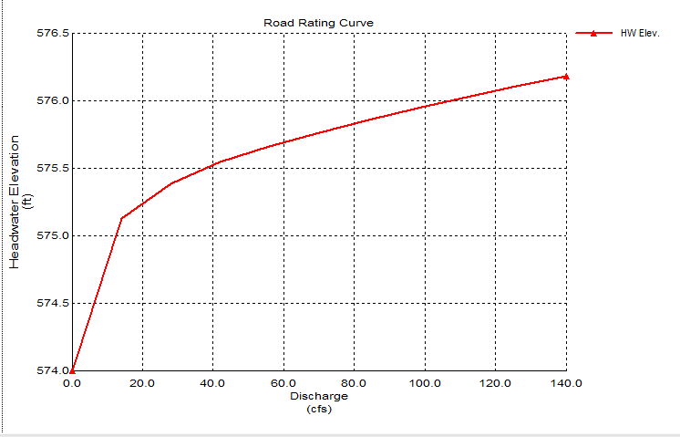
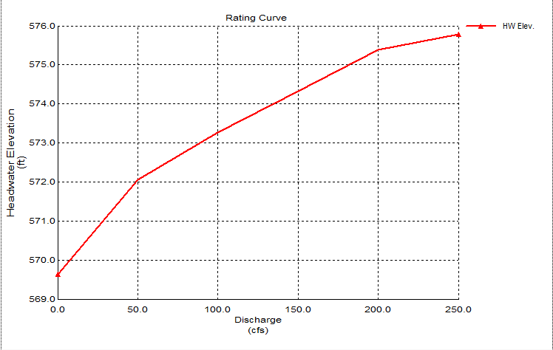
Rating Curves from CulvertMaster
Eanes Creek at Bee Caves Road Low water Crossing design flow = 139 cfs
Notes:
Using the analysis portion in culvertmaster I was able to enter the elevation of the roadway in stations, and also culvert data. The analysis section particularly helpful because I could model different culvert size combinations and add different sizes to the shape library. The roadway is modeled as a broadcrested weir and once the low water crossing reaches the road surface the program combines the culvert and road surface rating curves. It was also very interesting to find that I could obtain the road rating curve by itself.

Slide 14
Future Work
Compare results from arial LiDAR survey results to land based LiDAR results
Model culverts with blockages – possibly by increasing the entrance loss coefficients
Using Richard’s code, extract cross-sections for Eanes Creek rather than doing it manually

