Slide 1
Social Vulnerability within The NFIE
Frank Schalla
Flood Forecasting
May 6, 2015

Slide 2
Introduction
  “Prioritize… population groups that are at high risk”
    -Harry Evans
Risk = Hazard * (Vulnerability – Resources)
  Social vs. geographic vulnerability
Objective:
  Present methods to integrate the SVI into NFIE Response
  Present resources for the ERC for flood events
  Propose a resource for pet planning in flood response
Notes:
Building the tools to further refine and characterize flood risk by incorporating the SVI
Risk is the likelihood or expectation of loss; Hazard is a condition posing the threat of harm; Vulnerability is the extent to which persons or things are likely to be affected; and Resources are those assets in place that will diminish the effects of hazards.
Majority of households view pets as a member of their family. During a flood event we should prepare and expect to deal with pet evacuations alongside human evacuations.

Slide 3
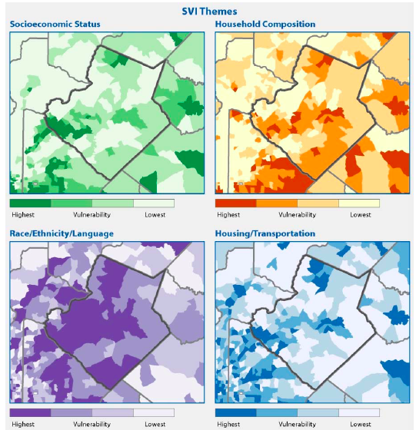
Social Vulnerability Index (SVI)
A tool to help identify communities that most likely need support before/during/after a hazardous event
U.S. Census 2010, Census Tract level
15 variables summarized within 4 themes and 1 overall ranking
  Percentile ranking
Notes:
Susan Cutter U. South Carolina
Census tracts, small subdivisions of counties, are designed to be demographically homogeneous. They generally have between 1,500 and 8,000 people, with an optimum size of 4,000 people (U.S. Census Bureau 2009a).
Socioeconomic Status: income, poverty, employment, and education variables
Household Composition/Disability: age, single parenting, and disability variables
Race/Ethnicity/Language: race, ethnicity, and English language proficiency variables
Housing/Transportation: housing structure, crowding, and vehicle access variables
Unique need dictates which theme to utilize
Uses:
-Estimate the amount of needed supplies like food, water, medicine, and bedding.
-Help decide how many emergency personnel are required to assist people.
-Identify areas in need of emergency shelters.
-Plan the best way to evacuate people, accounting for those who have special needs, such as people without vehicles, the elderly, or people who do not understand English well.
-Identify communities that will need continued support to recover following an emergency or natural disaster.

Slide 4
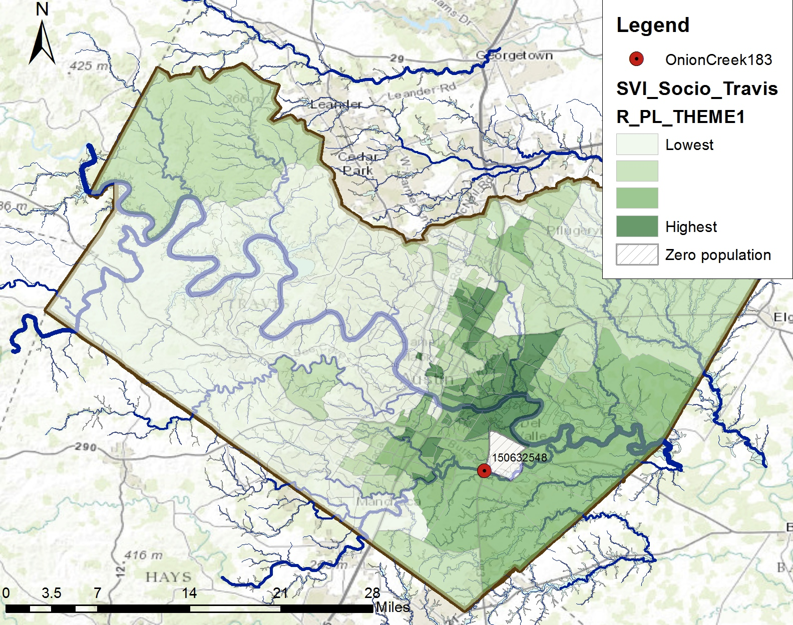
SVI Travis County
Notes:
SVI taken for entire state of Texas using a percentile ranking method. A percentile rank is defined as the proportion of scores in a distribution that a specific score is greater than or equal to.2 Percentile

Slide 5
Pleasant Valley Area
0.79
Notes:
Caveat with WZ intersection, not consider ppl driving crossing flooded roads.
170 evacuations, 900 address points in WZ

Slide 6
Pearce & I-130 Area
0.59
Notes:
45 Evacuations, 230 address points in WZ

Slide 7
Pinehurst Dr. Area
0.18
Notes:
15 evacuations, 160 address points in WZ

Slide 8
Bluff Springs Area
0.34
Notes:
120 evacuations, 79 address points in WZ

Slide 10
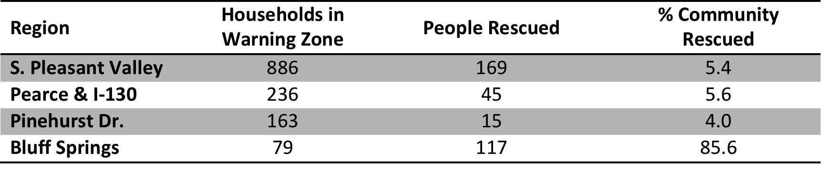
Notes:
Indicator that Social vulnerability alone is not a good metric for flood risk and it must be connected with a larger scope of NFIE

Slide 11
Notes:
HH in WZ with overall Percentile >0.9, 690

Slide 12
The Pet X-Factor
U.S. Pet Ownership and Demographic Sourcebook
  Number of pets per household in each State
  Percentage of households owning pets by
    Household income, household size, city size, etc.
Connect to US Census, Block Group
Dog & Cat numbers per household
Notes:
Source: American Veterinary Medical Association
Keith Brown: Pet Companion Law
Block Group ACS: 600 - 3,000 people
-connection with census block groups, eqns, weights
-Maps cats/dogs, intersection with warning zones

Slide 13
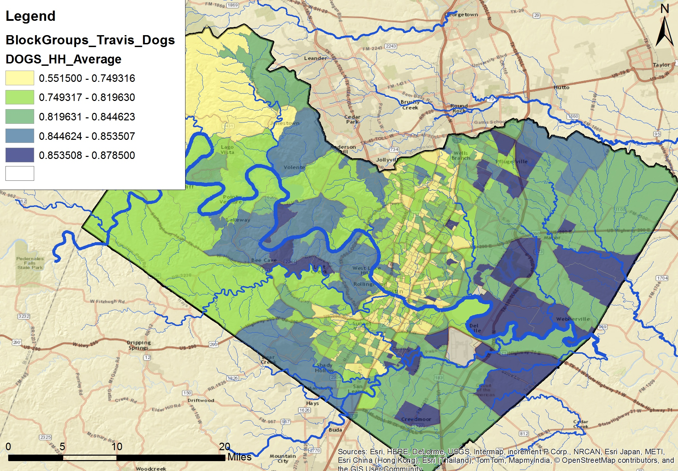
Notes:
Example chart and location comparisons
May not seem like a large spread, w 100 hh, difference of 35 dogs
Help in making staff/resource allocation decisions

Slide 16
Conclusions
SVI a valuable tool before/during/after flood event
  Enhance how we classify vulnerability/risk within NFIE
  Resource for ERC and community education
  SVI themes should be used independently
Pet populations starting point
  Incorporate more statistics, feedback from animal centers
  Potential for application to wildfires for horses
Need to be introduced to ERC

Slide 17

Questions?

Slide 18
Texas Demographics | Units | Dogs | Cats
Average Number of Pets Per Household - Texas | Number | 1.8 | 2.2
Percentage of Pet Owners - Texas | Percentage | 44 | 28.3
Households owning pets by annual household income
Under $20,000 | Percent | 34.5 | 34.1
$20,000 to $34,999 | Percent | 40 | 36.8
$35,000 to $54,999 | Percent | 42.4 | 35.6
$55,000 to $84,999 | Percent | 43.8 | 34
$85,000 and over | Percent | 43.9 | 31.7
Households that own pets by household size
One member | Percent | 26.8 | 29.8
Two member | Percent | 40.1 | 34.6
Three member | Percent | 50 | 38.3
Four member | Percent | 53.7 | 34.9
Five or more member | Percent | 54.2 | 38.1
Community Size
Less than 100,000 | Percent | 50.4 | 41.5
100,000 to 499,999 | Percent | 44.4 | 37
500,000 to 1,999,999 | Percent | 42.1 | 34
2,000,000 or more | Percent | 37.4 | 31.6
Source: U.S. Pet Ownership & Demographic Sourcebook, 2011
Weights assigned/adjusted to each statistic
Removal of city size statistic

Slide 19
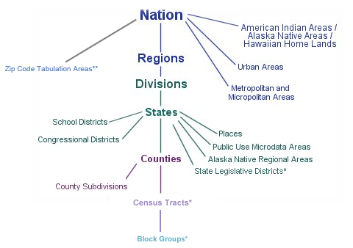
U.S. Census Data
Notes:
-Overview of ACS
-Ranking of census data: counties, Census tracks, block groups

