Slide 1
NFIE-River: Building a national stream addressing system
Prepared by Xing Zheng
Supervised by David R. Maidment
Center for Research in Water Resources
University of Texas at Austin

Slide 2
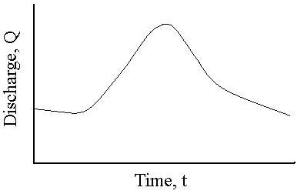
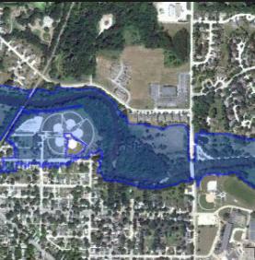
Task of NFIE-River
Forecast flow data
(Obtained from NFIE-Hydro)
Flood water surface elevation in the river channel
Flood inundation map over the floodplain
Notes:
As we have learnt from our class, NFIE-Hydro can provide us a higher resolution and more timely forecast discharge for the whole country. After we get that, the next step, which is the task of NFIE-River, is how can we realize the translation from flow data to the flood water surface elevation in the river channel and the flood inundation map over the floodplain?

Slide 3
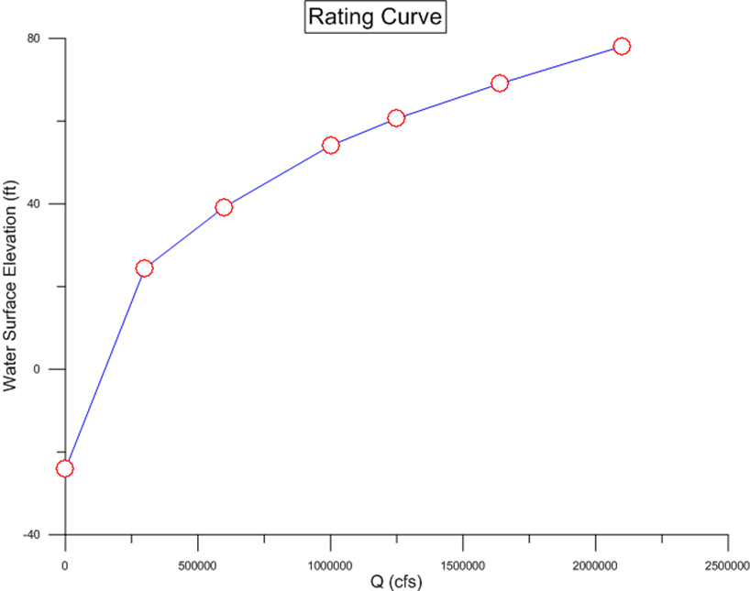
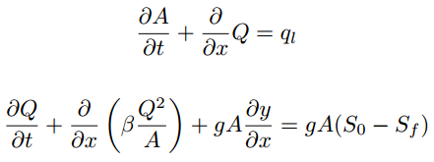
Methods used to go
From Discharge to Elevation
Rating Curve
Hydraulic Model
(Saint-Venant Equations)
Data about River Channels
Notes:
Usually, there are two common methods used for going from river discharge to water surface elevation. One is the rating curve, we collect discharge-elevation data pairs, and draw them on a plot. Then we use the experience we get from the past to predict the situation in the future. The other one is the hydraulic modelling, which we solve classic hydraulic equations like Saint-Venant Equations to derive the water surface elevation for a given discharge. For both approaches, data about the river channels are needed.

Slide 4
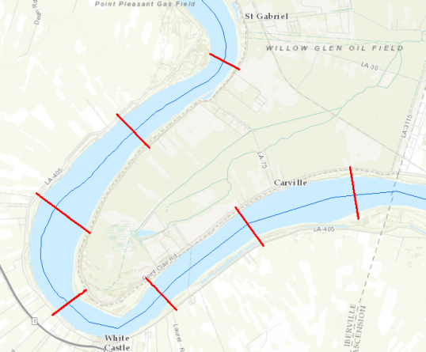
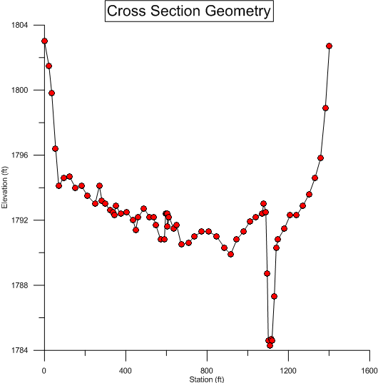
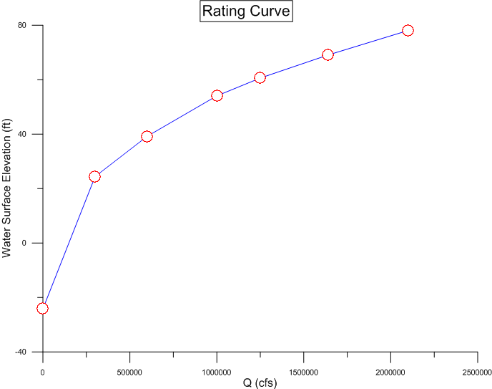
The basic unit to organize river channel data
—Cross Section
Notes:
The most classic and basic unit to organize river channel data is cross section. To have a full understanding of a cross section, there are three kinds of data we want to know. The first one is its geographic coordinates. We want to know where it is. The second one is its geometry. We want to know what it looks like. The third one is its rating curve. We want to the relationship of water depth and discharge at that place.

Slide 5

My Research
Cross Sections in MIKE11
Cross Sections From Field Survey
Cross Sections in HEC-RAS
Cross Sections From GeoNet
Hydraulic
Fabric
GIS
Hydraulic
Model
Notes:
For my research I develop a data model for cross sections named Hydaulic Fabric to organize three kinds of information in an integrated way. Cross section data from different sources can be stored in this data model in the same way. Also it is very convenient to query cross section data from our database developed using Hydraulic Fabric to apply it in different environment.
The second part of my research is I have developed some tools to facilitate cross section data exchange between GIS and hydraulic models.

Slide 6
Richard’s Work
(NHD Cross-section feature extraction)
My Topic Today
No Available Cross Sections
Existing Cross Section Dataset
How to generate them from DEM
How to locate them on NHD river network
Notes:
For Richard’s project he talked about last Wednesday, he mainly works on if there are no available cross sections, how can we generate them from DEM?
For my project, I need to figure out a way to locate existing cross sections on NHD flowline systems

Slide 7
Hierarchy of NHD Flowline System
NHD Flowline Dataset
NHD Reach
Identifier: ReachCode
NHD Flowline Feature
Identifier: COMID
Notes:
There is a hierarchy existing in the NHD flowline system. A NHD Flowline dataset, just like the flowline feature class we used in our NFIE-Geo assignment, is composed of many NHD reaches. Each reach is identified by a unique ReachCode. A NHD reach may have one or more NHD flowline features. And each flowline feature is identified by a unique COMID.

Slide 8
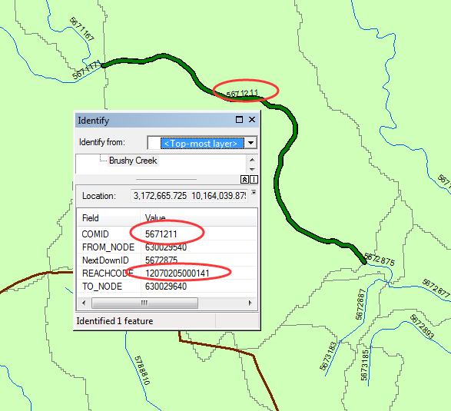
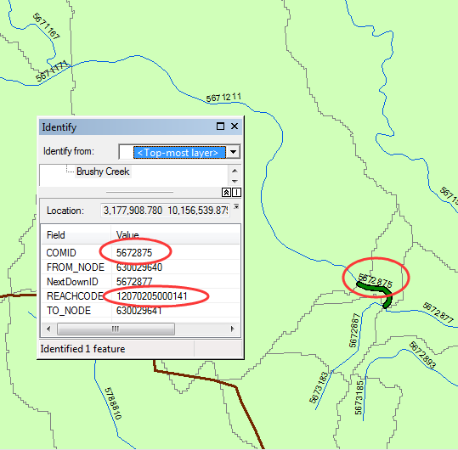
Flowline Hierarchy Example
Notes:
Here is an example explaining the hierarchy I just mentioned. For the first flowline I highlight in the left-hand-side picture, it has a COMID of 5671211, and a reachcode ending with 141. For the second flowline in the right-hand-side picture, it has a COMID of 5672875, and the same reachcode as the first one.

Slide 9
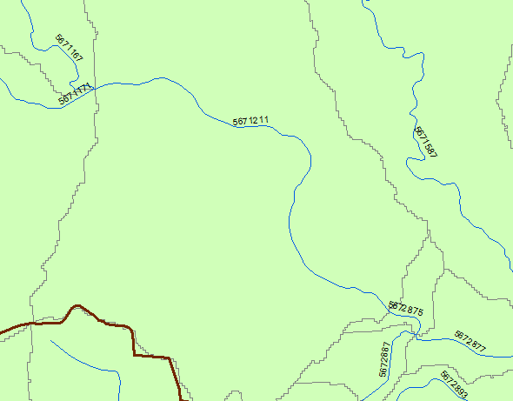
A Percentage Measure System
Set up for Every Reach
ToMeas: 100
100
FromMeas: 9.0024
0
ToMeas: 9.0024
FromMeas: 0
Notes:
A question you may have is that why these two flowlines are put into a singal reach. In most cases, it is decided by the topologic relationship. Still take the reach as an example, as you can see in the map, two branches converge at the upstream end of the reach. On the other side, at the downstream end of that reach, it meets with another branch to go to the downstream river. When the NHD flowline system was built, a percentage measure system was set up for every single reach. The downstream end of NHD reach was given a measure value of 0, and the upstream end was given a measure value of 100. Then for every single feature, it has two attributes FromMeas and ToMeas representing its start and end locations on that reach. For the downstream flowline feature, it has a FromMeas value of 0, and a ToMeas value of 9.0024. For the upstream one, it has a FromMeas of 9.0024, and a ToMeas of 100.

Slide 10
Locate Cross Section on Flowline
COMID: 123456
10
100
50
Notes:
The existence of this percentage measure system gives us a opportunity to locate cross sections on rivers in a uniform way across the whole country. We know the COMID, FromMeas, ToMeas of a flowline. When we get a cross section, we intersect it with the flowline to get an intersection between them. Next, we decide the measure value of the intersection, and give it back to the cross section together with the COMID of the flowline. In that way, the cross section is addressed on the river network of the country.

Slide 11
More Complicated Case
Notes:
But I do meet some more complicated situations in my practice. They are mainly about one cross section line intersects with several flowlines, or it passes one flowline several times. At this moment, my solution is just deleting the extra intersections we have. Just keep a singal intersection for every cross section.

Slide 12
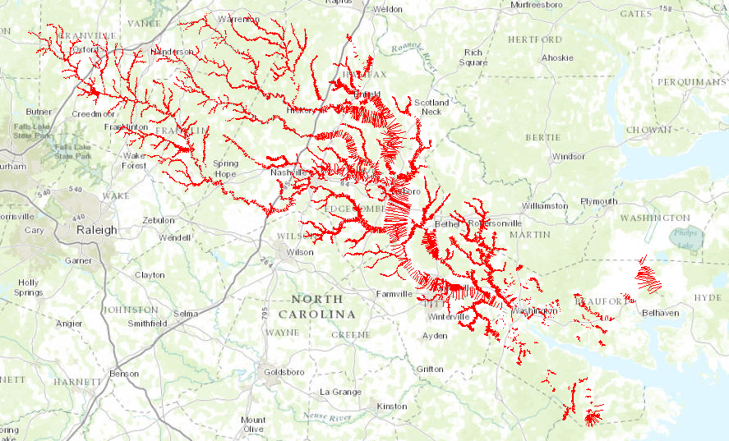
Case Study: North Carolina
Cross Section Dataset
17637 Cross Sections

Slide 13
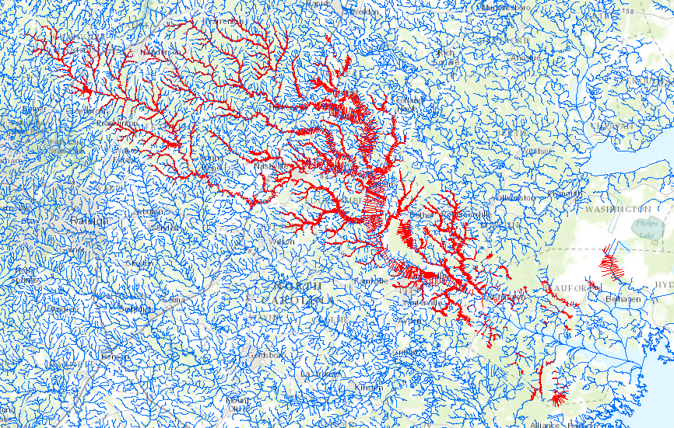
Add NHD Flowline Layer

Slide 14
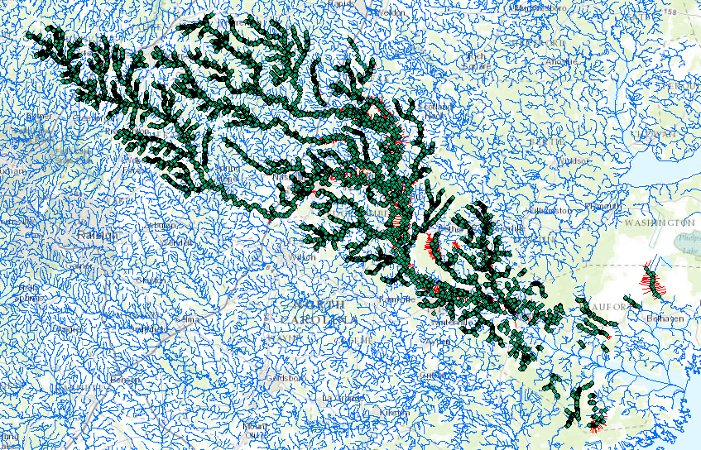
Create Intersections
19137 in total

Slide 15
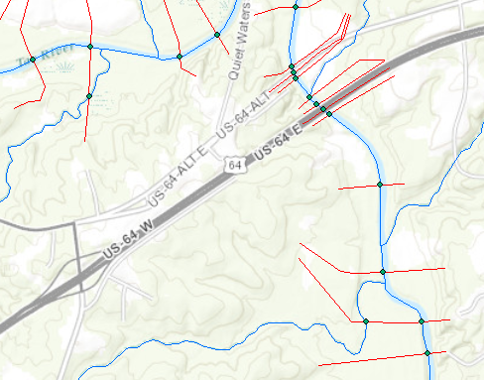
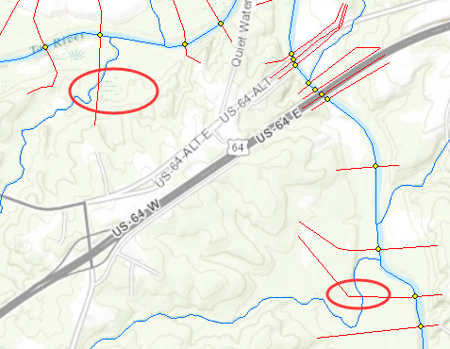
Delete Excess Intersections
19137 17223

Slide 16
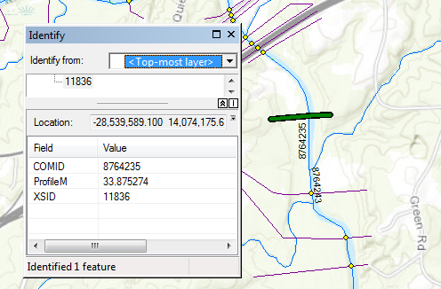
Do Linear Reference for Each Intersection
Then Return Measure Value to Cross Section Line
17191 Cross Section Location Decided

Slide 17
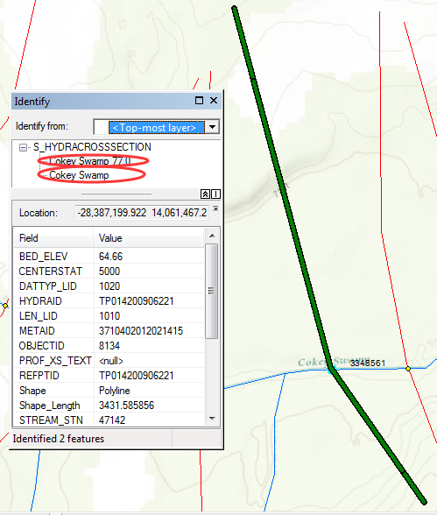
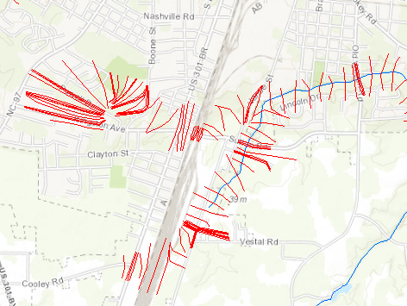
Difference In Numbers
17637
Cross Sections
17223
Singal Intersections
17191
Located Cross Sections

Slide 18
Questions?

