Slide 1
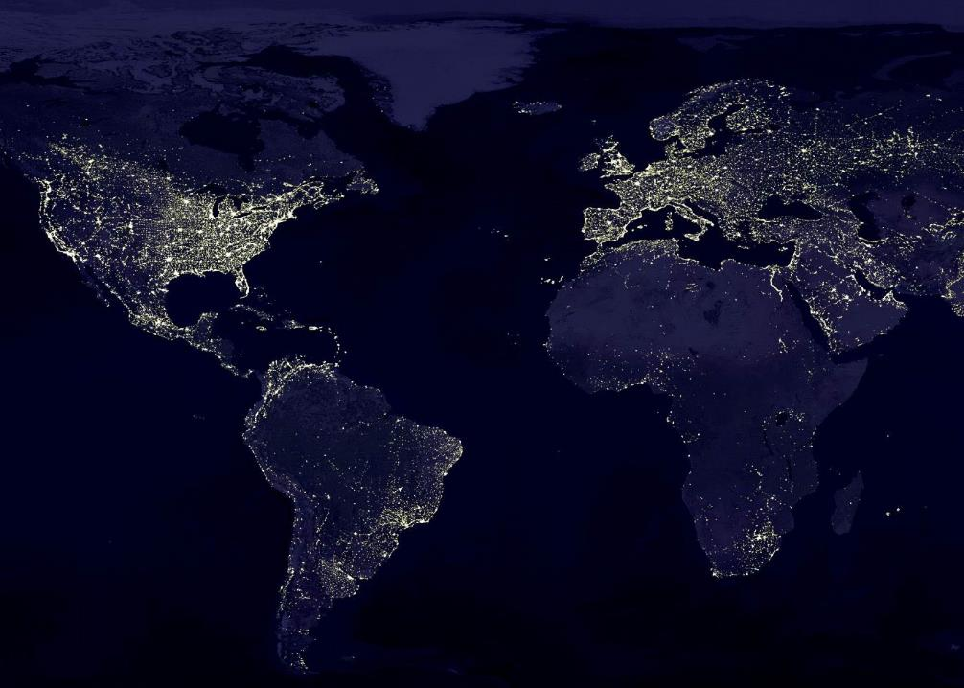
Introduction to OGC & ISO Standards for Sharing Geographic Information
Focus on WaterML for Flood Forecasting
CE 397 Flood Forecasting, Feb 2015
by David K Arctur

Slide 2
Purpose
Describe usages of WaterML in flood forecasting
But first: introduce concept of standards for sharing spatial-temporal information
between multiple providers & users
with multiple computing platforms and software
for purposes not known in advance
Requires a general model of spatial-temporal information, and a service architecture for exchange
Core shared concepts, independent of implementations

Slide 3
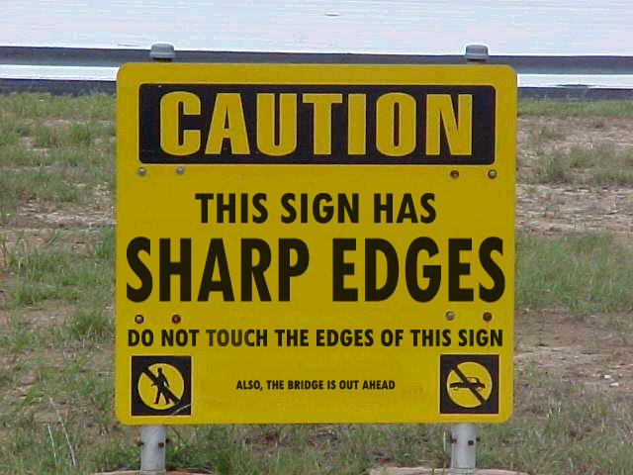
Caution: reading specs can be like…

Slide 4
Outline
General feature model for GIS
Discrete data vs. continuous data vs. observations
Open Geospatial Consortium intro
History of OGC WaterML
WaterML time series information model
What is Time? … a time series? … for the web?
Typical use: Gage height → rating curve → discharge
Flood forecasting: Discharge → rating curve → gage height
Data discovery & access: key OGC web services

Slide 5
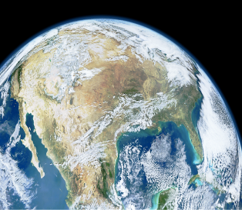
Geographic Features: Quick Overview
Feature: abstraction of a real-world phenomenon
Geographic Feature: a feature associated with a location relative to the Earth; digital representation of an aspect of the real world
Universe of discourse
Perceived in context of …
Geographic application
Digital Representation
Reality: phenomena
Classified as …
Feature Types
Defining [0..n]
Feature Instances
Data capture
Notes:
Notes:
Source: OGC Reference Model
URL:

Slide 6
How do we describe data models?
General Feature Model (OGC AS Topic 5; ISO 19101)
Feature relationships (OGC AS Topic 8)
Feature collections (OGC AS Topic 10)
Observations and Measurements (O&M) (OGC AS Topic 20)
Terminology (ISO 19104)
Conceptual Schema (UML) (ISO 19103)
Rules for Application Schema (ISO 19109)
Profiles (ISO 19106); Functional Standards (ISO 19120)
Encoding (UML, XML) (ISO 19118)
Conformance (ISO 19105)
AS = Abstract Spec

Slide 7
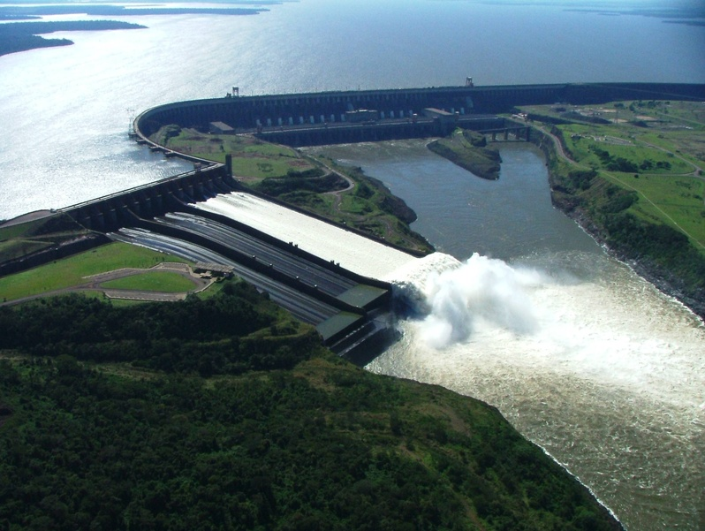
Features have Properties
Attributes: location/geometry, time, quality, metadata, other values
Operations: accessing & changing state, performing actions
Associations: relationships with features, eg, collections, topologies, other dependencies
Note 1: Feature associations may have attributes
Note 2: Feature Collections can be treated as Features

Slide 8
Different phenomena call for different forms of exchange
Two broad categories of features: discrete and continuous
Discrete: recognizable objects having distinct boundaries or spatial extent [vector]
Buildings, streams, measurement stations, …
Continuous: phenomena varying over space and time, with no specific extent [gridded, raster]
Temperature, soil composition, land cover, elevation, …
OGC “coverage”: defines a data model that associates spatio-temporal positions to data values or model outputs

Slide 9
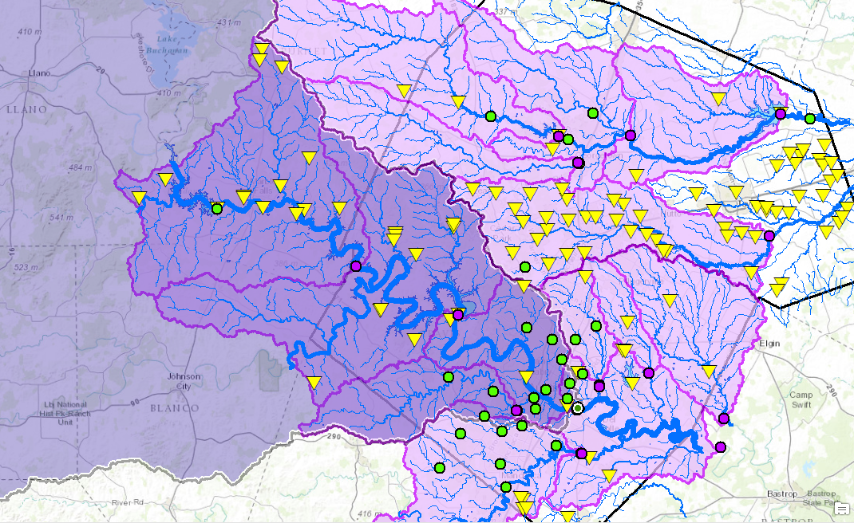
What kinds of things about discrete features do we need to exchange?
Metadata (OGC AS Topic 11; ISO 19115)
Authority, contact, sources, methods, provenance, …
Location; geometry (OGC AS Topic 3)
Spatial schema (ISO 19107); temporal schema (ISO 19108)
Spatial reference system(s) used (OGC AS Topic 2)
Coordinates (ISO 19111)
Identifiers, Gazetteer (ISO 19112)
Geodetic codes, parameters (ISO 19127)
Non-spatial attributes (determined by application schema)
AS = Abstract Spec
Notes:
CHANGE BACKGROUND GRAPHIC TO VECTOR MAP – NFIE GEO!

Slide 10
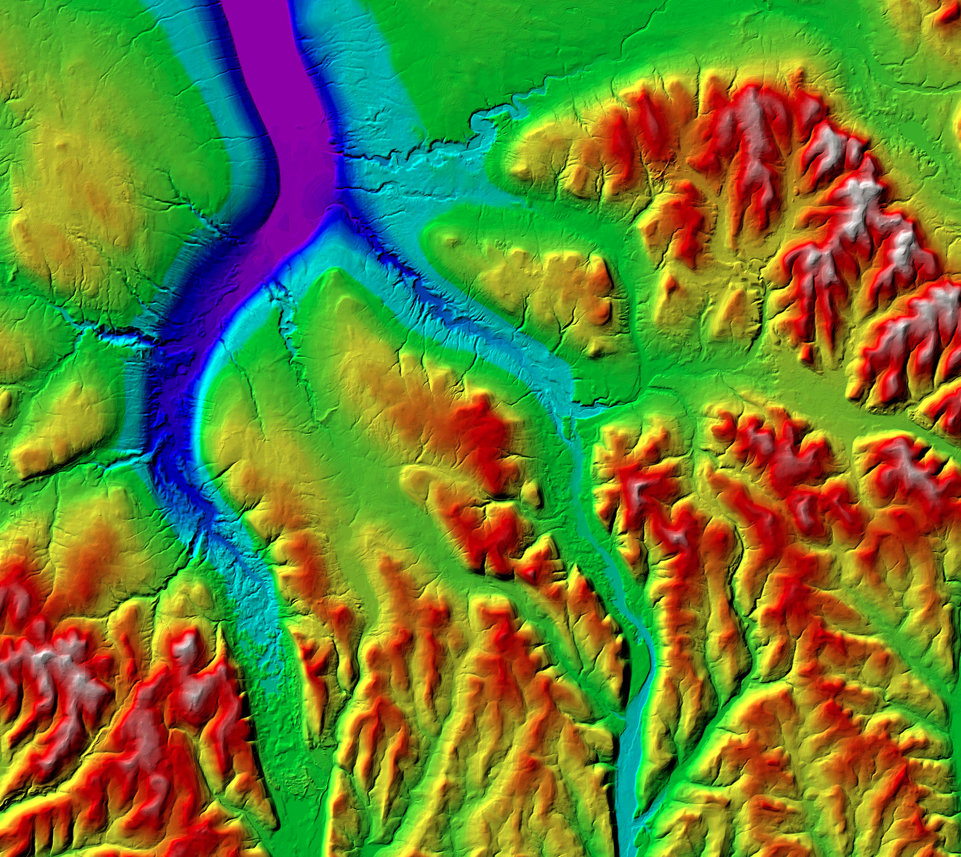
What different things about coverage features do we need to exchange?
Earth imagery; gridded data (OGC AS Topic 7; ISO 19121, 19129)
Coverage schema (OGC AS Topic 6; ISO 19123)
AS = Abstract Spec
Notes:
Source: http://www.geo.cornell.edu/geology/classes/Geo101/graphics/ithaca_dem.jpg

Slide 11
What different things about observations do we need to exchange?
Observations and Measurements: Related entities & their associations (OGC AS Topic 20, ISO 19156)
But this is very abstract… we need to create a profile for unambiguous use in hydrologic applications…
GFI_Feature
1
+featureOfInterest
0..*
OM_Observation
GF_PropertyType
+
phenomenonTime
1
+
resultTime
+observedProperty
+
validTime [0..1]
+
resultQuality [0..*]
+
parameter [0..*]
0..*
1
+procedure
+result
OM_Process
Any

Slide 12
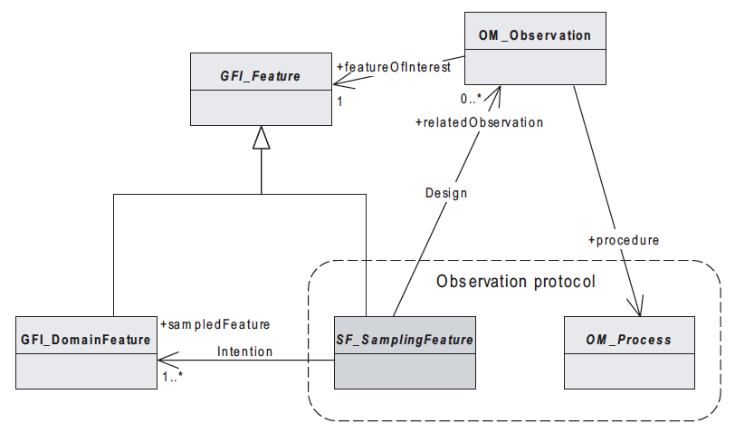
OGC Observations & Measurements Model: Sampled vs. Sampling Feature-of-Interest
Source: ISO/FDIS 19156:2011(E)
Notes:
The point of this slide is to show that the OGC O&M model is very general with respect to features of interest in hydrologic applications. The feature of interest could be either a sampling feature or a sampled feature. WaterML2 and the SOS 2.0 Hydrology Profile spell out the conventions to be followed for hydrology community.

Slide 13
Open Geospatial Consortium
More than 500 companies, agencies, institutions globally
Internet standards for
Map services
Feature + Observation services
Catalog services
Data models + encodings
www.opengeospatial.org
Notes:
This water standard is a result of years of efforts by a community of hydrologists and IT experts around the world, working through the Open Geospatial Consortium (OGC) Hydrology Domain Working Group. OGC is an international standards organization working on data exchange of spatial and temporal data across many different domains. The Hydrology DWG is one of the most active groups within OGC.

Slide 14
OGC/WMO Hydrology Domain Working Group
7+ Year International Effort – WaterML
(draft pending)
A time series for one variable at one location
Stage-Discharge values for one cross-section
WML2 Part 2 Ratings-Gaugings
Hydrology Domain Working Group formed
OGC at WMO Commission for Hydrology
Sensor Observation Service 2.0
Hydrology Profile
Best Practice
Memorandum of Understanding between the World Meteorological Organization and the Open Geospatial Consortium
Technical Meetings every 3 months
Five Interoperability Experiments (Surface water, groundwater, ratings-gaugings)
Annual week-long workshops
Involvement by many countries
2008
2009
2010
2011
2012
2013
2014
Acknowledgements: OGC, WMO, GRDC, NWS, CUAHSI, BoM/CSIRO, USGS, GSC, Kisters, …….
Notes:
(1) A four-year international effort has been undertaken to reconcile WaterML with international standards;
(2) This effort was initiated with the establishment of an Hydrology Domain Working Group by the Open Geospatial Consortium in September 2008;
(3) An OGC representative attended the WMO Congress of the Commission for Hydrology in 2008
(4) A formal agreement between Secretary General of WMO and President of OGC in 2009 to jointly develop standards for hydrology, climatology, oceanography and climatology;
(5) The joint OGC/WMO Hydrology Domain Working Group was supported by a large work effort, annual week-long workshops, four interoperability experiments for surface and groundwater data exchange, and participation by many countries;
(6) In June 2012, the OGC voted to adopt the revised version, WaterML2 as an international standard for exchange of water resources time series (the first such public standard that has existed);
(7) This Congress to the WMO Commission for Hydrology to whom I am speaking is considering WaterML2 for adoption as an official standard by WMO
(8) WaterML 2.0 Part 2 – Ratings and Gagings is ready for public comment, pending OGC approval to post.

Slide 15
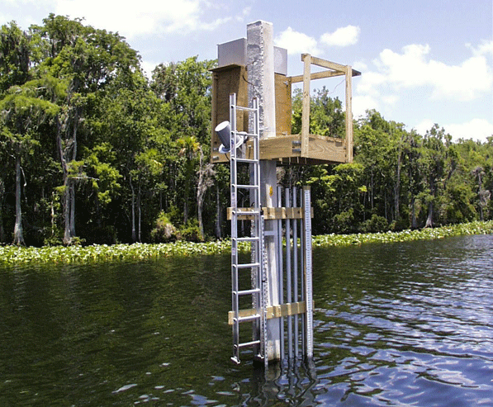
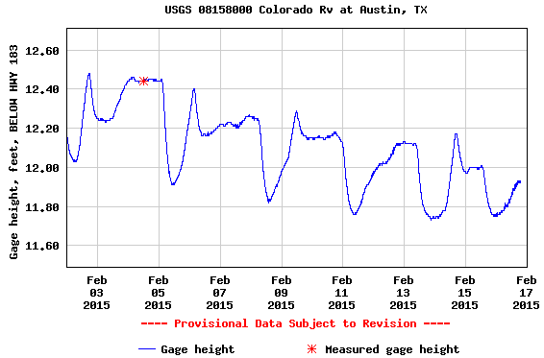
Using OGC O&M model for water level …
(WaterML2 Part 1)
GFI_Feature
Stream Gage
1
+featureOfInterest
sampling feature
River is a
sampled feature
0..*
Stage Height
OM_Observation
GF_PropertyType
+
phenomenonTime
1
+
resultTime
+observedProperty
+
validTime [0..1]
+
resultQuality [0..*]
+
parameter [0..*]
0..*
1
+procedure
+result
Time series of values
OM_Process
Any
Water level measurement
Source: USGS
An Observation is an action whose result is an estimate of the value of some property of the feature-of-interest, obtained using a specified procedure

Slide 16
What is Time? … on the web?
ISO 8601:2004[E] – Data elements and interchange formats – Information interchange – Representation of dates and times
Date and time values are ordered from the largest to smallest unit of time: year, month (or week), day, hour, minute, second, and fraction of second. This ordering corresponds to chronological order. This allows dates to be naturally sorted by computer file systems.
Each date and time value has a fixed number of digits that must be padded with leading zeros. (The “format template” in figure below will achieve this in Excel spreadsheets)
Two main formats – (1) a basic format with a minimal number of separators, or (2) an extended format with separators: hyphen between date values (year, month, week, and day) and colon between time values (hours, minutes, and seconds). Local time zone begins with + or – hours from UTC.
http://en.wikipedia.org/wiki/ISO_8601
Date and time expressed according to ISO 8601:
Format template: | yyyy-m-dTh:mm:ssZ
Date: | 2015-02-15
Date and time in UTC: … as Zulu: | 2015-02-15T19:39:11+00:00
 | 2015-02-15T19:39:11Z
Date & time in Austin: with Daylight Savings: | 2015-02-15T13:39:11-06:00 2015-02-15T14:39:11-05:00
Week: | 2015-W07
Ordinal date: | 2015-046

Slide 17
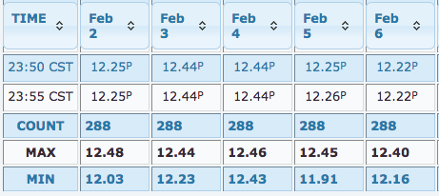
Time–Value Pairs: Building a time series for web exchange
How do you represent time series in a database?
Only precise instants are allowed.
<wml2:time>2015-02-02T23:55:00-06:00</wml2:time>
<wml2:value>12.25</wml2:value>
Notes:
Table source: http://waterdata.usgs.gov/nwis/uv?cb_00065=on&cb_00065=on&format=html&site_no=08158000&period=&begin_date=2015-02-02&end_date=2015-02-16
Graph source: http://waterdata.usgs.gov/nwis/uv?cb_00060=on&cb_00065=on&cb_00065=on&format=gif_default&site_no=08158000&period=&begin_date=2015-02-02&end_date=2015-02-16

Slide 18
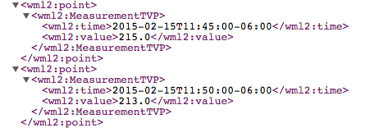
USGS NWIS: WaterML 2.0 sample output
Request: format=waterml,2.0&sites=08158000&period=P1D&parameterCd=00060
Time-Value Pairs (TVP)
Observation time metadata
http://waterservices.usgs.gov/nwis/iv/?format=waterml,2.0&sites=08158000&period=P1D&parameterCd=00060
Notes:
Complete URL for sample output, requested on Feb 16, 2015: http://waterservices.usgs.gov/nwis/iv/?format=waterml,2.0&sites=08158000&period=P1D&parameterCd=00060
It’s not important to learn how to write or edit this level of XML code. But it is always a good idea for hydrologists to be able to check the correctness of their data and metadata at the source level. WaterML encodes essential metadata a hydrologist might need to understand the associated data results, such as the measured variable name, units of measure, type of time series, etc. (see next slides)

Slide 19
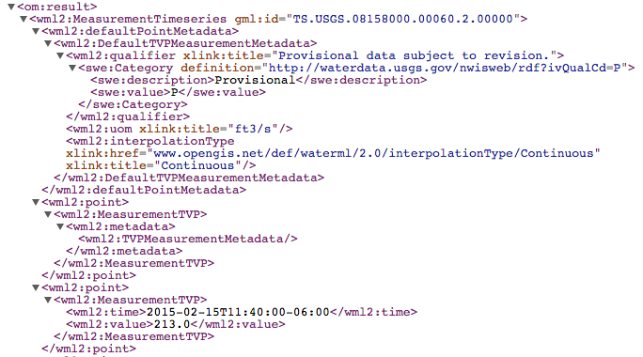
USGS NWIS: WaterML 2.0 sample metadata
Timeseries definition
Measured vs. observed time series
← units of measure
← interpolation type
Notes:
Sample output taken on Feb 16, 2015: http://waterservices.usgs.gov/nwis/iv/?format=waterml,2.0&sites=08158000&period=P1D&parameterCd=00060

Slide 20
USGS NWIS: WaterML 2.0 sample metadata
Feature of Interest & Sampled Feature
Procedure & Observed Property
What are all these special prefixes for?
om, wml2, gml, sa, sams, xlink …
Notes:
Sample output taken on Feb 16, 2015: http://waterservices.usgs.gov/nwis/iv/?format=waterml,2.0&sites=08158000&period=P1D&parameterCd=00060

Slide 21
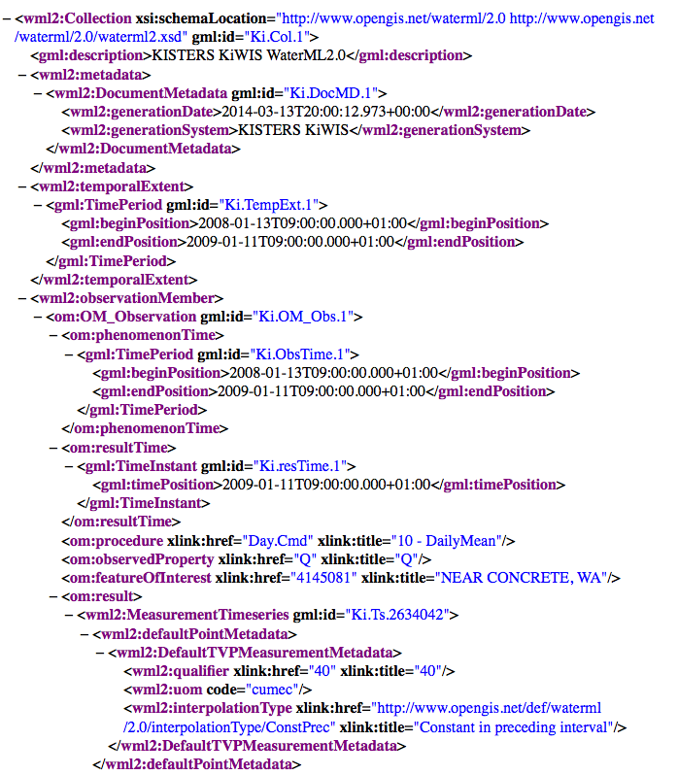
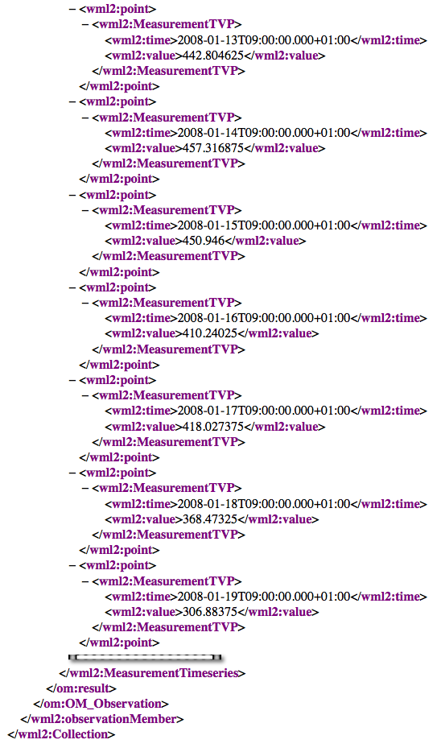
Putting it together:
WaterML 2.0
Document metadata
Observation description
Feature of interest
Observed property
Procedure
Phenomena time
Result time
Result
Time series metadata
Time series data
Time series data, cont’d
GFI_Feature
1
+featureOfInterest
0..*
OM_Observation
GF_PropertyType
+
phenomenonTime
1
+
resultTime
+observedProperty
+
validTime [0..1]
+
resultQuality [0..*]
XML Namespaces
+
parameter [0..*]
0..*
1
+procedure
+result
OM_Process
Any
Notes:
Reference schema and examples: http://schemas.opengis.net/waterml/
The namespaces that appear

Slide 22
Workflows
Flood Maps
8
Measured with water level recorder
Extent of inundation modeled in GIS
1
Stage Height
Stage Time Series
Measured with stream flow meter at a point in time
Apply rating curve to convert discharge to stage height time series
7
2
Discharge Value
Rating Curve
Derived from stage vs. discharge measurements over time at cross-section
Produced by hydraulic models & associated with cross-sections
6
3
Rating Curve
Discharge Time Series
Apply rating curve to convert stage height to discharge time series
Modeled by NFIE-Hydro for every NHDPlus Reach
5
4
Discharge Time Series
Typical Case
Flood Forecasting

Slide 23
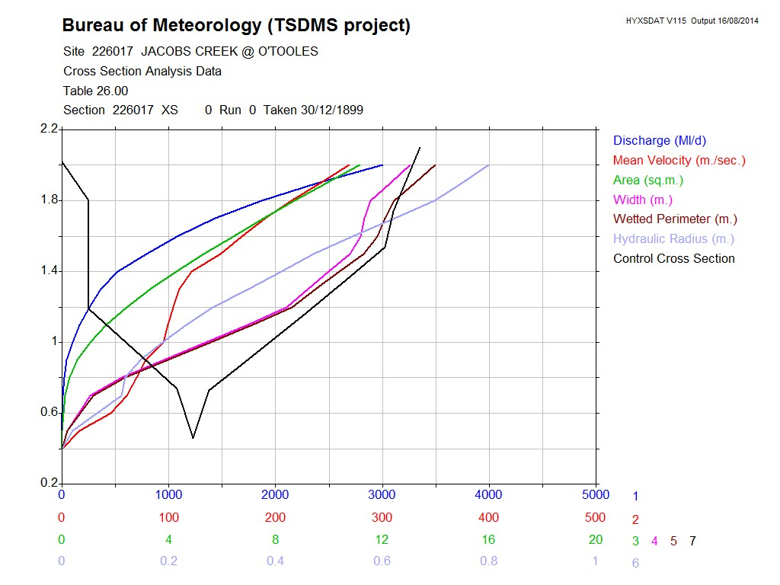
From stage height to streamflow
Stage height is very easily measured, compared with streamflow
Rating curves are developed through field work, to map stage to flow
Source: Paul Sheahan, Australia BoM

Slide 24
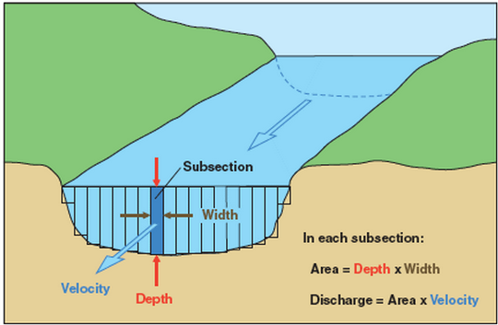
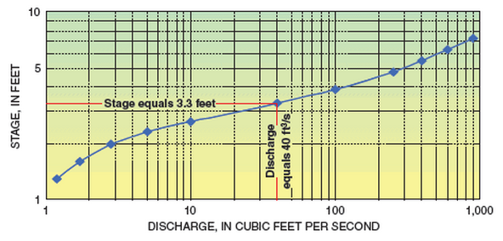
Treating rating curves as a measurement …
(WaterML2 Part 2)
GFI_Feature
Gage Location
1
+featureOfInterest
sampling feature
(Stage, Discharge) pair
0..*
OM_Observation
GF_PropertyType
+
phenomenonTime
1
+
resultTime
+observedProperty
+
validTime [0..1]
+
resultQuality [0..*]
+
parameter [0..*]
0..*
1
+procedure
+result
OM_Process
Any
(Stage, Discharge) tuples
Observation or Conversion Method
Source: USGS
An Observation is an action whose result is an estimate of the value of some property of the feature-of-interest, obtained using a specified procedure
Notes:
Rating curves are developed on infrequent, as-needed basis, by taking direct measurements of depth and flow, and plotting the curve from this data. The curve is then used to convert real-time measurements of depth into real-time values of discharge.
The object of WaterML 2.0 Part 2 is to apply the OGC O&M conceptual model and WaterML XML schema to convey the set of (stage, discharge) values.
Source: http://water.usgs.gov/edu/measureflow.html
See also: OGC 13-021r3 WaterML 2.0 – Part 2.

Slide 25
Workflows
Flood Maps
8
Measured with water level recorder
Extent of inundation modeled in GIS
1
Stage Height
Stage Time Series
Measured with stream flow meter at a point in time
Apply rating curve to convert discharge to stage height time series
7
2
Discharge Value
Rating Curve
Derived from stage vs. discharge measurements over time at cross-section
Produced by hydraulic models & associated with cross-sections
6
3
Rating Curve
Discharge Time Series
Apply rating curve to convert stage height to discharge time series
Modeled by NFIE-Hydro for every NHDPlus Reach
5
4
Discharge Time Series
Typical Case
Flood Forecasting

Slide 26
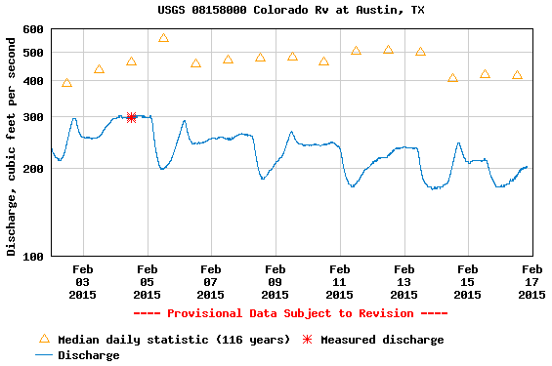
The stream flow can then be determined from the rating curve
(WaterML2 Part 1)
GFI_Feature
Stream Gage
1
+featureOfInterest
sampling feature
River is a
sampled feature
0..*
Discharge
OM_Observation
GF_PropertyType
+
phenomenonTime
1
+
resultTime
+observedProperty
+
validTime [0..1]
+
resultQuality [0..*]
+
parameter [0..*]
0..*
1
+procedure
+result
Time series of values
OM_Process
Any
Flow rate conversion
Source: USGS
An Observation is an action whose result is an estimate of the value of some property of the feature-of-interest, obtained using a specified procedure
Notes:
Graph source: http://waterdata.usgs.gov/nwis/uv?cb_00060=on&cb_00065=on&cb_00065=on&format=gif_default&site_no=08158000&period=&begin_date=2015-02-02&end_date=2015-02-16

Slide 27
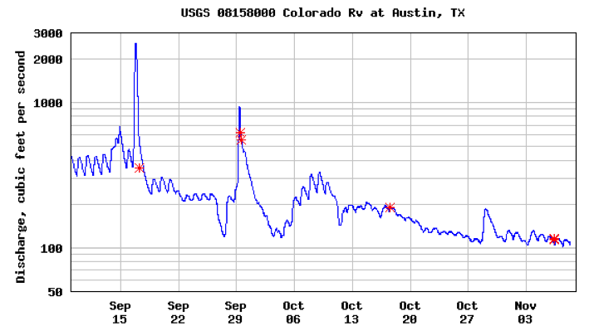
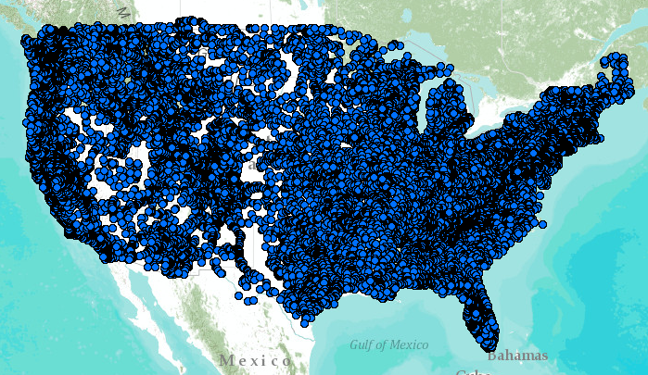
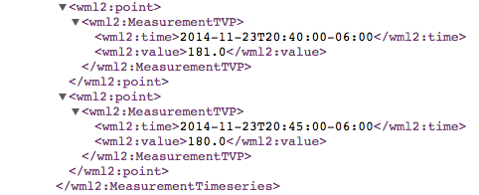
WaterML Web Services CUAHSI, USGS, OGC, WMO…
Water time series data on the internet
24/7/365 service
For daily and real-time data
. . . Operational water web services system for the United States
http://waterservices.usgs.gov/nwis/iv/?format=waterml,2.0&sites=08158000&period=P1D&parameterCd=00060
Notes:
Increasingly, national water data is being published using WaterML to describe time series of observations and model results. This is the current output from the US Geological Survey for one of their tens of thousands of river gauges (this one is on the Colorado River in Austin TX).

Slide 28
Workflows
Flood Maps
8
Measured with water level recorder
Extent of inundation modeled in GIS
1
Stage Height
Stage Time Series
Measured with stream flow meter at a point in time
Apply rating curve to convert discharge to stage height time series
7
2
Discharge Value
Rating Curve
Derived from stage vs. discharge measurements over time at cross-section
Produced by hydraulic models & associated with cross-sections
6
3
Rating Curve
Discharge Time Series
Apply rating curve to convert stage height to discharge time series
Modeled by NFIE-Hydro for every NHDPlus Reach
5
4
Discharge Time Series
Typical Case
Flood Forecasting

Slide 29
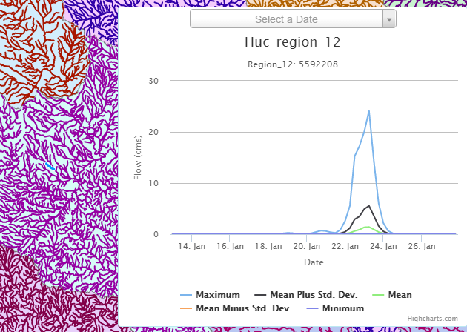
Ensemble Flow Forecast for Reach Catchment 5592208 made on Jan 13, 2015 (15 day horizon) Weather information source: European Center for Medium Range Weather Forecasting (ECMWF). Summary statistics compiled from 50 forecast hydrographs
Source: Jim Nelson, BYU

Slide 30
Workflows
Flood Maps
8
Measured with water level recorder
Extent of inundation modeled in GIS
1
Stage Height
Stage Time Series
Measured with stream flow meter at a point in time
Apply rating curve to convert discharge to stage height time series
7
2
Discharge Value
Rating Curve
Derived from stage vs. discharge measurements over time at cross-section
Produced by hydraulic models & associated with cross-sections
6
3
Rating Curve
Discharge Time Series
Apply rating curve to convert stage height to discharge time series
Modeled by NFIE-Hydro for every NHDPlus Reach
5
4
Discharge Time Series
Typical Case
Flood Forecasting

Slide 31
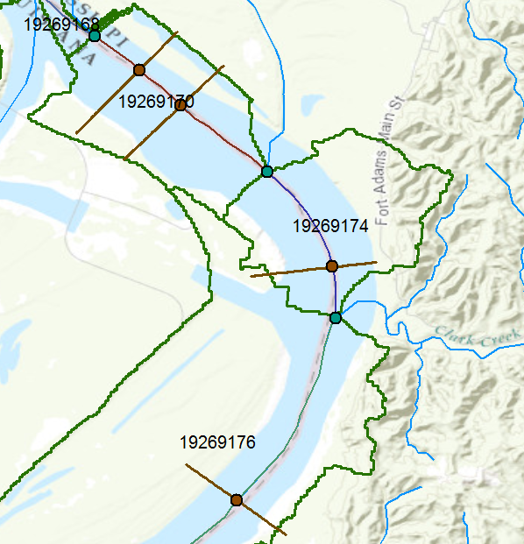
Going from discharge to stage height with simulated rating curves
Monitoring Point on x-section
GFI_Feature
1
+featureOfInterest
(Stage, Discharge) pair
sampling feature
0..*
OM_Observation
GF_PropertyType
+
phenomenonTime
1
+
resultTime
+observedProperty
+
validTime [0..1]
+
resultQuality [0..*]
+
parameter [0..*]
0..*
1
+procedure
+result
(Stage, Discharge) tuples
OM_Process
Any
Conversion Method
Source: USGS
An Observation is an action whose result is an estimate of the value of some property of the feature-of-interest, obtained using a specified procedure
Notes:
We already have rating curves at gages, and we can determine rating curves for any cross-section developed for hydraulic models.
That still doesn’t give us rating curves for all the NHDPlus reaches.
We can work from NED 10m, or LIDAR where available, to extract cross-sections where needed. Accuracy may vary!
Can then take a large-scale hydraulic model (SPRNT) to develop rating curves for all known cross-sections.

Slide 32
Workflows
Flood Maps
8
Measured with water level recorder
Extent of inundation modeled in GIS
1
Stage Height
Stage Time Series
Measured with stream flow meter at a point in time
Apply rating curve to convert discharge to stage height time series
7
2
Discharge Value
Rating Curve
Derived from stage vs. discharge measurements over time at cross-section
Produced by hydraulic models & associated with cross-sections
6
3
Rating Curve
Discharge Time Series
Apply rating curve to convert stage height to discharge time series
Modeled by NFIE-Hydro for every NHDPlus Reach
5
4
Discharge Time Series
Typical Case
Flood Forecasting

Slide 33
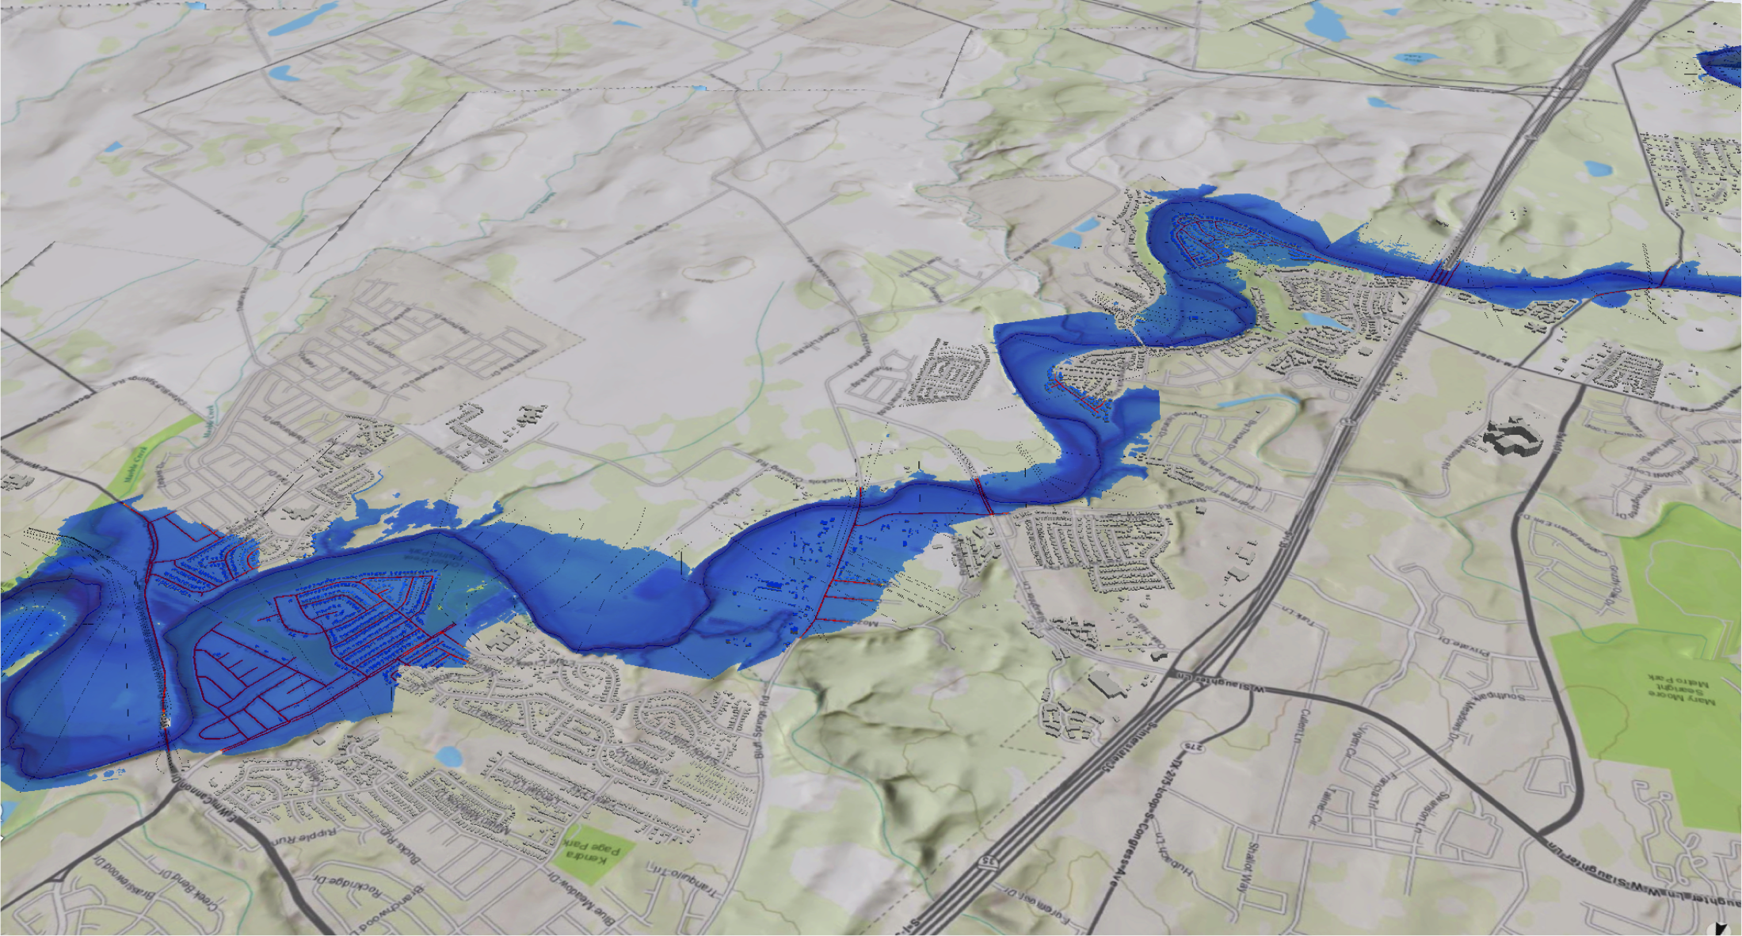
Flood Stage and Inundation

Slide 34
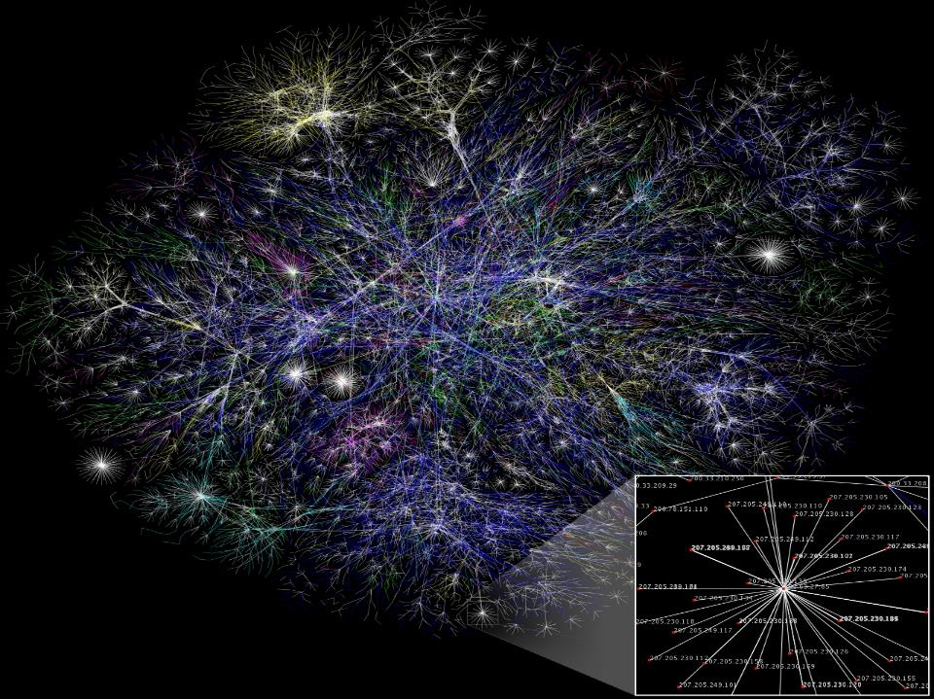
Data sharing occurs over the Web
OGC Service Architecture, AS Topic 12,
ISO 19119 Services

Slide 35
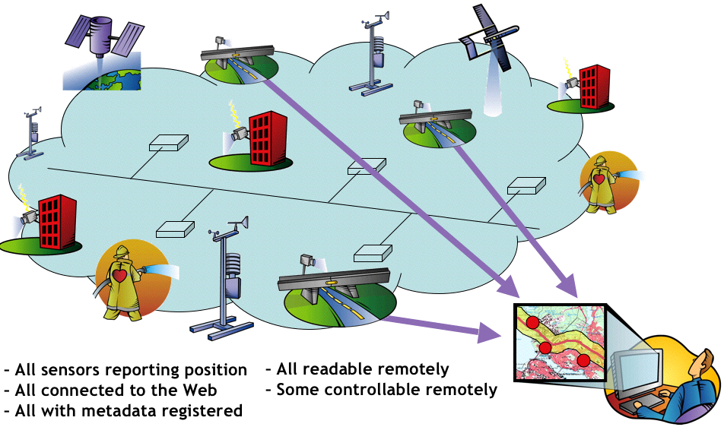
Sensor Web Enablement
OGC Observations & Measurement (O&M) AS Topic 13, ISO 19156,
Sensor Model Language (SensorML), Sensor Observation Service, Sensor Planning Service
Notes:
35
We have a broad definition of sensor – anything that has an IP address, provides information, and/or can be tasked to provide information. Sensors include imaging satellites, weather observing equipment, webcams, water quality monitoring devices, stream gages, stress gages – even a car can be considered a sensor, provided that it can report its location. The OGC Sensor Web Enablement (SWE) standards framework was designed to work with core OGC web services standards to provide for the registration, discovery, access, fusion and use of sensors and sensor data.

Slide 36
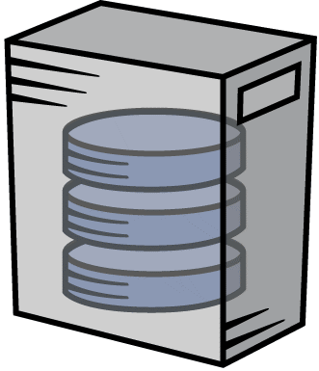
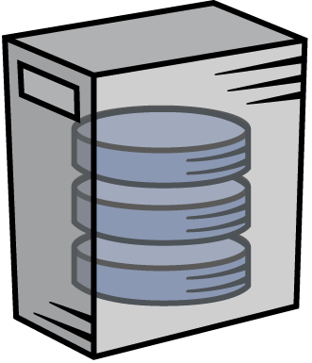
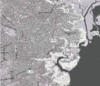
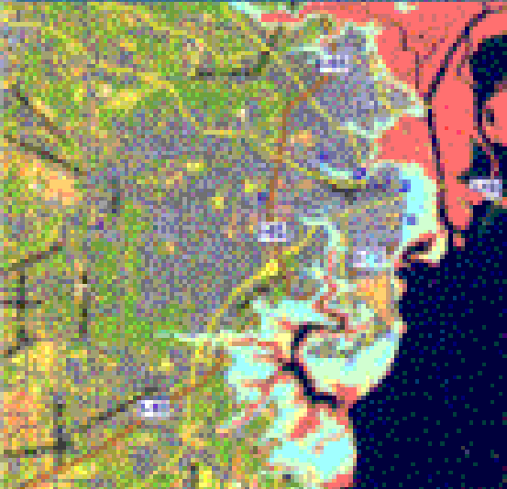
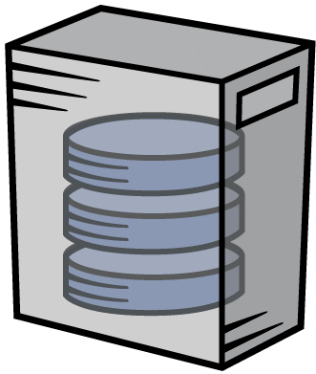
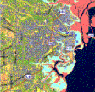
Roads, Gages
Web Feature Service (WFS)
Flooding
Web Coverage Service (WCS)
Web Client App
Gage Height
Sensor Observation
Service (SOS)
Base Map
Web Map Service (WMS)
With OGC web services, an analyst or operator can dynamically access that data which is relevant to the task at hand, directly from the authoritative data steward, using a variety of tools.
Notes:
WMS: http://www.opengeospatial.org/standards/wms
WFS: http://www.opengeospatial.org/standards/wfs
WCS: http://www.opengeospatial.org/standards/wcs
SOS: http://www.opengeospatial.org/standards/sos

Slide 37
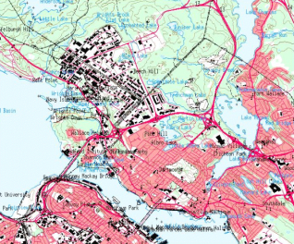
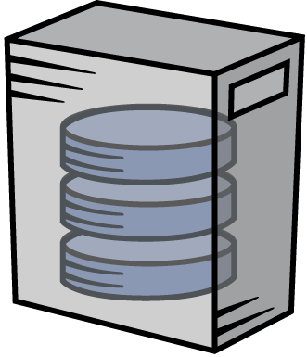
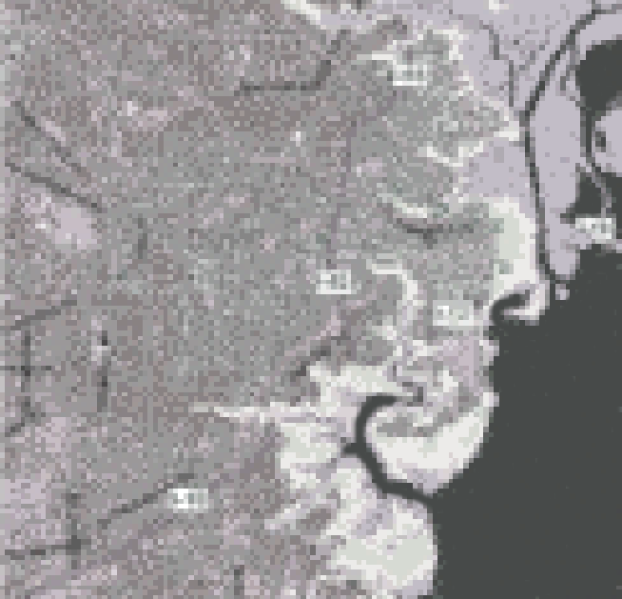
Web Service Geo-Processing Workflow
Service chaining enables modeling and integration from observation data
Scenario: Tracking spread of wildfire and proximity to highway
WCS = Web Coverage Service
WCTS = Web Coordinate Transform. Serv.
WPS = Web Processing Service
OGC
Interfaces
Decision Support Client
Internet
SOS
WCTS
WPS
WFS
…
Web Servers
Notes:
Web-based geospatial service chaining and decision support. How do we reliably and repeatedly combine results from several distributed services on the web to produce a result for a user? Service chaining is the term commonly used for the process of organizing disparate web based services into an orderly process. For instance, a raw image is sent to a service that performs a coordinate transformation. This services sends the transformed image to a classifier service that processes the image to highlight areas of active fire. The result of this service is sent to a user’s client along with other geospatial data such as vegetation overlays, transportation. Service chaining will play an important role in future capabilities.
WCTS: http://www.opengeospatial.org/standards/ct
WPS: http://www.opengeospatial.org/standards/wps

Slide 38
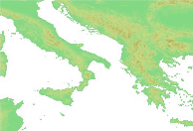
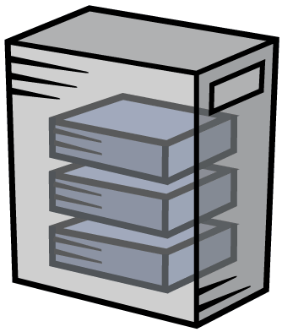
Web Map Service (WMS) can get multiple maps
_{Elevation}
_{Cloud Cover}
_{Borders}
_{Cities}
Multiple
overlaid maps
One GetMap
request:

Slide 39
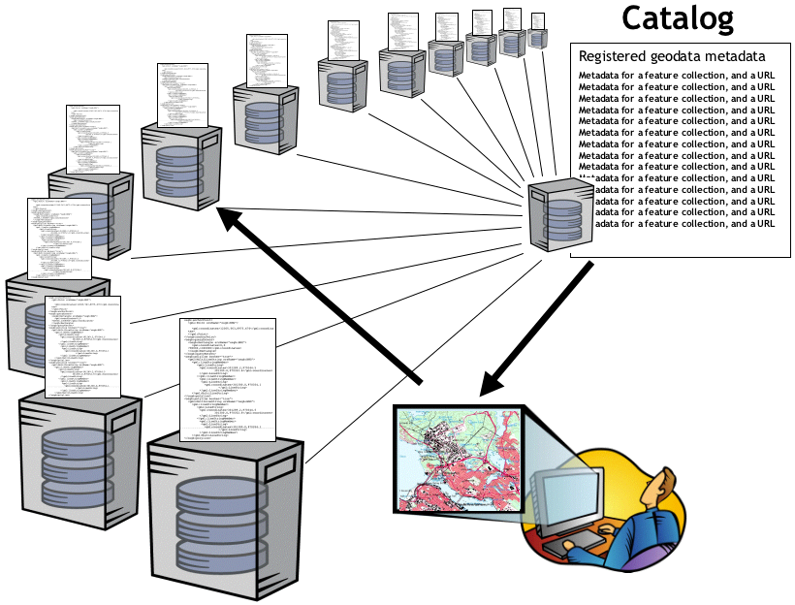
Publishing and Discovery
Catalogs register ISO conformant metadata about data services
Supports publishing and discovery of distributed geospatial data and associated services
OGC Catalogs, AS Topic 13,
ISO 19115/19119 Metadata Standards

Slide 40
References
The OpenGIS Abstract Specification Topic 0: Abstract Specification Overview, OGC 04-084, http://portal.opengeospatial.org/files/?artifact_id=7560
The OpenGIS Abstract Specification Topic 5: Features, OGC 08-126, http://portal.opengeospatial.org/files/?artifact_id=29536
OGC Reference Model (ORM) v2.1 http://www.opengeospatial.org/standards/orm
ISO 19101-1:2013 – Geographic Information – Reference Model – Part 1: Fundamentals, http://www.iso.org

Slide 42
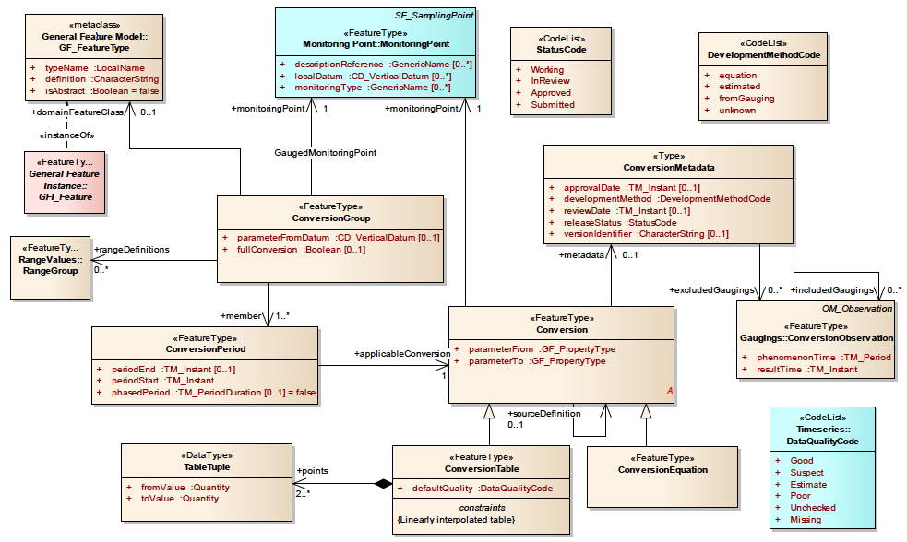
(draft) WaterML 2.0 Part 2: Conversions Model
Potentially, the actual conversion equation or other method could be exchanged, not just the data points on the rating curve.
Notes:
Source: OGC 13-021r3 WaterML2 Part 2 – Ratings, Gaugings and Sections Discussion Paper, chapter 7, page 14
Some hydrologists would like to exchange the equation or other method for the rating curve; not just the (x,y) points on the curve.
This is apparently a tough thing to conceptualize in a rigorous specification.

Slide 43
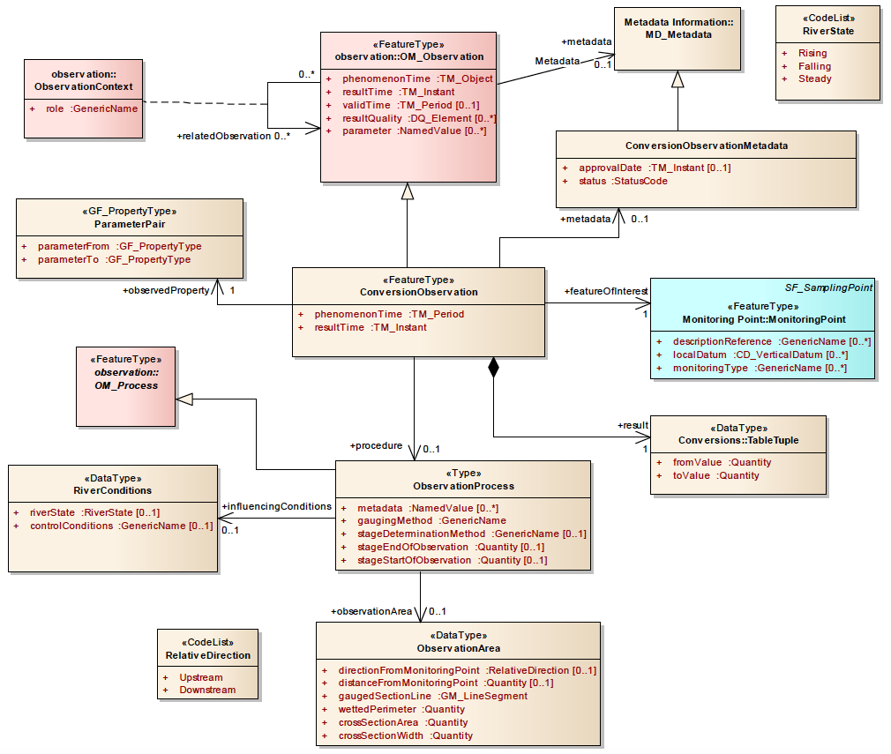
(draft) WaterML 2.0 Part 2: Gaugings Model
Notes:
Source: OGC 13-021r3 WaterML2 Part 2 – Ratings, Gaugings and Sections Discussion Paper, chapter 8, page 20

Slide 44
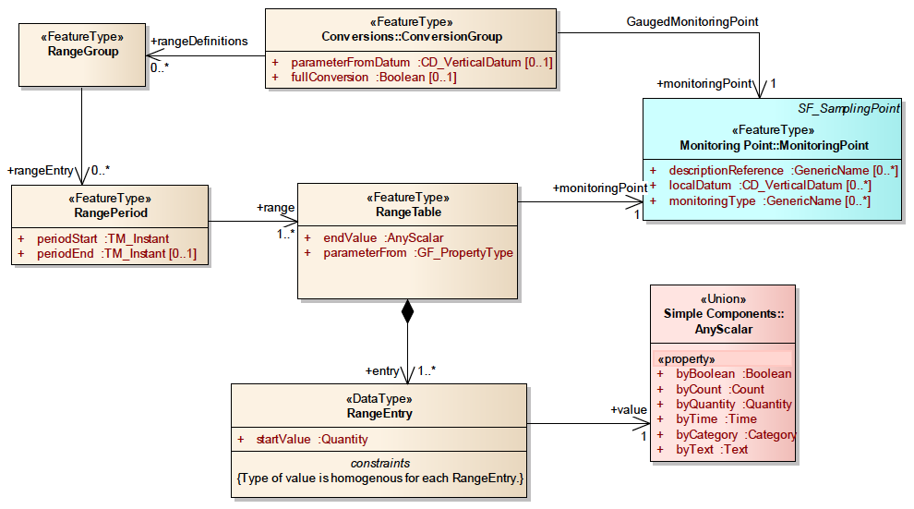
WaterML 2.0 Part 2: Model for Range Values
Similar to conversion table except that the value applies across a broad input range, and the content describes a state or condition that varies with the input range, rather than a conversion.
Notes:
Source: OGC 13-021r3 WaterML2 Part 2 – Ratings, Gaugings and Sections Discussion Paper, chapter 9, page 27

Slide 45
WaterML 2.0 Part 2: Model for Range Values
Range tables are a data structure that is similar to a conversion table except
The value applies across a broad input range and the content describes a state or condition that varies with the input range, rather than a conversion
Range tables may carry information that relates to, or adds value to, a conversion table.
E.g. Information describing the rating construction method.
A range table may carry information that is of value in it own right.
E.g. Stage V. over bank flow condition (confined to channel, over bank flow).
Notes:
Source: OGC 13-021r3 WaterML2 Part 2 – Ratings, Gaugings and Sections Discussion Paper, chapter 9, page 27

