Slide 1
CE 397 Flood Forecasting
University of Texas at Austin (David Maidment)
and University of Alabama (Andy Ernest)
Spring Semester, 2015
Lecture 1: Introduction to the National Flood Interoperability Experiment

Slide 2
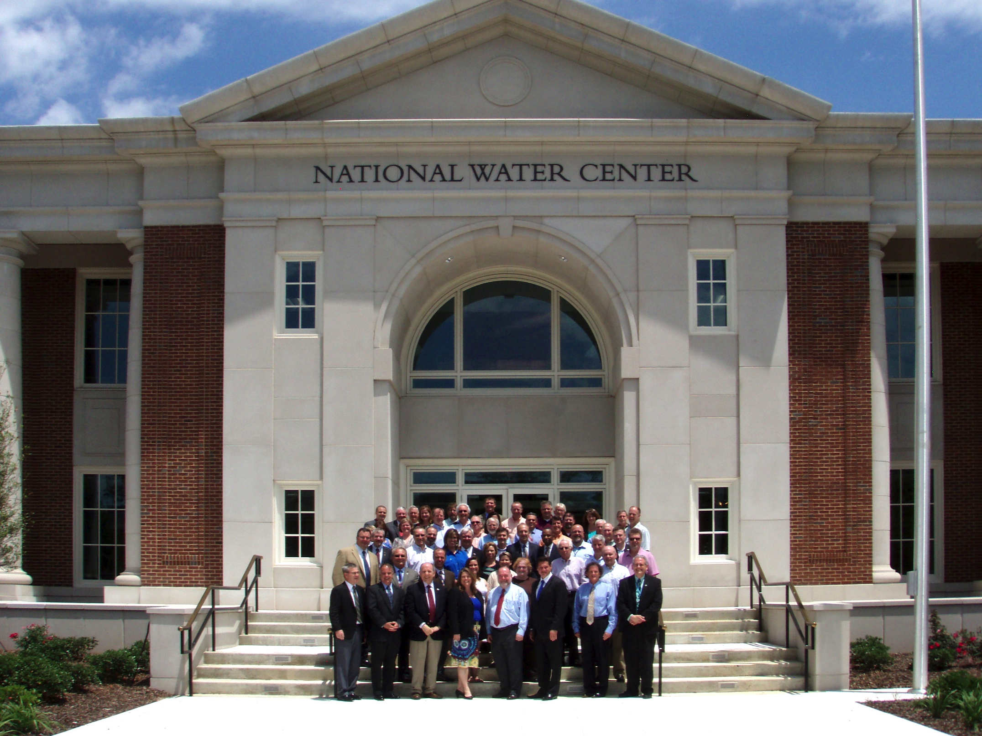
Proposal for National Flood Interoperability Experiment
Inaugural Meeting – May, 2014

Slide 3
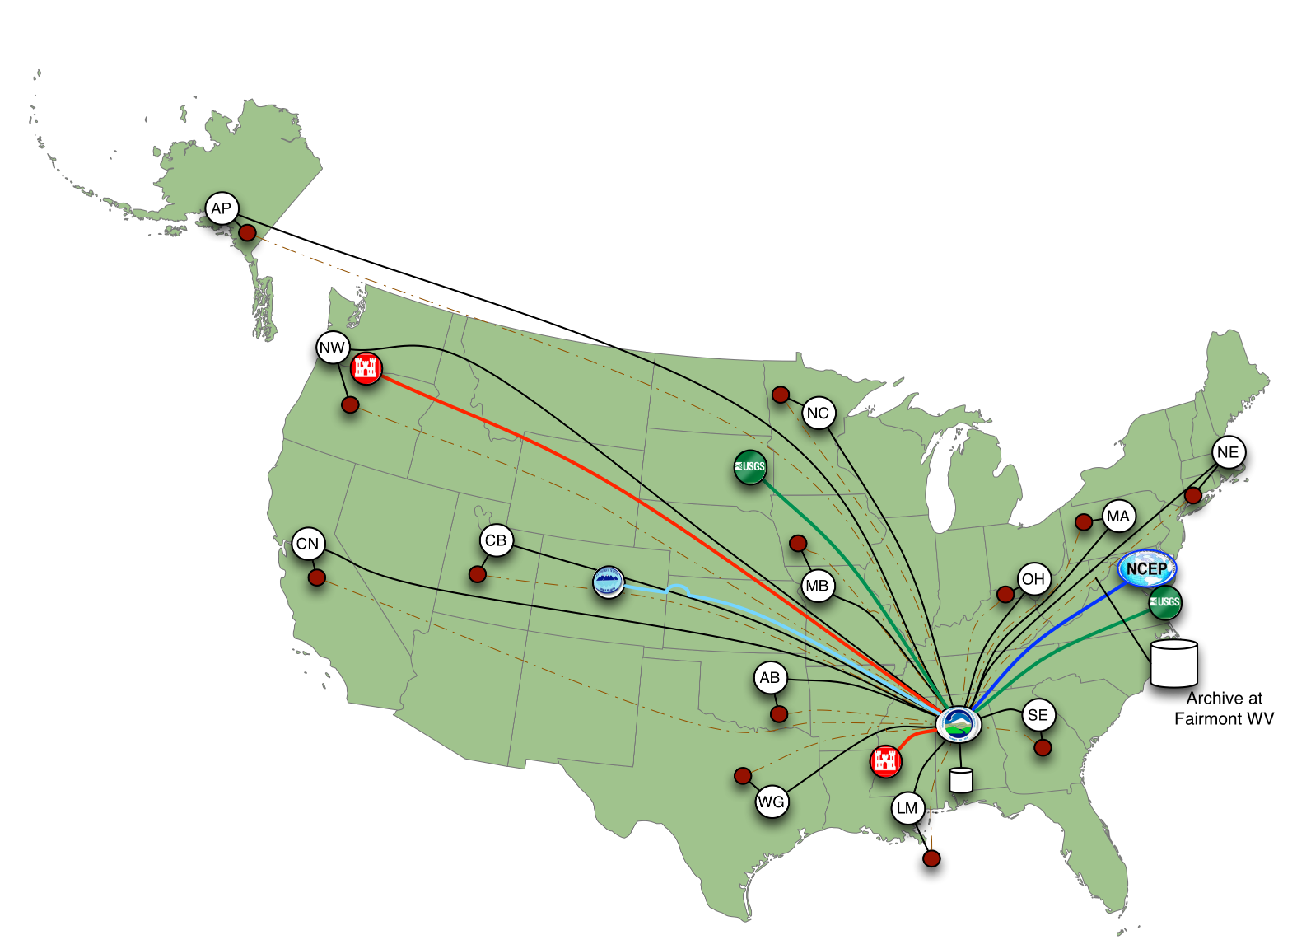
Nationally Synthesize Operations of Regional River Forecast Centers

Slide 4
National Flood Interoperability Experiment (NFIE)
Will be led by the academic community coordinated by CUAHSI in collaboration with the IWRSS partners through the National Water Center
Run from September 2014 to August 2015
  Preparatory phase to May 2015
  Summer Institute at the National Water Center, June 1 to July 17 2015

Slide 5
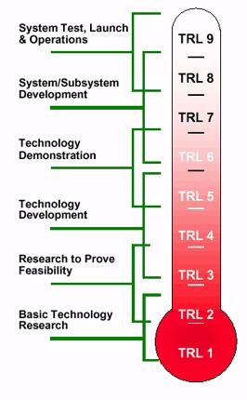
Technical Readiness Levels
The NFIE is a research effort
It will not create an operational system
It will not produce public forecast information
NFIE
http://en.wikipedia.org/wiki/Technology_readiness_level

Slide 6









NFIE Goal: Connect National Scale Flood Modeling with Local emergency planning and response
How can near-real-time hydrologic simulations at high spatial resolution, covering the nation, be carried out using the NHDPlus or next generation hydro-fabric (e.g. data structure for hillslope, watershed scales)?
How can this lead to improved emergency response and community resilience?
How can an improved interoperability framework support the first two goals and lead to sustained innovation in the research to operations process?
Slide: Ed Clark, NWS

Slide 7
National Flood Interoperability Experiment (NFIE):
Five Components
NFIE-Geo: National geospatial framework for hydrology
NFIE-Response: Wide area planning for flood emergency response
NFIE-Hydro: National high spatial resolution hydrologic forecasting
NFIE-River: River channel information and real-time flood inundation mapping
NFIE-Services: Web services for flood information

Slide 8
National Flood Interoperability Experiment (NFIE)
Component One: NFIE-Geo
NFIE-Geo: National geospatial framework for hydrology
NFIE-Response: Wide area planning for flood emergency response
NFIE-Hydro: National high spatial resolution hydrologic forecasting
NFIE-River: River channel information and real-time flood inundation mapping
NFIE-Services: Web services for flood information

Slide 9
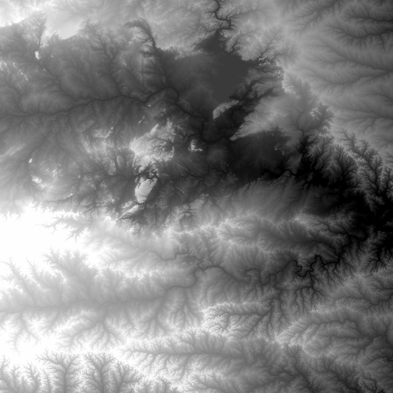
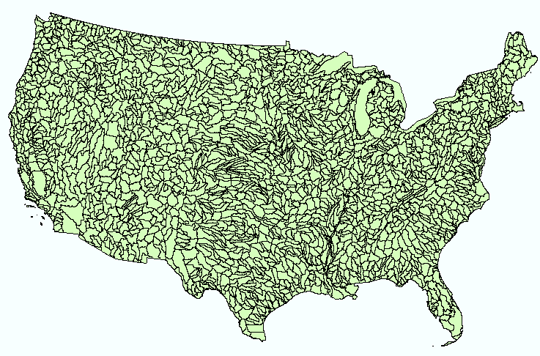
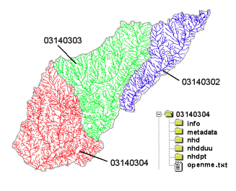
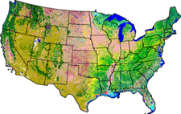
NHDPlus Version 2
Geospatial foundation for a national water data infrastructure
NHDPlus
2.67 million reach catchments in US
average area 3 km²
reach length 2 km
National Elevation Dataset
Watershed Boundary Dataset
National Hydrography Dataset
National Land Cover Dataset

Slide 10
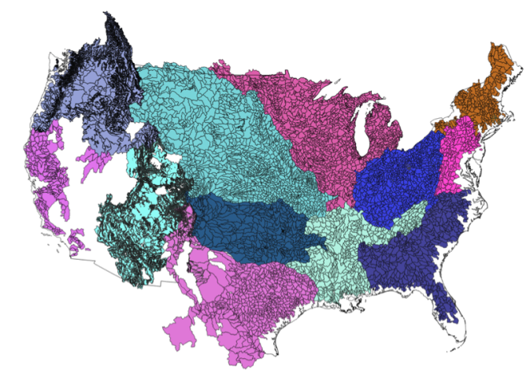


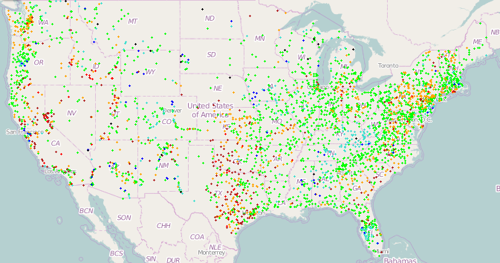
NFIE-Geo for National Flood Interoperability Experiment
Enhanced geospatial database for a national water data infrastructure
NWS Basins and
Forecast Points
USGS Water Watch
Points
National Flood
Hazard Layer
Feature classes:
Subwatershed (HUC12)
Catchment
Flowline
Waterbody
Dam
NFIE-Geo
9 feature classes
5 from NHDPlus
4 from IWRSS
NHDPlus

Slide 11
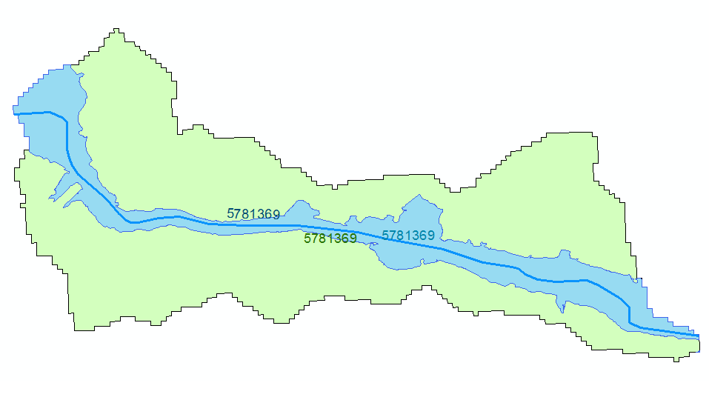
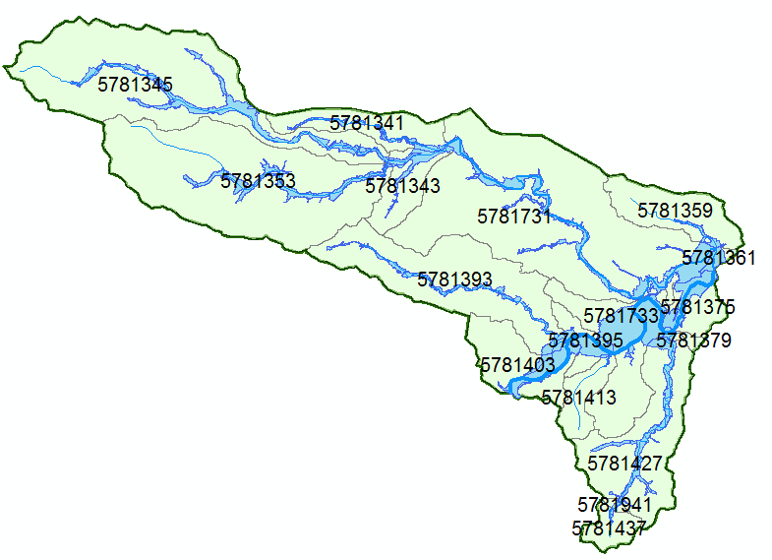
NHDPlus Reach Catchments and Subwatersheds
Reach Catchment
Subwatershed
Catchment 5781369
HUC12 Subwatershed
Contains reach catchments
Base for Hydrologic modeling
and flood emergency response planning
Each reach catchment has a single flow line
Uniquely labeled across the nation
Flood hazard zone defined by FEMA map

Slide 12
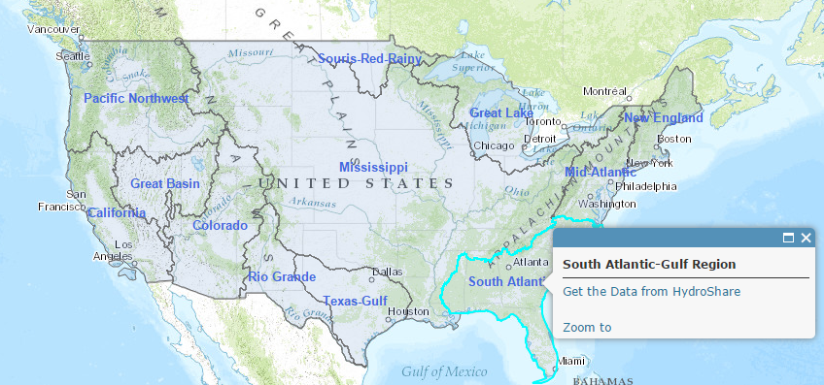
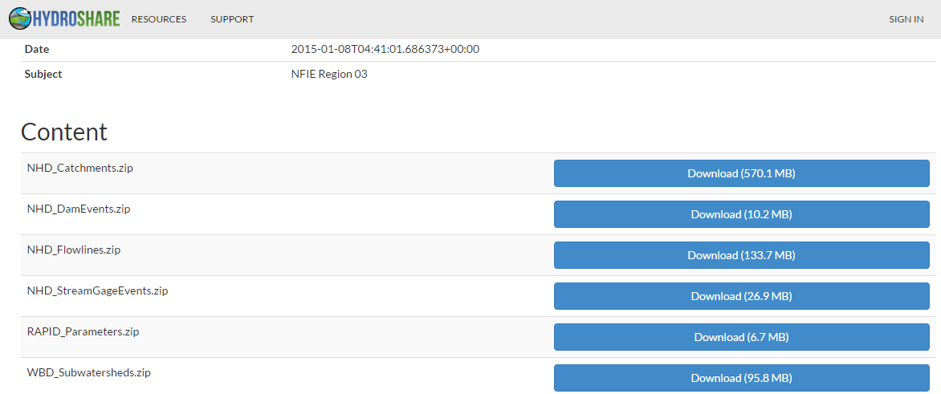
NFIE-Geo in HydroShare
https://www.arcgis.com/home/webmap/viewer.html?webmap=2c30160429984a59873f26b9d118dbfe
David Tarboton, Utah State Univ
and Ray Idaszak, RENCI

Slide 13

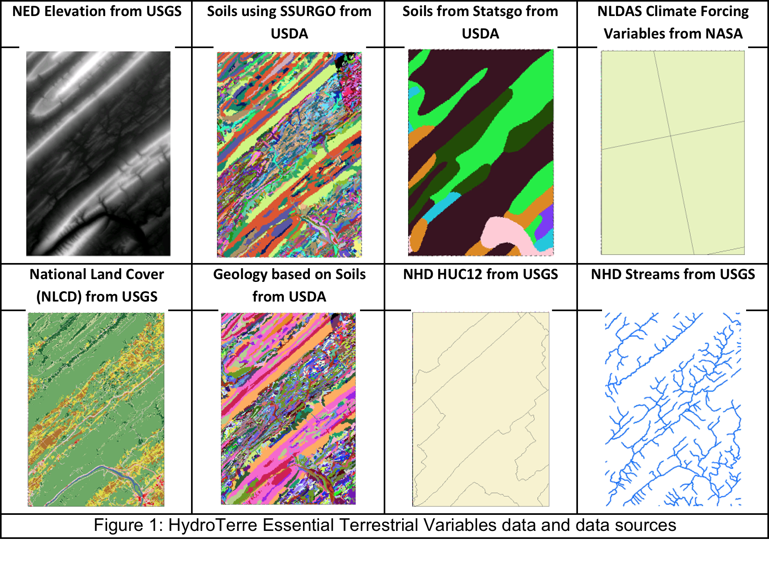
HydroTerre: A Service for HUC12 Data Access
Lorne Leonard and Chris Duffy
GSSURGO
Need workflow here
200 TB of information

Slide 14
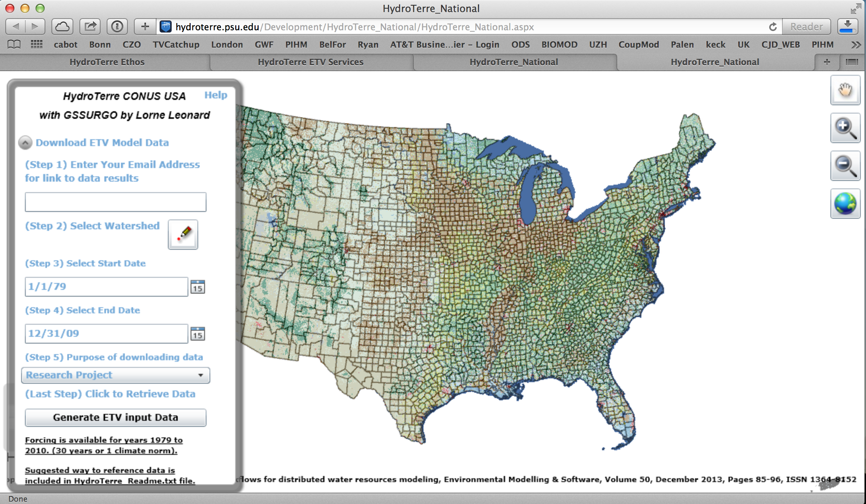
www.HydroTerre.psu.edu: Interface
200 TB of information
Leonard, L., C. Duffy. 2013. Essential Terrestrial Variable data workflows for distributed water resources modeling,
Environmental Modelling & Software, 50, p. 85-96

Slide 15
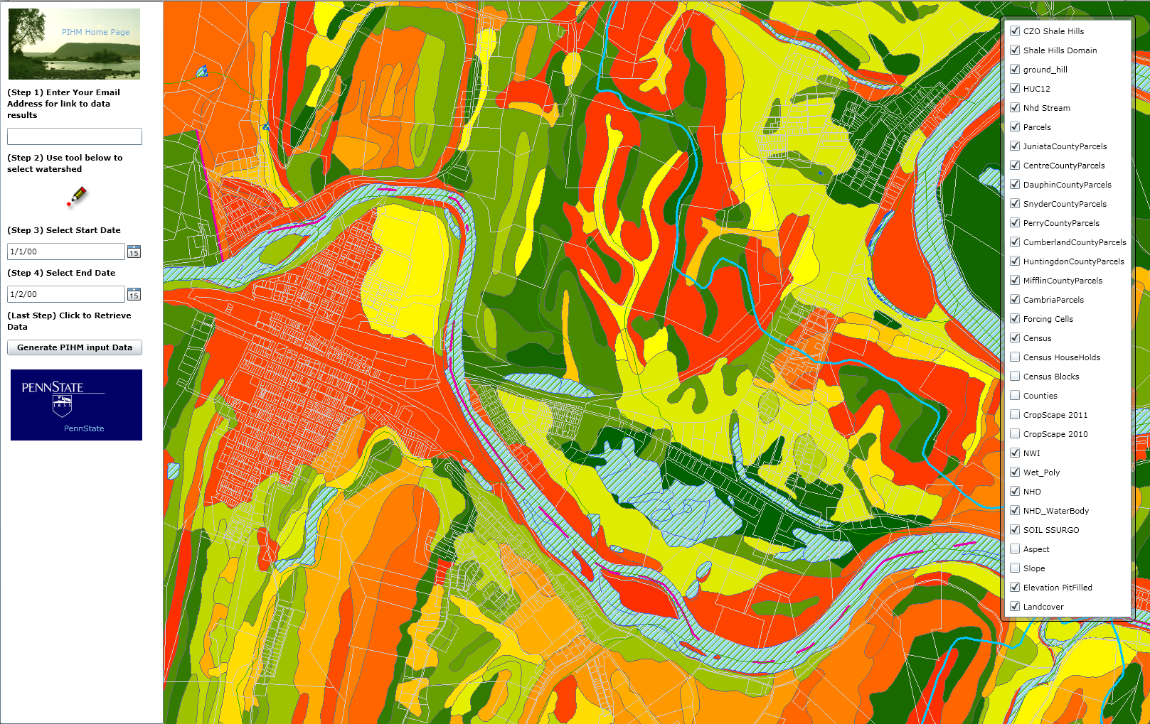
HydroTerre: A Prototype fo Model-Data Access
Land Parcel Data; NHD: Stream, Lake, HUC’; USDA: Soils/Crops; NLCD: LU_LC;

Slide 16
HydroTerre: A Prototype Model-Data Workflow
Produce new hydrologic models at HUC12 scale
Need workflow here

Slide 17
Penn State Integrated Hydrolgic Model

Slide 18
Xuan Yu Watershed Modeling with PIHM

Slide 19
National Flood Interoperability Experiment (NFIE)
Component Two: NFIE-Hydro
NFIE-Geo: National geospatial framework for hydrology
NFIE-Response: Wide area planning for flood emergency response
NFIE-Hydro: National high spatial resolution hydrologic forecasting
NFIE-River: River channel information and real-time flood inundation mapping
NFIE-Services: Web services for flood information

Slide 20
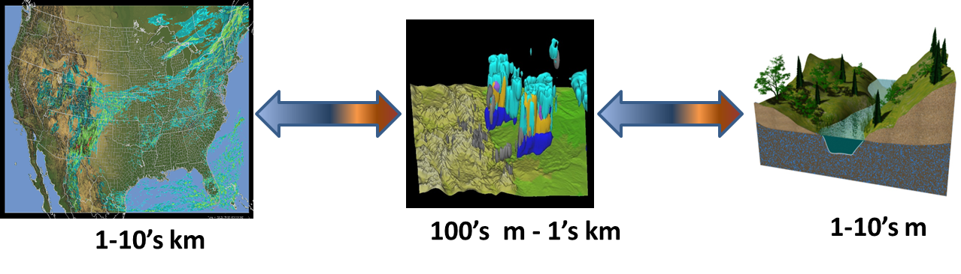
Overarching WRF-Hydro Scientific Objectives
(David Gochis, NCAR)
A community-based, supported coupling architecture designed to provide:
An extensible multi-scale & multi-physics land-atmosphere modeling capability for conservative, coupled and uncoupled assimilation & prediction of major water cycle components such as precipitation, soil moisture, snowpack, groundwater, streamflow, inundation
Streamflow prediction across scales (from 0-order headwater catchments to continental river basins & minutes to seasons)
A robust framework for land-atmosphere coupling studies

Slide 21
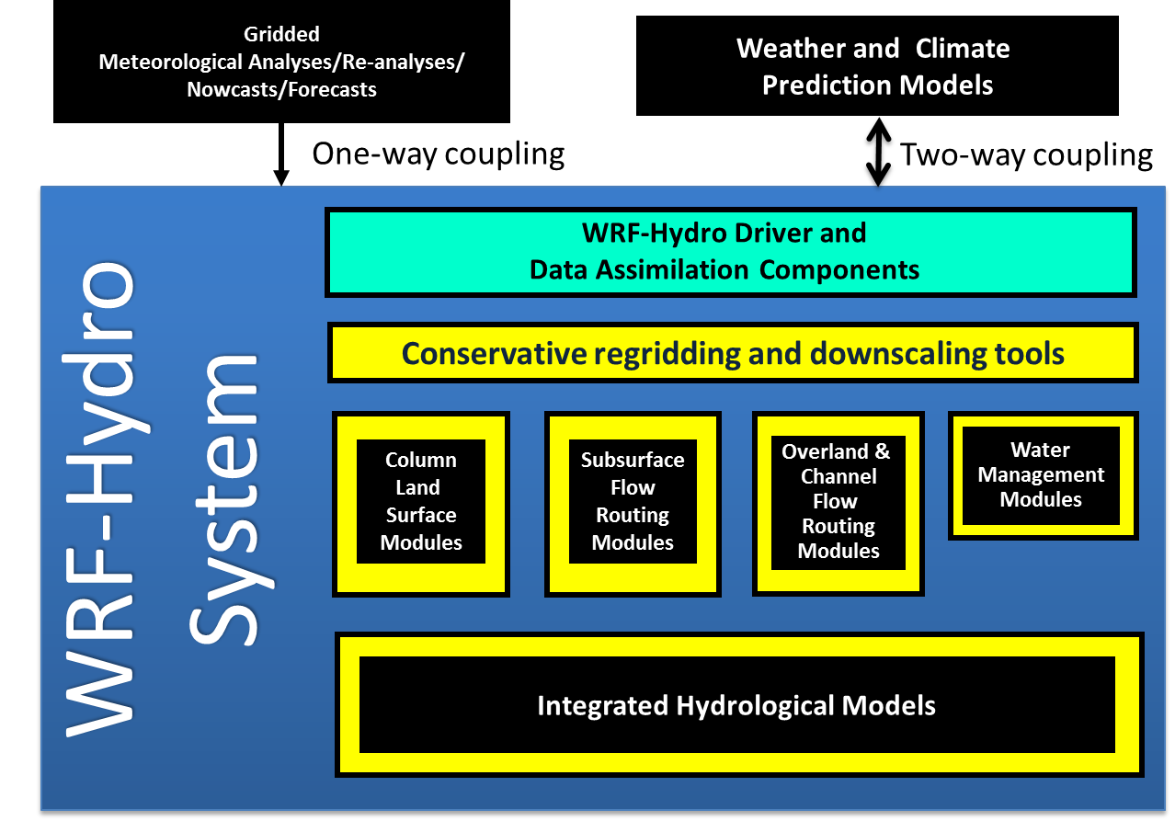
Notes:
Remember that LSM is only req’d when run ‘offline’, when run ‘coupled’ the land model with the atmo model can be used….

Slide 22
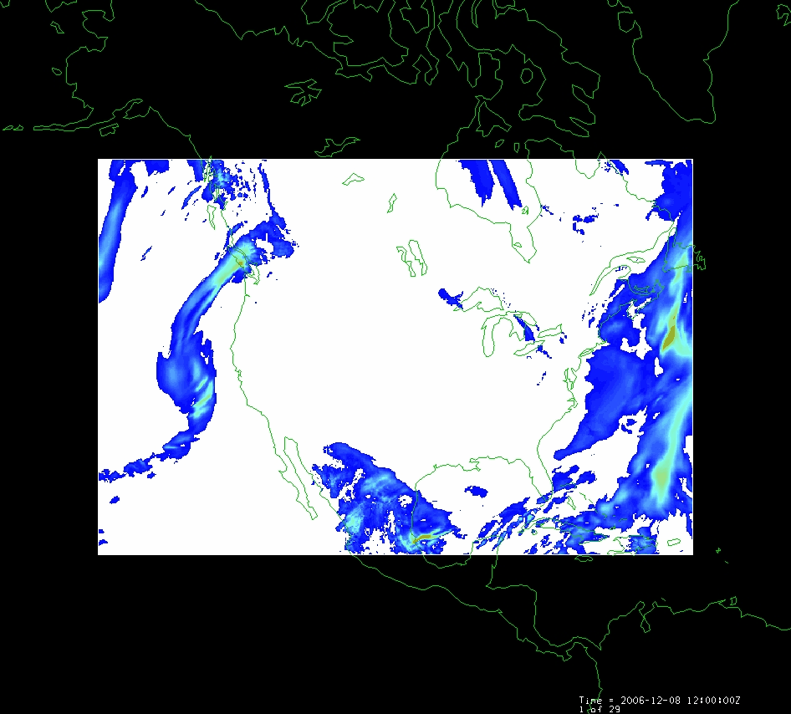
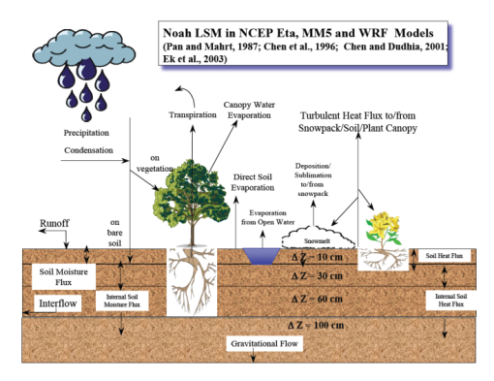
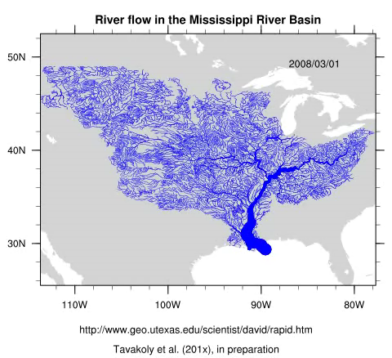
Modeling of Weather, Hydrology, River Flow in WRF-Hydro
Forcing:
Radiation
Precipitation
Surface climate
Evaporation
Soil Moisture
Runoff
Recharge
Observations Datasets, Numerical Weather Model
Soil
Vegetation
Terrain
Network River Flow
Land Surface Model
RAPID: River Routing
on NHDPlus

Slide 23

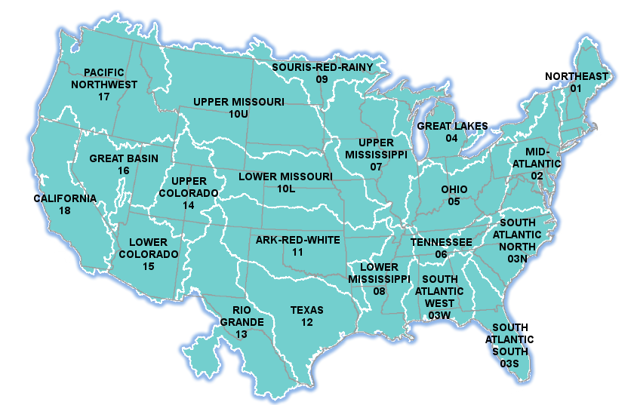

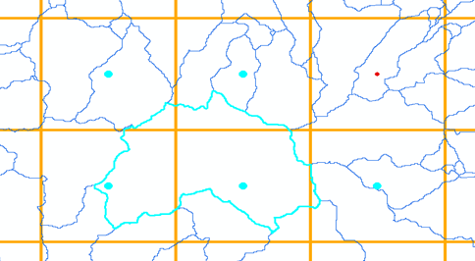
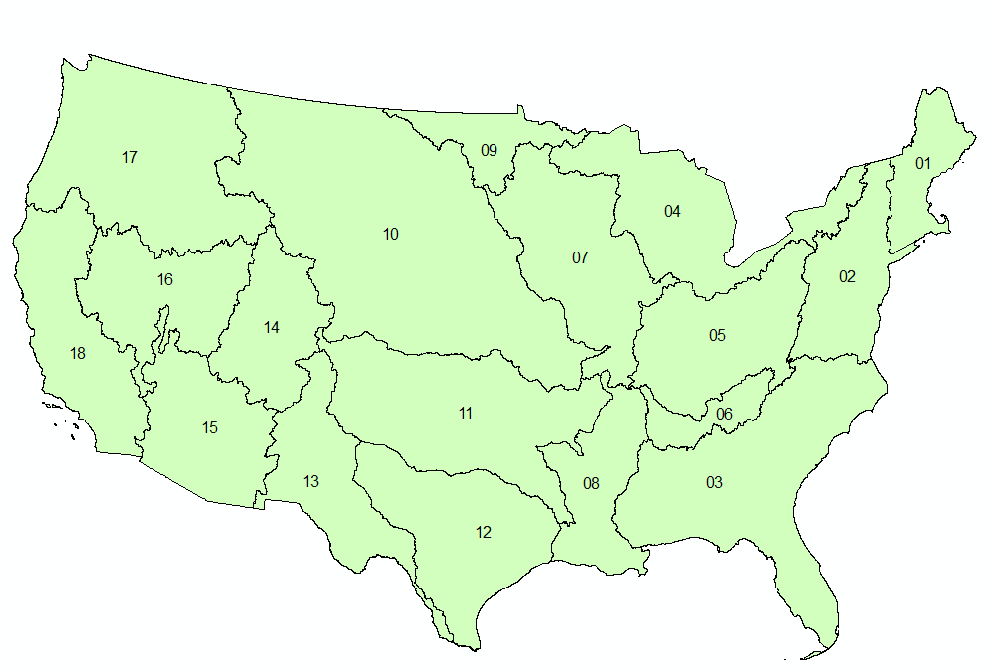
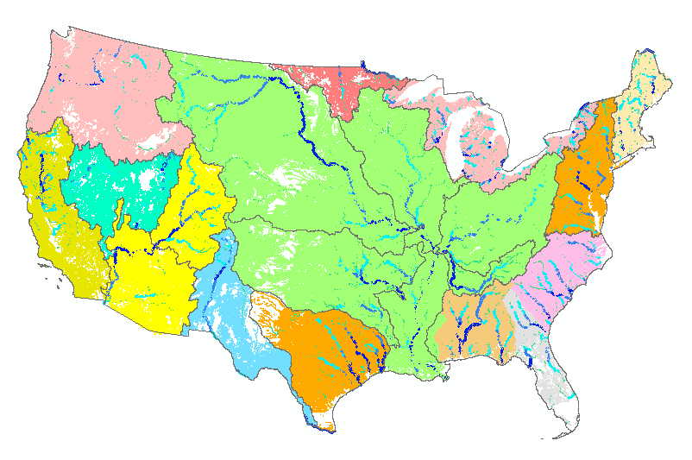
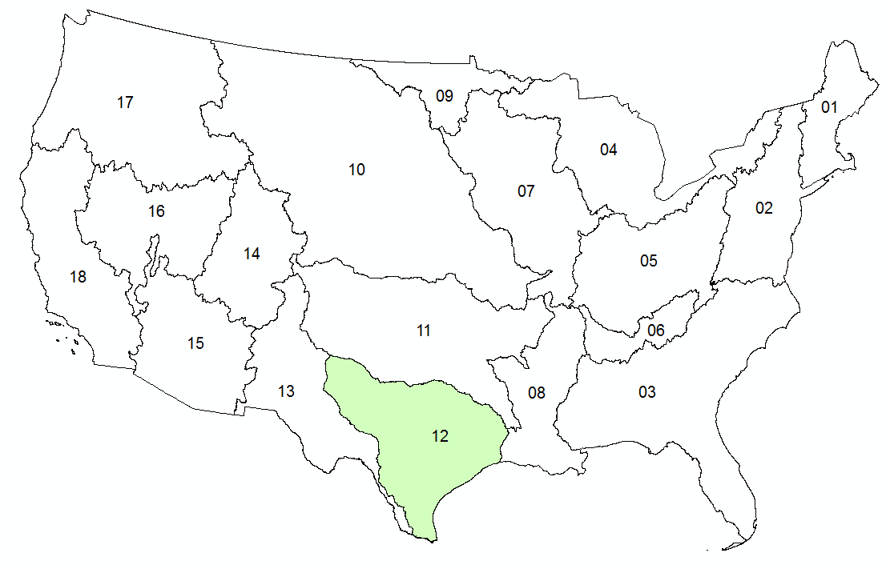

WRF-Hydro and RAPID
Pending
Completed
NWS River Forecasts
WRF-Hydro Model
NHDPlus to
RAPID Conversion
Grid to Catchment Linking
Forecast services
NFIE-Hydro

Slide 24
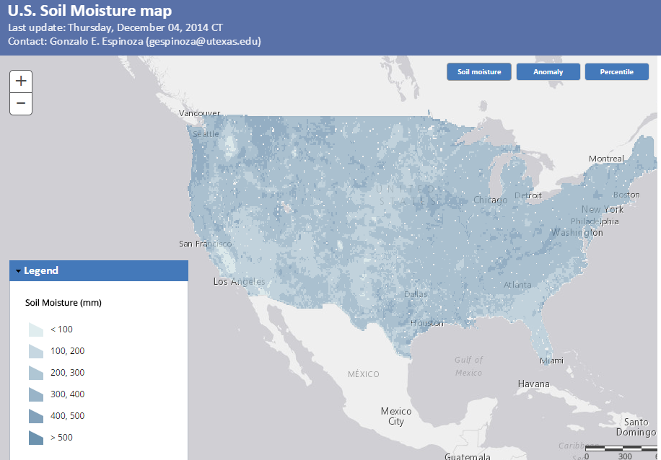
Soil Moisture Map (mm water in top 1 m of soil from NASA Land Data Assimilation System)
Map is created each day using NASA services
Include forecast soil moisture in NFIE
http://statsnldas.azurewebsites.net/

Slide 25
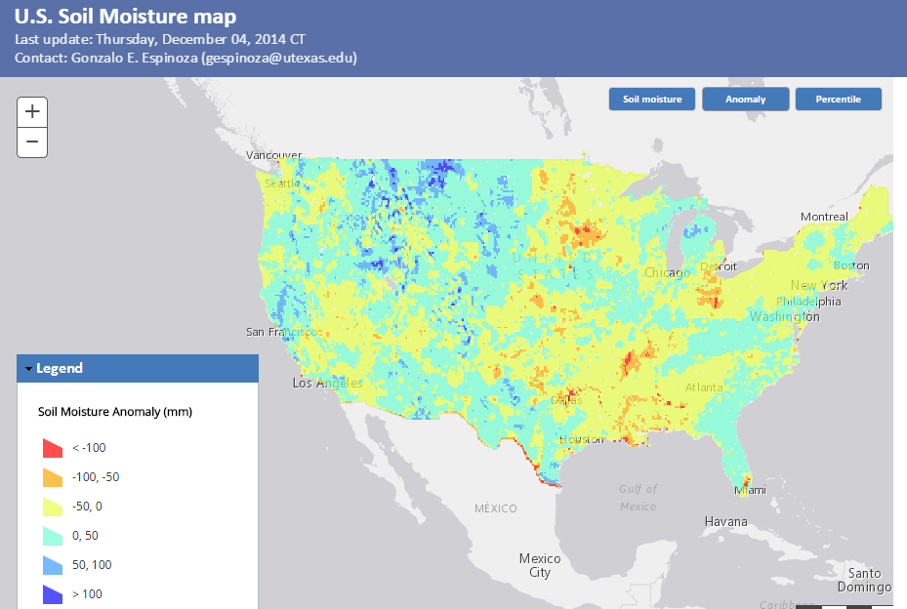
Soil Moisture Anomaly Map
(current value – mean for calendar day at each spatial point)
Map is created each day using NASA services
http://statsnldas.azurewebsites.net/

Slide 26
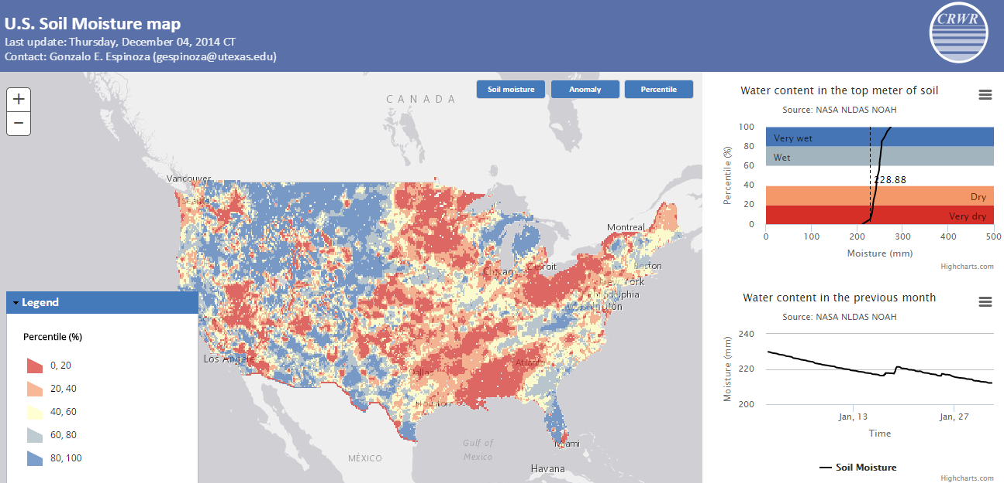
Soil Moisture Percentile Map
Current value expressed as a percentile based on historical data [1979 to present] on this calendar day at this spatial point
Compare present soil moisture with past conditions
http://statsnldas.azurewebsites.net/

Slide 27
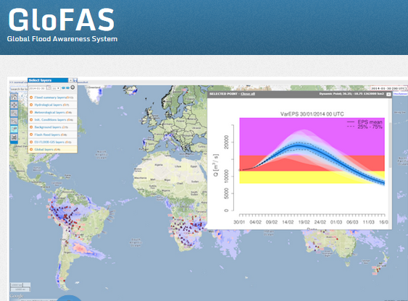
European Center for Medium Range Weather Forecasting and European Joint Research Commission
15 Day ahead forecast ensemble (50 hydrographs) at each location

Slide 28
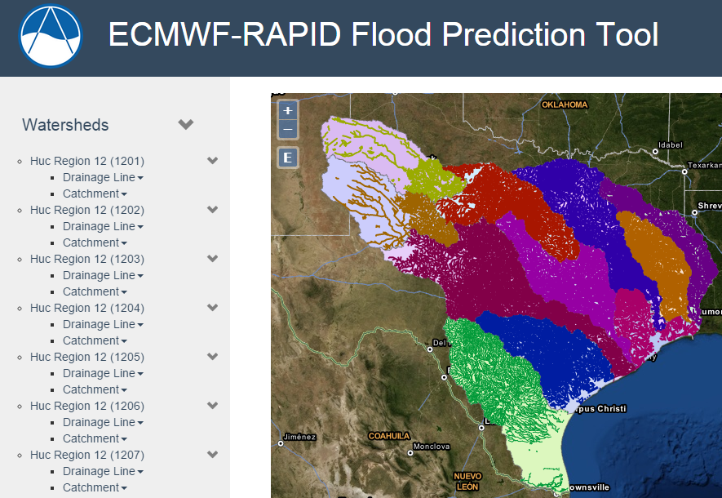
Hydrologic Forecasting for the Texas-Gulf Region
(from Brigham Young University)
(67,313 NHDPlus reaches)
Source: Jim Nelson, BYU
http://demo.tethys.ci-water.org/

Slide 29
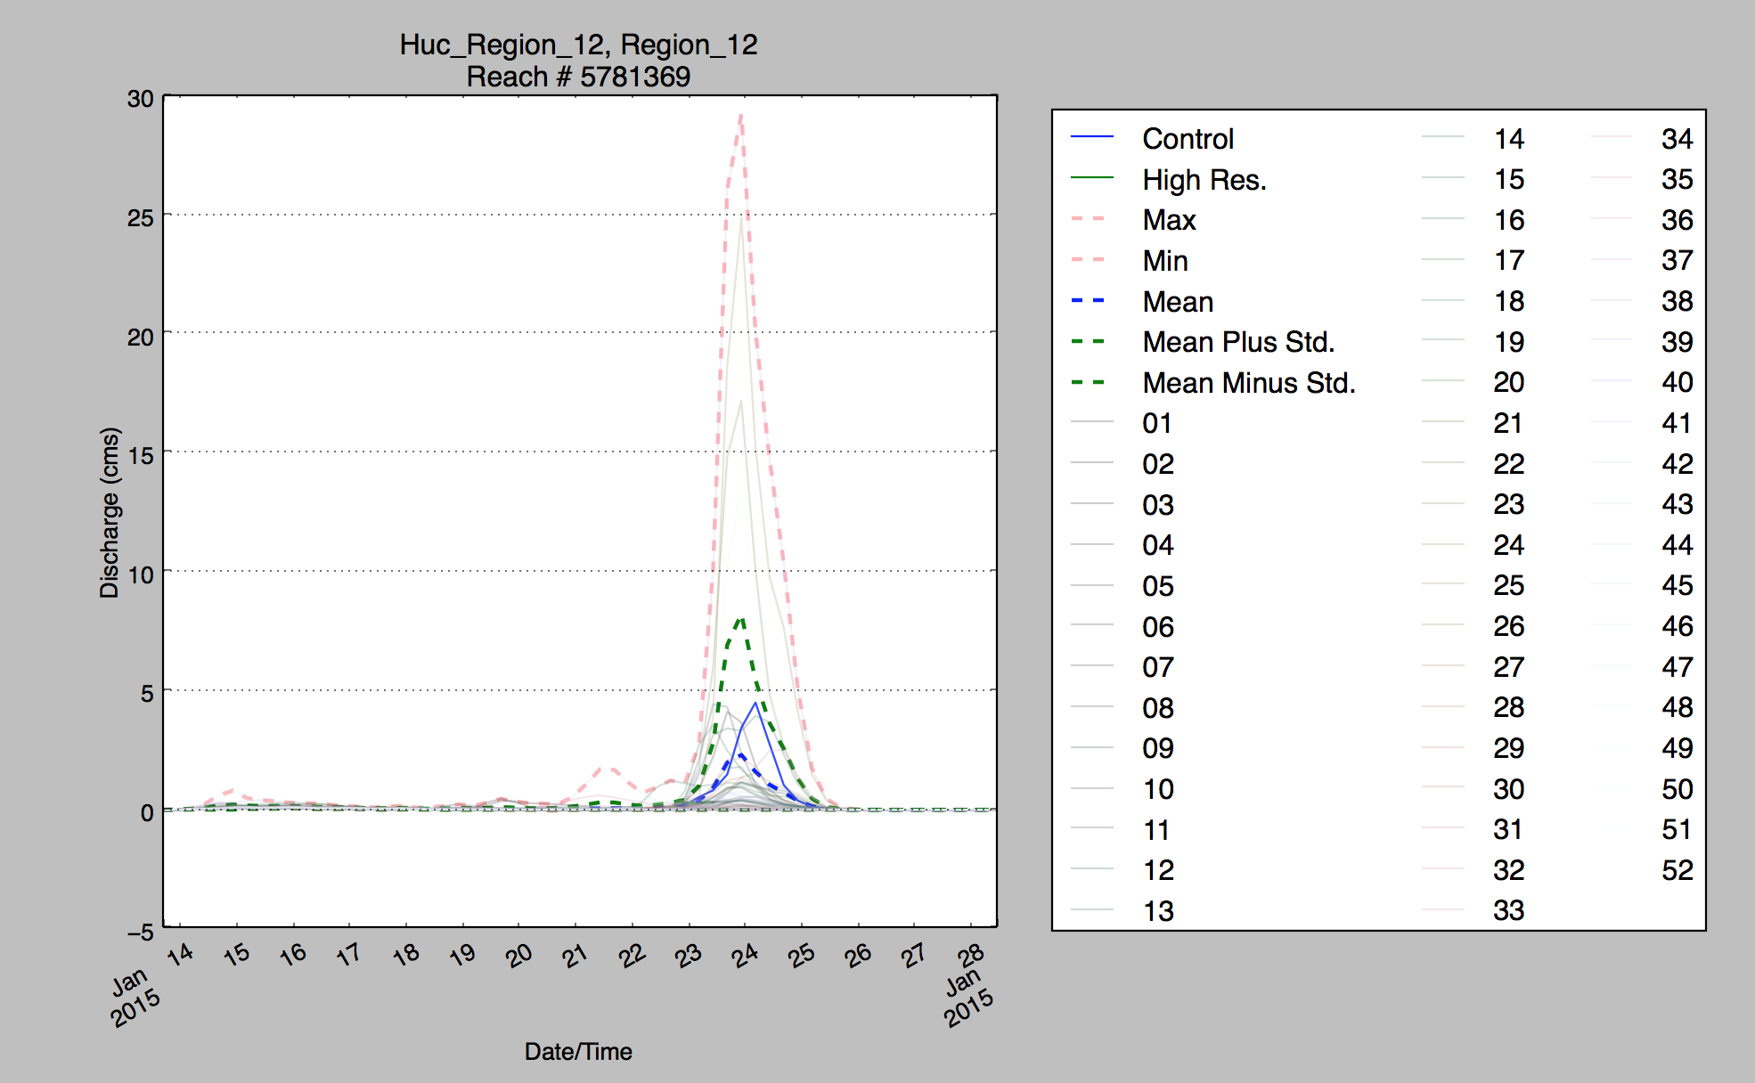
50 Ensemble Forecasts
Source: Jim Nelson, BYU

Slide 30
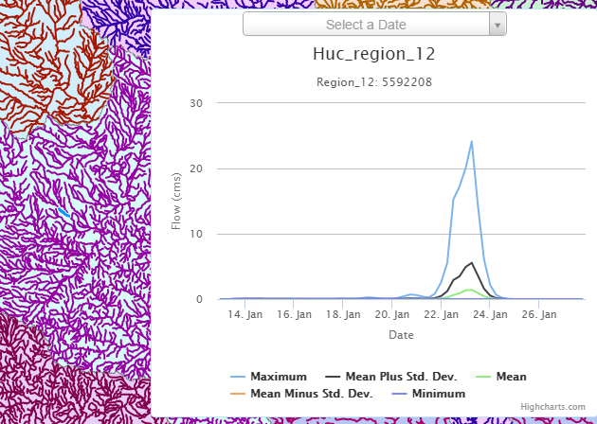
Ensemble Flow Forecast for Reach Catchment 5592208 made on Jan 13, 2015 (15 day horizon)
Weather information source: European Center for Medium Range Weather Forecasting (ECMWF). Summary statistics compiled from 50 forecast hydrographs
Source: Jim Nelson, BYU

Slide 31
National Flood Interoperability Experiment (NFIE)
Component Three: NFIE-River
NFIE-Geo: National geospatial framework for hydrology
NFIE-Response: Wide area planning for flood emergency response
NFIE-Hydro: National high spatial resolution hydrologic forecasting
NFIE-River: River channel information and real-time flood inundation mapping
NFIE-Services: Web services for flood information

Slide 32
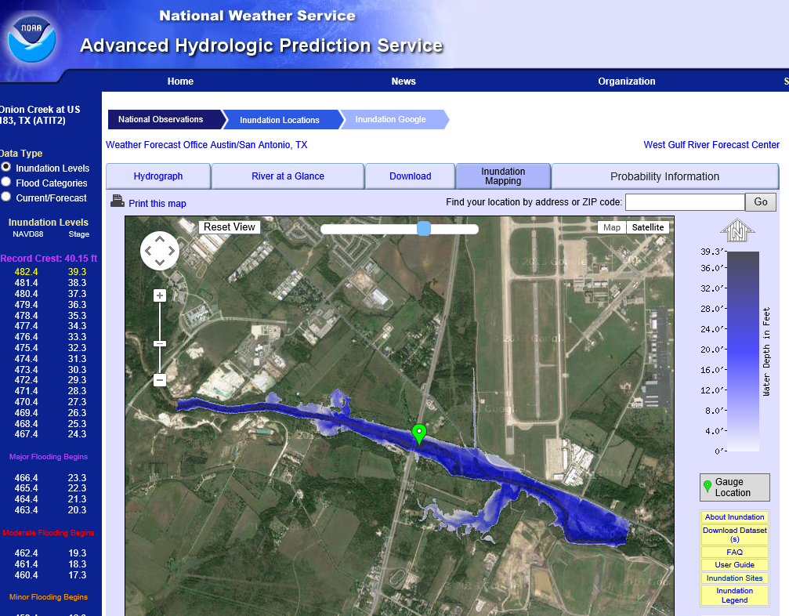
Real-Time Flood Inundation Mapping (USGS/NWS)
http://water.weather.gov/ahps2/inundation/inundation_google.php?gage=atit2

Slide 33
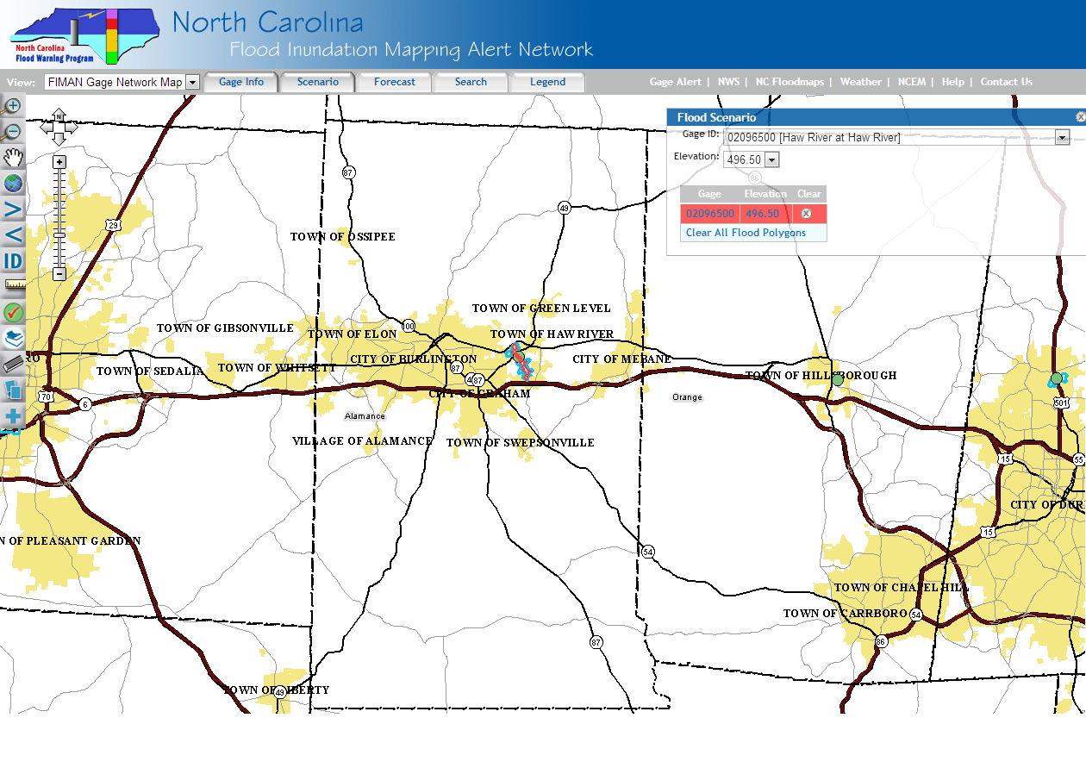
Another Gage up here
Gage is here
Big gaps in flood inundation mapping between gages need to be filled in
Another Gage down here…
Slide: Ken Ashe, NCFMP

Slide 34
North Carolina Floodplain Mapping Program HEC- RAS Models
  5 Recurrence Intervals: 10, 25, 50, 100, 500
  300,000 cross-sections
  Each cross-section has a rating curve
Slide: Ken Ashe, NCFMP

Slide 35
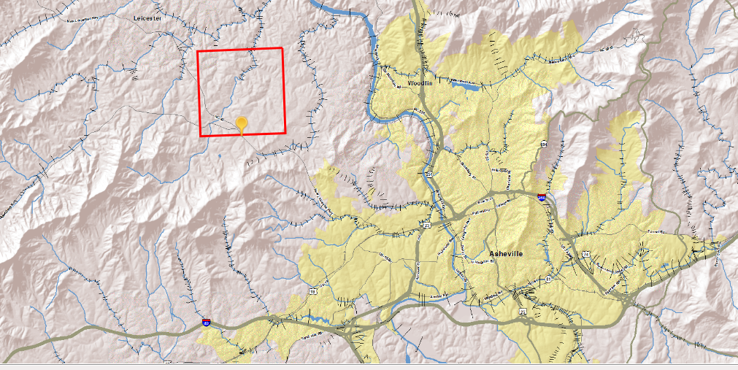
Our cross-sections give the ability to interpolate between gages expanding the real time information from ~200 locations to 10s of thousands to 100s of thousand of locations
Slide: Ken Ashe, NCFMP

Slide 36
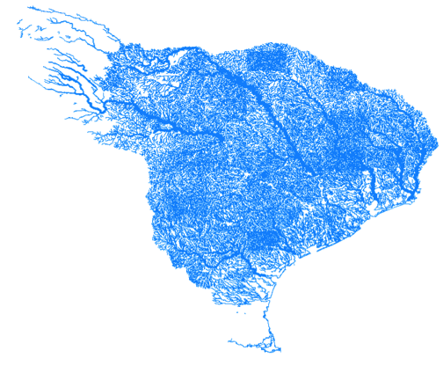
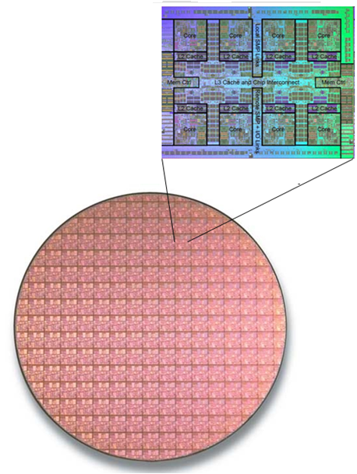
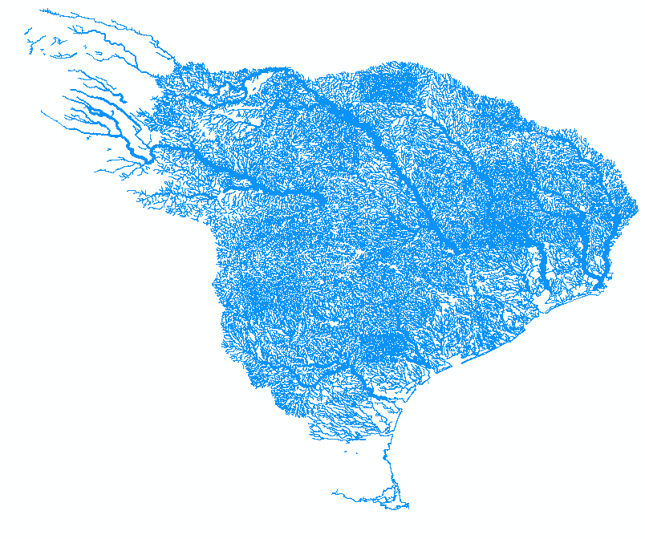
The Texas NHDPlus network looks complicated...
...with 10⁵ river reaches.
Slide: Ben Hodges

Slide 37
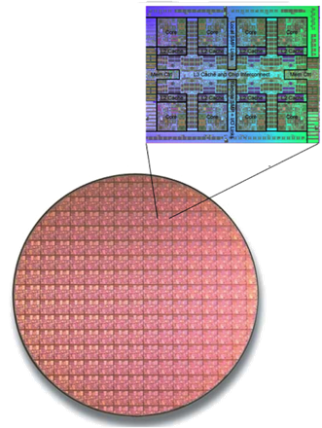
But silicon microchips can have a billion (10⁹) or more transistors.
Electrical engineers routinely solve huge nonlinear circuit network problems during chip design.
Slide: Ben Hodges

Slide 38
We don’t have to simplify!
Diffusive Wave
Kinematic Wave
Solve the full, nonlinear, unsteady, dynamic Saint-Venant equations (1D)
Slide: Ben Hodges

Slide 39



SPRNT
Simulation Program for River NeTworks
Frank Liu
IBM Research Austin
Ben R. Hodges
Univ. of Texas at Austin
Using ideas from computer chip design for river network analysis for fast solution
Slide: Ben Hodges

Slide 40
We can solve the complete river network,
... but we need river geometry:
- cross-section area vs. depth
- cross-section perimeter vs. depth
- river bottom slope
- channel roughness
Slide: Ben Hodges

Slide 41
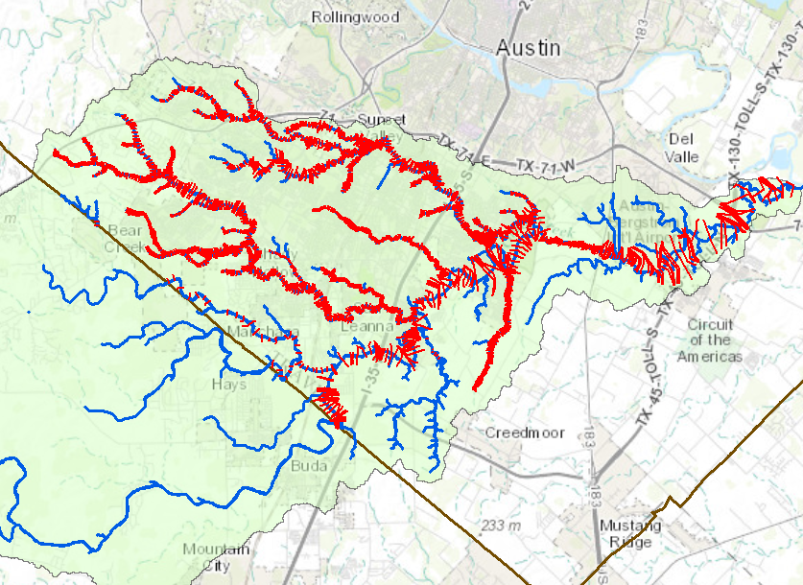
Cross-sections from HEC-RAS models
We need a national repository -- use HydroShare
Onion Creek watershed
Map: Xing Zheng
Data Source: City of Austin
Travis County
Hayes County

Slide 42
National Flood Interoperability Experiment (NFIE)
Component Four: NFIE-Response
NFIE-Geo: National geospatial framework for hydrology
NFIE-Response: Wide area planning for flood emergency response
NFIE-Hydro: National high spatial resolution hydrologic forecasting
NFIE-River: River channel information and real-time flood inundation mapping
NFIE-Services: Web services for flood information

Slide 43

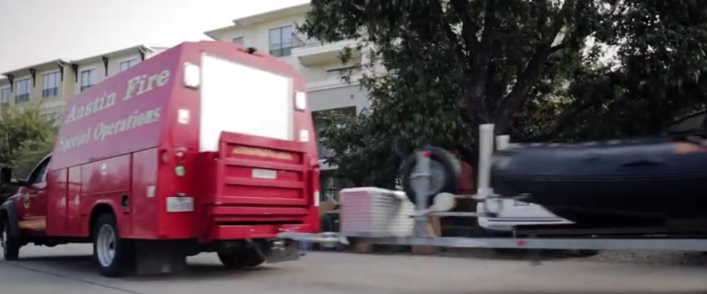
Link with the First Response Community
Harry Evans, Chief of Staff Austin Fire Department
Responsible for flood emergency response in Austin
https://www.youtube.com/watch?v=ympaR6YUxiA&feature=youtube

Slide 44
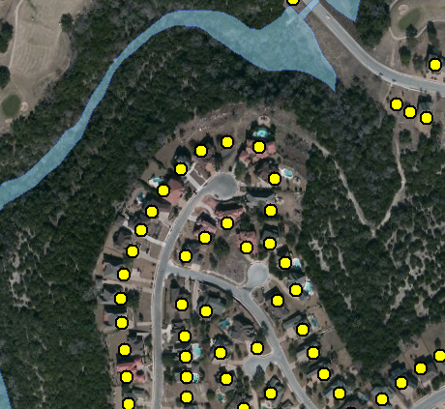


Address Points -- used for directing emergency response vehicles
All legal residences have an address point
Established when the lot is legally platted and registered with the county

Slide 45
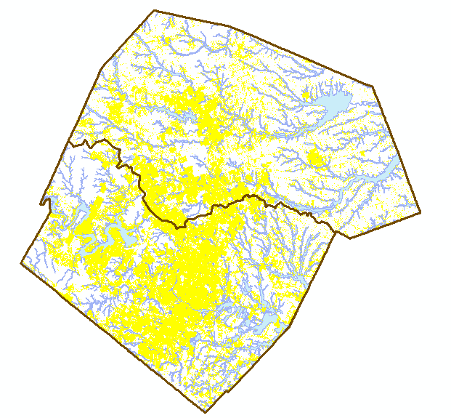
Address Points and the Flood Hazard Zone
Williamson County
495,000 Address points in the two counties
How many points are in the flood hazard zone?
Where are the high flood risk areas in these counties?
Austin, Texas
Travis County

Slide 46
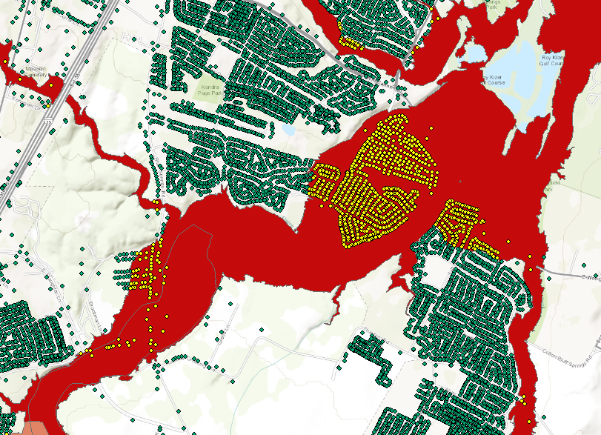

Address Points and the Floodplain

Slide 47
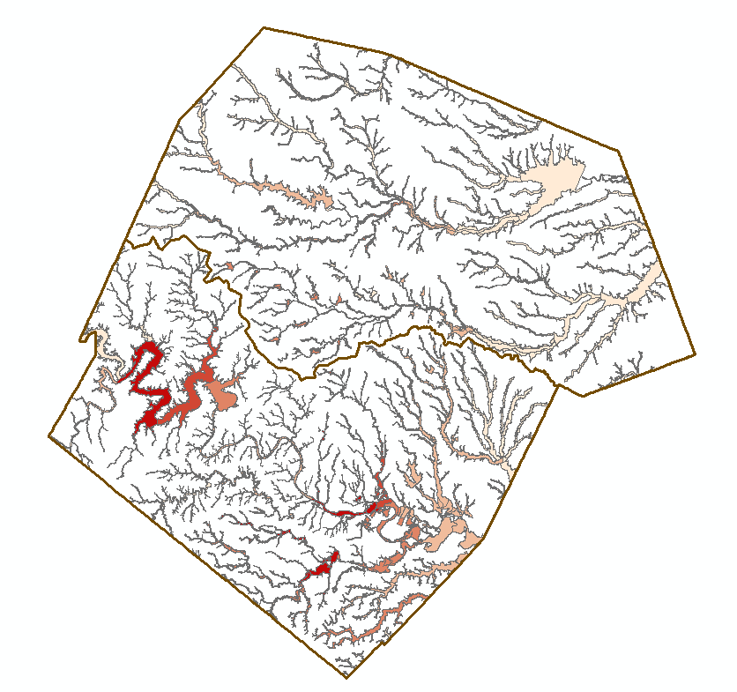
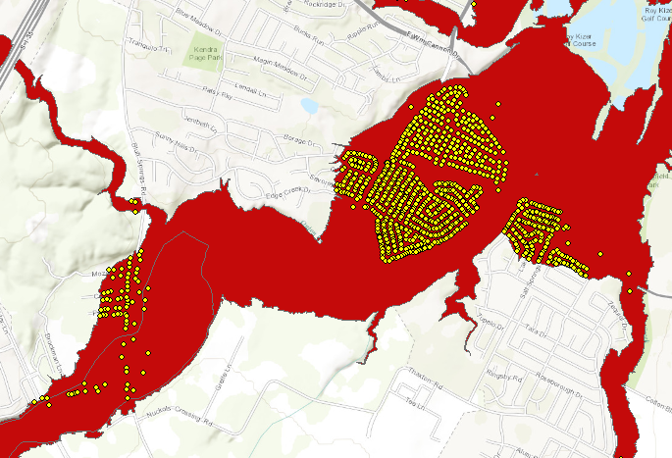

Address Points in the Floodplain
Address Points in Floodplain of Onion Creek
Floodpoints

Slide 48
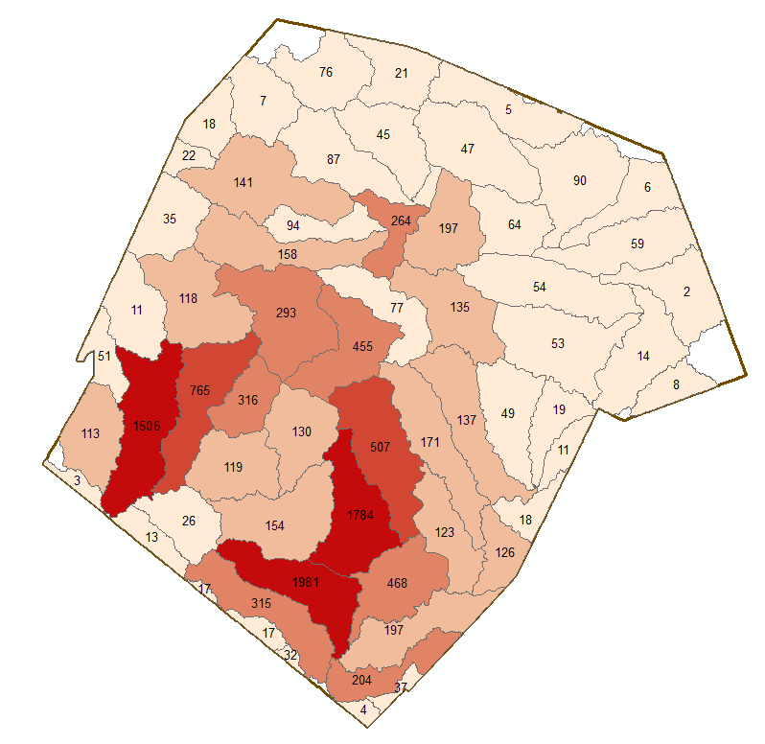

Address Points in Floodplain of a Subwatershed
Number of Address Points in the Floodplain
A total of 12,052 address points are in the floodplain out of 495,468 in the study region (2.5%)

Slide 49
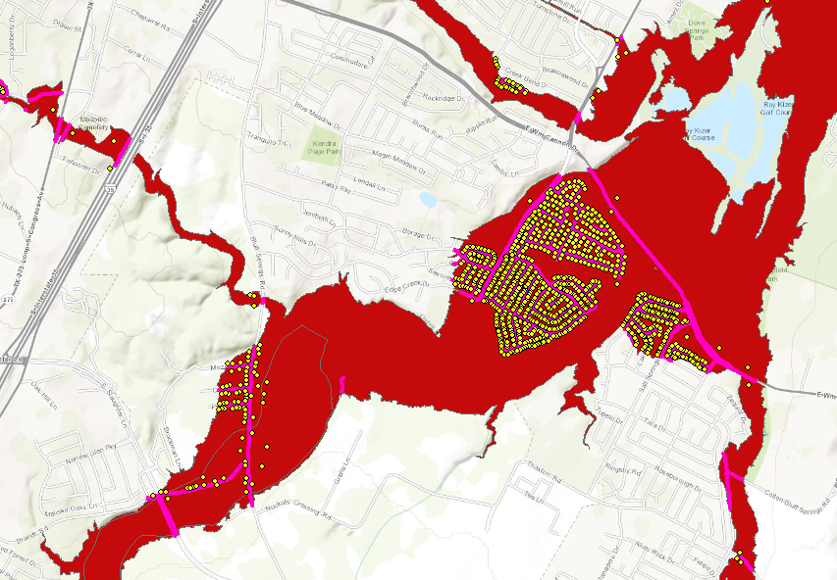

Address Points and Roads in Floodplain of Onion Creek

Slide 50
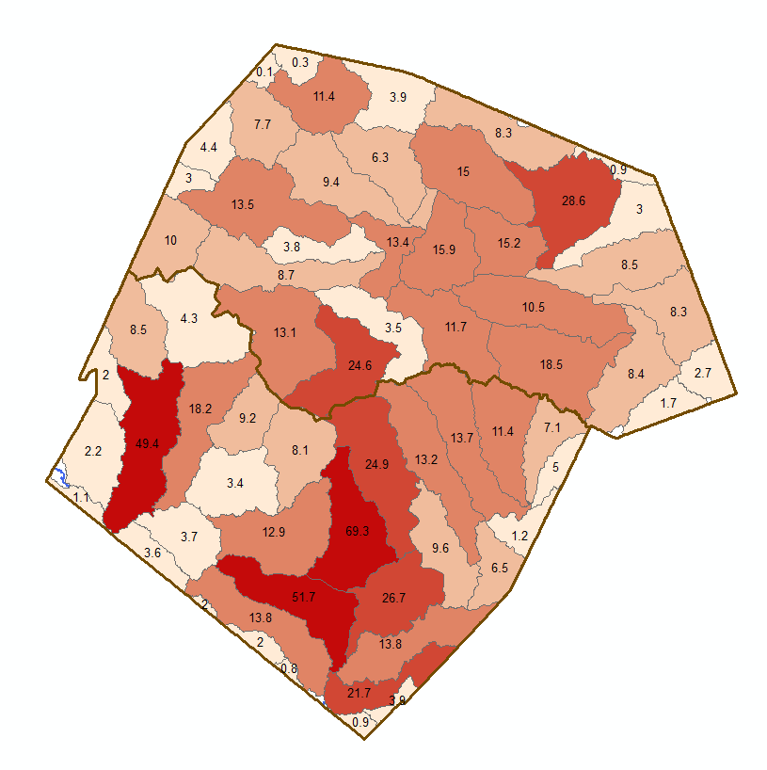

Length of Roads in Floodplain of a Subwatershed
Length of Roads in Floodplain (Km)
A total of 711 km of roads are in the floodplain out of 14,732 km in the study region (4.8%)

Slide 51
National Flood Interoperability Experiment (NFIE)
Component Five: NFIE-Services
NFIE-Geo: National geospatial framework for hydrology
NFIE-Response: Wide area planning for flood emergency response
NFIE-Hydro: National high spatial resolution hydrologic forecasting
NFIE-River: River channel information and real-time flood inundation mapping
NFIE-Services: Web services for flood information

Slide 52




WaterML Web Services – CUAHSI, USGS, OGC, WMO …..
Water time series data on the internet
24/7/365 service
For daily and real-time data
. . . Operational water web services system for the United States
http://waterservices.usgs.gov/nwis/iv/?format=waterml,2.0&sites=08158000&period=P1D&parameterCd=00060

Slide 53


Develop NWS Experimental Data Services
Experimental WRF-Hydro ¹
NWS CHPS Modeling Units: RFCs
Export Data elements from the simulation& forecast workflow including:
Inflow to the Channel (INFW)
Mean Areal Precipitation (MAP)
Streamflow (QINE) at ~3600 points
PI-XML to WaterML2²
netCDF
to
NHD+
Data Services – local runoff
Slide: Ed Clark, NWS
¹Responsibility of NCAR

Slide 54
NFIE: NWS Project ‘Elements’ or Functional Requirements
Acquire data from 13 CHPS Instances
  Establish hosting system – central FEWS data server at UoA
  Develop and implement extraction workflow (Based on WGRFC Export example)
  Develop and implement transmission capability – SFTP to UoA
Serve (make data available) constituent CHPS elements
  Publish geospatial--topology relationship corresponding to the time-series identifiers in CHPS extracted data sets¹ (metadata)
  Data reformatting to WaterML2²
  Provide access to CHPS data and metadata sets (data service)¹
  Develop data service monitoring capability (TBD via NWC)
Support Data Service through Aug 2015.
  Monitor & maintain
Slide: Ed Clark, NWS
¹on going through OWDI
² Via UoA FEWS-WaterML2-SOAP service

Slide 55


Align forecasts with those produced by regional NWS modeling
Color the reach catchment according to flood risk for all the reach catchments in the region
Produce a color-coded flood risk map service for a region

Slide 56
Conclusions
NFIE-Geo is really solid
NFIE-Hydro is a work in progress but is achievable at the Summer Institute
NFIE-River has good input information in some regions but needs national structure and data
NFIE-Response needs further development
NFIE-Services are just beginning
Your contribution to advance these components is very welcome!!

