Slide 1
Flood Forecasting and Impacts
CE 397 Flood Forecasting
David R. Maidment
6 Feb 2015
Credit: John Dorman and Ken Ashe, North Carolina Floodplain Mapping Program

Slide 2
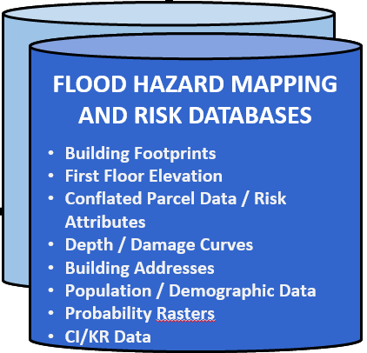
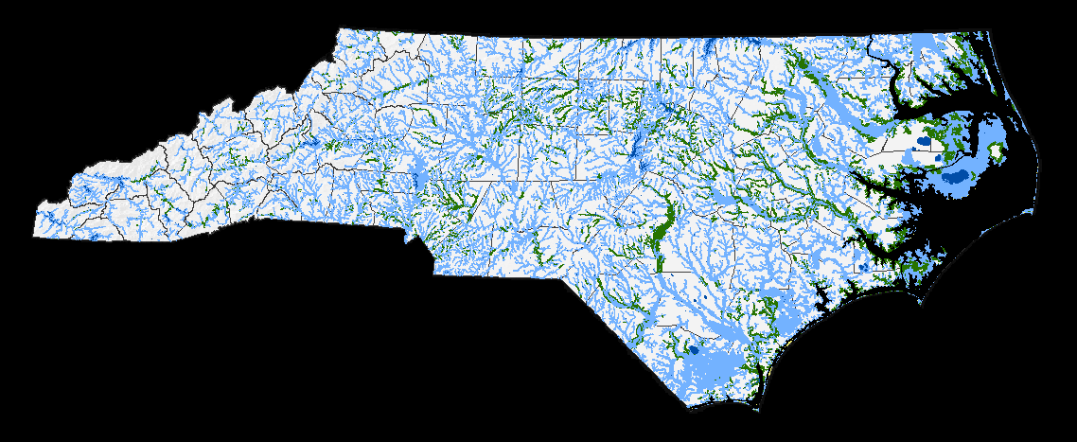
SFHA = 9,587.7 sqmi
SFHA = 18.2% State Area
Number of Cross-Sections = 259,576
Number of Mapped BFEs = 305,530
28,778 stream miles

Slide 3
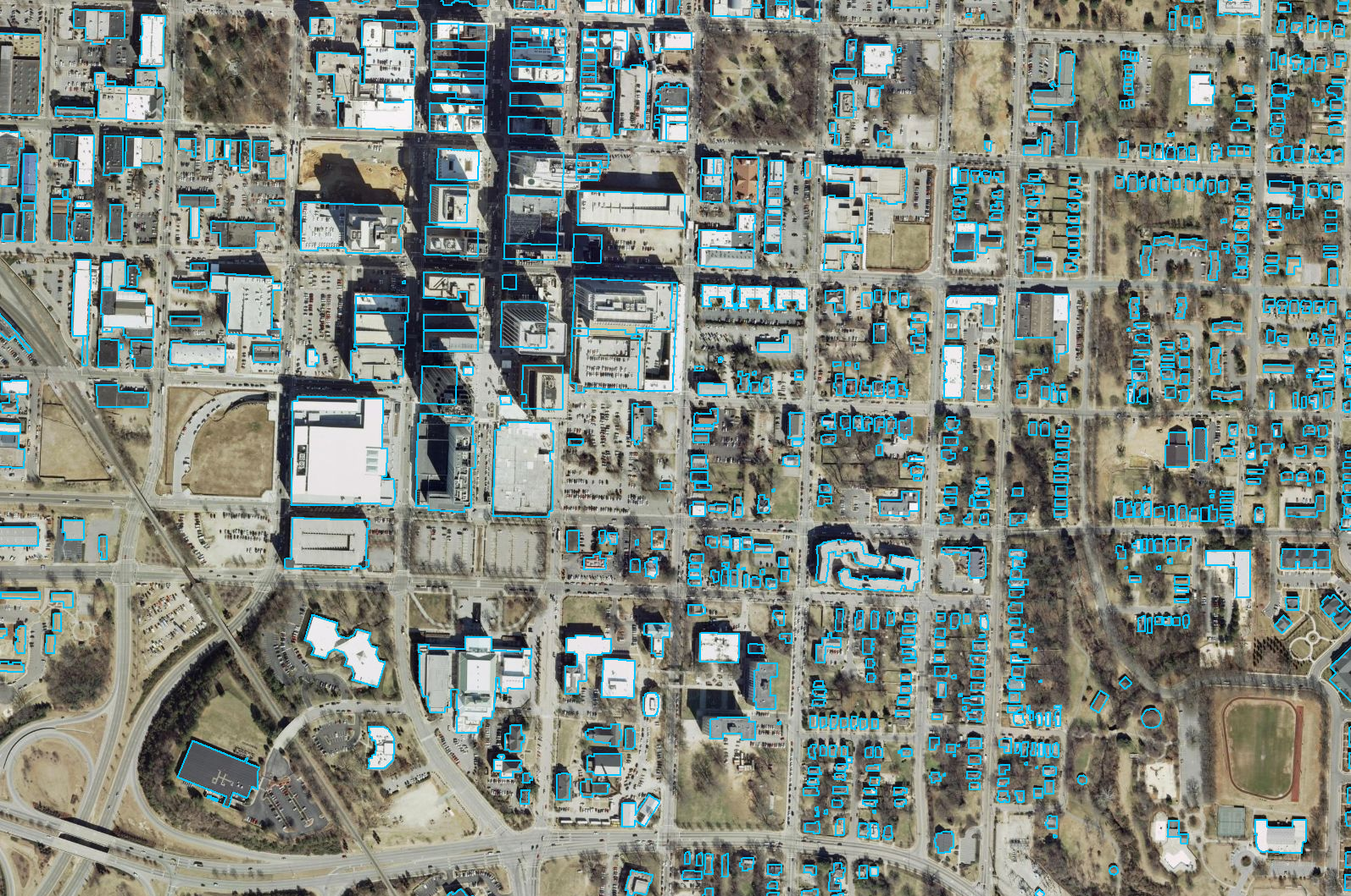
ACQUISITION / GENERATION - Building Footprints
Algorithm for building boundary generations
Approximately $0.30 / structure

Slide 4
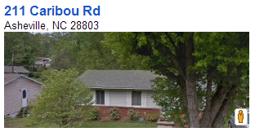
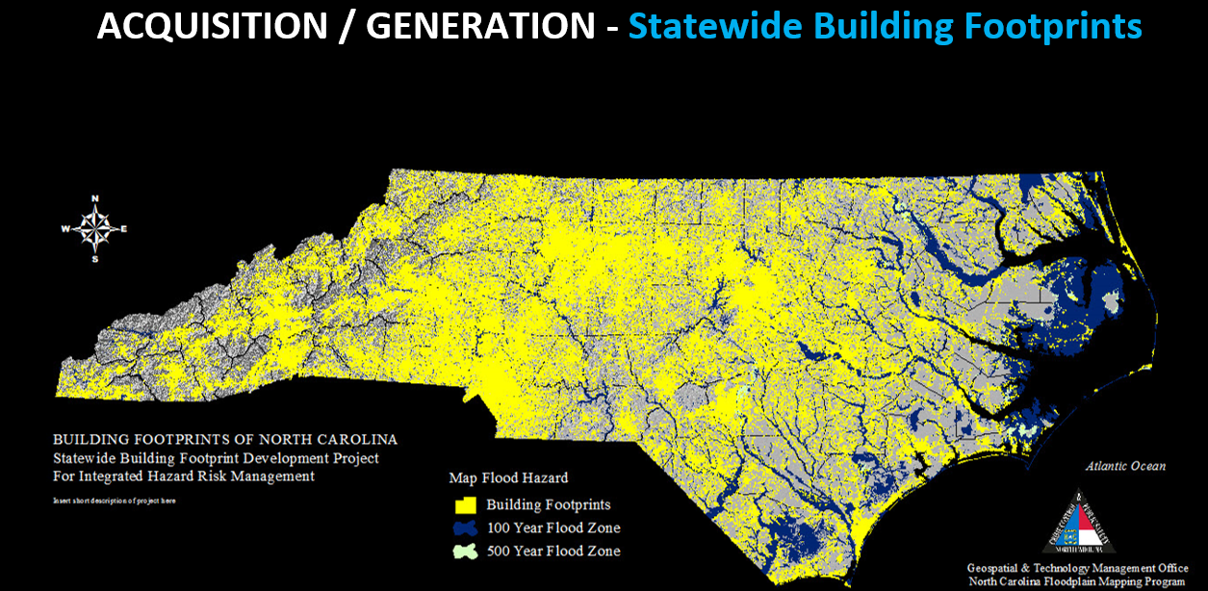
5 million building footprints in NC
An example for one home in the state

Slide 5
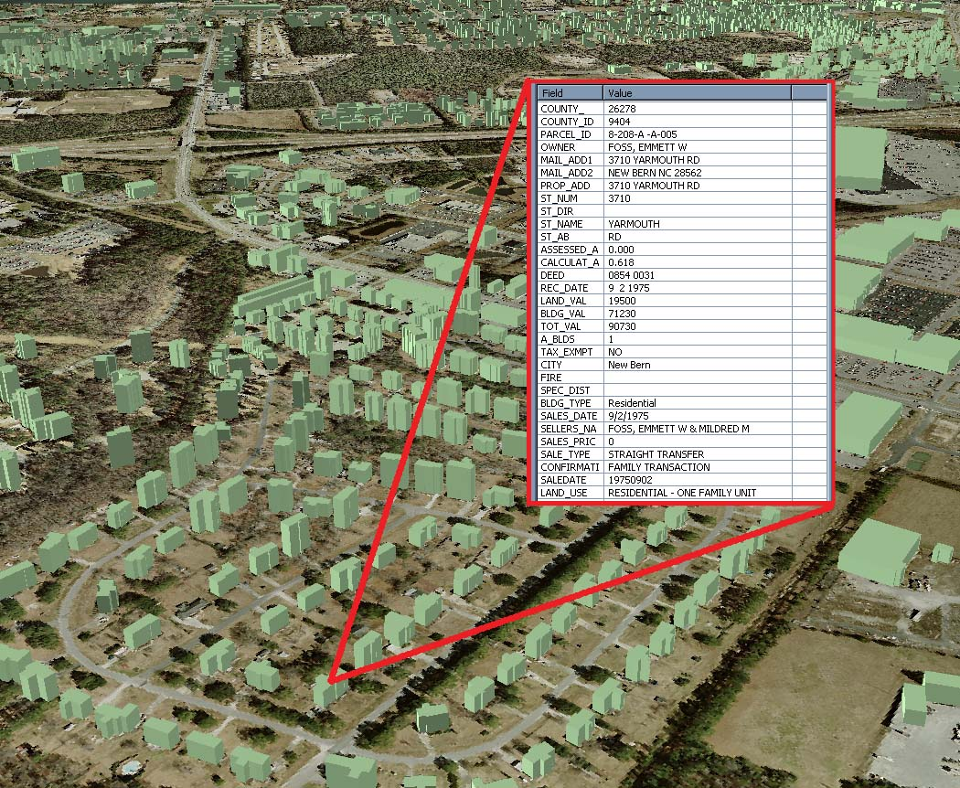

Slide 6
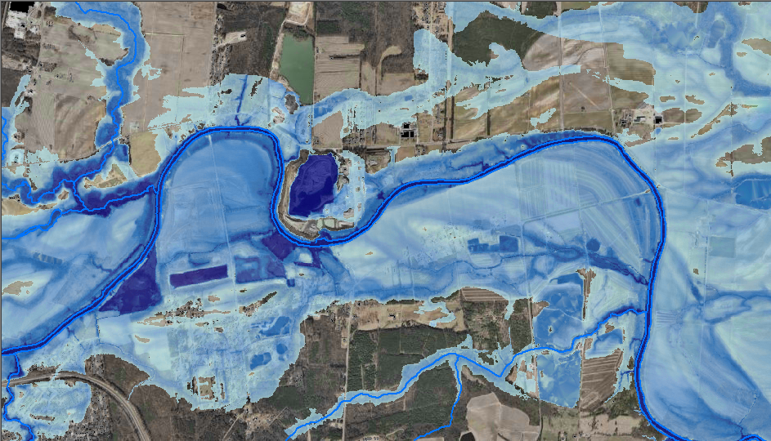

GENERATION - Flood Depth Grids
10-yr, 25-yr, 50-yr, 100-yr, 500-yr
FEMA RiskMap: Mapping Flood Depth

Slide 7
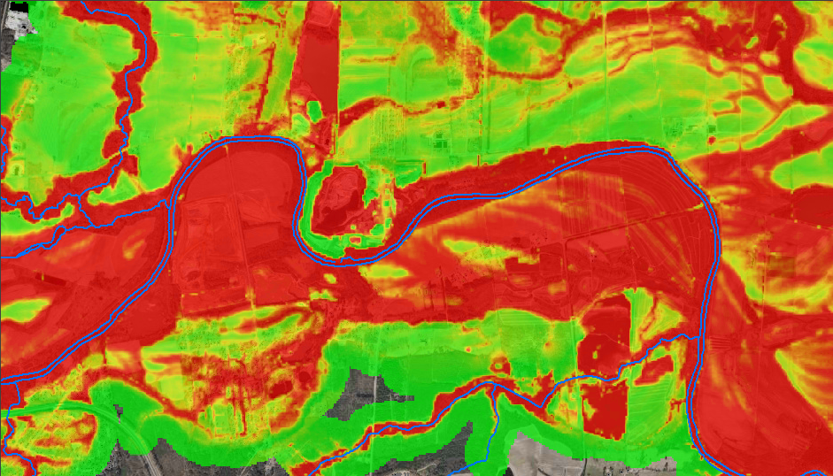

GENERATION - Probability Grids
10-yr, 25-yr, 50-yr, 100-yr, 500-yr
Mapping Flood Likelihood

Slide 8
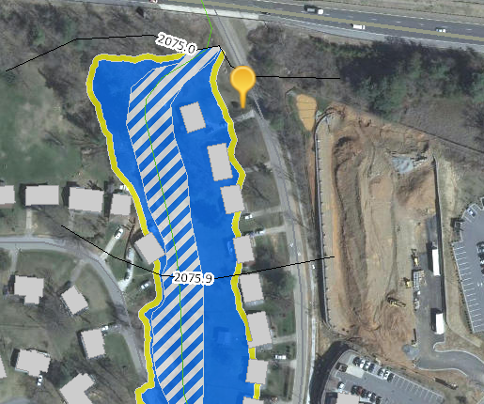
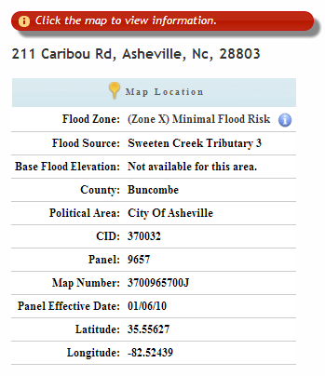
Flood Risk Information System (FRIS)
http://fris.nc.gov/fris/

Slide 9
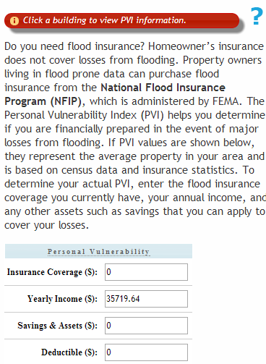
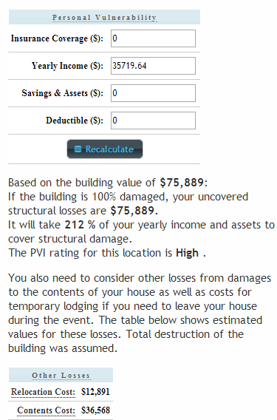
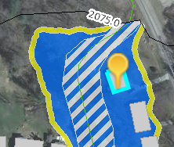
Personal Vulnerability Index

Slide 10
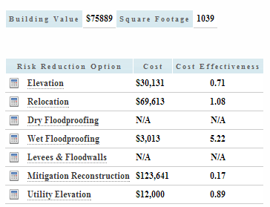
Cost Effectiveness of Mitigation

Slide 11
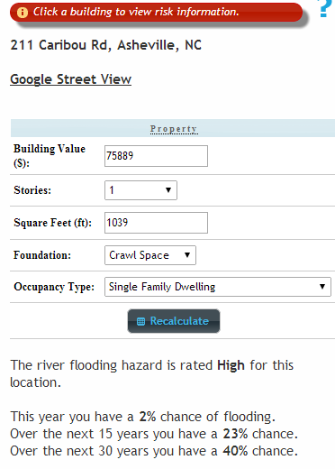
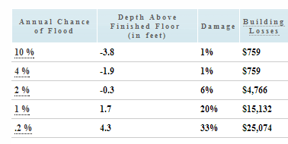
Annual Flood Damage

Slide 12
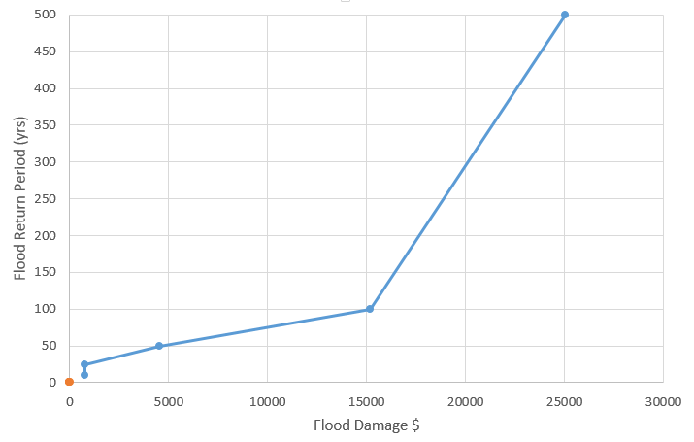

Flood Damage
Expected Annual Damage = $434
$161 (37%)
100 year
$99 (23%)
50 year
$174 (40%)

Slide 13
Where do we want to get to…
We want to understand how high the water
  Is now
  Will be at its peak
  Is water rising or falling?
What are the impacts of water at this elevation?
  Flooded buildings
    People needing rescue
  Flood streets and roads
    Need for road closures and rerouting
  Flooded critical infrastructure
    Potential failure of electricity supply or water pumping system

Slide 14
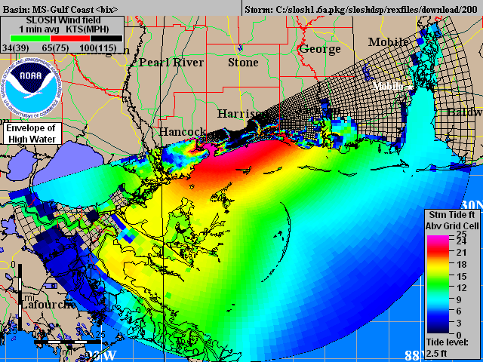
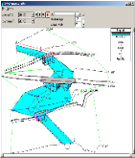
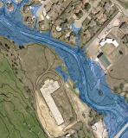
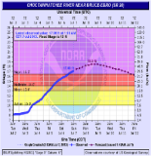


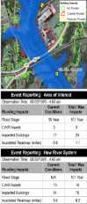
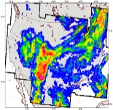
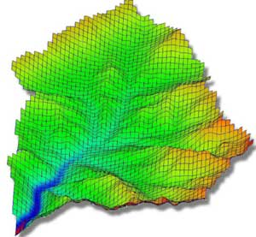
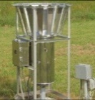
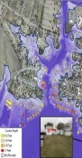
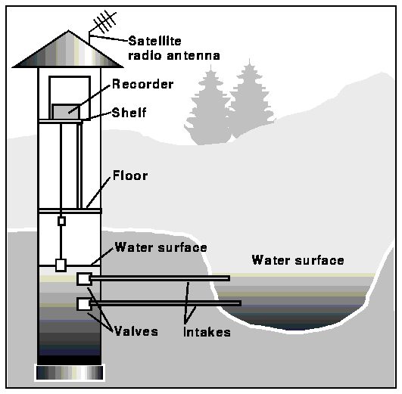
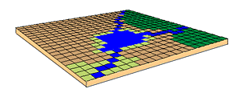
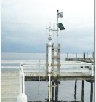
NATIONAL FLOOD INUNDATION AND WARNING SYSTEM
CONCEPTUAL FRAMEWORK
SOURCE INTELLIGENCE
HAZARD IDENTIFICATION
IMPACT / RISK ASSESSMENT
1) REAL-TIME
MODELING
2) REAL-TIME
MAPPING
LAND
Coastal
ECOLOGICAL
RESPONSE MANAGEMENT
ALERTS
END VISION
EMS
NWS
TV
Radio
SMS
Google Public Alerts
EFFICIENT RESPONSE
PREDICTIVE
AGRICULTURE
CI/KR
Financial Consequences
Receptors
Population / Demographic Impacts
Mitigation
Riverine
Option 1
Current and Predictive Modeling of Discharge and Surge Elevations
STRUCTURES
CI/KR
NEXRAD
If x + y, then …
PUBLIC AWARENESS
SOCIETAL
DISSEMINATION
CI/KR
Financial Consequences
Receptors
Population / Demographic Impacts
Mitigation
Current
Future
Elevation
Depth
Velocity
Road Impacts
Building Impacts
Option 2
Economics
Rainfall
North Carolina
“NEXFIM-NC” Solution
OBSERVED
River Stage
FLOOD HAZARD MAPPING AND RISK DATABASES
Building Footprints
First Floor Elevation
Conflated Parcel Data / Risk Attributes
Depth / Damage Curves
Building Addresses
Population / Demographic Data
Probability Rasters
CI/KR Data
Coastal / Tidal

Slide 15
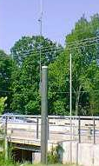
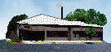
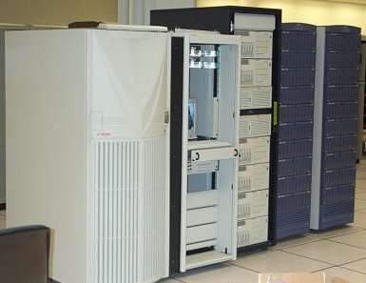
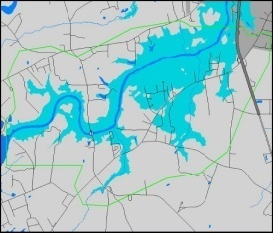
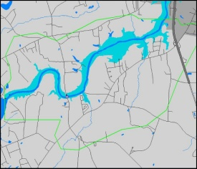
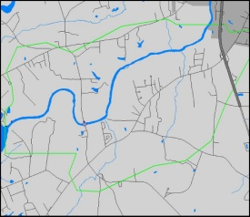
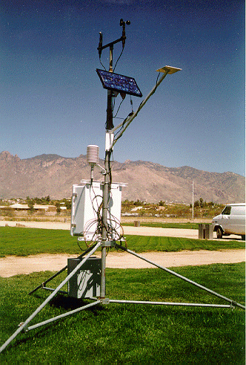
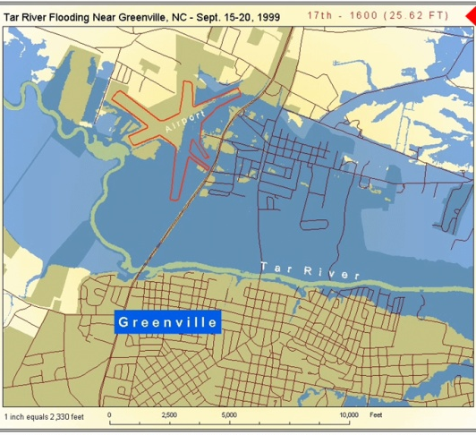
Flood Alert and Mapping Network
How it works
Stream Gage
NWS SE River Forecast Center
FMIS
Output of Flood Forecast Model
Library of Flood Profiles
Rain Gage
Flood Forecast and Flood Inundation Maps available to Emergency Managers and Public
Now
3hr
6hr
9hr
12hr
24hr

Slide 16
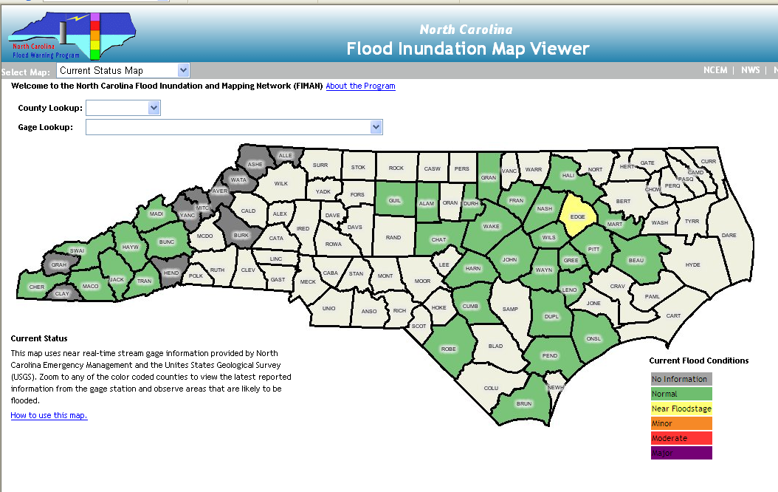
FIMAN Maps home page

Slide 17
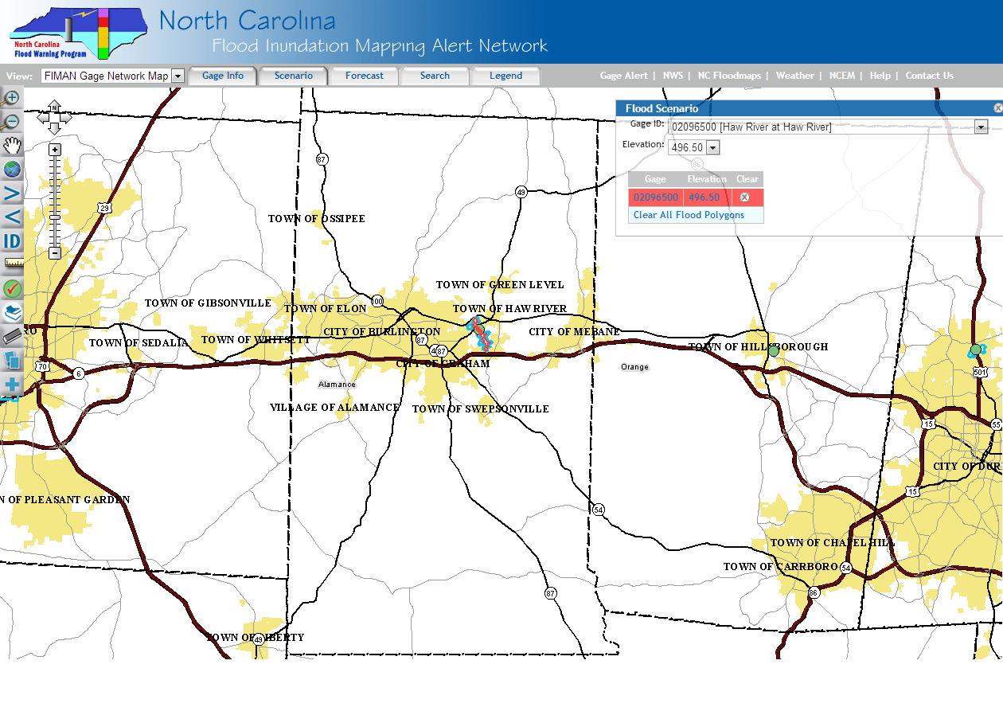
Another Gage up here
Gage is here
Another Gage down here…

Slide 18
Problem
Traditional FIMAN Libraries are “spatially limited”
Most extend
  1 mile US
  1 mile DS
Traditional Mapping Methods
  Develop a model (if none exists)
  Model each scenario (trail and error / rating curves)
  Map the results from the model
  Store each scenario in a library (database with a series of stacked polygons)

Slide 19
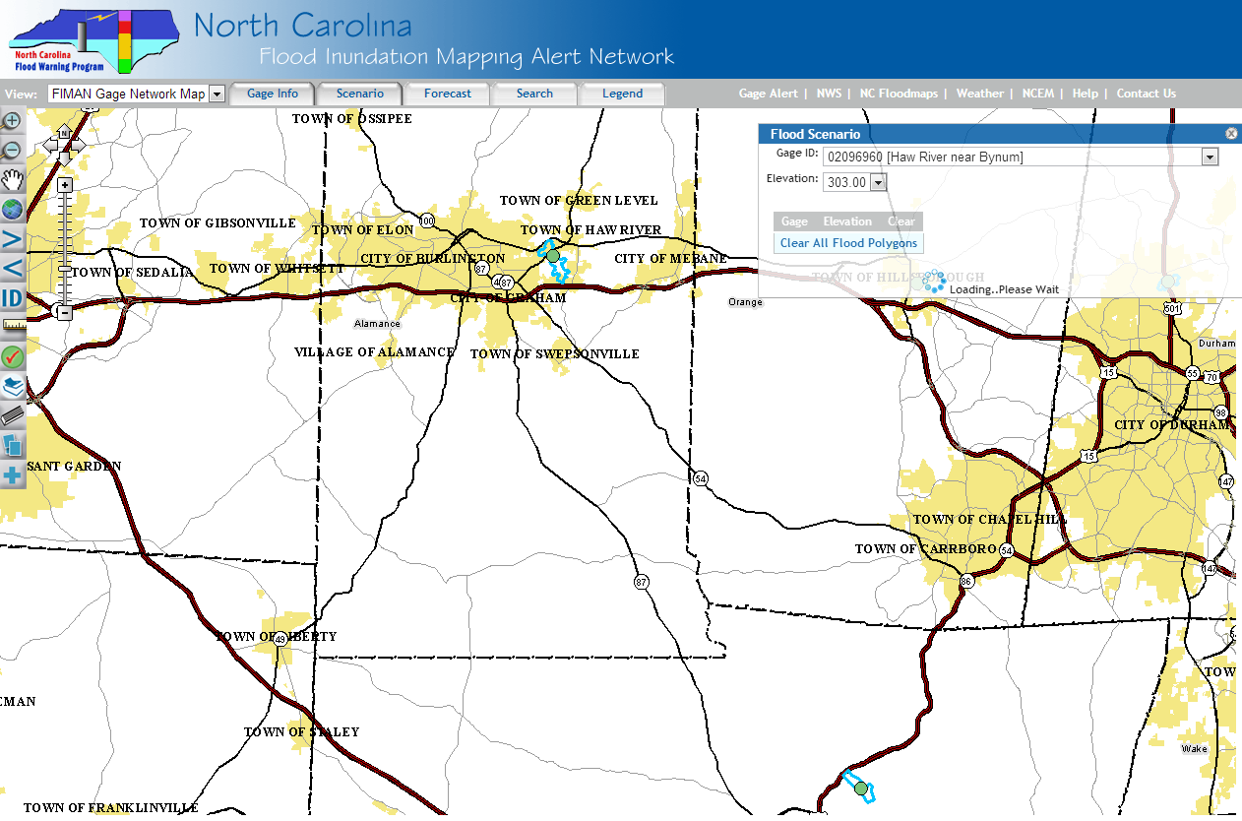
Goal was to Connect the Libraries
Gage #1
Gage #2

Slide 20
NCFMP HEC- RAS Models
  5 Recurrence Intervals: 10, 25, 50, 100, 500
  300,000 cross-sections
  Each cross-section has a rating curve

Slide 21
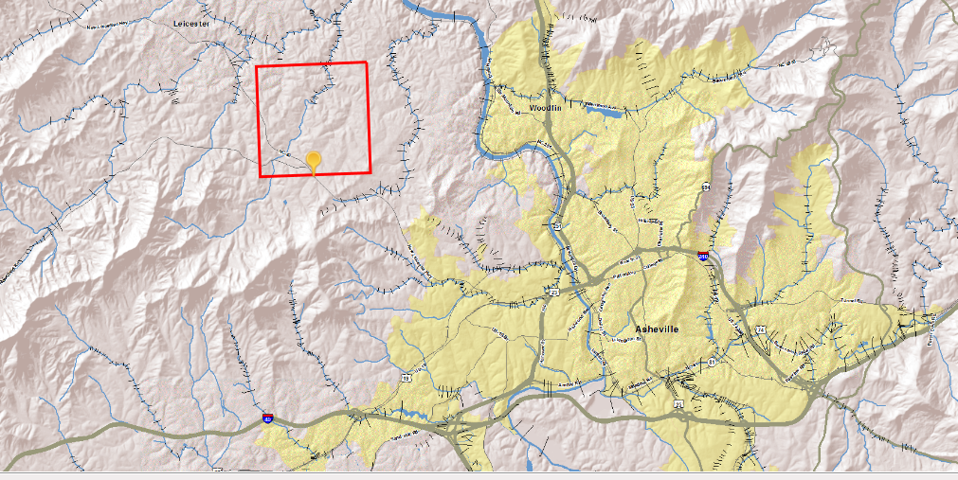
Our cross-sections give the ability to interpolate RI between gages expanding the real time information from ~200 locations to 10s of thousands to 100s of thousand of locations

Slide 22
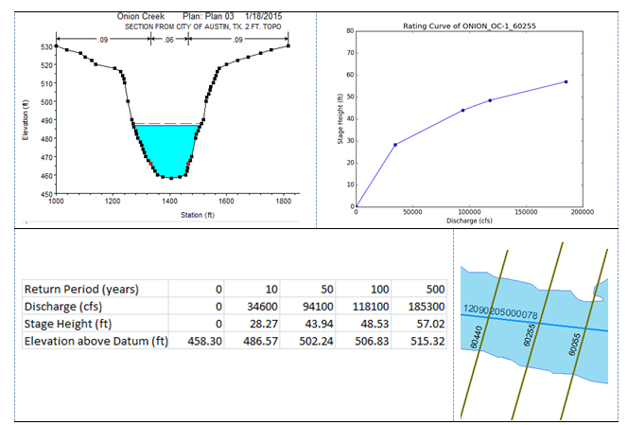
Return Period – Discharge – Stage Height – Water Surface Elevation

Slide 23
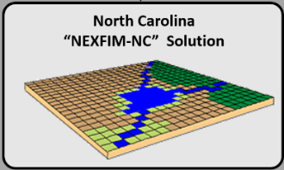
Bigger Solution
Tool was developed as part of the IHRM concept
The Percent Annual Chance (PAC) grid unlocks the solution
  Percent Annual Chance grid is a raster dataset
  Cell size (for now) = 10 ft
  Each cell stores estimated return period that floods that section of land (100 ft²)
The P.A.C. stores river response for a wide range of flows! (It’s built in)

Slide 24
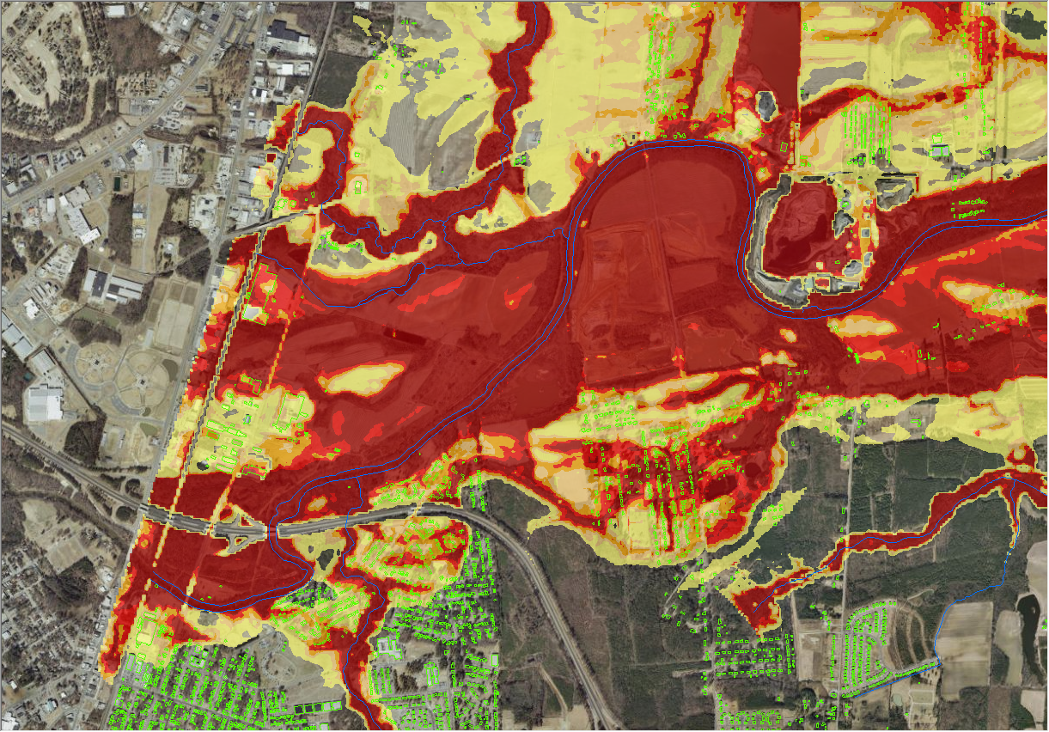
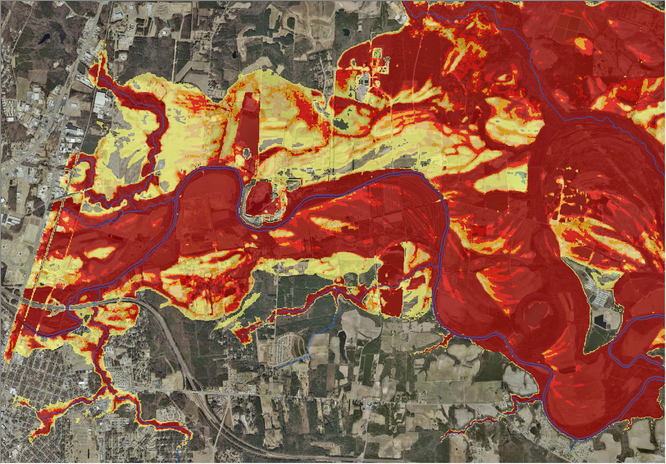


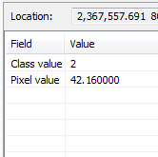
Each cell (10’ x 10’) knows the return period of the flood that first inundates it
42.16 year flood

Slide 25
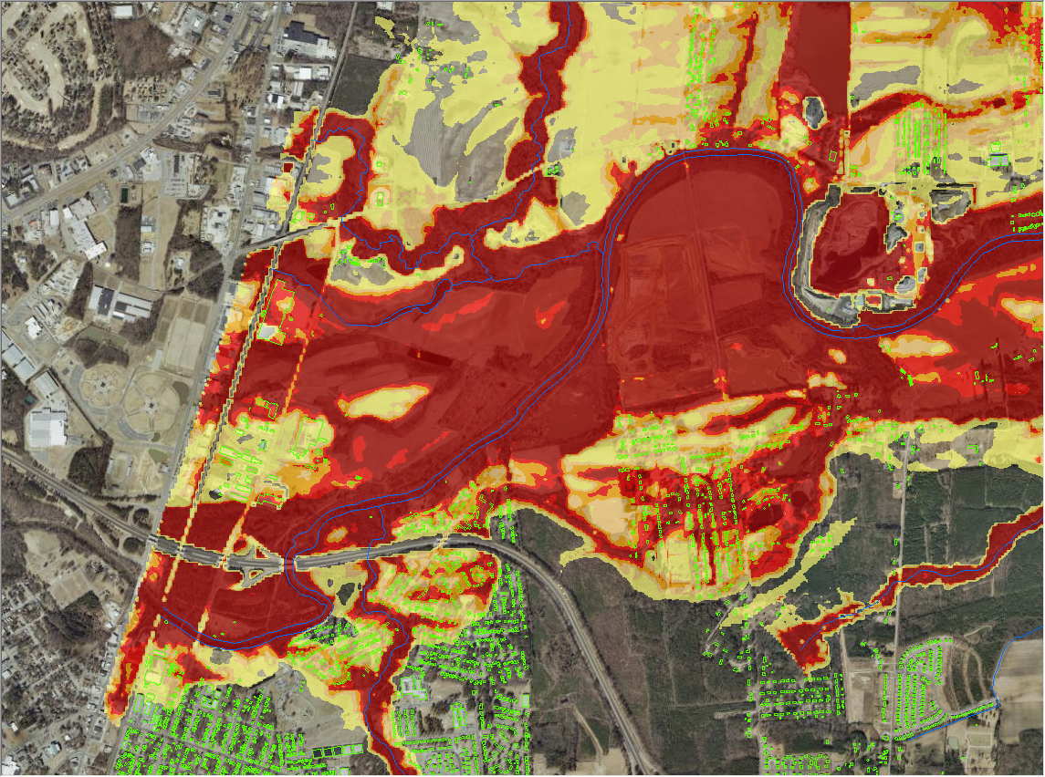
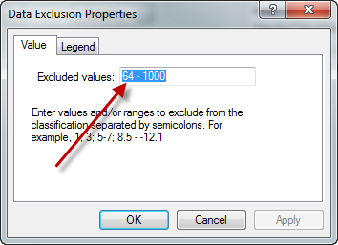
Query out the cells with return period 64 years or greater

Slide 26
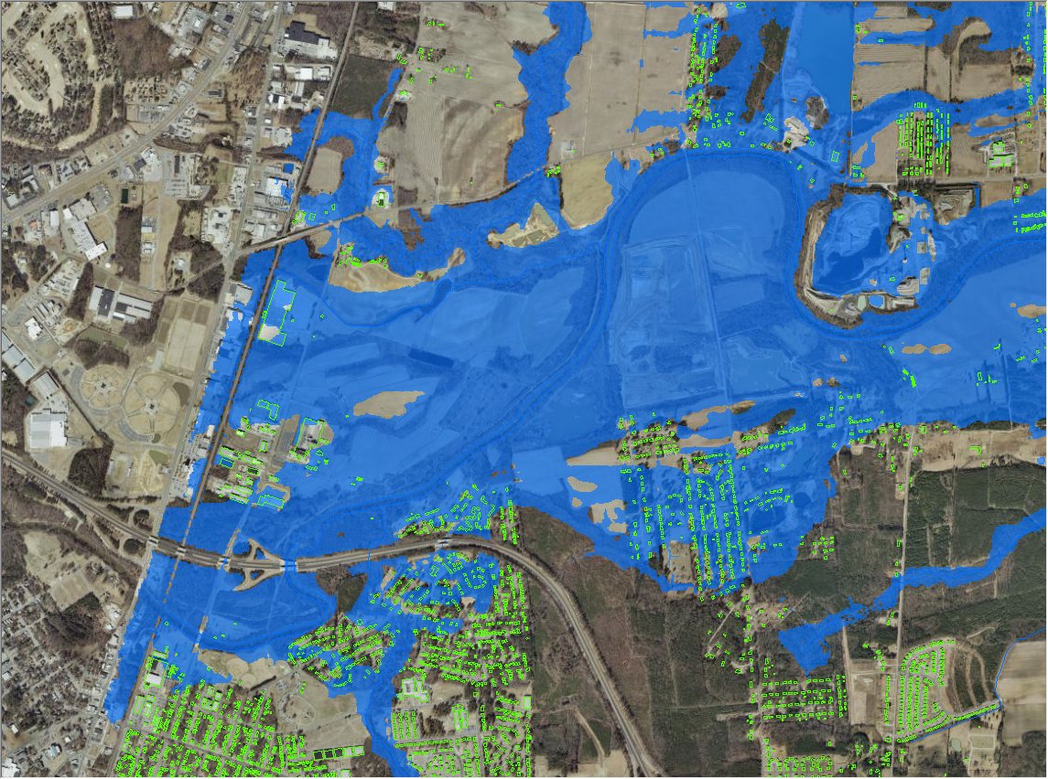
The 63 Year Floodplain!
Query out the cells with return period 64 years or greater

Slide 27
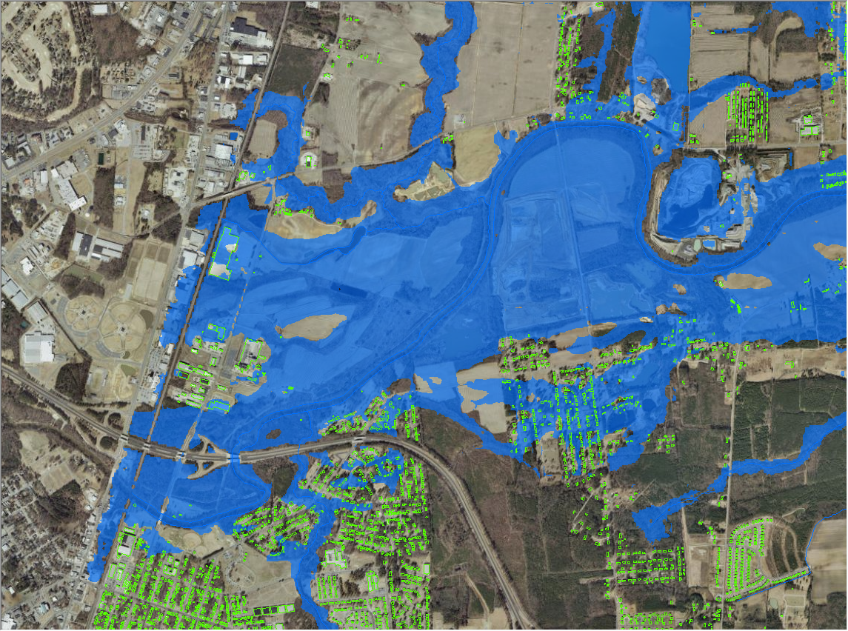
The 31 Year Floodplain!
Query out the cells with return period 32 years or greater

Slide 28

The 14 Year Floodplain!
Query out the cells with return period 15 years or greater
Limitation…… This assumes same
return period – EVERYWHERE!

Slide 29

Area of Interest
Haw River

Slide 30


Slide 31


Slide 32


Slide 33


Slide 34


Slide 35


Slide 36


Slide 37


Slide 38


Slide 39
Return Period – Discharge – Stage Height – Water Surface Elevation

Slide 40



Hydroeconomic analysis for flood mitigation
(USACE Flood Planning, FEMA RiskMap)
Elevation
Rating curve
Elevation-Damage curve
Discharge
Damage
Flood
Frequency
curve
Expected
Annual
Damage
Probability

Slide 41


Role of flood mapping
Translate river hydraulics into flooding at homes

Slide 42


Linking NWS Flood Forecasts to FEMA Flood Hazard Map
NWS River Forecast Subbasins
National Flood Hazard Map
The FEMA National Flood Hazard Map is intersected with the NHDPlus Catchments to
form “NHDPlus Flood Warning Zones”. The downscaled NWS flow forecast for each zone
is used to assess flood risk. If flood risk is high, a warning is sent to all cell phones in this zone.

Slide 43



Flood Response Planning
(NWS and federal partners, Local Flood Emergency Responders)
Elevation
Discharge
Impact
Wide area
flood planning
Probability

Slide 44




Flood Response Operations
(Local Emergency Responders)
Elevation
Rating curve for stream reach
Real-time flood map
Discharge
Impact
Flood Emergency
Response
NWS ensemble
streamflow forecast for stream reach
Probability

