Slide 1
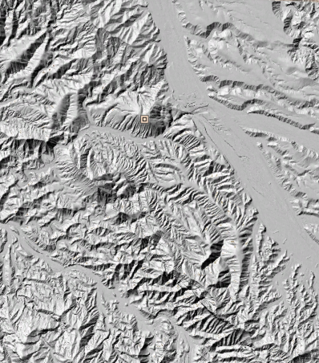
GeoNet: An automatic tool for channel network and channel head extraction from digital terrain data
Harish Sangireddy, Anna Kladzyk, Richard Carothers, and Paola Passalacqua

Slide 2
https://sites.google.com/site/geonethome/

Slide 3
History of GeoNet
PyGeoNet 1.0 ( November 2014)
Harish Sangireddy
Paola Passalacqua
GeoNet 1.0 (released beginning 2010)
Paola Passalacqua
Tien Do Trung (Ecole Normale Superieure de Cachan)
Efi Foufoula-Georgiou (Univ. of Minnesota)
Guillermo Sapiro (Univ. of Minnesota)
Bill Dietrich (UC Berkeley)
NSF Grants: EAR-0835789; EAR-0120914
GeoNet 1.0.1 (released September 2010)
Paola Passalacqua
Colin Stark (Columbia Univ.)
Nachiket Gokhale (Univ. of Minnesota)
Efi Foufoula-Georgiou (Univ. of Minnesota)
Guillermo Sapiro (Univ. of Minnesota)
Bill Dietrich (UC Berkeley)
NSF Grants: BCS-1063231/1063228; EAR-0120914
GeoNet 2.0 (released November 2011)
Paola Passalacqua
Colin Stark
Harish Sangireddy
GeoNet 2.0 and 2.1 (gdal) (May 2013)
Harish Sangireddy
Paola Passalacqua
GeoNet 2.1 (released Nov 2012)
Paola Passalacqua
Harish Sangireddy

Slide 4
Workflow of GeoNet

Slide 5
Workflow of GeoNet: Input DEM
GeoNet requires a bare earth lidar Digital Elevation Model (DEM)
UTM projections are preferred and recommended.
Data sources of Lidar DEMs
NCALM (National center for Airborne Laser Mapping) (http://ncalm.cive.uh.edu/ )
OpenTopography (http://www.opentopography.org/index.php)
USGS Click (http://lidar.cr.usgs.gov/ )
Various State Agencies e.g. TNRIS (https://tnris.org/maps-and-data/)
Interagency elevation Inventory (http://coast.noaa.gov/inventory/ )

Slide 6
United States Interagency Elevation Inventory

Slide 7
Important user-defined parameters
Filtering iterations
Flow accumulation area threshold
Search box size

Slide 8
Workflow of GeoNet: Non linear Filtering: a critical step when using lidar data
Errors in the representation of the landscape can be introduced several ways:
Acquisition
Preprocessing
Point cloud classification

Slide 9
Workflow of GeoNet: Filter Type Comparisons
Gaussian
Perona-Malik
Nonlinear diffusion equation:
Images: Passalacqua et al., 2010, DOI: 10.1029/2009JF001254 (top) Pelletier, 2013, DOI: 10.1029/2012WR012452 (bottom)

Slide 10
Workflow of GeoNet: Filtering iterations
Filtering iterations impacts amount of noise reduction
What is the suggested number of filtering iterations?
50 iterations
200 iterations

Slide 11
Workflow of GeoNet: Filtering iterations
What is the suggested number of filtering iterations?
If the unknown noise ‘n’ is uncorrelated to the unknown signal F, it would be reasonable to minimize the covariance of the noise (u(0) – u(t)) with the signal u(t), or better employed in a normalized form, the correlation coefficient.
The stopping time T (~ number of iterations) minimizes the correlation coefficient.
Mrázek, Pavel, and Mirko Navara. "Selection of optimal stopping time for nonlinear diffusion filtering." International Journal of Computer Vision 52.2-3 (2003): 189-203.

Slide 12
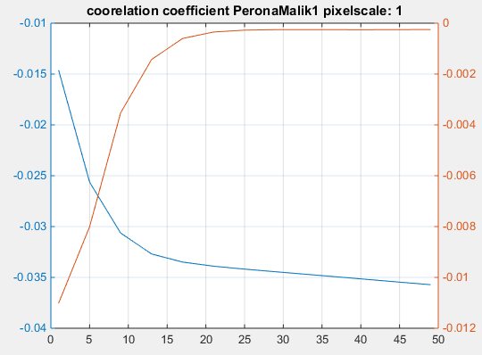
Workflow of GeoNet: Filtering iterations
$$g\left(∇I\right)=e^{−}{\left(\frac{\left|∇I\right|}{λ}\right)}^{2}$$
$$g\left(∇I\right)=\frac{1}{1+{\left(\frac{\left|∇I\right|}{λ}\right)}^{2}}$$
Correlation Coefficient
gradient of Correlation Coefficient
gradient of Correlation Coefficient
Correlation Coefficient
T ~ 25 iterations
T ~ 45 iterations
Number of iterations
Number of iterations
These results are shown for the Tennessee Valley, CA dataset

Slide 13
Workflow of GeoNet: Filtering iterations
The Perona Malik conductance function (1) involving exponential function decreases much faster than the (2)
The first function prefers high contrast edges over low contrast ones
The second function prefers larger-scale edges (channel banks) to very small-scale edges (rocks).
By default GeoNet uses equation (2) as the function prefers wide regions over smaller ones
‘$λ$’ – the edge threshold is set to the 90th quantile of the slope values in the landscape.
(Perona, Pietro, and Jitendra Malik. "Scale-space and edge detection using anisotropic diffusion." Pattern Analysis and Machine Intelligence, IEEE Transactions on 12.7 (1990): 629-639.)
$g\left(∇I\right)=e^{−{\left(\frac{\left|∇I\right|}{λ}\right)}^{2}}$ -- (1)
$g\left(∇I\right)=\frac{1}{1+{\left(\frac{\left|∇I\right|}{λ}\right)}^{2}}$ -- (2)

Slide 14
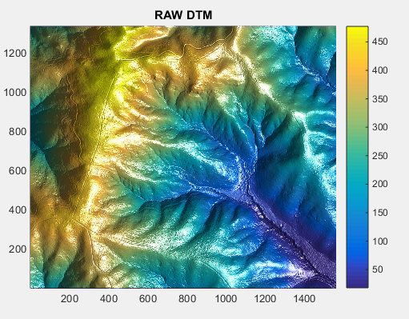
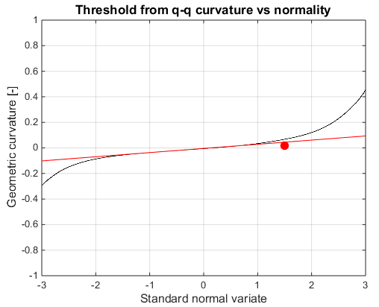
Workflow of GeoNet: Identification of likely channelized pixels
Channels
Diffusive portion of the landscape
Ridges
Geometric curvature
$$K=∇.\left(\frac{∇h}{\left|∇h\right|}\right)$$

Slide 15
Channel network extraction and bridge crossings (advantages)
Indian Creek, OH
By using Laplacian curvature, we can avoid the detection of roads and bridges in the skeleton map of likely channelized pixels

Slide 16
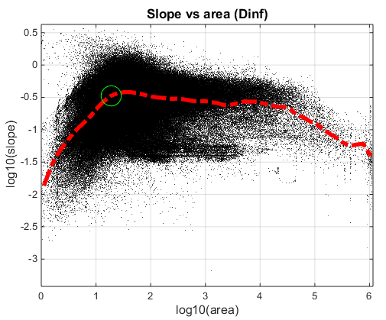
Workflow of GeoNet: Identification of likely channelized pixels
Clean the curvature threshold skeleton by using a small flow threshold determined from slope area plots
divergent
planar
convergent

Slide 17
Workflow of GeoNet: Identification of likely channelized pixels
Flow routing
D-infinity algorithm
Tells us the total number of cells which flow into a cell
Allows for flow divergence (flow can be directed into one or two neighboring cells depending on flow direction)
Image: Tarboton, 1997. http://www.neng.usu.edu/cee/faculty/dtarb/dinf.pdf

Slide 18
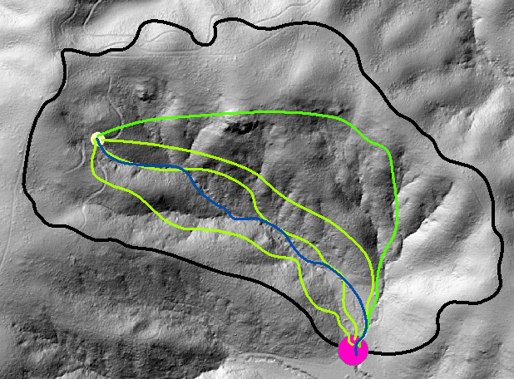
Workflow of GeoNet: Geodesics and cost function
Geodesics are defined as curves of minimal cost among all the possible paths that connect two points a and b.
$$ψ= \frac{1}{α A+ δ k}$$
Channel head
Geodesic curves
a
channel
Passalacqua et al. [2010] defined the cost function as a combination of surface curvature and flow accumulation area.
Basin outlet
b

Slide 19
Workflow of GeoNet: Geodesics and cost function
Fast Marching Algorithms are used to compute the geodesic distance by using the cost function for each of the outlets (identified as green dots).
The outlets are the starting point, and the draining basin is the region the fast marching can be done.
Big advantage: global operation using local information

Slide 20
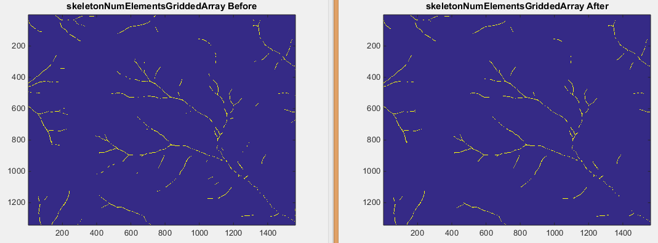
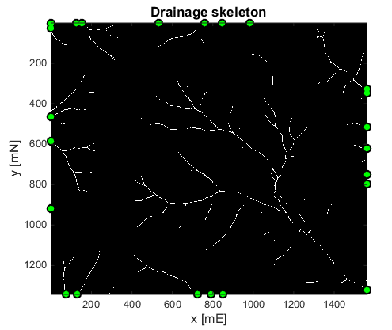
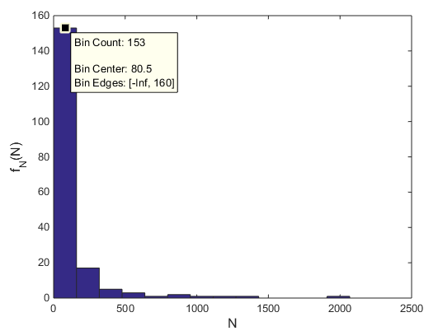
Workflow of GeoNet: channel head detection
The skeleton is not connected continuously
Each connected component is labeled
A histogram of the number of connected components is prepared and all components less than a small threshold are removed from the skeleton. This removes isolated skeleton pixels.

Slide 21
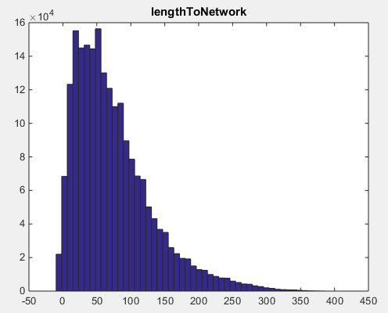
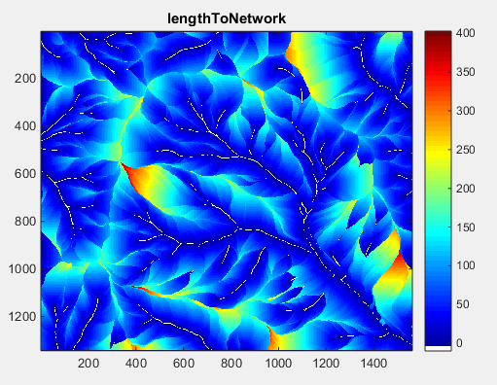
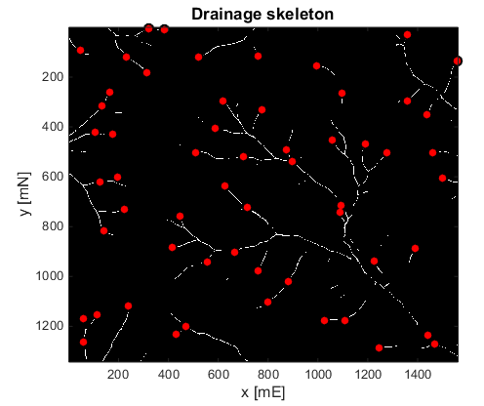
Workflow of GeoNet: channel head detection
The hillslope length for each pixel is estimated and the median hillslope length is determined.
This median hillslope length is set as the search box size for finding channel heads.
Pixels with maximum geodesic distance and belonging to a particular connected component are identified as the channel heads.

Slide 22
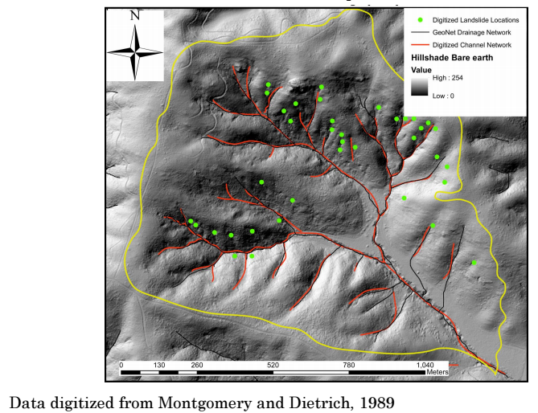
Workflow of GeoNet: Discrete Geodesics
Using the geodesic distance we do a gradient descent from channel heads to the outlet.
The map shows the comparison of the drainage network extracted by GeoNet against the digitized channel network by Montgomery and Dietrich 1989 for the Tennessee Valley basin, CA.

Slide 23
Suggestions for parameters
Filtering iterations: 50
Start with a small source area: ~ 50 m^2
(resolution dependent)
Search box: the median hillslope length
***As of version 2.1.1 this is automatic

Slide 24
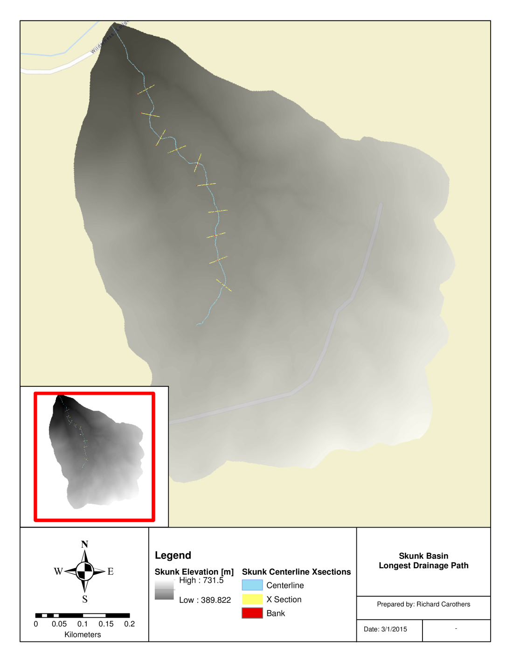
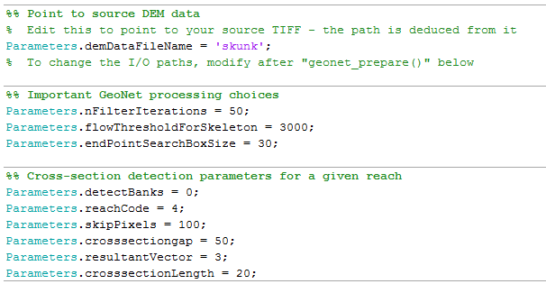
Original xSection Extraction
GeoNet extracts geodesic skeleton
Strikes xSections based on chosen parameters along longest centerline

Slide 25
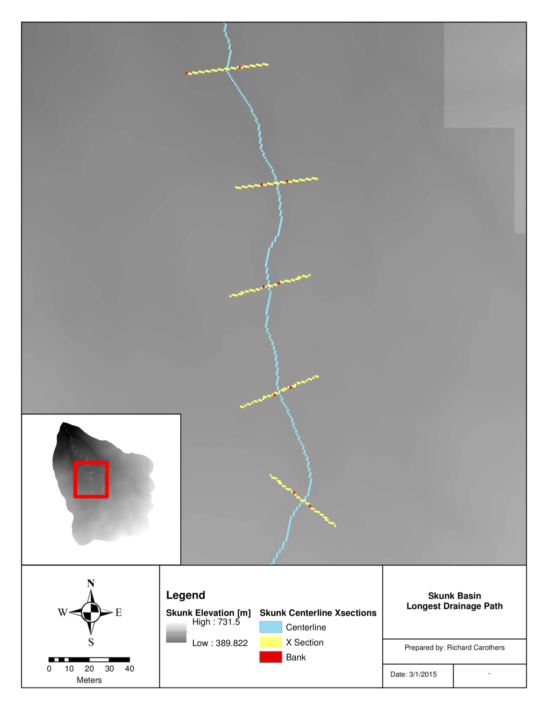
Original xSection Extraction
GeoNet extracts geodesic skeleton
Strikes xSections based on chosen parameters along longest centerline
Channel “banks” chosen based on maximum slope

Slide 26
Challenges with Current Methodology
Relies on GeoNet extracted centerline, thus subject to processing limitations of larger program
Without mapping toolbox, skeleton, bank locations, etc exported as geotiff

Slide 27
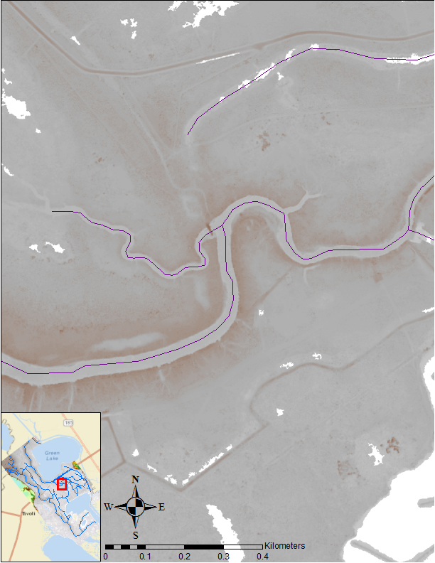
Adapted methodology
For research purposes, GeoNet’s bank location feature was adapted for user input centerlines

Slide 28
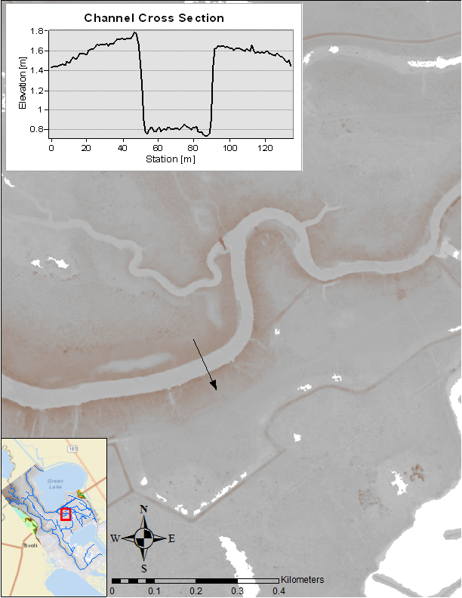
Adapted methodology
For research purposes, GeoNet’s bank location feature was adapted for user input centerlines
Same general methodology used for channel bank identification

Slide 29
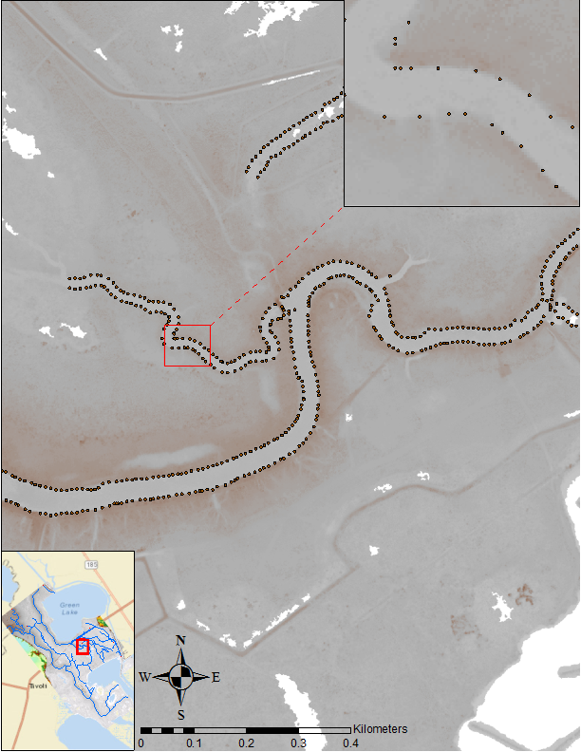
Adapted methodology
For research purposes, GeoNet’s bank location feature was adapted for user input centerlines
Same general methodology used for channel bank identification
Banks locations output as a csv to facilitate GIS interface

Slide 30
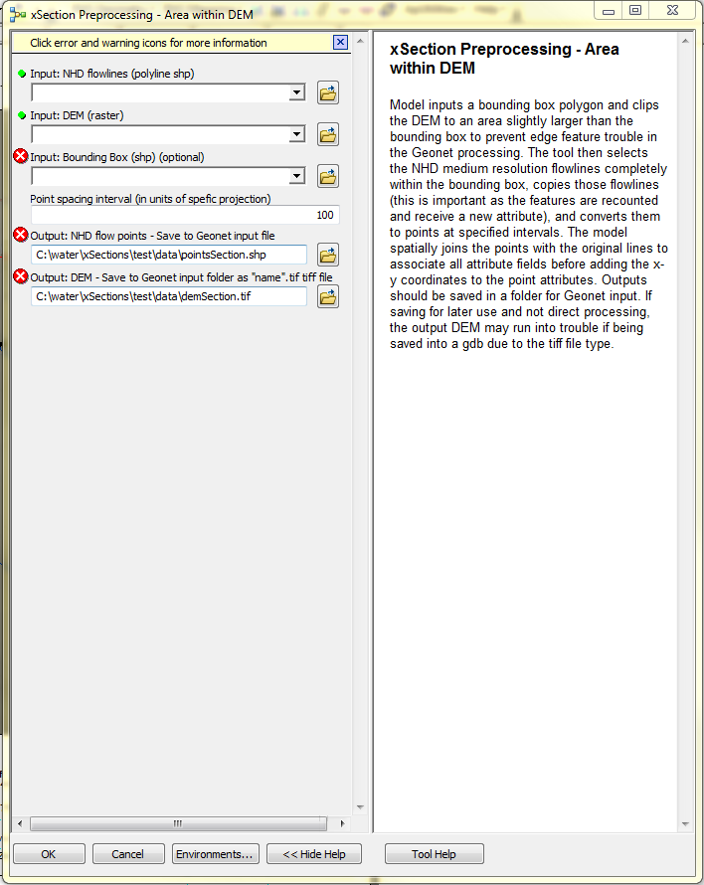
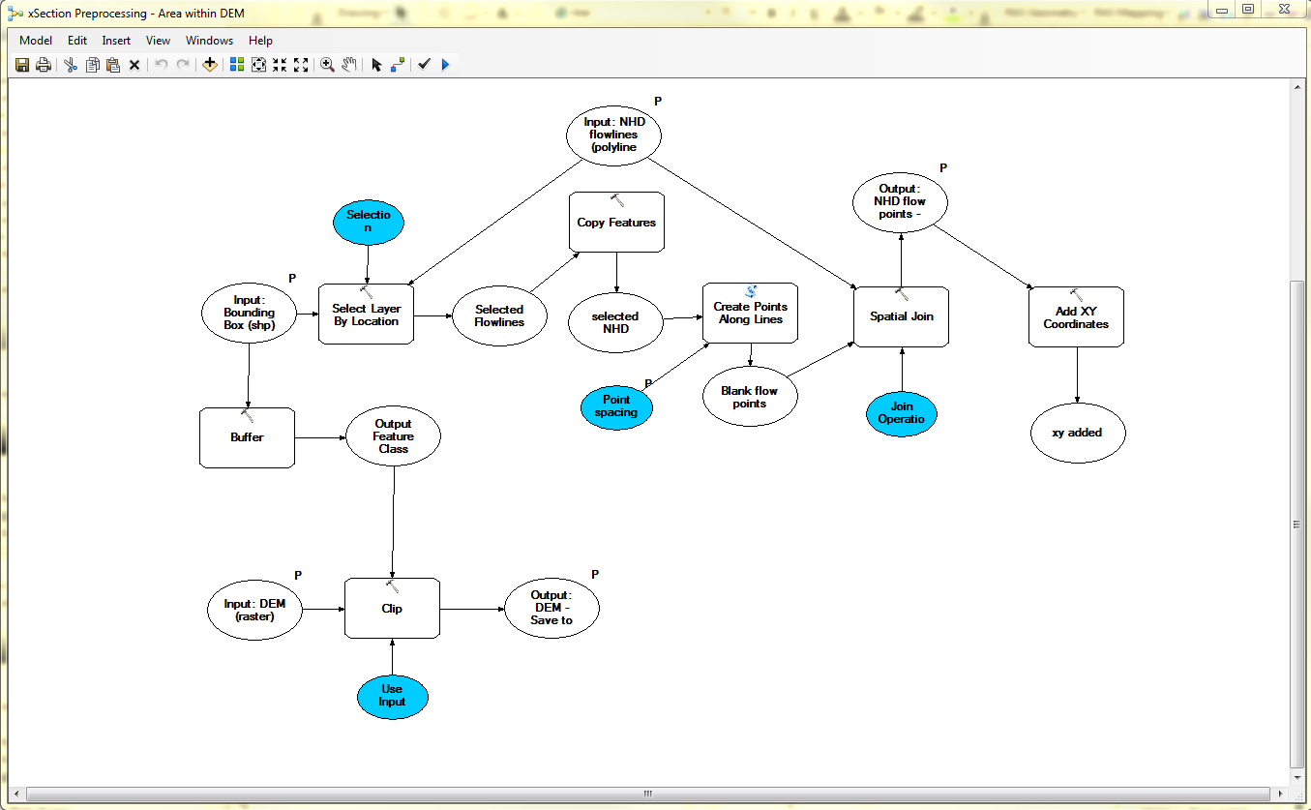
Generalizing the method further for NHD incorporation
Want to be able to extract cross sections from just the NHD and a DEM
Developed a model in ArcGIS preprocess the NHD and DEM and postprocess the csv results

Slide 31
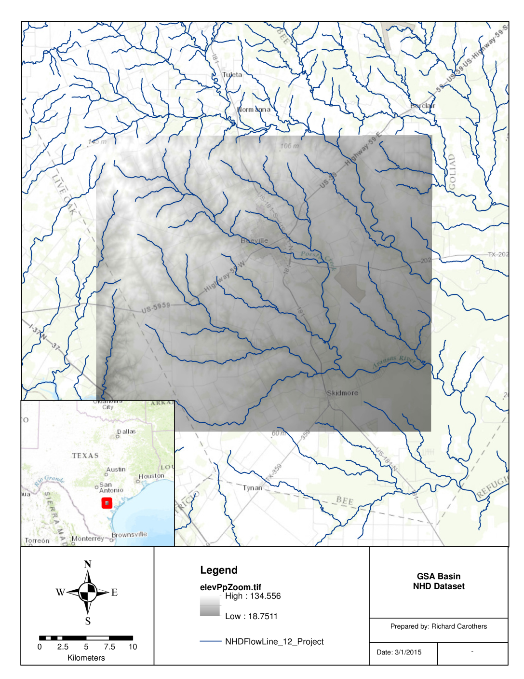
Generalizing the method further for NHD incorporation
Test study on San Antonio river basin section

Slide 32
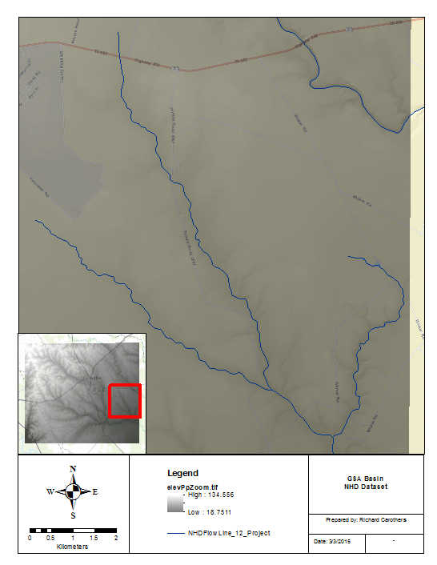
Generalizing the method further for NHD incorporation
Test study on San Antonio river basin section

Slide 33
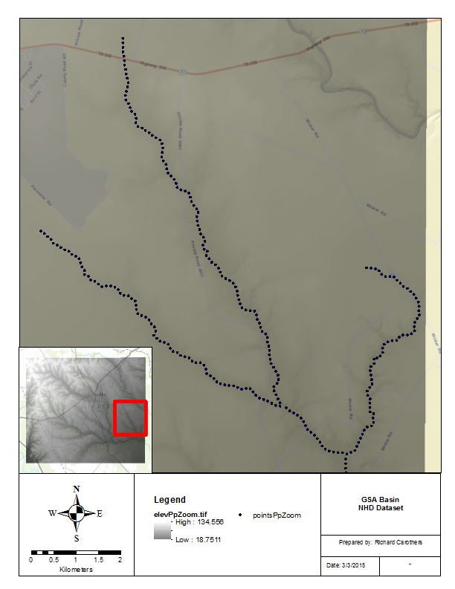
Generalizing the method further for NHD incorporation
Test study on San Antonio river basin section
Preprocessing in Arc

Slide 34
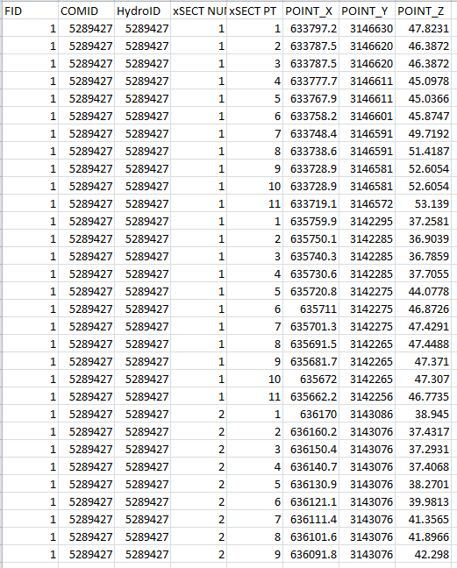
Generalizing the method further for NHD incorporation
Test study on San Antonio river basin section
Preprocessing in Arc
GeoNet csv output

Slide 35
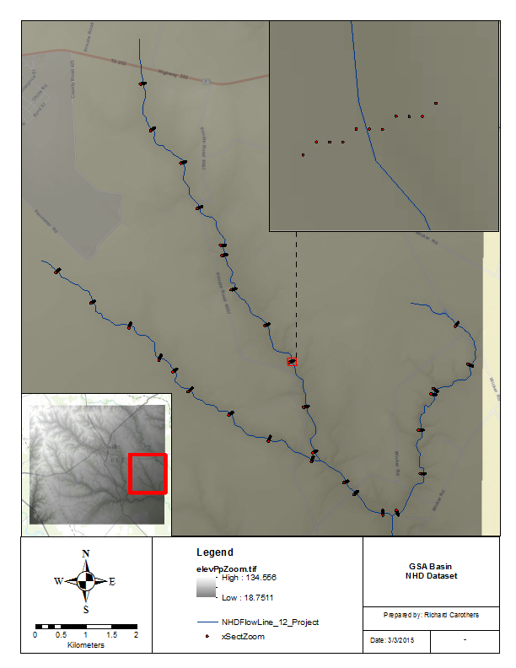
Generalizing the method further for NHD incorporation
Postprocessing model creates feature of results
Issues

Slide 36
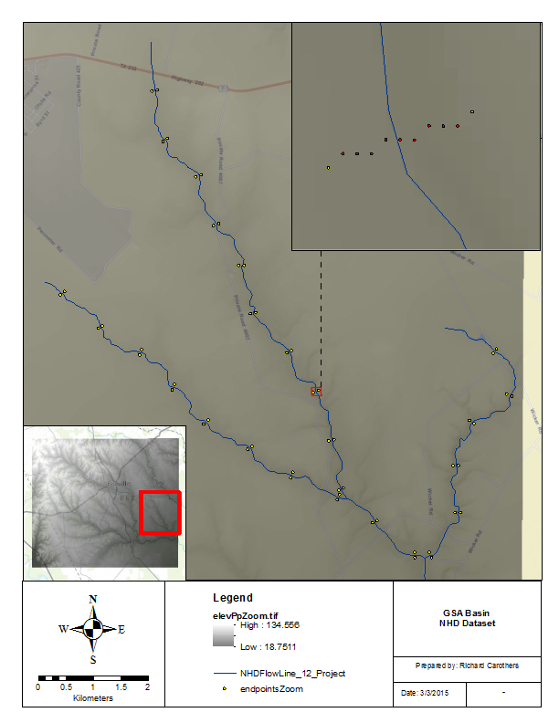
Generalizing the method further for NHD incorporation
Postprocessing model creates feature of results
Issues
Work with just the endpoints

Slide 37
Generalizing the method further for NHD incorporation
Postprocessing model creates feature of results
Issues
Work with just the endpoints
Further postprocessing produces straight section

Slide 38
Conclusion
Classical approaches to channel network extraction challenged by information in lidar data
GeoNet: open-source tool for channel extraction from lidar data
Good results achieved in channel network extraction and identification of channel initiation points
Improving method for larger watersheds. Upcoming GeoNet 3.0 release.
GeoNet approved as stream extraction tool and will be used by Forestry Corporation of New South Wales, Australia (press release March 2014 – implementation starts August 2014) over 1.3M hectares.

