Slide 1
Halloween Flood, Oct 30-31, 2015
Introduction to Hydrology by David Maidment
Flood emergency response by Harry Evans

Slide 2
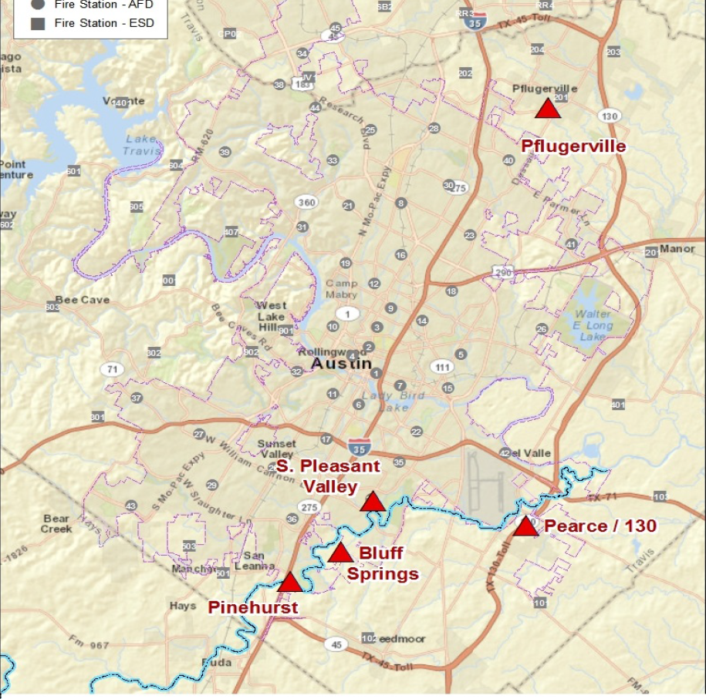
Austin, Texas
Onion Creek

Slide 3
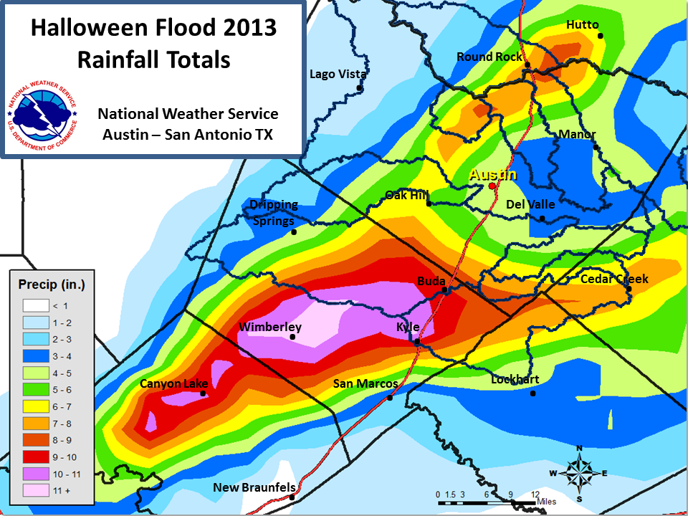
Actual Rainfall Totals
Onion Creek watershed

Slide 4
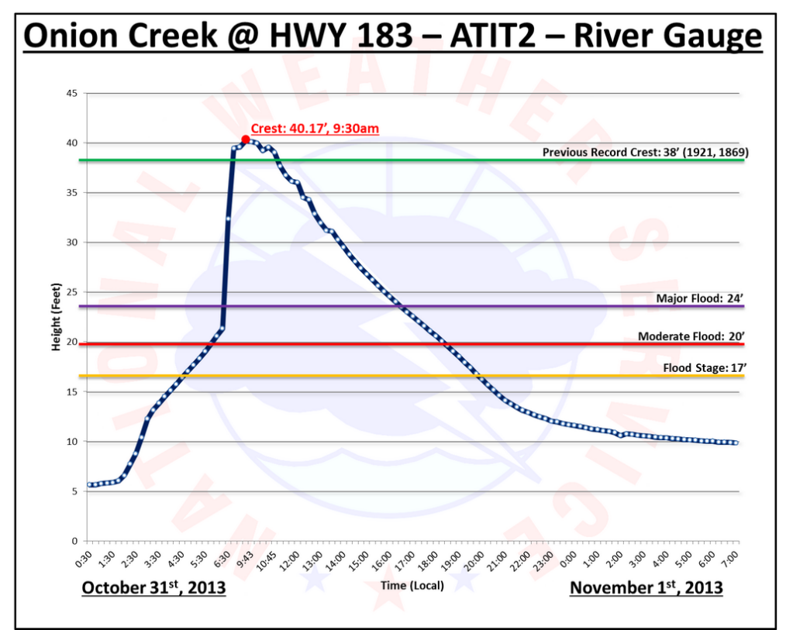

Slide 5
Flood Water Elevations
Halloween Flood
Hurricane Storm Surge on Gulf Coast
16 ft above major flood stage
16 ft of storm surge ~ Cat 3 hurricane

Slide 6
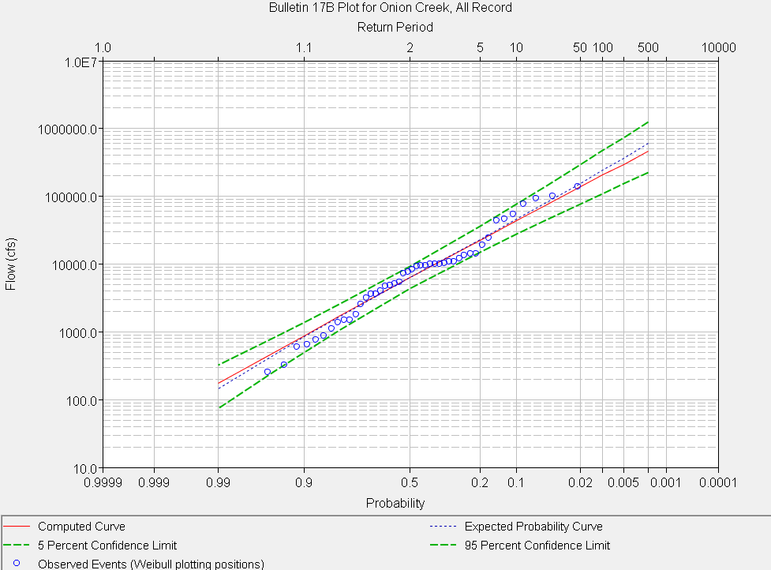

Frequency Analysis of Halloween Flood
Return Period (Years)
Halloween Flood (135,000 cfs)
Discharge (cfs)

Slide 7
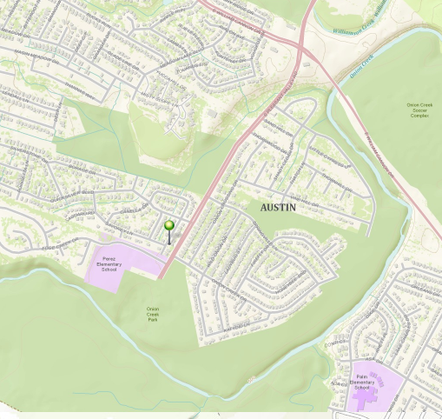
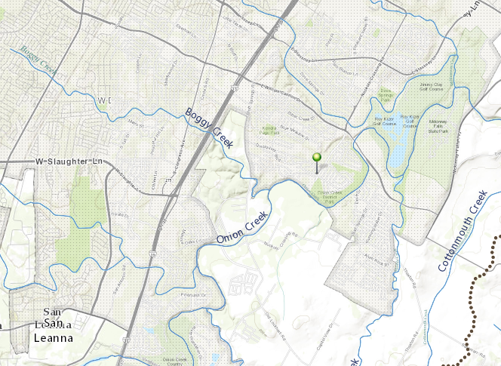
Onion Creek Flooding, 30-31 October 2013
IH-35
William Cannon Dr
A flooded home location

Slide 8
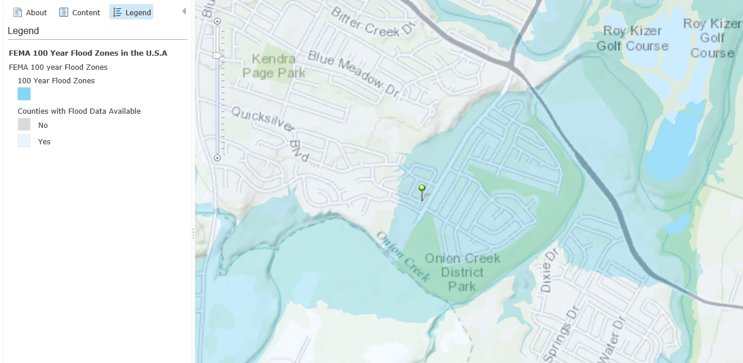
FEMA Flood Hazard Zone

Slide 9
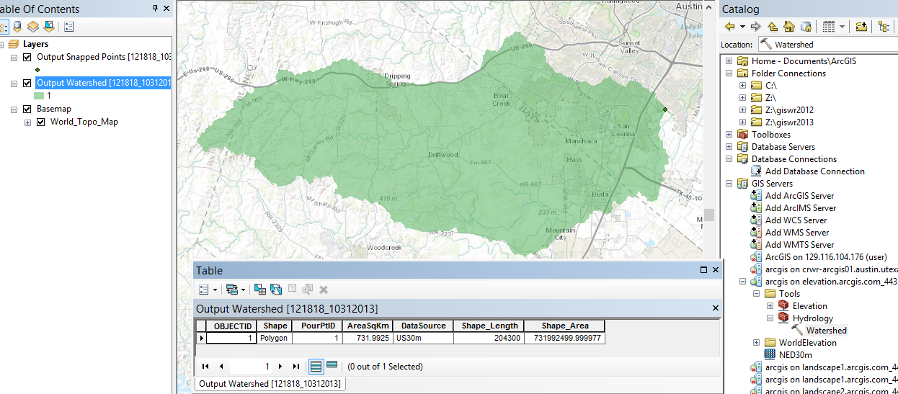
Drainage Area above Home
Drainage area = 732 km², or 282 miles² – larger than area of City of Austin
Watershed delineation using ESRI Watershed Delineation Services

Slide 10
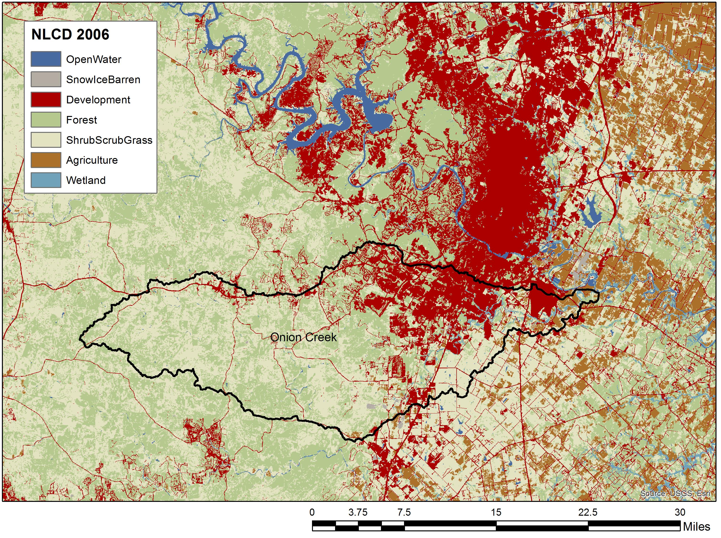
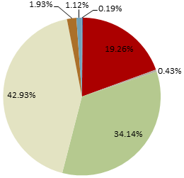
Land Cover in the Onion Creek Watershed (2006)
4% Other
19% Developed
43% Shrub,
Grass
34% Forest

Slide 11

Halloween Flood Emergency Response
Presented by Harry Evans,
Former Chief of Staff, Austin Fire Dept

Slide 12
Overview of AFD Structure
Austin Fire Department (AFD)
  11th largest municipal department in the US
  Serves ~850,000 citizens within 300 square miles
  AFD over 1200 personnel
  45 Stations geographically located
  On duty strength – 240 firefighters
  13 Aerial apparatus, 42 pumpers, 7 command units

Slide 13
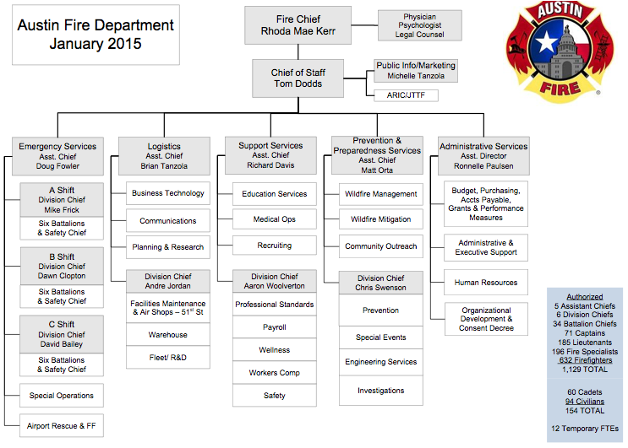

Slide 14
Overview of AFD Structure
Divisions within the city
  5 geographic battalions, 1 functional battalion
  Each is lead by a battalion chief
  On duty Shift Commander
  Functional battalion / Special Operations
    Hazardous Materials
    Structural Collapse
    Water Rescue
    High Angle Rescue

Slide 15
Overview of AFD Structure
Daily/Routine Response
  ~300 incidents ranging from single unit responses to multi unit
  Medical first response, collisions, fires, rescues
  Multi agency – Austin Travis County EMS, Austin Police, Travis County Sherriff, other fire departments

Slide 16
Emergency Operation Center
Emergency Operations Center (EOC)
  plan and prepare for emergencies
  educate the public about preparedness,
  develop volunteers
  manage grant funding to improve homeland security and public safety capabilities
  coordinate emergency response and recovery
  http://austintexas.gov/sites/default/files/files/hsem/Austin_Emergency_Ops_Plan_2-22-2012.pdf

Slide 17
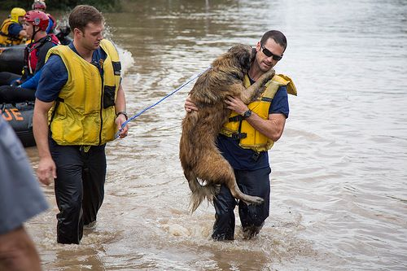
Halloween Flood, October 30-31, 2013
Between 8:30pm and 8:45am
  More than 800 incidents
  Five incident command areas
  370 people rescued by boat, helo, or contact rescue
  400 people evacuated by boat, vehicle or wading
  250 instructed to self- evacuate
  50 animals rescued

Slide 18
11:30PM, Oct 30
Incident Command Locations

Slide 19
Austin Fire Department
Pflugerville Incident Command (11:30pm)
  Worked Well
    Unified command/multi-agency coordination
    Dividing management structure geographically
  Challenges
    Just outside COA, but with COA resources – Transfer of command
    Awareness of other incidents in the region

Slide 20
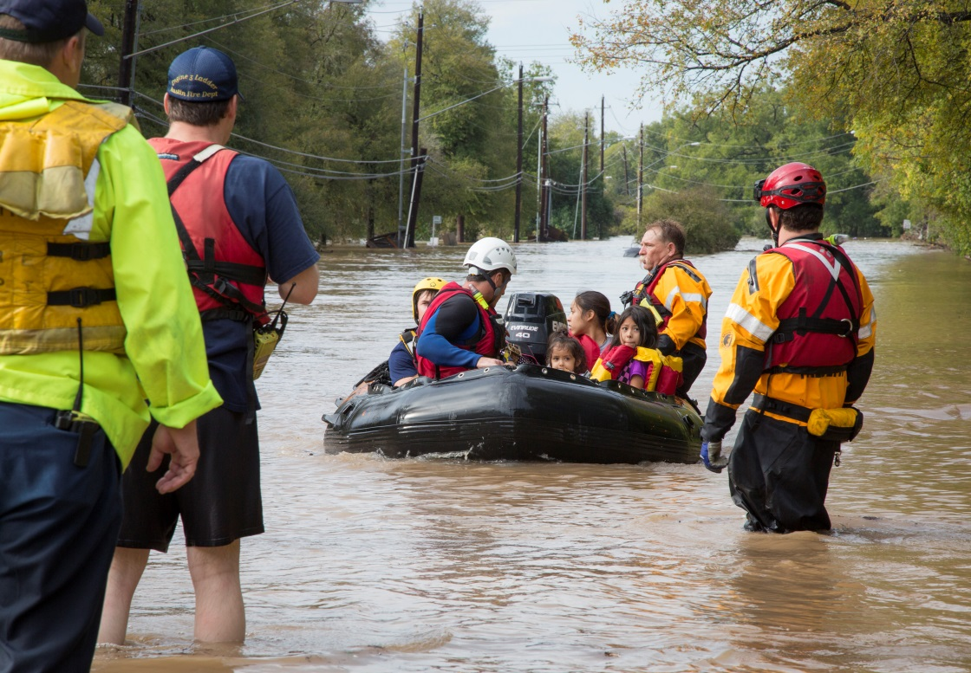
Austin Fire Department
Individual Water Rescue Calls
  Midnight to 2:00am
    Scattered water rescues throughout the area
  2:30am
    Water rescue/flood calls in East Austin and Eastern Travis County
  3:30am
    Water rescue/flood calls in South Austin area
  4:00am
    Increase of water rescue/flood calls in South Austin area

Slide 21
11:30PM, Oct 30
Incident Command Locations
4.25AM, Oct 31

Slide 22
Austin Fire Department
Bluff Springs Incident Command (4:25am)
  Worked Well
    Unified Command with ATCEMS and ESD 11
    Separate radio channels for each division
    Cell phone communication with department operations center (DOC)
  Challenges
    Dramatic change in flood waters without notice
    Better Command post location
    Need for evacuation type boats rather than rescue boats

Slide 23
11:30PM, Oct 30
Incident Command Locations
4.25AM, Oct 31
5.50AM, Oct 31

Slide 24
Austin Fire Department
Pinehurst Incident Command (5:50am)
  Worked Well
    Single incident command within a geographic area
    Cell phone communication with the DOC
  Challenges
    Low resources – already on other incidents
    Conflicting information on expected water levels
    Radio communication – other commands operating on the same channels

Slide 25
11:30PM, Oct 30
Incident Command Locations
6.00AM, Oct 31
4.25AM, Oct 31
5.50AM, Oct 31

Slide 26
Austin Fire Department
South Pleasant Valley Incident Command (6:00am)
  Worked Well
    Single incident command for a geographic area
    Dividing the incident geographically
    Animal Control
    Establish a victim process group
    A robust staging area to manage crowds
  Challenges
    Conflicting information on expected water levels
    Need for additional radio channels – use of cell phones

Slide 27
11:30PM, Oct 30
Incident Command Locations
6.00AM, Oct 31
8.00AM, Oct 31
4.25AM, Oct 31
5.50AM, Oct 31

Slide 28
Austin Fire Department
Pearce / 130 Incident Command (8:45am)
  Worked Well
    Unified command with Law Enforcement
  Challenges
    AFD boat operators/Swift Water Rescue technicians
    Fast changing conditions trapped first responders
    Need for additional resources due to equipment damage/failure

Slide 29
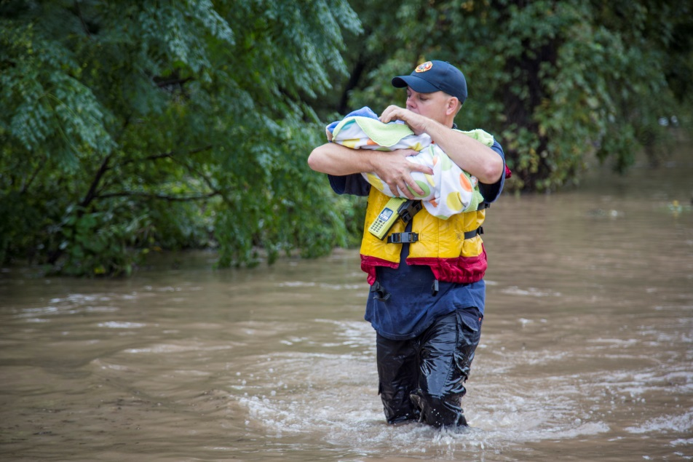
Austin Fire Department
Areas of Improvement
Implement a proactive staffing plan for water-related events, including correct number of boats and location.
Implement a community outreach plan to educate the community on AFD action plans at water-related events.
Vet information from the Emergency Operations Center and the Department Operations Center prior to dissemination to the field.
Implement an area command at large-scale incidents followed by formal notification through the chain of command.

Slide 30
Austin Fire Department
Status of Corrective Actions
The appropriate benchmark for proactively staffing and deploying water rescue resources – Complete
The appropriate number and type (swift water versus evacuation) of boats re-deployed throughout the city – Boats are re-deployed, additional boats are in the budget forecast
Boat resource availability amongst agencies within the region – Complete
Agencies within the region continue to collaborate on multiple planning initiatives – Ongoing
Community Outreach plan for “Ready Set Go for Flood Preparations”- June 2014

Slide 31

Public Education
Community resilience
  Promoting self reliance
  Areas of high risk
Public Awareness
  When conditions are right
  Meaningful and Actionable
Public Notification
  Reverse Notification System (RNS)
  Social media
  News Media
  Subscription Services

Slide 32
Emergency Response
Pre-planning
  Flood Prone areas – type of flooding – access and egress – critical infrastructure
Training and Equipment
  Swift Water Rescue – Flat Water Evac
Predictive Services
  NWS, NOAA, USGS….. How bad is bad?
Evacuations
  Timely Evacuations vs Protect in Place
Sheltering
  Where will they go? – Short term vs Long term

